Slide 1
Measuring the Impact of COVID-19 on the Ridership in the US Transit Systems
Luyu Liu, Harvey Miller
The Ohio State University
Center for Urban and Regional Analysis
{liu.6544, miller.81}@osu.edu

Slide 2
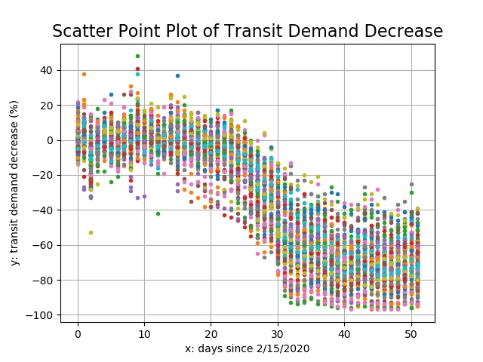
All transit systems

Slide 3
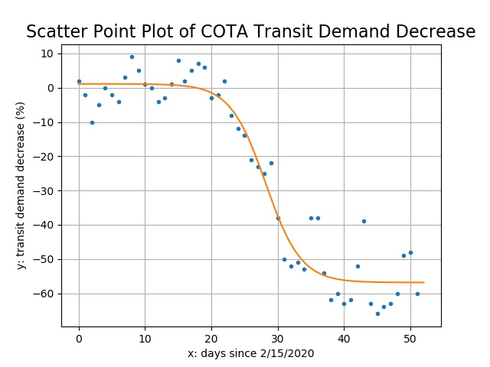
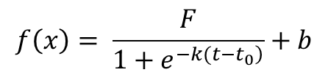
Logistic decline model
$$f\left(x\right)= \frac{F}{1+e^{\left.−k(t−t_{0}\right)}}+b$$
F: Floor value
What is the base level of patronage during this crisis?
Does this vary by city?
What explains this variation:
Transit dependence?
Jobs mix?
Socioeconomic status?
F

Slide 4
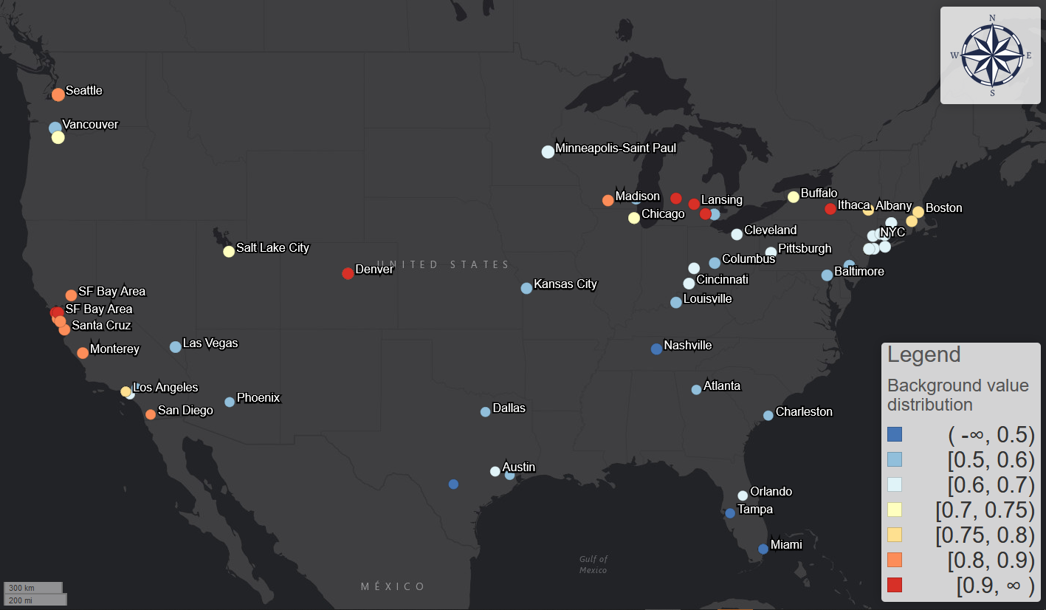
Blue versus red
Transit dependence?
Ability to work from home?
Concern, local leadership?
Floor

Slide 5
Floor
Cities have different floor values:
University of California Berkeley, The Ride Ann Arbor, and TCAT Ithaca: 90%+
Seattle and Bay area: 80%
New York City: 70%
Ohio (Columbus, Cincinnati, Cleveland): 50% - 60%
Florida (Tampa, Miami, and Orlando): 40% - 50%

Slide 6
Response interval
The time lag between covid-19 case increase and transit demand decrease
Demand decrease typically earlier than case increase in a community
But not always!
Objective: when did people start to avoid transit trips relative to the local community spread? Are there variations across cities?

Slide 7
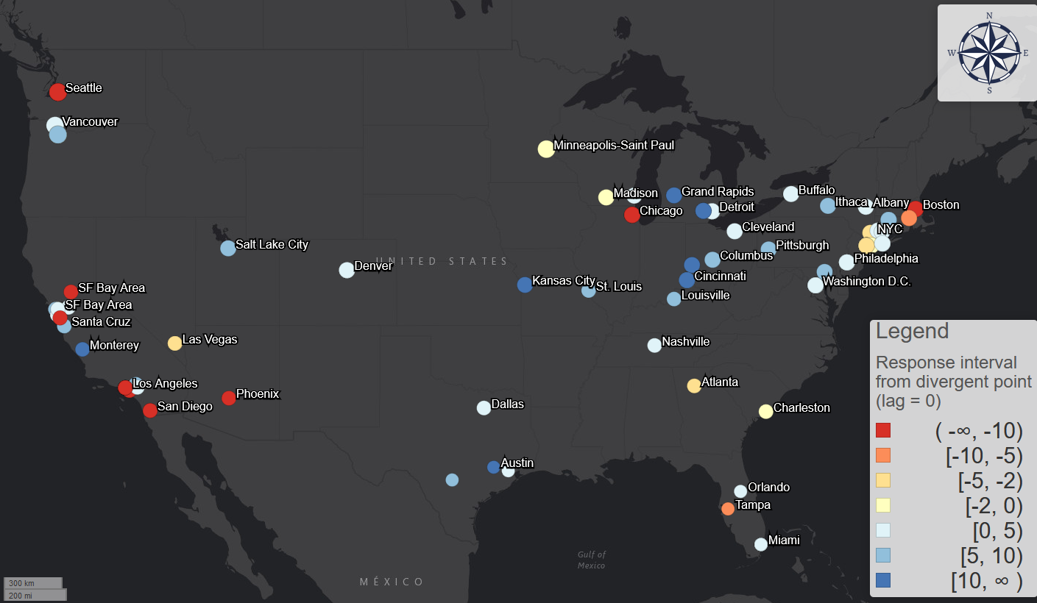
Blue: responded early
Red: responded late

Slide 8
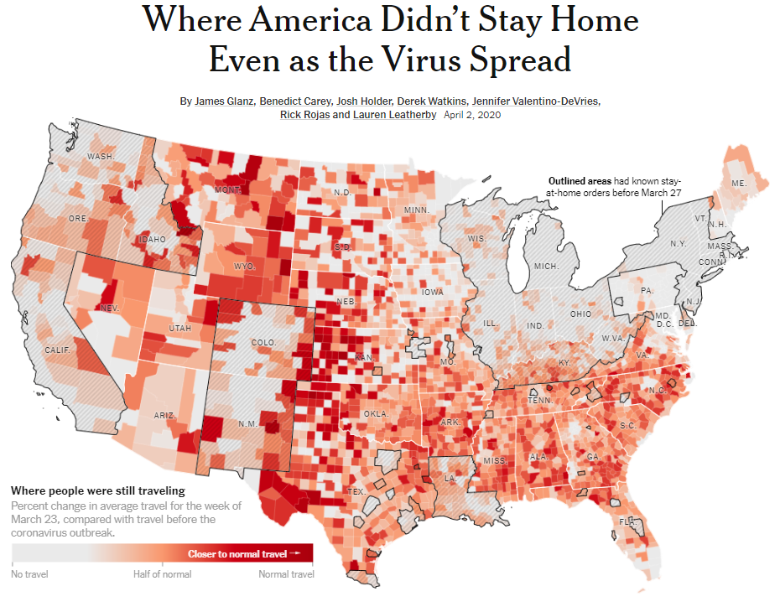

Slide 9
Questions for Transit

Slide 10
Need raw ridership/demand data for averaging purposes
Cannot aggregate different systems/days with percentages.
Need raw app activities data for the aggregation.
Request: raw app activities/demand data for daily data and hourly data from at least 2/15/2020 to present.
Good to have: If possible, we also would like to request the same data for the same period in 2019 and 2018 for calibration purposes.

Slide 11
Hourly data?
Current can only traced back to 3/7/2020.
Seattle already witness decrease from 2/18/2020.
Request: hourly app activities/demand data from at least 2/15/2020.

Slide 12
Local-scale data
Mobility dynamics change analyses concentrating on Columbus, Ohio;
Higher resolution on local geographies: Parcels? Census tracts?
Request: aggregated or anonymous app activities/demand data with higher spatial resolution (e.g. census tract) and higher temporal resolution (e.g. every 2 min) for the Franklin County, Ohio.
Good to have: aggregated or anonymous trip data with higher spatial and temporal resolution; OD matrix of the same geographies and same time period.

Slide 13
Representativeness of transit app data?
We collect 40 systems official ridership declining figures;
From local news and reports;
Though no bias for T-Test with small sample size, still questionable.
Average bias = 3.7%, Standard deviation = 15.96% (still large)
Good to have: Any further survey results on this issue? A good reference (like a Transit app blog?) will do.

Slide 14
Future: more data, more analyses
Hourly analysis
Shape similarity before and after: different city types.
Distance between curves before and after.
Weekday analysis.

