Slide 1
Measuring the Impact of COVID-19 on the Ridership in the US Transit Systems
Luyu Liu, Harvey Miller
The Ohio State University
Center for Urban and Regional Analysis
{liu.6544, miller.81}@osu.edu

Slide 2
Data – transit demand
Indicates how many people opened the Transit app in each single day;
Using the app is highly correlated with the actual ridership.
Mobile phone data: public dataset from Transit app;
For 113 transit systems in 70 cities in the US, including Columbus and COTA.

Slide 3
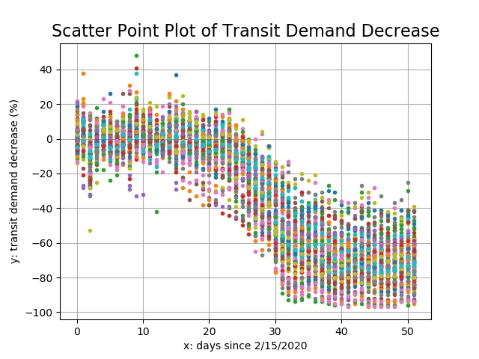
All transit systems

Slide 4
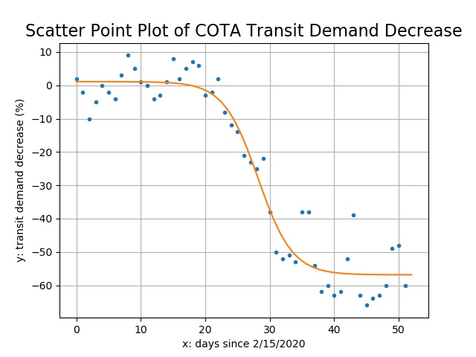
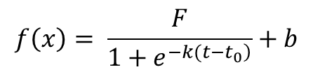
Logistic decline model
$$f\left(x\right)= \frac{F}{1+e^{\left.−k(t−t_{0}\right)}}+b$$
F: Floor value
What is the base level of patronage during this crisis?
Does this vary by city?
What explains this variation:
Transit dependence?
Jobs mix?
Socioeconomic status?
Floor value
F

Slide 5
Floor value
What is the base level of patronage during this crisis?
Or: how many people stopped to use transit during this pandemic?
Or: how many people continued to use transit?
Does this vary by city?
What explains this variation:
Transit dependence?
Jobs mix?
Socioeconomic status?

Slide 6
Floor value
Cities have different floor values:
University of California Berkeley, The Ride Ann Arbor, and TCAT Ithaca: 90%+
Seattle and Bay area: 80%
New York City: 70%
Ohio (Columbus, Cincinnati, Cleveland): 50% - 60%
Florida (Tampa, Miami, and Orlando): 40% - 50%

Slide 7
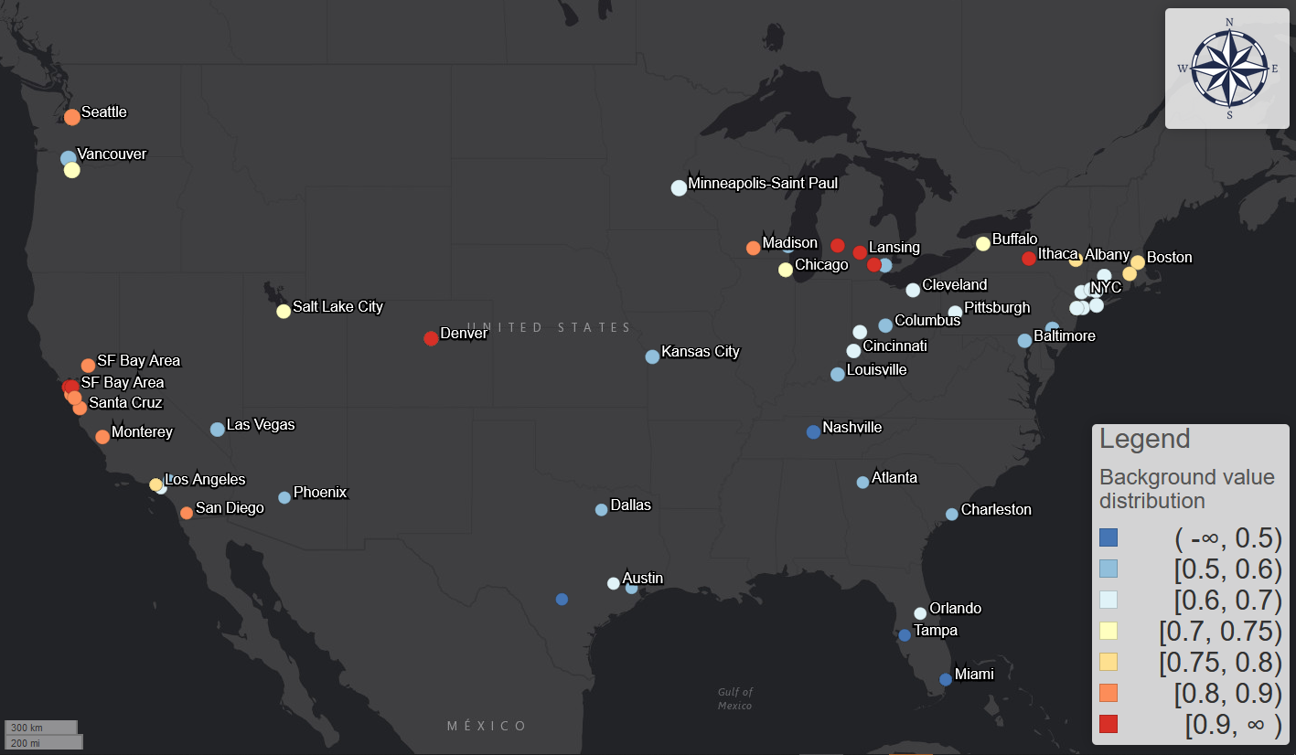
Blue versus red
Demography?
Ability to work from home?
Concern, local leadership?
Floor

Slide 8
Who are still using transit during the pandemic
Some conclusions from our research and the survey by Transit app

Slide 9
Survey
Transit app conduced a user survey (n= 25000, n = 15000 in US) about who are still using the transit during the pandemic.
Survey different aspects of the “essential transit users” during the pandemic, including mobility, social-economic, and demographic information.
Different data source, same conclusions.

Slide 10
Your occupation matters
From our research:
The amount of essential transit passengers is highly correlated with the ratio of people with non-physical occupations
Or: how many people can work from home
From the survey:
The top 4 industry:
Food;
Health care;
Sales;
Health care practioners and technical
The least 4 industry:
Management;
Architecture and engineering;
Legal;
Science.

Slide 11
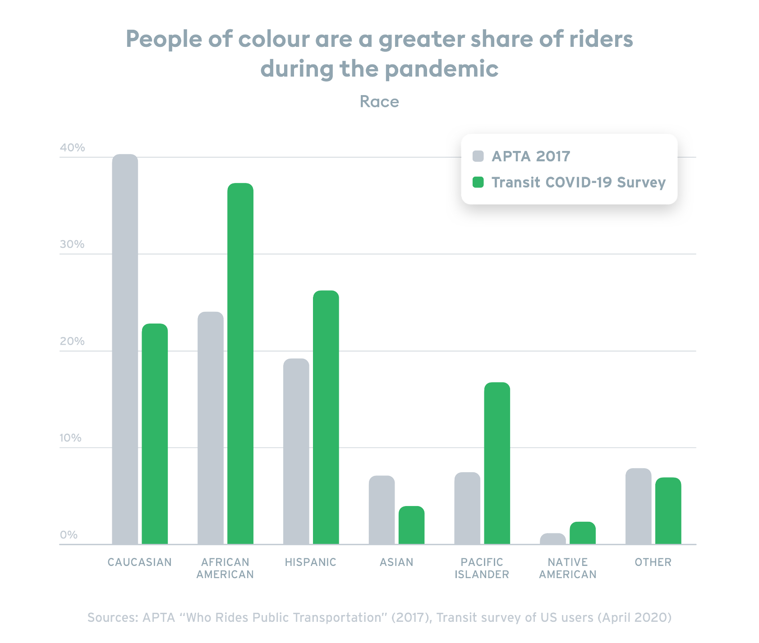
Your race matters
From our research:
A city’s demand decrease level is correlated with ratio of African American and Hispanic population.
Cities with more African American / Hispanic population are likely to have a higher floor value.
From the survey:

Slide 12
Your sex/gender matters
From our research: If a city has larger female ratio, the floor value is very likely to have a higher floor value.
From the survey: transit female/male ratio change from 49%/49% to 56%/40%
In cities like Philadelphia, more than 68% of riders are women.

Slide 13
Your preference does not matter
Social media and Google search statistics have no correlation with the floor value.
But Google search statistics are significantly correlated with the speed of the transit demand decrease.
The myth of “awareness”:
Essential workers know, yet they still have to work;
Awareness is only relevant to those who can work from home.

Slide 14
A building on fire
Awareness of the fact that building is on fire:
Is relevant to the fleeing speed of those who can run for their life;
Is not relevant to the amount of people who will run for their life;
Instead, your race, your age, your sex/gender, and your occupation are the factors that are relevant to whether you can run for your life.

Slide 15


Who is the essential workers again?

Slide 16
Peaks and commuting

Slide 17
Weekdays and weekends are no more
The pandemic made difference of the dynamic within a day between weekdays and weekends less obvious.
Weekends are more like weekdays. In many systems such the MTA system in New York City, the weekends curves show a two-peak patterns when it only had one peak. The cessation of the unessential businesses made the weekends trips become commuting-dominating.
Weekdays are more like weekends. Disproportional decrease of the morning and afternoon commuting activities in the weekdays made the difference between rush hours and normal hours less obvious.

Slide 18
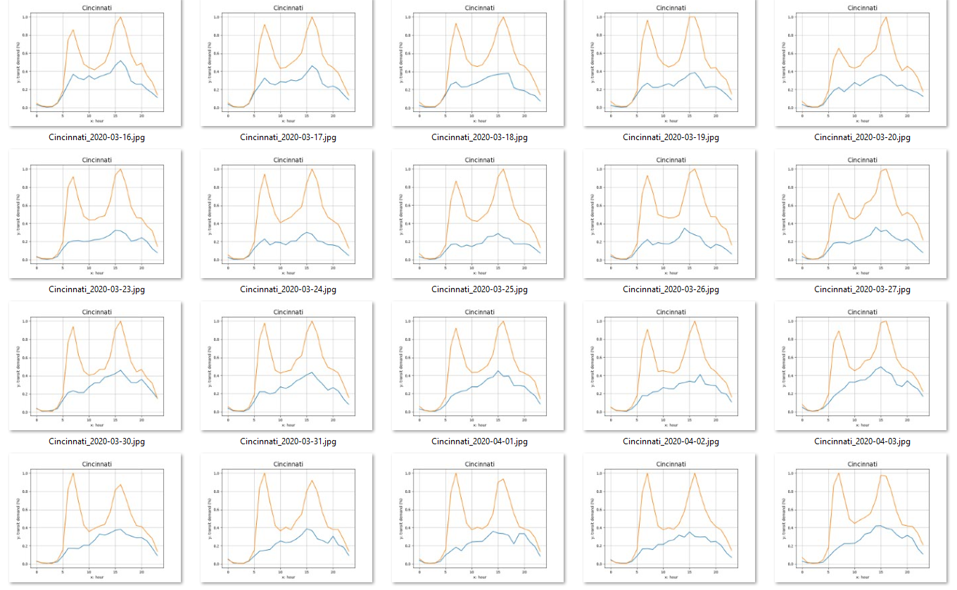

Slide 19
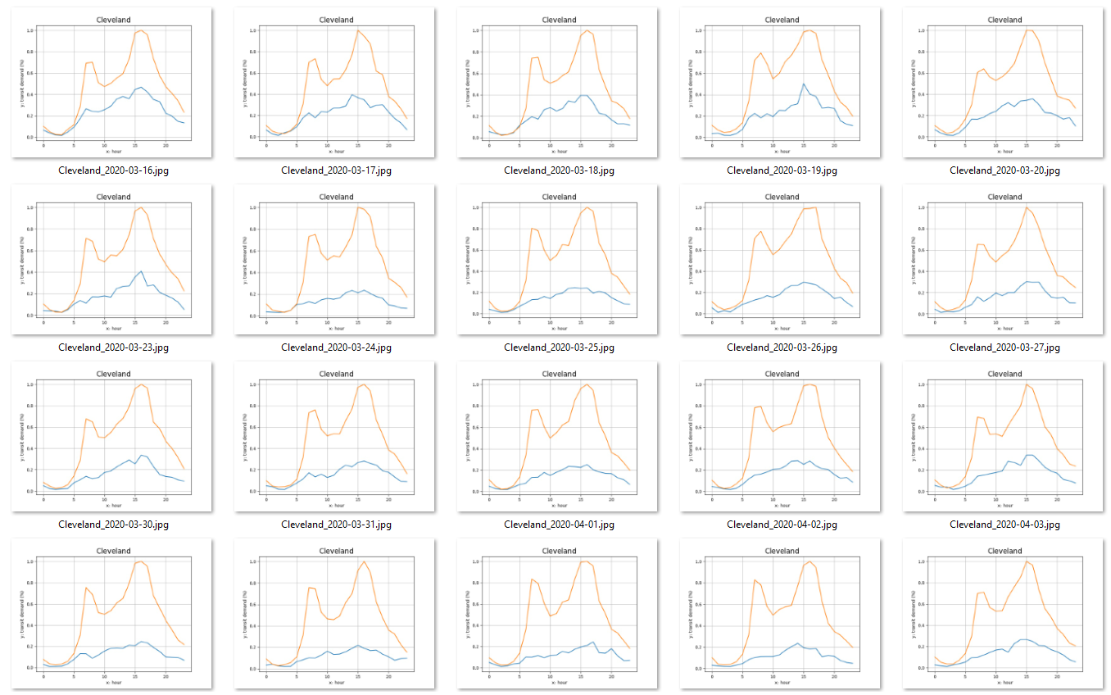

Slide 20
