Slide 1
Device Placement with Reinforcement Learning
Azalia Mirhoseini, Hieu Pham, Quoc V. Le, Benoit Steiner, Rasmus Larsen, Yuefeng Zhou, Naveen Kumar, Mohammad Norouzi, Samy Bengio, Jeff Dean

Slide 2
Several keywords
Device Placement
Reinforcement Learning
Model Description
Architecture Details
Experiements

Slide 3
Device placement?

Slide 4
Heterogeneous distributed environment
What?
Merging CPU and GPU environment
Neural network training
How to make the system works and improve performance

Slide 5
Heterogeneous distributed environment
Why?
Different purposes
CPU: fewer cores, higher frequency, more complicated and faster cache mechanism;
GPU: much more cores, SIMD, harder to program.

Slide 6
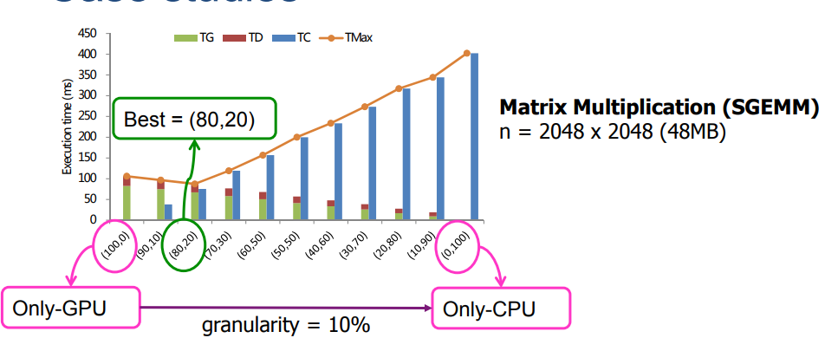
Heterogeneous distributed environment
Why, again?
Balanced workload
https://www.ntnu.edu/documents/139931/1275097249/NTNU_HetComp_toPublish.pdf/486588ee-23af-4104-8a04-bb18cd5a68c1

Slide 7
Heterogeneous distributed environment
Why, even more?
Decrease data communication
Increase flexibility and reliability
Increase energy efficiency

Slide 8
Heterogeneous distributed environment
Why not?
Programming difficulties - solutions:
Develop human-friendly libraries (tensorflow-gpu)
Hire more graduate students
Workload balance?
Hard to implement and optimize

Slide 9
Heterogeneous distributed environment
How?
Human specify:
Questionable;
Low reusability/generalizability
Algorithm:
Hard to tune the hyperparameters.

Slide 10
Reinforcement Learning?

Slide 11

Reinforcement Learning?
What?
Agents (Problem)
Exploration (Actions)
An environment (Markov decision process)
Cumulative reward (Feedback)
Notes:
It’s a random process
Agent is your problem, makes the decision of what action to take.
Action: could be go right or go left in a game, could be different set of motions.
Environment: basically a game engine, an auditor that decide your fate. It returns two things: your final state, and your reward.
Let’s say an example we all had: university application process or job application process. You are the agent, the university is the environment, you submit a CV with a bunch of exaggerating experience and skills to them and wait for the final results. If you succeed, your brain will say: okay it’s working, so if you want to do this again, you will keep the exaggerating part. Again, if you get an interview chance, but you cannot even answer a basic question, you will fail then you will say: okay it’s not working I shouldn’t lie in my CV. Congratulation you now know reinforcement learning and you can put this in your CV.

Slide 12
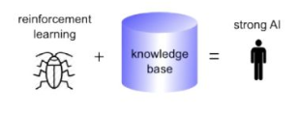
Reinforcement Learning?
Why?
A good strategy;
A good policy-finder.
Isn’t reinforcement learning just genetic algorithm?
Mutation and evolution;
(Kind of) metaheuristics optimization;
Search and memory;
Notes:
RL works faster, since not non-deterministic for GA;
RL benefits from features such as temporal credit assignment, which can speed up the convergence. It does so by maintaining a ‘trace’ of highly rewarding states.
GA is by definition, an inter-life algorithm, which means that the approach requires individuals to ‘die’ in order to progress. RL is intended to be an intra-life learning algorithm, with many recently (an not so recently) developed methods targeting the issue of continual learning and safe RL.

Slide 13
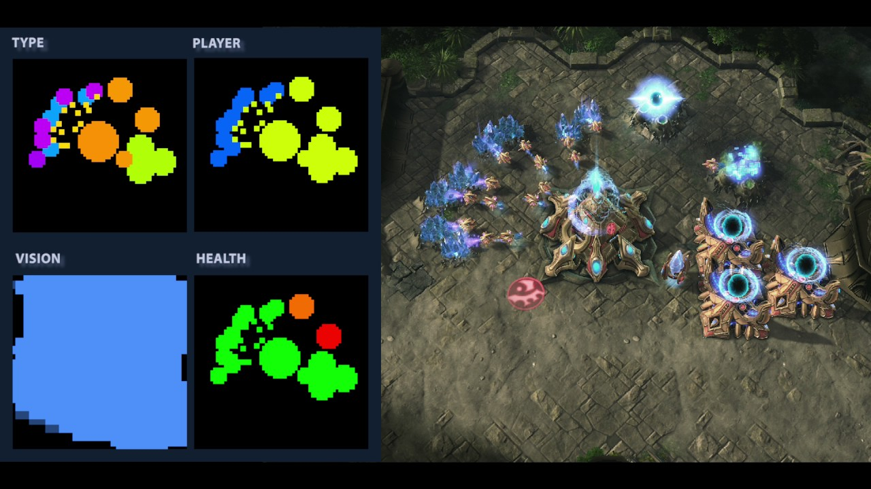
Reinforcement Learning?
Where?
Real-time strategy game
Atari game

Slide 14
Model description

Slide 15
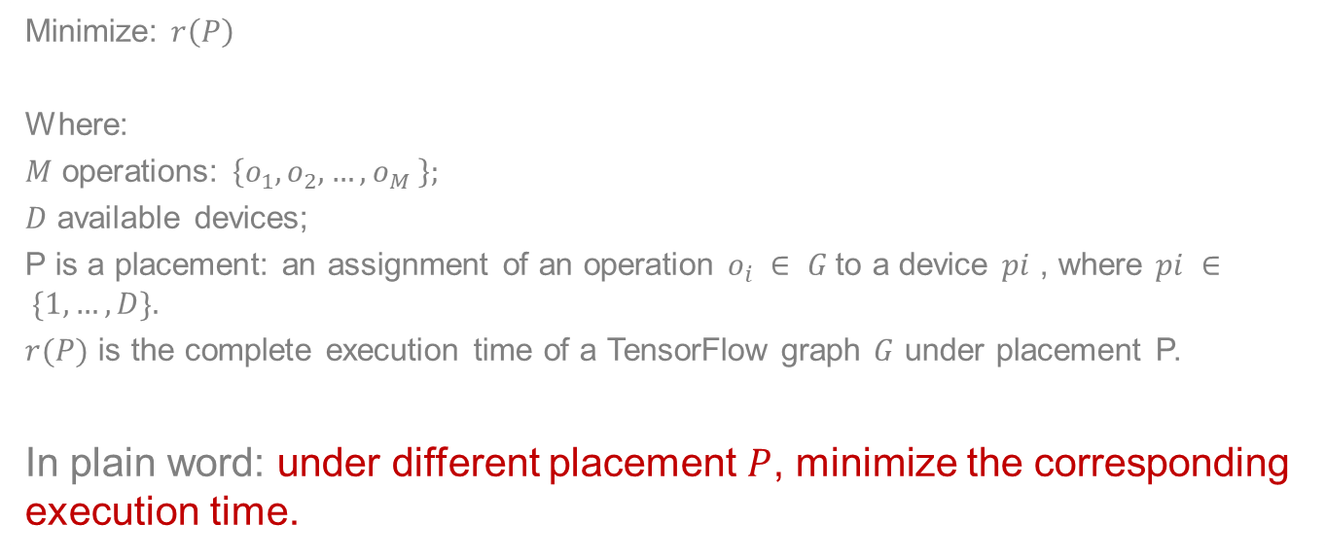
Question description
Minimize: $r\left(P\right)$
Where:
$M$ operations: $\left\{o_{1}, o_{2}, …, o_{M} \right\};$
$D$ available devices;
P is a placement: an assignment of an operation $o_{i} ∈ G$to a device $pi$ , where $pi ∈ \{1, …, D\}.$
$r(P)$ is the complete execution time of a TensorFlow graph $G$ under placement P.
In plain word: under different placement $P$, minimize the corresponding execution time.

Slide 16
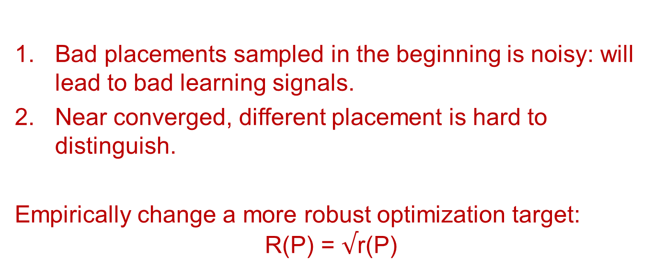
Why can’t we just do the math, based on r(P)?
Bad placements sampled in the beginning is noisy: will lead to bad learning signals.
Near converged, different placement is hard to distinguish.
Empirically change a more robust optimization target:
$$\text{R}\text{(}\text{P}\text{) = }√\text{r}\text{(}\text{P}\text{)}$$
Notes:
So we have to talk about an important feature of reinforcement learning: the reward is so hard to determine. In fact, a special problem requires a special reward design.

Slide 17
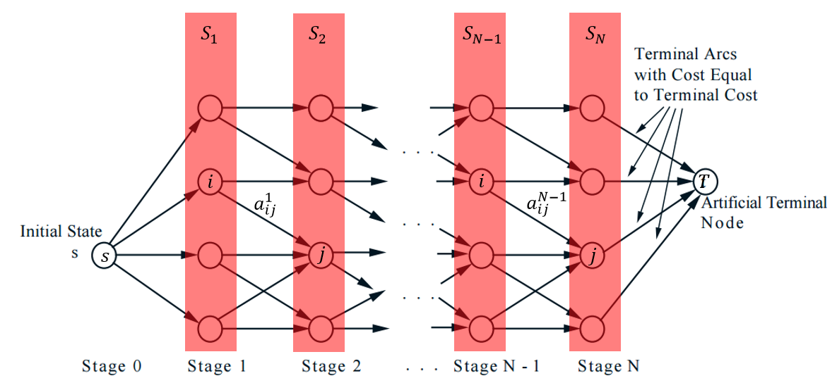
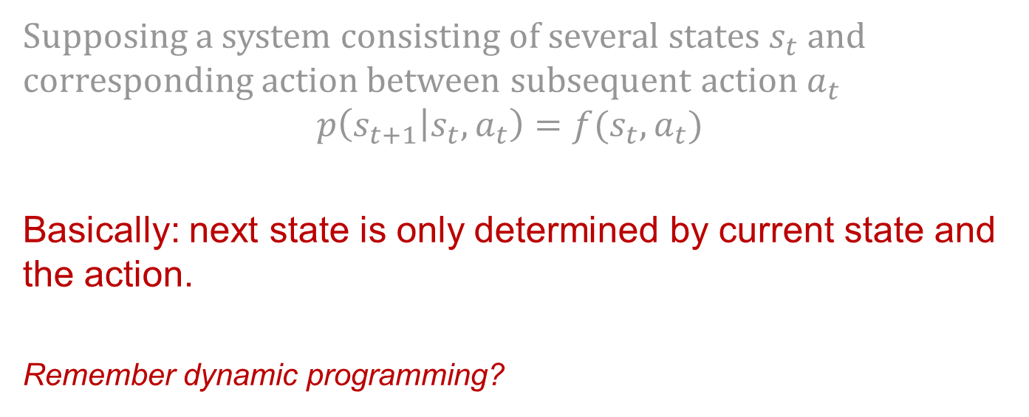
Markov assumption
Supposing a system consisting of several states $s_{t}$ and corresponding action between subsequent action $a_{t}$
$$p\left(s_{t+1} | s_{t},a_{t}\right)=f(s_{t},a_{t})$$
Basically: next state is only determined by current state and the action.
Remember dynamic programming?
https://towardsdatascience.com/the-almighty-policy-gradient-in-reinforcement-learning-6790bee8db6

Slide 18
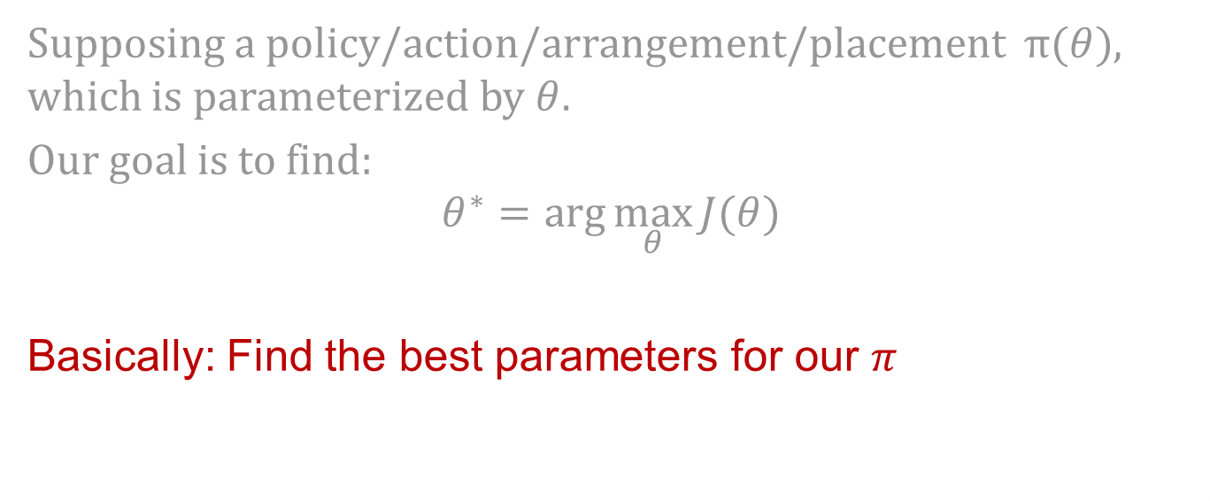
What do we want?
Supposing a policy/action/arrangement/placement $π(θ)$, which is parameterized by $θ$.
Our goal is to find:
$$θ^{∗}=\arg{\max_{θ}{J(θ)}}$$
Basically: Find the best parameters for our $π$
https://towardsdatascience.com/the-almighty-policy-gradient-in-reinforcement-learning-6790bee8db6

Slide 19

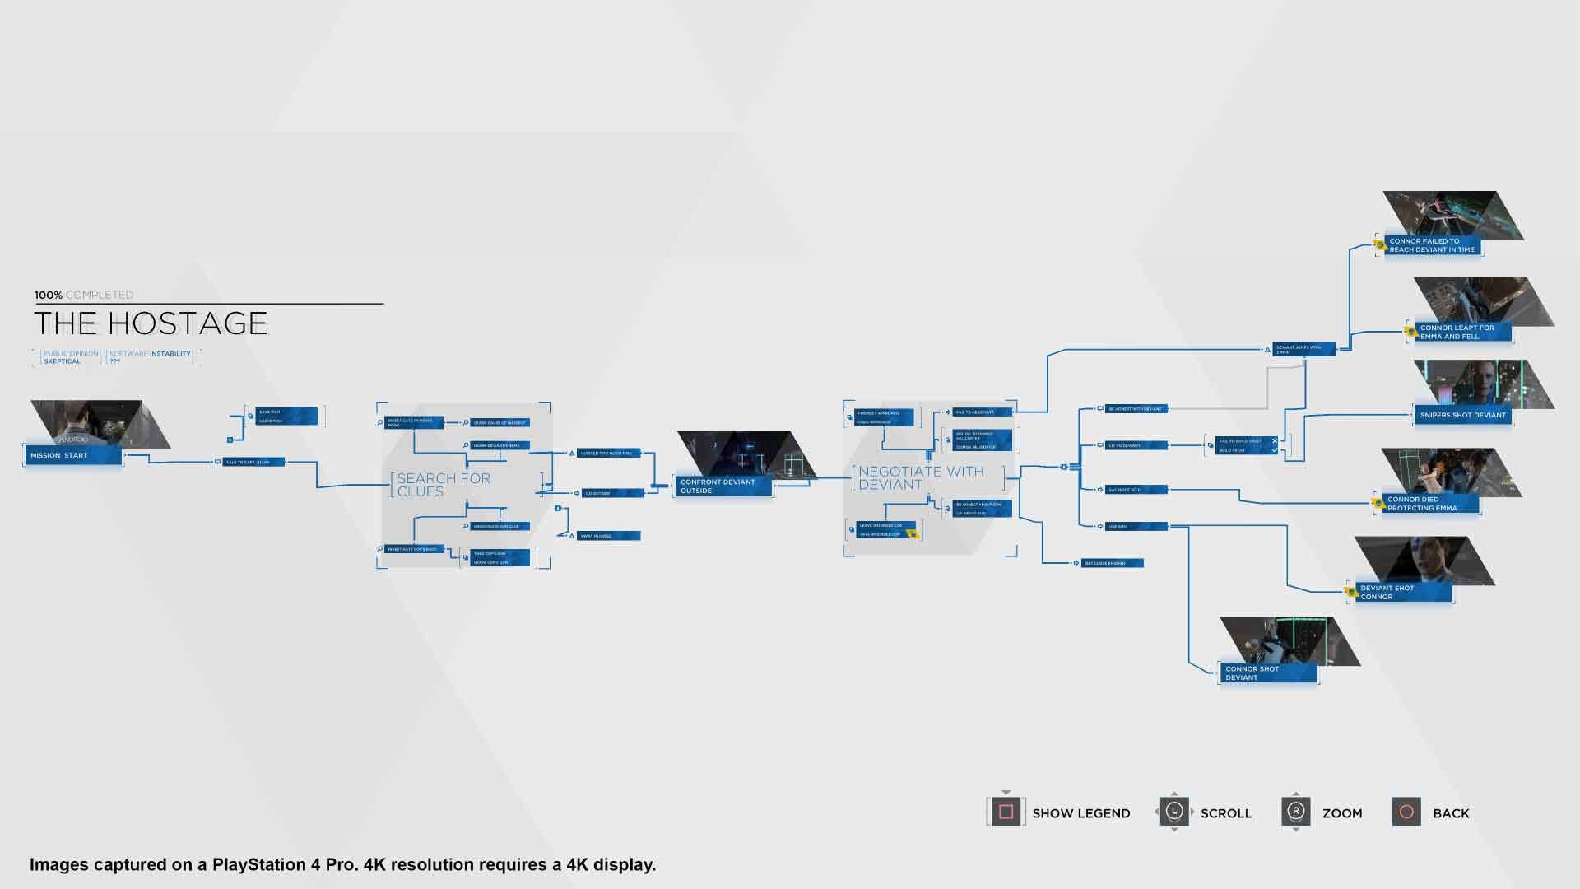

What is my reward?
We will need to assign a reward for our decision/policy:
$$J(θ) = E_{P∼π(P |G;θ)} [R (P)|G]$$
Basically: Find the best parameters for our $π$ with shortest time.
https://towardsdatascience.com/the-almighty-policy-gradient-in-reinforcement-learning-6790bee8db6

Slide 20
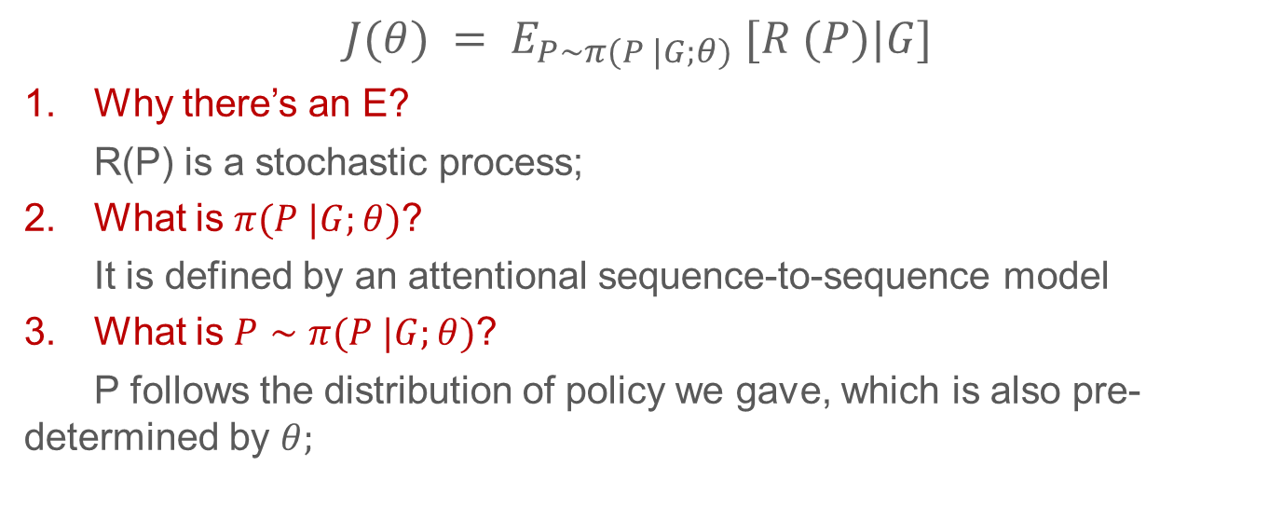
What the heck does this mean!
$$J(θ) = E_{P∼π(P |G;θ)} [R (P)|G]$$
Why there’s an E?
R(P) is a stochastic process;
What is $π(P |G;θ)$?
It is defined by an attentional sequence-to-sequence model
What is $P∼π(P |G;θ)$?
P follows the distribution of policy we gave, which is also pre-determined by $θ;$

Slide 21
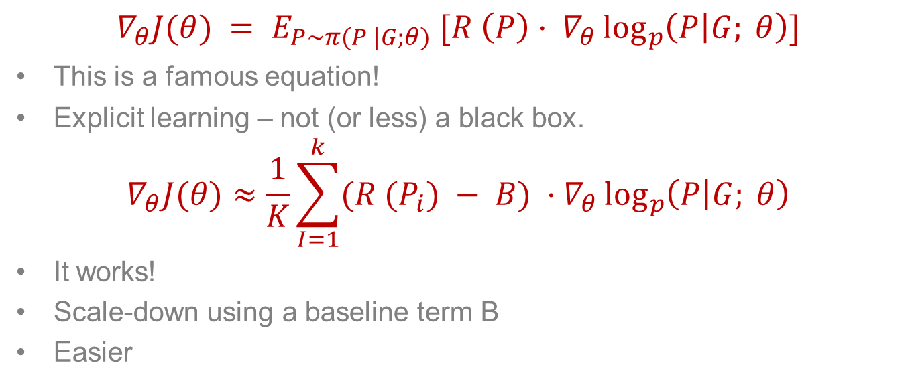
Policy gradient - REINFORCE equation
$$∇_{θ}J(θ) = E_{P∼π(P |G;θ)} [R \left(P\right)· ∇_{θ}\log_{p}\left(P | G; θ\right)]$$
This is a famous equation!
Explicit learning – not (or less) a black box.
$$∇_{θ}J(θ)≈\frac{1}{K}\sum_{I=1}^{k}{(R (P_{i}) − B)} ·∇_{θ}\log_{p}\left(P | G; θ\right)$$
It works!
Scale-down using a baseline term B
Easier
https://towardsdatascience.com/the-almighty-policy-gradient-in-reinforcement-learning-6790bee8db6

Slide 22
Difficulties in practice
Graphs with large memory footprint: fail to execute.
Instead, set a large failing signal, manually.
Some sporicidal and unexpected fail: especially after higher steps.
Instead, hard code the training process.
Initialize the baseline B with the failing signal results in more exploration.
Notes:
putting all of the operations of a huge LSTM on a single GPU will exceed the device’s memory limit. We will talk about this memory limit in the next paper.
Again we see a lot of manual setting and some of them are pretty questionable.

Slide 23
Architecture details

Slide 24
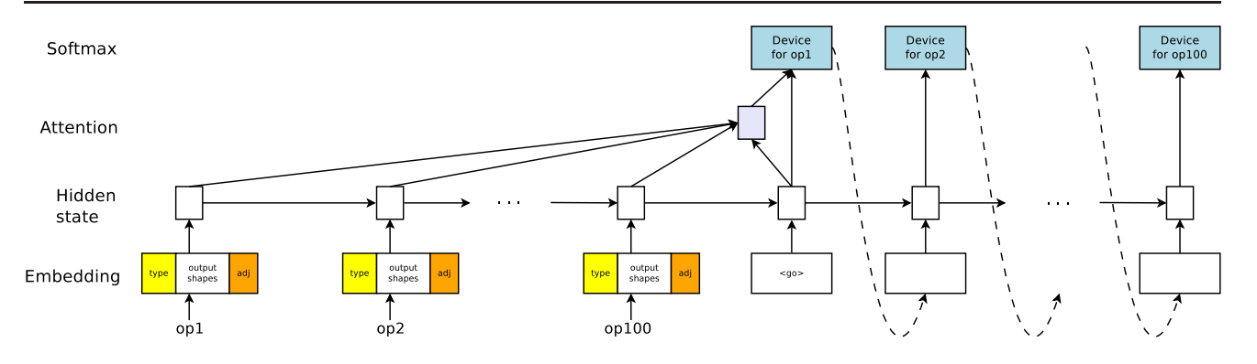
sequence-to-sequence model
With LSTM (Long short-term memory);
And a content-based attention mechanism;

Slide 25
Encoder
Input: Sequence of operations
Embed the operations by concatenating
Store a tunable embedding vector for each layer

Slide 26
Decoder
Attentional LSTM
Same steps as operations in graph G
Output: Each step outputs the device for the operation at the same encoder time step
Notes:
A potential issue with this encoder–decoder approach is that a neural network needs to be able to compress all the necessary information of a source sentence into a fixed-length vector. This may make it difficult for the neural network to cope with long sentences, especially those that are longer than the sentences in the training corpus.
Attention is the idea of freeing the encoder-decoder architecture from the fixed-length internal representation.
This is achieved by keeping the intermediate outputs from the encoder LSTM from each step of the input sequence and training the model to learn to pay selective attention to these inputs and relate them to items in the output sequence.
Put another way, each item in the output sequence is conditional on selective items in the input sequence.

Slide 27
Co-locating operations
A lot of operations in a graph;
Vanishing and exploding gradient;
Large memory footprints;
Solution: manually/heuristically forcing several operations located on same device.
With collocate_with feature of TensorFlow
Notes:
Another manually

Slide 28
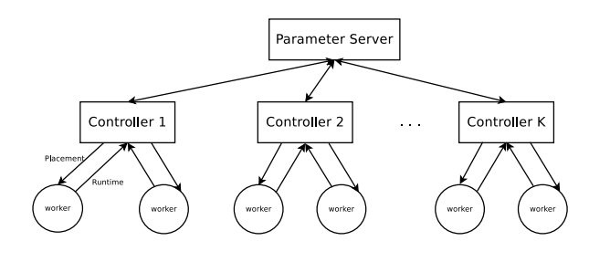
Distributed training
Asynchronous distributed
Several controllers;
Not storing input graph parameters on server to avoid latency;
Each controller control K workers.
Execute 10 steps for each benchmark
20 controller; each with 4 – 8 workers
Takes 12 – 27 hours to find best placement

Slide 29
Experiments

Slide 30
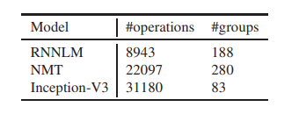
Benchmark models
Three established deep learning models:
Recurrent Neural Network Language Model (RNNLM) with 2 LSTM layers (size = 2048 and 1024): with Adam.
Neural Machine Translation with attention mechanism (NMT) (size = 2048 and 1024): with Adam.
Inception-V3 (299 × 299 × 3): with RMSProp
Co-location groups:
Notes:
The grid structure of this model introduces tremendous potential for parallel executions because each LSTM cell can start as soon as its input and previous states are available
its large number of hidden states due to the source and target sentences necessitates modeparallelism

Slide 31
Device
1 Intel Haswell 2300 CPU with 18 cores
OR
2 or 4 Nvidia Tesla K80 GPUs
50 GB of RAM

Slide 32
Baselines
Comparison with the trained placement:
Single-CPU;
Single-GPU;
Scotch static mapper;
MinCut
Expert-design
Notes:
We estimate the computational costs of each operation as well as the amount of data that flows along each edge of the neural network model, and feed them to the Scotch static mapper (Pellegrini, 2009). We also annotate the architecture graph (see Section 2) with compute and communication capacities of the underlying devices.
We use the same Scotch optimizer, but eliminate the CPU from the list of available devices fed to the optimizer. Similar to the single-GPU placement, if an operation has no GPU implementation, it runs on the CPU.

Slide 33
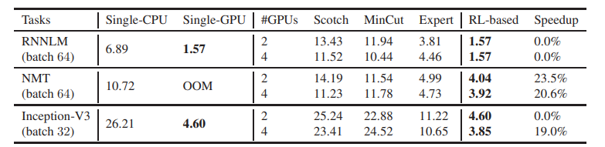
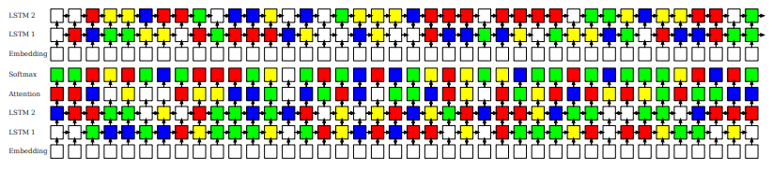
Single-Step Runtime Efficiency
Notes:
The group shows the RL-based learnt results. Color represent

Slide 34
For each model…
RNNLM: detects that it is possible to fit the whole RNNLM graph into one GPU, to save communication latencies.
Neural MT: Learns to put the less computational expensive operations, such as embedding lookups, on the CPU
Inception-V3: when only 2 GPUs available, the degree of freedom for model parallelism is limited. It thus places all the operations on a single GPU (although it could use 2 GPUs)
Again, unexpected results through searching!

Slide 35
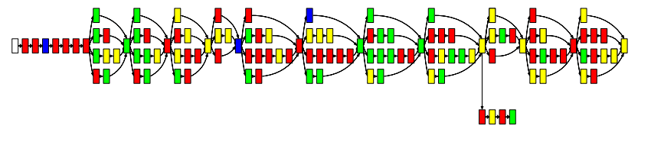
End-to-End Runtime Efficiency
Not only the single-step-wise training performance.
But also the entire training process.
Strangely, the paper only presented NMT and Inception-V3

Slide 36
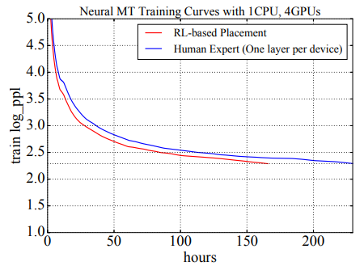
NMT
Expert-designed placement
229.57 hours
RLbased placement
165.73 hours

Slide 37
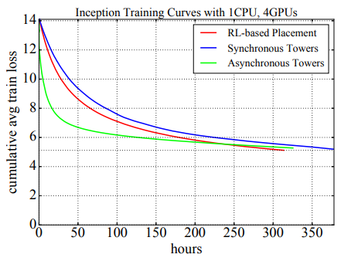
Inception-V3
Data parallelism, rather than model parallelism.
Asynchronous towers: puts one replica of the Inception-V3 network on each GPU
Synchronous Tower: the same as Asynchronous towers, except that it waits for the gradients of all copies before making an update

Slide 38
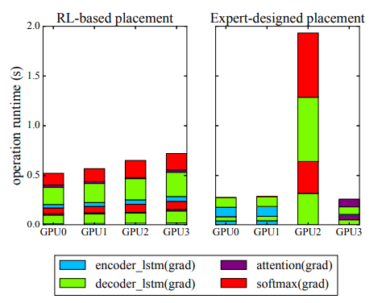
Computational load profiling of NMT model
RL-based placement balances the workload significantly better than does the expert-designed placement
The imbalance is much more significant when back-propagation time is considered.
Notes:
Interestingly, if we do not take into account the time for back-propagation, then expert-designed placement makes sense because the workload is more balanced (whilst still less balanced than ours).

Slide 39
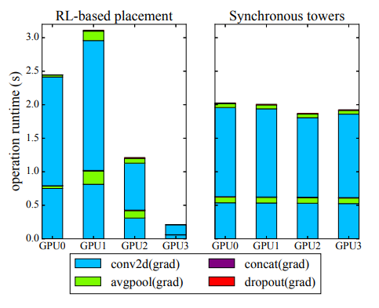
Computational load profiling of Inception-V3
RL-based placement does not seek to balance the computations between GPUs
Inception-V3 has more dependencies than NMT, allowing less room for model parallelism across GPUs

Slide 40
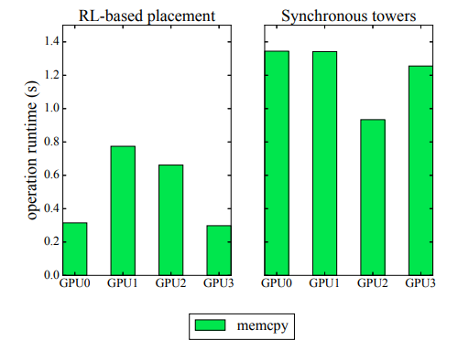
Memory copy profiling of Inception-V3
RL-based model parameters are on the same device as the operations that use them
Synchronous tower model has to wait for all parameters have to be updated and sent to them.
Reduce the communication cost, leading to overall reduction in computing time.

Slide 41
vDNN: Virtualized Deep Neural Networks for Scalable, Memory-Efficient Neural Network Design
Minsoo Rhu, Natalia Gimelshein, Jason Clemons, Arslan Zulfiqar, Stephen W. Keckler

Slide 42
Remember this?
Out of memory!
Why GPU memory is so small compared to main memory?
Ultra-high bandwidth
Cannot just add more memory chips
Increased electrical capacity & Decreased resistance
Spoil the timing on the memory bus.
Conspiracy: just another NVIDIA marketing strategy?

Slide 43
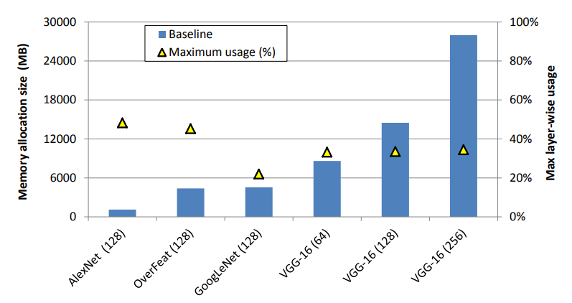
Memory management is significant
Maximum fraction of baseline allocation actually utilized when traversing layer-wise.
12 GB: the memory capacity of the state-of-the-art NVIDIA Titan X

Slide 44
Motivations
DNNs trained via stochastic gradient-descent (SGD) are designed and structured with multiple layers
the training involves a series of layer-wise computations, the order of which is statically fixed and repeated for numerous iterations throughout the entire training process

Slide 45

Common sense - Forward and backward propagation
Forward propagation: serialized process, highly dependent. Layer-wise.
Backward propagation
input gradient maps (dY)
output gradient maps (dX)
Deriving the value of dx for layer(n) generally requires memory for both its input/output gradient maps (dy and dx) but also the input/output feature maps (X and Y) for this layer: a lot of memory

Slide 46
Common sense - Batch size
Training a network involves both forward and backward propagation, which are repeated for millions to billions of iterations
Nature of SGD-based backward propagation, the network input is generally batched with hundreds of images
Batch increases memory allocation size but helps the network model better converge to an optimal solution.

Slide 47
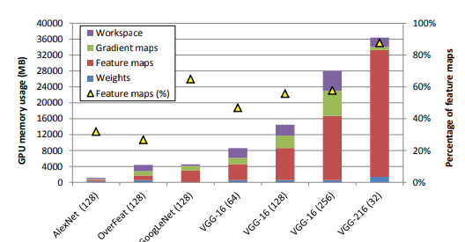
Motivation - again
Even though the GPU can, process a single layer’s computation, popular ML frameworks adopt a network-wide memory allocation policy
Popular ML frameworks suffer from severe limitations in the way they allocate and manage memory.
Sacrifice memory use to improve performance

Slide 48
Existing schemes overprovision the memory allocations to network-wise requirements, even though the GPU only use part of the memory for the layer-wise requirements.
53% to 79% of memory is wasted.

Slide 49
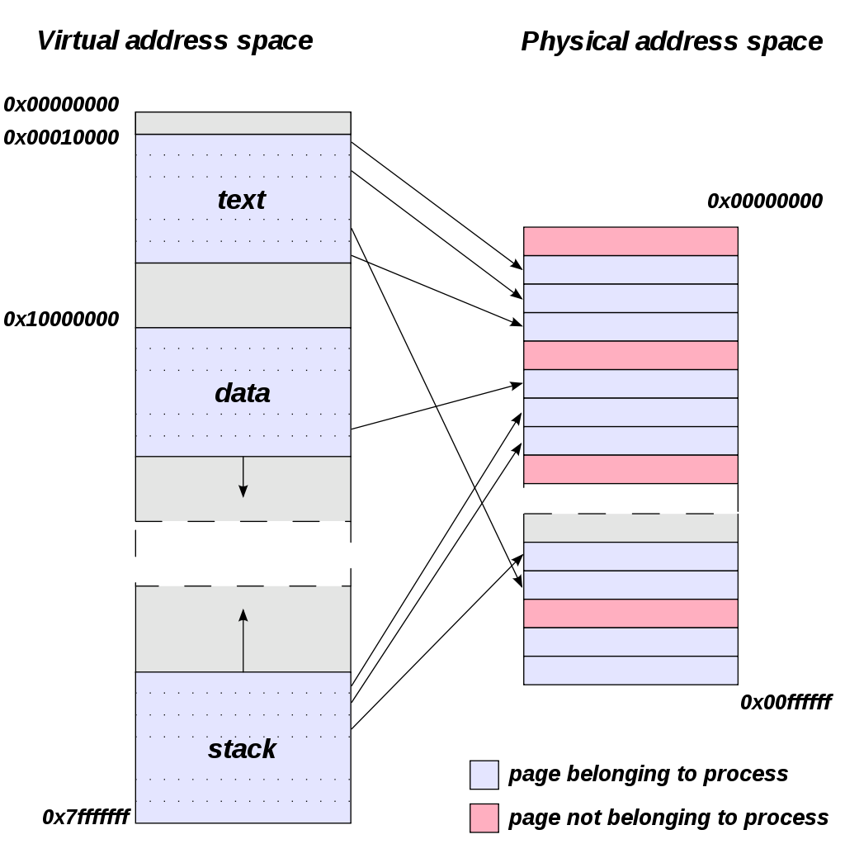
Memory page?
Memory is messy;
Humans are lazy;
Machines are stupid.
Page-migration based virtualization solutions will cause more I/O overhead:
page transfer
page table update.
Notes:
A page, memory page, or virtual page is a fixed-length contiguous block of virtual memory, described by a single entry in the page table. It is the smallest unit of data for memory management in a virtual memory operating system. Similarly, a page frame is the smallest fixed-length contiguous block of physical memory into which memory pages are mapped by the operating system.^{[1][2][3]}
A transfer of pages between main memory and an auxiliary store, such as a hard disk drive, is referred to as paging or swapping.^{[4]}

Slide 50
Memory mechanism
To reduce the latency of memory access by moving pages near to the processor where the process accessing that memory is running.
It’s slow! 80 – 200 MB/sec compared with DMA cudaMemcpy: 12.8 – 16 GB/sec.
Could take 10s per GB.
Notes:
ML frameworks will suffer from huge performance penalties when relying on page-migration for training DNNs.

Slide 51
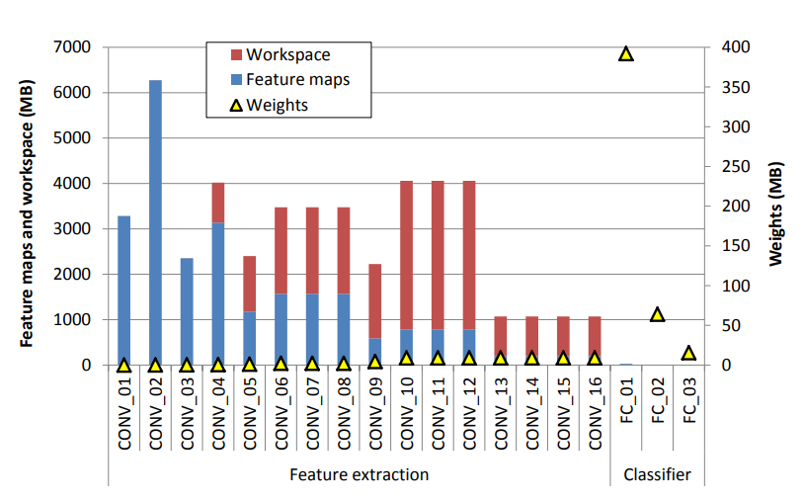
Find the gaps
First, the intermediate feature maps (blue) and workspace (red) incur an order of magnitude higher memory usage compared to the weights
Second, most of these intermediate data structures are concentrated on the feature extraction layers and are less significant in the later classifier layers
Third, the weights, smaller compared to these intermediate data, are concentrated on the classifier layers due to their full connectivity

Slide 52
How did we save memory traditionally?
Memory-efficient convolutional algorithm:
Get rid of the workspace: no-WS incurred algorithm.
E.g.: Implicit GEMM in cuDNN
Implicit GEMM operates natively on the convolution input tensors, converting the computation into a matrix multiply on the fly. It is important to note that corresponding matrices are never created in memory. Thus, to calculate arithmetic intensity, one can use the original tensor sizes.
But, it is bad for the performance.
Notes:
Arithmetic intensity is a measure of floating-point operations (FLOPs) performed by a given code (or code section) relative to the amount of memory accesses (Bytes) that are required to support those operations. It is most often defined as a FLOP per Byte ratio (F/B).
You can imagine a

Slide 53
VDNN’s goals
Virtualize the memory usage of DNNs
Using both GPU and CPU memory
Minimizing its impact on performance
Transparent to programmer
Concentrate on the feature extraction layers
Notes:
Virtualization enables the possibility of memory transfer and efficiently usage.
GPU memory is precious! CPU memory, on the other hand, is significantly cheaper.
Virtualization is harmful for performnace.

Slide 54
Design principles
Sliding-window based, layer-wise memory management strategy
Runtime memory manager conservatively allocates memory from its memory pool.
Useless intermediate data structures will be released.
Memory-wise, to store all the input data in the system is not economic, although they can be reused.
Notes:
In that sense, we ask two questions:
Is the data useful later, if not, just release;
Is the data useful right now, if not, just transfer to CPU

Slide 55
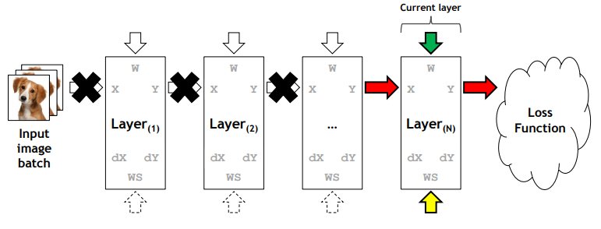
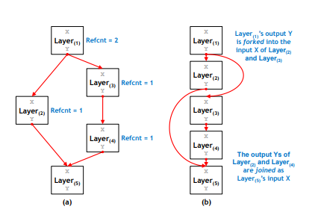
Forward propagation
Be careful! Do not kill useful distant data!

Slide 56
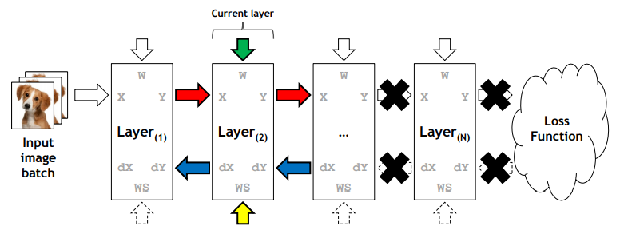
Back propagation
vDNN immediately frees up a layer’s Y and dY once this layer’s backward computation is complete
X and dX are not released as the preceding layer’s backward propagation will be needing these values for gradient derivation

Slide 57
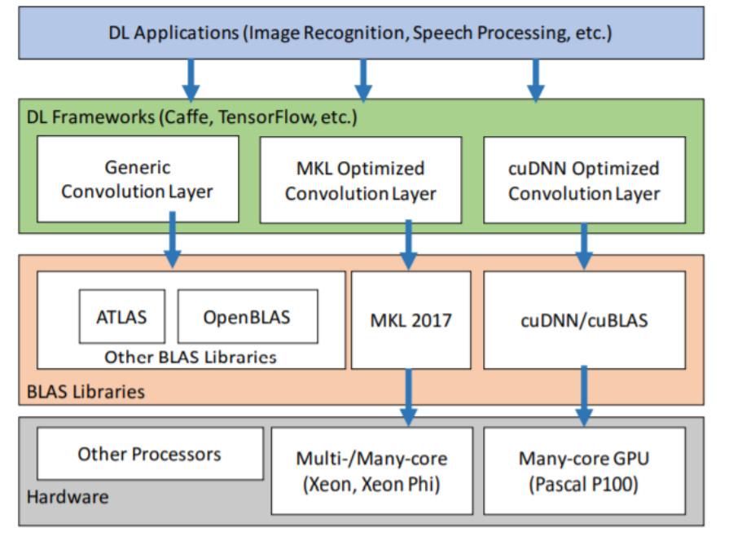
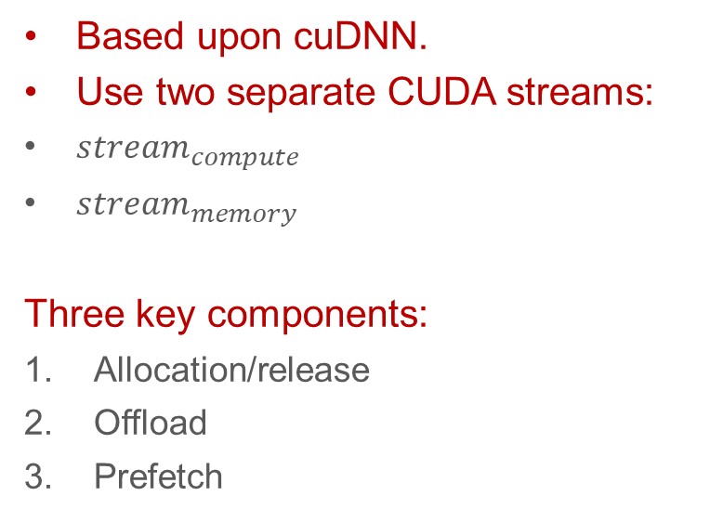
Implementation
Based upon cuDNN.
Use two separate CUDA streams:
$stream_{compute}$
$stream_{memory}$
Three key components:
Allocation/release
Offload
Prefetch

Slide 58
Memory allocation/release
CUDA only has synchronous de/allocations
Will increase communication overhead
Instead, use an asynchronous API provided by NVIDIA

Slide 59
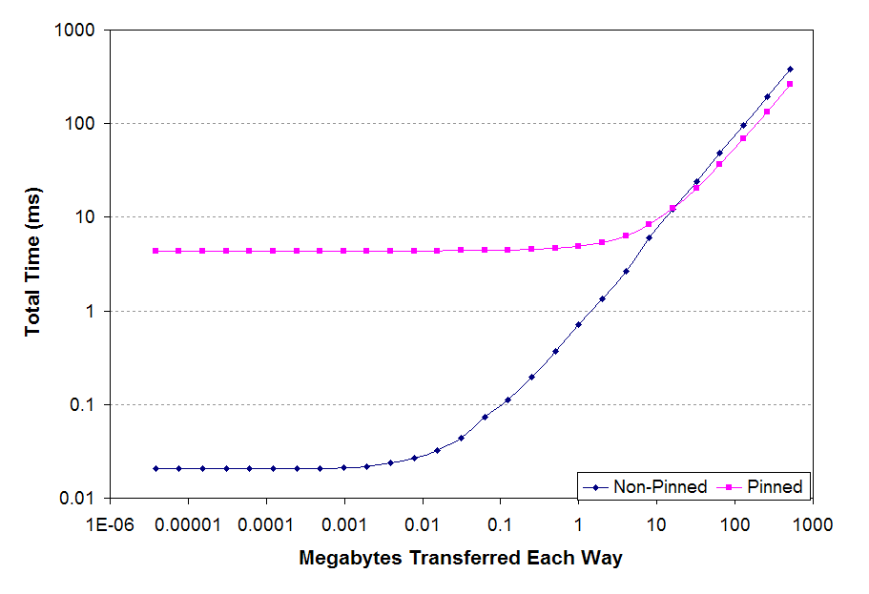
Memory Offloads (input feature maps)
Non-blocking memory transfer of X to the pinned memory via PCIe
Much faster than disk searching; slower than direct memory reading
Purpose: save GPU memory use.
Pinned memory: faster than unpinned memory.
https://www.cs.virginia.edu/~mwb7w/cuda_support/pinned_tradeoff.html
Notes:
Pinned memory is memory allocated using the cudaMallocHost function, which prevents the memory from being swapped out and provides improved transfer speeds.

Slide 60
Offload – for each layer
Convolutional and pool layers’ input feature maps are read-only data structures
Overlapping a layer’s offload operation with the same layers’ forward propagation is okay.
Activation layers only use Y and dY, so do not need to offload

Slide 61
Prefetch
Prefetching offloaded input feature maps (Xs) back to GPU memory
Unlike offload, need to fetch the input data of layer n when the backward propagation of layer m: n<m
If n and m’s difference is too large, benefit will be less;
Data of layer n-1 needs to be ready before layer n’s backward propagation is over: force synchronization
Notes:
In other words, prefetching data too early in time will again suboptimally utilize GPU memory as the prefetched data will once again camp inside the GPU memory without immediate usage.
Consequently, any prefetch operation launched during layer(n) ’s backward computation is guaranteed to be ready before layer(n−1)’s computation

Slide 62
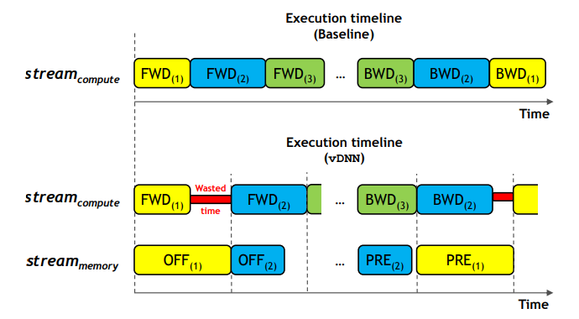
Simultaneously
Notes:
The baseline is the normal process of training. From forward propagation 1 to n, then backward propagation n to1.
In the vDNN, it’s all the same, but with memory allocation and transfer.
If offload or prefetch process is longer than the actual propagation, then it has to wait.

Slide 63
vDNN Memory Transfer Policy
Optimization problem
Subject to:
GPU memory capacity;
Overall layer-wise memory usage;
Network-wide performance.
The network should be able to be trained while saving memory, but the performance should not be too bad.

Slide 64
Performance-wise consideration
Where did the performance loss come from?
Additional latency from offload and prefetch;
The memory-efficient algorithm per se, i.e. implicit GEMM in cuDNN for this paper.
So, need to optimize the problem using a heuristic-based memory transfer policies.
Notes:
GEMMs (General Matrix Multiplications)
The implicit GEMM approach is a variant of direct convolution, and operates directly on the input weight and activation tensors. Alternatively, convolutions can be computed by transforming data and weights into another space, performing simpler operations (for example, pointwise multiplies), and then transforming back. The cuDNN library provides some convolution implementations using FFT and Winograd transforms.

Slide 65
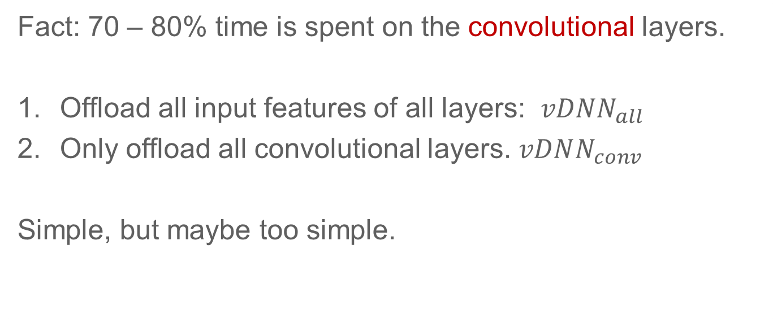
Static vDNN
Fact: 70 – 80% time is spent on the convolutional layers.
Offload all input features of all layers: $vDNN_{all}$
Only offload all convolutional layers. $vDNN_{conv}$
Simple, but maybe too simple.
Notes:
All layers to save GPU memory
Only convolutional layers: which is the major memory killer

Slide 66
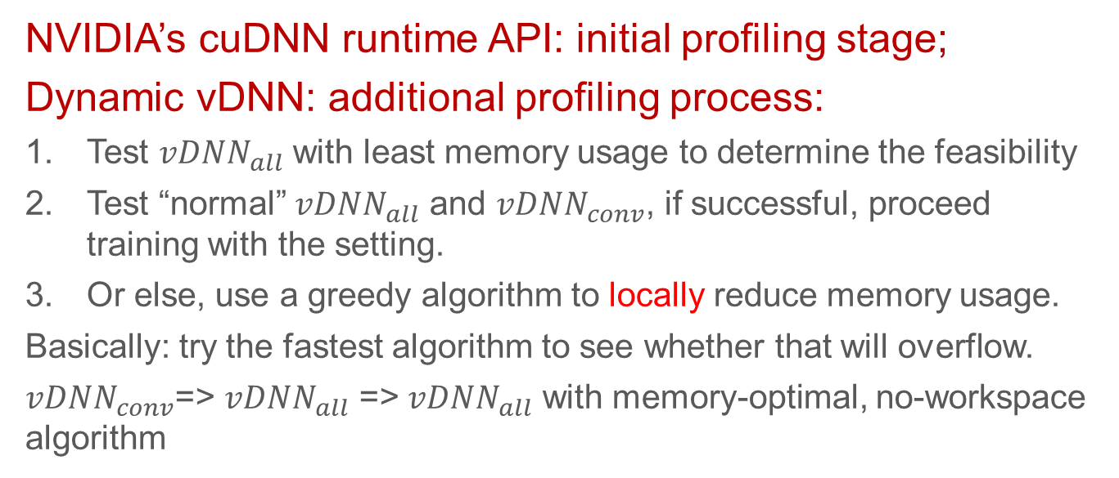
Dynamic vDNN
NVIDIA’s cuDNN runtime API: initial profiling stage;
Dynamic vDNN: additional profiling process:
Test $vDNN_{all}$ with least memory usage to determine the feasibility
Test “normal” $vDNN_{all}$ and $vDNN_{conv}$, if successful, proceed training with the setting.
Or else, use a greedy algorithm to locally reduce memory usage.
Basically: try the fastest algorithm to see whether that will overflow.
$vDNN_{conv}$=> $vDNN_{all}$ => $vDNN_{all}$ with memory-optimal, no-workspace algorithm
Notes:
Performance is better

Slide 67
GPU node setting
NVIDIA’s Titan X
highest math throughput (single precision throughput of 7 TFLOPS)
memory bandwidth (max 336 GB/sec)
memory capacity (12 GB)
Intel i7- 5930K (containing 64 GB of DDR4 memory) via a PCIe switch (gen3), which provides a maximum 16 GB/sec data transfer bandwidth

Slide 68
Benchmarks
AlexNet
OverFeat
GoogLeNet
Three different batch sizes for VGG-16 (the deepest network with 16 CONV and 3 FC layers)
Very deep networks:
Series of VGG: 16 CONV layers to 416 CONV layers (16/116/216/316/416)
Notes:
. The feature extraction layers are conceptually divided into five groups of CONV layers, separated by the intermediate POOL layers. The only difference among these CONV layer groups is that the number of output feature maps grows from 64 to 512, from the first to the last layer group.

Slide 69
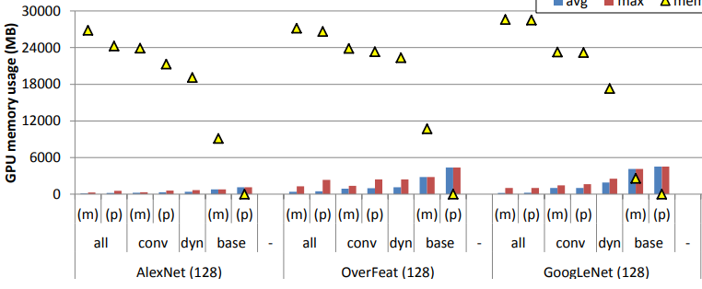

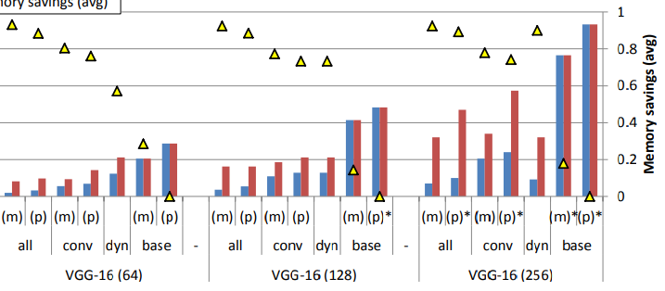
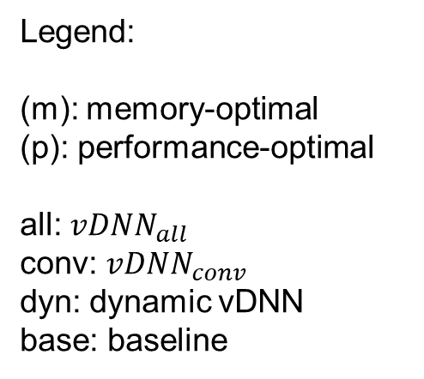
Memory usage and saving
Legend:
(m): memory-optimal
(p): performance-optimal
all: $vDNN_{all}$
conv: $vDNN_{conv}$
dyn: dynamic vDNN
base: baseline

Slide 70
GPU Memory Usage
The smaller the average memory usage becomes, the more likely vdnn will have headroom to improve performance, by:
Employing performance-efficient convolutional algorithms that require larger workspace
Reducing the total number of offload layers and prevent potential performance drops due to offloading

Slide 71
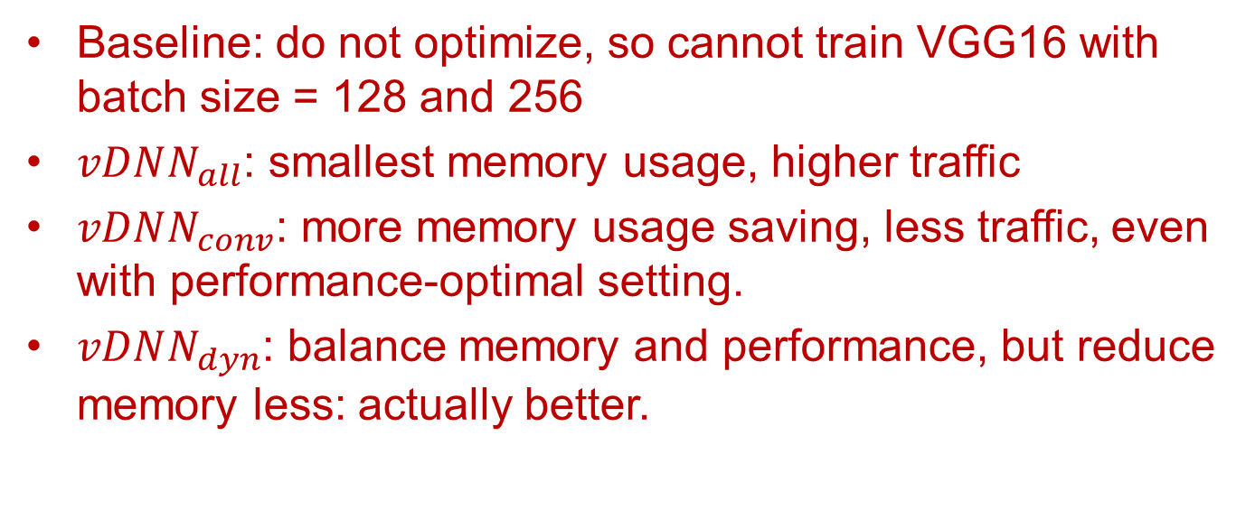
GPU Memory Usage – Quick facts
Baseline: do not optimize, so cannot train VGG16 with batch size = 128 and 256
$vDNN_{all}$: smallest memory usage, higher traffic
$vDNN_{conv}$: more memory usage saving, less traffic, even with performance-optimal setting.
$vDNN_{dyn}$: balance memory and performance, but reduce memory less: actually better.

Slide 72
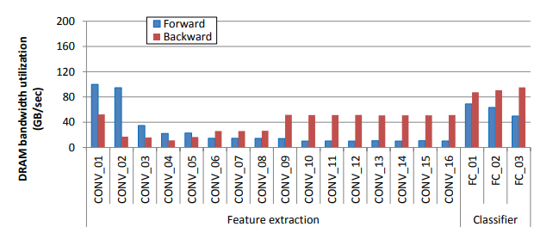
Impact on memory system

Slide 73
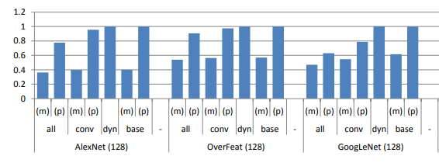
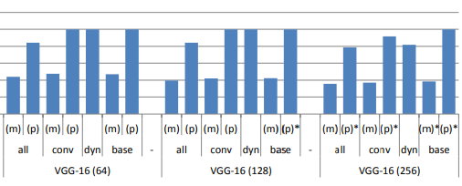
Performance (normalized to baseline)
Legend:
(m): memory-optimal
(p): performance-optimal
all: $vDNN_{all}$
conv: $vDNN_{conv}$
dyn: dynamic vDNN
base: baseline

Slide 74
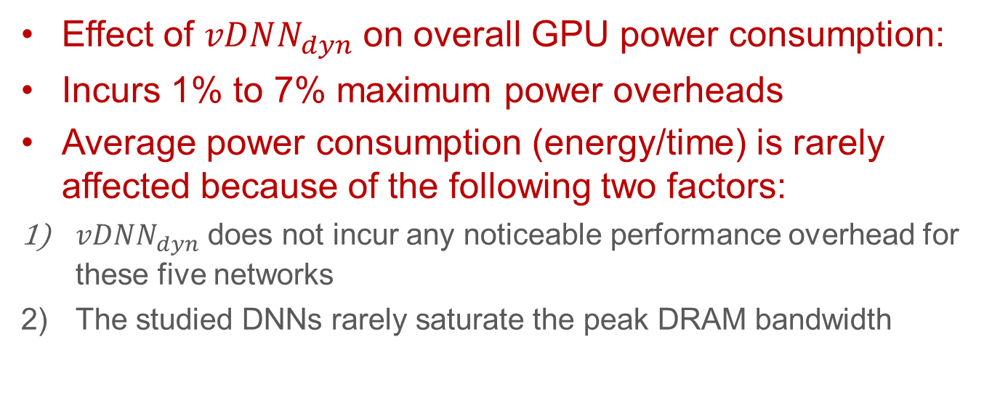
Power
Effect of $vDNN_{dyn}$ on overall GPU power consumption:
Incurs 1% to 7% maximum power overheads
Average power consumption (energy/time) is rarely affected because of the following two factors:
$vDNN_{dyn}$ does not incur any noticeable performance overhead for these five networks
The studied DNNs rarely saturate the peak DRAM bandwidth
Notes:
Overall, vDNNall and vDNNconv with memory-optimal algorithms exhibit an average 58% and 55% performance loss (maximum 65% and 63% degradation) compared to baseline

Slide 75
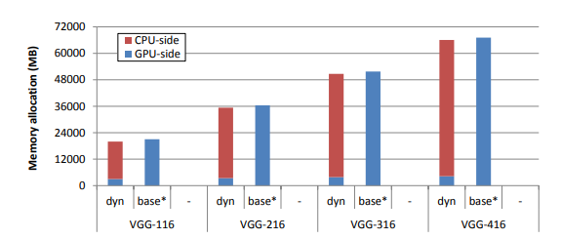
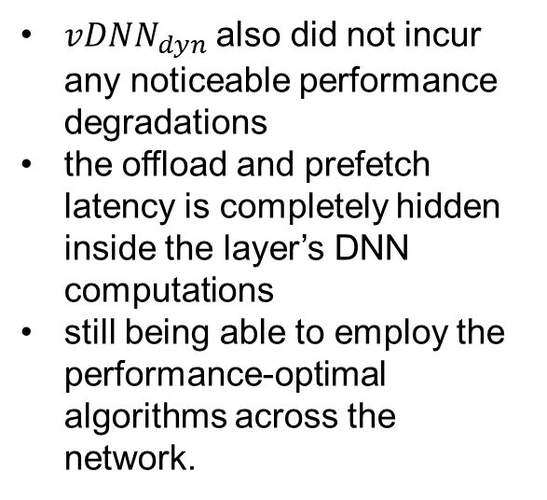
On very deep networks
vDNN’s scalability
$vDNN_{dyn}$ also did not incur any noticeable performance degradations
the offload and prefetch latency is completely hidden inside the layer’s DNN computations
still being able to employ the performance-optimal algorithms across the network.

Slide 76
Conclusion
A scalable, memory-efficient runtime memory manager
Reduces the average GPU memory usage
Balance memory saving and performance

