Slide 1
Device Placement with Reinforcement Learning
Azalia Mirhoseini, Hieu Pham, Quoc V. Le, Benoit Steiner, Rasmus Larsen, Yuefeng Zhou, Naveen Kumar, Mohammad Norouzi, Samy Bengio, Jeff Dean

Slide 2
The abstract: find the fancy words
Device Placement Optimization with Reinforcement Learning
The past few years have witnessed a growth in size and computational requirements for training and inference with neural networks. Currently, a common approach to address these requirements is to use a heterogeneous distributed environment with a mixture of hardware devices such as CPUs and GPUs. Importantly, the decision of placing parts of the neural models on devices is often made by human experts based on simple heuristics and intuitions. In this paper, we propose a method which learns to optimize device placement for TensorFlow computational graphs. Key to our method is the use of a sequence-to-sequence model to predict which subsets of operations in a TensorFlow graph should run on which of the available devices. The execution time of the predicted placements is then used as the reward signal to optimize the parameters of the sequence-to-sequence model. Our main result is that on Inception-V3 for ImageNet classification, and on RNN LSTM, for language modeling and neural machine translation, our model finds non-trivial device placements that outperform hand-crafted heuristics and traditional algorithmic methods.

Slide 3
Several keywords
Device Placement
Reinforcement Learning
Sequence-to-sequence model

Slide 4
Device placement?

Slide 5
Heterogeneous distributed environment
What?
Merging CPU and GPU environment
Neural network training
How to make the system works and improve performance

Slide 6
Heterogeneous distributed environment
Why?
Different purposes
CPU: fewer cores, higher frequency, more complicated and faster cache mechanism;
GPU: much more cores, SIMD, harder to program.

Slide 7
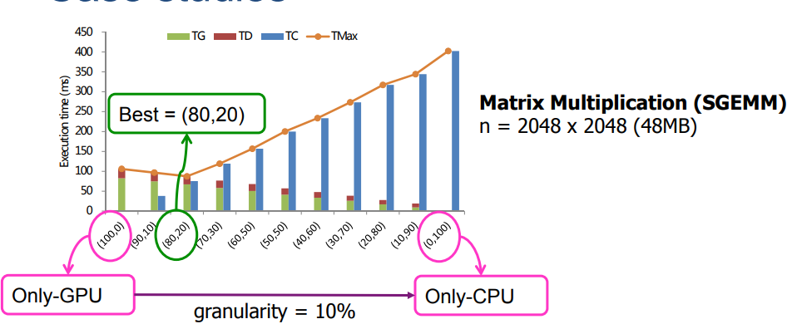
Heterogeneous distributed environment
Why, again?
Balanced workload
https://www.ntnu.edu/documents/139931/1275097249/NTNU_HetComp_toPublish.pdf/486588ee-23af-4104-8a04-bb18cd5a68c1

Slide 8
Heterogeneous distributed environment
Why, even more again?
Decrease data communication
Increase flexibility and reliability
Increase energy efficiency

Slide 9
Heterogeneous distributed environment
Why not?
Programming difficulties - solutions:
Develop human-friendly libraries (tensorflow-gpu)
Hire more graduate students
Workload balance?
Hard to implement and optimize

Slide 10
Heterogeneous distributed environment
How?
Human specify:
Questionable;
Low reusability/generalizability
Algorithm:
“I used the stones to destroy the stones” - Thanos
Hard to tune the hyperparameters.

Slide 11
Reinforcement Learning?

Slide 12

Reinforcement Learning?
What?
Agents (Problem)
Exploration (Actions)
An environment (Markov decision process)
Cumulative reward (Feedback)

Slide 13
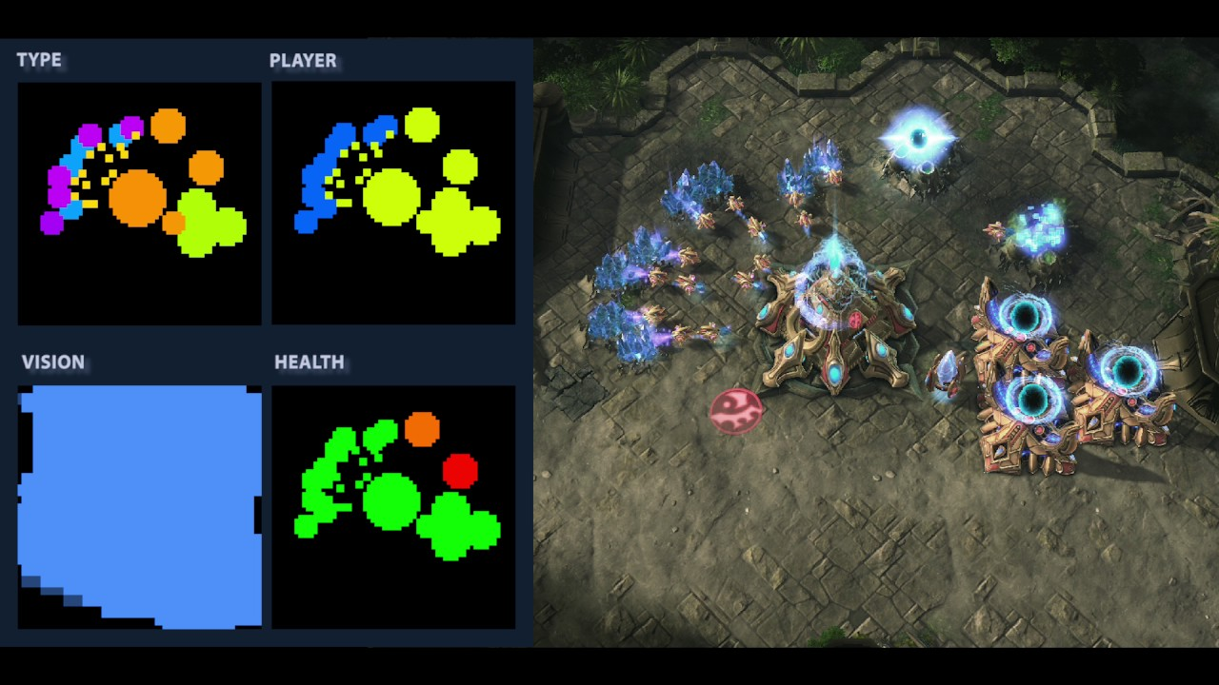
Reinforcement Learning?
Where?
Real-time strategy game
Atari game

Slide 14
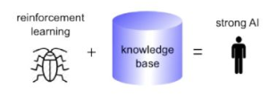
Reinforcement Learning?
Why?

