Slide 1
Device Placement with Reinforcement Learning
Azalia Mirhoseini, Hieu Pham, Quoc V. Le, Benoit Steiner, Rasmus Larsen, Yuefeng Zhou, Naveen Kumar, Mohammad Norouzi, Samy Bengio, Jeff Dean

Slide 2
Several keywords
Device Placement
Reinforcement Learning
Sequence-to-sequence model

Slide 3
Device placement?

Slide 4
Heterogeneous distributed environment
What?
Merging CPU and GPU environment
Neural network training
How to make the system works and improve performance

Slide 5
Heterogeneous distributed environment
Why?
Different purposes
CPU: fewer cores, higher frequency, more complicated and faster cache mechanism;
GPU: much more cores, SIMD, harder to program.

Slide 6
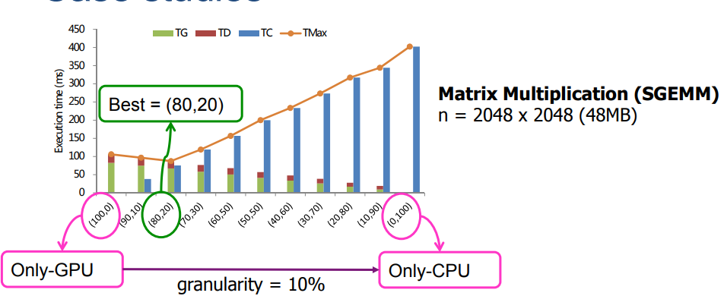
Heterogeneous distributed environment
Why, again?
Balanced workload
https://www.ntnu.edu/documents/139931/1275097249/NTNU_HetComp_toPublish.pdf/486588ee-23af-4104-8a04-bb18cd5a68c1

Slide 7
Heterogeneous distributed environment
Why, even more?
Decrease data communication
Increase flexibility and reliability
Increase energy efficiency

Slide 8
Heterogeneous distributed environment
Why not?
Programming difficulties - solutions:
Develop human-friendly libraries (tensorflow-gpu)
Hire more graduate students
Workload balance?
Hard to implement and optimize

Slide 9
Heterogeneous distributed environment
How?
Human specify:
Questionable;
Low reusability/generalizability
Algorithm:
Hard to tune the hyperparameters.

Slide 10
Reinforcement Learning?

Slide 11

Reinforcement Learning?
What?
Agents (Problem)
Exploration (Actions)
An environment (Markov decision process)
Cumulative reward (Feedback)

Slide 12
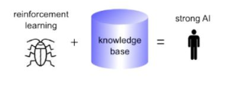
Reinforcement Learning?
Why?
A good strategy;
A good policy-finder.
Isn’t reinforcement learning just genetic algorithm?
Mutation and evolution;
(Kind of) metaheuristics optimization;
Search and memory;
Notes:
RL works faster, since not non-deterministic for GA;
RL benefits from features such as temporal credit assignment, which can speed up the convergence. It does so by maintaining a ‘trace’ of highly rewarding states.
GA is by definition, an inter-life algorithm, which means that the approach requires individuals to ‘die’ in order to progress. RL is intended to be an intra-life learning algorithm, with many recently (an not so recently) developed methods targeting the issue of continual learning and safe RL.

Slide 13
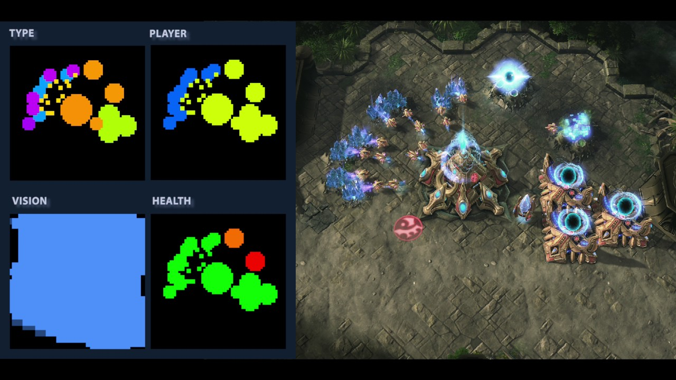
Reinforcement Learning?
Where?
Real-time strategy game
Atari game

Slide 14
Model description

Slide 15
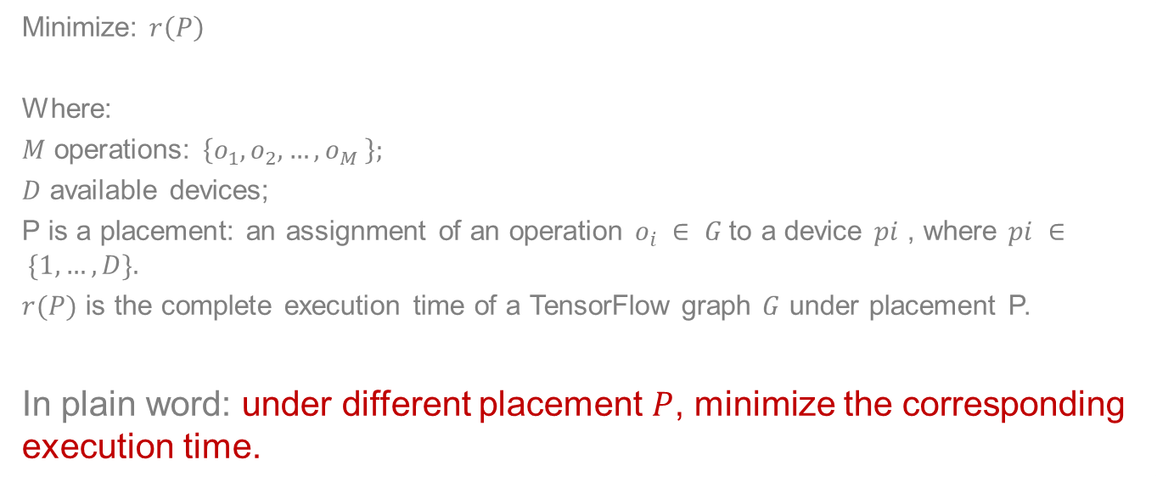
Question description
Minimize: $r\left(P\right)$
Where:
$M$ operations: $\left\{o_{1}, o_{2}, …, o_{M} \right\};$
$D$ available devices;
P is a placement: an assignment of an operation $o_{i} ∈ G$to a device $pi$ , where $pi ∈ \{1, …, D\}.$
$r(P)$ is the complete execution time of a TensorFlow graph $G$ under placement P.
In plain word: under different placement $P$, minimize the corresponding execution time.

Slide 16
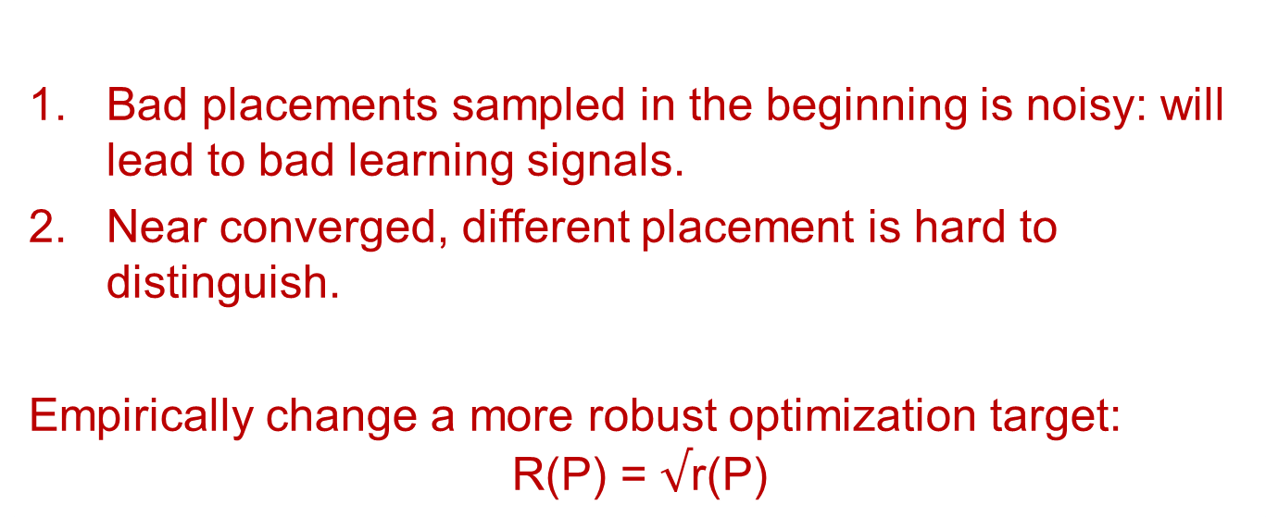
Why can’t we just do the math, based on r(P)?
Bad placements sampled in the beginning is noisy: will lead to bad learning signals.
Near converged, different placement is hard to distinguish.
Empirically change a more robust optimization target:
$$\text{R}\text{(}\text{P}\text{) = }√\text{r}\text{(}\text{P}\text{)}$$

Slide 17
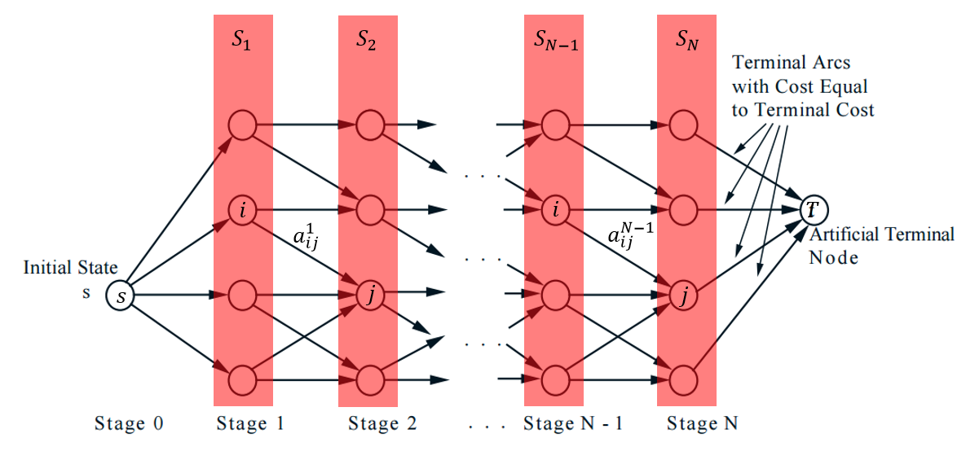
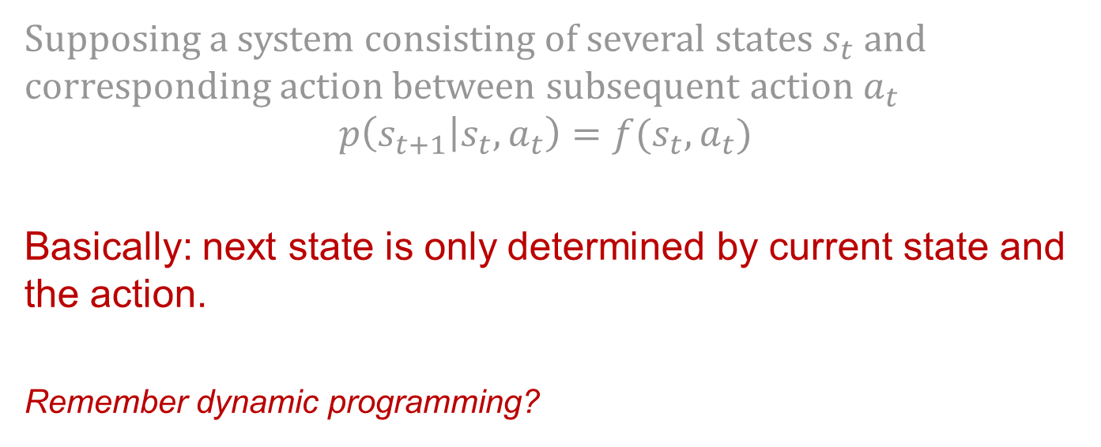
Markov assumption
Supposing a system consisting of several states $s_{t}$ and corresponding action between subsequent action $a_{t}$
$$p\left(s_{t+1} | s_{t},a_{t}\right)=f(s_{t},a_{t})$$
Basically: next state is only determined by current state and the action.
Remember dynamic programming?
https://towardsdatascience.com/the-almighty-policy-gradient-in-reinforcement-learning-6790bee8db6

Slide 18
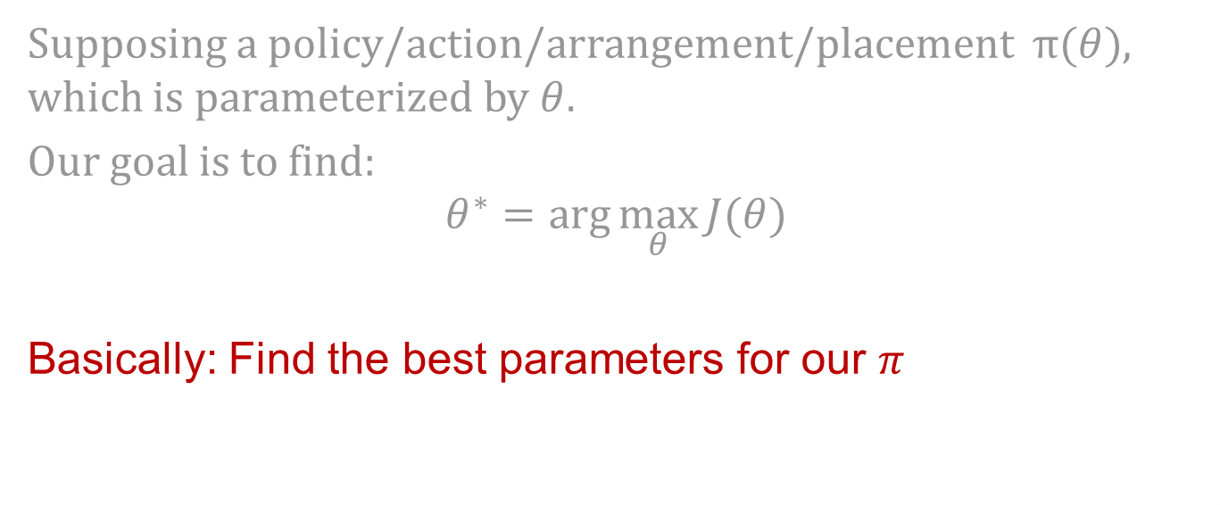
What do we want?
Supposing a policy/action/arrangement/placement $π(θ)$, which is parameterized by $θ$.
Our goal is to find:
$$θ^{∗}=\arg{\max_{θ}{J(θ)}}$$
Basically: Find the best parameters for our $π$
https://towardsdatascience.com/the-almighty-policy-gradient-in-reinforcement-learning-6790bee8db6

Slide 19

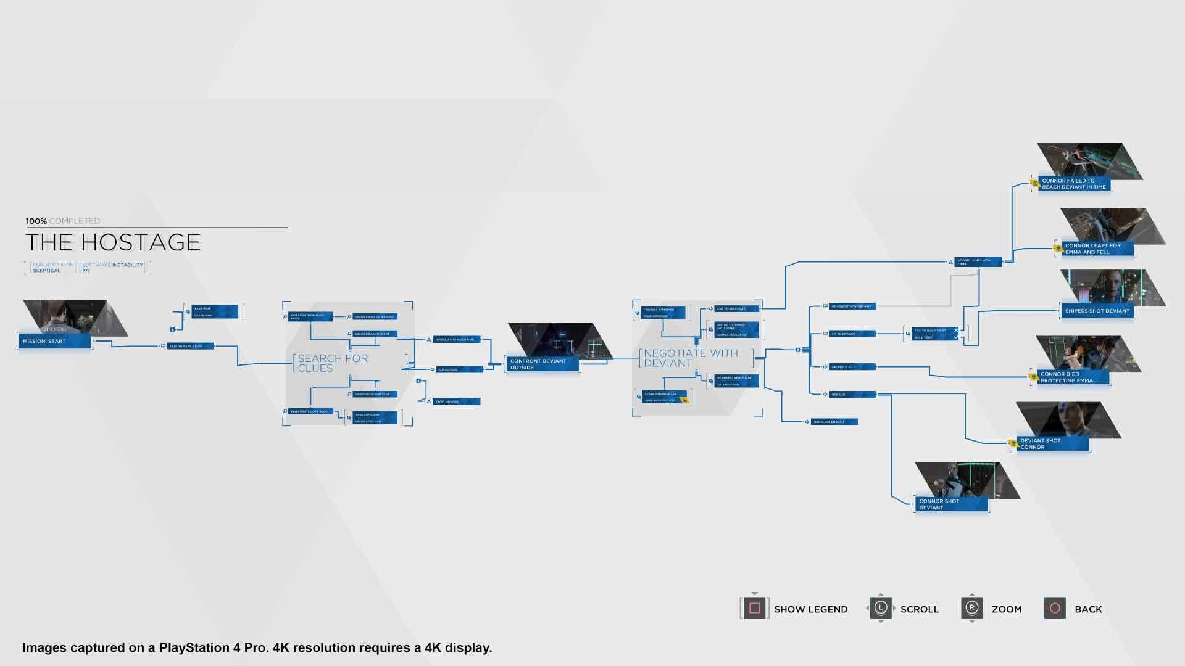

What is my reward?
We will need to assign a reward for our decision/policy:
$$J(θ) = E_{P∼π(P |G;θ)} [R (P)|G]$$
Basically: Find the best parameters for our $π$ with shortest time.
https://towardsdatascience.com/the-almighty-policy-gradient-in-reinforcement-learning-6790bee8db6

Slide 20
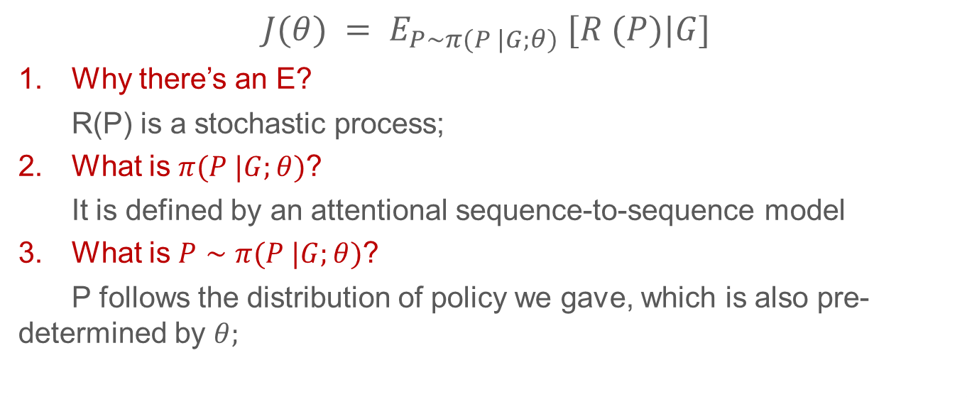
What the heck does this mean!
$$J(θ) = E_{P∼π(P |G;θ)} [R (P)|G]$$
Why there’s an E?
R(P) is a stochastic process;
What is $π(P |G;θ)$?
It is defined by an attentional sequence-to-sequence model
What is $P∼π(P |G;θ)$?
P follows the distribution of policy we gave, which is also pre-determined by $θ;$

Slide 21
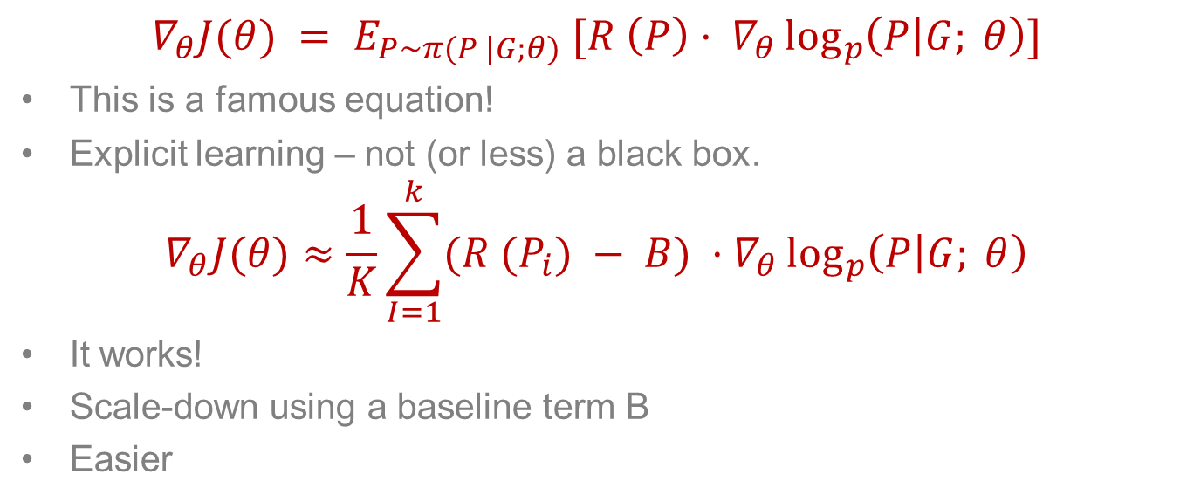
Policy gradient - REINFORCE equation
$$∇_{θ}J(θ) = E_{P∼π(P |G;θ)} [R \left(P\right)· ∇_{θ}\log_{p}\left(P | G; θ\right)]$$
This is a famous equation!
Explicit learning – not (or less) a black box.
$$∇_{θ}J(θ)≈\frac{1}{K}\sum_{I=1}^{k}{(R (P_{i}) − B)} ·∇_{θ}\log_{p}\left(P | G; θ\right)$$
It works!
Scale-down using a baseline term B
Easier
https://towardsdatascience.com/the-almighty-policy-gradient-in-reinforcement-learning-6790bee8db6

Slide 22
Difficulties in practice
Graphs with large memory footprint: fail to execute.
Instead, set a large failing signal, manually.
Some sporicidal and unexpected fail: especially after higher steps.
Instead, hard code the training process.
Initialize the baseline B with the failing signal results in more exploration.
Notes:
putting all of the operations of a huge LSTM on a single GPU will exceed the device’s memory limit.

Slide 23
Architecture details

Slide 24
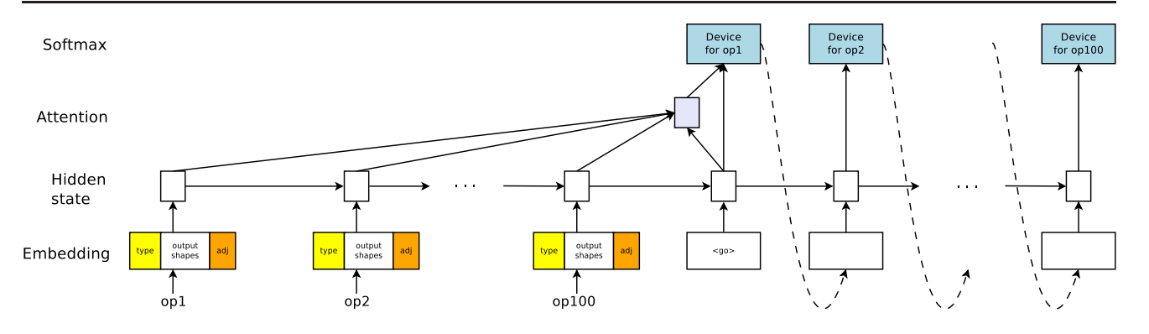
sequence-to-sequence model
With LSTM;
And a content-based attention mechanism;

Slide 25
Encoder
Sequence of operations
Embed the operations by concatenating
Store a tunable embedding vector
Each graph’s operation has a computation type:
MatMul or conv2d

Slide 26
Decoder
Attentional LSTM
Same steps as operations in graph G
Each step outputs the device for the operation at the same encoder time step

Slide 27
Co-locating operations
A lot of operations in a graph;
Vanishing and exploding gradient;
Large memory footprints;
Solution: manually forcing several operations located on same device.
With collocate_with feature of TensorFlow

Slide 28
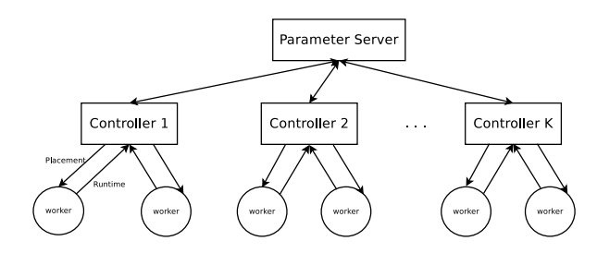
Distributed training
Asynchronous distributed
Several controllers;
Not storing input graph parameters on server to avoid latency;
Each controller control K workers.

