Slide 1
CSE 519401 Pytorch Team
Lab1 and Lab2
Luyu Liu, Subash Chebolu, Zicong Zhang

Slide 2
Lab1

Slide 3
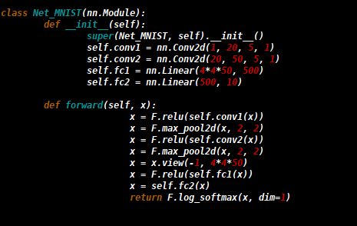
MNIST Model
Accuracies | MNIST
CPU | .99 or 99%
GPU | .97 or 97%
Training Time | MNIST
CPU | 48 Sec
GPU | 17.995 Sec

Slide 4
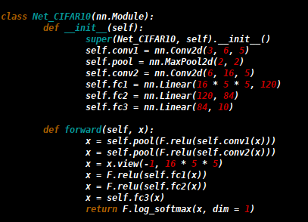
CIFAR10 Model
Accuracies | CIFAR10
CPU | .40 or 40%
GPU | .47 or 47%
Training Time | CIFAR10
CPU | 19.4762 Sec
GPU | 16.68 Sec

Slide 5
MNIST and CIFAR10 Conclusions
Models with less parameters tend to train faster
CPU training is more affected by larger number of parameters than GPU
All models were run for 5 epochs and results are averaged
All runs used the SGD optimizer
Training Time | MNIST
CPU | 48 Sec
GPU | 17.995 Sec
Training Time | CIFAR10
CPU | 19.4762 Sec
GPU | 16.68 Sec

Slide 6
Dataset – Word2Vec 1 billion benchmark
For Language models
Relatively small volumes compared to other datasets
Large sample amounts
Suitable: word prediction; model finetuning; etc.
Notes:
The scale of Word2Vec is rather large in terms of the quantity of the words; however, its overall size is the smallest of all three datasets. We wanted to choose the ImageNet datasets since we all have a background on the image processing with DNN, however, the size of the dataset is so large that it takes so long to download and unzip, considering both the instable speed of the network in the environment and the difficulties to share a large dataset between different accounts in the OSC environment. As a result, we chose Word2Vec for its abundancy and relative small volume.
Moreover, the dataset consists of many vocabularies, each of which is followed by a paragraph explaining the word. The model is trained on LM objects, which means the model is trained to learn to predict the next word given previous word sequence. As a result, accuracy and perplexity are then used as metrics to measure the quality of the model after certain amount of training.

Slide 7
Language Modeling with Gated Convolutional Networks
Yann N. Dauphin, Angela Fan, Michael Auli, David Grangier
Facebook AI Research

Slide 8
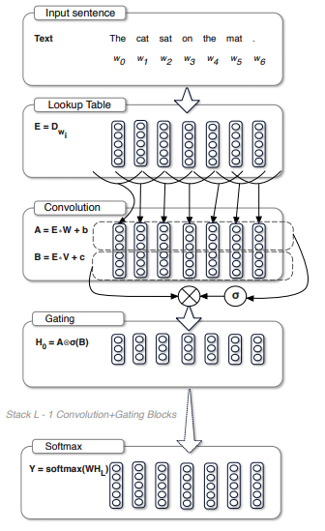
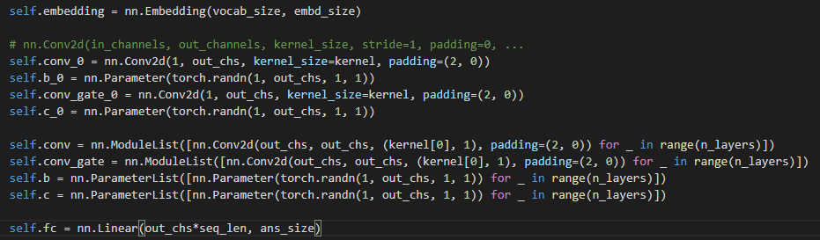
Gated CNN
Published in 2017;
Based on CNN;
Achieve near-RNN accuracy

Slide 9
GatedCNN CPU
Final accuracy | CPU with 7 threads | CPU with 14 threads | CPU with 28 threads
Batch size = 32 | 0.4018 | 0.4021 | 0.0898
Batch size = 64 | 0.4297 | 0.4303 | 0.4295
Batch size = 80 | 0.4341 | 0.4303 | 0.4353
Average epoch time | CPU with 7 threads | CPU with 14 threads | CPU with 28 threads
Batch size = 32 | 4109.6 | 3789.2 | 5235
Batch size = 64 | 3683.4 | 2178.6 | 3185.2
Batch size = 80 | 2044.4 | 1843.6 | 2038.6

Slide 10
GatedCNN GPU
 | accuracy | training time
Batch size = 32 | 0.1077 | 538
Batch size = 64 | 0.4328 | 291
Batch size = 80 | 0.4323 | 273

Slide 11
Transformer-XL: Attentive Language Models Beyond a Fixed-Length Context
Zihang Dai, Zhilin Yang, Yiming Yang, Jaime Carbonell, Quoc V. Le, Ruslan Salakhutdinov
Carnegie Mellon University, Google Brain

Slide 12
Motivation
Transformers have a potential of learning longer-term dependency, but are limited by a fixed-length context in the setting of language modeling.
As a result, Transformer-XL learns dependency that is 80% longer than RNNs and 450% longer than vanilla Transformers, achieves better performance on both short and long sequences, and is up to 1,800+ times faster than vanilla Transformers during evaluation.

Slide 13
Transformer-XL CPU
Batch Size: 16 | CPU(14 cores) | CPU(28 cores) | GPU(single)
Training Steps | 20000 | 23000 | 210000
Batch Size: 16 | CPU(14 cores) | CPU(28 cores) | GPU(Single)
Best ppl achieved | ~400 | ~400 | ~100
300 million parameters for base models
Model takes forever to load on cpu

Slide 14
Transformer-XL GPU
Single GPU | Accuracy | Perplexity | Loss
Batch size: 32 | 0.59 | 171 | 5.15
Batch size: 64 | 0.69 | 108 | 4.68
Batch size: 80 | 0.72 | 96 | 4.57
single V100 GPUs
Notes:
The paper trains the model using 4 NVidia GPUs, which is not feasible for our experiment. We are using a single V100 GPUs and are observing various diverging training phase. Thus, we take the best performance during the training and record as the result shown above for each different batch.

Slide 15
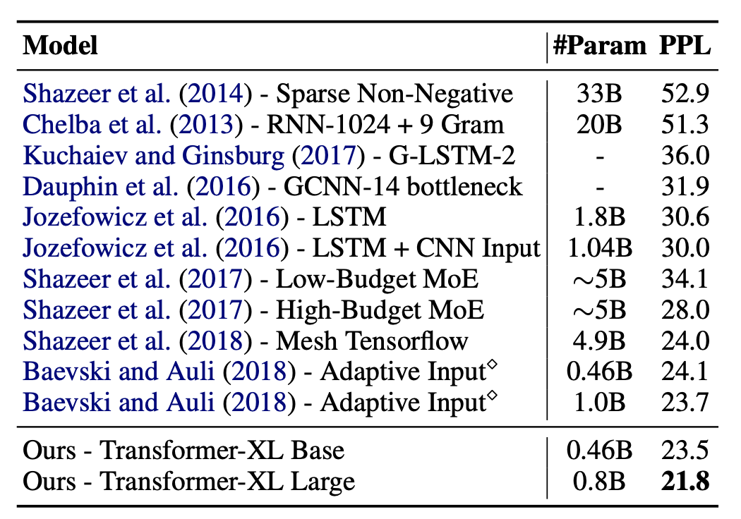
Expected Outcome

Slide 16
Cross-model Comparison
GCN model only has 3 million parameters
while TXL has 3 hundred million parameters.
TXL’s accuracy (59% - 72%) is significantly higher than GCN’s (40% - 43%).
However, GCN’s results are also non-trivial

Slide 17
Lab2:
Distributed

Slide 18
Possible solutions
Native Pytorch.distributed API.
Clumsy and hard to use.
Apex.
A PyTorch Extension: Tools for easy mixed precision and distributed training in Pytorch
Notes:
Hard to use
Do not know how to execute code on separate node
Scalability is bad
Not a video game’s name
Good choice, native NVidia support
Need higher privilege to use on the OSC system
module does not have apex
Less stable: buggy

Slide 19
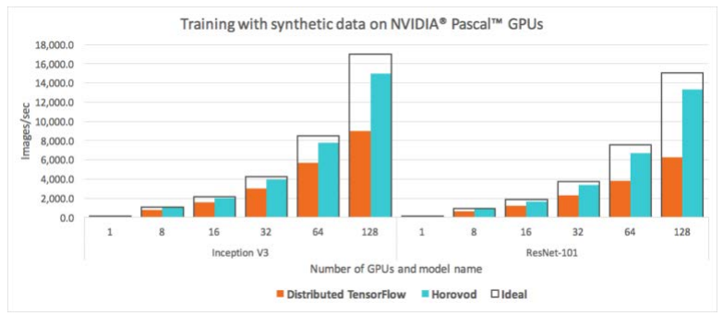
Horovod
Easy to use
Possible to install and use on OSC system
May achieve better performance

Slide 20
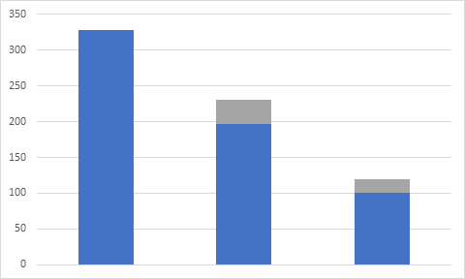
Horovod GPU experiments for Gated CNN
# Node | accuracy | training time (s)
1 | 0.4114 | 273/278
2 | 0.4015 | 328
4 | 0.4042 | 197
8 | 0.3910 | 101
Results with ideal scalability
(blue: actual training time; gray: performance loss compared to the ideal scenario)
Notes:
Unlike tensorflow, Pytorch is a define-by-run framework, which may result in overhead in the beginning compared to non-distributed version.

Slide 21
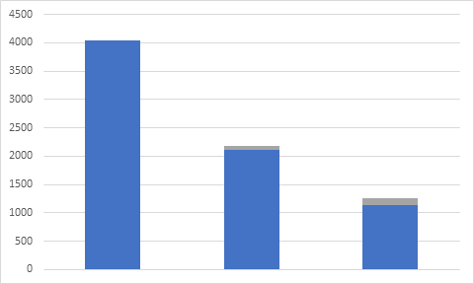
Horovod CPU experiments for Gated CNN
# Node | accuracy | training time (s)
1 | 0.4263 | 2038
2 | 0.4085 | 4043
4 | 0.4002 | 2105
8 | 0.4012 | 1132
Results with ideal scalability
(blue: actual training time; gray: performance loss compared to the ideal scenario)

Slide 22
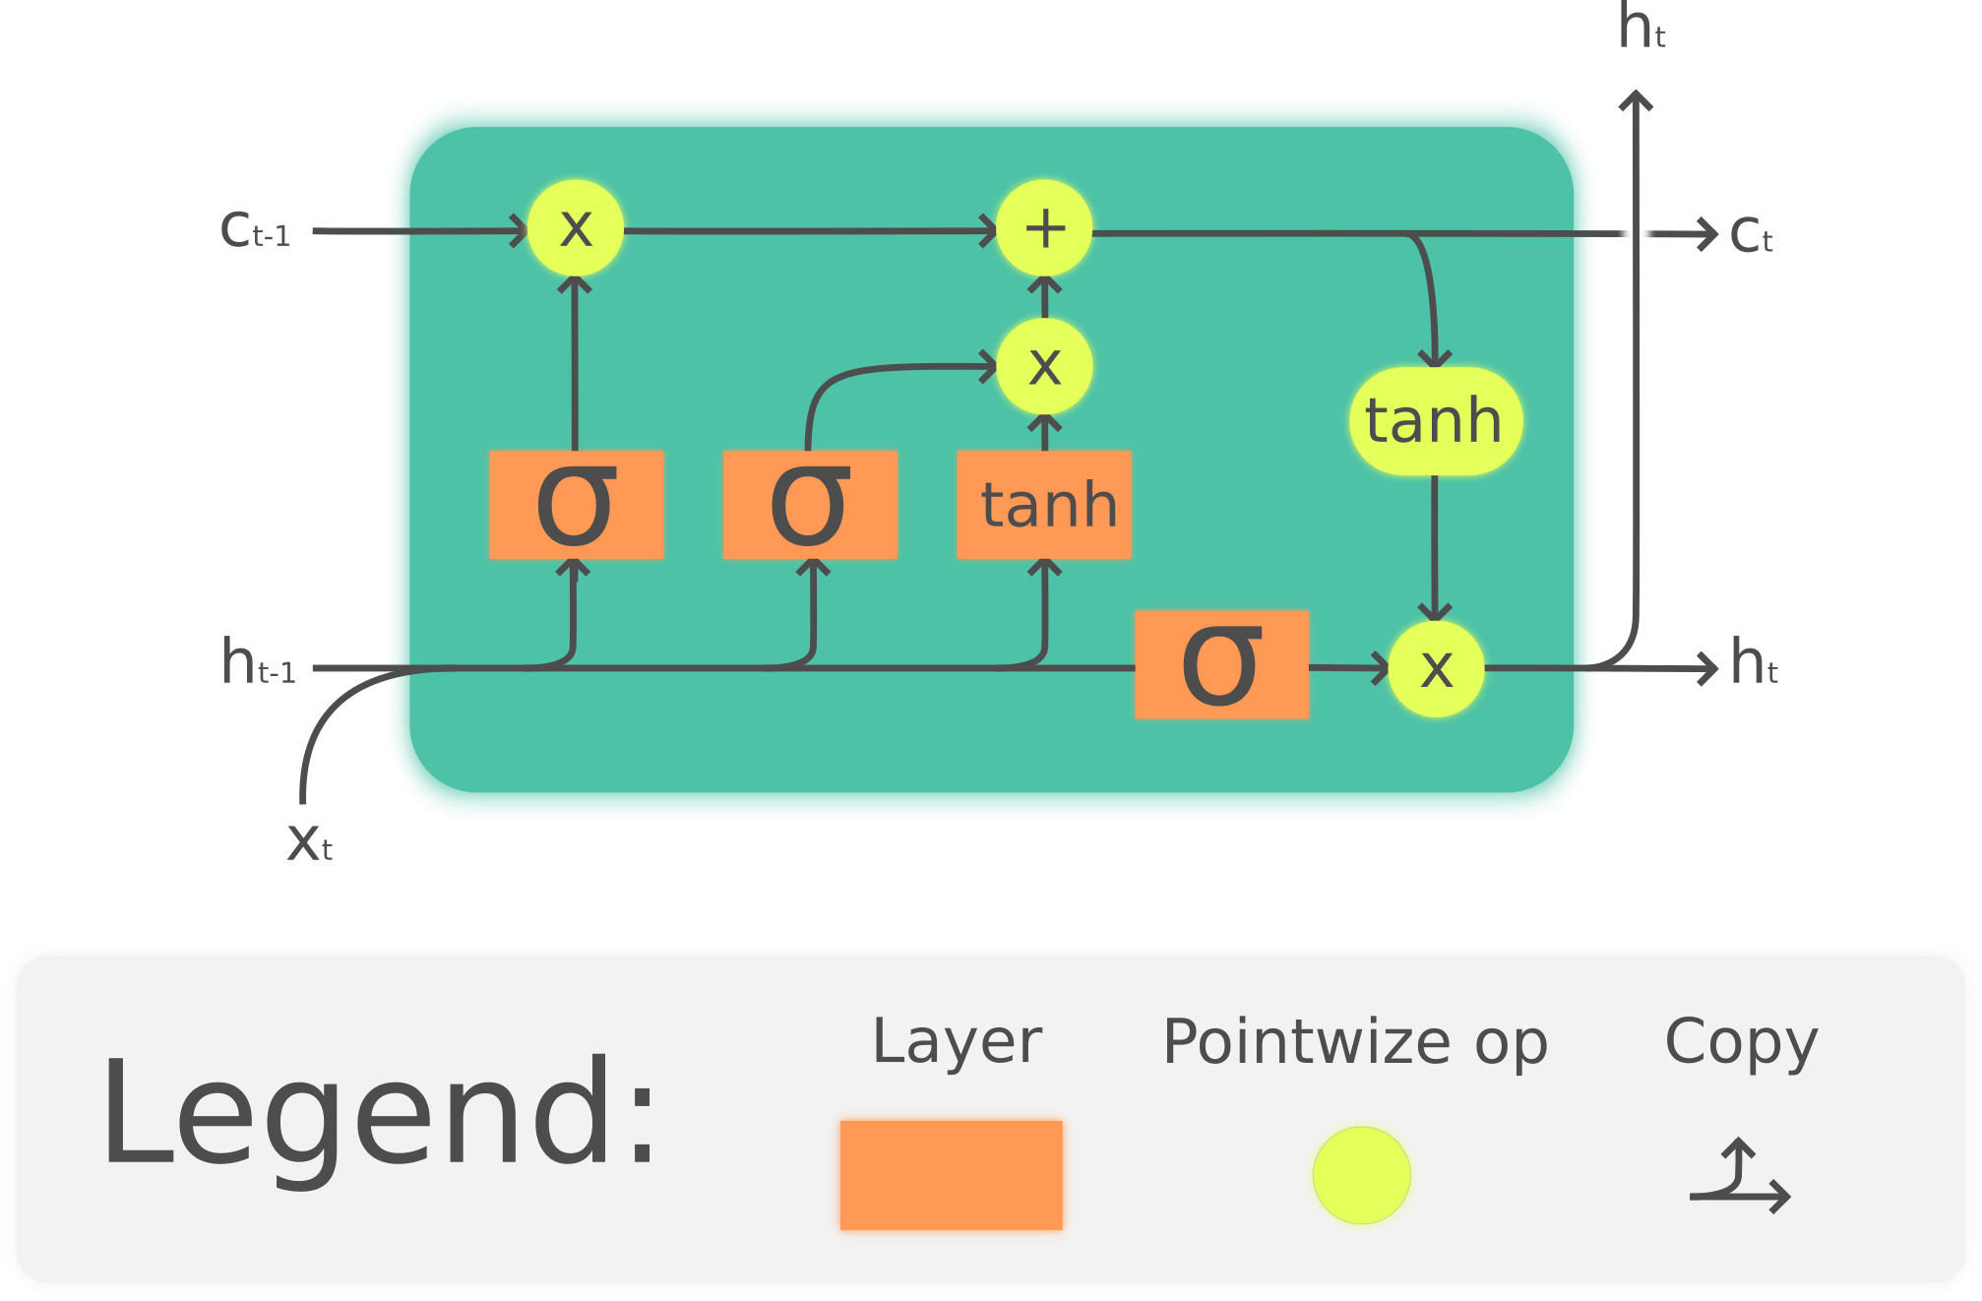
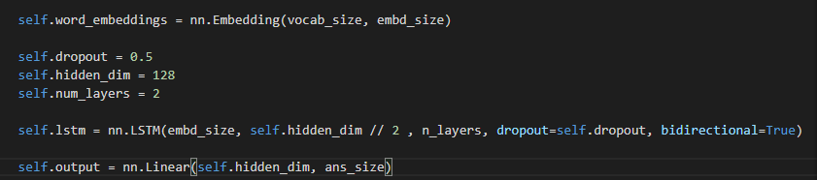
LSTM
Long short-term memory model
A variant of RNN
Have good performance to deal with the long sequence

Slide 23
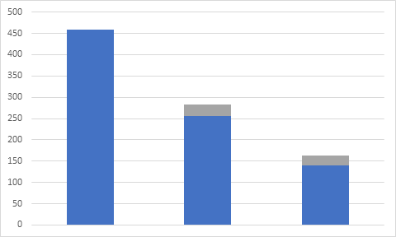
Horovod GPU experiments for LSTM
# Node | accuracy | training time (s)
1 | 0.1951 | 464
2 | 0.1951 | 459
4 | 0.1952 | 256
8 | 0.1951 | 139

Slide 24
Horovod CPU experiments for LSTM
Hardly finished
Significantly slower
Random pattern
Reasons:
Large amount of cores
CPU natures
MPI version
# Node | accuracy | Training speed (sample/s)
1 | 0.1951 | 159
2 | Job Killed | Job Killed
4 | Job Killed | 4.4
8 | Job Killed | Job Killed

Slide 25
Distributed Learning on TransformerXL
Need to go into implementations to optimize individual part separately
Communication Overhead
Code build naturally for single node training with pytorch
 | single GPU | 2 nodes | 4 nodes | 8 nodes
ms/batch | 42ms | 1800ms | ~2000ms | ~1000ms

Slide 26
Take-away for new people
Several things that lab0 should have covered:
MPI instruction
(mpiexec -ppn 1 -binding none -env python)
Set up environment
anaconda/miniconda + horovod
Do NOT use native pytorch distributed API
OSC system is busy, be patient

