Slide 1
Revisiting the Impacts of Transit Real-time Information on Waiting Time Reduction: An Empirical Analysis in Columbus, Ohio
Luyu Liu, Harvey J. Miller

Slide 2
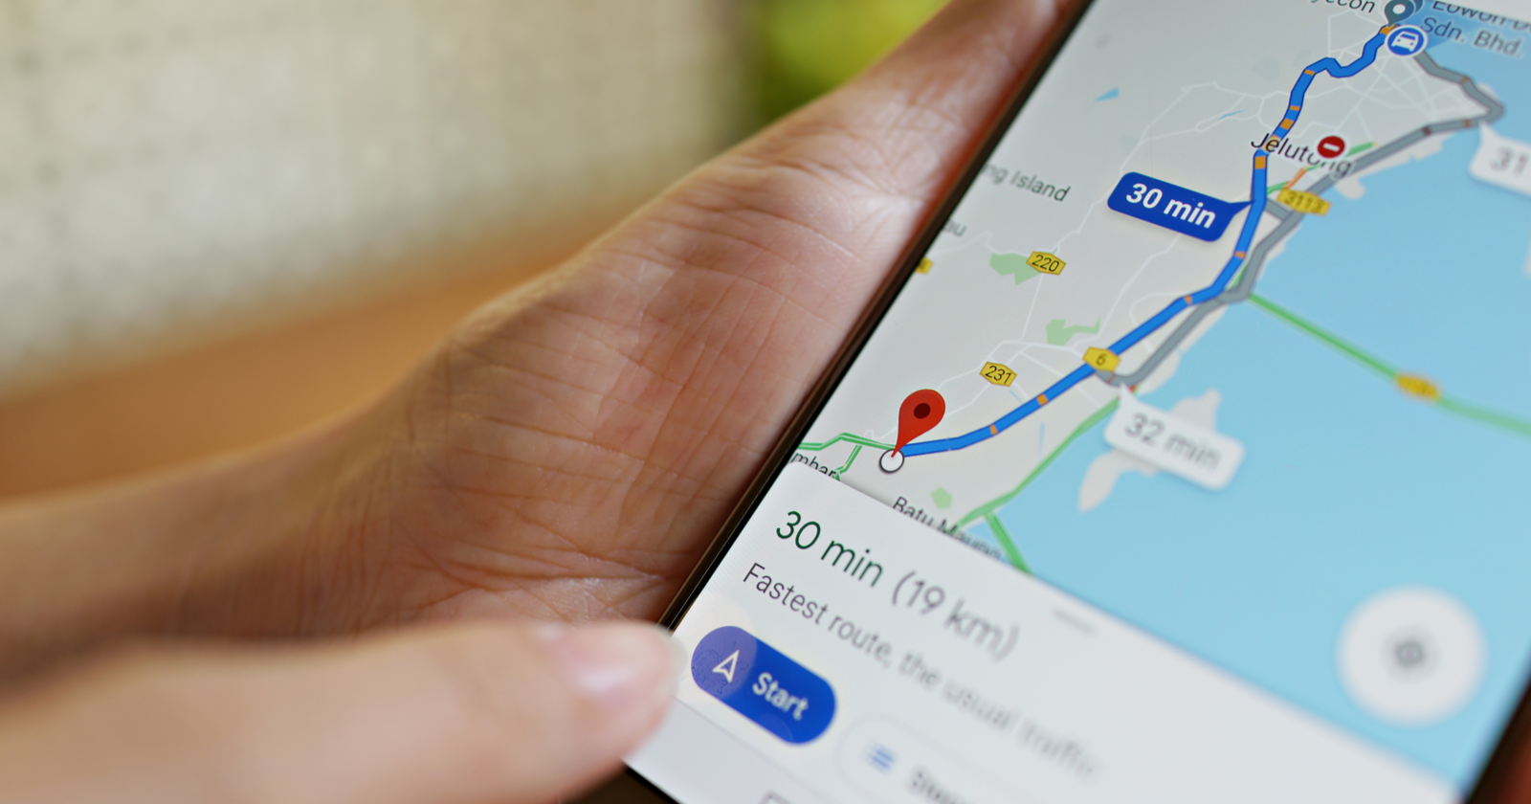
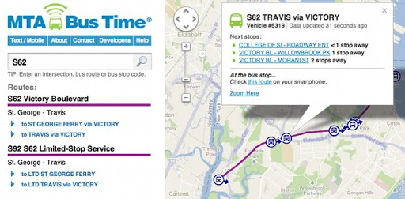
Real-time data is a game-changer for transit
Decreased waiting time
Decreases in total travel time
Increased transit use
Increased satisfaction
Increased security perception
……
Decreased waiting time is the most common positive finding in the literature for real-time information (RTI)

Slide 3
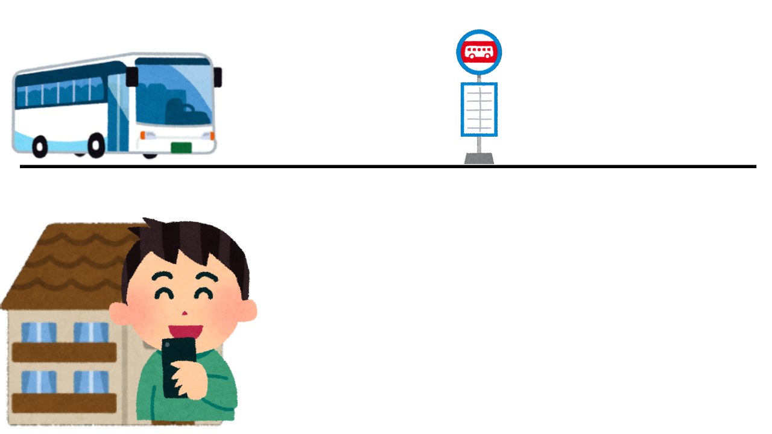
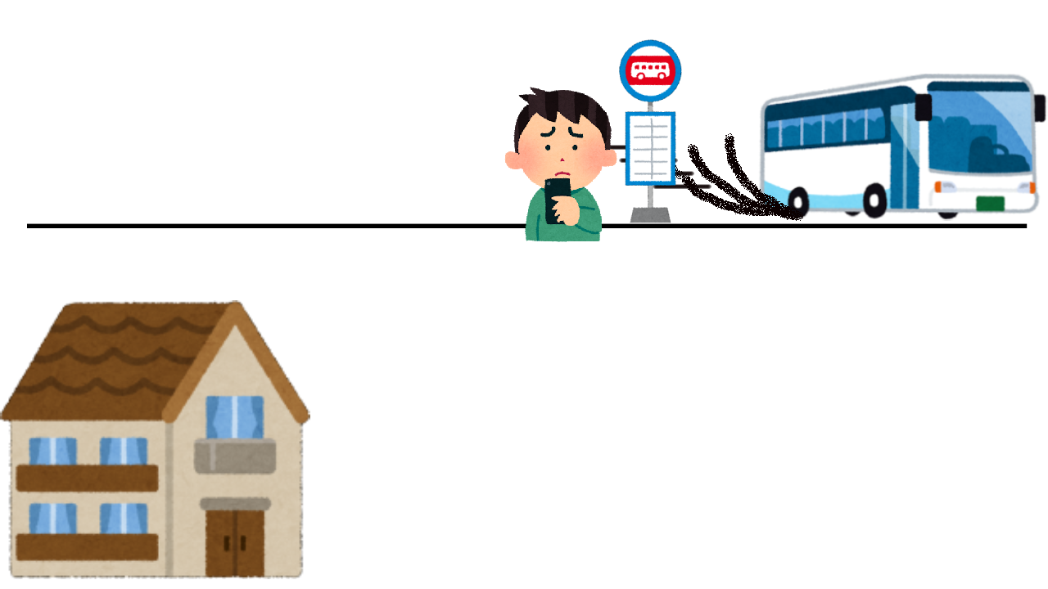
Risk of missing a bus
Reclaimed delay: bus drivers compensating for being late
Discontinuity delay: RTI is not timely updated
Many RTI algorithms use a greedy strategy to aim for 0 wait time
Ignore reliability and can be risky.
Can miss the bus and wait an even longer time
App:
Bus delayed for 5 minutes
you should leave at 9:00am
Bus accelerated when you walking
App:
Bus delayed for 2 minutes
you should leave at 8:57am

Slide 4
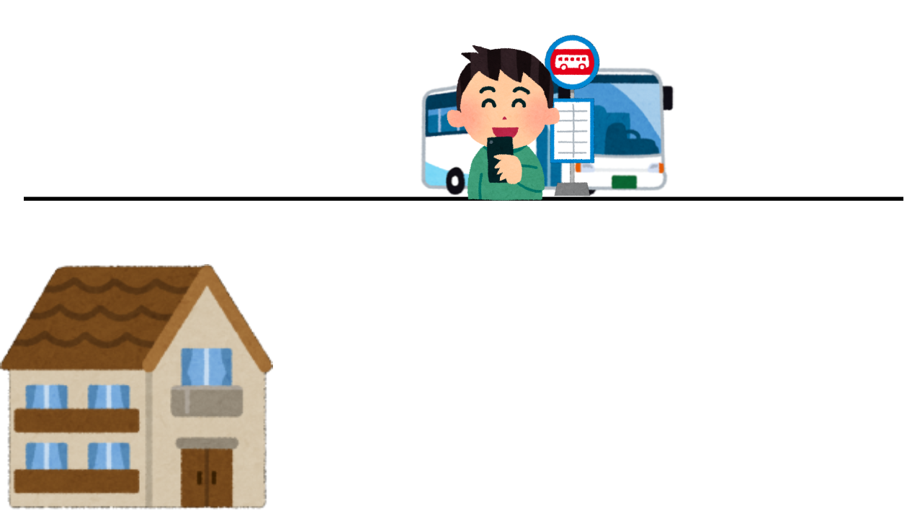
Avoid the risk of missing a bus
Insurance buffer: a short time buffer to decrease missing risk
It is a more prudent RTI strategy
Need to find the optimal insurance buffer for each user and time
App:
Bus delayed for 5 minutes
you should leave at 9:00am
But I will leave 3 min earlier at 8:57am just in case
Bus accelerated when you walking
App:
Bus now delayed for 2 minutes
you should leave at 8:57am
Phew, just in time.

Slide 5
Other strategies
Follow the schedule (scheduled strategy)
No early bus policy: low risk of missing bus
May wait a long time if long delay
Leave randomly (arbitrary strategy)
Leave home randomly
Average waiting time will be half of the headway

Slide 6
Data and methods
General Transit Feed Specification real-time and Automatic passenger counter data
Actual time of arrival and estimated time of arrival every 1 minutes: 145, 200, 000 GTFS records, 2 TB volume
Calculate the optimal insurance buffer for prudent RTI strategy
Simulate different users’ behavior for greedy, prudent, schedule, and arbitrary strategies in Python and MongoDB environment

Slide 7
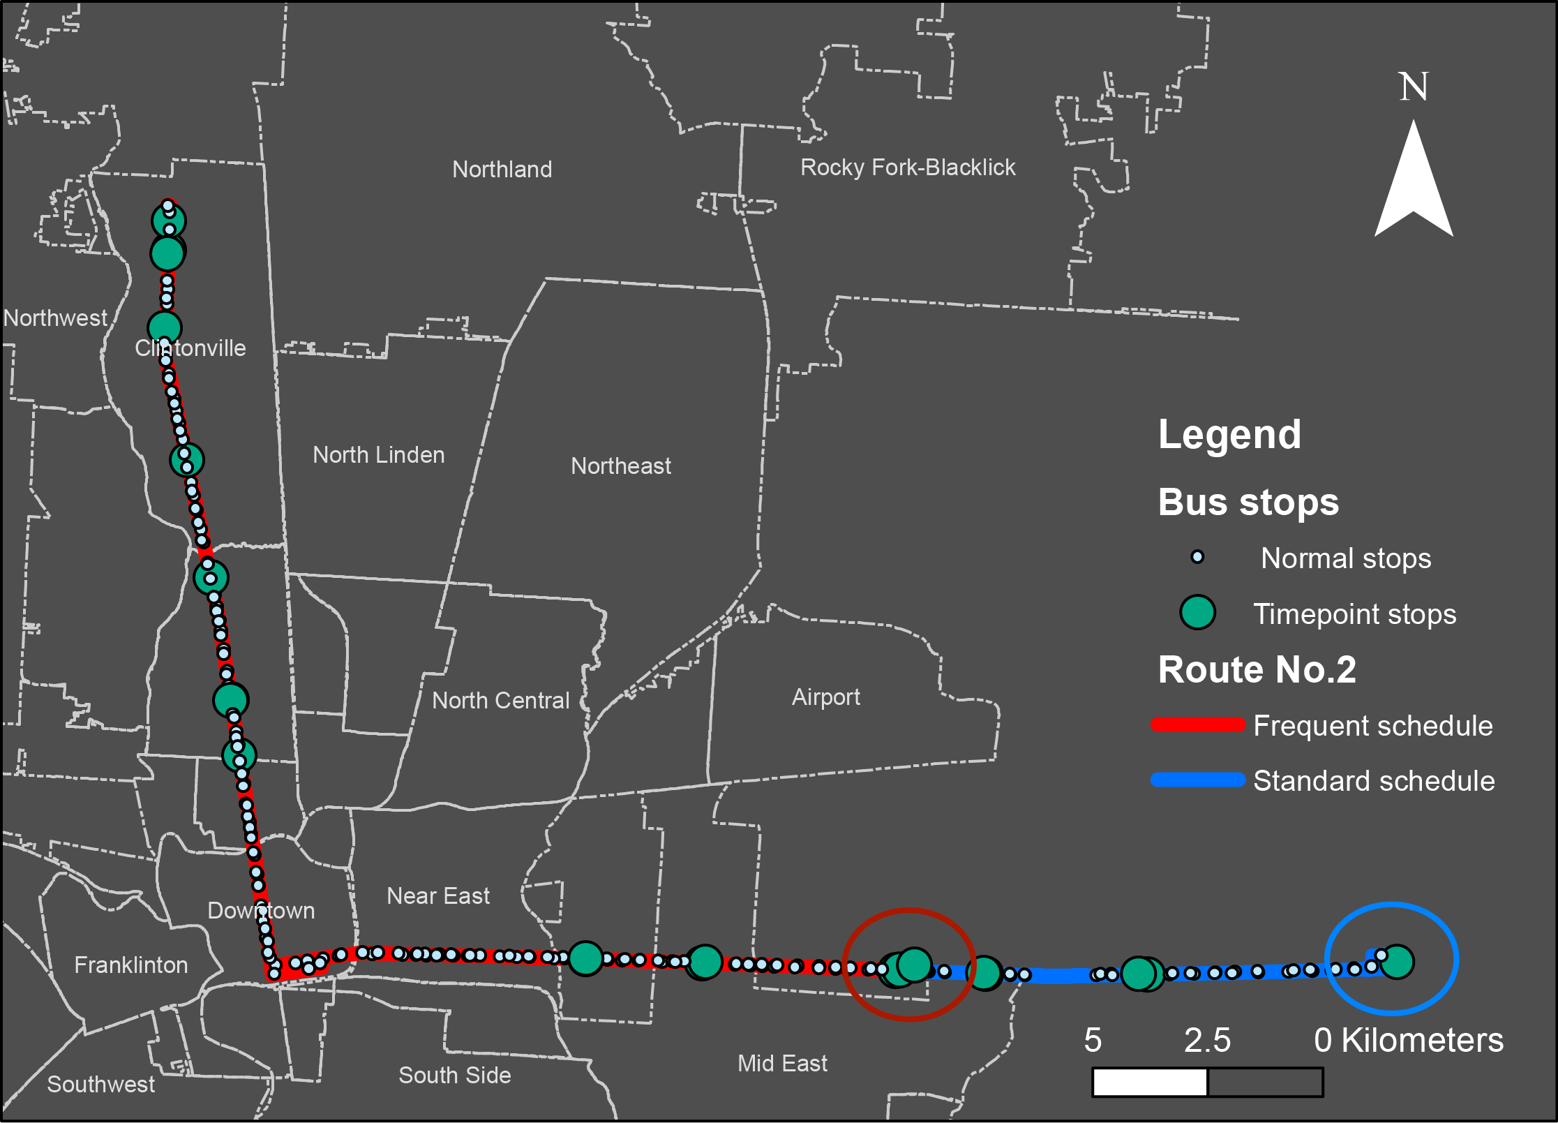
Case study: Columbus, OH
Bus route No.2 in Central Ohio Transit Authority (COTA), Columbus, OH
Also test 5 other routes for generalizability (spoiler alert: it’s generalizable)

Slide 8
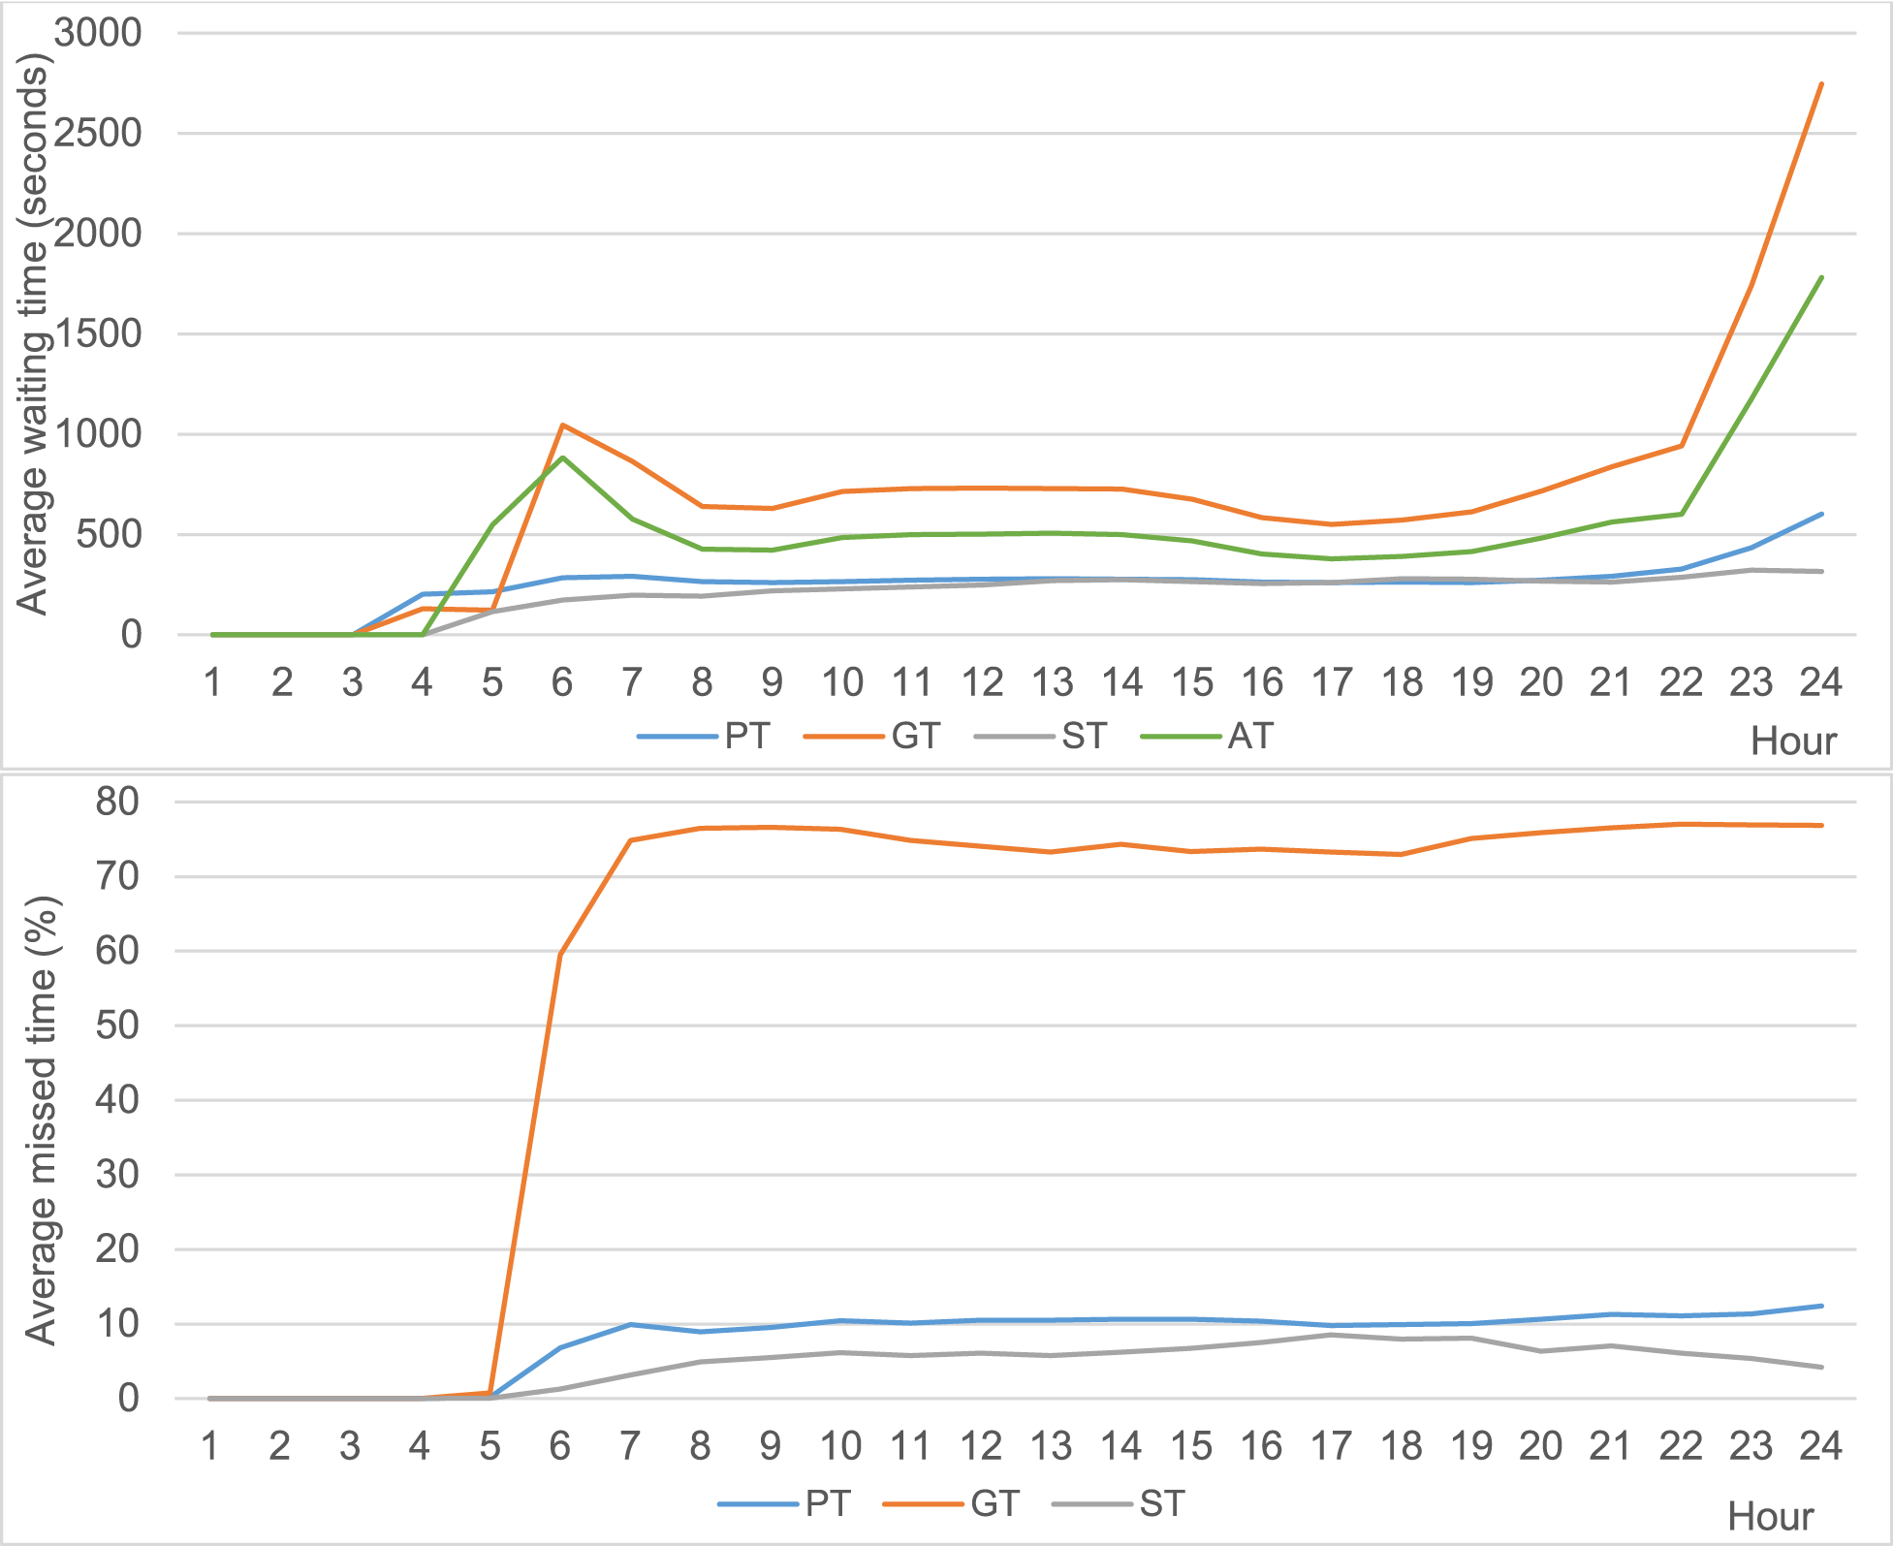
Hourly average waiting time
Following Schedule is close to the optimal RTI (Prudent) strategy
The Greedy RTI strategy’s performance is even worse than the Arbitrary strategy
RTI is only useful when used properly
Headway has an impact on the waiting time and risk of missing a bus

Slide 9
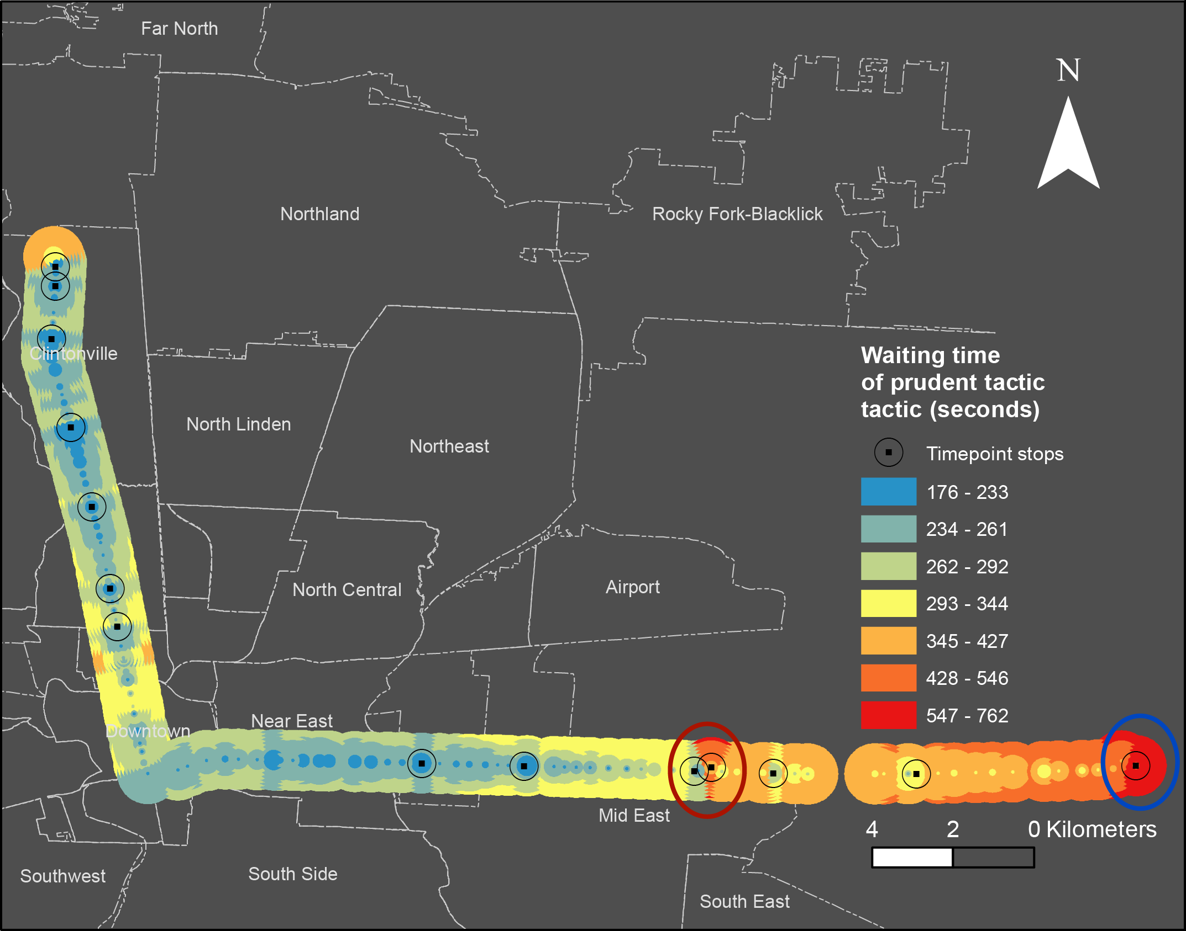
Prudent RTI strategy’s spatial pattern
Stops near the start stations have worse performance
Timepoints, where bus sticks to the schedule, have shorter waiting time
Higher headway service has longer wait time

Slide 10
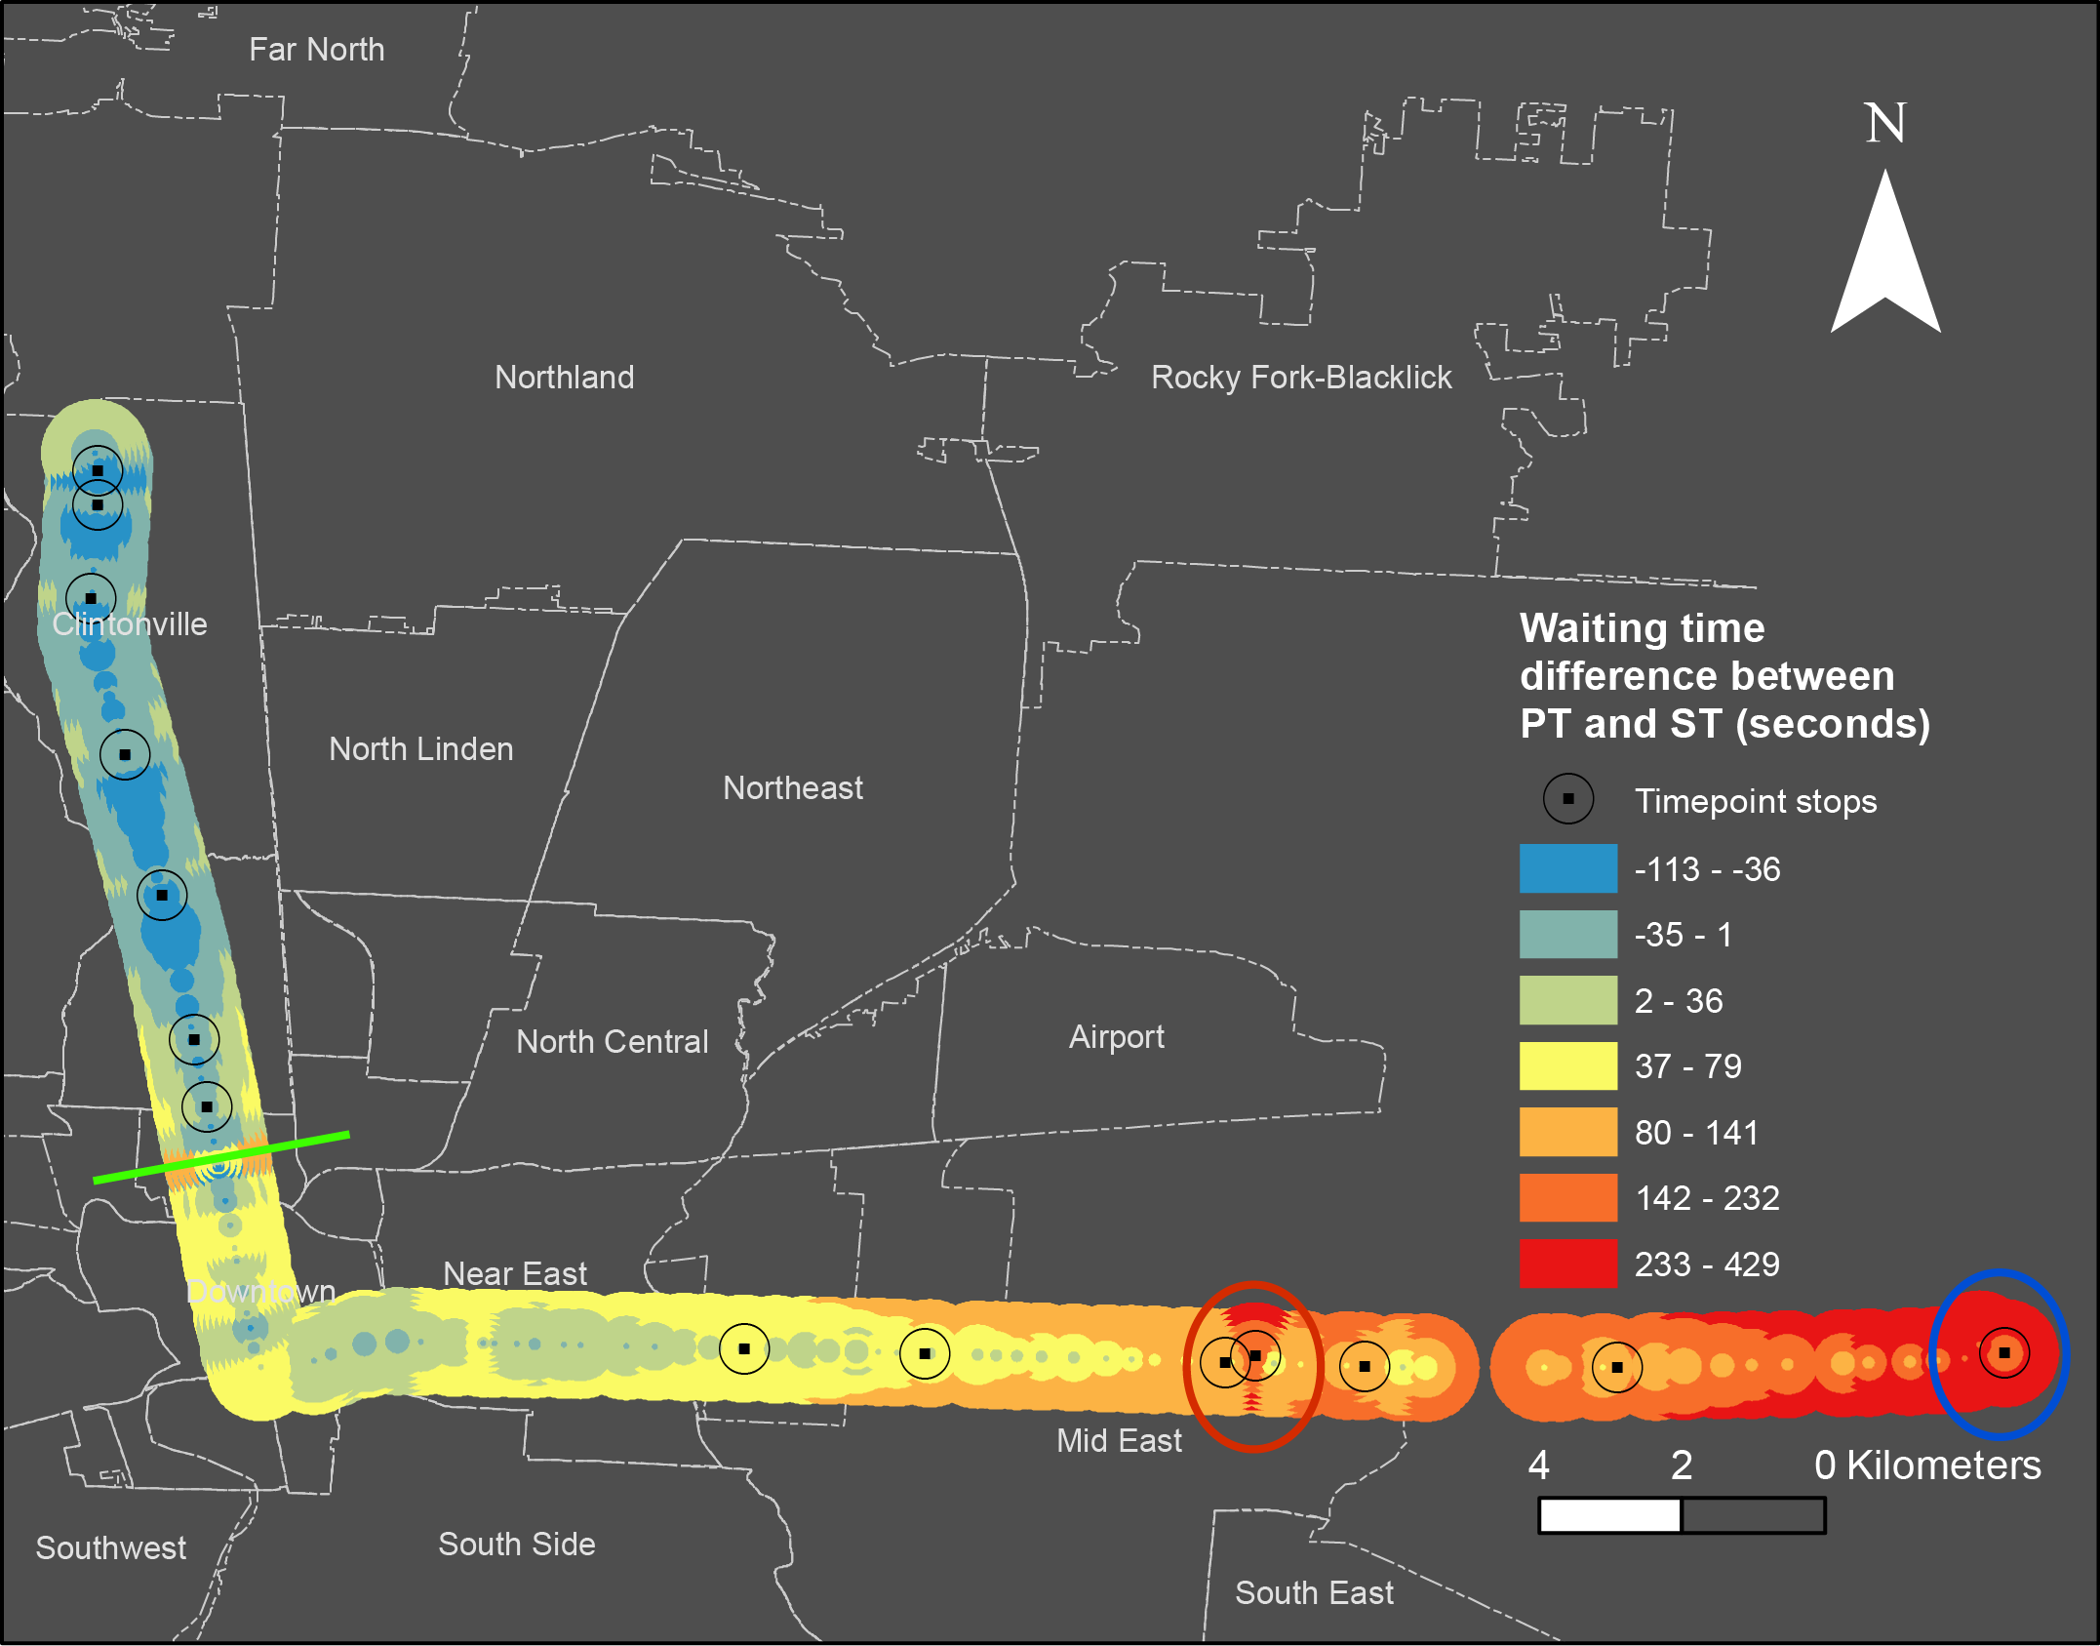
Compare Prudent and schedule
Upstream stops near the origin:
Less delay
Prudent is worse than schedule
Downstream stops near the destination:
More delay
Prudent is better than schedule

Slide 11
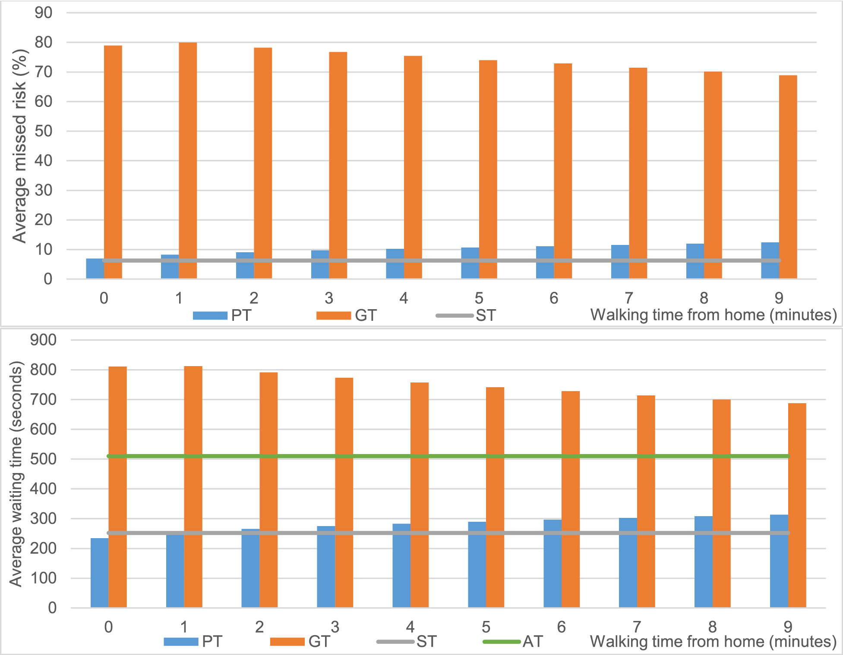
Walking distance
Schedule and Arbitrary: walking distance has no impact
Prudent RTI: more walking time leads to more wait time
Greedy RTI: more walking time leads to less wait time
Walking distance from the origin to the bus stop makes a difference for RTI strategies

Slide 12
Conclusion
Overall, the two RTI strategies do not outperform simply following schedule
Real time information can reduce waiting time for some users based on location and time
Including a time buffer improves the greedy approach used by some algorithms
We need to consider the transit performance in a more real-time and dynamic manner

Slide 13
Thanks!
liu.6544@osu.edu

