Slide 1
Revisiting the Impacts of Transit Real-time Information on Waiting Time Reduction: An Empirical Analysis in Columbus, Ohio
Luyu Liu, Harvey J. Miller
Notes:
Hellow everyone, welcome to my presentation today! My name is luyuliu, my title is ///////

Slide 2
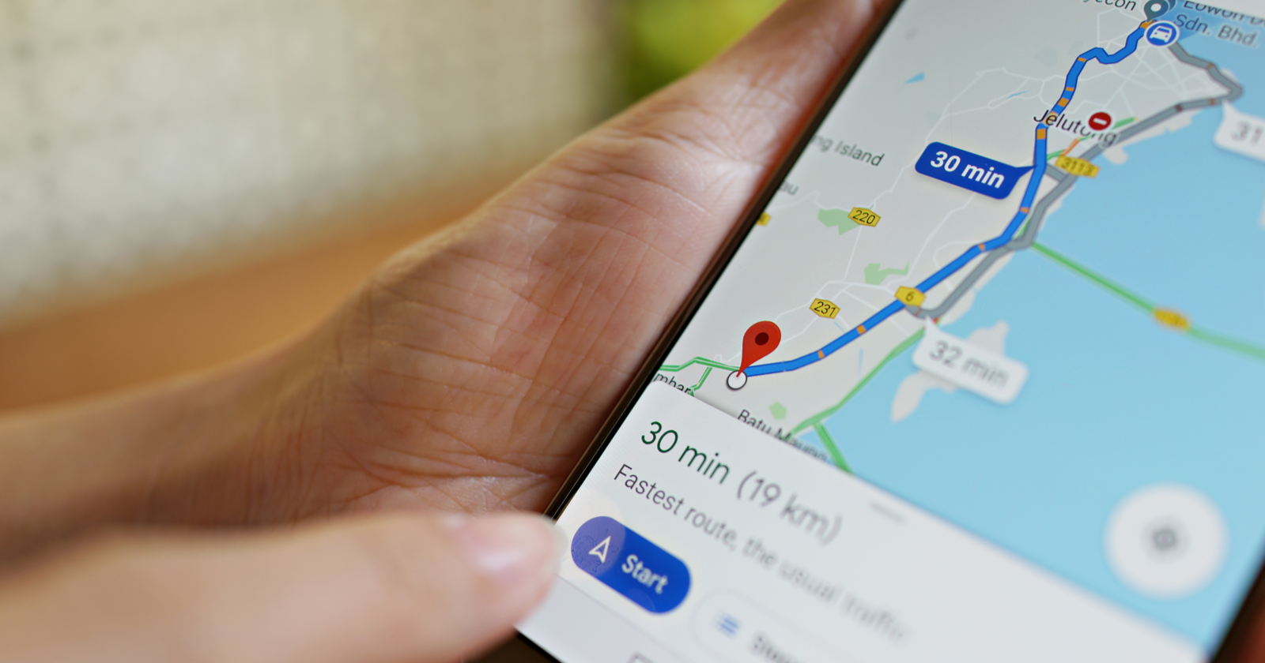
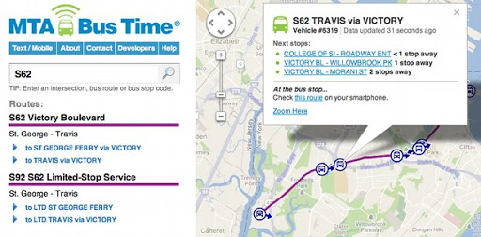
Real-time data is a game-changer for transit
Decreased waiting time
Decreases in total travel time
Increased transit use
Increased satisfaction
Increased security perception
……
Decreased waiting time is the most common positive finding in the literature for real-time information (RTI)
Notes:
First I would like to discuss about real-time data in general as a game changer for transit users. Real-time information is reported to have many benefits suchas decreased waiting time, total time , increase ridereship and satisfication,. But among them all, the most common positive fing in the literature for real-time information is decrease waiting time. However, despite the overall impact on waiting time is well explored, there are still some mechanism behind the benefit we did not fully discussed. For example, we have long regareded the RTI as a gift from the Prometheus we think it is always beneficial to users. But, Realtime information can actually increase the risk of missing a bus under some circumstances.

Slide 3
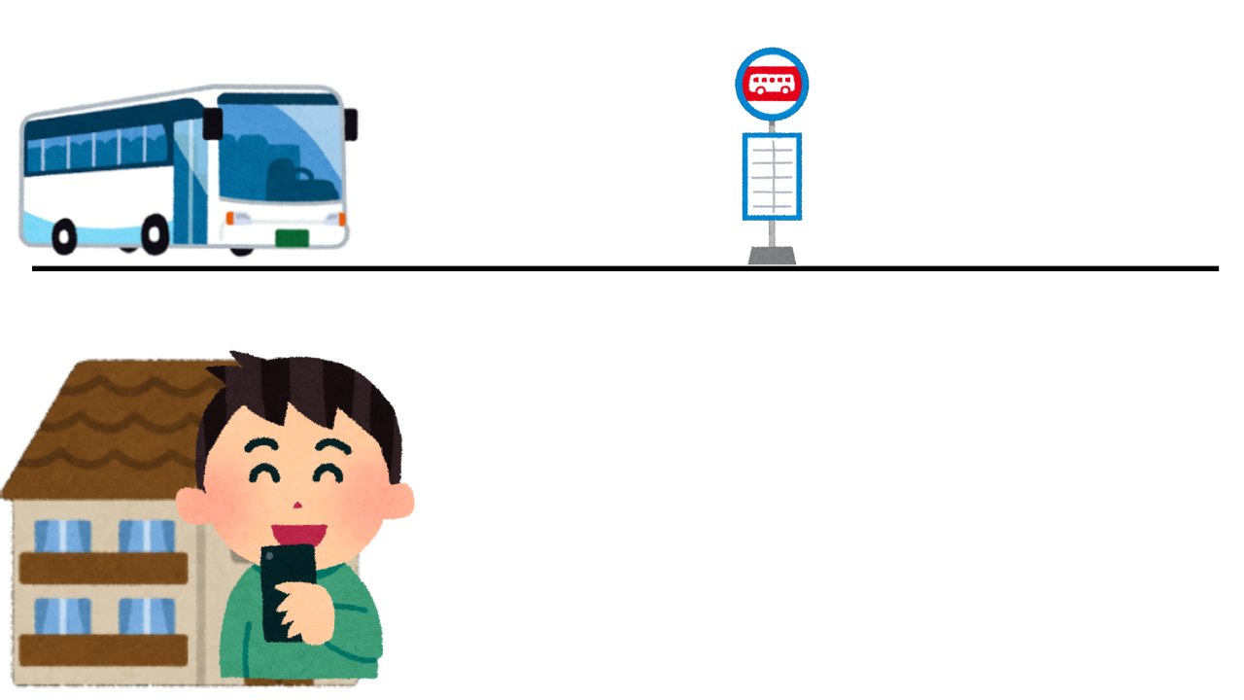
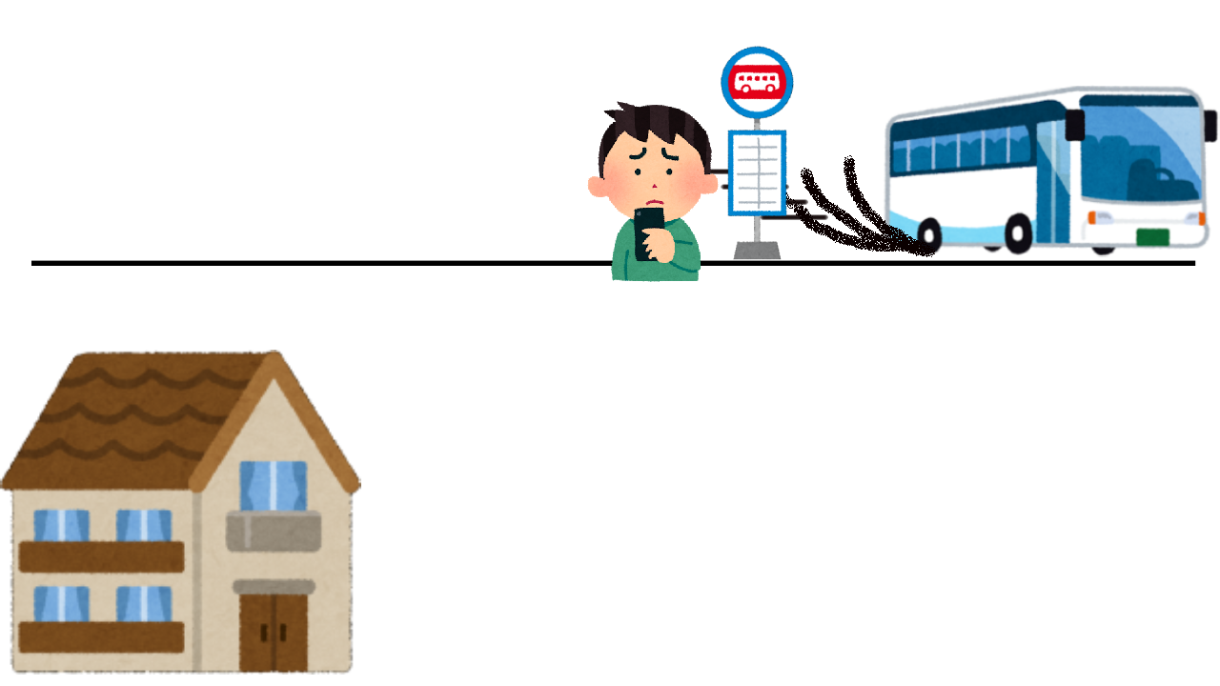
Risk of missing a bus
Reclaimed delay: bus drivers compensating for being late
Discontinuity delay: RTI is not timely updated
Many RTI algorithms use a greedy strategy to aim for 0 wait time
Ignore reliability and can be risky.
Can miss the bus and wait an even longer time
App:
Bus delayed for 5 minutes
you should leave at 9:00am
Bus accelerated when you walking
App:
Bus delayed for 2 minutes
you should leave at 8:57am
Notes:
There are two factors that can contribute to higher risk of missing a bus: reclaimed delay, bus drivers compensating for being late and discountinuity delay, that RTI is not timely updated. The most important factor is reclaimed dely, we show ane xample in the left. For example, a user wants to go to his office and he checked his trip planning app. The app will say something like the bus is delayed for 5 min and you should leave at 9 am. So at 9 am the user follow the suggested time. However, during the user is walking, the bus can accelerated to offset some delay. And by the time the user arrives, the bus is already gone and the app will tell the user like you should have leave at eight fifty seven.
So you see, in this process nobody is doing wrong right? The bus driver is simply following the rules, the user is doing what he’s told, and the trip planning app is simply reporting what the real-time feed’s expectation right now. However, the actual reason is that the the RTI algorithms use a greedy strategy to aim for 0 waiting time. It ignores reliabtility and there can be risky. Therefore, the user can miss the bus and wait an even longer time,

Slide 4
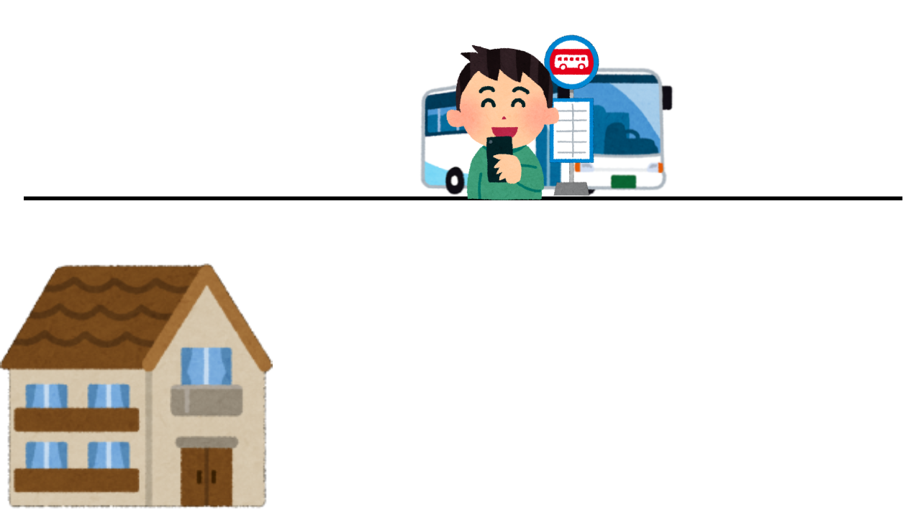
Avoid the risk of missing a bus
Insurance buffer: a short time buffer to decrease missing risk
It is a more prudent RTI strategy
Need to find the optimal insurance buffer for each user and time
App:
Bus delayed for 5 minutes
you should leave at 9:00am
But I will leave 3 min earlier at 8:57am just in case
Bus accelerated when you walking
App:
Bus now delayed for 2 minutes
you should leave at 8:57am
Phew, just in time.
Notes:
However, there is a very simple and effective strategy that can avoid the risk of missing a bus, which is to add a short insurance buffer before the suggested time. For example, for the same scenario we shoed last slide, before the user leave the home, the user will not believe the suggested time but to leave a 3 minutes buffer before it. So when the bus accelerate, the buffer could offset the reclaimed delay. As you can see, this is a more prudent RTI strategy. The only requirement is that we need to find the optima insurance buffer for each user and time

Slide 5
Other strategies
Follow the schedule (scheduled strategy)
No early bus policy: low risk of missing bus
May wait a long time if long delay
Leave randomly (arbitrary strategy)
Leave home randomly
Average waiting time will be half of the headway
Notes:
We introduced two RTI strategy greedy and prudent, and there are two common non-RTI strategies: the first one is followingthe schedule. This streategy has a low risk of missing bus because there is usually no early bus policy for many transit authorities. Howecer, these users can wait a long time if there is long delay.
And there is another strategy which is leave randonmly. The average waiting timewill be very long because it will be half othe headway.

Slide 6
Data and methods
General Transit Feed Specification real-time and Automatic passenger counter data
Actual time of arrival and estimated time of arrival every 1 minutes from May 2018 – May 2019: TB-level volume
Calculate the optimal insurance buffer for prudent RTI strategy
Simulate different users’ behavior for greedy, prudent, schedule, and arbitrary strategies in Python and MongoDB environment
Notes:
So we introduce the four strategies as benchmarks for rti and nonrti users, we used GTFS real-time and APC data as our data source, From these datasets, we derived actual time of arrival and estimate of arrival for every 1 minutes: The total volume of the GTFS database is at Terabtype level for the whole year from May 2018 to 2019.
Based on this enomerous dataset, we cacluate the optima linsurance buffer for prudent RTI strategy and simulate the four strategy for different user’s’ behavior.

Slide 7
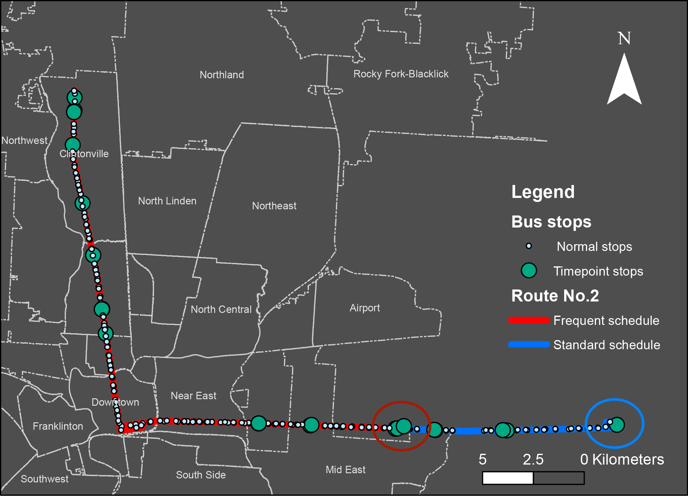
Case study: Columbus, OH
Bus route No.2 in Central Ohio Transit Authority (COTA), Columbus, OH
Also test 5 other routes for generalizability (spoiler alert: it’s generalizable)
Notes:
Based on these medthod, we conduct a case study in bus route no.2 in central ohio transit authority cota in columbus ohio. The route has the most ridershp and a large spatial coverage. We also test 5 other routes for generalizability purposes and the results still hold.

Slide 8
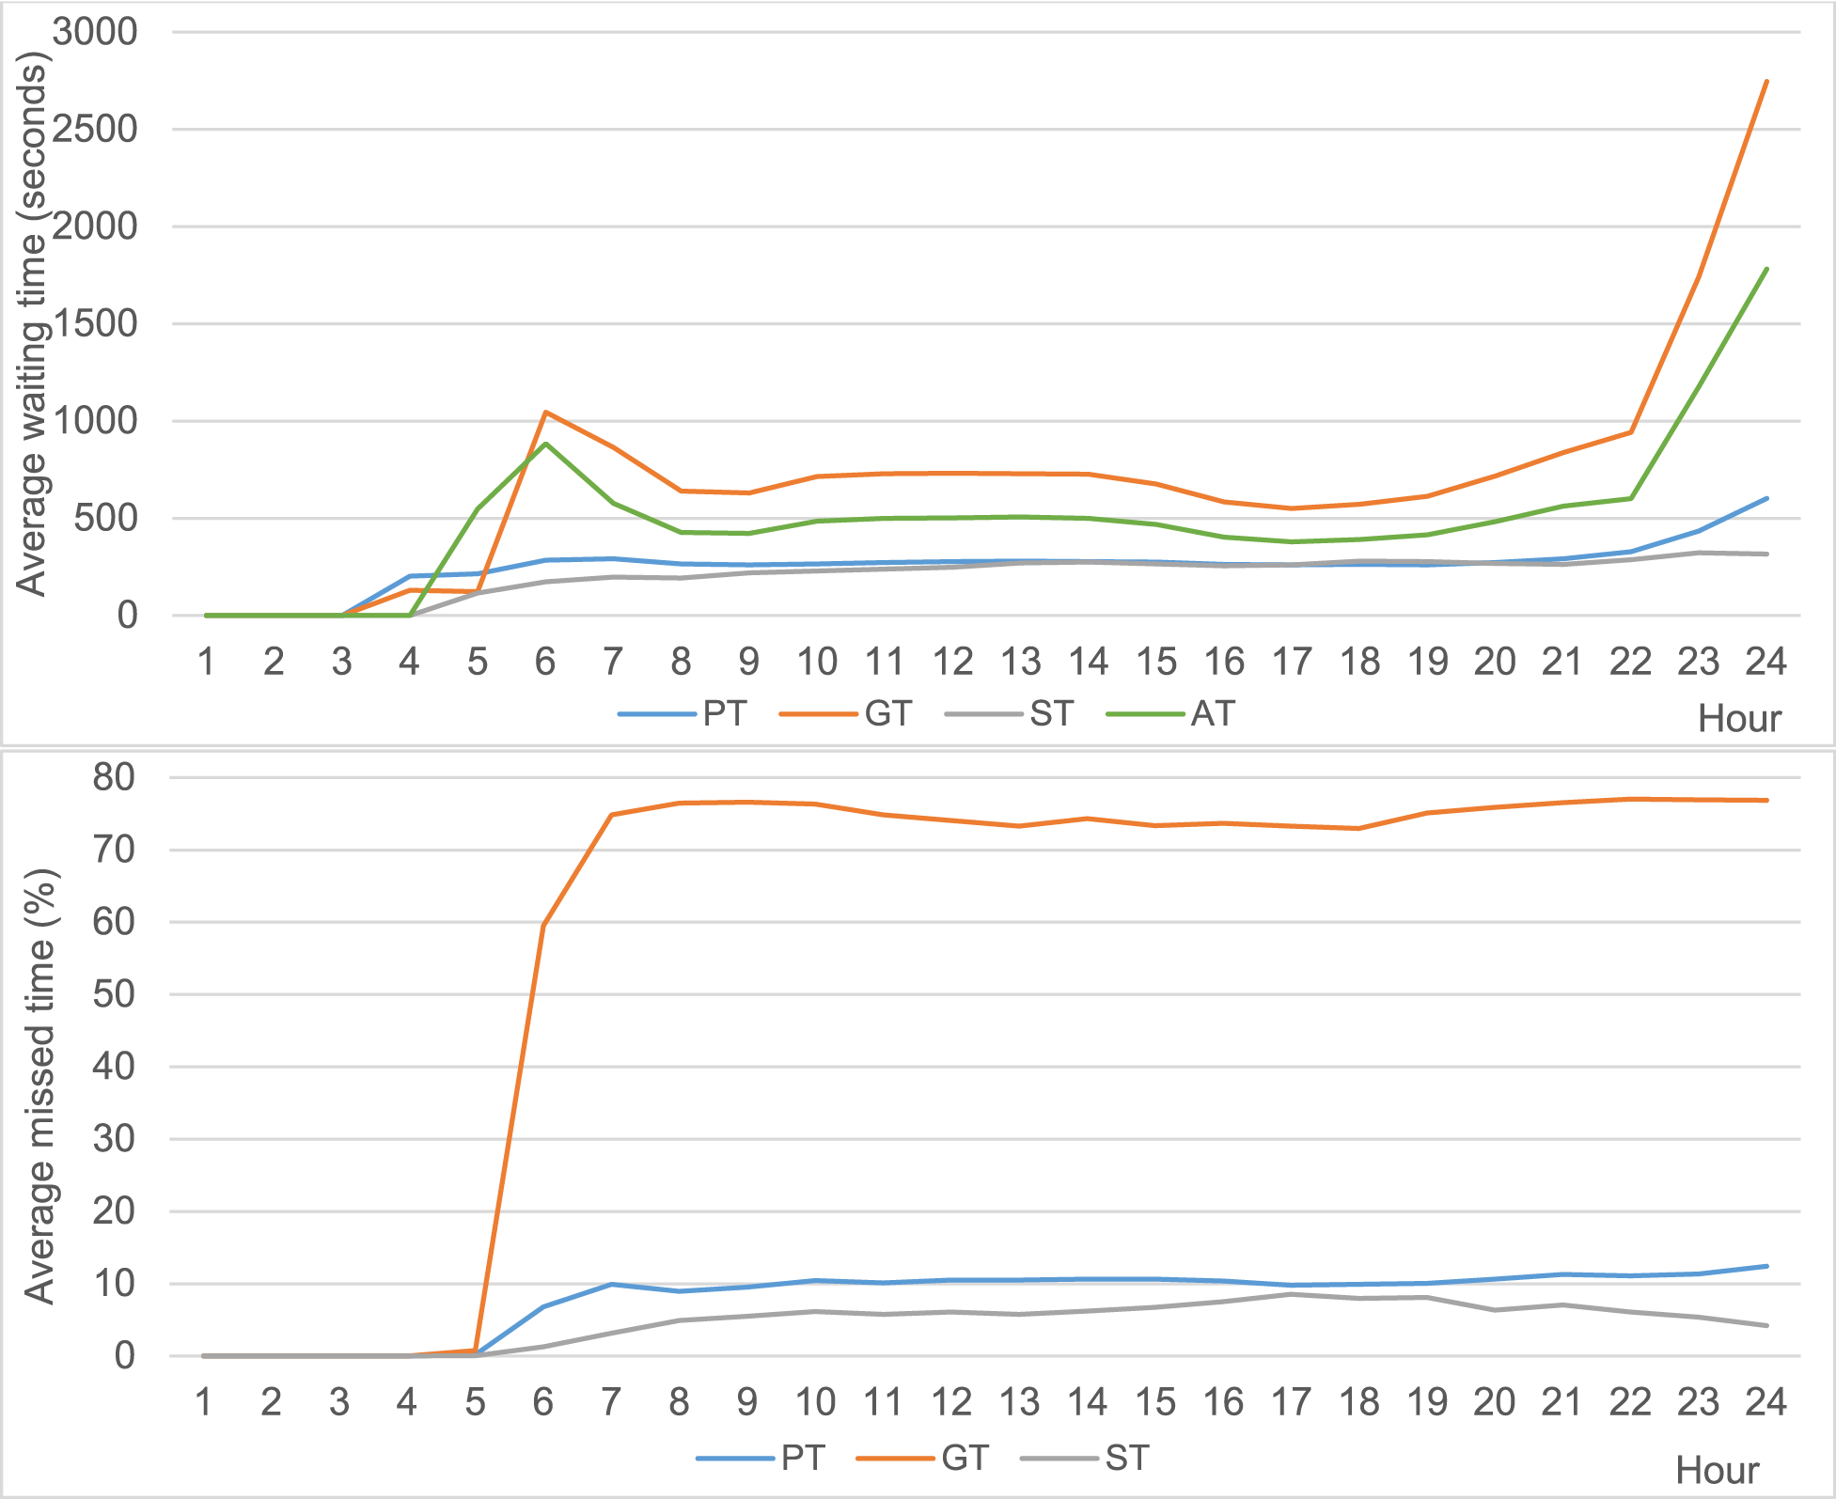
Hourly average waiting time
Following Schedule is close to the optimal RTI (Prudent) strategy
The Greedy RTI strategy’s performance is even worse than the Arbitrary strategy
RTI is only useful when used properly
Headway has an impact on the waiting time and risk of missing a bus
Notes:
The firstr analysis we did is the hourly average waiting time for every hour in a day. First result we see is that following schedule is close to the optimal prudent strategy.
However, the greedy rti strategy is even woese than leaving home randomly. This result show that RTI is only useful when used properly. And headway has na impact on the waiting time and risk of missinga bus

Slide 9
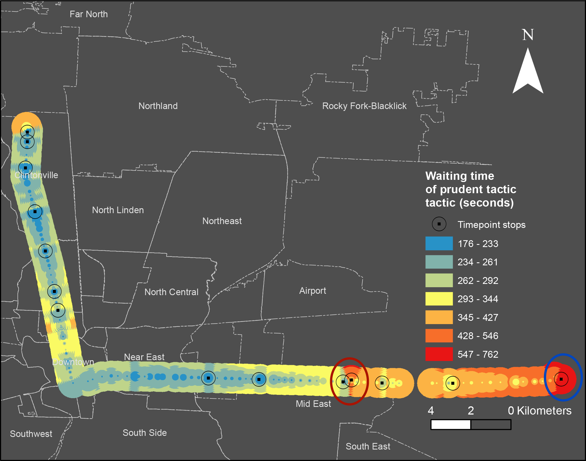
Prudent RTI strategy’s spatial pattern
Stops near the start stations have worse performance
Timepoints, where bus sticks to the schedule, have shorter waiting time
Higher headway service has longer wait time
Notes:
After knowing the temporal pattern, we also visualizae the prudent rti strategy’s spatial pattern. [READ THE PPT]

Slide 10
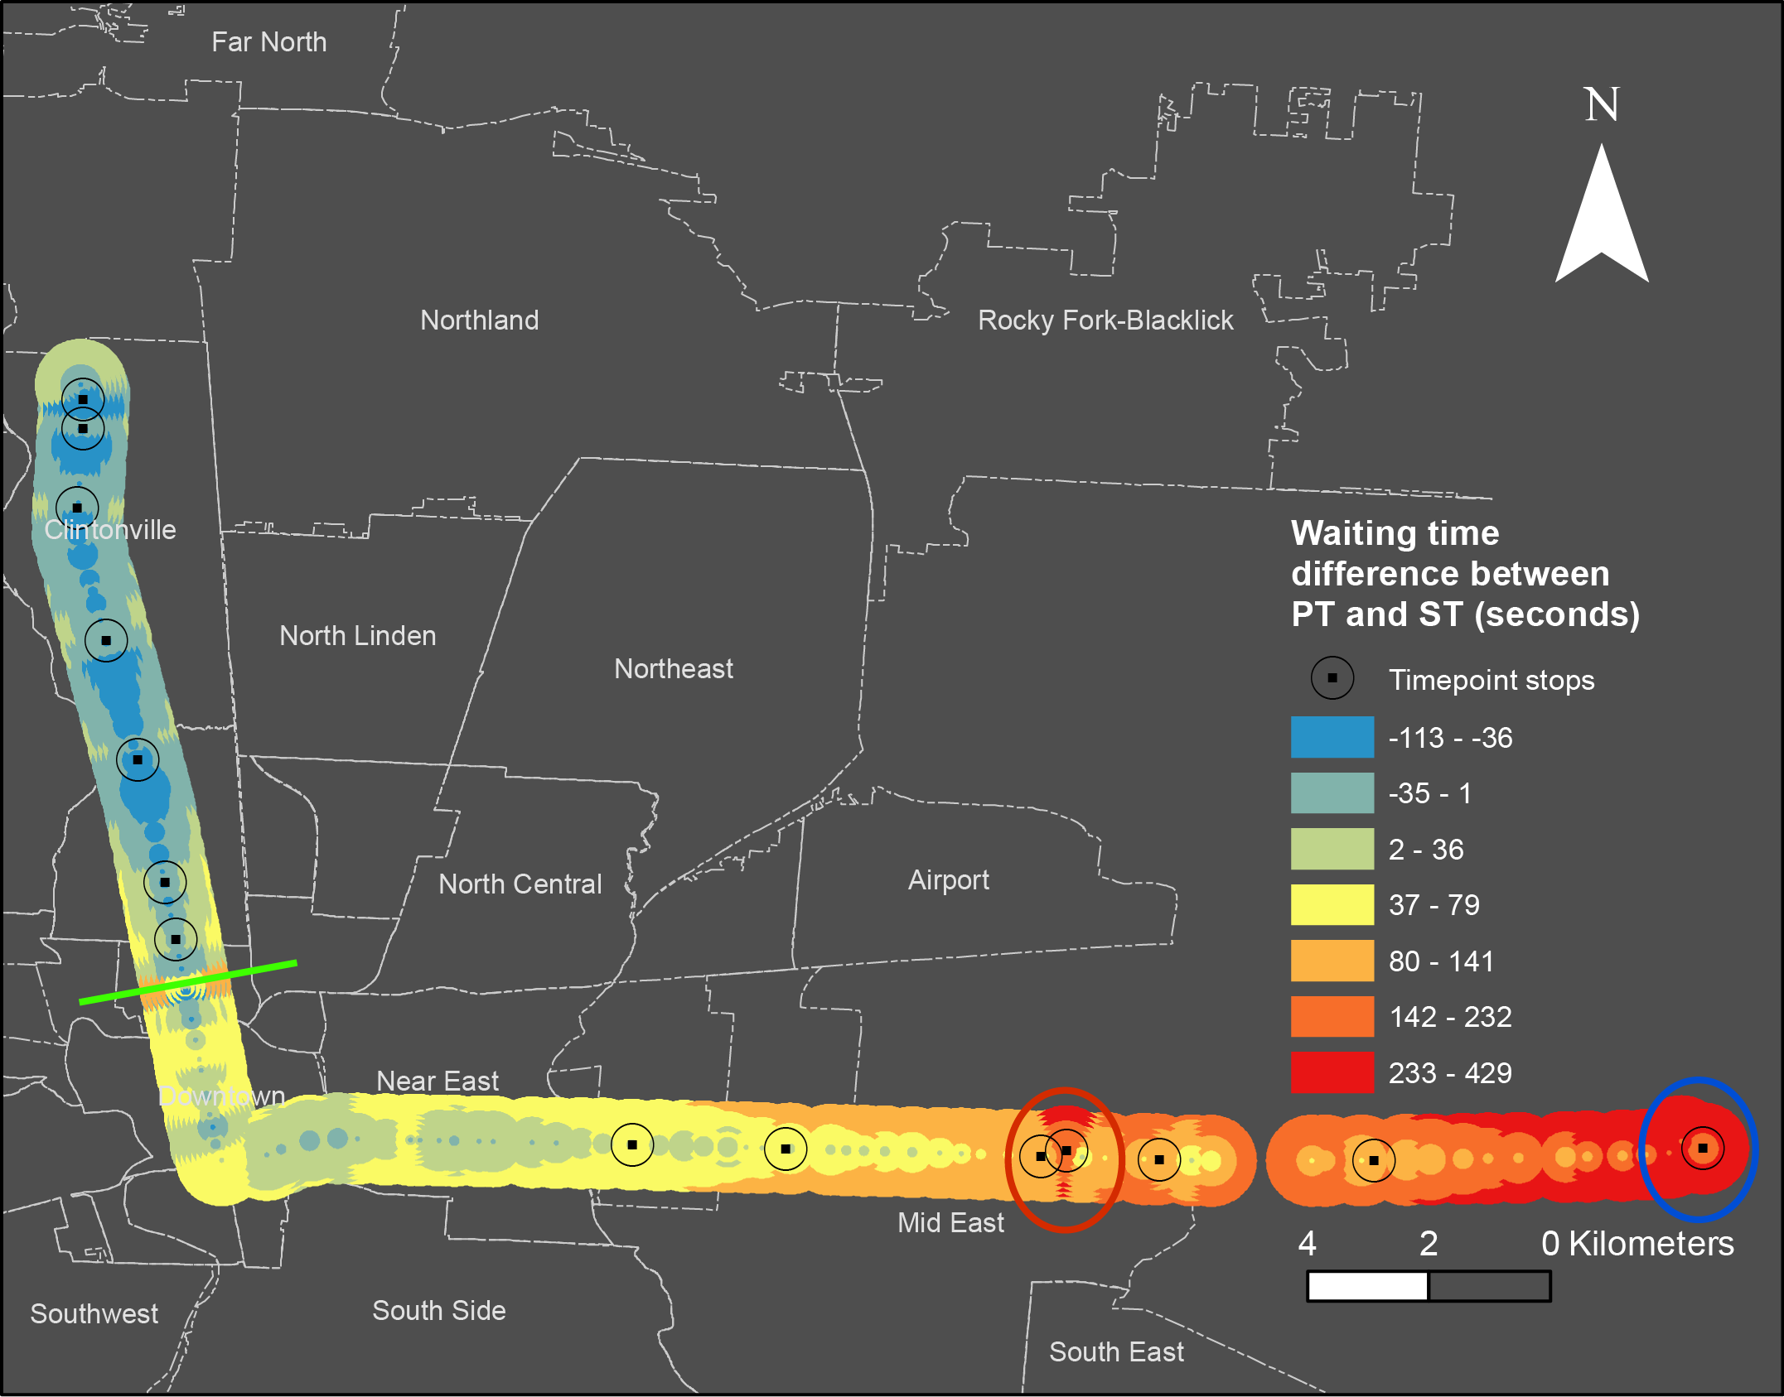
Compare Prudent and schedule
Upstream stops near the origin:
Less delay
Prudent is worse than schedule
Downstream stops near the destination:
More delay
Prudent is better than schedule
Notes:
So we know that the best rti and best nonrti strategy, which are prudent and schedule strategies, have very similar performance, so we calculate the difference between the two strategy. We find out if you are near the upstream stops near the origin, where there is less delay, prudent is worse than schedule. If you live near the downstream stop near the destination, where have more delay, prudent is better than schedule, which means you should use more RTI.
There is several other interesting patterns in this map, First is the presence of a diagonoal patterns. is that each stop have several concentric circles, which indicates different walking time. From the center to the outer ring, the waiting time is increasing.

Slide 11
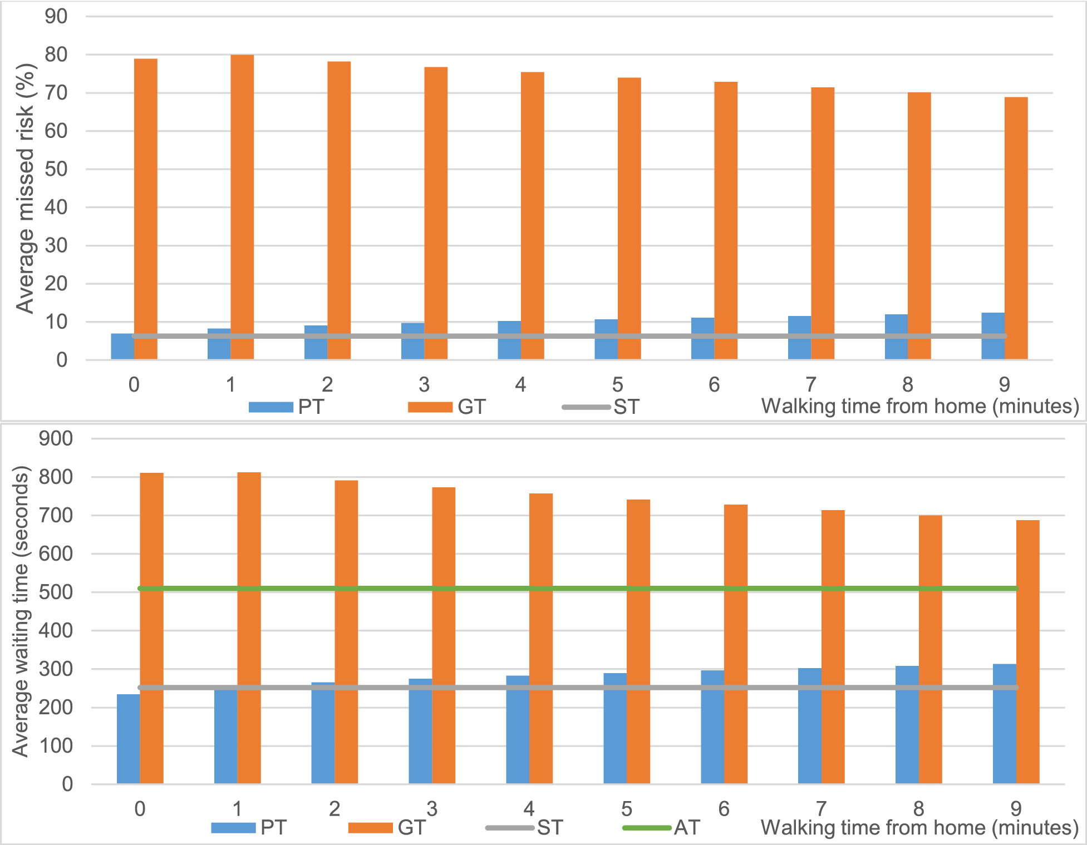
Walking distance
Schedule and Arbitrary: walking distance has no impact
Prudent RTI: more walking time leads to more wait time
Greedy RTI: more walking time leads to less wait time
Walking distance from the origin to the bus stop makes a difference for RTI strategies
Notes:
Therefore, walking distance from the origin to the bus stop makes a difference for RTI strategy. For non-RTI strategies, walking distance has no impact. For prudent RTI, more waling time leads to more waiting time because more walking time means more uncertainties and higher risk of missing a bus. For greedy RTI, more walking time leads to less waiting time. Longer walking time actually serves as a buffer time. So as walking time increase, the two rti strategies performance is actually converging.

Slide 12
Conclusion
Overall, the two RTI strategies do not outperform simply following schedule
Real time information can reduce waiting time for some users based on location and time
Including a time buffer improves the greedy approach used by some algorithms
We need to consider the transit performance in a more real-time and dynamic manner
Notes:
So based on what we discussed, we can see:

Slide 13
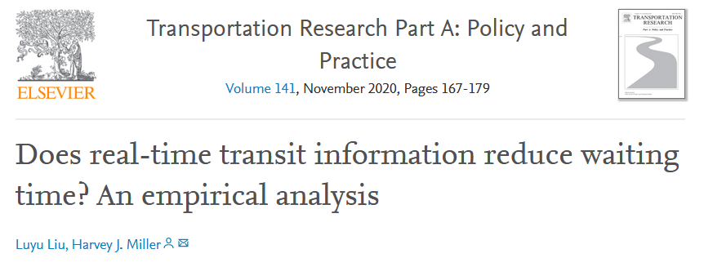
Thanks!
liu.6544@osu.edu

