Slide 1

Geo-visualization 101: Learn to make your First Webmap
Luyu Liu
Department of Geography
The Ohio State University

Slide 2
Learning Objectives
By the end of this workshop, you should be able to:
Explain the structure of web pages
Report HTML, JavaScript, and CSS’s usages
Report HTML, JavaScript, and CSS’s simple grammar
Share a web map with GitHub Pages
Get all materials at https://github.com/luyuliu/vizathon-geovisualization

Slide 3
0. Why Web Map?

Slide 4
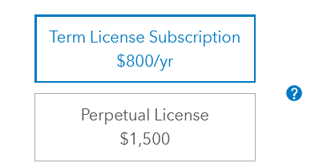
Why web-map? Accessible
Low costs
For both users and developers
No hidden fees
Low dependencies
Internet and Web browser
No other installation needed

Slide 5
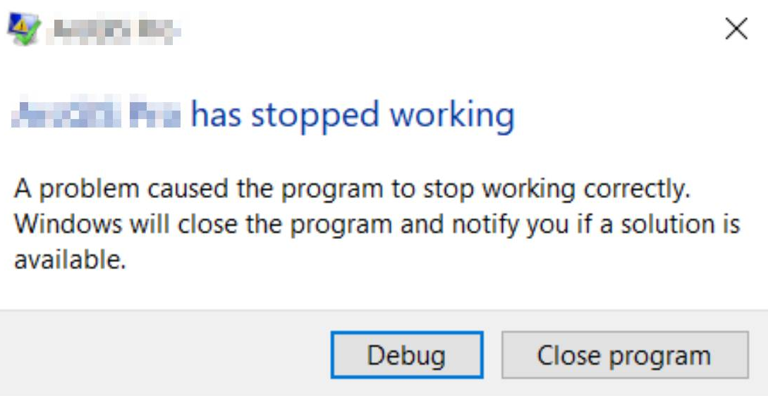
Why web map? Robust
Working 24/7
Low risk of failing

Slide 6

Why web map? Compatible
Cross platforms
Different devices
Different OS – Windows, iOS, Linux...
Touching screen friendly

Slide 7
1. Webpage Basics - HTML

Slide 8

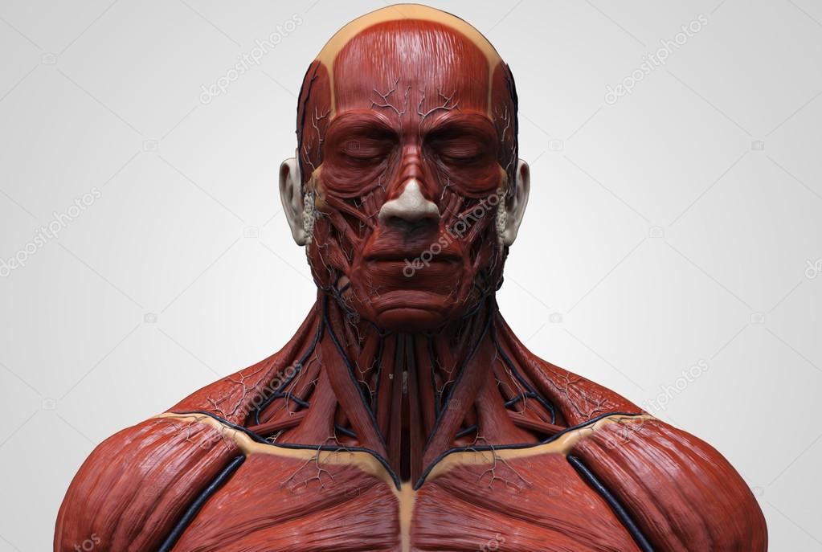
Webpage
Web page is essentially contents in web browser
A typical web page consists of three parts:
HTML
JavaScript
CSS
We can think this webpage as a human’s face:
Bone
Muscle and senses
Make-up

Slide 9
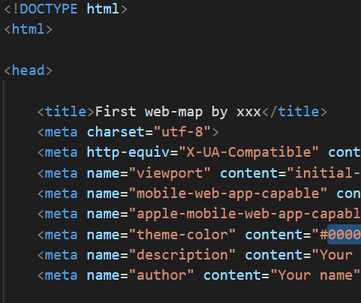
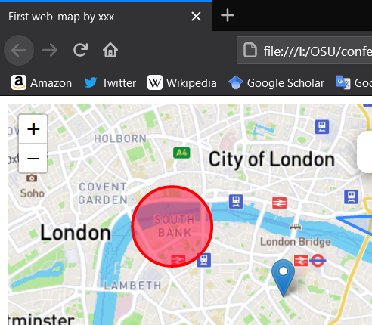

HTML – Your Bones
Hyper Text Markup Language (HTML)
Is essentially a rich-text file with some media
Like a word document, but written in codes
HTML is the foundation of the webpages
Translated by your web browser

Slide 10
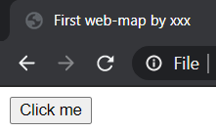
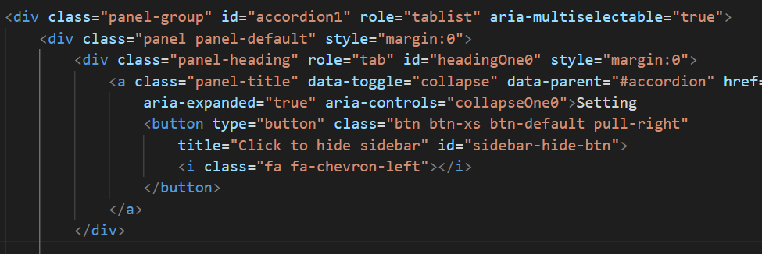


HTML Element and Tag
A webpage consists of different elements
Indicated by a part of tags, represent its type
<button>Click me</button>
<button> shows it is a button
“Click me” is the text on the element
Can further include other elements inside, like onion
1
2
3
4
5
6

Slide 11


HTML Tag Attributes
Like a record in shapefile, a tag also have attributes
<a class="link" id="this-link" href="#">I am a link!</a>
<a>: the tag name
id: a name for this specific element
Useful to select a specific element
class: a name for a group of elements
Useful to select or apply settings on many elements
href: the hyperlink attached to this element
There are many other attributes for different uses

Slide 12

HTML Alone is not Enough
HTML alone is static
Hard to interact
HTML alone can still show videos and GIFs
HTML alone is ugly
It is not good-looking
Hard to read, write, and maintain
HTML is NOT a programming language
It is a markup language

Slide 13

HTML head and body
Just like your bones, HTML can be divided into head part and body part
Head part: include metadata, necessary libraries (JS and CSS, discussed later), and your other files
Body part: actual HTML elements you see on the screen
Head part can usually be reused

Slide 14
2. Webpage Basics - JavaScript

Slide 15

JavaScript – Muscles and Senses
JavaScript (JS) is a programming language
To support and manipulate HTML
Actions (functions)
Can change contents
Reactions (events)
Can detect and react to a change or input
e.g.: background change after click a button
“JavaScript is not Java, just like ham is not hamster”
More on: http://javascriptisnotjava.com/

Slide 16
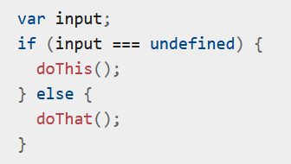
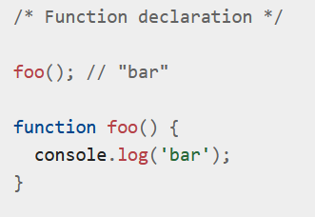

JS – Basic Grammar
JS has a very similar grammar like other scripting language like python/R
‘var’ or ‘let’: declare a variable
‘if’: conditional clause
‘function foo()’: define a function
‘foo()’: execute a function
Semicolon: recommended, but not necessary
Comment: ‘//’ (for a line) or ‘/* */’ (for many lines)
Source

Slide 17

JS – Important Data Structure
List:
Square bracket: []
Simple and efficient to enumerate
But hard to find a specific one
Object:
Curly bracket: {}
Attribute-value pairs
Simple to enumerate and fast to find a specific one
But take twice space to store the same information
Source

Slide 18
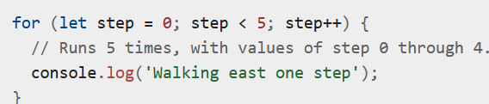
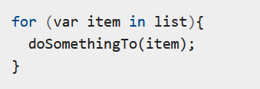
JS – For Loop
Useful to repeat or enumerate data structure
Repeat for certain times
Start from 0, end at 5,
The value will be 0, 1, 2, 3, 4
Enumerate
Variable ‘item’ is an item in the ‘list’
Source

Slide 19

JS Library: jQuery
Native JS is not enough sometimes
jQuery is a very useful library
Its function starts with a dollar sign ($) and usually two steps
Step 1: Select the object(s)
Step 2: Do something or ask it react to something
Examples
Step 1
Select an object: $("#the_id")
Select a class of objects: $(".the_class")
Step 2
Change the value of an input box: $("#input").val(“text changed!”)
Add an event to a button that when a user clicks it, show a text

Slide 20
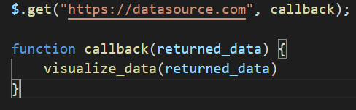

JS – Make a Request
We cannot store everything in our code
Need to make requests to get data
$.get: the jQuery function to GET data. It has two parameters:
“datasource.com”: the online dataset URL
callback (a function): what you will do to the data if data is available
returned_data: the returned data structure

Slide 21
3. Webpage Basics - CSS

Slide 22
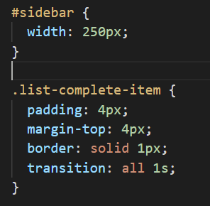

CSS – Make-up On the Face
Cascading Style Sheets (CSS)
Layout: position and sequence of HTML elements
Colors and fonts
For a specific object
Change its width to 250 pixel
For objects with this class name
Change padding to 4px
Change margin to the top to 4px
Change border style
Change transition style

Slide 23

CSS is Hard
CSS seems trivial among the three, but requires much more work
Just like makeup, buy from professional
Try CSS framework and libraries
Bootstrap: Great for arranging layout and simple style
Font Awesome: Vector icons and logos

Slide 24

Summary
HTML is the bone
Foundation of a website
JS is the muscle and senses
Actions and reactions
CSS is the makeup
Layout and style

Slide 25


Combining the Three
We need to include JS and CSS files and libraries to our main HTML to make them work
For JS:
For CSS:
Make sure adding your main JS and CSS AFTER other libraries to not fail the dependencies.

Slide 26
4. Web Browser

Slide 27

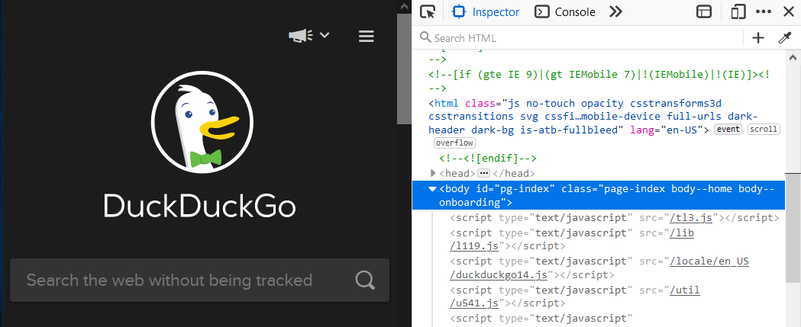

Understand Your Browser
It is a software that translate online HTML/JS/CSS codes into contents
Debug window: press F12 or right click -> inspect
Inspector: show elements in current HTML
: pick element on page and show HTML code
Important:
Current HTML may be different from the original HTML file you wrote, because your JS files will add and change the contents

Slide 28
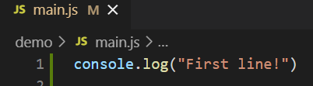
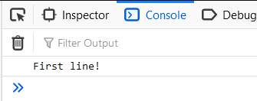
Web Console
This is the JavaScript console for the current page
console.log(): equivalent to print() in Python and R
Console will show the information printed from your JS code
Very useful for simple debug
You can change the current HTML contents by typing commands
For example, try typing document.body.innerHTML = “” in any page

Slide 29
CORS Restrictions
Cross-origin resource sharing (CORS) is a rule that websites cannot request resources from other domains
aaa.com cannot directly request a CSV file hosted on bbb.com unless bbb.com explicitly says so, even if it is a public file. This includes local files.
Instead, aaa.com can only request resources with aaa.com domains, such as aaa.com/file.csv
It is enforced by most web browsers
Solutions for local development:
Start a local server (localhost)
Use Firefox developer edition and CORS everywhere plugin

Slide 30
5. Mapping Library

Slide 31
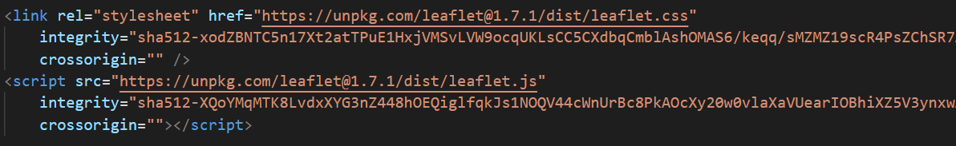

Leaflet
A very useful JavaScript library to support mapping
Adding the library:
Just like jQuery’s $, Leaflet’s functions start with L
e.g. Adding a map object to HTML element with id = “mapid”
A JS leaflet map
Leaflet’s create map function
Targeted HTML element
Method to set the map to a specific view
The view’s latlng
The Zoom level
Human language translate: Leaflet, create a map on the HTML element called “mapid”, and set my view to this place with this zoom level

Slide 32
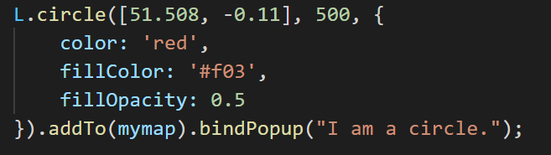
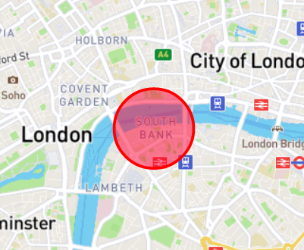

Leaflet Function Logic
All elements must addTo(mymap) to show on the map
Layer: Raster layer (L.tileLayer, including base layers), vector layer…
Other single symbols: circle (L.circle), polygon…
Information media: popup
Structure: L.function(important parameters, {optional parameters...})
Desired location
Radius
Add to the map
Add a popup with this content on this circle

Slide 33
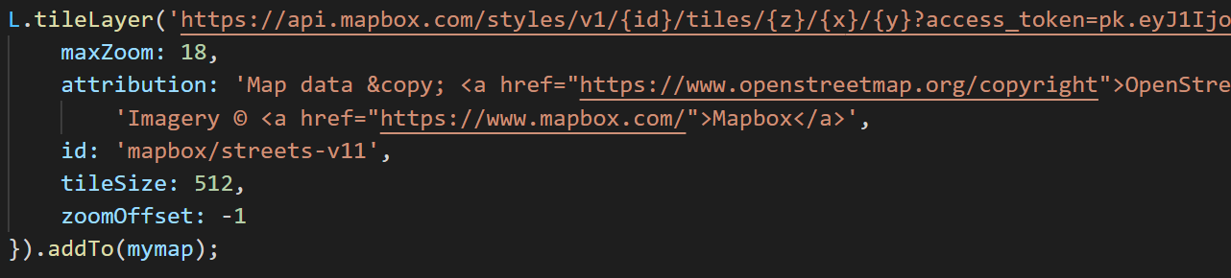
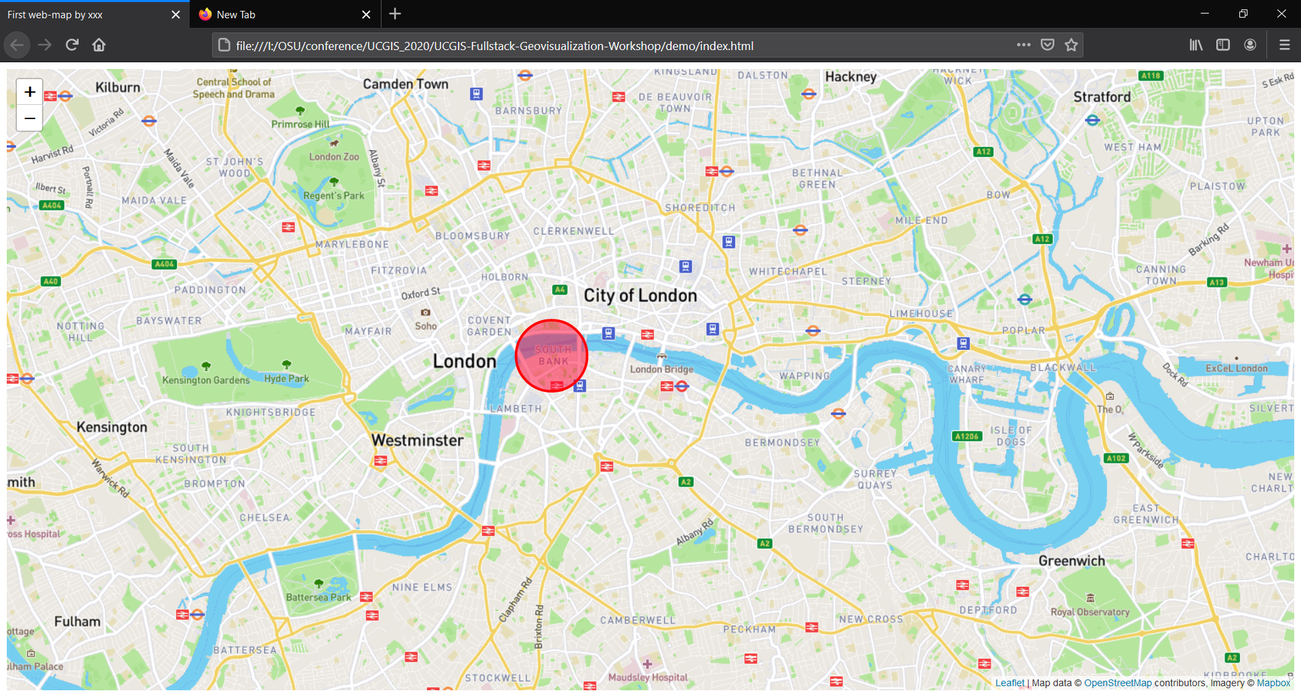
Add a map box base Layer
You now have a web-map!

Slide 34
6. See a Demo

Slide 35
7. Going Online?

Slide 36
Solutions to Host a Website
Borrow or buy a server
A server is an online computer that works 24/7
It can support a back-end and more actions
GitHub Pages
Can only support simple websites
Free and persistent

Slide 37
GitHub and Git
Git is a version control software
Record your every committed change
GitHub is a website that can:
Record your committed changes to an online server
Host static webpage

Slide 38
How to GitHub
Register a GitHub account and create a new repository or fork my repo
Go to your GitHub repository page -> settings -> Pages -> Source -> select main
Access by: youname.github.io/yourreponame/ + the path to your html file
To save your changes on the online map with GitHub Desktop:
Commit: record your current change to local
Push: upload your files to the GitHub server
In few minutes, the Pages will update your change

Slide 39
More Extra Contents
Please visit https://github.com/luyuliu/vizathon-geovisualization#adding-a-geojson-layer for more contents!
Any questions?

