Slide 1

Machine Learning Integration in Operations Research Process
Depth Examination
Xinglu Wang
Simon Fraser University
Burnaby, British Columbia, Canada

Slide 2
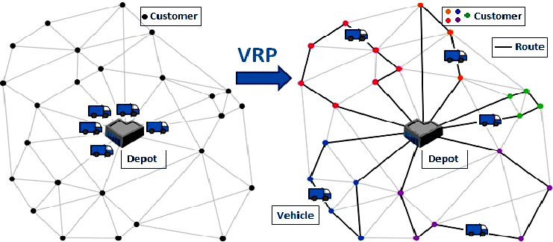

Operations Research (OR) process
Background
(Rajgopal 2004)
Example (Vehicle Routing Problem, VRP): A grocery delivery company has one central warehouse and deliver orders to various customers routinely.
Problem Identification
and Definition
Steps in the OR pipeline
Generate parameters – the coefficients in the objective and constraints.
Parameter Generation
Math Program Formulation
Problem statement in plain language, outlining the objective and constraints.
Optimization
Write down a math program
Decision variables
Objective formula
Constraints formula
Detailed VRP formulation in appendix
lnterpretation
and Validation
Solve and obtain a (near)-optimal solution
“Translate” the solution to efficient routes

Slide 3
ML enhances OR steps
Outline: ML for OR
Problem ldentification
and Definition
Steps in the OR pipeline
Possible ways that ML enhances at each step
Parameter Generation
Sub-category of the ML-enhancing ways
Math Program Formulation
Sequential Relation
Predict-then-Optimize and its variants
Subordinate Relation
Optimization
LLMs for Math Programming
lnterpretation
and Validation
Algorithm agnostic
Automatic Algorithm
Configuration
Algorithm aware
Continuous
Optimization Algorithm Selection and Design
Discrete
Optimization Algorithm Selection and Design

Slide 4
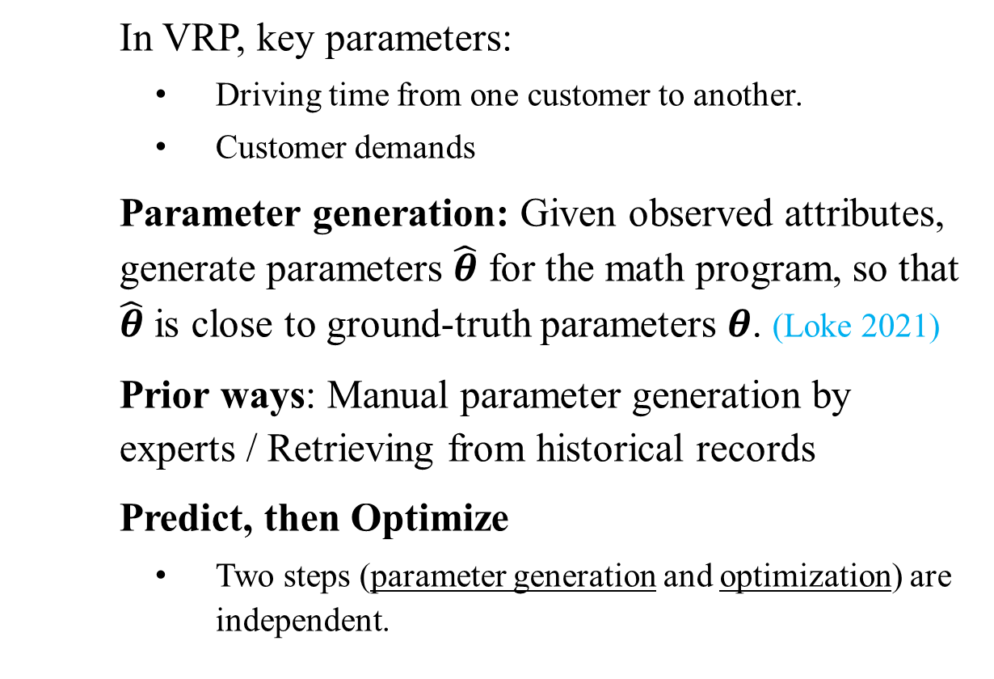



Background
ML for Parameter Generation
In VRP, key parameters:
  Driving time from one customer to another.
  Customer demands
Parameter generation: Given observed attributes, generate parameters $\hat{θ}$ for the math program, so that $\hat{θ}$ is close to ground-truth parameters $θ$. (Loke 2021)
Prior ways: Manual parameter generation by experts / Retrieving from historical records
Predict, then Optimize
  Two steps (parameter generation and optimization) are independent.
Predict, then optimize
Training stage
Inference stage
Attributes
Attributes
*
ML model
$${\text{Pre}\text{−}\text{trained} ML \text{Model}}^{∗}$$
$$θ$$
$$θ$$
$$θ$$
Optimization
Math program’s parameters
Decision
*
ML model’s parameter is frozen

Slide 5
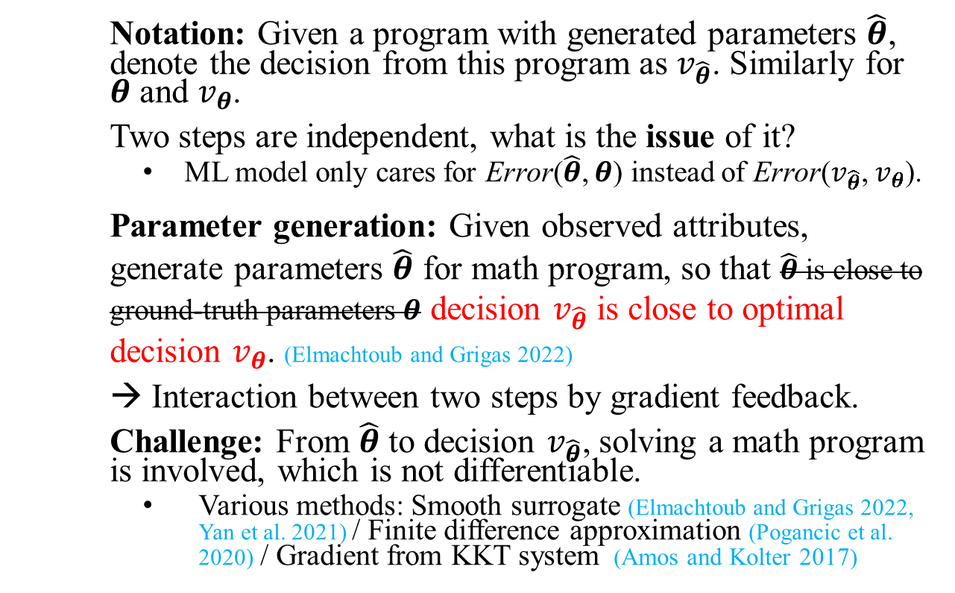




Variant 1 of “Predict, then Optimize”
ML for Parameter Generation
Interact by gradient feedback
Notation: Given a program with generated parameters $\hat{θ}$, denote the decision from this program as $v_{\hat{θ}}$. Similarly for $θ$ and $v_{θ}$.
Two steps are independent, what is the issue of it?
  ML model only cares for Error($\hat{θ}$, $θ$) instead of Error($v_{\hat{θ}}$, $v_{θ}$).
Parameter generation: Given observed attributes, generate parameters $\hat{θ}$ for math program, so that $\hat{θ}$ is close to ground-truth parameters $θ$ decision $v_{\hat{θ}}$ is close to optimal decision $v_{θ}$. (Elmachtoub and Grigas 2022)
→ Interaction between two steps by gradient feedback.
Challenge: From $\hat{θ}$ to decision $v_{\hat{θ}}$, solving a math program is involved, which is not differentiable.
  Various methods: Smooth surrogate (Elmachtoub and Grigas 2022, Yan et al. 2021) / Finite difference approximation (Pogancic et al. 2020) / Gradient from KKT system (Amos and Kolter 2017)
Training stage
Inference stage
Attributes
Attributes
ML Model
*
$${\text{Pre}\text{−}\text{trained} ML \text{Model}}^{∗}$$
$$θ$$
$$θ$$
Feedback by Gradient
Optimization
Optimization
Decision
Decision
*
ML model’s parameter is frozen
$$θ$$
Math program’s parameters
$$θ$$
Math program’s parameters

Slide 6
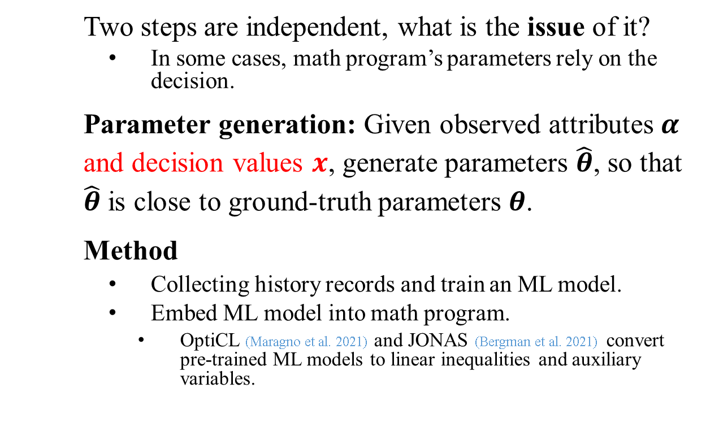

Variant 2 of “Predict, then Optimize”
ML for Parameter Generation
Interact by loop
Two steps are independent, what is the issue of it?
  In some cases, math program’s parameters rely on the decision.
Parameter generation: Given observed attributes $α$ and decision values $x$, generate parameters $\hat{θ}$, so that $\hat{θ}$ is close to ground-truth parameters $θ$.
Method
  Collecting history records and train an ML model.
  Embed ML model into math program.
    OptiCL (Maragno et al. 2021) and JONAS (Bergman et al. 2021) convert pre-trained ML models to linear inequalities and auxiliary variables.
Training stage
Inference stage
Attributes +Decisions
Attributes
ML model
*
$${\text{Pre}\text{−}\text{trained} ML \text{Model}}^{∗}$$
$$θ$$
$$θ$$
Take in
Optimization
Decision
*
ML model’s parameter is frozen
$$θ$$
Math program’s parameters

Slide 7

Large language models (LLMs) for Math Programming
ML for Math Programming
The task of Programming: Constructing math program from textual problem statement
A berry picker must pick at least 3000 strawberries and 15000 raspberries. He visits two farms. For each hour at farm 1 he spends, he can pick 50 strawberries and 300 raspberries. For each hour at farm 2 he spends, he can catch 70 strawberries and 200 raspberries. How many hours should he spend at each farm to minimize the amount of time he spends at both farms?
Variables:
x hours in farm 1
y hours in farm 2
Minimize: x + y
Subject to:
50x + 70y ≥ 3000
300x + 200y ≥15000
x，y ≥ 0
User
A textbook-level OR problems (Ramamonjison et al. 2023)
  LLMs have recently demonstrated remarkable performance in language-related tasks and beyond (Brown et al. 2020, Touvron et al. 2023). We wonder LLMs’ potential in math programming. Next, we will
  Introduce LLM background
  Provide insights on LLM for programming

Slide 8
How does LLM works (Taori et al. 2023)
LLM for math Programming
Large Unlabelled Dataset
Small Labelled Dataset
Small Labelled Dataset
Pretraining
Finetuning
Finetuning
Pretrained LLM
Instruction-following
Domain-specific LLM
Understand text and have common-sense knowledge
Align with human’s intentions
Be good at specific tasks

Slide 9
Insights on LLM for programming
LLM for math Programming
  Textbook-level problems from NL4OPT benchmark (Ramamonjison et al. 2023).
    Found insights:
      Commercial LLMs are easy to use and performs well on textbook-level problems
      Increasing model size is less effective than finetuning with a high-quality and relevant dataset.
  Real-world problem from research paper (Blazewicz et al. 1991). Refer to appendix slides.
    Insights: LLMs are prone to errors on complex problems. However, LLMs can assist experts.
LLMs | #Parameter (Billion) | Pretrain Data | Finetuning Data | Acc
Llama-2-13b-chat (Touvron et al. 2023) | 13 | Open domain, e.g., Wiki, Arxiv, … | Instruct following | 24%
Llama-2-70b-chat (Touvron et al. 2023) | 70 | Open domain | Instruct following | 37%
Llama-2-13b-chat (Touvron et al. 2023) | 13 | Open domain | Instruct following+NL4OPT train set | 82%
Code-Llama-34b-instruct(Rozi`ere et al. 2023) | 34 | Open domain+Code domain | Instruct following (code related) | 65%
GPT 3.5 (OpenML. 2023) | 175 | Unknown | Unknown | 77%
GPT 4 (OpenML. 2023) | 1500 | Unknown | Unknown | 93%
(Xing et al. 2024)

Slide 10
Motivation
Al-driven Optimization Methods
Vehicle Routing Problem (VRP): A delivery company wants to solve large-scale VRPs routinely in acceptable time. These VRPs share certain properties.
Prior way: Consult OR experts to design/select specialized optimization algorithm for their VRPs.
Opportunity: The programs are correlated.
Goal: Automatically improve an optimization algorithm and specialize it for correlated programs.
Two streams of methods:
  Algorithm agnostic: Perceives the algorithms as black box, focusing on tuning their configuration. Refer to appendix slides.
  Algorithm aware: Focus on a single algorithm, understand its internal mechanism, and enhance its components with ML techniques.

Slide 11
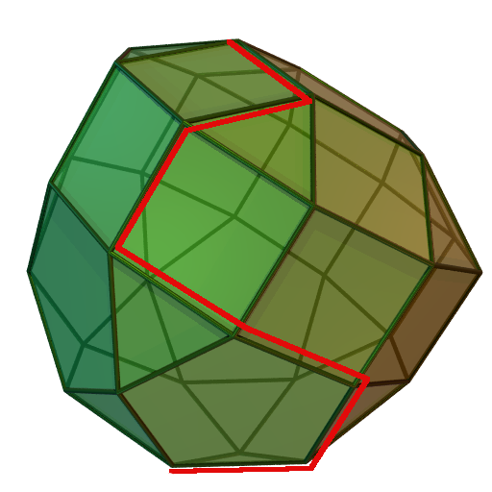



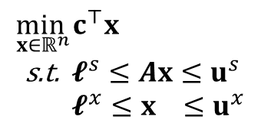
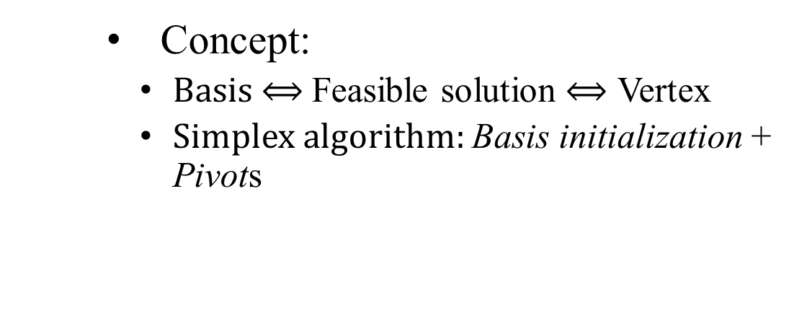
Background: Simplex algorithm
Al-driven Optimization Methods
Simplex algorithm is widely used in solving linear programs
$$\begin{aligned}\min_{x∈ℝ^{n}} &c^{⊤}x \\ \text{s}\text{.}\text{t}\text{. }&𝓵^{s}≤Ax≤u^{s} \\ &𝓵^{x}≤x ≤u^{x}\end{aligned}$$
$$𝓑^{∗}$$
Concept:
      Basis $⟺$ Feasible solution $⟺$ Vertex
      Simplex algorithm: Basis initialization + Pivots
$$𝓑^{(0)}$$
$$𝓑^{(1)}$$
Figure credits to https://en.wikipedia.org/wiki/Simplex_algorithm

Slide 12
ML enhances Simplex algorithm
Al-driven Optimization Methods
ML enhances basis initialization
  Motivation:
    Classical initial basis strategies → not necessarily close-to-optimal.
    Fails to utilize past-solving experience from correlated programs.
  Fan et al. (2023) proposes a GNN-based initial basis selection strategy.
    Basis initialization task → a classification task.
    The classification results is converted to a valid close-to-optimal basis.
ML enhances pivot
  Motivation:
    Classical pivot rules are greedy → the pivot path is not shortest.
    Finding a shortest pivot path requires information in the future.
  Suriyanarayana et al. (2022) uses reinforcement learning (RL) techniques to switch between existing pivoting rules.
  Instead of limited by existing pivot rules, Li et al. (2022) allow the action space to contain all feasible pivot directions.

Slide 13
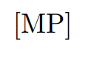
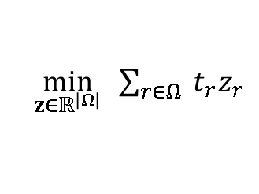
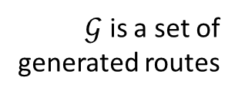

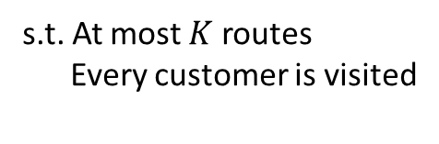
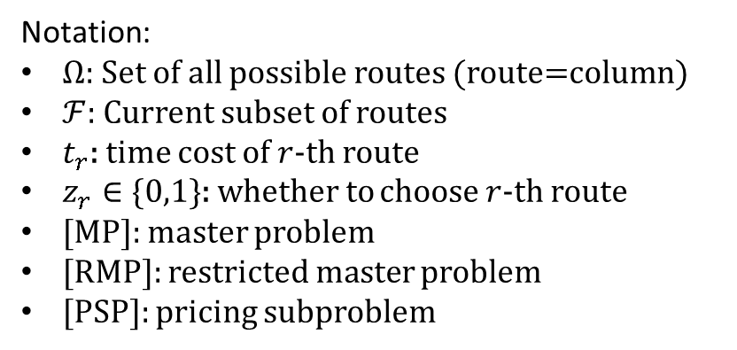
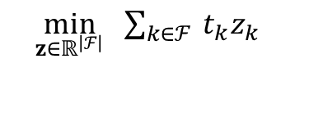
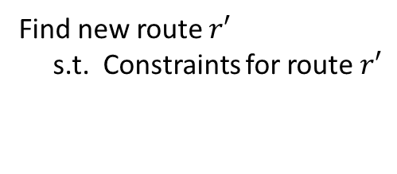

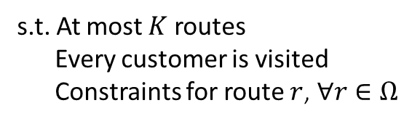
Background: Column generation (CG) algorithm
Al-driven Optimization Methods
CG is suitable for linear problem with a prohibitively large number of variables.
[RMP]
1$\begin{aligned}&\min_{z∈ℝ^{\left|ℱ\right|}} &&\sum_{k∈ℱ}{ }t_{k}z_{k} \\ & \\ & &&\end{aligned}$
s.t. At most $K$ routes
Every customer is visited
RMP
1$\min_{z∈ℝ^{\left|Ω\right|}} \sum_{r∈Ω}{ }t_{r}z_{r}$
$$ℱ←ℱ∪𝒢$$
s.t. At most $K$ routes
Every customer is visited
Constraints for route $r$, $∀r∈Ω$
New column(s) $𝒢$
Dual
values
Dual value
→ Calculate how much a new route changes the obj of [RMP]
$𝒢$ is a set of generated routes
PSP
Notation:
$Ω$: Set of all possible routes (route=column)
$ℱ$: Current subset of routes
$t_{r}$: time cost of $r$-th route
$z_{r}∈\{0,1\}$: whether to choose $r$-th route
[MP]: master problem
[RMP]: restricted master problem
[PSP]: pricing subproblem
[PSP]
Find new route $r′$
s.t. Constraints for route $r′$
Obj of [RMP] improves

Slide 14

ML enhances CG algorithm
Al-driven Optimization Methods
RMP
Improve aspect 1: 𝒢 should be generated within reasonable time
    The hardness of [PSP] varies with the context of the specific problem
      For vehicle routing problem, [PSP] is P problem.
      For graph coloring problem, [PSP] is NP-hard.
        For this [PSP], Shen et al. (2022) train a support vector machine to predict the solutions.
Improve aspect 2: 𝒢 should be promising for faster convergence.
    Desaulniers et al. (2020) propose: Promising = the next-iteration [RMP] improves + size of G is small
    Chi et al. (2022) use a similar function above as reward and integrate into reinforcement learning.
New column(s) $𝒢$
Dual
values
ML Model
Al model generates columns
RMP
Suggested column(s)
Current state
Al model
Dual
values
Candidate columns
PSP
Al model selects from candidate columns

Slide 15
Conclusion & Future Directions
Conclusion: ML techniques help steps in the OR pipeline, from parameter generation, math programming to optimization algorithm.
Future directions:
  Interaction among different OR steps: Literature explored the interaction between parameter generation and optimization. It is interesting to explore more other types of interactions. For example:
    Adapting the math program if the optimization step indicates suboptimality or slow convergence;
    Providing a “counterfactual explanation" for the generated parameter if optimization indicates infeasibility – a minimal change to parameters that results in a feasible solution.
  Correlation Metrics: recall the assumption in ML for optimization -- problem instances are correlated. However, there is no formal metric for correlation, not to mention studying how correlation affects the performance of ML models trained on certain distribution of instances.

Slide 16
Thank you!
Any Question?
Recap outline:
Introduction
ML for Operations Research
  ML for Parameter Generation
    Predict, then optimize
    Interact by gradient feedback
    Interact by loop
  ML for Math Programming
    Background on LLM
    Insights on using LLM for programming
  ML for Math Optimization
    Algorithm agnostic
    Algorithm aware
      ML for Simplex algorithm
      ML for Column Generation algorithm
      ML for Branch-and-bound algorithm
Conclusion and Future Works

Slide 17
Appendix
Math program for TSP
ML for Parameter Generation: comparison
LLM for programming: example for a real-world problem
ML for optimization
  Algorithm agnostic
  Linear program’s representation
Difference with existing surveys

Slide 18







Comparison
ML for Parameter Generation
No interaction.
Predict then optimize
(b) Interact by gradient feedback
(c) Interact by loop
*
*
$${\text{Pre}\text{−}\text{trained} ML \text{Model}}^{∗}$$
ML Model
$${\text{Pre}\text{−}\text{trained} ML \text{Model}}^{∗}$$
*
Parameters
Frozen
$$θ$$
$$θ$$
$$θ$$
Feedback by Gradient
Take in
$$θ$$
The Modeling parameters
Math Program
Math Program
Math Program
Decision
Decision
Decision
ML receives gradient updates?
ML and optimization integrated?

Slide 19

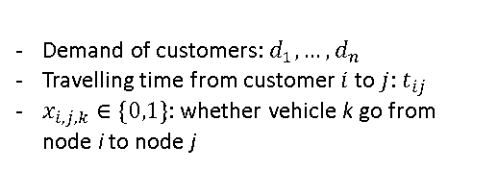
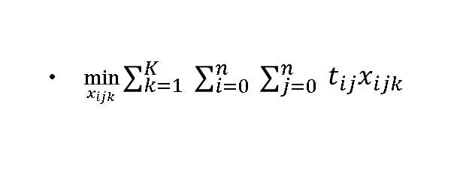
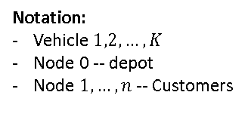
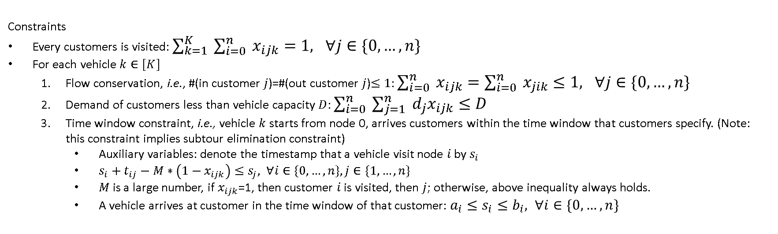
Math program for VRP
Problem statement: A grocery delivery company has one central warehouse and deliver orders to various customers routinely. For the constraint of VRP, the company have a certain number of delivery vehicles, each with a limited capacity for carrying groceries. On customers side, they have different demands and specific time windows during which they must receive their deliveries. The objective is minimizing the total traveling time of all delivery vehicles.
Notation:
Vehicle $1,2,…,K$
Node 0 -- depot
Node $1,…,n$ -- Customers
Demand of customers: $d_{1},…,d_{n}$
Travelling time from customer $i$ to $j$: $t_{ij}$
$x_{i,j,k}∈\{0,1\}$: whether vehicle k go from node i to node j
$\min_{x_{ijk}}\sum_{k=1}^{K}{ }\sum_{i=0}^{n}{ }\sum_{j=0}^{n}{ }t_{ij}x_{ijk}$
Constraints
Every customers is visited: $\sum_{k=1}^{K}{ }\sum_{i=0}^{n}{ }x_{ijk}=1, ∀j∈\{0,…,n\}$
For each vehicle $k∈[K]$
  Flow conservation, i.e., #(in customer $j$)=#(out customer $j$)$≤1$: $\sum_{i=0}^{n}{ }x_{ijk}=\sum_{i=0}^{n}{ }x_{jik}≤1, ∀j∈\{0,…,n\}$
  Demand of customers less than vehicle capacity $D$: $\sum_{i=0}^{n}{ }\sum_{j=1}^{n}{ }d_{j}x_{ijk}≤D$
  Time window constraint, i.e., vehicle $k$ starts from node 0, arrives customers within the time window that customers specify. (Note: this constraint implies subtour elimination constraint)
    Auxiliary variables: denote the timestamp that a vehicle visit node $i$ by $s_{i}$
    $s_{i}+t_{ij}−M∗\left(1−x_{ijk}\right)≤s_{j}, ∀i∈\{0,…,n\},j∈\{1,…,n\}$
    $M$ is a large number, if $x_{ijk}$=1, then customer $i$ is visited, then $j$; otherwise, above inequality always holds.
    A vehicle arrives at customer in the time window of that customer: $a_{i}≤s_{i}≤b_{i}, ∀i∈\{0,…,n\}$

Slide 20

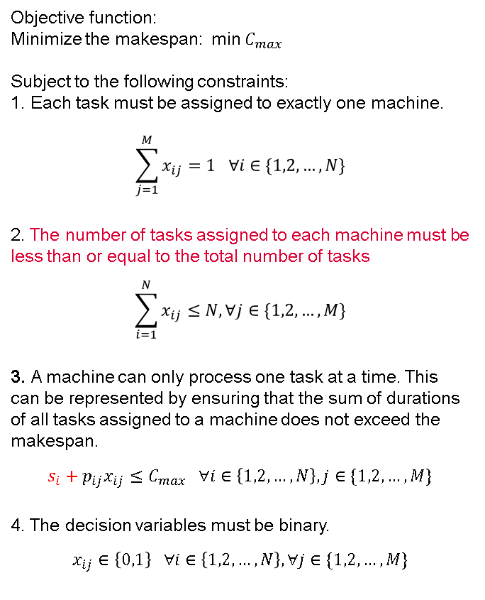
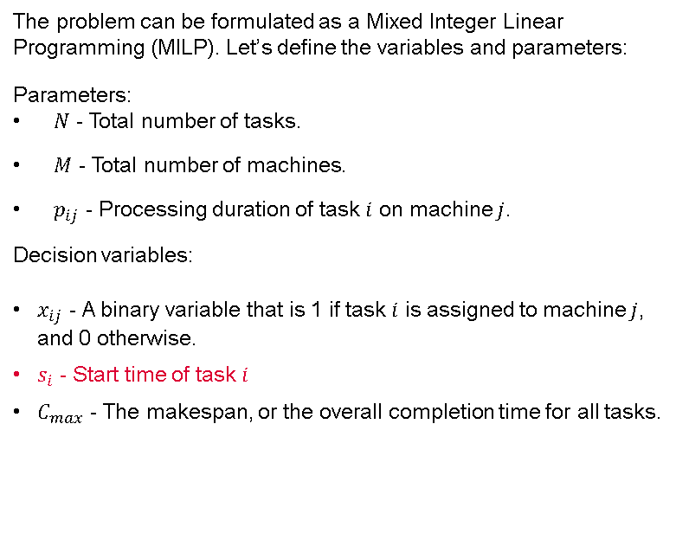
U
Write a Math program of the following problem description “We want to distribute 𝑁 tasks to 𝑀 machines. The processing time of each task on each machine is known. Please decide an distribution plan that minimize the overall completion time."
Objective function:
Minimize the makespan: min $C_{max}$
Subject to the following constraints:
1. Each task must be assigned to exactly one machine.
$$\sum_{j=1}^{M}{x_{ij}}=1 ∀i∈\{1,2,…,N\}$$
2. The number of tasks assigned to each machine must be less than or equal to the total number of tasks
$$\sum_{i=1}^{N}{x_{ij}}≤N,∀j∈\{1,2,…,M\}$$
3. A machine can only process one task at a time. This can be represented by ensuring that the sum of durations of all tasks assigned to a machine does not exceed the makespan.
$$s_{i}+p_{ij}x_{ij}≤C_{max} ∀i∈\left\{1,2,…,N\right\}, j∈\{1,2,…,M\}$$
4. The decision variables must be binary.
$$x_{ij}∈\left\{0,1\right\} ∀i∈\left\{1,2,…,N\right\}, ∀j∈\{1,2,…,M\}$$
The problem can be formulated as a Mixed Integer Linear Programming (MILP). Let’s define the variables and parameters:
Parameters:
$N$ - Total number of tasks.
$M$ - Total number of machines.
$p_{ij}$ - Processing duration of task $i$ on machine $j$.
Decision variables:
$x_{ij}$ - A binary variable that is 1 if task $i$ is assigned to machine $j$, and 0 otherwise.
$s_{i}$ - Start time of task $i$
$C_{max}$ - The makespan, or the overall completion time for all tasks.

Slide 21
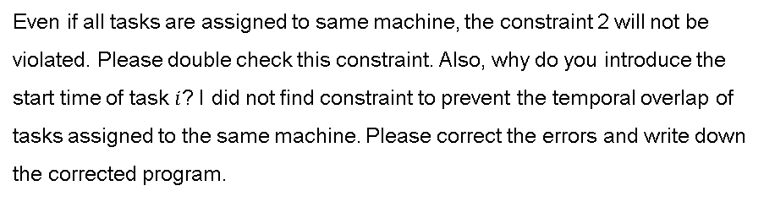
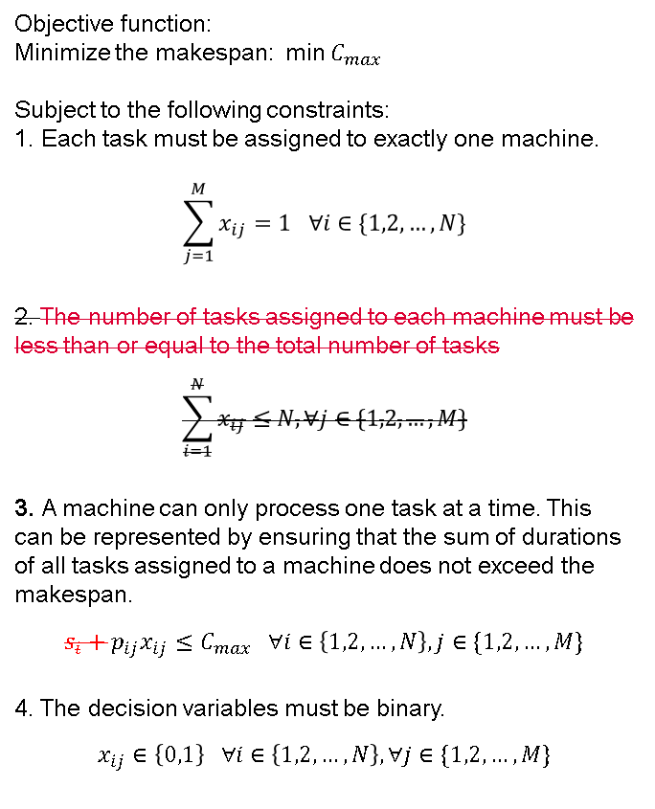
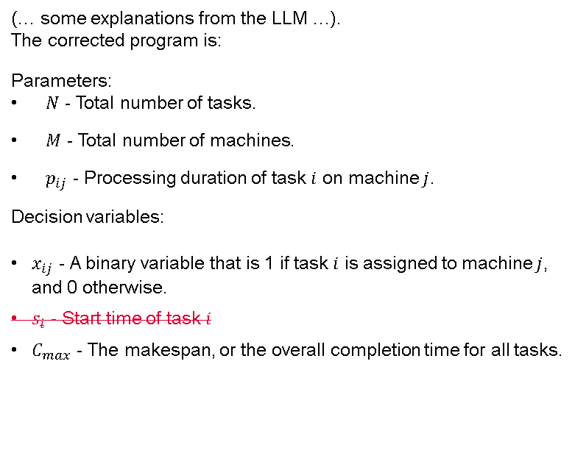
U
Even if all tasks are assigned to same machine, the constraint 2 will not be violated. Please double check this constraint. Also, why do you introduce the start time of task $i$? I did not find constraint to prevent the temporal overlap of tasks assigned to the same machine. Please correct the errors and write down the corrected program.
Objective function:
Minimize the makespan: min $C_{max}$
Subject to the following constraints:
1. Each task must be assigned to exactly one machine.
$$\sum_{j=1}^{M}{x_{ij}}=1 ∀i∈\{1,2,…,N\}$$
2. The number of tasks assigned to each machine must be less than or equal to the total number of tasks
$$\sum_{i=1}^{N}{x_{ij}}≤N,∀j∈\{1,2,…,M\}$$
3. A machine can only process one task at a time. This can be represented by ensuring that the sum of durations of all tasks assigned to a machine does not exceed the makespan.
$$s_{i}+p_{ij}x_{ij}≤C_{max} ∀i∈\left\{1,2,…,N\right\}, j∈\{1,2,…,M\}$$
4. The decision variables must be binary.
$$x_{ij}∈\left\{0,1\right\} ∀i∈\left\{1,2,…,N\right\}, ∀j∈\{1,2,…,M\}$$
(… some explanations from the LLM …).
The corrected program is:
Parameters:
$N$ - Total number of tasks.
$M$ - Total number of machines.
$p_{ij}$ - Processing duration of task $i$ on machine $j$.
Decision variables:
$x_{ij}$ - A binary variable that is 1 if task $i$ is assigned to machine $j$, and 0 otherwise.
$s_{i}$ - Start time of task $i$
$C_{max}$ - The makespan, or the overall completion time for all tasks.
Insights: LLMs are prone to errors on complex problems, so they cannot replace OR experts. However, LLMs can assist experts, by (1) Providing a starting point for math programming. (2) Correcting the errors through iterative dialogue with experts.

Slide 22
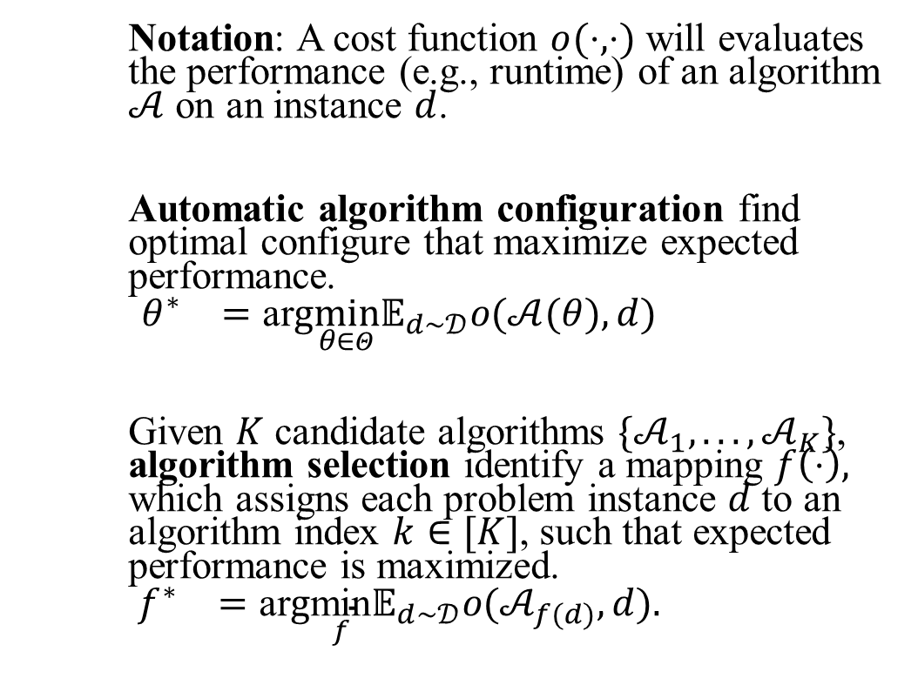
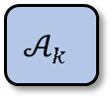



Algorithm agnostic
Al-driven Optimization Methods
Problem
Instances
Notation: A cost function $o(⋅,⋅)$ will evaluates the performance (e.g., runtime) of an algorithm $𝒜$ on an instance $d$.
Automatic algorithm configuration find optimal configure that maximize expected performance.
$$\begin{matrix}θ^{∗} & =\text{ar}g\min_{θ∈Θ}{\text{𝔼}}_{d∼𝒟}o(𝒜(θ),d)\end{matrix}$$
Given $K$ candidate algorithms $\{𝒜_{1},...,𝒜_{K}\}$, algorithm selection identify a mapping $f\left(⋅\right),$ which assigns each problem instance $d$ to an algorithm index $k∈[K]$, such that expected performance is maximized.
$$\begin{matrix}f^{∗} & =\text{ar}g\underset{f}{\text{min}}{\text{𝔼}}_{d∼𝒟}o(𝒜_{f(d)},d).\end{matrix}$$
Returns
cost
Solves
Configurator
Calls with different configures
Target Algorithm
Optimal configure $θ^{∗}$
A problem
Instance $d$
Algorithms
$$𝒜_{1}$$
…
$$𝒜_{k}$$
Selector
Best Algorithm

Slide 23
Algorithm aware
Al-driven Optimization Methods
Various optimization algorithms are designed for different math programs.
Next, how ML enhances Simplex/ Column-generation / B&B algorithm is presented.
Algorithm | Target math program
Gradient-based algorithms | Unconstraint math program
ADMM-type algorithms | Seperable convex program
Simplex algorithm | Linear program
Column-generation algorithm | Large linear program (with many variables)
Cutting-plane algorithm | Mixed-integer linear program
Branch-and-bound (B&B) algorithm | Mixed-integer linear program
B&B + relaxation/linearization techniques | Mixed-integer program (including linear & non-linear)
Heuristics | Mixed-integer program
Continuous
Optimization Algorithm
Discrete
Optimization Algorithm

Slide 24





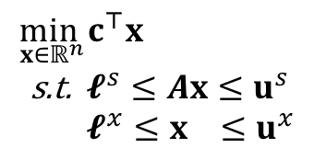








Linear program’s representation
ML-driven optimization methods
Transform to graph representation
Graph Representation
$${\left[𝓁_{1}^{s},u_{1}^{s}\right]}^{⊤}$$
$$s_{1}$$
$$x_{1}$$
$${\left[ℓ_{1}^{x},u_{1}^{x},c_{1}\right]}^{⊤}$$
Linear Program
$$\begin{aligned}\min_{x∈ℝ^{n}} &c^{⊤}x \\ \text{s}\text{.}\text{t}\text{. }&𝓵^{s}≤Ax≤u^{s} \\ &𝓵^{x}≤x ≤u^{x}\end{aligned}$$
…
…
Conversion
$$A_{ij}$$
$${\left[ℓ_{j}^{x},u_{j}^{x},c_{j}\right]}^{⊤}$$
$${\left[𝓁_{i}^{s},u_{i}^{s}\right]}^{⊤}$$
$$s_{i}$$
$$x_{j}$$
…
…
$${\left[𝓁_{m}^{s},u_{m}^{s}\right]}^{⊤}$$
$$s_{m}$$
$$x_{n}$$
$${\left[ℓ_{n}^{x},u_{n}^{x},c_{n}\right]}^{⊤}$$
Constraint vertices
Variable vertices

Slide 25
Difference with existing surveys
Existing surveys:
  Bengio et al. (2021) , Zhang et al. (2022) and Lodi and Zarpellon (2017) focus on how ML assists Mixed Integer Programming algorithms, like branch-and-bound and heuristic methods.
  Schede et al. (2022) survey automatic algorithm configuration methods.
  Apart from ML assisting optimization algorithms, Kotary et al. (2021) also survey End-to-End learning, where machine learning directly predicts the solution of math program.
Difference of the slides with existing ones
  A holistic perspective: how ML could assist each stage of the OR pipeline.
  Not been discussed in the existing surveys: LLM for math program, and enhancement specific algorithms like Simplex and column generation algorithms.
  Emphasize the interactions between different components, e.g., the interaction between Math model’s parameter generation and optimization

Slide 26
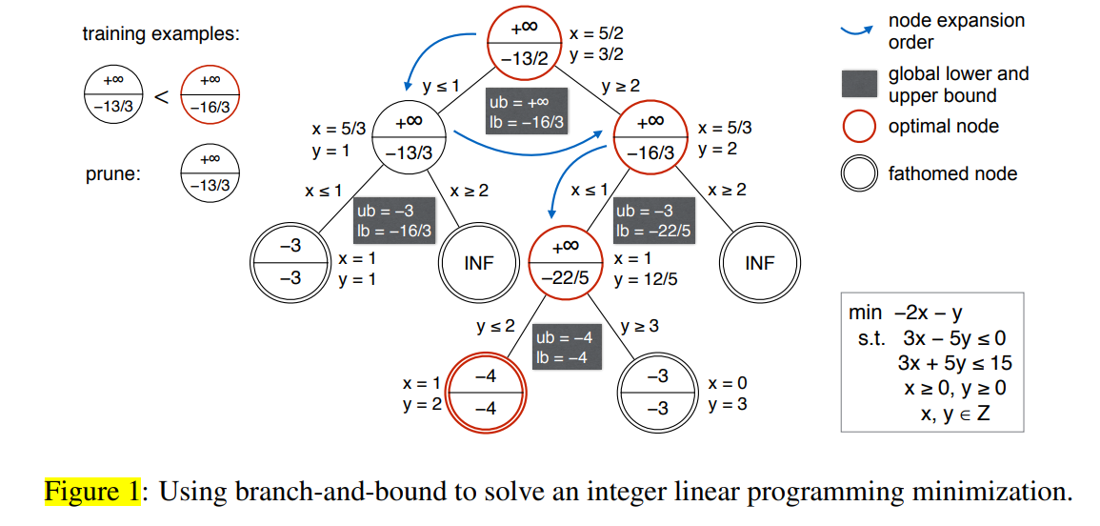





Background: Branch-and-bound (B&B) algorithm
Al-driven Optimization Methods
Stop
Initialize Root Node
Node
Selection
Process
(Solve LP Relaxation)
Variable Selection
(i.e., branching)
Variable selection (i.e., branching): choosing which variable to branch on at each node of the search tree.
  Existing branching strategies
    Most-infeasible branching: selects the variable with the largest fractional part.
    Strong branching: select the fractional variable that result in the best dual bound.
    Pseudocost branching: compare to strong branching, replace dual bound with an average derived from historical dual bounds observed in previous branchings.
Node selection: choosing which picking node (i.e., child LP problem) to solve
  Existing strategies: Depth-first/breadth-first search
The node to be selected if optimum is known
Leave node
Leave node
Figure credits to Huang et al. (2021)

Slide 27
ML enhances B&B algorithm
Al-driven Optimization Methods
Variable selection
  Learn to switch between existing strategies (Di Liberto et al. 2016)
  Learn to combine the scores returned by existing strategies (Balcan et al. 2018)
  Learn to mimic the strong branching strategy (Khalil et al. 2016, Alvarez et al. 2017, Gasse et al. 2019, Gupta et al. 2020, Gupta et al. 2022)
  Learn a novel branching strategy (Sun et al. 2020, Qu et al. 2022)
  Node selection
    Learn to mimic a theoretically optimal node selection strategy which knows the optimal solution in advance and only expands nodes containing the optimal solution.
    (He et al. 2014, Song et al. 2018, Labassi et al. 2022)
    Learn to mimic other heuristics that find (near-) optimal solutions (Yilmaz and Yorke-Smith 2021, Hottung et al., 2020)

