Slide 1



Backgrounds
Scenario: serving large MoE model, like DeepSeek v3 on Huawei’s CloudMatrix384
MoE 𝑛+1
Attention $n+1$
5
Mixture of Expert (MoE) models replace the traditional dense feed forward network (FFN) after attention with a router and experts.
After attention, a router computes which experts are best suited for the token.
The token is routed to such experts.
The experts apply their weights with a matrix multiplication.
Combine to form the single token again.
Continue to the next attention.
MoE output hidden states
+
4
3
1
2
3
4
N-3
N-2
N-1
N
MoE $n$
...
2
Router
1
Attention output hidden states
Attention $n$
MLA Attention

Slide 2
Model Parallelism
Some background on model parallelism:
Data parallel (DP): total number of attention modules running in parallel. Each NPU in DP will run one attention module.
Expert parallel (EP): total number of NPUs we allocate to MoE. Each NPU in EP will contain # experts // EP.
DP0
DP1
DP2
DP3
DP4
DP5
DP6
DP7
Attention in DP8
MoE waits for all DP to send then processes DP0-7 batches at once
EP0
0-31
EP1
32-63
EP2
64-95
EP3
96-127
EP4
128-159
EP5
160-191
EP6
192-223
EP7
224-255
Experts in EP8

Slide 3
Aggregated MoE Models
Attn L0D0
Attn L0D1
Attn L0D2
Attn L0D3
all-to-all distributed operation
All cards
MoE L0E0
MoE L0E1
MoE L0E2
MoE L0E3
for i in range(num_layers):
hidden_attn = attn(hidden_attn)
hidden_moe = send_recv_tensors(hidden_attn) # tensors for current EP rank
hidden_moe = moe(hidden_moe)
hidden_attn = send_recv_tensors(hidden_moe) # tensors for current DP rank
all-to-all
Attn L1D0
Attn L1D1
Attn L1D2
Attn L1D3
all-to-all
MoE L1E0
MoE L1E1
MoE L1E2
MoE L1E3
all-to-all
...
...
...
...
NPU 0
NPU 1
NPU 2
NPU 3

Slide 4
MA Disaggregation: benefits
MA disaggregation has better theoretical throughput than traditional aggregated deployments [1]
MA disaggregation can scale attention and MoE modules independently of each other
MA disaggregation allows for easy fault tolerance by allowing the system to remain running even through hardware failures
[1]: [2504.02263] MegaScale-Infer: Serving Mixture-of-Experts at Scale with Disaggregated Expert Parallelism

Slide 5
Disaggregated MoE Models
Attn L0D0
Attn L0D1
a2e group-to-group operation
Attention cards
for i in range(num_layers):
hidden_attn = recv_from_moe()
hidden_attn = attn(hidden_attn)
send_to_moe(hidden_attn)
MoE L0E0
MoE L0E1
e2a
Attn L1D0
Attn L1D1
MoE cards
for i in range(num_layers):
hidden_moe = recv_from_attn()
hidden_moe = moe(hidden_moe)
send_to_attn(hidden_moe)
a2e
MoE L1E0
MoE L1E1
e2a
...
...
...
...
NPU 0
NPU 1
NPU 2
NPU 3

Slide 6
Runtime Scenario
Serving a DeepSeek V3 model
1 NPU experiences a hardware failure
How to recover?
Naive method to restart entire serving instance is costly
  1-2 minutes to start the instance again
  Up to 13 minutes for graph mode compile
  System is down for 15 minutes!

Slide 7
Key Ideas
What if we do not restart the instance and take down the failed card?
  Several challenges:
    Need to handle communication domain restart
    Model weights need to be intact
    Graph mode
Ideas:
  For Attention Failure Scenario
    DP weights are replicated, losing 1 DP is okay
  For MoE Failure Scenario
    Losing a EP rank is not okay, but we can replace a missing EP with 1 DP
  Communication reinitialization:
    CPU comm (gloo): same comm domain, creating new groups
    NPU comm (XCCL): creating a new domain using a new ID
  Graph mode can be sped up by precompiling for failure scenario

Slide 8
Proposal
MoE Failure Scenario
Migrate requests
DP0
Multi-step plan:
Migrate requests from DP instances
Role switch DP -> EP (if EP failure)
Reinitialize communications
Start inference loop again
Cache compile
System is running again with 1 missing card.
DP1
DP2
DP3
Role switch
...
EP0
EP1

Slide 9
Running State
DP0
2. Scheduler snapshot state at every step using deepcopy
Scheduler
Forward Loop
1. Heartbeat report running state of each Executor. Exception thrown will trigger recovery.
Model Instance
DP1
Scheduler
Forward Loop
Engine
Model Instance
DP2
Scheduler
Forward Loop
Model Instance
EP0
Forward Loop
Model Instance

Slide 10
Attention Failure Scenario
DP0
6a
Scheduler
Forward Loop
2. Collect failed sequences from failed instance to executor. Failed sequences are a deep copy of sequences but prompt is now prompt_token_ids + output_token_ids (recompute way of migrating)
Model Instance
DP1
Scheduler
Forward Loop
Engine
Model Instance
1. Failure triggers exception on all executors. Forward loop cancelled on all executors.
3. Redistribute extra sequences to available MasterExecutors set in WAITING state
Send Ray commands:
4a. reinit communication in model instance on all executors.
5a. Restart MoEExecutor forward loop.
6a. Restore latest scheduler snapshot and delete old snapshots on MasterExecutors.
7a. Restart MasterExecutor forward loop.
DP2
Scheduler
Forward Loop
Model Instance
EP0
Forward Loop
Model Instance

Slide 11
Engine side: failure handling
def handle_npu_fail_in_master_executor(self, failed_idx: int):
logger.info('=======' * 10)
logger.info(f"START handle npu fail in master executor {failed_idx}")
t0 = time.time()
peer_master_idxs = [i for i in self.master_exec_idxs if i != failed_idx]
assert peer_master_idxs, "all MasterExecutors are dead"
with Timer("Cancelled forward tasks"):
ray.get([
exe.cancel_loop_in_background.remote()
for exe in self.master_execs + self.moe_execs
])
with Timer("Collected & redistributed failed sequences"):
failed_executor = self.get_execs_from_idxs([failed_idx])[0]
failed_seqs: List[Sequence] = ray.get(failed_executor.collect_failed_seqs.remote())
for i, seq in enumerate(failed_seqs):
peer_idx = peer_master_idxs[i % len(peer_master_idxs)]
seq.dp_group_index = peer_idx
self.request_list[peer_idx].append((RequestType.PREFILL, {"seq": seq}))
self.put_requests()
# Reinitialize comm group
affected_execs = self.get_execs_from_idxs(peer_master_idxs + self.moe_exec_idxs)
with Timer("Reinitialized comm group"):
ray.get([
exe.reinitialize_model_parallel.remote([failed_idx])
for exe in affected_execs
])
with Timer("Set default device"):
ray.get([exe.set_device.remote() for exe in affected_execs])
peer_master_execs = self.get_execs_from_idxs(peer_master_idxs)
with Timer("Restarted moe forward loop"):
ray.get([exe.start_loop_in_background.remote() for exe in self.moe_execs])
with Timer("Restored snapshot"):
ray.get([exe.restore_snap.remote() for exe in peer_master_execs])
with Timer("Restarted peer master loops"):
ray.get([exe.start_loop_in_background.remote() for exe in peer_master_execs])
self.manager[failed_idx].executors[0].stop_all.remote(is_blocking=False) # this release NPU memory in background
logger.info(f"[{(time.time() - t0) * 1000:.1f}ms] DONE! handle npu fail exception")
logger.info('=======' * 10)
Redistribute failed requests to other MasterExecutors
Create new GLOO groups, reinitialize XCCL, change gating

Slide 12
MasterExecutor side: collect failed sequences
def collect_failed_seqs(self):
from itertools import chain
all_seqs=[]
reqs:List[Tuple[RequestType, Dict]] = self._request_queue.dequeue_all_no_block()
for req_type, req_dict in reqs:
if 'seq' not in req_dict:
continue
seq:Sequence=req_dict['seq']
all_seqs.append(seq)
logger.info(f"Added seq from request queue: {seq}")
for seq in self._scheduler.waiting:
all_seqs.append(seq)
logger.info(f"Added seq from scheduler.waiting: {seq}")
batch = self._scheduler.batch_tracker
# for seq in chain.from_iterable(batch.prefills):
# logger.info(f'find in batch.prefills {seq}')
# all_seqs.append(seq)
for batch in batch.batches:
for seq in batch.running:
# by creating new_seq, the seq state will change from running to waiting
new_seq = Sequence(
request_id=seq.request_id,
seq_id=seq.seq_id,
arrival_time=seq.arrival_time,
params=seq.sampling_params or seq.pooling_params,
prompt=seq.prompt+seq.output_text, # TODO output_text is not updated, pls read /data/xinglu/ma-recovery/src/inference/flow_serve/flow_serve/model_executor/tokenizer/tokenizer.py and update
prompt_token_ids=seq.data.prompt_token_ids+seq.data.output_token_ids,
block_size=seq.block_size,
dp_group_index=seq.dp_group_index,
multi_modal_data=seq.multi_modal_data,
lora_request=seq.lora_request,
context_caching_handle=seq.context_caching_handle,
constrained_processor=seq.constrained_processor
)
logger.info(f'create {new_seq} from {seq}')
# new_seq=seq
all_seqs.append(new_seq)
for seq in all_seqs:
seq.status = SequenceStatus.WAITING
# seq.data.set_stage_to_prefill()
return all_seqs
Keep currently generated decode tokens

Slide 13
Result: Time of Fast-recovery method is smaller than TPOT
5 layers R1 w8a8 model
Init the system, time: ~30s
After a warmup batch,
  TPOT: 0.11867598179847966 s
  TTFT: 0.12845162936719134 s
Handle NPUFailure on Attention side
Handle NPUFailure on Moe side
 | 操作说明 | 耗时
1 | Cancelled moe forward tasks | 2.1ms
2 | Cancelled master loops | 1.5ms
3 | Reinitialized comm group | 6.5ms
4 | Collected & redistributed sequences | 2.8ms
5 | Set default device | 1.3ms
6 | Started receiver/sender | 2.0ms
7 | Restarted moe forward loop | 1.9ms
8 | Restored master snapshot | 1.1ms
9 | Restarted peer master loops | 5.6ms
总计 |  | 30.0ms
 | 操作说明 | 耗时(ms)
1 | Cancelled forward tasks | 1.9
2 | Reinitialized comm group Added print comm group name to avoid hccl error Included other steps, e.g., reset default device | 106.7ms
3 | Switch master exec to moe exec | 6400.7ms
4 | Started receiver/sender | 3.4
5 | Restarted peer moe forward loop | 1.6
6 | Restored master snapshot | 1.5
7 | Restarted master executor loops | 1.2
总计 |  | 6518.6ms

Slide 14
Timings
DP=16, EP=128, 144 die 9 nodes, 61 layers R1 w8a8 model, bsz per die=16
Step | DP Failure Case (ms) | EP Failure Case (ms)
Cancel Forward Loop | 21.5 | 21.2
Migrate Requests | 9.2 | 10.0
Role Switch | - | 725.5
Reinitialize Communication Groups (gloo) | 3638.8 | 3459.6
Initialize model and weight load | - | 45104.0
Reinitialize XCCL | 3037.3 | 1126.5
Set default device | 24.3 | 23.3
Set cache compile | 452.8 | 446.5
Restart MoE Forward Loop | 17.0 | 20.7
Restore Executor Snapshot | 4.3 | 4.9
Restart Attn Forward Loop | 3.9 | 4.4
Cache Compile Att | 4105.3 – 6114.5 | 4105.1 – 5738.0
Cache Compile MoE | 699.0 – 1333.7 | 697.7 – 1233.8
Total | 11314.4 - 13323.6 | 53925.2 - 55558.1
0 if using redundant experts
Parallel
Parallel

Slide 15
Appendix

Slide 16
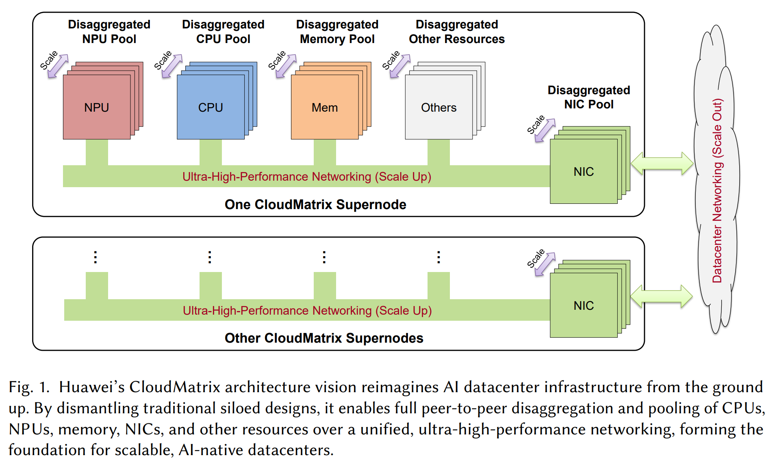
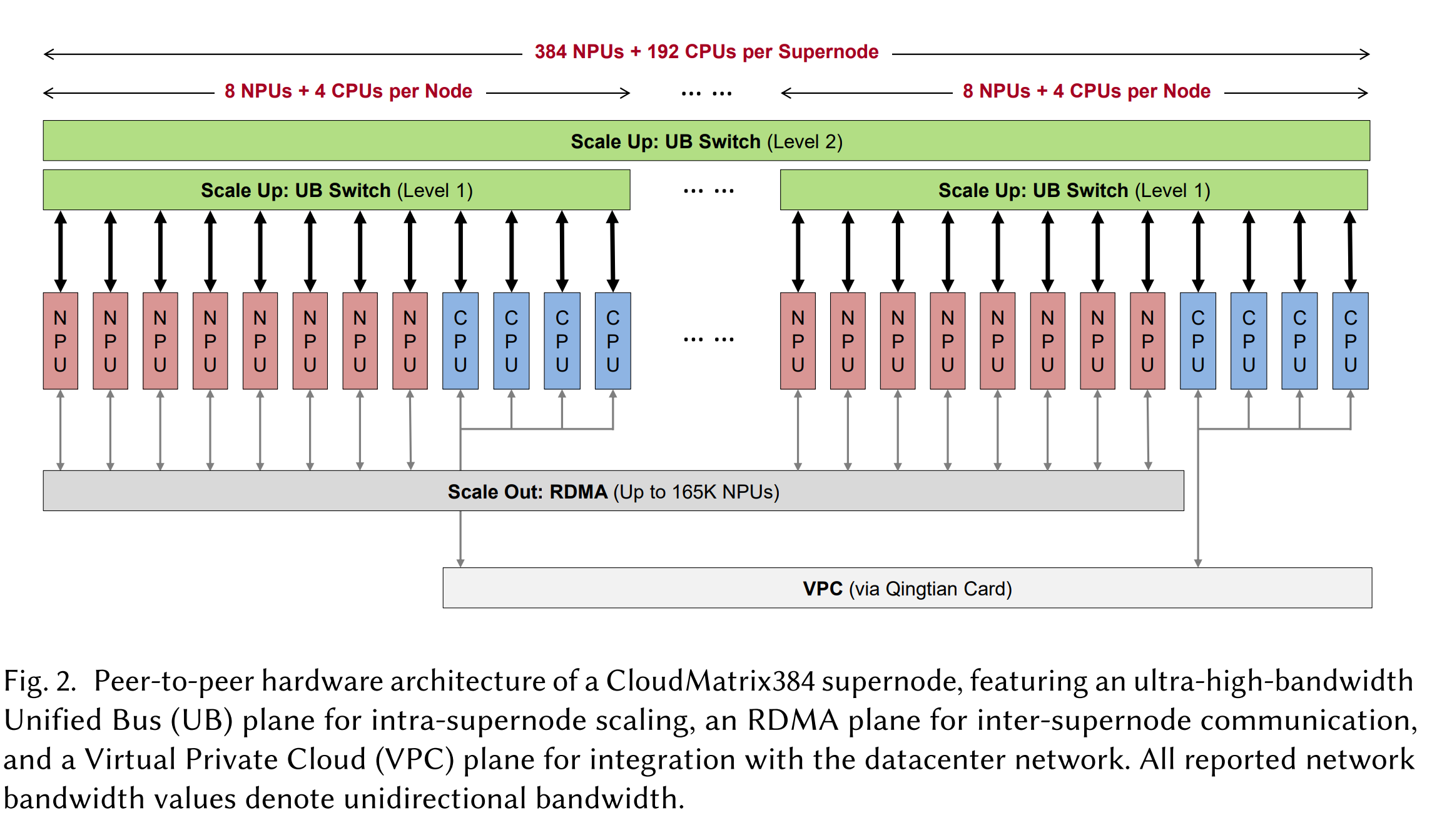
CloudMatrix384 Background
CloudMatrix384 is Huawei’s next generation AI datacenter infrastructure [1]. It connects high-performance hardware needed for AI inference into supernodes.
Large NPU and CPU pool + high bandwidth/low latency unified bus network for large AI deployments
[2506.12708] Serving Large Language Models on Huawei CloudMatrix384

Slide 17


Software Stack
Attn Executor 0
XCCL a2e + e2a
MoE Executor 0
Software Used
Attn Executor 1
MoE Executor 1
Docker: for containerizing our deployment and having everything preinstalled
XDS/flowserve: our model code, engine, scheduler
Ray: form communication domain between NPUs and run executors
XCCL: high performance communications library for a2e and e2a operations
...
...
Attn Executor 15
MoE Executor 15
XDS
flowserve
Server 1
Server 4
Attention servers x3
MoE servers x18

Slide 18
MoE disaggregation benefit: Throughput by Microbatching
Without microbatching, aggregated needs to wait between communication
Compute
A0
M0
A1
M1
Aggregated
Comm
Time
MA makes it easy to split a batch into microbatches, so when attention finishes a microbatch, it can immediately start another
Attention
A0
A0
A0
A0
A1
A1
A1
A1
MA Disaggregated
A to M
MoE
M0
M0
M0
M0
M1
M1
M1
M1
M to A
Time

Slide 19
Attention Failure Scenario
Master Executor
MoE Executor
Failure detection polling,
request routing
r0
NPU0
NPU4
Master Executor
MoE Executor
Engine
r1
NPU1
NPU5
Master Executor
MoE Executor
r2
NPU2
NPU6
Master Executor
MoE Executor
r3
NPU3
NPU7
G2G
Comm
Start recovery: Engine polling detects failure and initiates recovery

Slide 20
Attention Failure Scenario
Master Executor
MoE Executor
Failure detection polling,
request routing
r0
NPU0
NPU4
r3
Master Executor
MoE Executor
Engine
r1
NPU1
NPU5
Master Executor
MoE Executor
r2
NPU2
NPU6
Master Executor
MoE Executor
failed requests
NPU3
NPU7
G2G
Comm
Recovery steps:
Reinitialize communication so G2G will work by removing NPU3 from parallel state
Abort requests from failed MasterExecutor and redistribute to other executors

Slide 21
Attention Failure Scenario
Master Executor
MoE Executor
Failure detection polling,
request routing
r0
NPU0
NPU4
r0
Master Executor
MoE Executor
Engine
r1
NPU1
NPU5
Master Executor
MoE Executor
r2
NPU2
NPU6
MoE Executor
NPU7
G2G
Comm
Recovery steps:
Reinitialize communication so G2G will work by removing NPU3 from parallel state
Abort requests from failed MasterExecutor and redistribute to other executors
Remove executor

Slide 22
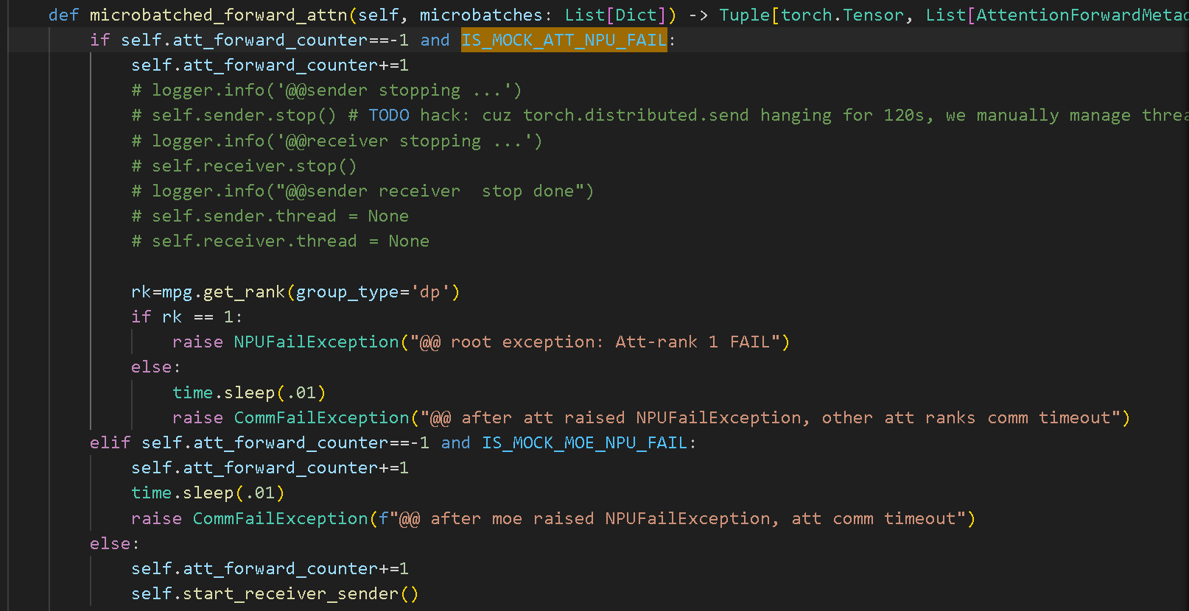
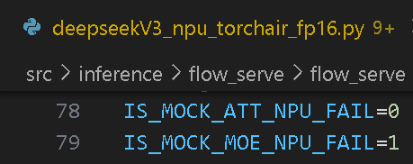
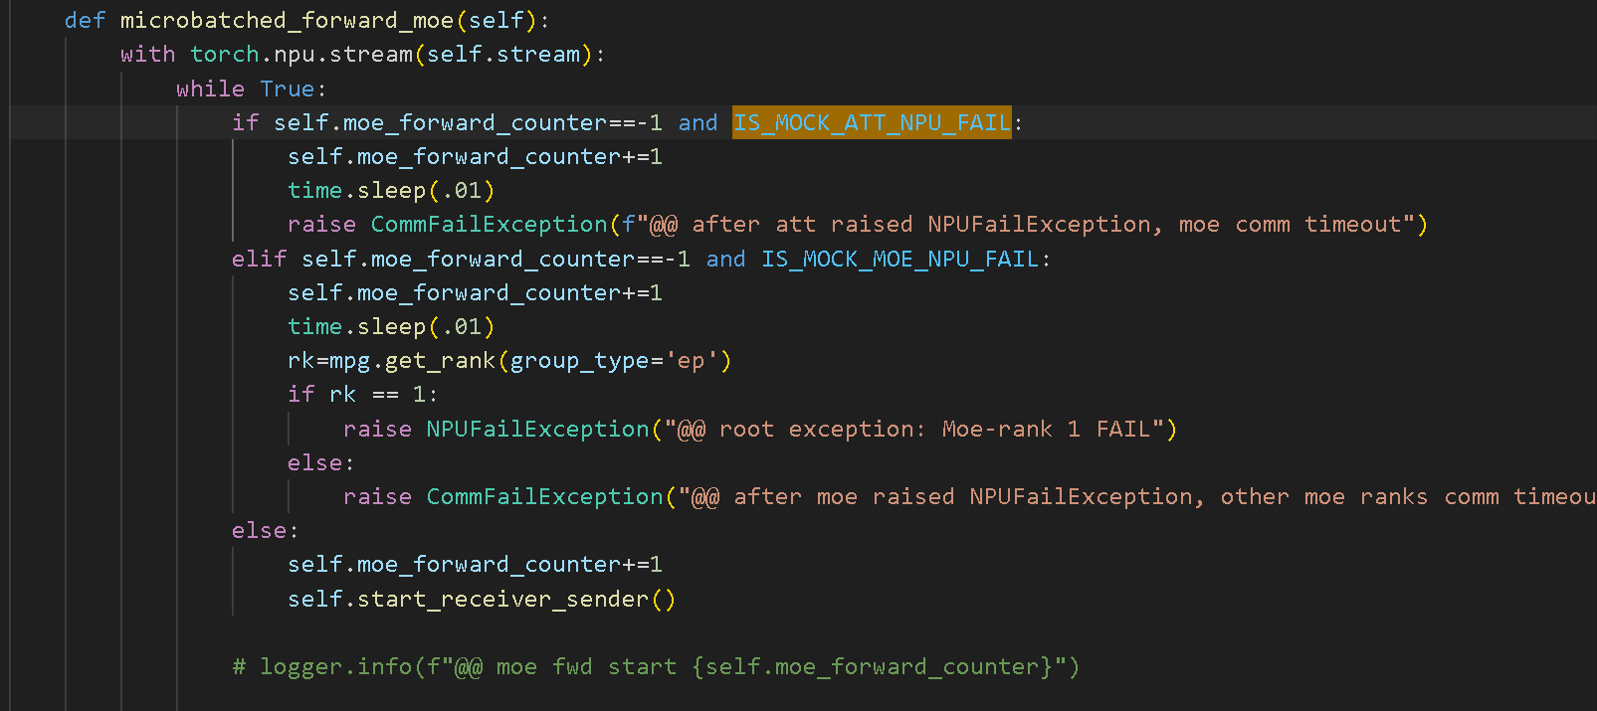
Mock NPU Failure
NPUFailure on Attention side
Rank 1: root exception
Rank 0,2,3: CommException that follows

Slide 23
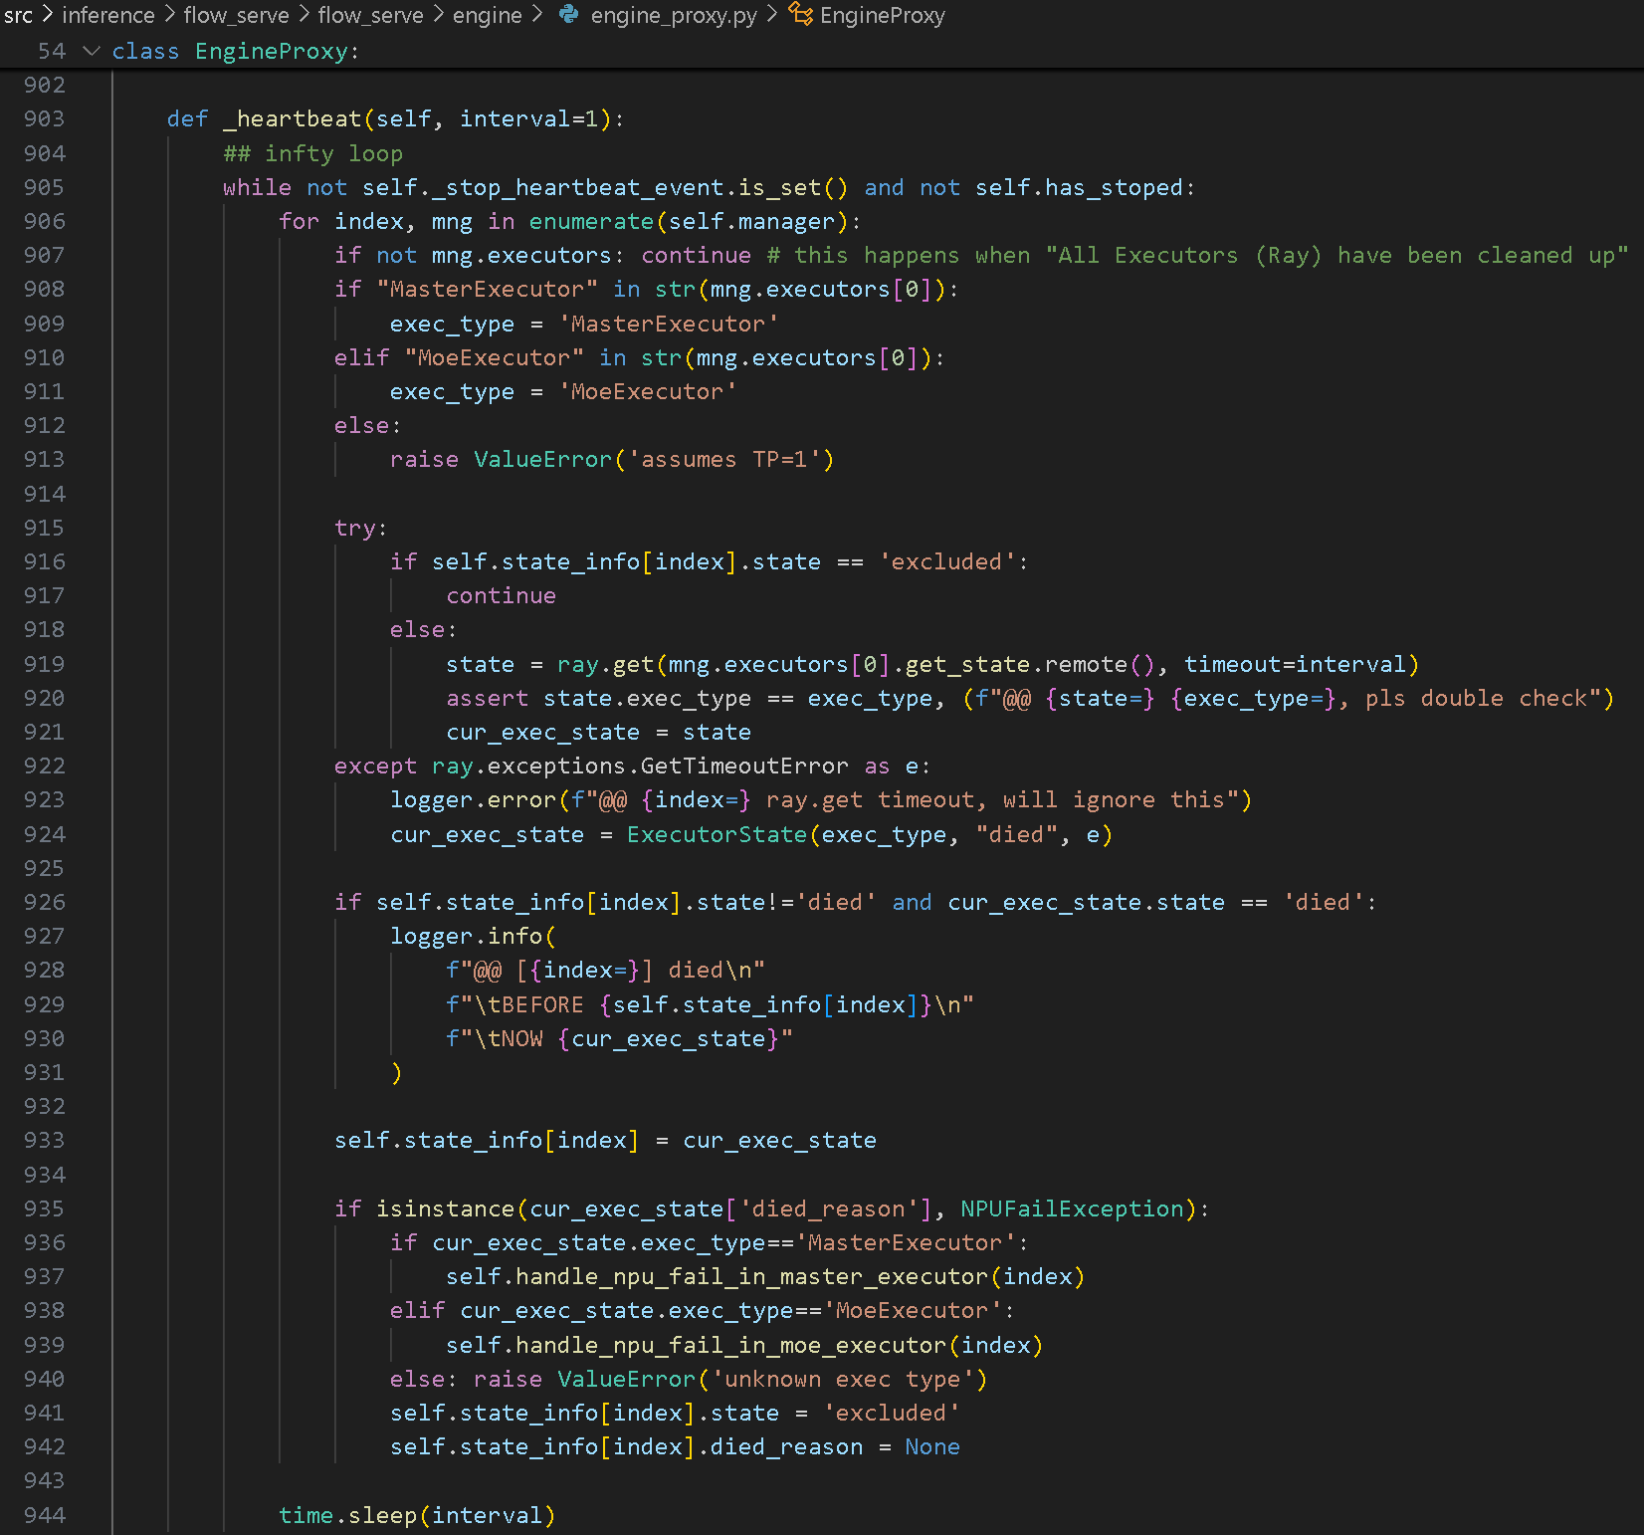
Heartbeat

Slide 24
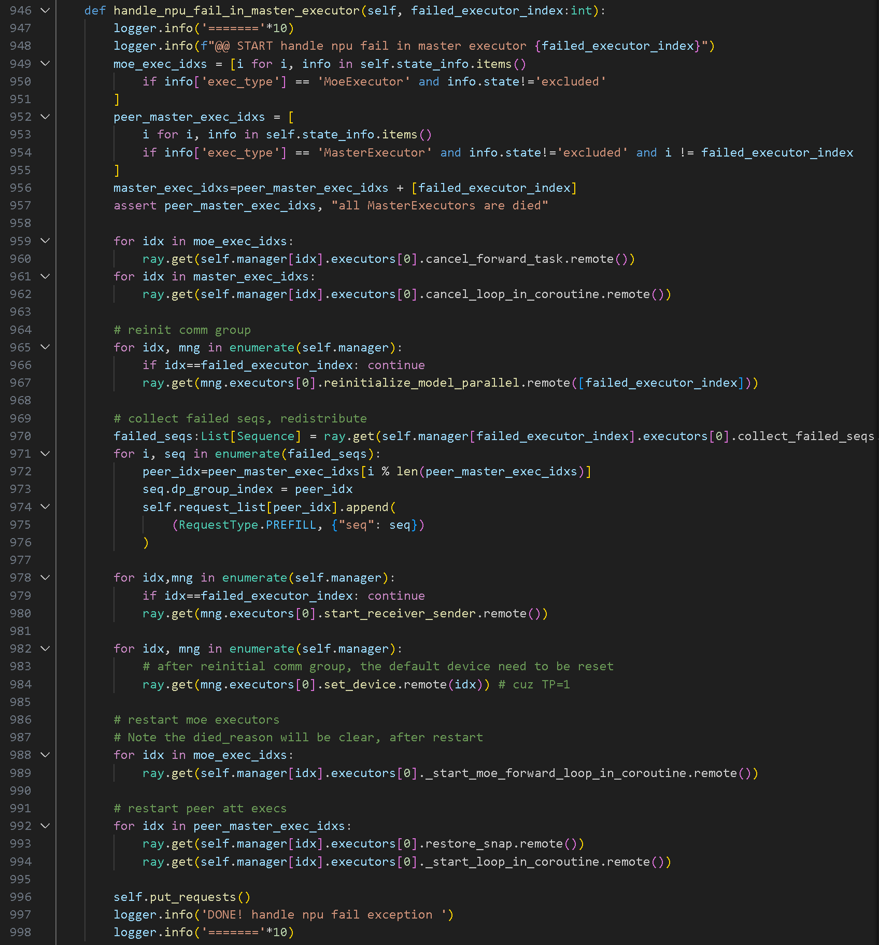
Handle NPUFailure on Attention side, steps:
Stop the loop for all executors
Reinitialize communication
Abort requests from failed MasterExecutor and redistribute to other executors
Reset the default device, because after previous step, it was set to NPU:0
Restore snapshot for unfailed MasterExecutor
  Prioritized the requests from previous iter
Restart loop for all executors
Each iter in loop of MasterExecutor
  Snapshot ~3ms
    RtcEngine deepcopy took ~2ms

Slide 25
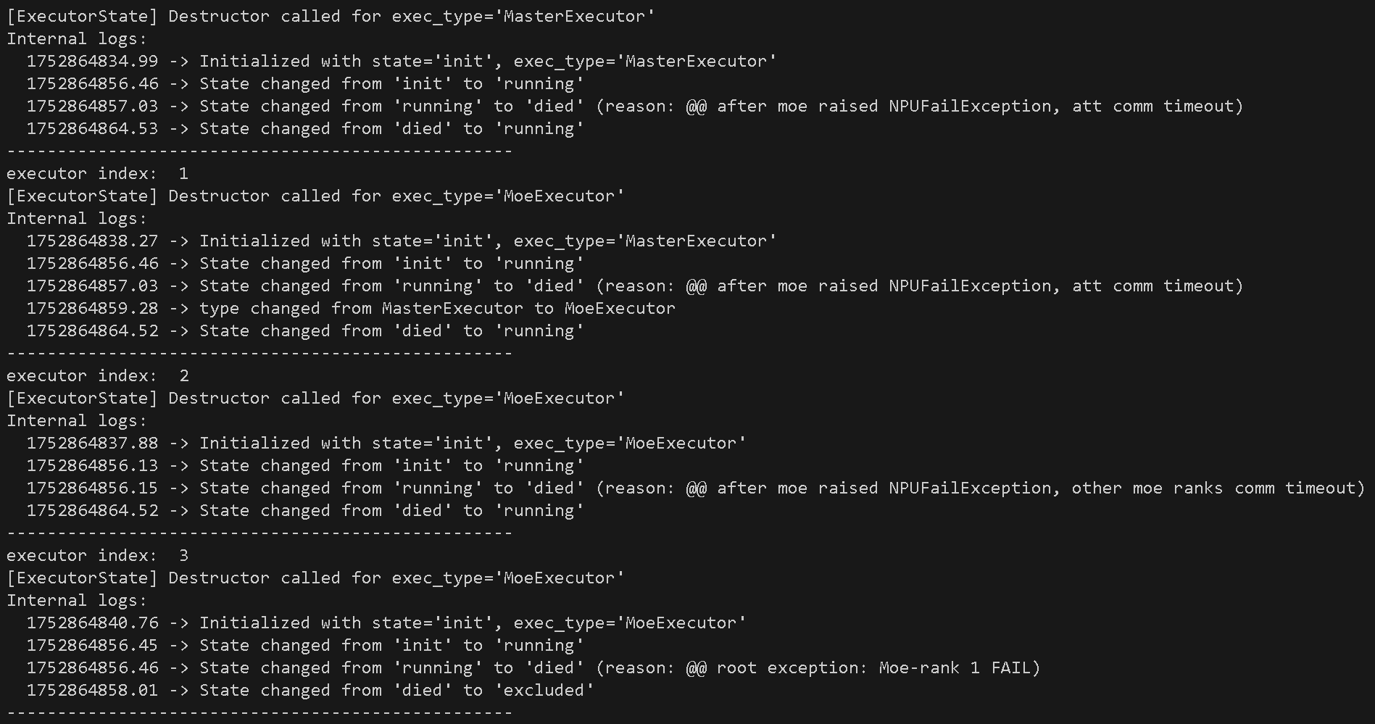

Slide 26
Hacks:
Exception raised at beginning of moe and att forward (need HQ provided no-block version of XCCL)
sender recvr thread is postponed start (no this thread in graph mode)
For MoE side, not yet implement moving Att module
  Switch ray.actor[MasterExecutor] to ray.actor[MoeExecutor]. Not kill-then-instantiate, because cannot torch.distributed.init_process_group again after destroy_process_group
    Make sure NPU memory is released
    Create a ProxyExecutor class that holds references to both executors. It delegates work to the currently active executor and allows switching between them at runtime.
    In new EP comm group, allow arbitrary NPUs and order, instead of “last half NPUs assigned to MOE” assumption
    Apart from executor initialization, check whether any code in engine level break above assumption
    Note: not well tested, e.g., other device_idxs fail/switch

Slide 27
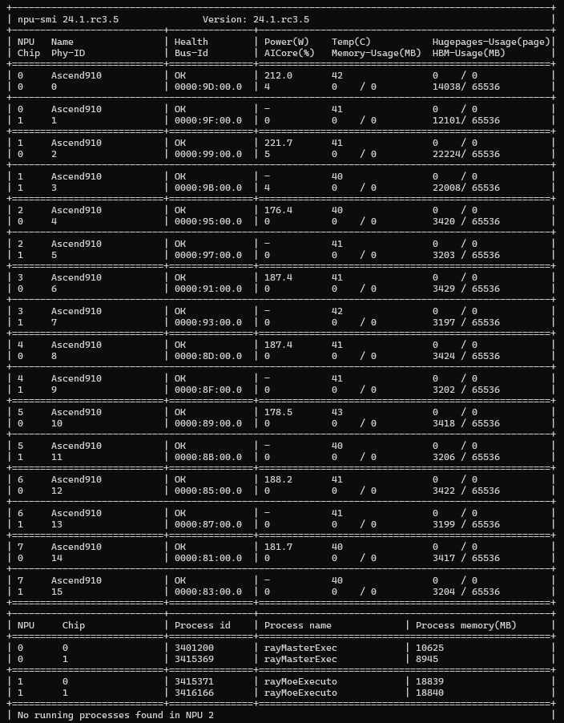
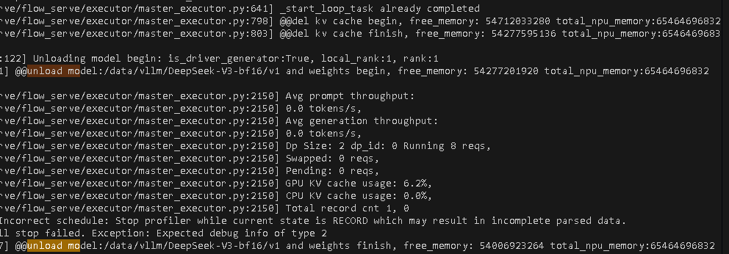
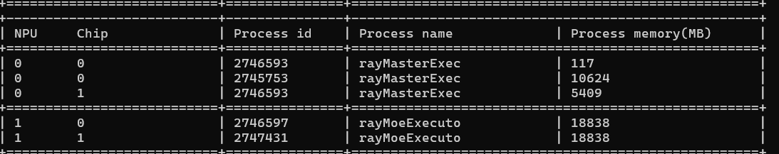
    Make sure NPU memory is released

Slide 28
MoE Failure Scenario
Master Executor
MoE Executor
Failure detection polling,
request routing
r0
NPU0
NPU4
Master Executor
MoE Executor
Engine
r1
NPU1
NPU5
Master Executor
MoE Executor
r2
NPU2
NPU6
Master Executor
MoE Executor
r3
NPU3
NPU7
Start recovery: Engine polling detects failure and initiates recovery

Slide 29
MoE Failure Scenario
Master Executor
MoE Executor
Failure detection polling,
request routing
r0
NPU0
NPU4
r3
Master Executor
MoE Executor
Engine
r1
NPU1
NPU5
Master Executor
r2
NPU2
Master Executor
MoE Executor
NPU3
NPU7
Recovery steps:
Reinitialize communication without NPU3 and NPU6
Migrate requests from NPU3 and remove its executor
Reinitialize communication so that system keeps running missing an MoE rank

Slide 30
MoE Failure Scenario
Master Executor
MoE Executor
Failure detection polling,
request routing
r0
NPU0
NPU4
Master Executor
MoE Executor
Engine
r1
NPU1
NPU5
Master Executor
r2
NPU2
MoE Executor
NPU7
Recovery steps:
Reinitialize communication so G2G will work by removing NPU3 from parallel state
Migrate requests from NPU3
Reinitialize communication so that system keeps running missing an MoE rank
Change NPU3 to MoE and load weights
MoE Executor
NPU3

Slide 31
MoE Failure Scenario
Master Executor
MoE Executor
Failure detection polling,
request routing
r0
NPU0
NPU4
Master Executor
MoE Executor
Engine
r1
NPU1
NPU5
Master Executor
r2
NPU2
MoE Executor
Recovery steps:
Reinitialize communication so G2G will work by removing NPU3 from parallel state
Migrate requests from NPU3
Reinitialize communication so that system keeps running missing an MoE rank
Change NPU3 to MoE and load weights
Reinitialize communication when NPU3 is done to put experts back into use
NPU7
MoE Executor
NPU3

