Slide 1

Exploring the Synergies Between Operations Research and Machine Learning
Ph.D. Thesis Defence
Xinglu Wang
Examining Committee:
Dr. Jian Pei, Co-supervisor
Dr. Jiannan Wang, Co-supervisor
Dr. Tianzheng Wang, Committee Member
Dr. Wuyang Chen, Internal Examiner
Dr. Wei Wang, External Examiner
Dr. Jiangchuan Liu, Chair
School of Computing Science
Simon Fraser University

Slide 2

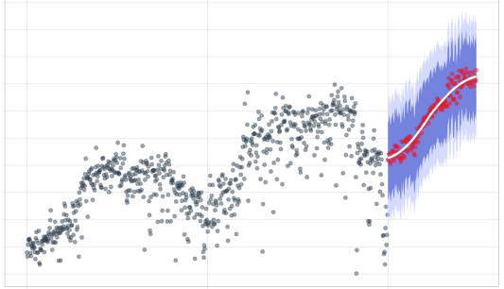
Two powerful problem-solving tools
Figure 1 Production planning
Figure 2 Time series prediction
Operations Research (OR)
Machine Learning (ML)
OR is a scientific approach to decision-making that seeks to operate a system optimally, usually under constraints and scarce resources. (Winston, 2004)
ML allows computers to learn from data without being explicitly programmed. (Goodfellow et al., 2016)

Slide 3
Bottlenecks in the OR process?
OR follows a standard pipeline widely used in industrial applications
A typical OR process (Rajgopal et al., 2024)
Math Program Formulation
Problem Identification
Solution Methods
lnterpretation
& Validation
Problem Identification
Solution Methods
lnterpretation
& Validation
Parameter Generation
Parameter Generation
Real-world problems are increasingly complex.
Complexity may introduce inefficiencies in certain stages.
Can ML be leveraged to enhance efficiency of these stages?

Slide 4

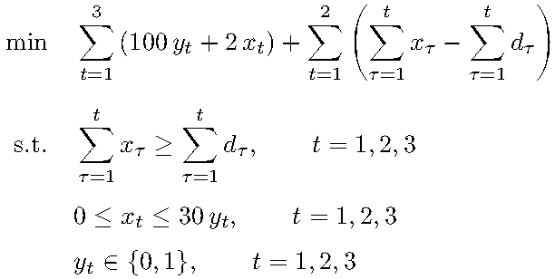

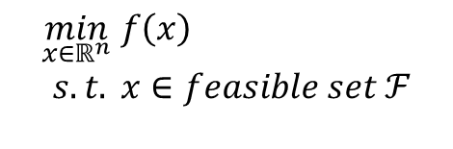
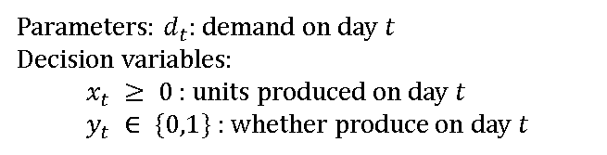
Inefficiency in the Formulation stage
Math Program
Opportunity:
Formulation experience
Problem:
Product Planning
A factory can produce up to 30 boxes of apple slices per day. Given user demands over a planning horizon, please decide daily production quantities to satisfy all demands on time, while minimizing total machine setup, production, and inventory carryover costs.
Parameters: $d_{t}:$ demand on day $t$
Decision variables:
  $x_{t} ≥ 0$: units produced on day $t$
  $y_{t} ∈ \{0,1\}$ : whether produce on day $t$
Descriptions of problem instances
$$\begin{aligned}\min_{x∈ℝ^{n}} & f\left(x\right) \\ s.t.& x∈feasible set ℱ \\ &\end{aligned}$$
Known parameters:
Demands on 3 days
Daily Capacity
20, 30, 1
30 Boxes
Setup Cost
Production Cost
$100 / Day
$2 / Box
Inventory Carryover
Carryover Cost
Programs
Allowed
$1 / Box / Day
Challenge in modeling efficiency

Slide 5
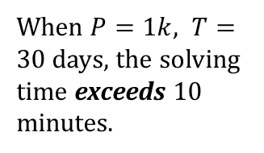
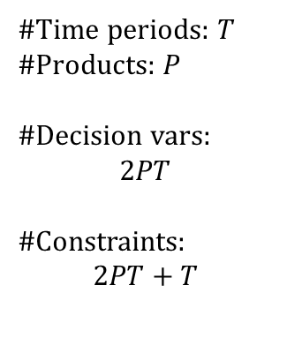
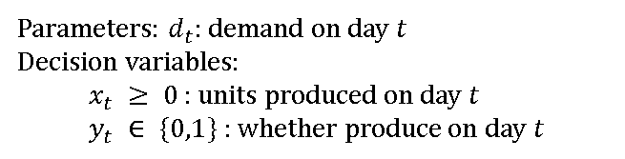
Inefficiency in the Solution stage
Math Program
Opportunity: Solving experience
Program size
Parameters: $d_{t}:$ demand on day $t$
Decision variables:
  $x_{t} ≥ 0$: units produced on day $t$
  $y_{t} ∈ \{0,1\}$ : whether produce on day $t$
#Time periods: $T$
#Products: $P$
#Decision vars:
$$2PT$$
#Constraints:
$$2PT+T$$
Demands=[20,30,1]
Programs
Demands=[20,30,2,
10,10]
Solutions
When $P=1k, T=30$ days, the solving time exceeds 10 minutes.
Challenge in computational efficiency (solving)

Slide 6


Thesis Overview
ML for OR
OR
ML
Learns from experience
[ICML’2023]
Q1. Past solving experience → learn to speed new solves?
… …
Challenge in Computational efficiency
Solution Methods
Math Program Formulation
Challenge in Modeling efficiency
[COLING’2024]
… …
Q2. Auto-formulation via Large Language Models (LLMs); How to evaluate?
OR Process

Slide 7



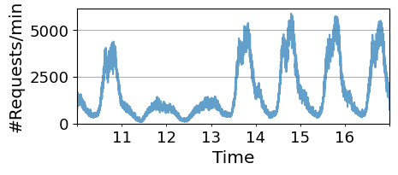
Bottlenecks in the ML lifecycle?
Large language model (LLM) serving
Requests
…
A simplified ML lifecycle (De Silva et al., 2022)
Problem Identification
Data Preparation
Model Training & Evaluation
Deployment & Serving
Problem Identification
Data Preparation
Model Training & Evaluation
Deployment & Serving
Dispatch
Serving system
…
Instance 1
Instance 2
Heterogeneous Workloads
Time-Varying Workloads
Application
Request rate of a Chatbot app in a week
Workload
Requirement
Summarizer
Offline, response in 24 hours
Heavy
ChatBot
Response 1 token every 50 ms
Light
Fri Sat Sun Mon Tue Wed Thu

Slide 8

Thesis Overview
ML for OR
OR
ML
Learns from experience
System-level optimization
[ICML’2023]
Q1. Past solving experience → learn to speed new solves?
OR for ML
… …
Challenge in Computational efficiency
Solution Methods
(In Submission, OSDI)
… …
Q3. OR-inspired efficient serving strategy?
Math Program Formulation
Deployment & Serving
Challenge in Modeling efficiency
Challenge in System efficiency
[COLING’2024]
… …
… …
Q2. Auto-formulation via Large Language Models (LLMs); How to evaluate?
OR Process
ML Lifecycle

Slide 9
Roadmap
Introduction
To answer the three research questions:
  Smart initial basis selection for linear programs [ICML’ 23]
  ML enhances OR
  Towards human-aligned evaluation for linear programming word problems [COLING’ 24]
OR enhances ML
  HFX: Joint Design of Algorithms and Systems for Multi-SLO Serving and Fast Scaling (In Submission, OSDI)
Conclusion and future directions

Slide 10

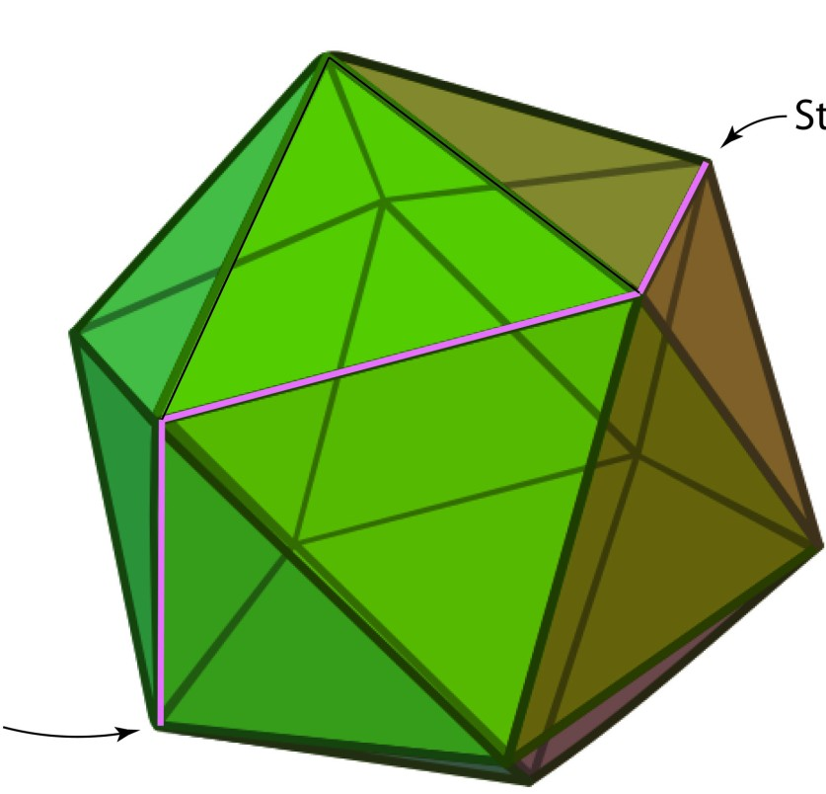


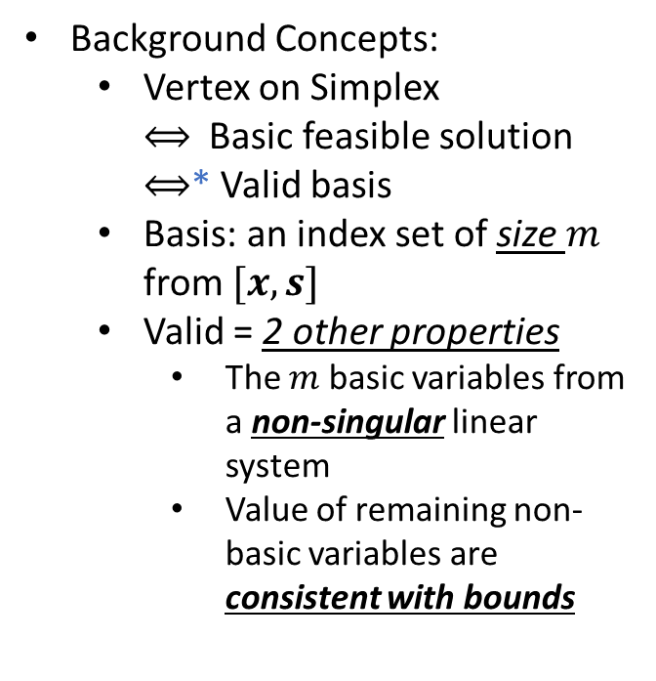
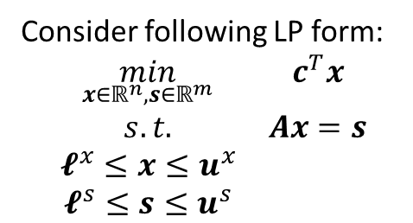
Scope and background
Past solving experience → learn to speed new solves?
Q1
A typical OR process
Math Program Formulation
Background Concepts:
  Vertex on Simplex
  $⟺$Basic feasible solution
  $⟺$* Valid basis
  Basis: an index set of size $m$ from $[x,s]$
  Valid = 2 other properties
    The $m$ basic variables from a non-singular linear system
    Value of remaining non-basic variables are consistent with bounds
Problem Identification
Solution Methods
lnterpretation
& Validation
Parameter Generation
Consider following LP form:
$\begin{matrix}\min_{x∈ℝ^{n},s∈ℝ^{m}} & c^{T}x \\ s.t. & Ax=s \\ 𝓵^{x}≤x≤u^{x} & \\ 𝓵^{s}≤s≤u^{s} & \end{matrix}$
Solving linear programs --- Simplex algorithm
Rule-based initial basis selection strategy → ML-enhanced strategy
Optimum
Figure 1 Illustration of Simplex algorithm
Initialization
* Comment: Refer to Link for details about
  Valid basis → Basic infeasible solution → Find a basic feasible solution

Slide 11
Problem definition
Given historical solving experience (LP problem v.s. its optimal basis), learn a mapping: a new LP instance → a close-to-optimal basis.
Challenge: This mapping should have following properties
  Handle LPs of varying sizes (#constraints and #decision variables)
  Permutation equivariance.
  Output a valid basis.
11

Slide 12
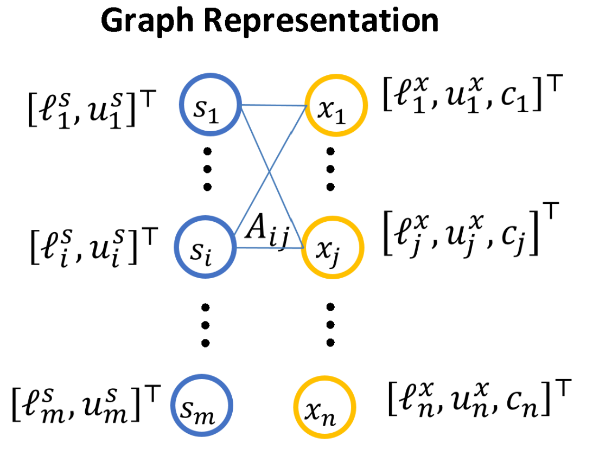



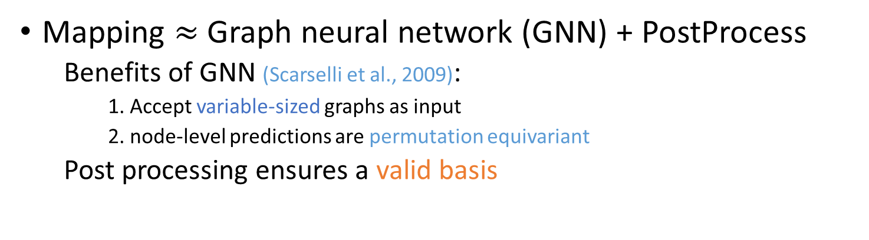












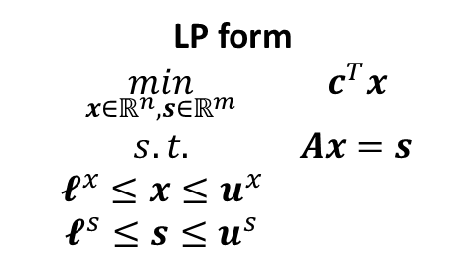



Method design
Mapping $≈$ Graph neural network (GNN) + PostProcess
  Benefits of GNN (Scarselli et al., 2009):
    1. Accept variable-sized graphs as input
    2. node-level predictions are permutation equivariant
  Post processing ensures a valid basis
Message passing
$$s_{1}$$
$$x_{1}$$
$$s_{1}$$
$$x_{1}$$
…
…
…
…
$$A_{ij}$$
$$s_{i}$$
$$A_{ij}$$
$$x_{j}$$
$$s_{i}$$
$$x_{j}$$
…
…
…
…
$$s_{m}$$
$$x_{n}$$
$$s_{m}$$
$$x_{n}$$
LP form
$\begin{matrix}\min_{x∈ℝ^{n},s∈ℝ^{m}} & c^{T}x \\ s.t. & Ax=s \\ 𝓵^{x}≤x≤u^{x} & \\ 𝓵^{s}≤s≤u^{s} & \end{matrix}$
Convert
GNN
basis status probability vectors
Probability vector for $s_{1}$
Probability
Constraint nodes
Variable nodes
$$s_{1}=ℓ_{1}^{s}$$
$$s_{1}=u_{1}^{s}$$
12
$s_{1}$ is basic

Slide 13
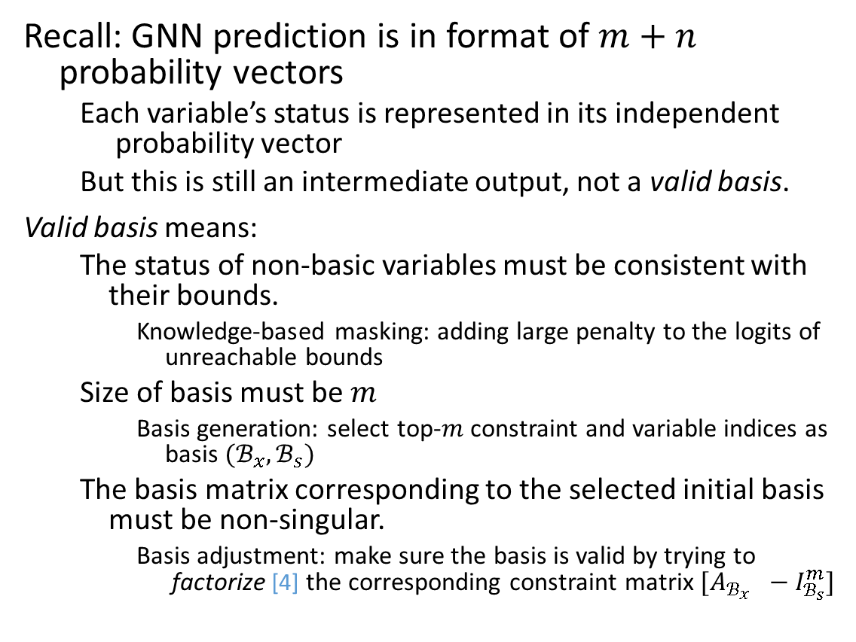
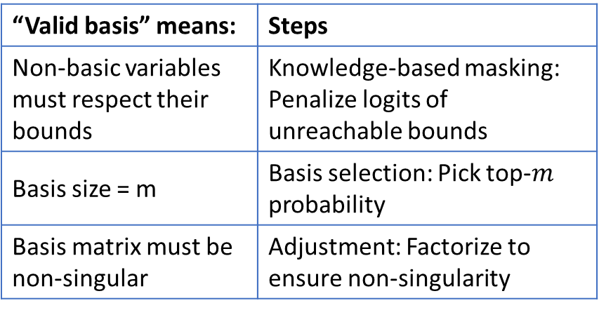
Method: Post process: output a valid basis
Recall: GNN prediction is in format of $m+n$ probability vectors
  Each variable’s status is represented in its independent probability vector
  But this is still an intermediate output, not a valid basis.
Valid basis means:
  The status of non-basic variables must be consistent with their bounds.
    Knowledge-based masking: adding large penalty to the logits of unreachable bounds
  Size of basis must be $m$
    Basis generation: select top-$m$ constraint and variable indices as basis $(ℬ_{x},ℬ_{s})$
  The basis matrix corresponding to the selected initial basis must be non-singular.
    Basis adjustment: make sure the basis is valid by trying to factorize [4] the corresponding constraint matrix $[A_{ℬ_{x}} −I_{ℬ_{s}}^{m}]$
“Valid basis” means: | Steps
Non-basic variables must respect their bounds | Knowledge-based masking: Penalize logits of unreachable bounds
Basis size = m | Basis selection: Pick top-$m$ probability
Basis matrix must be non-singular | Adjustment: Factorize to ensure non-singularity
[4] Bixby, R. E. and Saltzman, M. J. Recovering an optimal LPbasis from an interior point solution. Oper. Res. Lett., 15(4):169–178, 1994.

Slide 14
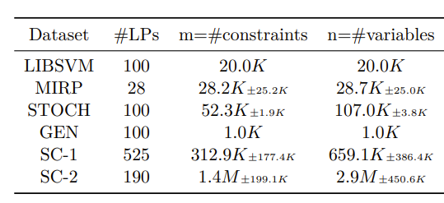
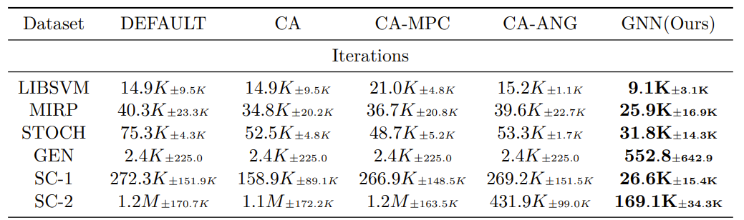
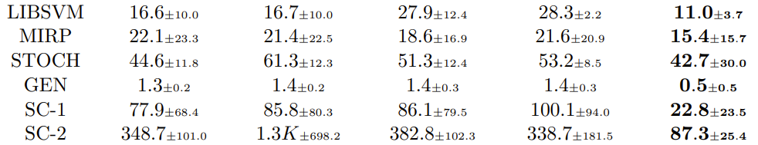
Experiment: Does GNN predicted basis provide effective warm-start?
Setup
  Dataset: open-sourced and private large-scale ones
  Optimization Solvers: open-source HIGHS and commercial OptVerse
  Baselines: Default and traditional (CA / CA-MPC / CA-ANG) initial-basis strategies
Table 1 Dataset statistic
Table 2 Performance comparison between the GNN and baselines strategies, measured by the Number of Solver Iterations.

Slide 15
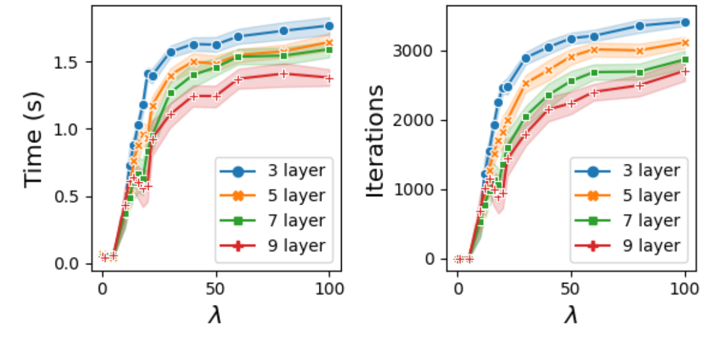
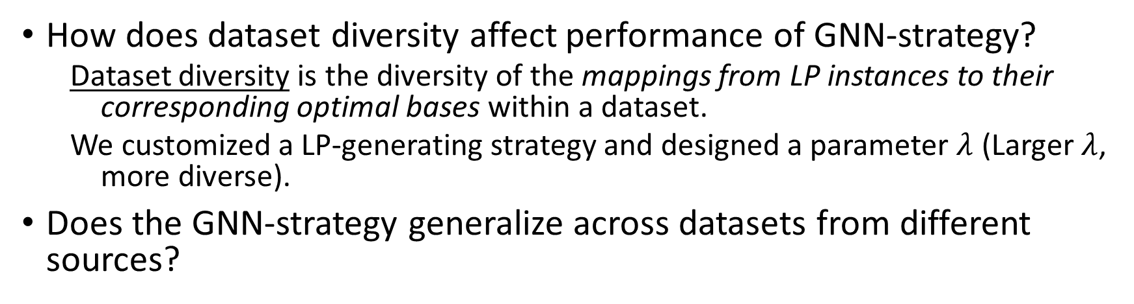
Experiment: limitations
How does dataset diversity affect performance of GNN-strategy?
  Dataset diversity is the diversity of the mappings from LP instances to their corresponding optimal bases within a dataset.
  We customized a LP-generating strategy and designed a parameter $λ$ (Larger $λ$, more diverse).
Does the GNN-strategy generalize across datasets from different sources?
Target Source | LIBSVM | MIRP | STOCH | GEN | SC-1 | SC-2
LIBSVM | 0.8 | 1.1 | 2.1 | 1.8 | 1.8 | 2.5
MIRP | 1.1 | 0.7 | 1 | 3.5 | 1.2 | 1.2
STOCH | 1 | 1.6 | 0.9 | 0.7 | 1.7 | 3.9
GEN | 2 | 1.1 | 2.1 | 0.1 | 3.1 | 7.4
SC-1 | 1.2 | 0.8 | 3.1 | 1.1 | 0.3 | 0.3
SC-2 | 1 | 1 | 1.2 | 1 | 0.6 | 0.3

Slide 16
Roadmap
Introduction
To answer the three research questions:
  Smart initial basis selection for linear programs [ICML’ 23]
  ML enhances OR
  Towards human-aligned evaluation for linear programming word problems [COLING’ 24]
OR enhances ML
  HFX: Joint Design of Algorithms and Systems for Multi-SLO Serving and Fast Scaling (In Submission, OSDI)
Conclusion and future directions

Slide 17
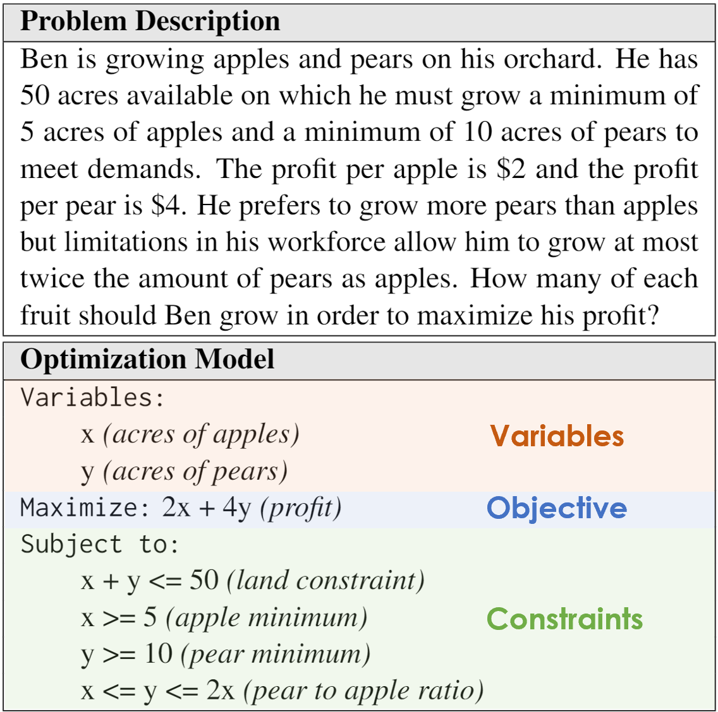

Scope
Problem description
A typical OR process
Expertor LLM
Math Program Formulation
Math program
(in variables-objective-constraint format)
Problem Identification
Solution Methods
lnterpretation
& Validation
Parameter Generation
Formulation often requires expert experience. With the emerge of LLMs, non-experts can utilize it to generate formulations now. (Fan et al., 2025; Tasnim et al., 2024)
LLM
Auto-formulation via Large Language Models (LLMs); How to evaluate?
Q2
A new evaluation metric
Existing metrics:
Declaration-based evaluation metric
Execution-based evaluation metric

Slide 18

Limitation of existing metrics
Declaration-based evaluation metric (Ramamonjison et al., 2022)
Example 1
Problem description
An LLM predicts
An Expert annotates ground truth
Math program
Variables:
x’ (acres of pears)
y’ (acres of apples)
Maximize: 4x’ + 2y’
Subject to:
x’ + y’ <= 50
x’ >= 10
y’ >= 5
y’ <= x’ <= 2y’
Permute
    Permutation invariance
18

Slide 19
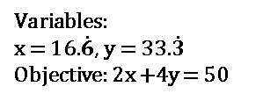
Limitations of existing metrics
Execution-based evaluation metric (Prasath and Karande, 2023)
Example 2
Problem description
Example 3
An LLM predicts
Problem description 1
Problem description 2
An Expert annotates ground truth
Math program
Objective: Infeasible
Objective: Infeasible
Variables:
x (acres of apples)
y (acres of pears)
Maximize: 2x + 4y
Subject to:
x + y <= 50
y <= 2x
=
Missing Info
Variables:
x = 16.$\dot{6}$, y = 33.$\dot{3}$
Objective: 2x +4y = 50
=
Variables:
x = 16.$\dot{6}$, y = 33.$\dot{3}$
Objective: 2x +4y = 50
    Measure consistency
    → original info
19

Slide 20
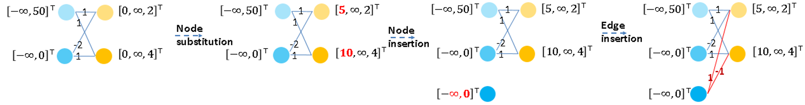
Proposed Evaluation Metric
  Design a metric that is better aligned with human judgment. Desired properties:
    Permutation invariance
    Measure consistency with the original problem’s information.
Graph representation
#Attribute-level edits
Propose a metric based on graph edit distance (GED-based metric).
  Step 1&2: Format conversion. LLM prediction → LP general form → LP graph
  Step 3: Compute the GED between the LP graph from the LLM prediction and the ground-truth LP graph.
LP graph from prediction
----------------------- A series of graph editing operations ----------------------->
Ground-truth LP graph
Graph Edit Distance = 6
20

Slide 21
Experiment: which metric aligns better with human judgement?
Setup
  Dataset: NL4OPT test set (289 samples)
  For each sample:
    4 predicted formulations from 4 LLMs
    1 human-written reference formulation
  Human Evaluation → Human Ranking List
  Automatic Metrics → Metric-based Ranking List
  Metrics:
    Exact match rate:
    Are the two ranking lists identical?
    Pairwise match rate:
    Breaks down the ranking lists into pairs.
Metrics | Exact match rate | Pairwise match rate
Execution-based | 9 / 289 | 716 / 1734
Declaration-based | 64 / 289 | 1336 / 1734
GED-based | 178 / 289 | 1641 / 1734
Table 3: Ranking match rate between automatic evaluation metrics and human judgements.

Slide 22
Roadmap
Introduction
To answer the four research questions:
  Smart initial basis selection for linear programs [ICML’ 23]
  ML enhances OR
  Towards human-aligned evaluation for linear programming word problems [COLING’ 24]
OR enhances ML
  HFX: Joint Design of Algorithms and Systems for Multi-SLO Serving and Fast Scaling (In Submission, OSDI)
Conclusion and future directions

Slide 23
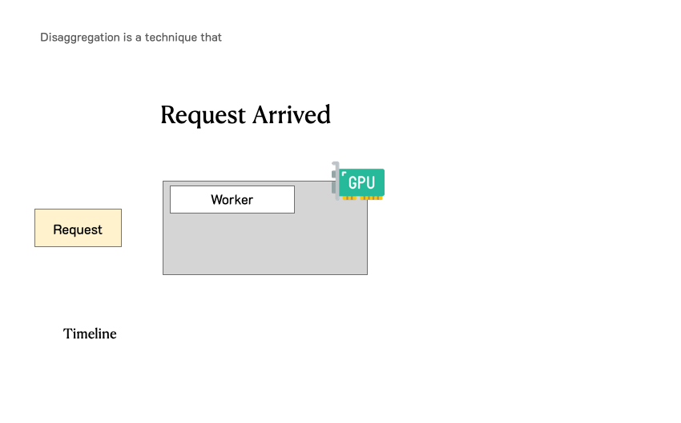
Background
Challenge:
Heterogeneity & Variability
OR-inspired efficient serving strategy?
Q3
Existing serving systems
  vLLM (Kwon et al., 2023): colocated mode
For a single request, inference consists of 2 stages: Prefill stage and Decode stage
Requests
Load Balancer
vLLM Instance 1
vLLM Instance 2
  DistServe (Zhong et al., 2024): disaggregated mode
Requests
Load Balancer 1
Prefill Instance 1
Prefill Instance 2
Load Balancer 2
From https://hao-ai-lab.github.io/blogs/distserve/
Key service-level objectives (SLOs)
Time to first token (TTFT) requirement.
Time per output token (TPOT) requirement.
Decode Instance 1
Decode Instance 2
23

Slide 24







Algorithms and Systems Designs
Heuristic algo:
Challenges | Features | Designs
Heterogeneity | SLO-aware | Heuristic algo
Variability | Elasticity
 | Real-time decision
 | Fast scaling | System tech
2 modes | Compatibility
Protect in-flight requests to guarantee their SLOs (safety condition)
Greedily admission once safe
…
$$r_{1}$$
$$r_{2}$$
$$r_{3}$$
$$r_{4}$$
State indicator
Dispatching
Problem definition:
Decision Timing: On prefill/decode iteration completion and new request arrival
Decisions
Dispatch: assign pending requests to workers
Scaling: decide whether to scale and which workers to remove
Objectives: Minimize system cost & Maximize SLO attainment
Instance 1
…
Instance $n$
…
Scaling
Running batch 1
Running batch $n$
Safety fallback → scale-out
Idle → scale-in

Slide 25
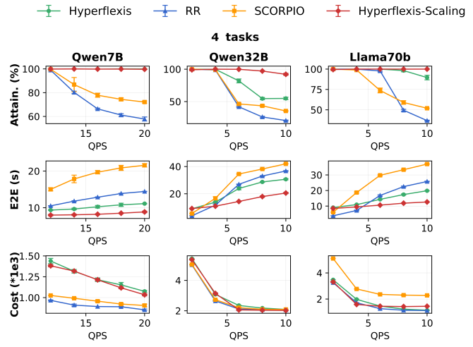
Experiment
Setup:
  Workloads: 4-task multi-SLO benchmarks
  Models: Qwen7B, Qwen32B, LLaMA70B (FP16, TP=1/2/8)
    Deployment Mode: Colocated
  #Instances: 2 by default, up to 4 with scaling
  Baselines:
  Main metrics: SLO Attainment, Cost
Method | Multi-SLO aware | Scaling | Disagg.
RR | ✗ | ✗ | ✓
SCORPIO | ✓ | ✗ | ✗
HyperFlexis-Scaling | ✓ | ✓ | ✓
SLO attainment ↑↑
Cost modest ↑
SLO attainment ↑↑
Cost modest roughly same

Slide 26

Conclusion and future directions
Demonstrated synergy between ML and OR.
  ML for OR:
    Proposed ML-guided LP initialization and accelerated correlated LPs’ solving.
    For LLM-based LP modeling, developed an improved evaluation metric.
  OR for ML: Designed OR-inspired methods improving efficiency in LLM serving.
Landscape of future directions:
ML for OR OR for ML
Program formulation
Solution method
Solution Explanation
Feasibility Relaxation
Deployment: serving efficiency, failure recovery, live reconfig
Model selection
Contribution valuation
Unlearning
Integrated OR–ML
Jointly optimize and learn in one pipeline to solve a problem
OR and ML enhance each other
Examples: Predict then optimize (Adam et al., 2022), differentiable optimization layer (Broandon et al. 2017)

Slide 27
Reference
  (*co-first authors)
[ICML’ 23] Fan, Zhenan*, Xinglu Wang*, Oleksandr Yakovenko*, Abdullah Ali Sivas, Owen Ren, Yong Zhang, and Zirui Zhou. 2023. "Smart initial basis selection for linear programs." In Proceedings of the 40th International Conference on Machine Learning, 9650–9664.
[COLING’ 24] Xing, Linzi*, Xinglu Wang*, Yuxi Feng, Zhenan Fan, Jing Xiong, Zhijiang Guo, Xiaojin Fu, Rindra Ramamonjison, Mahdi Mostajabdaveh, Xiongwei Han, Zirui Zhou, and Yong Zhang. 2024. "Towards Human-aligned Evaluation for Linear Programming Word Problems." In Proceedings of the 2024 Joint International Conference on Computational Linguistics, Language Resources and Evaluation, 16550–16556.
(In Submission, OSDI) Yousefijamarani, Zahra*, Xinglu Wang*, Qian Wang*, Morgan Lindsay Heisler, Taha Shabani, Niloofar Gholipour, Parham Yassini, Hong Chang, Kan Chen, Qiantao Zhang, Xiaolong Bai, Jiannan Wang, Ying Xiong, Yong Zhang, and Zhenan Fan. 2025. “HyperFlexis: Joint Design of Algorithms and Systems for Multi-SLO Serving and Fast Scaling.” arXiv preprint arXiv:2508.15919.
Other papers during PhD study:
  Fan, Zhenan, Huang Fang, Xinglu Wang, Zirui Zhou, Jian Pei, Michael P. Friedlander, and Yong Zhang. 2024. “Fair and Efficient Contribution Valuation for Vertical Federated Learning.” In Proceedings of the Twelfth International Conference on Learning Representations.
  Gholami, Mohsen, Mohammad Akbari, Xinglu Wang, Behnam Kamranian, and Yong Zhang. 2023. “Etran: Energy-Based Transferability Estimation.” In Proceedings of the IEEE/CVF International Conference on Computer Vision, 18613–18622.
  Fan, Zhenan, Bassem Ghaddar, Xinglu Wang, Lingzi Xing, Yong Zhang, and Zirui Zhou. 2025. “Artificial Intelligence for Optimization: Unleashing the Potential of Parameter Generation, Model Formulation, and Solution Methods.” European Journal of Operational Research.
  Singh, Gursimran, Xinglu Wang, Yifan Hu, Timothy Yu, Linzi Xing, Wei Jiang, Zhefeng Wang, Xiaolong Bai, Yi Li, Ying Xiong, Yong Zhang, Zhenan Fan. 2025. “Efficiently Serving Large Multimodal Models Using EPD Disaggregation.” In Proceedings of the 42nd International Conference on Machine Learning.
  Heisler, Morgan; Yousefijamarani, Zahra; Wang, Xinglu; Wang, Qian; et al. 2025. LLM Inference Scheduling: A Survey of Techniques, Frameworks, and Trade-offs. TechRxiv Preprint. DOI: 10.36227/techrxiv.176238087.79673350 (v1).

Slide 28
Thank you!

Slide 29
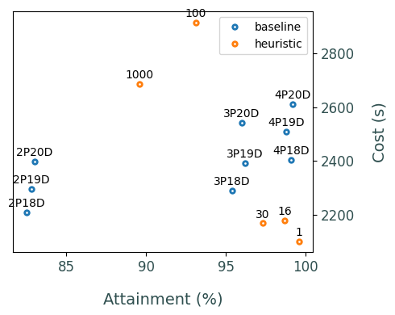
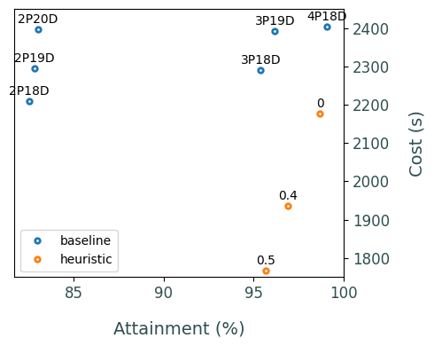

Simulation experiment
(i.e., P or D worker not actually run, just log the estimated time, using simpy tool)
Model: Opt-13b
Static scenario:
  1k requests from ShareGPT benchmark.
  Requests arrive following Poisson distribution with rate of 12 reqs/s.
  Randomly generate SLO: TTFT ~ uniform[20ms, 500ms], TPOT ~ uniform[5ms, 50ms].
Methods:
  Baseline: FCFS + dispatching to least loaded workers
  Our heuristic: SLO-aware scheduling & P/D auto scale
Metrics: attainment & cost
Experiment 2: Setting Cold Start Time to 16ms; Allowing Heuristic to Trade Off Between Attainment and Cost
Conclusion: With similar attainment (96%), the heuristic method can save 20% of the cost.
Meaning: baseline deploys 2P20D workers
Experiment 1: The Impact of Cold Start Time on Performance Metrics
Conclusion: The heuristic method shows improvement when the cold start time is no more than 30 ms.
Meaning: worker’s cold start time is 16ms
Heuristic maintains attainment at 96%

Slide 30
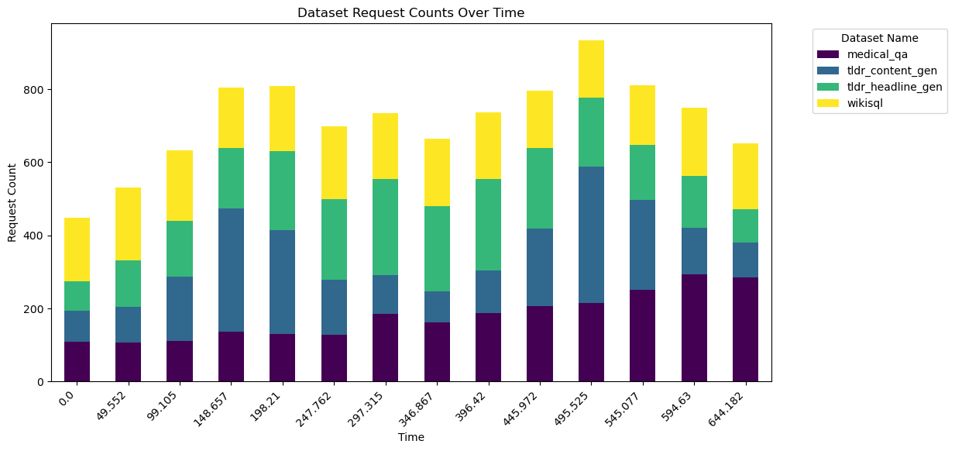
Results and Visualizations
Real-GPU experiment (implemented upon DistServe code)
Real scenario: Four different real-world tasks. Each task has its SLO requirement.
Scenario 3: Urgent requests arrive occasionally
 |  |  |  | Dataset statistics
Task | TTFT requirement | TPOT requirement | QPS (req/s) | #in | #out | Median #in | Median #out
medical_qa [6] | 600 ms | 50 ms | Linear w.r.t. time | [25,275] | [0,700] | 110 | 125
tldr_headline_gen [7] | 2 s | 300 ms | Single peak | [50,250] | [10,80] | 126 | 16
tldr_content_gen [7] | 600 ms | 500 ms | Double peak | [40,120] | [25,225] | 50 | 96
wikisql [7] | 600 ms | 60 ms | Const. | [250,2000] | [20,70] | 475 | 29
 | cost (s) | attainment (%)
baseline (1P7D) | 212 | 95%
heuristic (starting from 1P7D) | 170 | 97%
Scenario 2 (Sleep scenario): request rate changes with time
 | cost (s) | attainment (%)
Baseline (3P4D) | 272 | 88%
baseline (1P6D) | 273 | 53%
heuristic (starting from 3P4D) | 184 | 86%
heuristic (starting from 1P6D) | 191 | 80%
 | cost (s) | attainment (%)
baseline (4P4D) | 190 | 75%
heuristic (starting from 4P4D) | 95 | 76%

Slide 31
Appendix: VFL Contribution Valuation

Slide 32


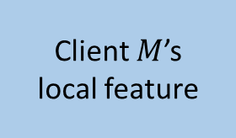




VFL aligns samples and partitions features
Label
Client 1’s
local feature
Client $M$’s
local feature
$N$ samples
. . .
M clients share N aligned sample IDs, but each client owns a different feature subset.
Each client computes local embeddings for a mini-batch.
The label-holding server aggregates embeddings, predicts, and evaluates loss without pooling raw features.
Local model
Client 1
Client 1’s
local feature
$$θ_{1}$$
Batch
. . .
. . .
. . .
Prediction
Client $M$’s
local feature
$$θ_{M}$$
Loss
Client $M$
Batch
Label
Local clients’ embeddings
Liu et al., “FedBCD,” IEEE TSP, 2022. DOI: 10.1109/TSP.2022.3198176
Global server

Slide 33
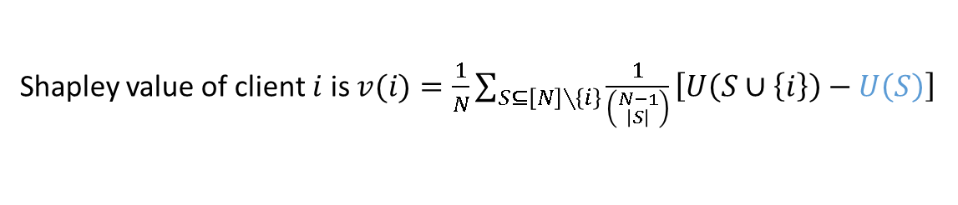
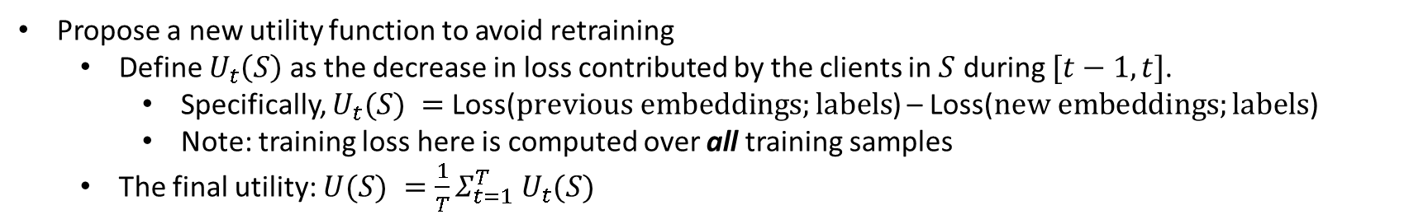

Shapley value allocates coalition utility fairly
Contribution Valuation in Federated Learning: assessing the contribution of a client towards the outcome model.
  Shapley Fairness [7]: 4 axioms
  Shapley value is the unique solution that satisfies 4 axioms [7].
utility created by clients in $S$
Shapley value of client $i$ is $v(i)=\frac{1}{N}\sum_{S⊆\left[N\right]∖\left\{i\right\}}{\frac{1}{\left({N−1 \atop \left|S\right|}\right)}\left[U\left(S∪\left\{i\right\}\right)−U\left(S\right)\right]}$
marginal utility gain
Drawback: Computing utilities requires retraining the model
Propose a new utility function to avoid retraining
  Define $U_{t}\left(S\right)$ as the decrease in loss contributed by the clients in $S$ during $[t−1,t]$.
    Specifically, $U_{t}(S) =$ Loss($previous embeddings;labels$) – Loss($new embeddings;labels$)
    Note: training loss here is computed over all training samples
  The final utility: $U(S) =\frac{1}{T}Σ_{t=1}^{T} U_{t}(S)$
[7] L. S. Shapley. A Value for n-Person Games. Technical Report P-295, RAND Corporation, Santa Monica, CA, 1952.

Slide 34
VerFedSV reuses one training trajectory
At timestamp t, coalition S refreshes its embeddings; every client outside S keeps its timestamp t−1 embedding.
Average marginal utility over t = 1,…,T and every coalition:
Takeaway: one training trajectory supplies timestamped utilities—without coalition-wise model retraining.

Slide 35
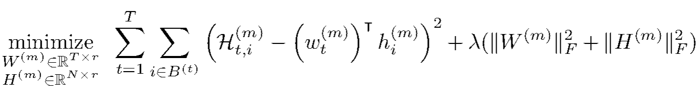
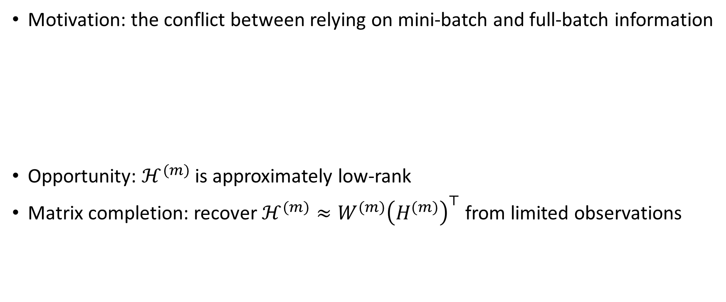

How can matrix completion technique help?
Motivation: the conflict between relying on mini-batch and full-batch information
Opportunity: $ℋ^{(m)}$ is approximately low-rank
Matrix completion: recover $ℋ^{(m)}≈W^{(m)}{\left(H^{(m)}\right)}^{⊤}$ from limited observations
embedding matrix for client $m$
$T$ timestamps
$ℋ^{(m)}$ =
. . .
Observations from mini-batch $B^{(t)}$
$N$ samples

