Slide 1
Close Cubic B-Spline Snake
Zengxiang Lu

Slide 2
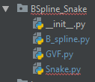
Introduction:
This project is trying to build a module in python which can be used to extract contour of objects by applying an active contour method called B-Spline Snake. This module contains 3 parts: GVF, B_spline, Snake.
Reference: Yue Wang, Eam Khwang Teoh & Dinggang Shen, Structure-Adaptive B-Snake for Segmenting Complex Objects.

Slide 3
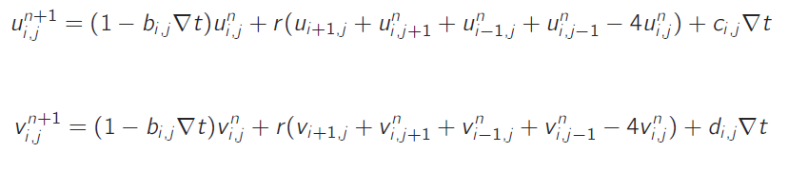
GVF:
Get edge by applying Laplacian Filter: OpenCV.
Image gradient of edge.
GVF can be approximated iteratively using the next equations:
4. Termination of iteration:
The change of flow is lower than a certain level.
Change of flow stays in a certain level during a period of time.
Demo1
Demo2

Slide 4
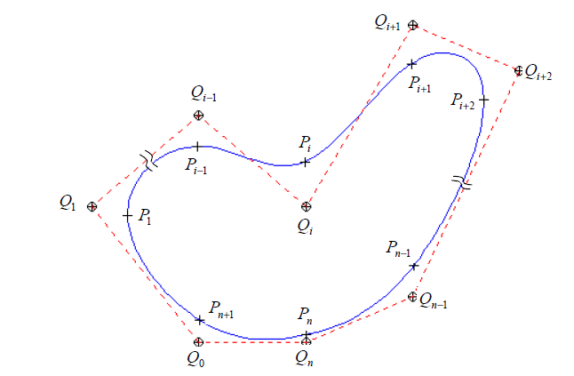
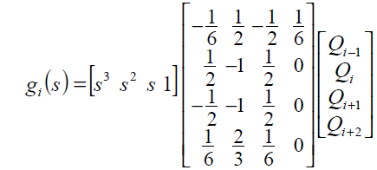
B_spline:
0

Slide 5
B_spline:
Class B_spline()
1.Init : control_point
sample_nmber: int= 10
sample_s=None
2.reset_sample_s
3.reset_control_points
4.get_sample_s
5.plot
6.add_knot
7.get_sample_force: get the force at the position of sample points
8.get_fq: get the force of control point

Slide 6
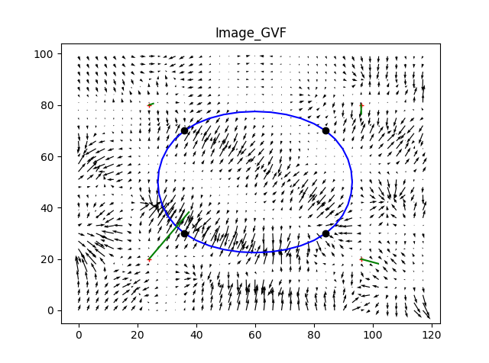
B_spline:
get_fq:

Slide 7

B_spline:
get_fq:
1. Minimum Mean Square Energy Approach :
Find the movement of control points that could minimize the error of movements of sample points.
M: m by n matrix
m: number of sample points
n: number of control points
Complexity: O(n^3) + O(n*n*m) + O(n*m*1)

Slide 8
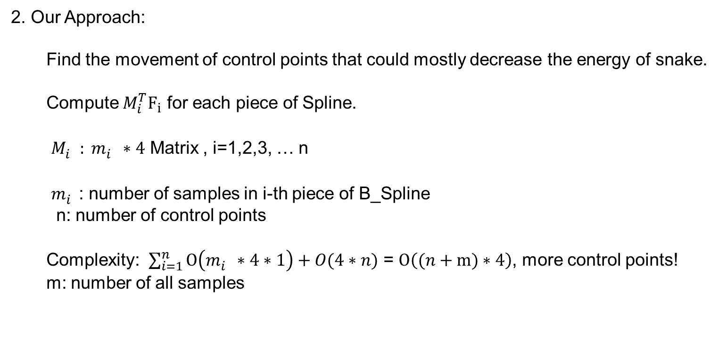
B_spline:
get_fq:
2. Our Approach:
Find the movement of control points that could mostly decrease the energy of snake.
Compute $M_{i}^{T}F_{i}$ for each piece of Spline.
$M_{i}^{}: m_{i}^{}∗4$ Matrix , i=1,2,3, … n
$m_{i}^{}$: number of samples in i-th piece of B_Spline
n: number of control points
Complexity: $\sum_{i=1}^{n}{O\left(m_{i}^{}∗4∗1\right)+O(4∗n)}$ = $O\left((n+m)∗4\right)$, more control points!
m: number of all samples

Slide 9
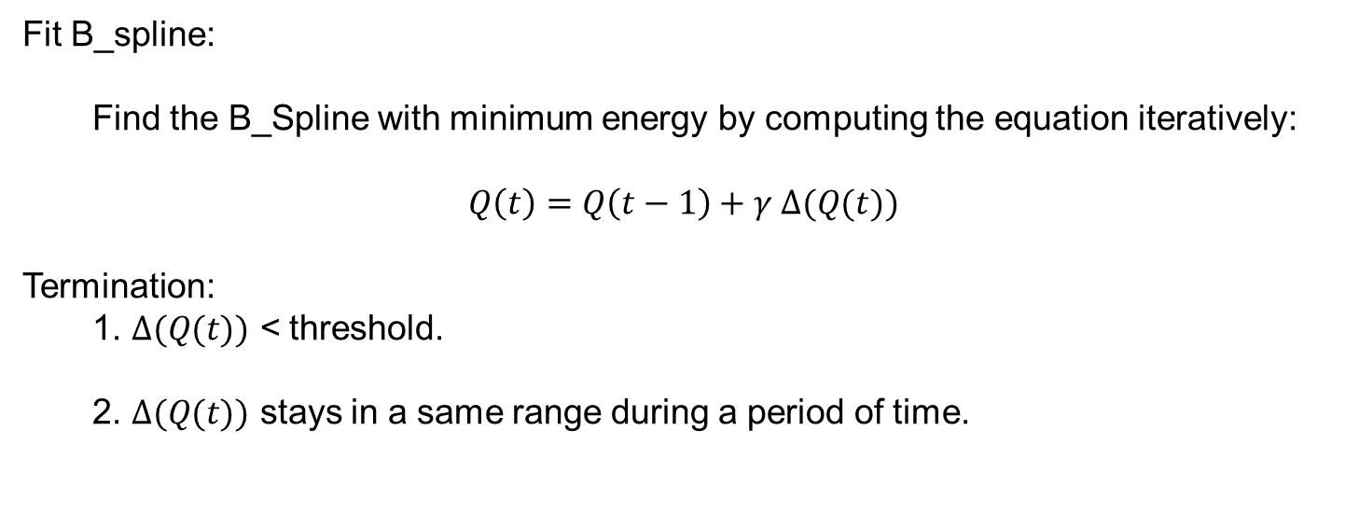
Snake:
Fit B_spline:
Find the B_Spline with minimum energy by computing the equation iteratively:
$$Q\left(t\right)=Q\left(t−1\right)+γ Δ(Q(t))$$
Termination:
1. $Δ(Q(t))$ < threshold.
2. $Δ(Q(t))$ stays in a same range during a period of time.
Demo1
Demo2 (second_loop_break_inspect_time= None)
Demo3 (init_control_num=100)

Slide 10
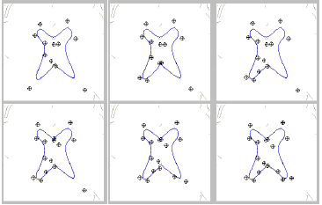
Snake:
Add_knots:
1. Fit B_spline.
2. Add control points -> Add knot at the position of sample that has largest force.
This method does not work well.
Demo1 ( Work)
Demo2 (Stuck- most cases)

Slide 11
Conclusion:
1 . A functional module is built for Cubic B_spline.
2. Modify the original algorithm and make it faster and more efficient.
3. Add_knot should be replaced by other reasonable algorithm.
4.Git hub: https://github.com/luzengxiang/B_spline-Snake

