Slide 1
Threat Recognition Algorithms
A Study of Deep CNN-Based Classification of Image
Motivation:
Department of Homeland Security raises a Kaggle competition to improve the accuracy of its threat recognition algorithms.
The algorithm is about recognizing threat (e.g., weapon, dangerous materials) from different part of human body.
The speed and accuracy of the algorithm directly effects the waiting time and safety of passengers.
Our goal is: improve accuracy of algorithm supported by deep learning.

Slide 2
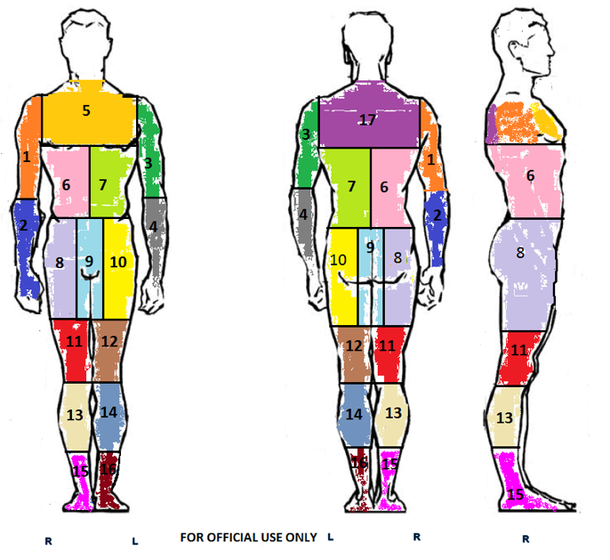
Raw Data (Provide by Kaggle Competition):
1.Data source:
https://www.kaggle.com/c/passenger-screening-algorithm-challenge/data
2.Image data:
The data for each scan performed by the HD-AIT system is referred to as an HD-AIT Frame. A frame consists of the following four binary files:
_.ahi = calibrated object raw data file (2.26GB per file)
_.aps = projected image angle sequence file (10.3MB per file)
_.a3d = combined image 3D file (330MB per file)
_.a3daps = combined image angle sequence file (41.2MB per file)
Considering the size of each format, _.aps is used in this project. Each scan data is consisted of 17 image taken from different angles.
Because the scan image is highly sensitive, bellow is a self-take picture illustrating how it looks like.
3.Label:
For every scan in the dataset, thread is labeled in each of 17 body zones.
The data is strongly unbalanced.

Slide 3
Data preprocessing:
1.Select scan images with labels,
and then split it into train and test datasets at rate = 0.3.
2. For each body zone, select a 250*250 area from scan image of different angles which contains this zone.
For each body zone, we get 17 images which has size of 250*250 and 0-1 binary label as well.
 | Sample size
raw
Labeled
Training
Testing

Slide 4
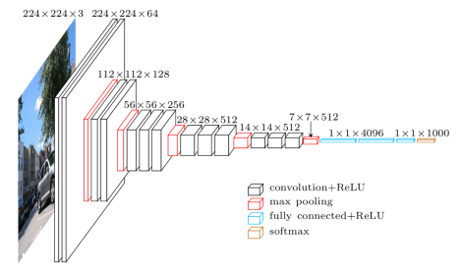
Convolution neural network:
Structure:
Size should be checked
Image is from:https://www.cs.toronto.edu/~frossard/post/vgg16/
Hyper parameter for Training:
1.Data is strongly unbalanced. Weight samples to make it balanced.
2.
3.

Slide 5
Implementation environment and time.
Language and package:
Python: Keras.
Platform:
GPU:
Memory:
Running time:
Data processing:
Around 5mins for each zone.
Training and validation.
33s for each iteration. 200 iteration for each zone.

Slide 6
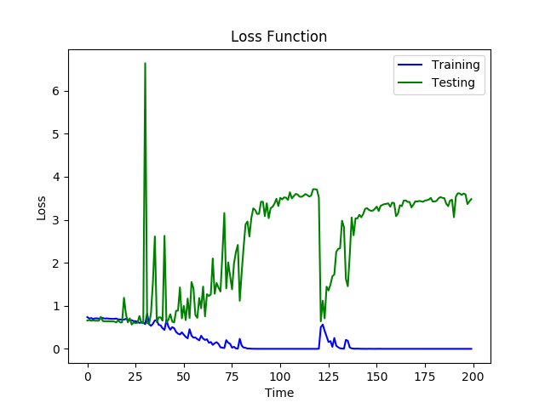
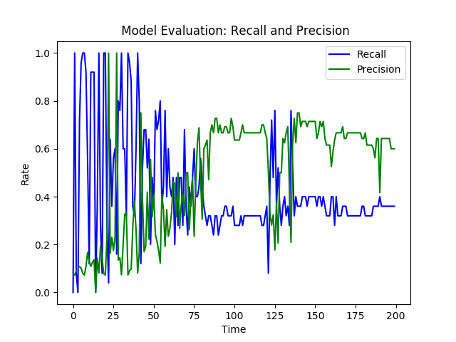
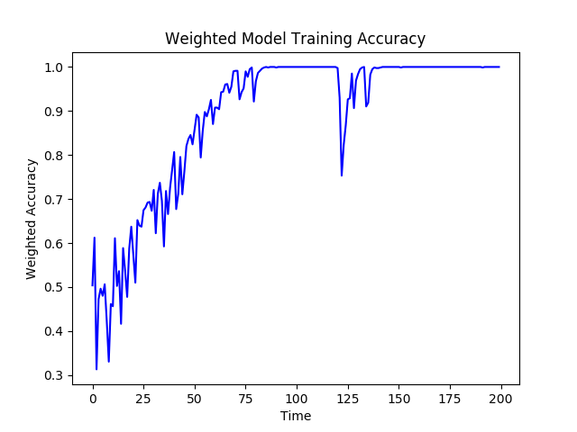
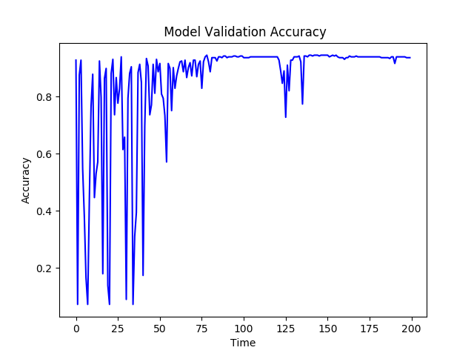
Training processing of Zone 7:

Slide 7
Model Summary(Zone1-Zone7):
Zone | Bench Mark | Train_Acc | Val_Acc | Val_Recall | Val_ Precision
1 | 0.884 | 1 | 0.8812 | 0.2647 | 0.36
2 | 0.8901 | 1 | 0.8551 | 0.1 | 0.2222
3 | 0.9093 | 0.0898 | 0.0928 | 1 | 0.0928
4 | 0.9189 | 1 | 0.9449 | 0.36 | 0.75
5 | 0.9058 | 1 | 0.9101 | 0.3125 | 0.5263
6 | 0.8989 | 1 | 0.8667 | 0.0541 | 0.1538
7 | 0.9076 | 1 | 0.9304 | 0.5 | 0.625
Bench mark: Predict with majority.
The model only improves prediction accuracy on Zone 4
and 7, and recall and precision is not satisfying.Which means
vgg-16 CNN is not a successful model to extract threat features from scan images.

Slide 8
Summary of Project:
The project shows that vgg16 seems fail to extract threat
features from scan image.
Recall the training process, vgg16 CNN tries to extract features. The low accuracy may be caused by small sample size and model construct.

