Slide 1
Issues/Parameters in Vector Model
Term weighting
Term selection
    (special case of term weighting
    stop words = words with weight 0)
Vector similarity functions
    (Dice, Jaccard, Cosine)
Clustering approach
    (Agglomerative hierarchical clustering)

Slide 2
Term Weighting Strategies
 Boolean weighting
Weight_{t,d} = 1 if term t present in document d
0 if term t NOT present in document d
 Term weight ∝ term frequency
Weight_{t,d} = Freq _{t,d}
term document
raw frequency of term in document
● Normalized term frequency
Weight_{t,d} =
Freq _{t,d}
Freq _{t,corpus}
normalized term frequency
by overall corpus frequency

Slide 3
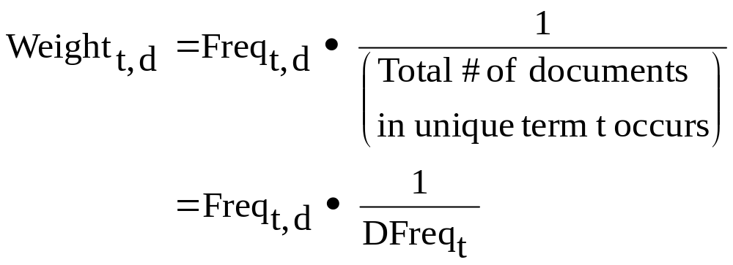
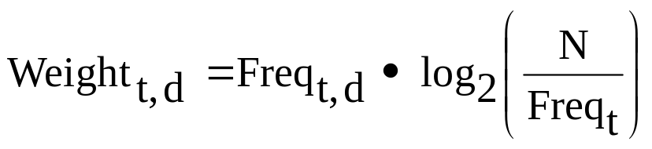
Term Weighting Strategies
 TF-IDF
Term Frequency
(frequency of term in documents)
Inverse Document Frequency
 TF log IDF  “TF-IDF”
# of doc. in the corpus
TF  IDF
# of doc. with term t

Slide 4
Term Selection/Weighting
What makes a good term?
Poor
Terms
Freq.
of
term
in
Doc.
High freq. function words
(in all documents, e.g. the, in of, for)
Low freq. function words
(e.g. certainly)
Doc. #

Slide 5
Localized, but Not too Infrequent
Freq.
of
term
in
Doc.
Poor signal/noise ratio
example
term = 183
1
0
Doc. #

Slide 6
Document Internal Weighting
“Genome” – 20 times in document more indicative
than 10 times ?
than 2 times ?
Question assumption
that Weight_{t,d} ∝ Freq_{t,d}
??
indicativeness
1
# of times
(unit length)

Slide 7
Better Terms
Localized to subset of documents
→ Presence of term “indicative” of documents
Terms like
“genome”,
“cytochrome-c”,
“Plasmasis”
Freq.
of
term
in
Doc.
1
0
Doc. #

Slide 8
Stoplists
Human intuition of which terms are bad
  → Excludes from vector

Slide 9
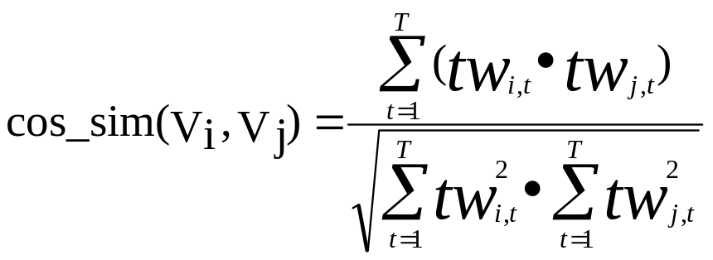
Similarity Functions/Measures
Compiler
DNA
Comput* C++ Sparc genome bilog* protein
Doc V₁
3 5 4 1 0 1 0 0
Doc V₂
1 0 0 0 5 3 1 4
Doc V₃
2 8 0 1 0 1 0 0
Sum over all terms in document
Weight of term t
in document j
Normalizing factor

Slide 10
Region Weighting
Title
Keywords
Abstract
Section Heads
Body Text
  1st page
  30th page
Footnotes
Should words in each of these
regions be weighted equally?

W_{t,d} = RW_{R} • TF_{t,d} • (IDF)
3.0 Keywords
2.0 Title
0.8 Body Text
multiplicative weightings factor
depending on region word appears in

Slide 11
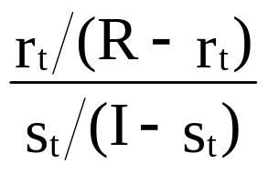
Relevance Weighting
TF F_{t,d} • TermRel_{t}
# of relevant documents in corpus
raw term freq.
# of relevant documents with term t
# of irrelevant documents with term t
# of irrelevant documents in corpus
Theoretically optimal if you know Relevance

Slide 12
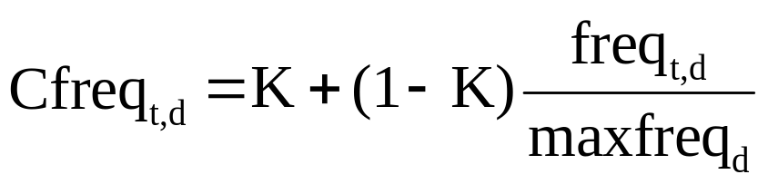
Type of Document
(Title vs.
Abstract
vs. Paper
vs. Query)
if Term t in d,
weight TF
[ Croft, ’83]
(for titles) K = 1  boolean weighting
(for full text) K = 0  similar to Freq_{t,d}

Slide 13
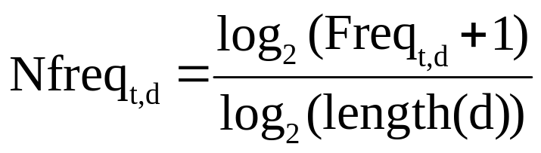
Document Interval Term Weighting
use instead of Freq_{t,d} in TF-IDF [Harman ’86]

Slide 14
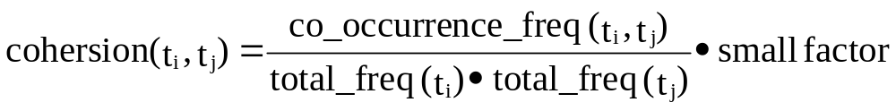
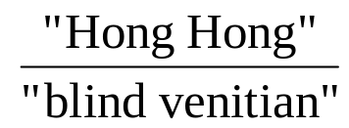
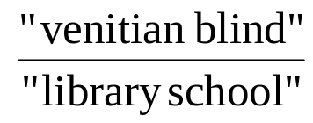
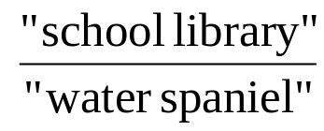
Compound Identification
Salton + McGill(1983) – cohersion measure
Measure is similar to :
Mutual Information
Examples:
Compounding
may increase
or decrease
vocabulary
size
Collocation extraction :
Choueka(1988)
Smadia(1992)
dog

