Slide 1
Vector Models for Person / Place
PERSON CENTROID
KEY
PERSON
PLACE
PLACE CENTROID

Slide 2
Vector Models for Lexical Ambiguity Resolution /
Lexical Classification
Treat labeled contexts as vectors
Class
W-3
W-2
W-1
W0
W1
W2
W3
PLACE
long
way
from
Madison
to
Chicago
COMPANY
When
Madison
investors
issued
a
Convert to a traditional vector just like a short query
V328
V329

Slide 3
Training Space (Vector Model)
Per
Pl
Pl
Pl
Per
Pl
Per
Pl
Per
Per
Pl
Per
Per
Pl
Person Centroid
Place Centroid
new example
Eve
Co
Company Centroid
Co
Eve
Co
Co
Eve
Co
Co
Event Centroid
Co

Slide 4
Plant
 | 1 | 2 | 3 | 4 | 5 | 6
1 |  | * |  |  |  | *
2 | * |  |  |  |  | *
3 | * | *
S1
Xi
Sum += V[i]
For each vector
Sim (1, i)
For each term in vecs[docn]
Sum[term] +=
vec[docn]
S2
Sim (2,i)
S1 > S2 assign sense 1
else sense 2
Sum | 1 | 2 | 3 | 4 | 5 | 6
* | * | * | * |  | * | *
S1 – S2 for all terms in sum vec[sum][term] != 0

Slide 5
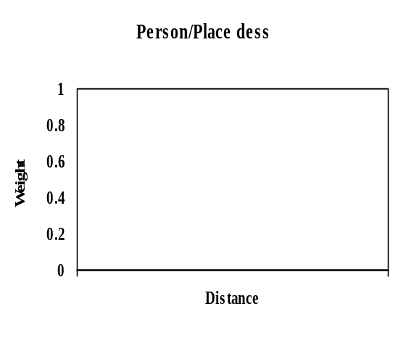
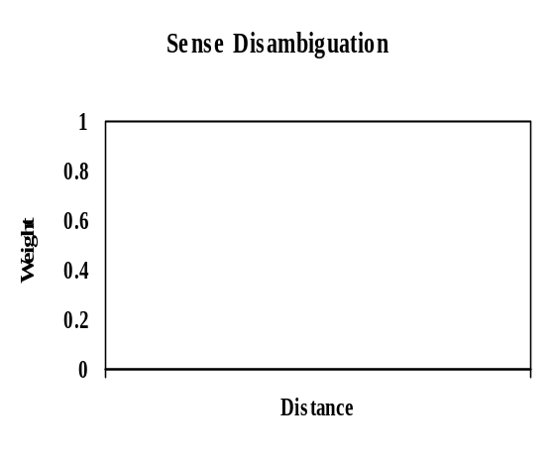
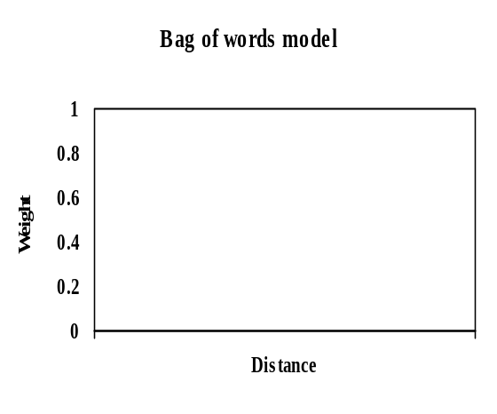
Observation
Distance matters
  Adjacent words more salient than those 20 words away
All positions give same weight

Slide 6
For sense disambiguation,
** Ambiguous verbs (e.g., to fire) depend heavily on words in local context (in particular, their objects).
** Ambiguous nouns (e.g., plant) depend on wider context.
For example, seeing
[ greenhouse, nursery, cultivation ] within a window of +/- 10 words is very indicative
of sense.

Slide 7
Order and Sequence Matter:
plant pesticide ➔ living plant
pesticide plant ➔ manufacturing plant
a solid lead ➔ advantage or head start
a solid wall of lead ➔ metal
a hotel in Madison ➔ place
I saw Madison in a hotel bar ➔ person

Slide 8
Deficiency of “Bag-of-words” Approach
context is treated as an unordered bag of words
-> like vector model
(and also previous neural network models etc.)

Slide 9
Collocation
Means (originally):
- “in the same location”
- “co-occurring” in some defined relationship
  Adjacent (bigram allocations)
  Verb/Object collocations
  Co-occurrence within +/- k words collocations
Fire her
Fire the long rifles
Made of lead, iron, silver, …
Other Interpretation:
  An idiomatic (non-compositional high frequency association)
    Eg. Soap opera, Hong Kong

Slide 10
Observations
Words tend to exhibit only one sense in a given collocation or
word association
2 word
Collocations
(word to left or word to the right)
Prob(container) | Prob(vehicle)
.99 + | .01 -
.01 - | .99 +
.96 + | .04 -
oxygen | Tank
Panzer | Tank
Empty | Tank
P (Person) | P (Place)
.01 | .99
.95 | .05
.99 | .01
.01 | .99
.02 | .98
.96 | .04
In | Madison
With | Madison
Dr. | Madison
 | Madison Airport
 | Madison mayor
Mayor | Madison

Slide 11
Formally P (sense | collocation) is a low entropy distribution

Slide 12
Observations
Words tend to exhibit only one sense in a given discourse or document
= word form
Very unlikely to have living Plants / manufacturing plants referenced in the same document
  (tendency to use synonym like factory to minimize ambiguity)
  communicative efficiency (Grice)
Unlikely to have Mr. Madison and Madison City in the same document
Unlikely to have Turkey (both country and bird) in the same document

