Slide 1




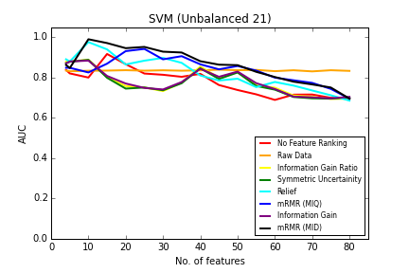
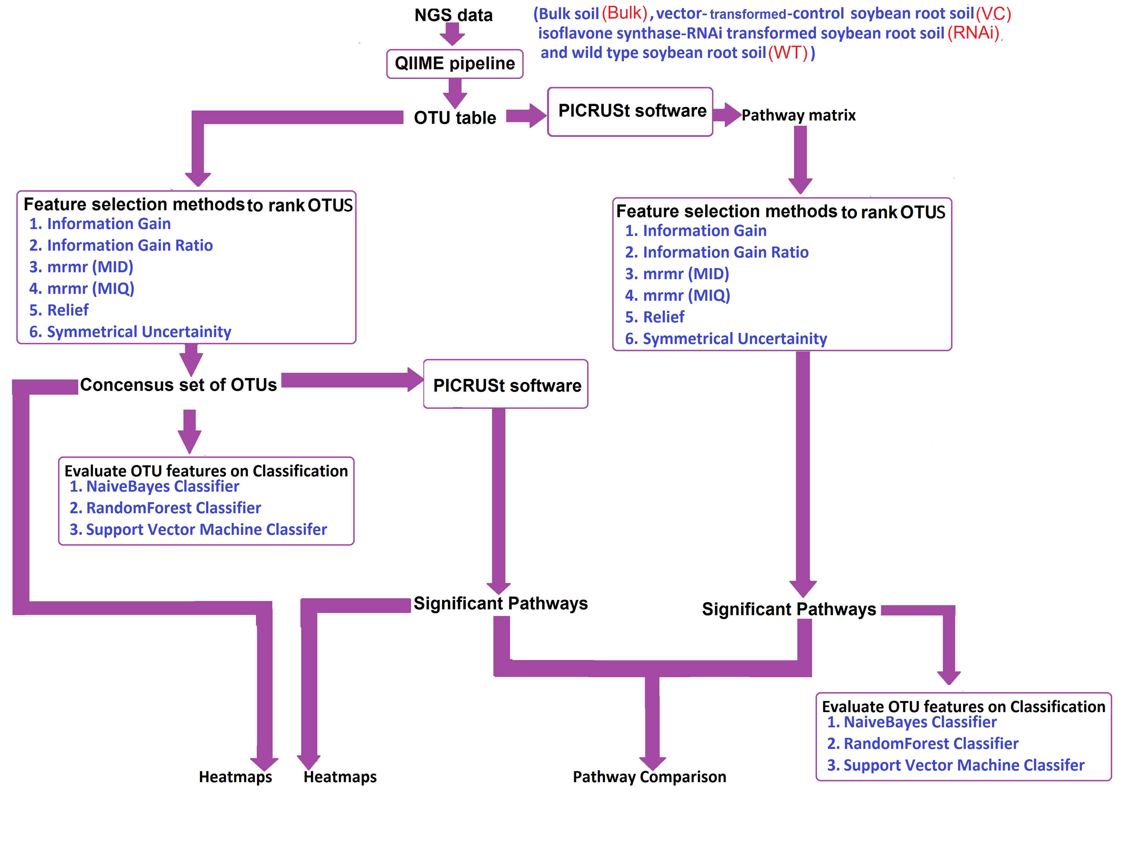
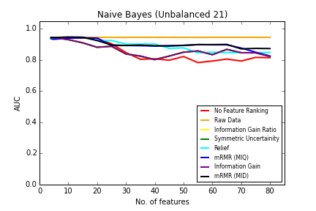

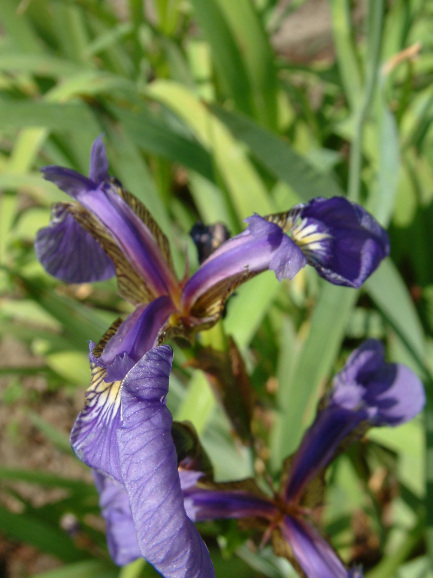
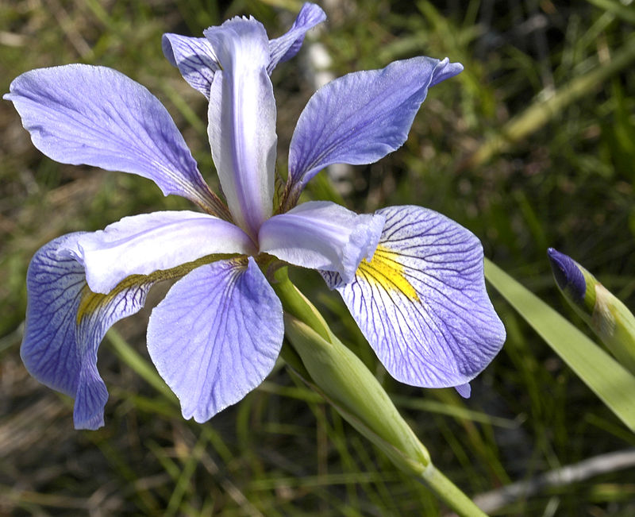
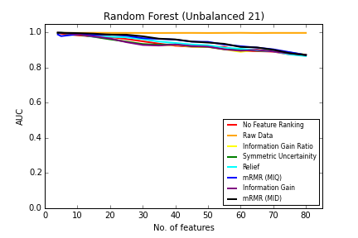
Evaluating feature selection and classification methods for multiclass data with small number of samples
Zhixiu Lu ^{2,3}, Miyuraj Harishchandra ^{1,3}, Laura J. White ⁴, Karuppaiuan Jothibasu ⁵,R. Neil Reese ⁴, Volker S. Brozel ^{4, 6}, Senthil Subramanian ^{4, 5}, and Erliang Zeng ^{1, 2, 3}
¹ Department of Biology, ² Department of Computer Science, University of South Dakota, Vermillion, USA
³ Bioinformatics and Computational Systems Biology Laboratory (BioComs Lab), University of South Dakota, Vermillion, USA
⁴ Department of Biology and Microbiology, ⁵ Department of Plant Science, South Dakota State University, Brookings, USA
⁶ Department of Microbiology and Plant Pathology, University of Pretoria, Pretoria 004, South Africa
abstract
objectives
Results (roc curves)
Prediction of microbial communities influenced by isoflavonoids of soybean roots with a metagenomics analysis is a subject we have been working on. Four different soybean data with small samples is provided for analysis. To verify that our method works for multiclass data with small samples, we introduce the well known Iris dataset to test the performance of our test method.
We aim to simulate the pipeline on small, unbalanced Iris data sets. On the purpose of proving that this pipeline is suitable for multiclass data sets with small samples. Also the result helps us analyze features of different methods we use.
PIPELINE
Feature selection
.
Iris versicolor
Iris setosa
Iris virginica
Future directions and impacts
Acknowledgement
The framework applies to many biologically significant patterns. Performance of the framework has been proven efficient. An open source tool for public use is being developed.
The project is supported by University of South Dakota Bioinformatics & Computational systems biology lab and
the SD EPSCoR Biochemical Spatiotemporal Network Resource (BioSNTR)

