Slide 1
Introduction to sequential decision-making for ecologists
Tutorial
Luz Pascal

Slide 2
3 examples
Weather predictions with Markov Chains
  Running Markov chains in R
Tiger problem (adapted from Chades et al., 2008)
  Basic implementation of the techniques using R
Wolf culling (adapted from Marescot et al., 2013)
  tutorial/03-tutorial wolf culling.R

Slide 3
Weather predictions

Slide 4
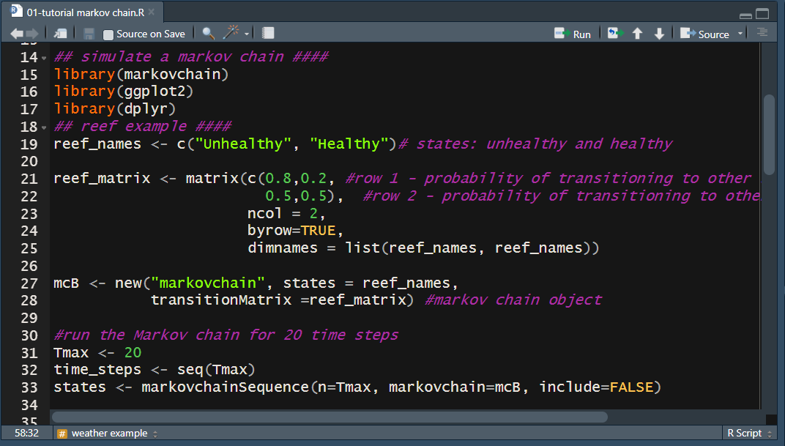
Weather predictions
tutorial/01-tutorial markov chain.R

Slide 5
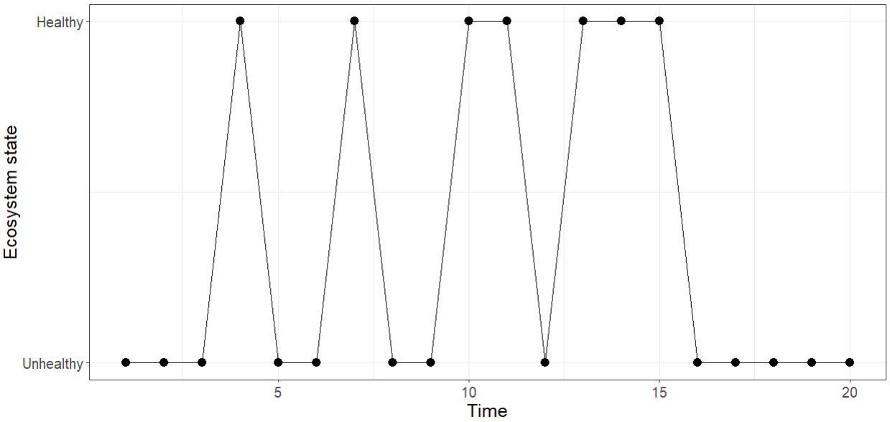
tutorial/01-tutorial markov chain.R

Slide 6


Markov Chains
Your turn!
If it is rainy today, the probability that tomorrow is sunny is 0.6
If it is sunny today, the probability that tomorrow is rainy is 0.2.
  Define the state space
  Define the transition function
To:
$$\left(\begin{matrix}0.4 & 0.6 \\ 0.2 & 0.8\end{matrix}\right)$$
Transition function:
States:
From:

Slide 7
Markov Chains
Code the weather Markov chain
Run a simulation
If we were running a large number of simulations, how frequently would we have a sunny day and a rainy day?

Slide 8
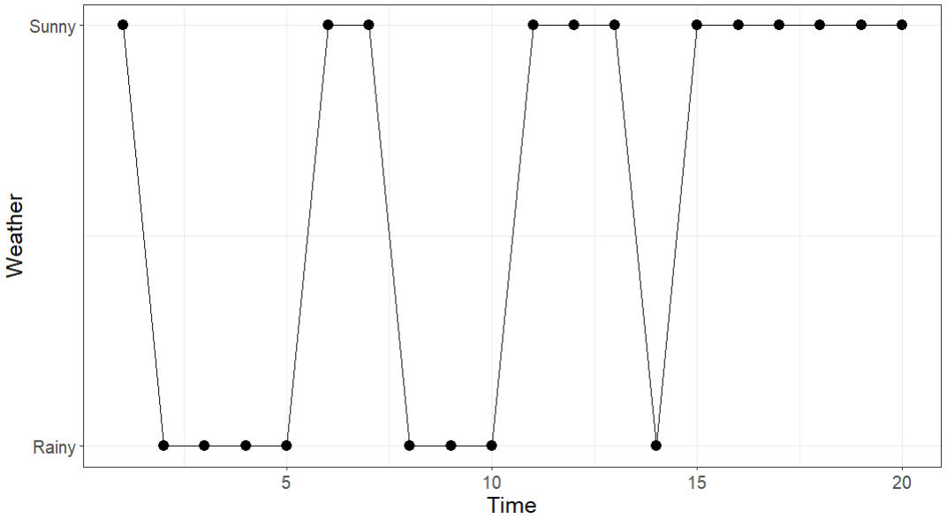

Slide 9
Tiger problem

Slide 10

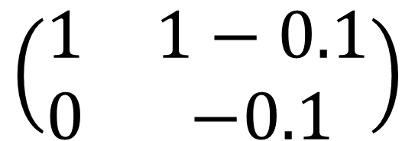
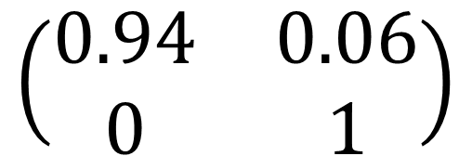
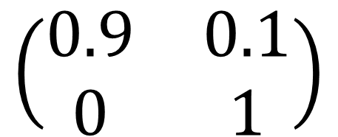
Tiger problem
States:
Actions:
Extant
Extinct
Transition function:
Reward function:
$$\left(\begin{matrix}0.9 & 0.1 \\ 0 & 1\end{matrix}\right)$$
$$\left(\begin{matrix}0.94 & 0.06 \\ 0 & 1\end{matrix}\right)$$
$$\left(\begin{matrix}1 & 1−0.1 \\ 0 & −0.1\end{matrix}\right)$$

Slide 11
Tiger problem
What is the best management strategy over 20?
  Use the function mdp_finite_horizon from the package MDPtoolbox
Think about ways to represent the optimal strategy

Slide 12
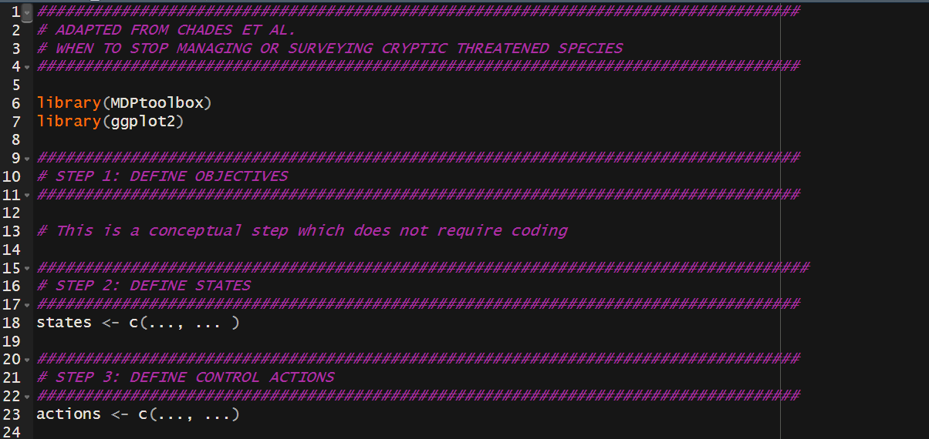
tutorial/01-tutorial tiger.R

Slide 13
Wolf culling

Slide 14

Wolf culling

Slide 15
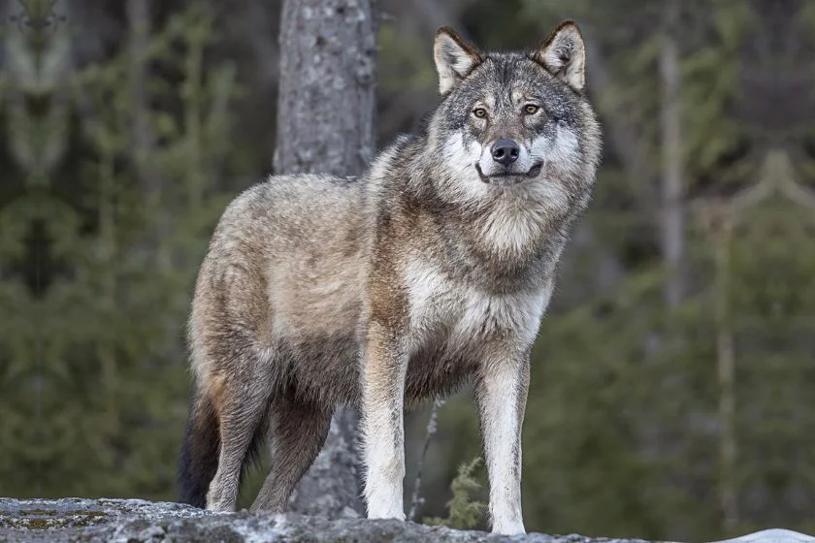
Wolf culling

Slide 16
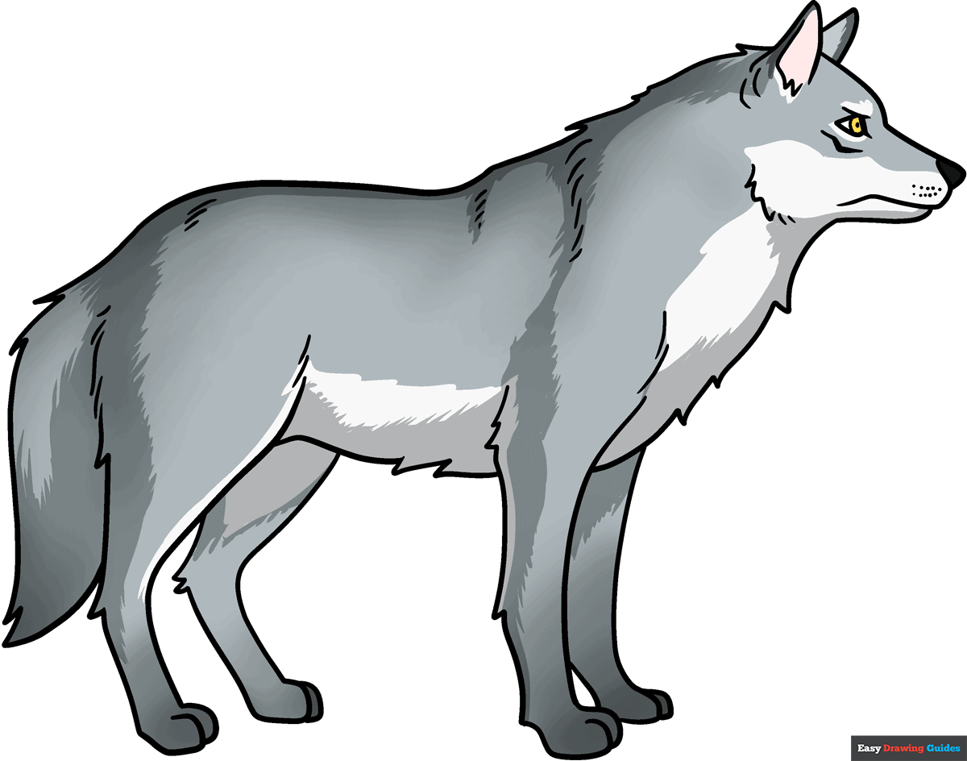

Wolf culling
Every year, the wolf population increases by a factor $λ$=1.25 with some stochasticity:
$$N_{t+1}\sim Poisson(λN_{t})$$
Number of wolves
Time
0
1
2
3
4
5

Slide 17
Wolf culling
Too many wolves
Just right
Number of wolves
Not enough wolves
Time
0
1
2
3
4
5

Slide 18
Wolf culling
Too many wolves
Culling
Just right
Number of wolves
Not enough wolves
Time
0
1
2
3
4
5

Slide 19
Wolf culling
Benefits:
  1 point per wolf
Costs:
  If the number of wolves > 200: we get 0 benefits
  If the number of wolves < 50: we get 0 benefits
  Culling costs 1 point per wolf
What is the best culling strategy over 50 years?

Slide 21
Wolf culling: possible solution
Objective: maximize cumulative rewards over a 50-year period
States: Number of wolves e.g. 0,1,…,200,…,250
  With state 250 an “absorbing state” (population larger than 250)
Actions: Rate of wolf culling e.g. 0, 0.01, …, 1
  Alternative: number of wolves removed

Slide 22
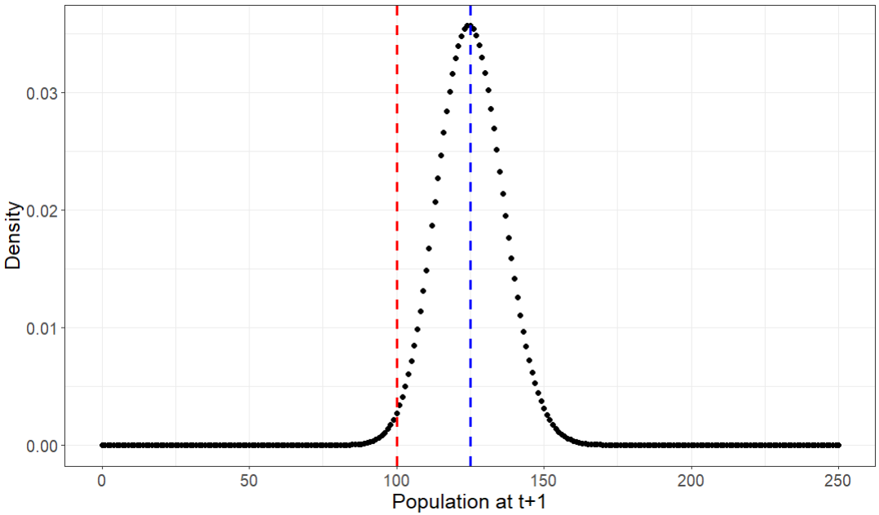


Wolf culling
Building the transition function with a Poisson process
$${λN}_{t}=125$$
$$N_{t}=100$$

Slide 23
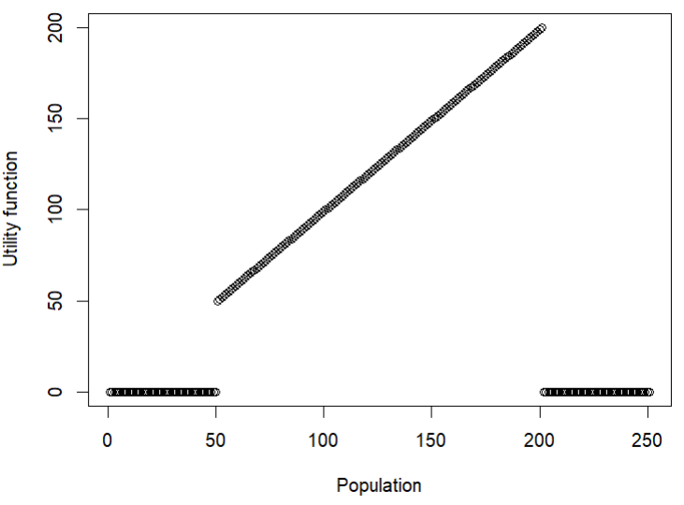
Wolf culling
Building the reward function

Slide 24
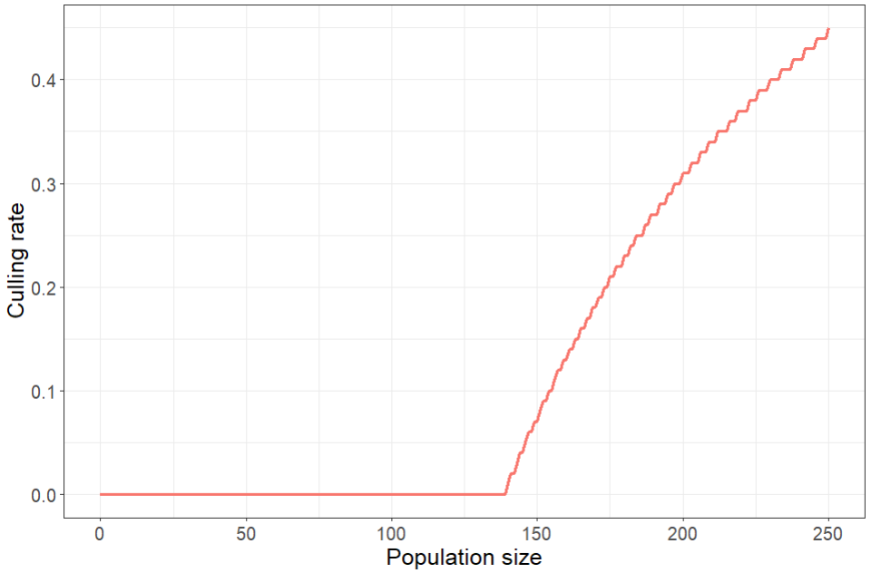
Wolf culling

Slide 25
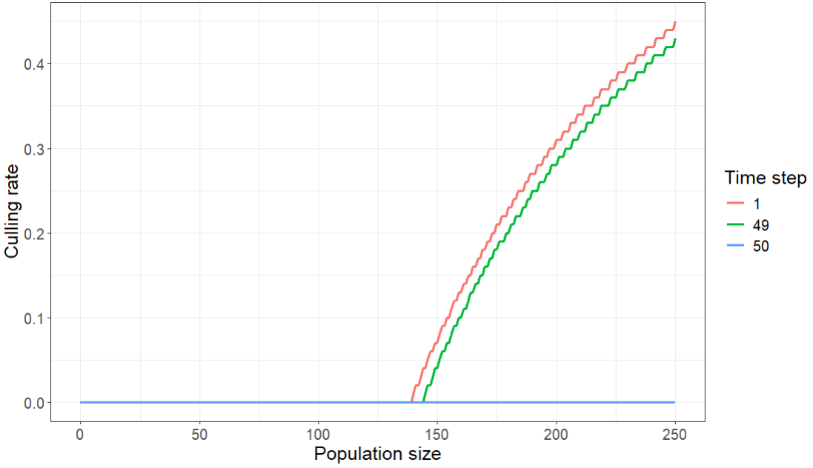
Wolf culling

Slide 26
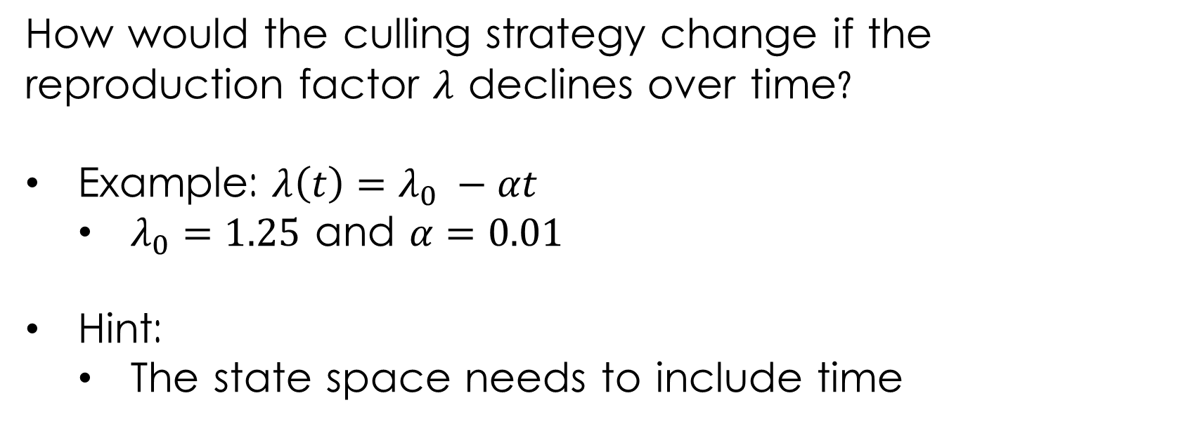
Wolf culling in changing environments
How would the culling strategy change if the reproduction factor $λ$ declines over time?
Example: $λ\left(t\right)=λ_{0} −αt$
  $λ_{0}=1.25$ and $α=0.01$
Hint:
  The state space needs to include time

