Slide 1

Acknowledgement of Country
  The University of Queensland (UQ) acknowledges the Traditional Owners and their custodianship of the lands on which we meet.
  We pay our respects to their Ancestors and their descendants, who continue cultural and spiritual connections to Country.
  We recognise their valuable contributions to Australian and global society.
Image: Digital reproduction of A guidance through time by Casey Coolwell and Kyra Mancktelow
Notes:
Guidelines for use:
Use this slide when presenting at UQ or at any site in Australia, when appropriate.
Remember to pause briefly after acknowledging Country as a sign of respect.
If you are more familiar with acknowledging Country you may add a statement about the event, meeting or forum’s connection with Country.
For example, at a higher education event you might acknowledge that the campus has always been a space for teaching, learning, research and collaboration tens of thousands of years before it was established as a university campus, and this continues today.
When to use longer version:
If you are the main speaker at the event/gathering
If you are the first person to present.
When to use a shorter version:
If you are not the first person to acknowledge Country
In a more informal setting
Thanking a Traditional Owner for welcoming people to Country.
Longer version
I acknowledge the Traditional Owners and their custodianship of the lands on which we meet today. On behalf of *, I pay our respects to their Ancestors and their descendants, who continue cultural and spiritual connections to Country. We recognise their valuable contributions to Australian and global society.
* If you are hosting an event, meeting or seminar, you might say something like, “On behalf of the event organisers or your section….”
Shorter version
I (too,) acknowledge the Traditional Owners and their custodianship of the lands on which we meet today and pay my respect to their Ancestors and their descendants.
You may wish to verbally include a line acknowledging the artwork and artists – “We extend our respect and acknowledge sisters and Quandamooka artists Casey Coolwell and Kyra Mancktelow for A guidance through time, the beautiful and powerful representation of reconciliation at UQ.”
Slide last updated February2023. Source: PVC(IE)/ATSISU (contact Nicole Rawson-Harris: uqrap@uq.edu.au).

Slide 2
Introduction to sequential decision-making for ecologists
Luz Pascal

Slide 3
Today:
9h30 – 10h30 | 1h lecture
10h30-11h00 | Morning tea
11h00-12h30 | Collaborative tutorial: implementing methods in R
12h30-13h30 | Lunch
13h30-16h00 | Collaborative tutorial 2: implementing methods in R And drop-in session: conversations

Slide 4
Context & motivation
How can we manage dynamic ecosystems?
How can we adapt our decisions to climate change?
How can we fish more sustainably?

Slide 5
Context & motivation
Markov Chains
Markov Decision Processes

Slide 6
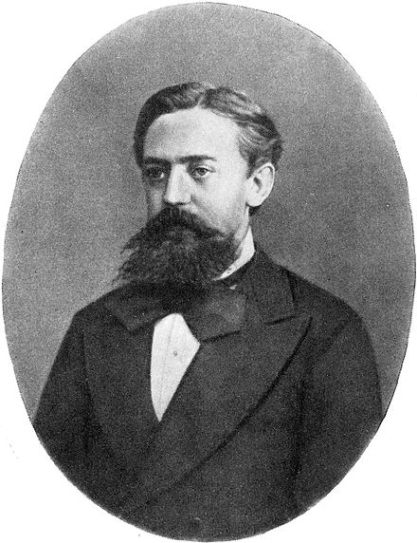
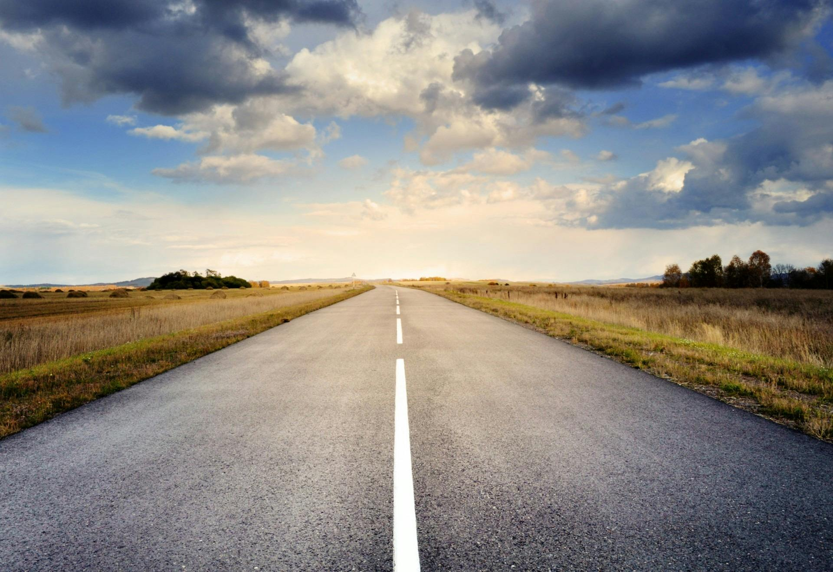

Markov Chains
Your past doesn’t
define your future
Your past doesn’t
define your future
Stochastic process describing a sequence of possible events in which the probability of each event depends only on the state attained in the previous event.
Let $X_{0}, X_{1}, X_{2},…$ be a sequence of random variables. This sequence is a discrete-time Markov chain if:
$$P\left(X_{n+1}=x\right|X_{0}=x_{0},X_{1}=x_{1},…,X_{n}=x_{n})$$
$$=P\left(X_{n+1}=x\right|X_{n}=x_{n})$$
Andrey Markov

Slide 7
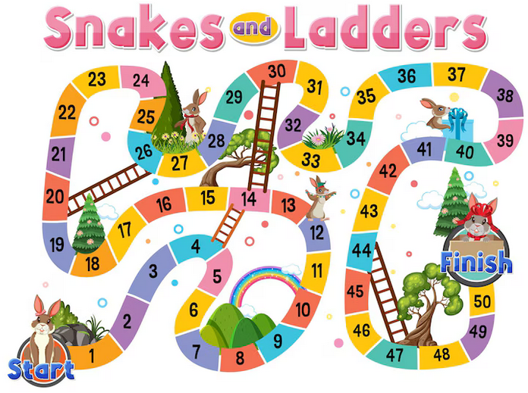
Markov Chains

Slide 8
Markov Chains
1/6 probability for each cell
Does not depend on the cells I have visited before

Slide 9
Markov Chains
How do I define a Markov chain?
  States: possible configurations of the studied system
  Transition function: how the system evolves over time

Slide 10



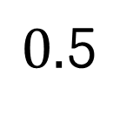
Markov Chains
Example:
  Reef ecosystem that can be described as unhealthy or healthy
  If unhealthy, the probability of staying unhealthy is 0.8
  If healthy, the probability of staying healthy is 0.5
To:
States:
Transition function:
0.8
0.2
From:
0.5
$0.$5

Slide 11
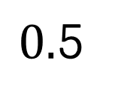

Markov Chains
To:
0.8
0.2
From:
0.5
$0.$5
0.2
0.8
Time
0
1
2
3
4
5
6

Slide 12
Markov Chains
To:
0.8
0.2
From:
0.5
$0.$5
0.2
0.8
Time
0
1
2
3
4
5
6

Slide 13


Markov Chains
To:
0.8
0.2
From:
0.5
$0.$5
$$0.2$$
$$0.8$$
Time
0
1
2
3
4
5
6

Slide 14
Markov Chains
To:
0.8
0.2
From:
0.5
0.5
$0.$5
0.5
Time
0
1
2
3
4
5
6

Slide 15
Markov Chains
To:
0.8
0.2
From:
0.5
$0.$5
Time
0
1
2
3
4
5
6

Slide 16
Markov Chains
To:
0.8
0.2
From:
0.5
$0.$5
Time
0
1
2
3
4
5
6

Slide 17
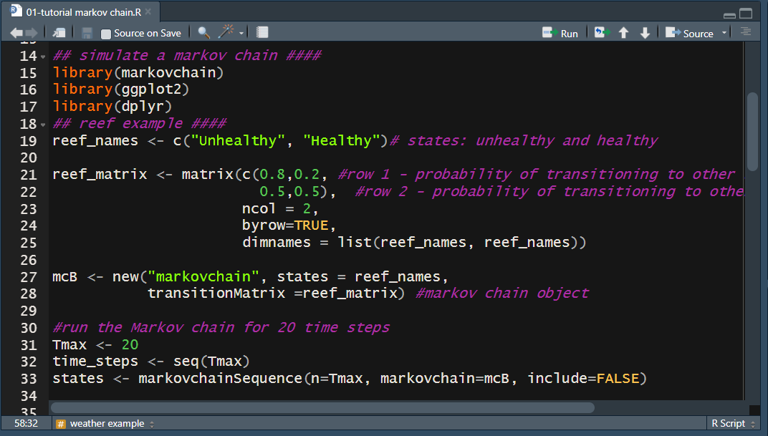
tutorial/01-tutorial markov chain.R

Slide 18
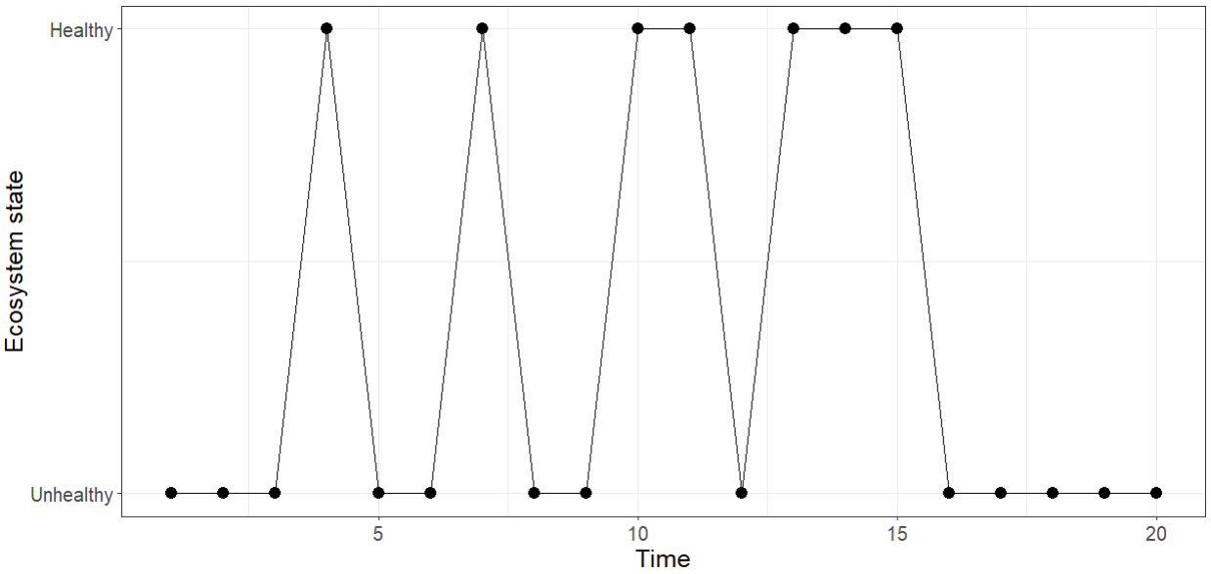
tutorial/01-tutorial markov chain.R

Slide 19


Markov Chains
Your turn!
If it is rainy today, the probability that tomorrow is sunny is 0.6
If it is sunny today, the probability that tomorrow is rainy is 0.2.
  Define the state space
  Define the transition function
To:
$$\left(\begin{matrix}0.4 & 0.6 \\ 0.2 & 0.8\end{matrix}\right)$$
Transition function:
States:
From:

Slide 20
Context & motivation
Markov Chains
Markov Decision Processes

Slide 21
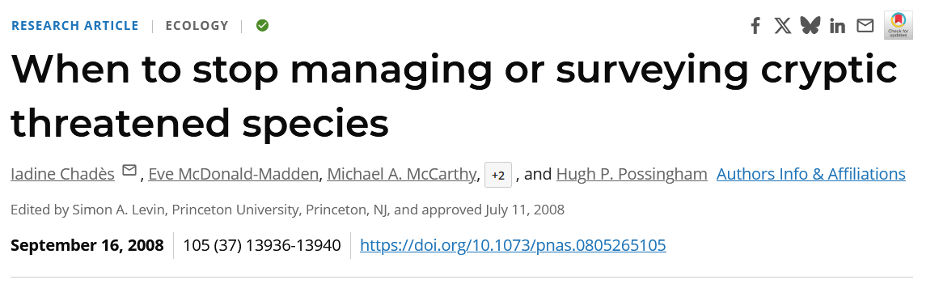
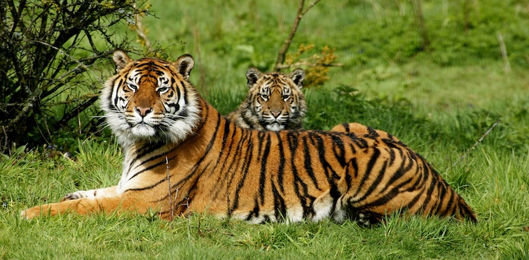

Slide 22


Markov Decision Processes
States:
Actions:
Extant
Extinct
Do nothing → free
Invest in management → helps with protection but costs money
…
Objective: find the best strategy to maximise our benefits over time

Slide 23
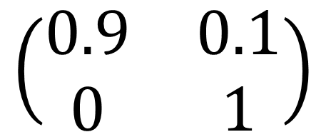
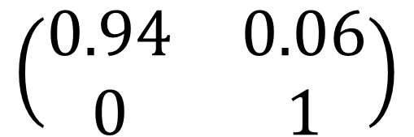
Markov Decision Processes
States:
Actions:
Extant
Extinct
Transition function:
To:
To:
$$\left(\begin{matrix}0.9 & 0.1 \\ 0 & 1\end{matrix}\right)$$
$$\left(\begin{matrix}0.94 & 0.06 \\ 0 & 1\end{matrix}\right)$$
From:
From:

Slide 24
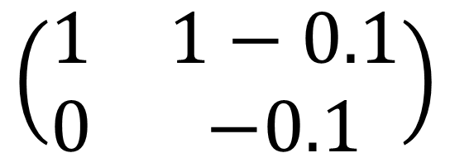
Markov Decision Processes
States:
Actions:
Extant
Extinct
Reward function:
$$\left(\begin{matrix}1 & 1−0.1 \\ 0 & −0.1\end{matrix}\right)$$

Slide 25
Markov Decision Processes
What action should I do?
or
0
-0.1
+ 1
0
Time
0
1
2
3
4
5
6

Slide 26


Markov Decision Processes
What action should I do?
0
$$0.9$$
+ 1
$$0.1$$
0
Time
0
1
2
3
4
5
6

Slide 27


Markov Decision Processes
What action should I do?
-0.1
$$0.96$$
+ 1
$$0.04$$
0
Time
0
1
2
3
4
5
6

Slide 28
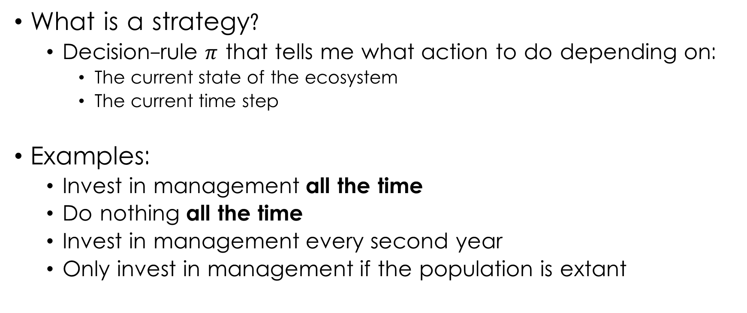
Markov Decision Processes
What is a strategy?
  Decision-rule $π$ that tells me what action to do depending on:
    The current state of the ecosystem
    The current time step
Examples:
  Invest in management all the time
  Do nothing all the time
  Invest in management every second year
  Only invest in management if the population is extant

Slide 29
Markov Decision Processes
-0.1
Let’s say I invest in management all the time
$0.9
$$0.96$$
+ 1
$$0.04$$
0
Time
0
1
2
3
4
5
6
Total points: $0.9

Slide 30


Markov Decision Processes
-0.1
Let’s say I invest in management all the time
$0.9
$0.9
$$0.96$$
+ 1
$$0.04$$
0
Time
0
1
2
3
4
5
6
Total points: $0.9
Total points: $1.8

Slide 31


Markov Decision Processes
-0.1
Let’s say I invest in management all the time
$0.9
$0.9
$0.9
$$0.96$$
+ 1
$$0.04$$
0
Time
0
1
2
3
4
5
6
Total points: $1.8
Total points: $2.7

Slide 32
Markov Decision Processes
-0.1
Let’s say I invest in management all the time
$0.9
$0.9
$0.9
$0.9
$0.9
$0.9
$0.9
+ 1
0
Time
0
1
2
3
4
5
6
Total points: $1.8
Total points: $6.3

Slide 33
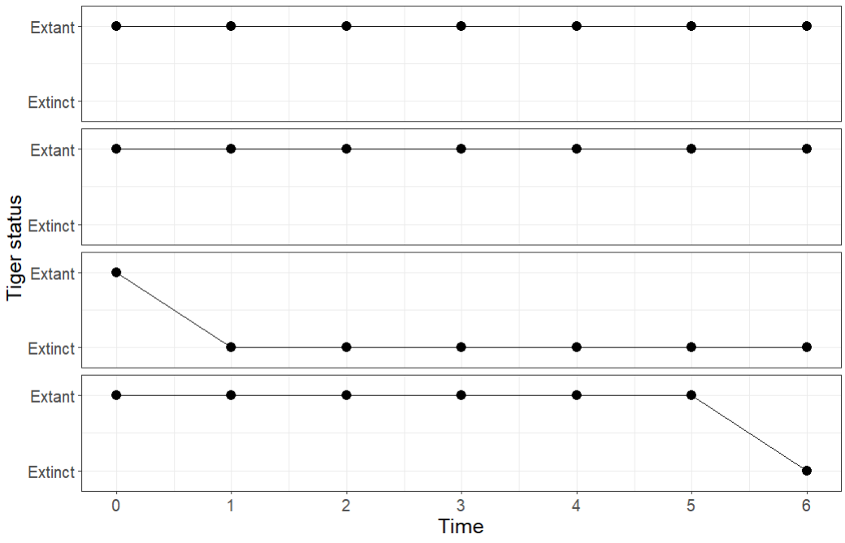
Simulation 1
Simulation 2
Simulation 3
Simulation 4

Slide 34
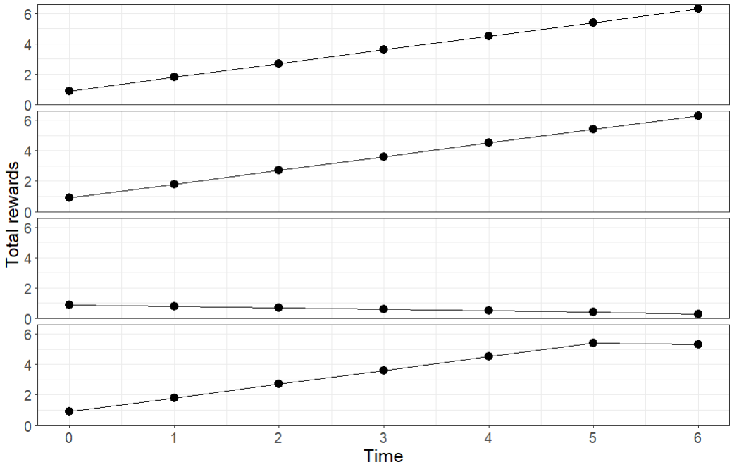
Simulation 1
Simulation 2
Simulation 3
Simulation 4

Slide 35
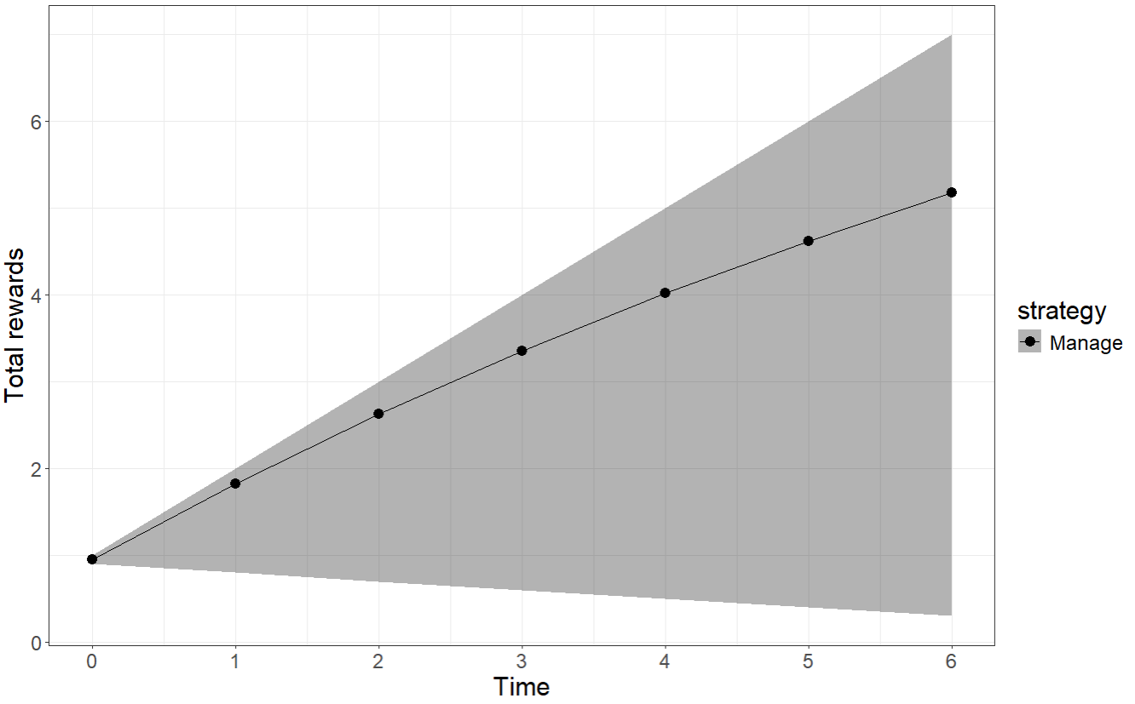
Over 1000 simulations
Mean value of doing “always manage”
95% quantiles

Slide 36
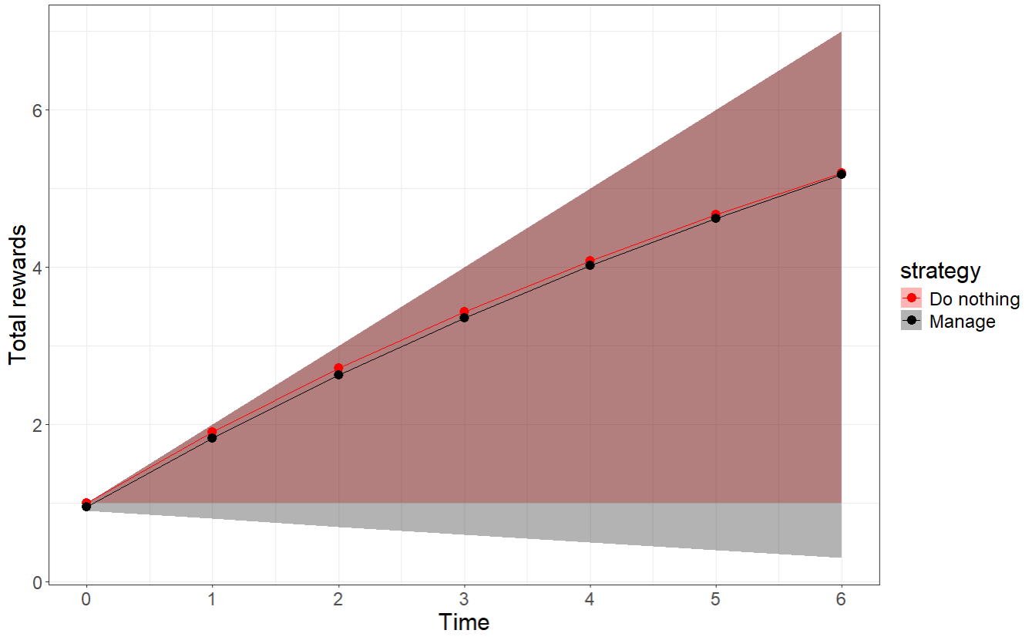
Over 1000 simulations

Slide 37
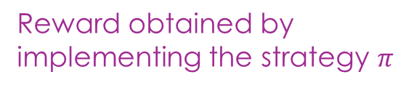

Markov Decision Processes
In one run of the strategy, I obtain:
$$\sum_{t=0}^{H}{{ γ}^{t}r(s_{t},π\left(s_{t}, t\right))}$$
When I have many runs, on average I obtain:
$$𝔼\left(\sum_{t=0}^{H}{{ γ}^{t}r(s_{t},π\left(s_{t}, t\right))} | s_{0}=s\right)$$
Reward obtained by implementing the strategy $π$
Discount factor
Initial state

Slide 38

Markov Decision Processes
What is a good strategy?
  Strategy that maximises the expected sum of rewards
$$V^{∗}\left(s\right)=max{𝔼\left(\sum_{t=0}^{H}{{ γ}^{t}r(s_{t},π\left(s_{t},t\right))} | s_{0}=s\right)}$$
$$π$$
Optimal value function:
“how much could I expect to obtain at best”

Slide 39

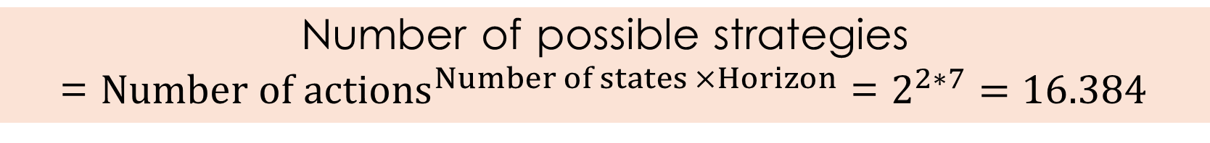
Markov Decision Processes
So many strategies I could test…
+ 1
0
Time
0
1
2
3
4
5
6
Number of possible strategies
= $Number of {actions}^{Number of states ×Horizon}$ = $2^{2∗7}=16.384$

Slide 40
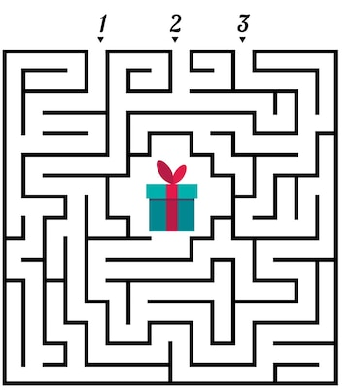

How can we solve an MDP?

Slide 41
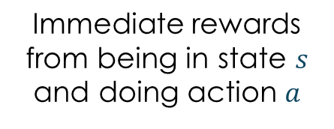
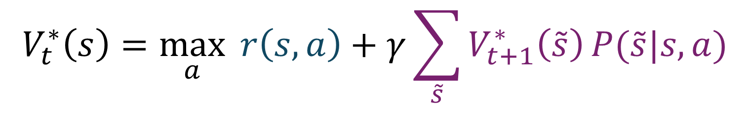
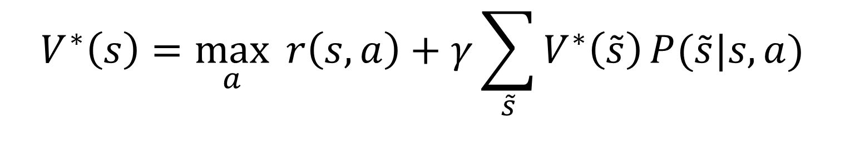
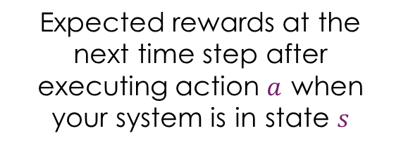
How can we solve an MDP?
  Bellman equation
$$V_{t}^{∗}\left(s\right)=\max_{a}{ r\left(s,a\right)+γ\sum_{\tilde{s}}{V_{t+1}^{∗}\left(\tilde{s}\right)}P(\tilde{s}|s,a)}$$
  Finite horizon:
Immediate rewards from being in state $s$ and doing action $a$
Expected sum of future rewards at the time step t
Expected rewards at the next time step after executing action $a$ when your system is in state $s$
$$V^{∗}\left(s\right)=\max_{a}{ r\left(s,a\right)+γ\sum_{\tilde{s}}{V^{∗}\left(\tilde{s}\right)}P(\tilde{s}|s,a)}$$
  Infinite horizon:

Slide 42

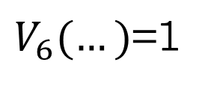
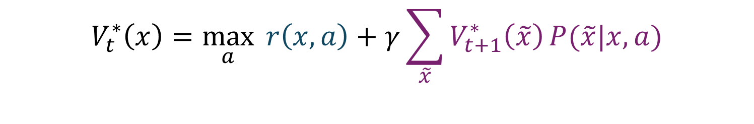
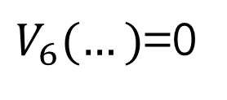
Markov Decision Processes
$$γ=0.9$$
$$V_{t}^{∗}\left(x\right)=\max_{a}{ r\left(x,a\right)+γ\sum_{\tilde{x}}{V_{t+1}^{∗}\left(\tilde{x}\right)}P(\tilde{x}|x,a)}$$
+1
$V_{6}(…)$=1
0
$V_{6}(…)$=0
Time
0
1
2
3
4
5
6

Slide 43
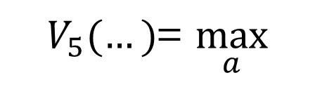


Markov Decision Processes
$$γ=0.9$$
$$V_{t}^{∗}\left(x\right)=\max_{a}{ r\left(x,a\right)+γ\sum_{\tilde{x}}{V_{t+1}^{∗}\left(\tilde{x}\right)}P(\tilde{x}|x,a)}$$
+1
$V_{6}(…)$=1
$V_{5}(…)$= $\max_{a}$
$$0+γ{[1∗V}_{6}\left(…\right)+0∗V_{6}(…)]=0$$
$$0$$
$$−0.1+γ{[1∗V}_{6}\left(…\right)+0∗V_{6}(…)]=−0.1$$
0
$V_{6}(…)$=0
$$1$$
Time
0
1
2
3
4
5
6

Slide 44
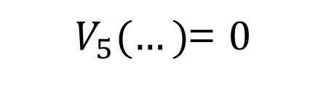
Markov Decision Processes
$$γ=0.9$$
$$V_{t}^{∗}\left(x\right)=\max_{a}{ r\left(x,a\right)+γ\sum_{\tilde{x}}{V_{t+1}^{∗}\left(\tilde{x}\right)}P(\tilde{x}|x,a)}$$
+1
$V_{6}(…)$=1
0
$V_{5}(…)$= $0$
$V_{6}(…)$=0
Time
0
1
2
3
4
5
6

Slide 45

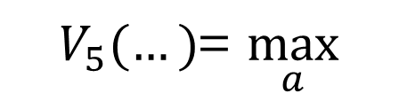

0.9+
Markov Decision Processes
$$γ=0.9$$
$$V_{t}^{∗}\left(x\right)=\max_{a}{ r\left(x,a\right)+γ\sum_{\tilde{x}}{V_{t+1}^{∗}\left(\tilde{x}\right)}P(\tilde{x}|x,a)}$$
+1
$$1+γ{[0.1∗V}_{6}\left(…\right)+0.9∗V_{6}(…)]=1.81$$
$$0.9$$
$V_{5}(…)$= $\max_{a}$
$V_{6}(…)$=1
$$0.1$$
0
$V_{6}(…)$=0
Time
0
1
2
3
4
5
6

Slide 46

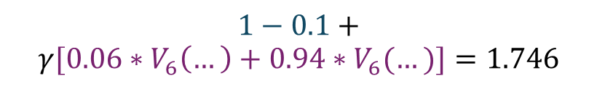

Markov Decision Processes
$$γ=0.9$$
$$V_{t}^{∗}\left(x\right)=\max_{a}{ r\left(x,a\right)+γ\sum_{\tilde{x}}{V_{t+1}^{∗}\left(\tilde{x}\right)}P(\tilde{x}|x,a)}$$
+1
$$1+γ{[0.1∗V}_{6}\left(…\right)+0.9∗V_{6}(…)]=1.81$$
$$0.94$$
$V_{5}(…)$= $\max_{a}$
$V_{6}(…)$=1
$$1−0.1+$$
$$γ{[0.06∗V}_{6}\left(…\right)+0.94∗V_{6}(…)]=1.746$$
$$0.06$$
0
$V_{6}(…)$=0
Time
0
1
2
3
4
5
6

Slide 47

Markov Decision Processes
$$γ=0.9$$
$$V_{t}^{∗}\left(x\right)=\max_{a}{ r\left(x,a\right)+γ\sum_{\tilde{x}}{V_{t+1}^{∗}\left(\tilde{x}\right)}P(\tilde{x}|x,a)}$$
+1
$V_{6}(…)$=1
$V_{5}(…)$=
$$1.81$$
0
$V_{5}(…)$= $0$
$V_{6}(…)$=0
Time
0
1
2
3
4
5
6

Slide 48



Markov Decision Processes
$$γ=0.9$$
$$V_{t}^{∗}\left(x\right)=\max_{a}{ r\left(x,a\right)+γ\sum_{\tilde{x}}{V_{t+1}^{∗}\left(\tilde{x}\right)}P(\tilde{x}|x,a)}$$
+1
$V_{6}(…)$=1
$$2.46$$
$V_{5}(…)$=
$$1.81$$
0
$$0$$
$V_{5}(…)$= $0$
$V_{6}(…)$=0
Time
0
1
2
3
4
5
6

Slide 49











Markov Decision Processes
$$γ=0.9$$
$$V_{t}^{∗}\left(x\right)=\max_{a}{ r\left(x,a\right)+γ\sum_{\tilde{x}}{V_{t+1}^{∗}\left(\tilde{x}\right)}P(\tilde{x}|x,a)}$$
+1
$V_{6}(…)$=1
$$4.12$$
$$3.8$$
$$3.43$$
$$2.99$$
$V_{5}(…)$=
$$1.81$$
$$2.46$$
0
$$0$$
$V_{5}(…)$= $0$
$V_{6}(…)$=0
$$0$$
$$0$$
$$0$$
$$0$$
Time
0
1
2
3
4
5
6

Slide 50
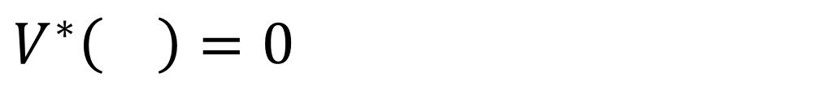
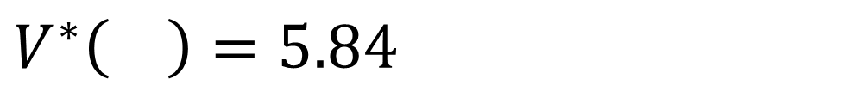
Markov Decision Processes
Infinite horizon
Optimal strategy:
Optimal value function:
$V^{∗}\left( \right)=5.84$
$V^{∗}\left( \right)=0$

Slide 51
Markov Decision Processes
5 steps:
Define your objective: what to we want to achieve?
Define the set of states:
Define the decision variables:
Build your transition model (Markov chain!!!!)
Define your utility function: costs and benefits of each action in each state

Slide 52
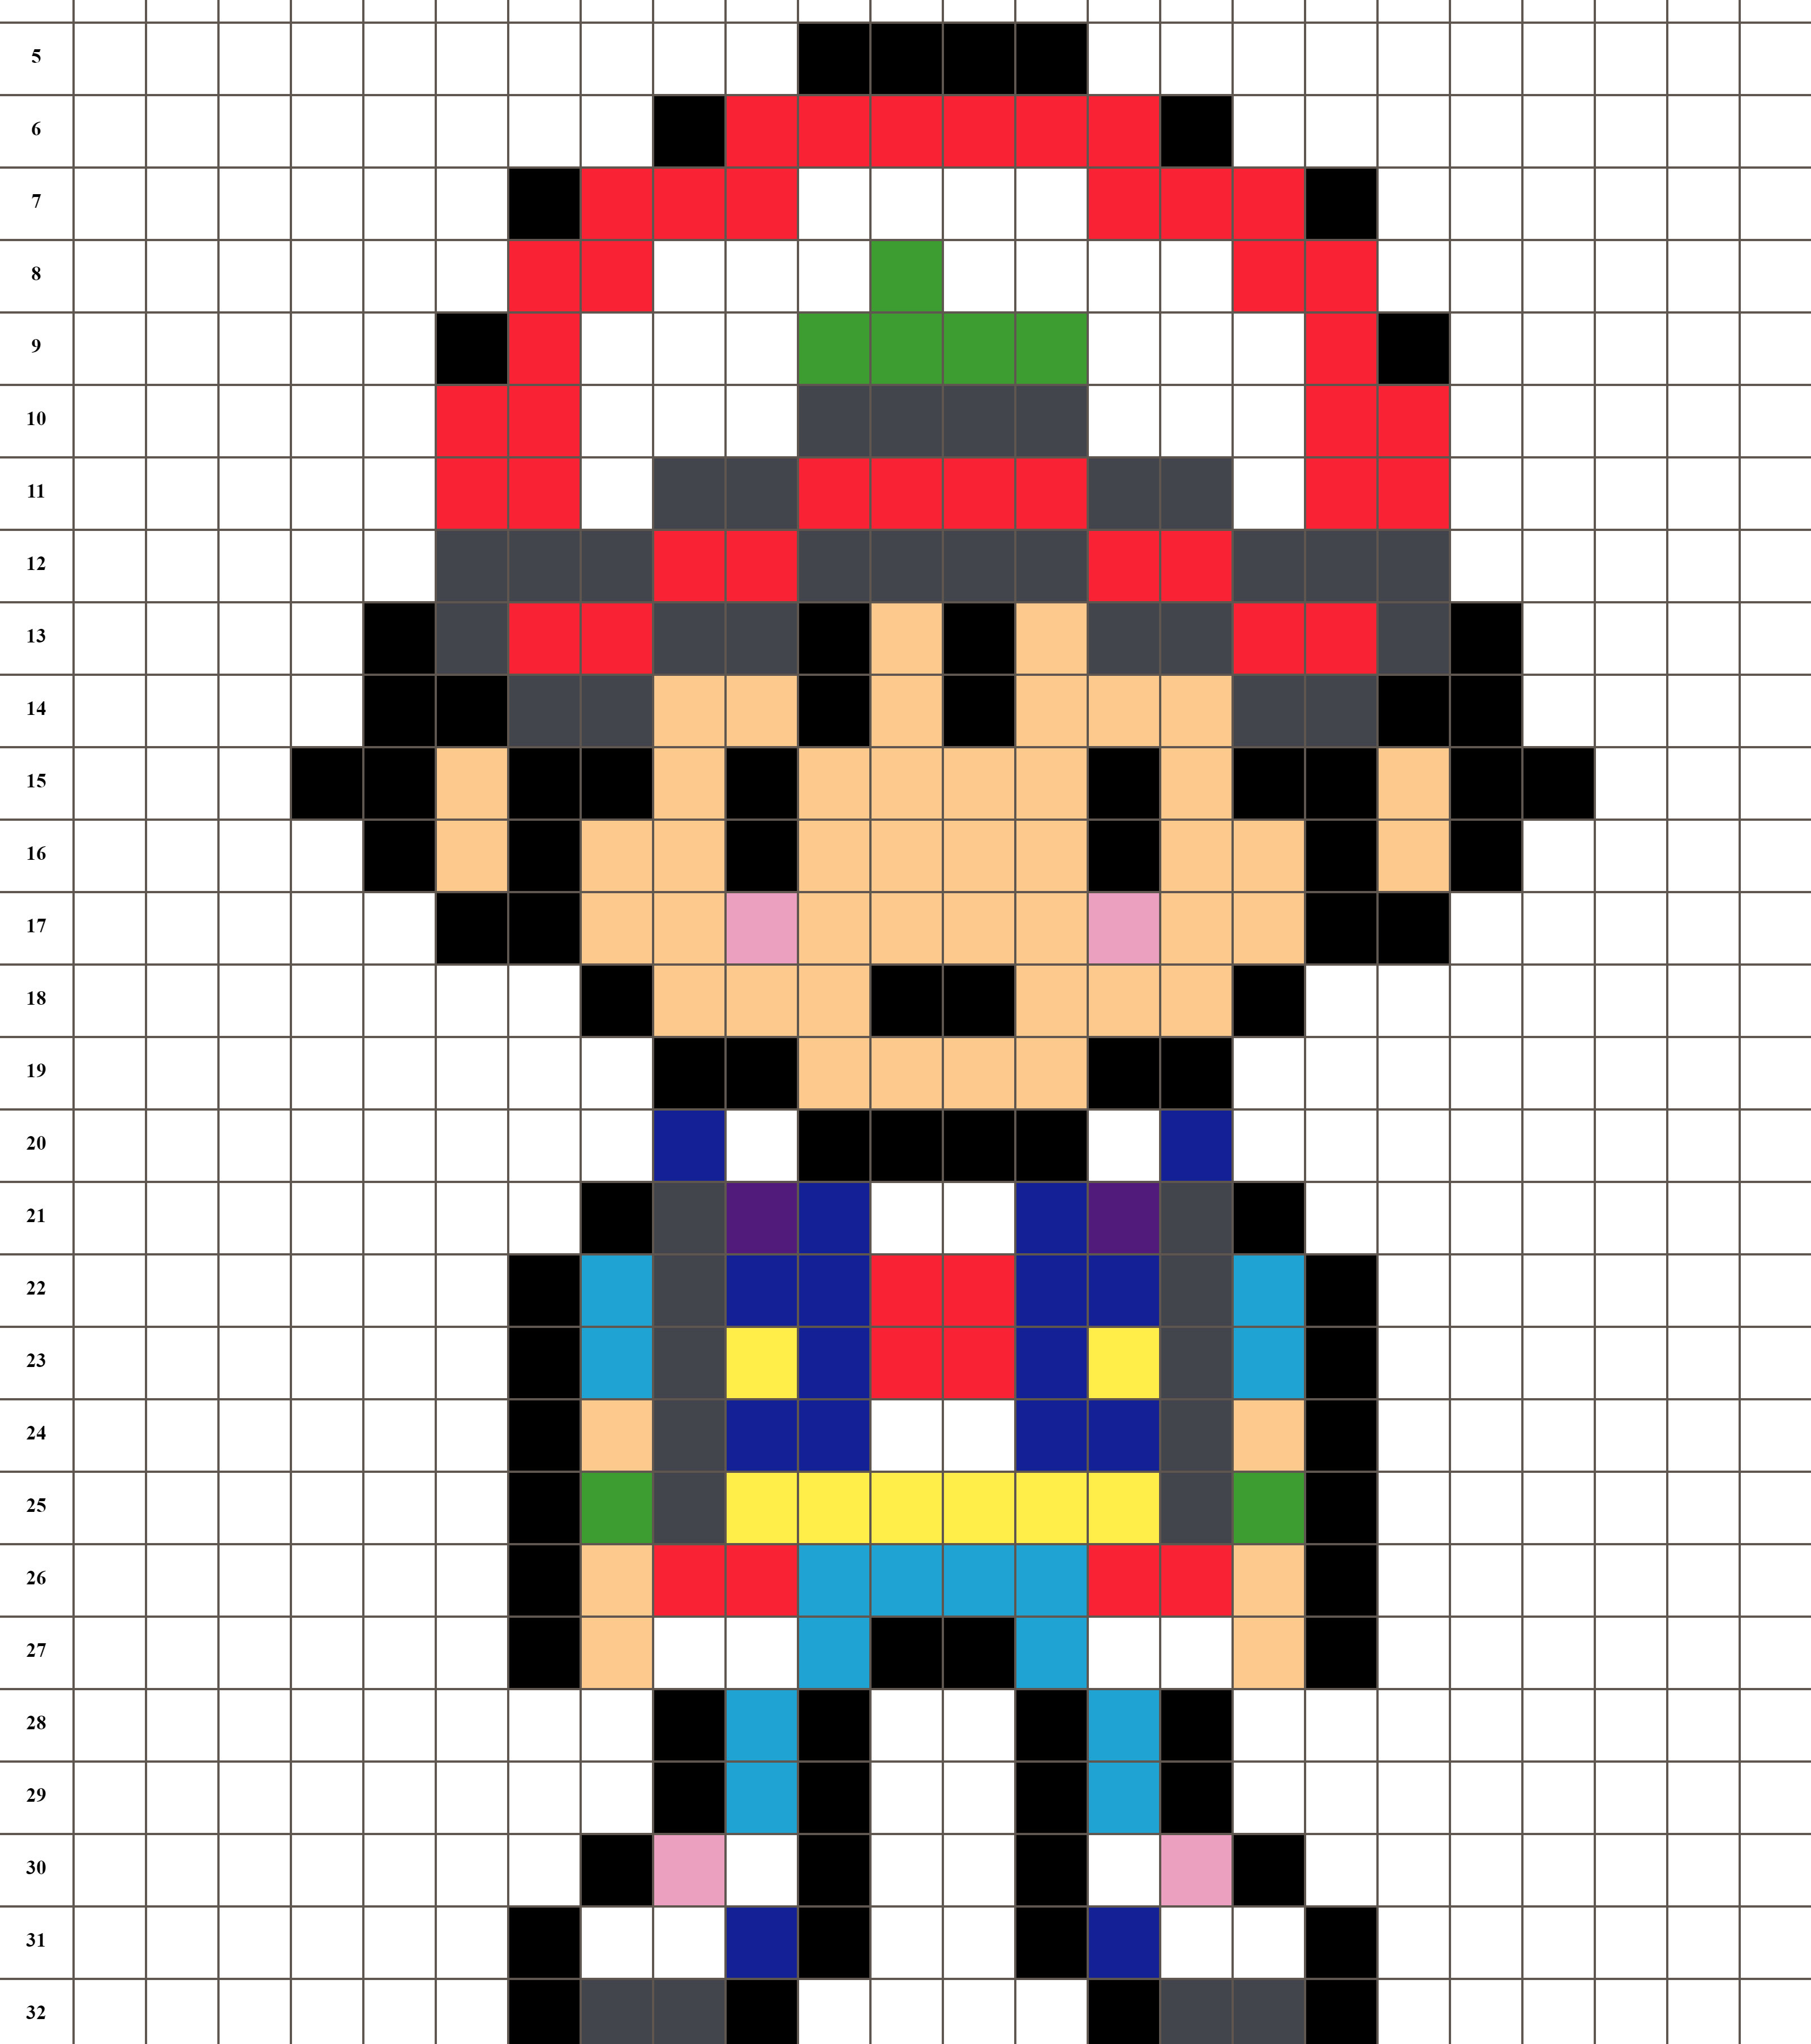


Markov Decision Processes
Your turn!
Moving from one cell to another costs 1.
Stepping on a trap costs 1.
Catching Lugia gives a reward of 10 and ends the game.
Define:
State space
Action space
The reward function
Intuitively what do you think is the best path to catch Lugia?

Slide 53
Markov Decision Processes
State space

Slide 54
Markov Decision Processes
State space

Slide 55
Markov Decision Processes
State space

Slide 56
Markov Decision Processes
State space

Slide 57
Markov Decision Processes
State space

Slide 58
Markov Decision Processes
State space

Slide 59
Markov Decision Processes
State space

Slide 60
Markov Decision Processes
State space

Slide 61
Markov Decision Processes
State space

Slide 62

Markov Decision Processes
Action space

Slide 63
Markov Decision Processes
Reward function
-1
-1

Slide 64
Markov Decision Processes
Reward function
-1
-1
-2

Slide 65
Markov Decision Processes
Reward function
-1
-1
-1
9

Slide 66
Markov Decision Processes
Best path?

Slide 67
Markov Decision Processes
Best path?
Black: 6 points
-1
-2
9

Slide 68
Markov Decision Processes
Best path?
Black: 6 points
Orange: 6 points
-1
-2
9

Slide 69
Markov Decision Processes
Best path?
Black: 6 points
Orange: 6 points
Green: 5 points
-1
-1
-1
9
-1

