Slide 1
By: Fan Guo (A20473828)
Hong Yao (A20472837)
Team:
Algorithm & Logarithm
Face Mask Detection for Covid
By: Fan Guo (A20473828) Hong Yao (A20472837)
Team: Algorithm & Logarithm

Slide 2
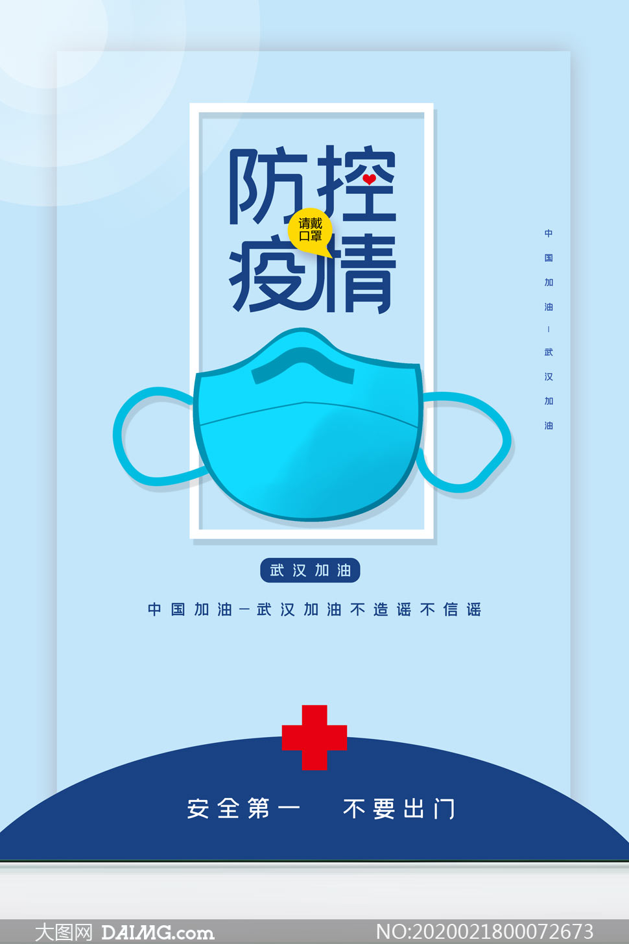
1. Motivation And Problem Description
Ever since the outbreak of convid-19 pandemic, the world is heavily hit. The number of diagnosed infection case is still growing, and people are still suffering from this disease physically, economically, and spiritually. Right now, it seems the spreading momentum is slightly constrained, with the help of vaccine, potent drugs and other successful anti-virus experiences.
1
2
putting a mask
over the face is not a natural and comfortable habit
many people are still emotionally against wearing masks in public.
Thus, Develop A System about Face Mask Detection.

Slide 3
2. Objectives
Objective 1
Objective 2
We try to optimize existing similar programs on Kaggle, making full use of online dataset, wishing to achieve a higher accuracy rate.
It should be a good practice of what we have learned from the course CS584, such as the Convolutional Neural Network, Transfer Learning, and so on.

Slide 4
3. Algorithm Essence
Xception
Inspired by the concept of transfer learning, we make use of the Xception model to train ”whether or not to wear a mask”. It is supposed to be time-saving and should reduce the magnitude of the calculation.
Note: Xception is a highly recognized efficient model for target detection, fine-grained classification, face attributes and large-scale geolocation scenarios.
Initially, we tried another model, MobileNet, but the result isn’t quite what we expected, so we switched to Xception Model.

Slide 5
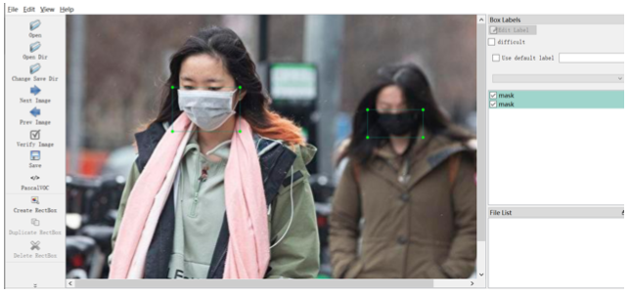
4. Prepare Image Dataset
----Download a dataset from Kaggle
----Tagged by the tool Labelimg
Labelimg is a graphical image annotation tool, written in Python and uses Qt for its graphical interface.
After successfully installing Labelimg, we label each picture, mark them with the W key, and save as LXML files. (Shown as below)

Slide 6
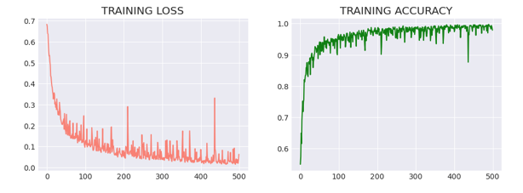
5. Project results
As the number of epoch increases, we achieve a high accuracy almost 100%, which is quite good.
Even though our program is a Mask Detection system, its algorithm should be able to implemented in many classification problems. If without the time limit, we think we can add more features to the system. And It can be used as a basis model for similar classification problems in our future work.

Slide 7
PART 02
Code Detail

Slide 8
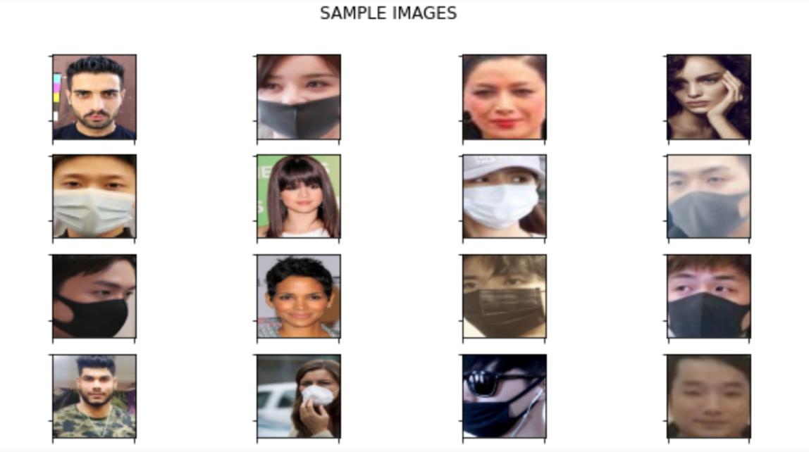
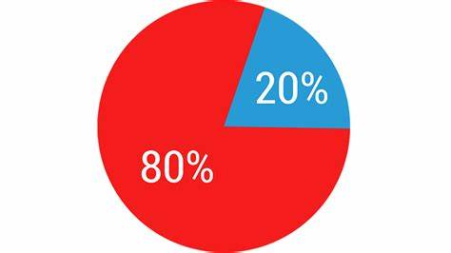
103 images of COVID-19, 500 images of non-COVID-19 pneumonia, and 500 images of the healthy lung were downloaded from links provided by the COVID-Net Github site. To balance the dataset, I expanded COVID-19 class to 500 images by slight rotation (probability=1, max rotation=5) and zooming (probability=0.5, percentage_area=0.9) of the original images using the Augmentor python package. 80% of images were assigned for training and 20% for validating the ML models.
1. Dataset
1915 images with mask and 1918 images without mask.(Face Mask Detection Data)
80% of images were assigned for training and 20% for validating the ML models.
Notes:
1915 images with mask and 1918 images without mask.They were downloaded from links provided by the Kaggle site. 80% of images were assigned for training and 20% for validating the ML models.
When evaluate the predictive performance of model, its essential that the process be unbiased. Using train_test_split() from the data science library scikit-learn, We can split our dataset into subsets that minimize the potential for bias in evaluation and validation process.

Slide 9
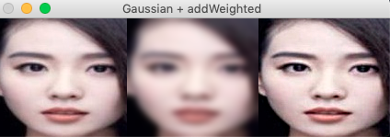
103 images of COVID-19, 500 images of non-COVID-19 pneumonia, and 500 images of the healthy lung were downloaded from links provided by the COVID-Net Github site. To balance the dataset, I expanded COVID-19 class to 500 images by slight rotation (probability=1, max rotation=5) and zooming (probability=0.5, percentage_area=0.9) of the original images using the Augmentor python package. 80% of images were assigned for training and 20% for validating the ML models.
2. Preprocessiong The Images
1. blur the image.
2. subtract this smoothed image from the original image.
Finally the original image will enhance the high-frequency components.
image
Blur the image
Apply Unsharp masking
Notes:
OpenCV provides cv2.gaussianblur function to apply Gaussian Smoothing on the input source image.
First, we blur the image. We know by smoothing an image we suppress most of the high-frequency components.
Then, we subtract this smoothed image from the original image(the resulting difference is known as a mask). Thus, the output image will have most of the high-frequency components that are blocked by the smoothing filter.
Adding this mask back to the original will enhance the high-frequency components.

Slide 10
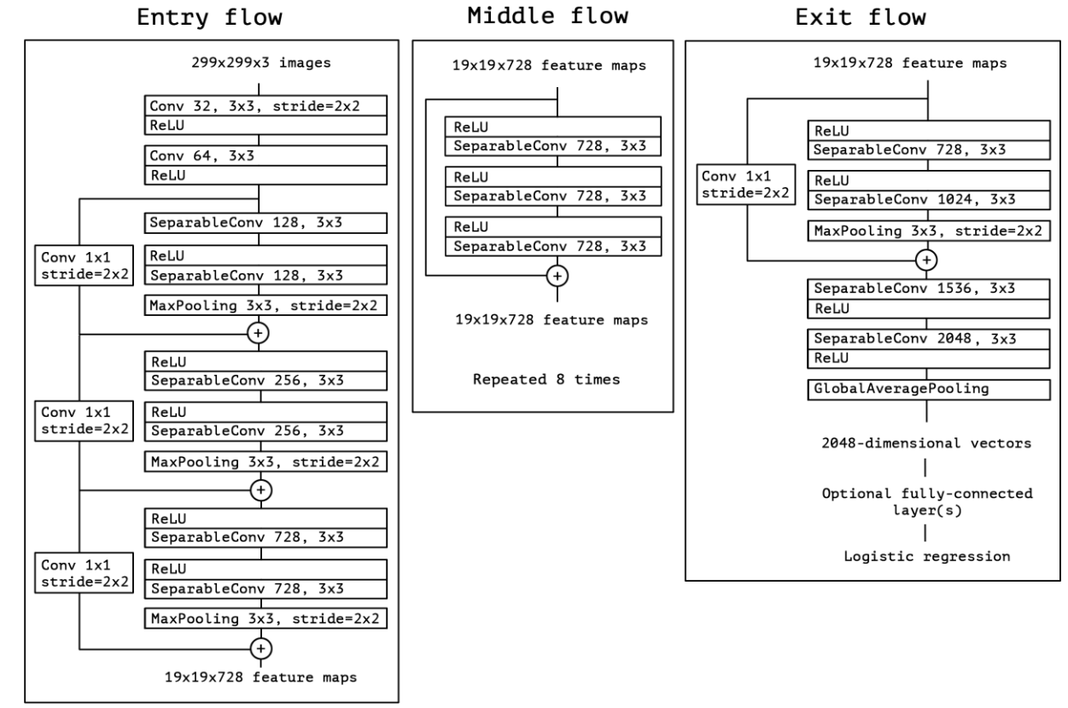
3. Xception Algorithm
Notes:
For this model, I used transfer learning with the Xception model pre-trained on the Image dataset (3833 images in 2 categories). Xception model, with depthwise separable convolution, is an advanced deep learning model that beat the competition in Image classification. Transfer learning is a useful tool when you don’t have large enough dataset to train the model .

Slide 11
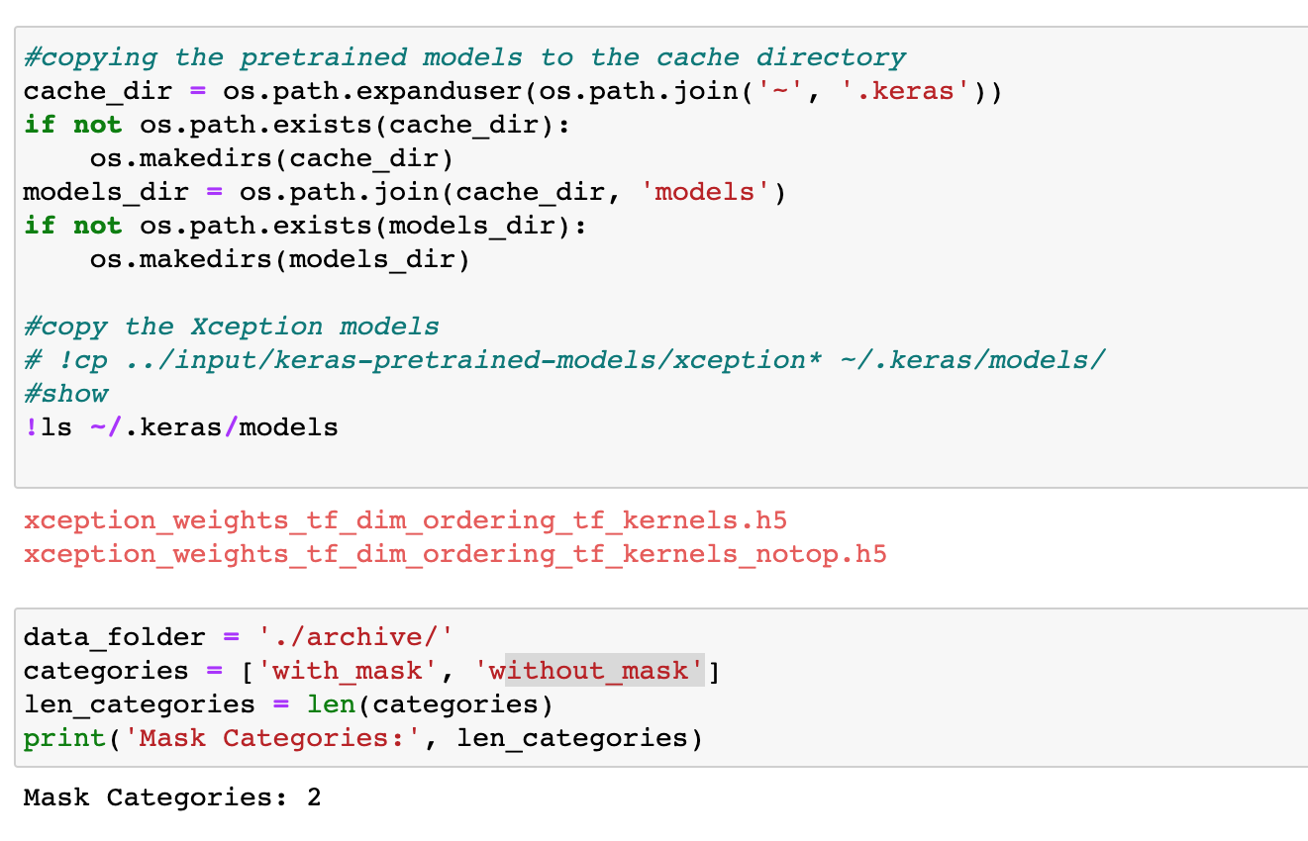
4. Data Utilities

Slide 12
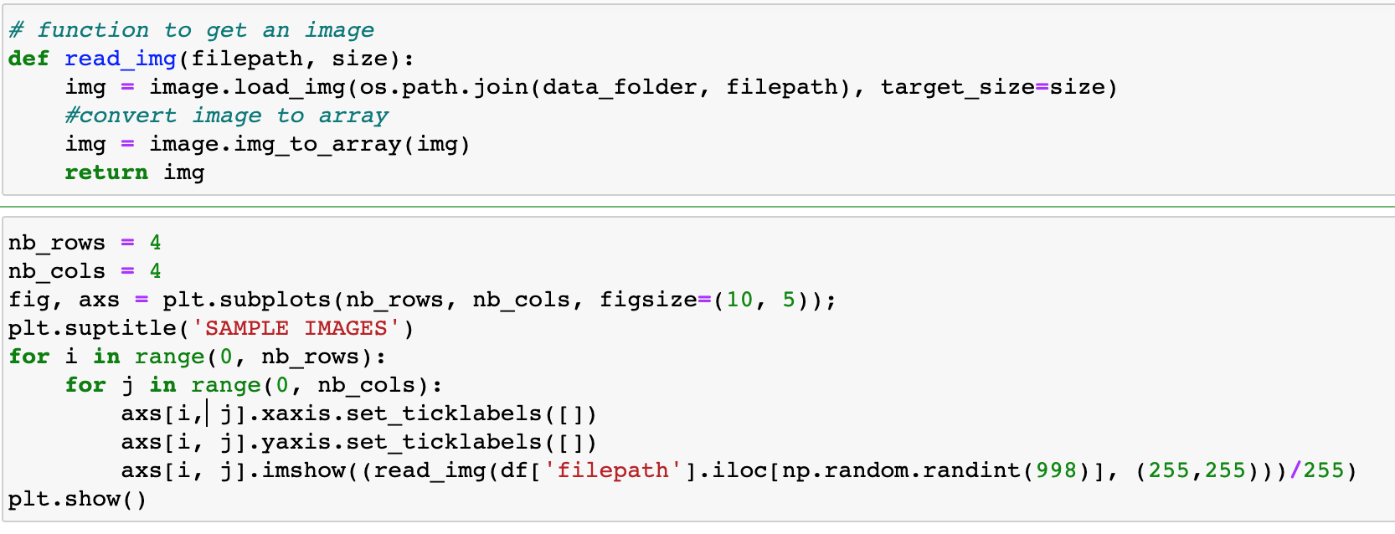
5. Show Sample Images

Slide 13
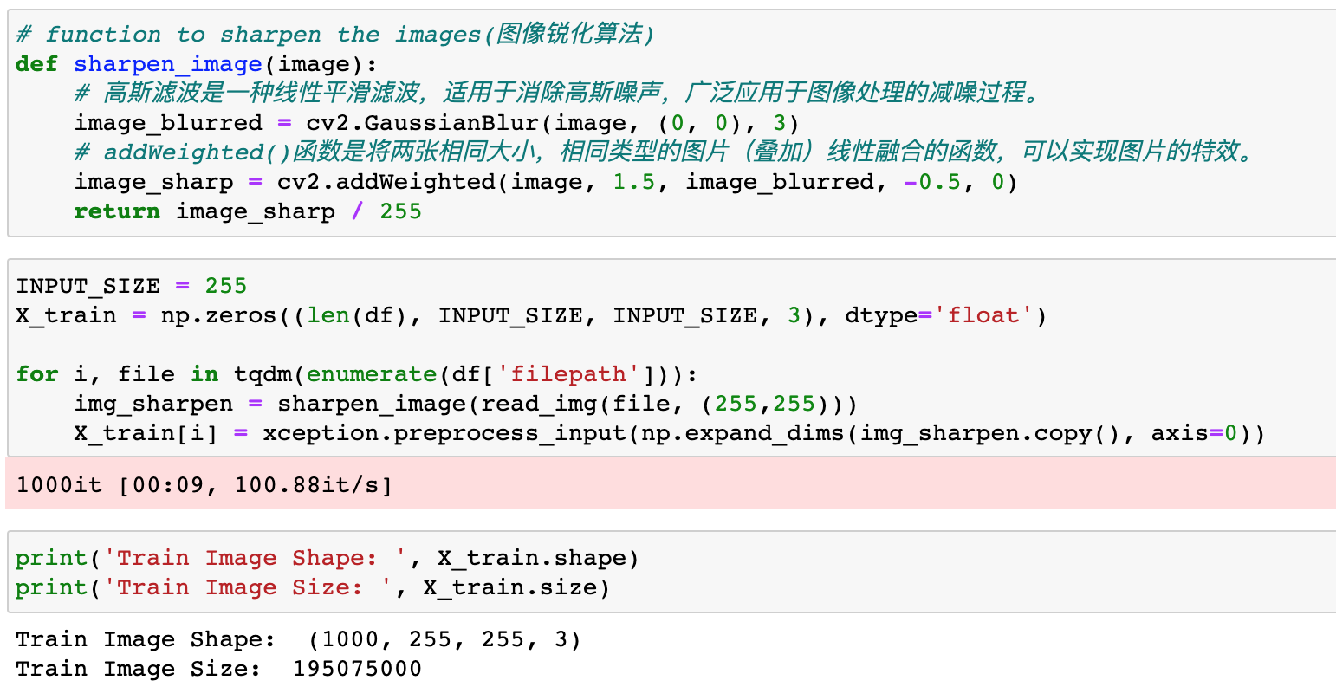
6.Preprocessing The Images

Slide 14
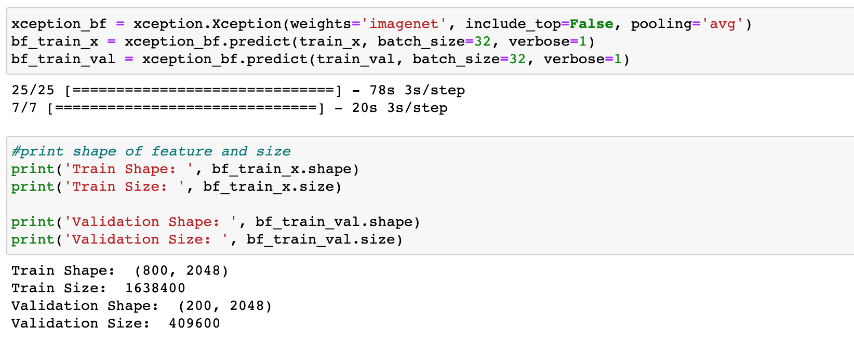
7. Bottleneck Feature Extraction

Slide 15
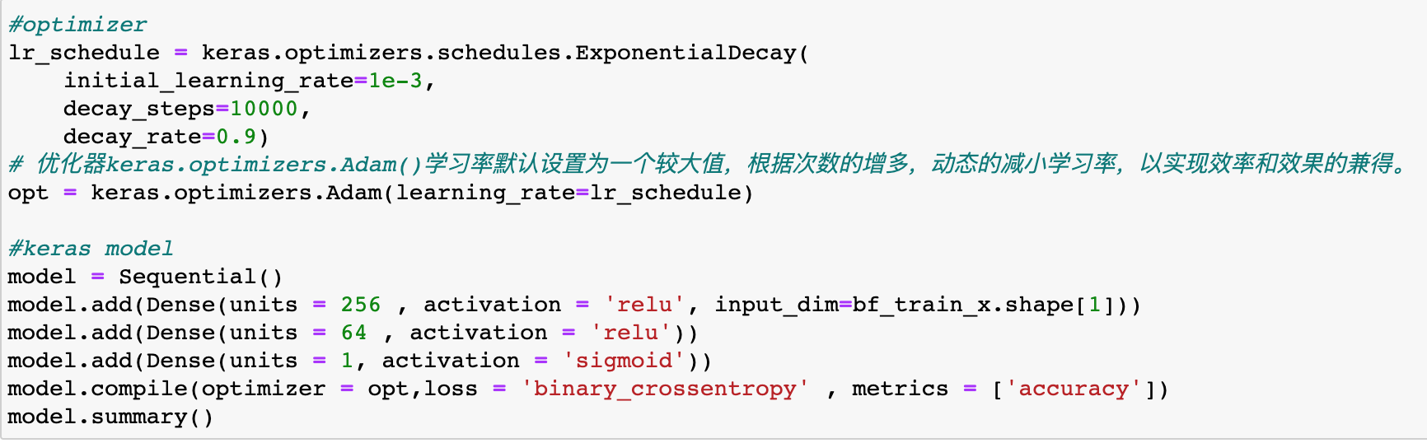
8. Modelling

Slide 16
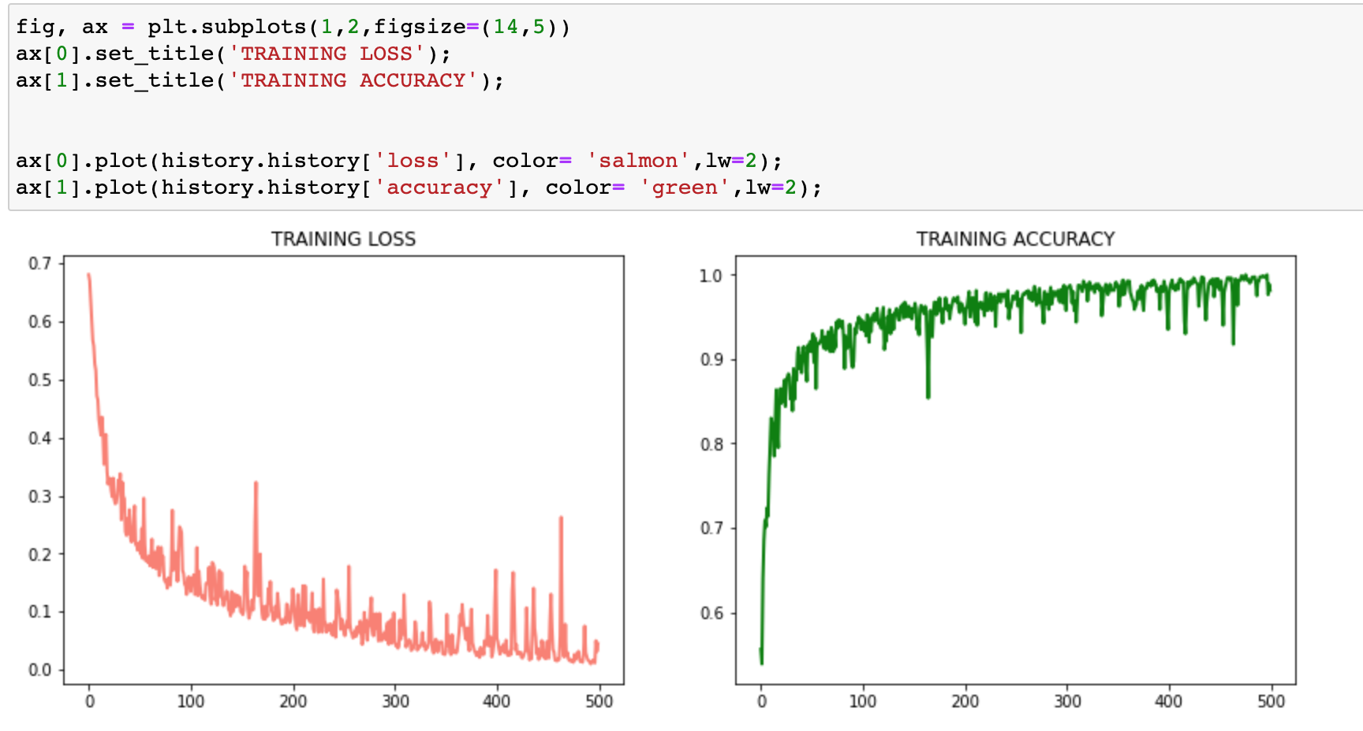
9. Loss And Accuracy

Slide 17
Thanks
By: Fan Guo (A20473828) Hong Yao (A20472837)
Team: Algorithm & Logarithm

