Slide 1
[GRAPHIC INTERFACE] Title: Country Concert Selector (Data provided by SeatGeek)
Menu Button
Label
Label output
Menu
California
June 14
June in Country Music
Check Button
Colorado
June 15
Select you State
SShow Results
SClear
Results
DC
June 16
Button
Select you Day
NDisplay results
Georgia
June 17
Text output
PPrice:
Less than $20
EAs presented in the seven next slides, each input gradually filter more narrowly the database. At anytime, the user is able to display the results or to clear the output text field, the output label fields and to turn the check-buttons off.
$20-$99.99
$100-$199.99
$200-$399.99
Clear Selection

Slide 2
[GRAPHIC INTERFACE] Title: Country Concert Selector (Data provided by SeatGeek)
Menu Button
Check button ON
Menu
California
June 14
June in Country Music
Check Button
Colorado
June 15
Select you State
SShow Results
SClear
Results
DC
June 16
Button
Select you Day
June 14 from 8:00 PM to 10:00 PM.
Front Country at Sacramento, California.
Location: Harlows Night Club.
Price is starting from $15.
Try your link: http://www.ticketfly.com/event/1468222-front-country-sacramento/
Georgia
June 17
Text output
PPrice:
Less than $20
This slide displays the results when the check buttons in red are ON.
$20-$99.99
$100-$199.99
$200-$399.99
Database filtered by:
State
Clear Selection

Slide 3
[GRAPHIC INTERFACE] Title: Country Concert Selector (Data provided by SeatGeek)
Menu Button
Check button ON
Menu
California
June 14
June in Country Music
Check Button
Colorado
June 15
Select you State
SShow Results
SClear
Results
DC
June 16
Button
Select you Day
June 14 from 8:00 PM to 10:00 PM.
Front Country at Sacramento, California.
Location: Harlows Night Club.
Price is starting from $15.
Try your link: http://www.ticketfly.com/event/1468222-front-country-sacramento/
Georgia
June 17
Text output
PPrice:
Less than $20
This slide displays the results when the check buttons in red are ON.
$20-$99.99
$100-$199.99
$200-$399.99
Database filtered by:
Day
Clear Selection

Slide 4
[GRAPHIC INTERFACE] Title: Country Concert Selector (Data provided by SeatGeek)
Menu Button
Check button ON
Menu
California
June 14
June in Country Music
Check Button
Colorado
June 15
Select you State
SShow Results
SClear
Results
DC
June 16
Button
Select you Day
June 14 from 8:00 PM to 10:00 PM.
Front Country at Sacramento, California.
Location: Harlows Night Club.
Price is starting from $15.
Try your link: http://www.ticketfly.com/event/1468222-front-country-sacramento/
Georgia
June 17
Text output
PPrice:
Less than $20
This slide displays the results when the check buttons in red are ON.
$20-$99.99
$100-$199.99
$200-$399.99
Database filtered by:
Less than $20
Clear Selection

Slide 5
[GRAPHIC INTERFACE] Title: Country Concert Selector (Data provided by SeatGeek)
Menu Button
Check button ON
Menu
California
June 14
June in Country Music
Check Button
Colorado
June 15
Select you State
SShow Results
SClear
Results
DC
June 16
Button
Select you Day
June 14 from 8:00 PM to 10:00 PM.
Front Country at Sacramento, California.
Location: Harlows Night Club.
Price is starting from $15.
Try your link: http://www.ticketfly.com/event/1468222-front-country-sacramento/
Georgia
June 17
Text output
PPrice:
Less than $20
This slide displays the results when the check buttons in red are ON.
$20-$99.99
$100-$199.99
$200-$399.99
Database filtered by:
State
Day
Clear Selection

Slide 6
[GRAPHIC INTERFACE] Title: Country Concert Selector (Data provided by SeatGeek)
Menu Button
Check button ON
Menu
California
June 14
June in Country Music
Check Button
Colorado
June 15
Select you State
SShow Results
SClear
Results
DC
June 16
Button
Select you Day
June 14 from 8:00 PM to 10:00 PM.
Front Country at Sacramento, California.
Location: Harlows Night Club.
Price is starting from $15.
Try your link: http://www.ticketfly.com/event/1468222-front-country-sacramento/
Georgia
June 17
Text output
PPrice:
Less than $20
This slide displays the results when the check buttons in red are ON.
$20-$99.99
$100-$199.99
$200-$399.99
Database filtered by:
State
Less than $20
Clear Selection

Slide 7
[GRAPHIC INTERFACE] Title: Country Concert Selector (Data provided by SeatGeek)
Menu Button
Check button ON
Menu
California
June 14
June in Country Music
Check Button
Colorado
June 15
Select you State
SShow Results
SClear
Results
DC
June 16
Button
Select you Day
June 14 from 8:00 PM to 10:00 PM.
Front Country at Sacramento, California.
Location: Harlows Night Club.
Price is starting from $15.
Try your link: http://www.ticketfly.com/event/1468222-front-country-sacramento/
Georgia
June 17
Text output
PPrice:
Less than $20
This slide displays the results when the check buttons in red are ON.
$20-$99.99
$100-$199.99
$200-$399.99
Database filtered by:
Day
Less than $20
Clear Selection

Slide 8
[GRAPHIC INTERFACE] Title: Country Concert Selector (Data provided by SeatGeek)
Menu Button
Check button ON
Menu
California
June 14
June in Country Music
Check Button
Colorado
June 15
Select you State
SShow Results
SClear
Results
DC
June 16
Button
Select you Day
June 14 from 8:00 PM to 10:00 PM.
Front Country at Sacramento, California.
Location: Harlows Night Club.
Price is starting from $15.
Try your link: http://www.ticketfly.com/event/1468222-front-country-sacramento/
Georgia
June 17
Text output
PPrice:
Less than $20
This slide displays the results when the check buttons in red are ON.
$20-$99.99
$100-$199.99
$200-$399.99
Database filtered by:
State
Day
Less than $20
Clear Selection

Slide 9
Diagram of the Data Structure
STATES
California
Colorado
DC
Georgia
Illinois
…
Washington
Wisconsin
June 14
June 15
…
June 30
DAY and TIME
CONCERT, CITY and STATE
LOCATION
PRICE
LINK
Less than $20
$20-$99.99
$100-$199.99
$200-$399.99

Slide 10
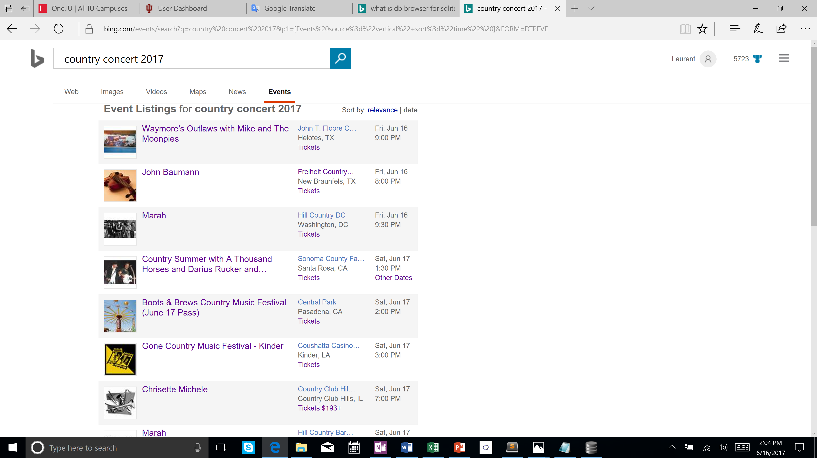
Data Source

Slide 11
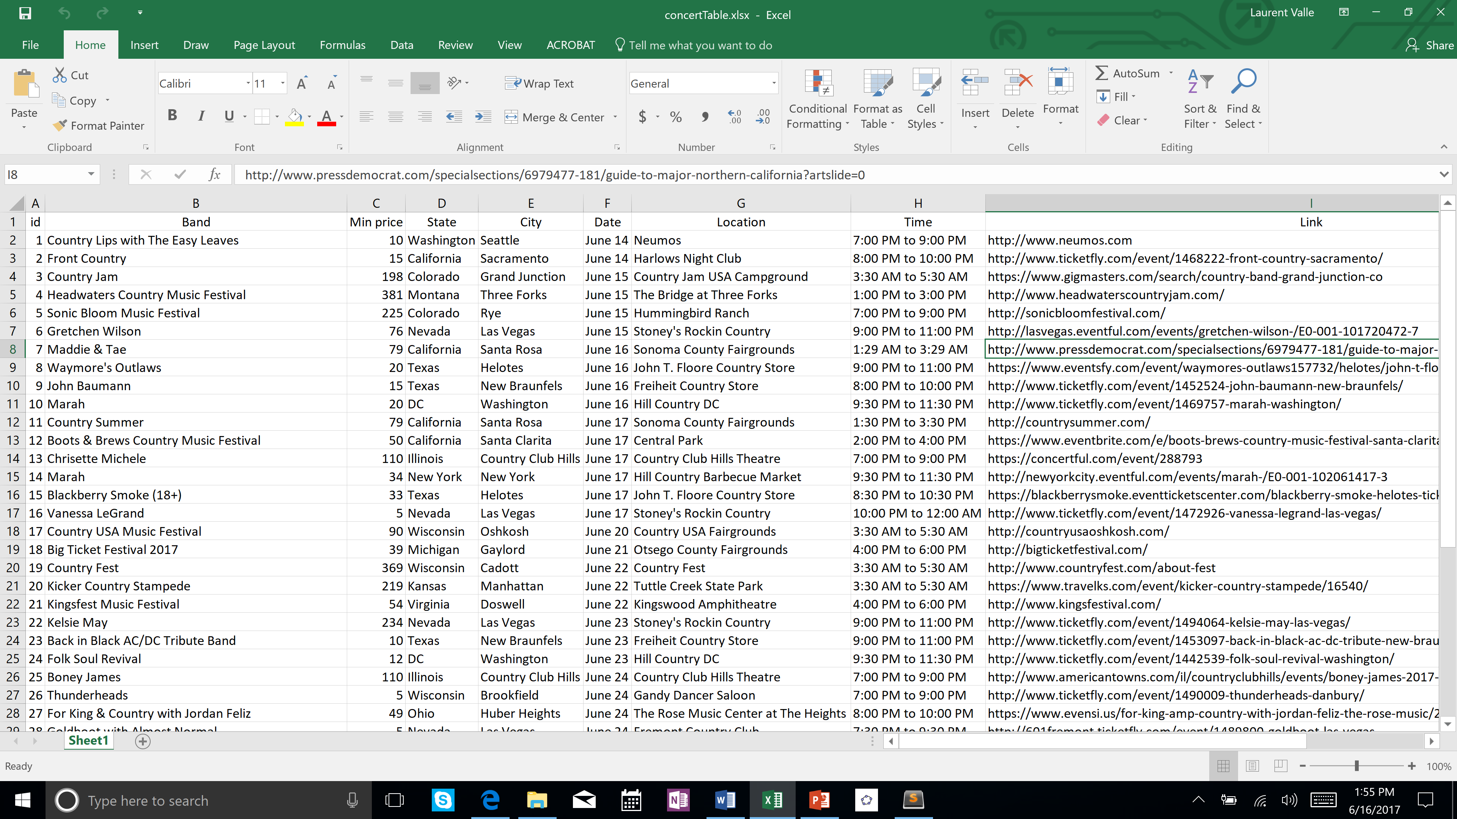
Excel File of the Main Table

Slide 12
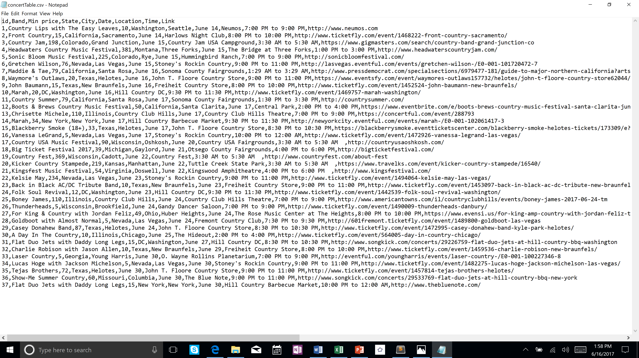
Convertion to CVS File (view from notepad)

Slide 13
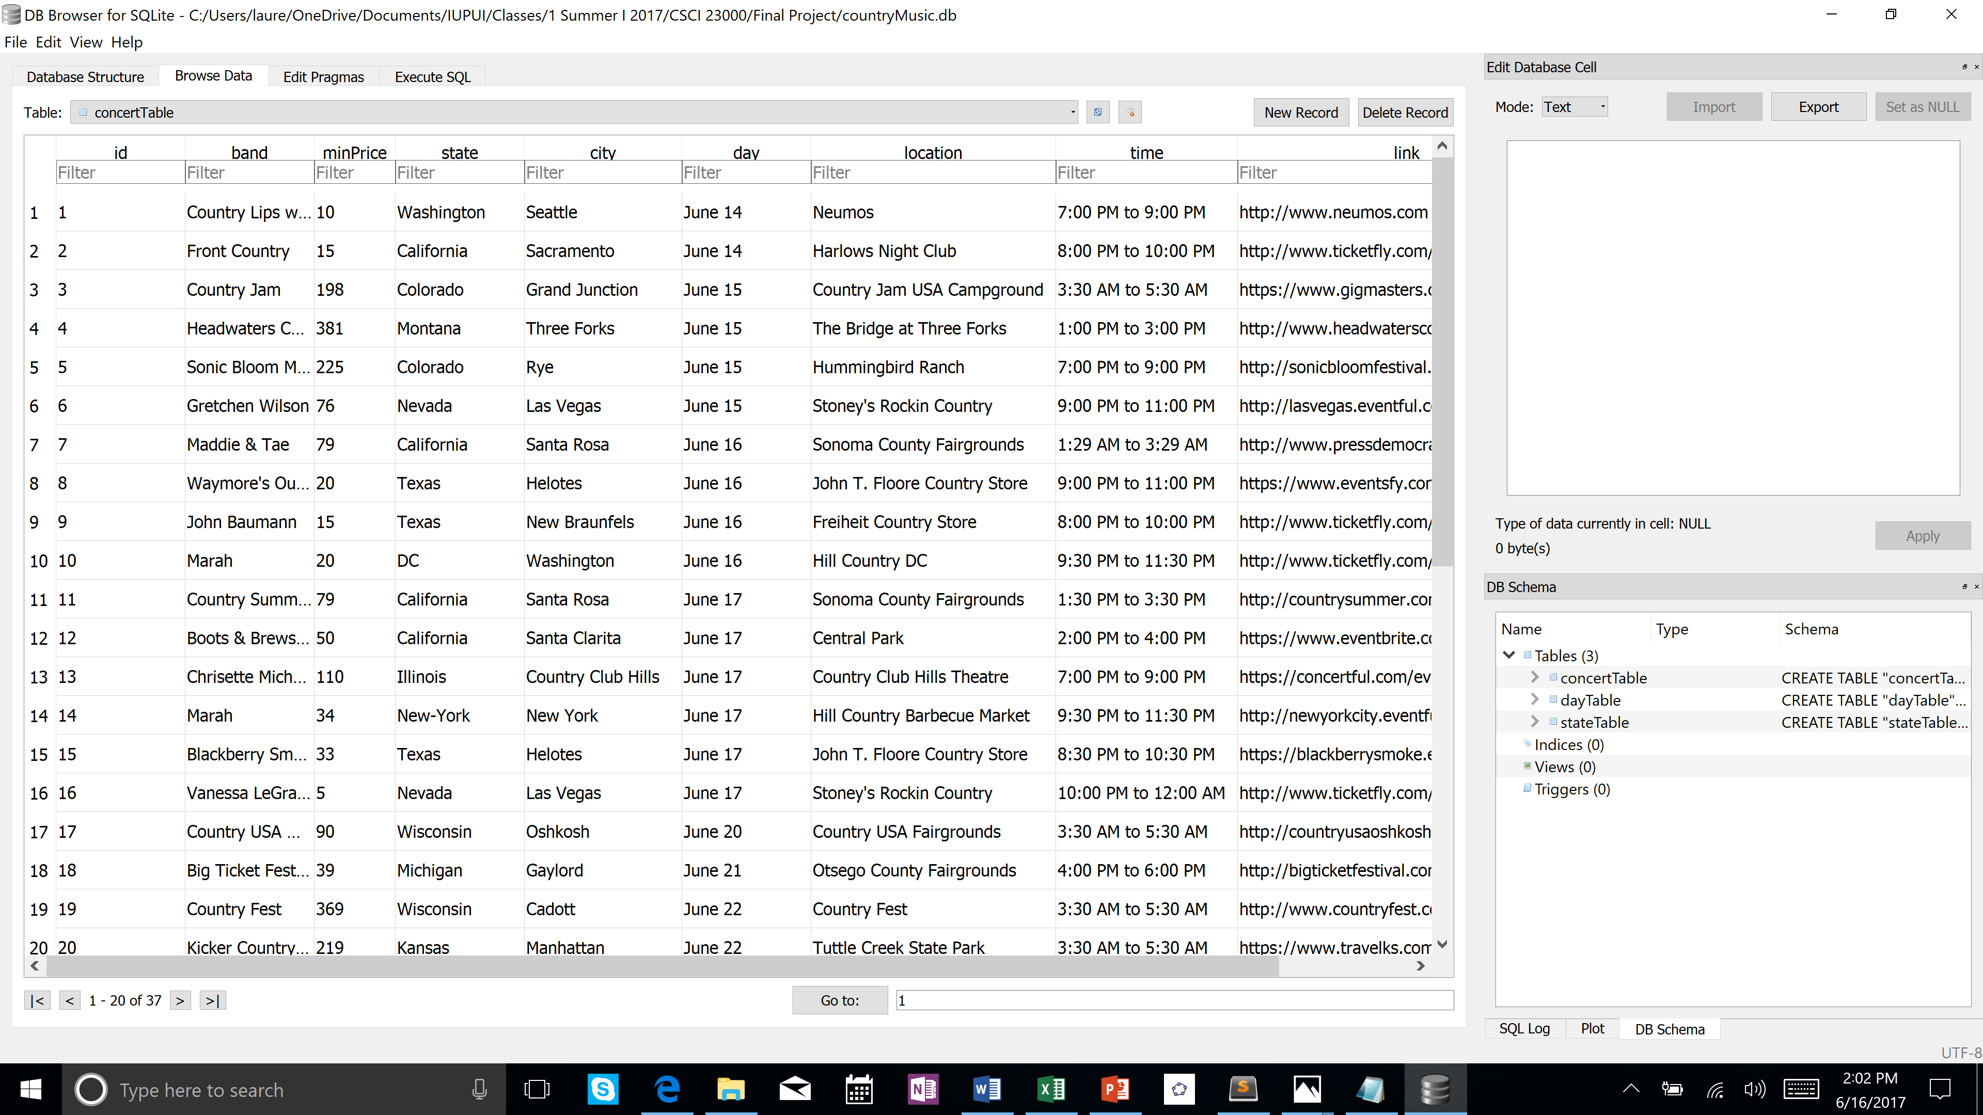
CVS File Importation in DB Browser for SQLite – Creation of the concertTable

Slide 14
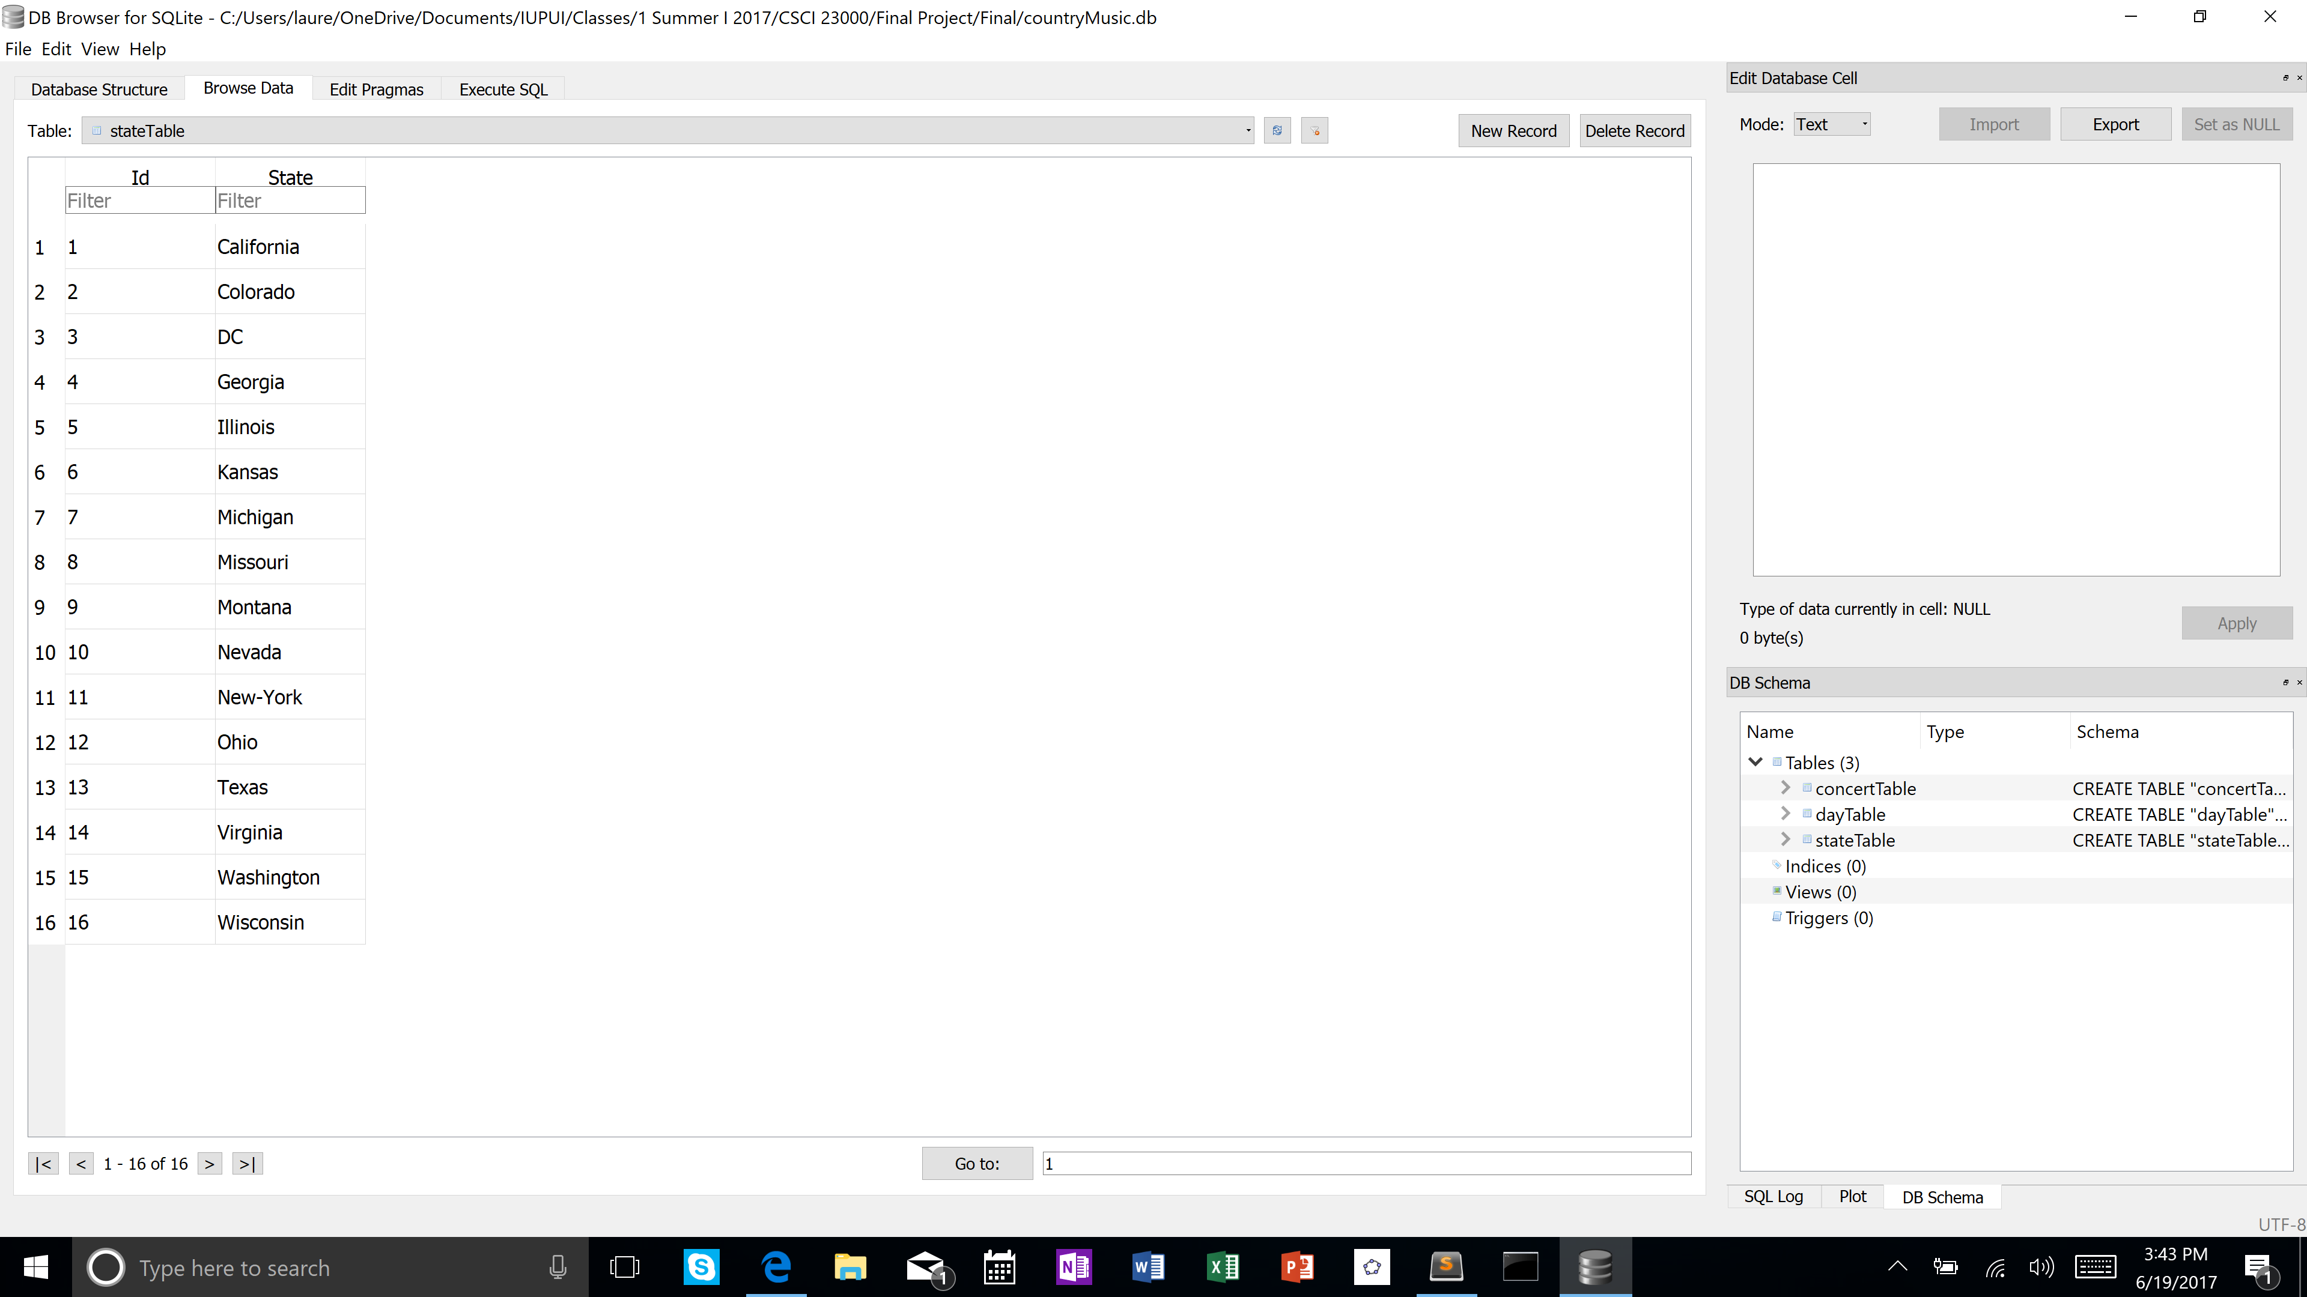
Creation of the stateTable

Slide 15
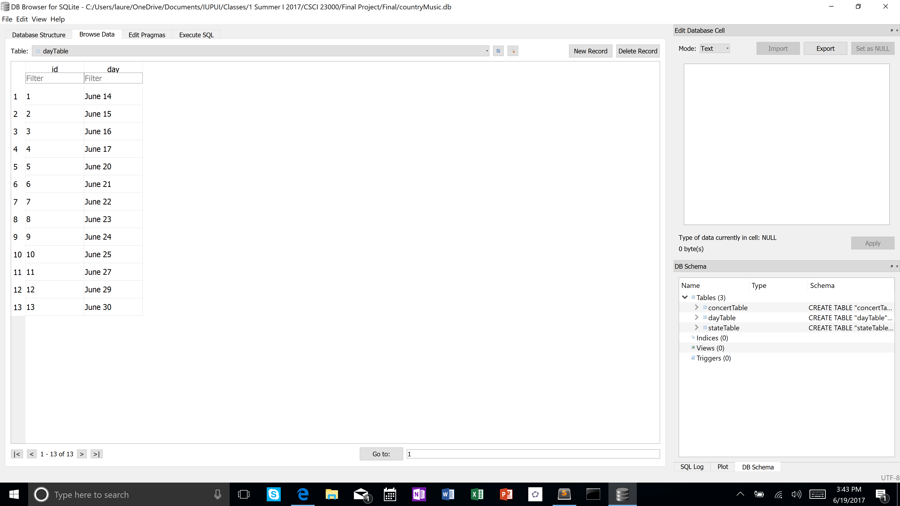
Creation of the dayTable

