Slide 1
Linear Algebra Applications
Ranking in Search Engines – One of the most important applications of linear algebra is in the creation of Google. The most complicated ranking algorithm is created with the help of linear algebra.
Signal Analysis – It is massively used in encoding, analyzing and manipulating the signals that can be either audio, video or images etc.
Linear Programming – Optimization is an important application of linear algebra which is widely used in the field of linear programming.
Error-Correcting Codes – It is used in coding theory. If encoded data is tampered with a little bit and with the help of linear algebra it should be recovered. One such important error-correcting code is called hamming code
Prediction – Predictions of some objects should be found using linear models which are developed using linear algebra.
Facial Recognition- An automated facial recognition technology that uses linear algebraic expression is called principal component analysis.
Graphics- An important part of graphics is projecting a 3-dimensional scene on a 2-dimensional screen which is handled only by linear maps.

Slide 2
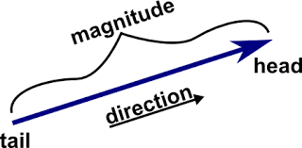
Another Simple Vector

