Slide 1
Parallel Sudoku Solver with OpenMP
Team Silverback
Luke Vandecasteele
Matthew Trappett
November 29, 2021
Notes:
Why Team Silverback?
Because of our original project Idea

Slide 2
Previous Project – Gorila Framework
Gorila - distributed Reinforcement learning
Python w/ pyCUDA/OpenCL, mpi4python
Great balance: Matt – Python, Luke – C
Libraries were not loading on Talapas

Slide 3
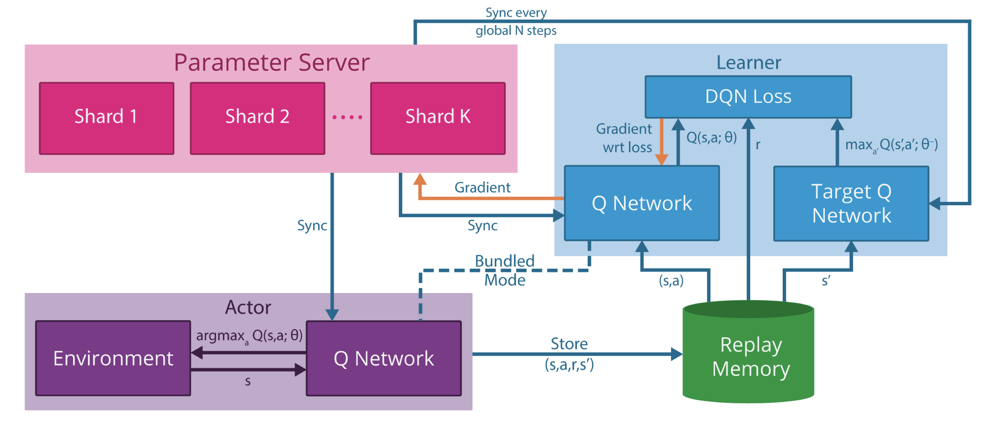
Gorila - DQN
Notes:
Brief Description of DQN for everyone.

Slide 4
Sudoku Solver
New Project

Slide 5
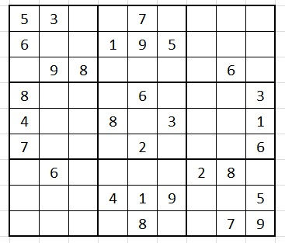
Sudoku
The rules are simple:
For an n*n puzzle. Each number [1,n] can appear only once in each:
Row
Column
Nonet (square)
Traditionally, sudoku implies a 9x9 puzzle.
However, they can be different sizes.
This Photo by Unknown Author is licensed under CC BY-NC

Slide 6
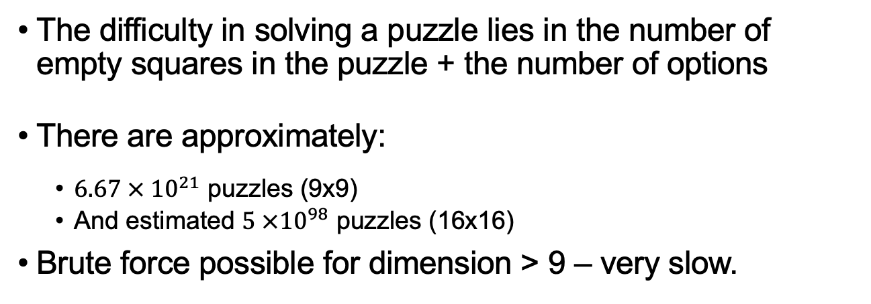
Possible Puzzle Solving Approaches
The difficulty in solving a puzzle lies in the number of empty squares in the puzzle + the number of options
There are approximately:
$6.67 × {10}^{21}$ puzzles (9x9)
And estimated $5 ×{10}^{98}$ puzzles (16x16)
Brute force possible for dimension > 9 – very slow.

Slide 7
Possible Puzzle Solving Approaches
Other approaches:
Simulated Annealing – only easy problems
Linear system approach – hard to solve with fewer clues
X-wing
Swordfish
Forcing Chains
Serial methods are fast for 9x9, but slower for 16x16 puzzles.
We are more interested in the potential speedup for larger puzzles
Found difficult to parallelize these methods.

Slide 8
Parallel Algorithm Overview
A combination of two different tactics + a guess and check.
Tactics: elimination and lone ranger
Guess and check: easily done recursively, but recursion is bad for OpenMP
We first apply our tactics, make a guess, and then apply our tactics again. If the guess was wrong, we make another and then repeat.

Slide 9
Parallel algorithm: Tactics
Elimination: when there is only one possible value for an empty square, then it must belong in that square.
Lone Ranger: when there is only one candidate that is a possible value for a given row, column, or nonet, then it must belong in that square.
1 | 2 | 3 | 4,7 | 5,8,9 | 6 | 4,7 | 5,9 | 5,9
1 | 2 | 3 | 4,7 | 5,8,9 | 6 | 4,7 | 5,9 | 5,9

Slide 10
Guess and Check Overview
First, pick an empty tile
Make a guess
Apply elimination and lone ranger
Not valid: make a different guess
Valid and Complete: done
Valid and not complete: pick another empty tile and repeat

Slide 11
start

Slide 12
start

Slide 13
Guess and Check
How do we choose a value for our empty square?
We make our guess only from the possible values that could be in that square
How do we pick an empty square?
Each time we make a guess, we pick the empty square with the smallest number of possible values.

Slide 14
Guess and Check Parallelization
Guess and check is slow because we will make many wrong guesses.
This means we will have to go back up the stack in order to make a new guess
For our parallel method, we want to make multiple guesses at the same time.

Slide 15
Guess and Check Parallelization
For an empty square with n possible guesses, we want to run our two tactics on n different puzzles, where each puzzle gets a different guess for the empty square.
Options: 1 2 4
5 | 3 |  |  | 7
6 |  |  | 1 | 9 | 5
 | 9 | 8 |  |  |  |  | 6
8 |  |  |  | 6 |  |  |  | 3
4 |  |  | 8 |  | 3 |  |  | 1
7 |  |  |  | 2 |  |  |  | 6
 | 6 |  |  |  |  | 2 | 8
 |  |  | 4 | 1 | 9 |  |  | 5
 |  |  |  | 8 |  |  | 7 | 9

Slide 16
Problems
There are several problems with this solution:
Different threads accessing the same puzzle
Each thread needs to have its own copy of the puzzle to solve
Recursion is bad for OpenMP
Instead, we use a stack to keep track of our different puzzles
Our stack needs to have some initial puzzles at the start so that each thread has work to do at the start
Stack needs to be mutually exclusive

Slide 17
Parallel Algorithm
Apply elimination and lone ranger.
If we solved the puzzle -> return
Initialize stack with possible puzzles.
# of puzzles = # of threads
We still ensure we are picking the tiles with the least amount of possible guesses

Slide 18
Parallel Algorithm (cont.)
3) While loop until stack is empty:
Each thread pops a puzzle off the stack
Apply elimination and lone ranger
If puzzle is not valid -> move to next puzzle in stack
If puzzle is complete and valid -> cancel all threads, return the solved puzzle
If puzzle is valid and not complete ->
Pick empty tile
Make puzzle with each possible guess for the tile
Store each puzzle on the stack
Move to next puzzle in the stack

Slide 19
Data

Slide 20
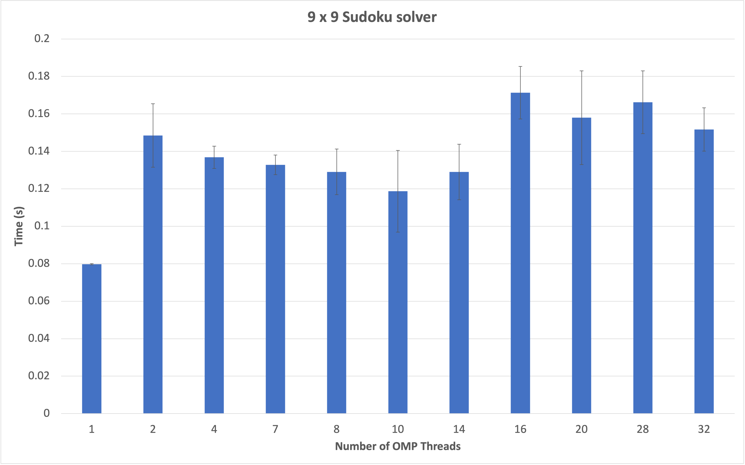
Notes:
For 9x9 puzzles, serial is already fast, so the overhead of creating more threads outweighs the performance gained. Seems to be fastest right around where the number of threads equals the size of the puzzle. Also talk about how this range is very small (only 0 to 0.2 seconds so the difference between the number threads used is minimal

Slide 21
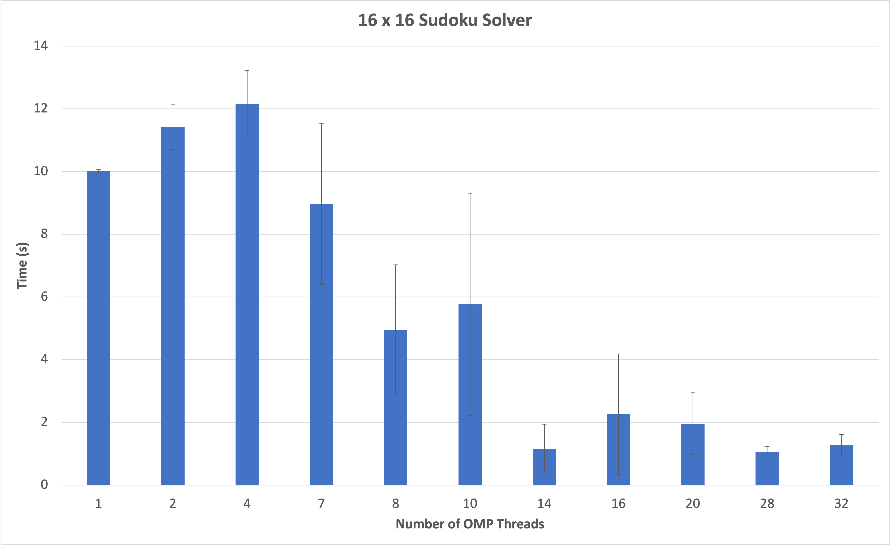
Notes:
Initially, our parallel method is around the same speed as our serial implementation. However, as we increase the number of threads, it quickly become much faster

Slide 22
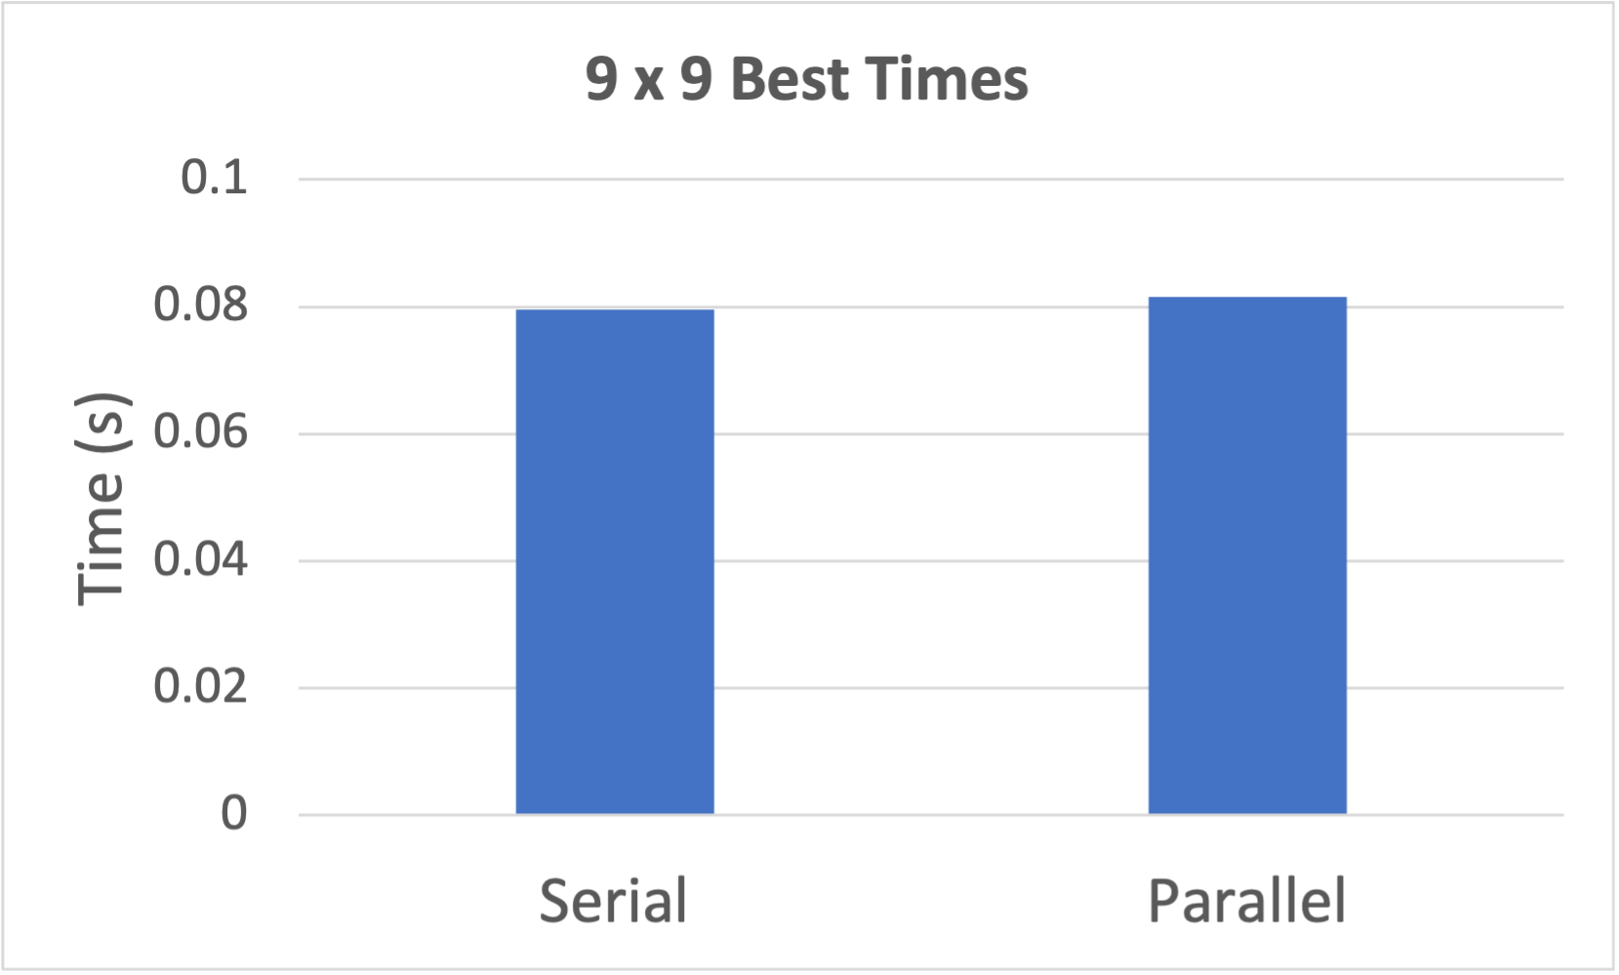
9 x 9 Parallel vs Serial
Notes:
9x9 is already fast for serial, so it is hard to beat with our parallel implementation

Slide 23
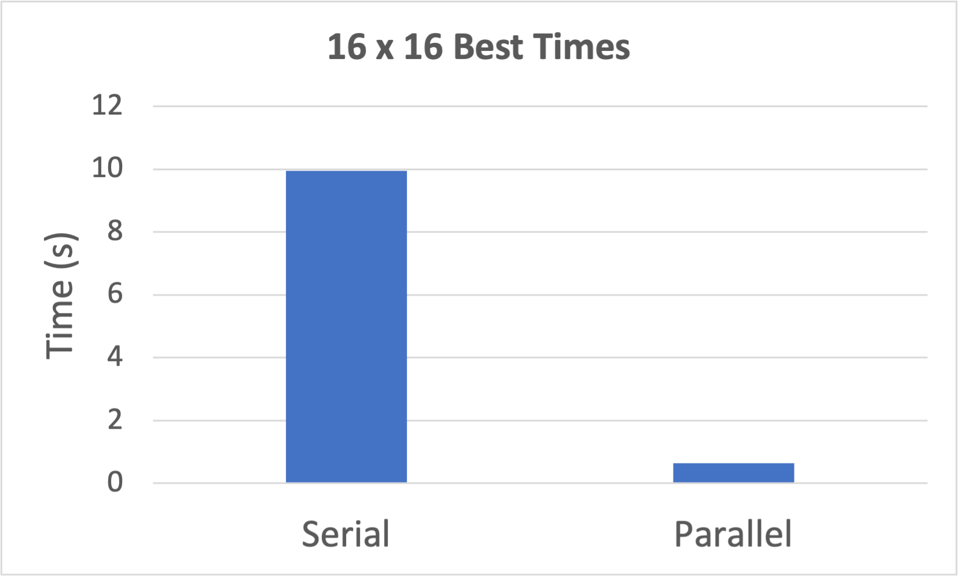
16 x 16 Parallel vs Serial
Notes:
Our parallel 16x16 method is much faster.

Slide 24
Future Work
GPU implementation
Improvements with current method:
Goal: 25x25

Slide 25
Sources
https://www.dcc.fc.up.pt/~acm/sudoku.pdf
http://forum.enjoysudoku.com/su-doku-s-maths-t44-525.html#p15909
http://www.afjarvis.staff.shef.ac.uk/sudoku/sudoku.pdf
http://forum.enjoysudoku.com/number-of-possible-16x16-sudoku-grids-t37053.html

Slide 26
Questions?

