Slide 1
TDD & BDD
Hung Le

Slide 2
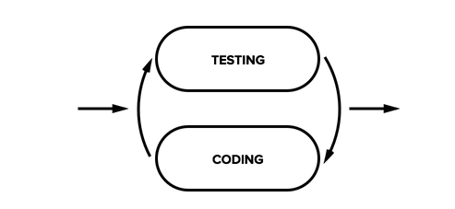
Test first -development

Slide 3
TDD
Test-Driven Development is a developer practice that involves writing tests before writing the code being tested. Begin by writing a very small test for code that does not yet exist. Run the test, and, naturally, it fails. Now write just enough code to make that test pass.

Slide 4
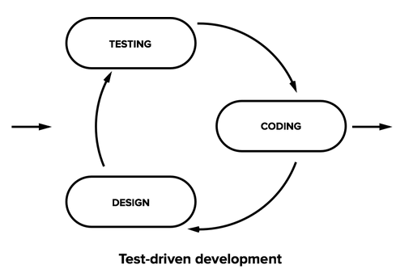
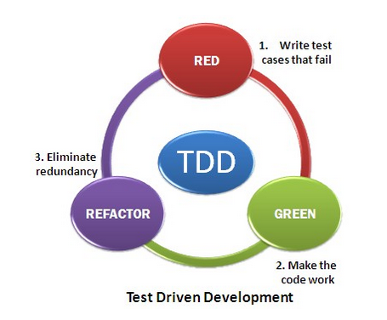
Test Driven Development

Slide 5
DRY : Don’t repeat yourself

Slide 6
Why should use TDD ?
Clean code -Good design
Refactor code with confidence
Creating a unit test helps a developer to really consider what needs to be done.
There can be no misunderstanding a specification written in the form of executable code.
Other developers can see how to use this new code by browsing the tests better understanding of the actual code before you write it

Slide 7
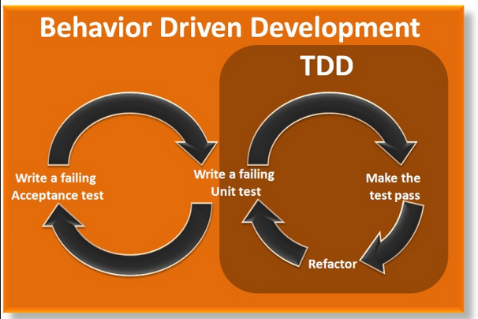
BDD

Slide 8
BDD ,TDD
BDD : Team gets feedback from the Product Owner
TDD : Coder gets feedback from code

Slide 9
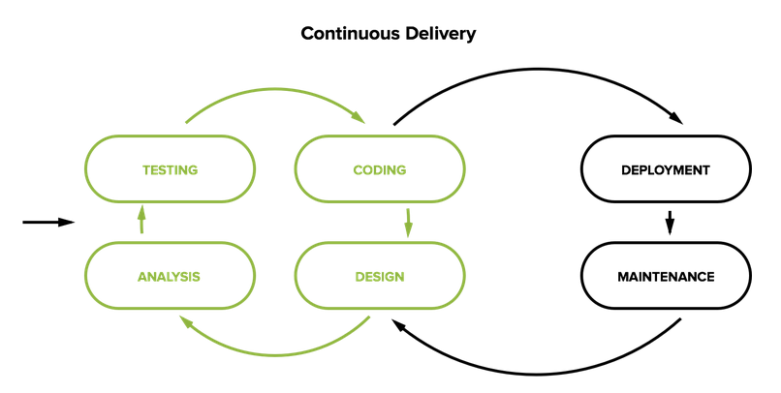
BDD

Slide 10
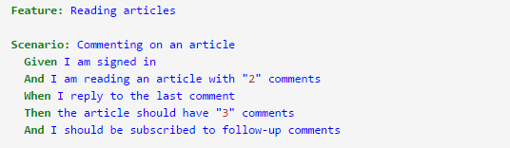
BDD
BDD uses Examples in conversations to illustrate behaviour

Slide 11
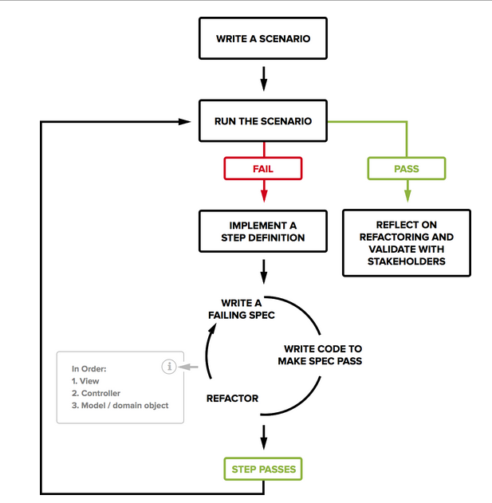
BDD Ruby on Rails

Slide 12
Tools,Languages
Cucumber
R spec
Capybara
Database Cleaner
Faker
Selenium
Gherkin
Factory girl
Jasmine

Slide 13
Cucumber
What is Cucumber? Cucumber is a tool that executes plaintext functional descriptions as automated tests.
The language that Cucumber understands is called Gherkin.

Slide 14
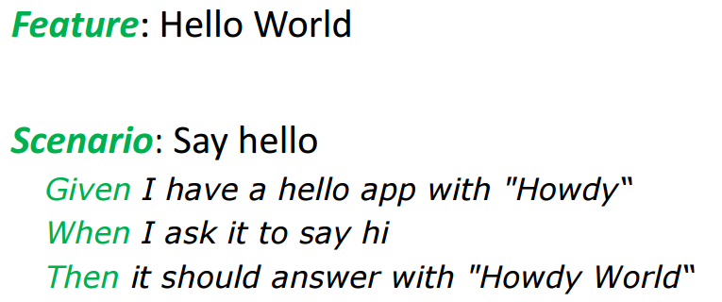
Gherkin
Gherkin :Describe software’s behaviour without detailing how that behaviour is implemented

Slide 15
Good books
The Rspec book Behaviour Driven Development with Rspec Cucumber and Friends
Cucumber book Behaviour-Driven Development for Testers and Developers

Slide 16
THANKS!
Any questions?

