Slide 1







DBL
Digital Building LogBook
DBP
Digital Building Permit
EPC
Energy Performance Certificate
LCA
Life Cycle Analysis
BAMB
Building as a Material Bank
3DC
3D Cadastre
REM
Real Estate Management
PRA
Public Revenue Administration
d4SU services
FastAPI
redis
Celery
Ifc
IfcOpenShell
Ifc2JSON
PostGIS
AGE
PostgreSQL

Slide 2
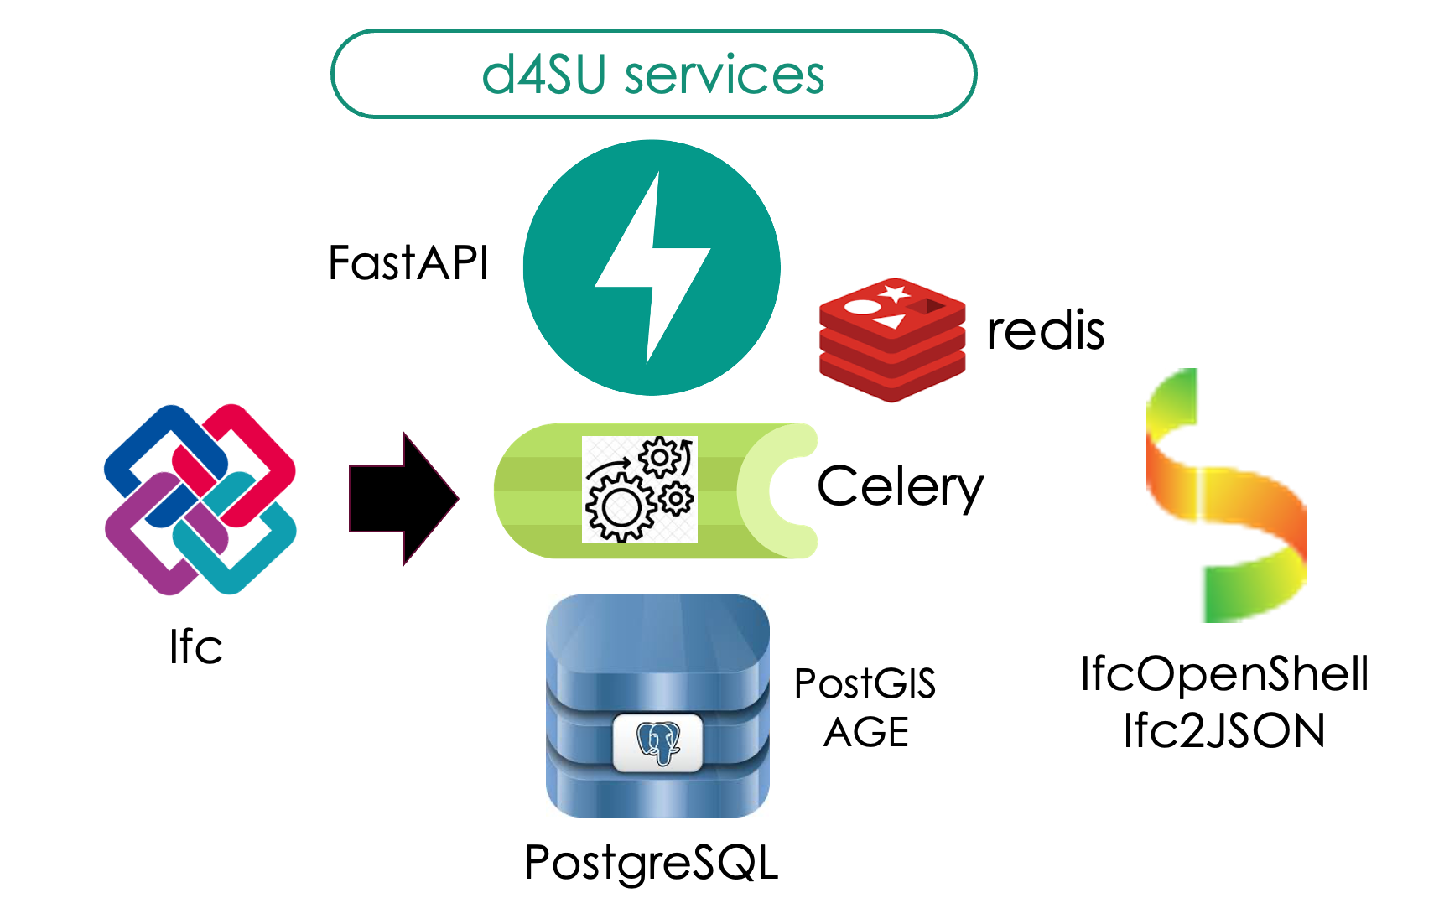

Slide 3
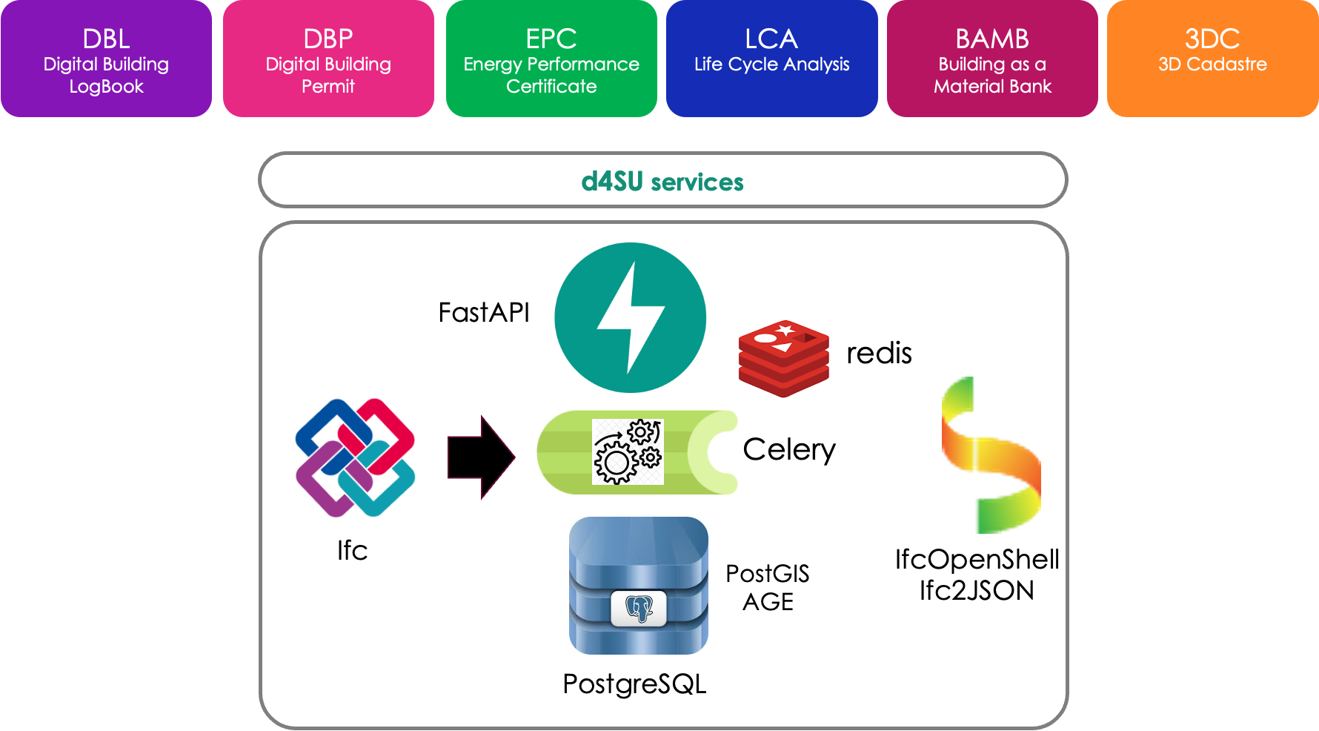

Slide 4
