Slide 1
Deep Learning and Natural Language Processing
Lesson 4 – Pytorch in Production
Pieter Blok

Slide 2
Group formations
Can the following students please subscribe themselves to one of the groups on Canvas:
Marit Bosch
Jasper Gregoire
Hieke van Heesch
Zonne Heijnsbroek
Martijn van Iterson
Danish Khan
Vasilis Loridas
Leopold Paris
Garoé Roque Hernandez
Victor van Gerwen
Noa Verrijt
Bora Şenel

Slide 3
Pytorch concepts
Tensors
Datasets
Dataloaders
Models
Layers
Loss functions
Optimization algorithms
Autograd
Regularization
Visualization tools
Save and load models
Reproducing results
Putting everything together!

Slide 4
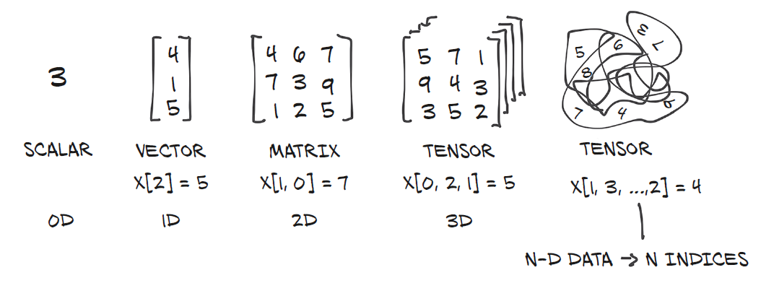
tensors
Tensors are fundamental data structures for storing and manipulating numerical data in deep learning
From a data perspective, a tensor is a multi-dimensional array:
Compared to NumPy arrays, PyTorch tensors have several advantages: - ability to perform very fast operations on graphical processing units (GPUs) - distribute operations on multiple devices or machines - keep track of the computation graph
Image from: Deep learning with Pytorch (Manning)

Slide 5
Numpy arrays vs pytorch tensors
import numpy as np
# create a numpy array
new_array = np.array([[1,2], [3,4]])
# create a 2x3 array with zeros
zero_array = np.zeros([2,3])
# create a 2x3 array with ones
ones_array = np.ones([2,3])
# create a 2x3 array with random values(0-1)
rand_array = np.random.rand(2,3)
# create a 2x3 array with mean 0 and var 1
randn_array = np.random.randn(2, 3)
import torch
# create a pytorch tensor
new_tensor = torch.Tensor([[1,2], [3,4]])
# create a 2x3 tensor with zeros
zero_tensor = torch.zeros([2,3])
# create a 2x3 tensor with ones
ones_tensor = torch.ones([2,3])
# create a 2x3 tensor with random values(0-1)
rand_tensor = torch.rand(2,3)
# create a 2x3 tensor with mean 0 and var 1
randn_tensor = tensor.randn(2, 3)

Slide 6
Tensors
In the previous slide, torch.Tensor was used, which is an alias for the default tensor type: torch.FloatTensor. Its default data type is torch.float32 (32-bit floating-point)
In future use, it is recommended to use torch.tensor instead, because this allows you to specifically set the data type and device (thereby you never get confused what is happening):
# create a pytorch tensor, and specify the data type
new_tensor = torch.tensor([[1,2], [3,4]], dtype=torch.float32)
# set the device to GPU, if available
device = torch.device("cuda" if torch.cuda.is_available() else "cpu")
# send the tensor to the GPU
new_tensor = new_tensor.to(device)

Slide 7
Tensor operations
Like Numpy, Pytorch has hundreds of underlying operations that can be directly applied to tensors, like:
# check the data type
new_tensor.dtype
# check the device
new_tensor.device
# check if tensor or numpy array
new_tensor.type()
# accessing tensor value
new_tensor.data
# indexing
new_tensor[index]
# reshape the tensor from 2x2 to 4
reshaped_tensor = new_tensor.reshape(4)
# swaps two dimensions
transp_tensor = new_tensor.transpose(0,1)
# adds a new dimension to a tensor at dim=0
dim_tensor = new_tensor.unsqueeze(0)
# remove a dimension of a tensor at dim=0
new_tensor = dim_tensor.squeeze(0)
# flattens a tensor (common in CNN models)
new_tensor = new_tensor.flatten()

Slide 8
Conversions and operations
It’s also possible to directly convert a Numpy array to a Pytorch tensor and vice versa:
# convert a numpy array to a pytorch tensor
new_tensor = torch.from_numpy(new_array)
# convert a pytorch tensor to a numpy array, when on cpu
new_array = new_tensor.numpy()
# convert a pytorch tensor to a numpy array, when on gpu
new_array = new_tensor.cpu().numpy()
# convert a pytorch tensor to a numpy array, when on gpu and on computation graph (e.g. requires_grad=True)
new_array = new_tensor.cpu().detach().numpy()

Slide 9
Tensor dataset
In PyTorch, datasets can be loaded and managed with classes from torch.utils.data
TensorDataset is a predefined dataset that loads the data and the targets (both tensors)
It is used for small datasets that don’t need batching
import torch
from torch.utils.data import TensorDataset
# add data as tensor
data = torch.tensor([[1, 2], [3, 4], [5, 6]])
# add targets as tensor
targets = torch.tensor([0, 1, 0])
# create TensorDataset
dataset = TensorDataset(data, targets)

Slide 10
Customized datasets
A more versatile class that allows batching of data is the Dataset class from torch.utils.data
Custom datasets can be created by inheriting from this class.
A custom dataset should consist of the following three functions:
__init__(self): prepares and initializes the dataset. Static data preprocessing can happen here (e.g., normalizing / standardizing the entire dataset)
__len__(self): returns the number of samples in the dataset, which is needed for Pytorch to do the iteration and batching
__getitem__(self, index): Needed for Pytorch’s Dataloader (when batching). It retrieves a data sample and its corresponding label by index and apply transformations if necessary. Especially handy when you want different random transformations per epoch.

Slide 11
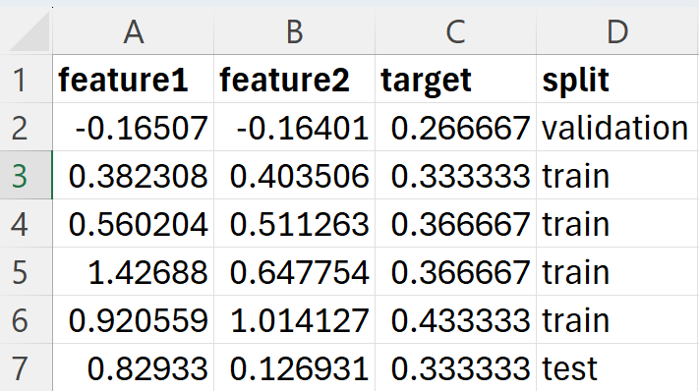
Customized datasets - regression
data.csv
It can be customized to your specific data wishes:
import pandas as pd
import torch
from torch.utils.data import Dataset
class CustomDataset(Dataset):
def __init__(self, csv_file, split):
super().__init__()
self.data = pd.read_csv(csv_file)
self.data = self.data[self.data['split'] == split]
def __len__(self):
return len(self.data)
def __getitem__(self, index):
row = self.data.iloc[index]
features = torch.tensor([row['feature1'], row['feature2']], dtype=torch.float32)
target = torch.tensor(row['target'], dtype=torch.float32).unsqueeze(0)
return features, target
# usage
csv_file = 'data.csv'
train_dataset = CustomDataset(csv_file, split='train')
val_dataset = CustomDataset(csv_file, split='validation')
test_dataset = CustomDataset(csv_file, split='test')
Needed to create similar ‘nested’ shapes for batching:
features.shape = torch.Size([2])
target.shape = torch.Size([1])

Slide 12
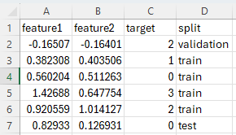
Customized datasets - classification
data.csv
It can be customized to your specific data wishes:
import pandas as pd
import torch
from torch.utils.data import Dataset
class CustomDataset(Dataset):
def __init__(self, csv_file, split):
super().__init__()
self.data = pd.read_csv(csv_file)
self.data = self.data[self.data['split'] == split]
def __len__(self):
return len(self.data)
def __getitem__(self, index):
row = self.data.iloc[index]
features = torch.tensor([row['feature1'], row['feature2']], dtype=torch.float32)
target = torch.tensor(row['target'], dtype=torch.long)
return features, target
# usage
csv_file = 'data.csv'
train_dataset = CustomDataset(csv_file, split='train')
val_dataset = CustomDataset(csv_file, split='validation')
test_dataset = CustomDataset(csv_file, split='test')
Data type needs to be changed! Integers instead of floats
(torch.long = torch.int64)

Slide 13
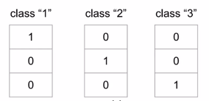
Dataset operators: full one-hot encoding
One-hot encoding is needed when inputs or targets are categorical and need to be represented in a numerical form for machine learning models:
For deep learning: use the full one-hot encoding variant instead of dummy or reduced-rank encoding
Vector with C classes
full one-hot encoding
labels

Slide 14
Dataset operators: full one-hot encoding
features pd dataframe:
feature_01 | color
0.152 | red
0.569 | green
0.478 | blue
0.963 | blue
0.571 | red
0.124 | blue
… | …
0.851 | green
import pandas as pd
# define a dictionary for the strings and their desired numeric values
color_mapping = {'red': 0, 'green': 1, 'blue': 2} # this will transform the strings to numeric values, e.g. [0, 1, 2, 2, 0, 2, …, 1]
color_labels = features['color'].map(color_mapping).values
# this will transform the numeric values to full one-hot encoded arrays
# 0: [1, 0, 0]
# 1: [0, 1, 0]
# 2: [0, 0, 1] color_one_hot = torch.nn.functional.one_hot(torch.tensor(color_labels), num_classes=3)

Slide 15
Dataset operators: data splits
In lab session 2, we have seen how to randomly split a dataset: For customized data splitting techniques, like cross-validation, stratified sampling, oversampling:
Cross-validation: Kfold or StratifiedKFold from sklearn library
Stratified sampling: train_test_split with stratify from sklearn library
Oversampling: WeightedRandomSampler from torch.utils.data URL for oversampling: https://medium.com/data-science/demystifying-pytorchs-weightedrandomsampler-by-example-a68aceccb452
import torchvision.datasets as datasets
train_dataset = datasets.MNIST(root='./data', train=True, transform=transforms.ToTensor())
test_dataset = datasets.MNIST(root='./data', train=False, transform=transforms.ToTensor())
# split the original training dataset into a training subset of 80% and a new validation set of 20%
train_dataset, val_dataset = torch.utils.data.random_split(train_dataset, [0.8, 0.2])

Slide 16
Dataset operators - normalization
Normalization is needed to scale the data between 0-1 to enable efficient learning:
For efficiency and consistency, it’s best to implement this normalization directly in the Pytorch Dataset class:
for static preprocessing on the entire dataset, this normalization can be implemented in the __init__ function.
for dynamic preprocessing, or when the dataset doesn’t fit the memory, this can be implemented in the __getitem__ function.
import torch
data = torch.tensor([
[10.0, 100.0, 1000.0],
[20.0, 200.0, 2000.0],
[30.0, 300.0, 3000.0],
[40.0, 400.0, 4000.0],
[50.0, 500.0, 5000.0],
])
# min-max normalization: (x - min) / (max - min)
min_val = data.min(dim=0, keepdim=True).values
max_val = data.max(dim=0, keepdim=True).values
normalized_data = (data - min_val) / (max_val - min_val)
normalized_data = tensor([[0.0000, 0.0000, 0.0000],
[0.2500, 0.2500, 0.2500],
[0.5000, 0.5000, 0.5000],
[0.7500, 0.7500, 0.7500],
[1.0000, 1.0000, 1.0000]])

Slide 17
Dataset operators - standardization
Standardization transforms features to have a mean of 0 and unit variance (1), ensuring that all features contribute equally to the model’s learning process:
import torch
data = torch.tensor([
[10.0, 100.0, 1000.0],
[20.0, 200.0, 2000.0],
[30.0, 300.0, 3000.0],
[40.0, 400.0, 4000.0],
[50.0, 500.0, 5000.0],
])
# compute mean and standard deviation
mean = data.mean(dim=0, keepdim=True)
std = data.std(dim=0, keepdim=True)
standardized_data = (data - mean) / std
For efficiency and consistency, it’s best to implement this standardization directly in the Pytorch Dataset class:
for static preprocessing on the entire dataset, this standardization can be implemented in the __init__ function.
for dynamic preprocessing, or when the dataset doesn’t fit the memory, this can be implemented in the __getitem__ function.
standardized_data = tensor([[-1.2649, -1.2649, -1.2649],
[-0.6325, -0.6325, -0.6325],
[0.0000, 0.0000, 0.0000],
[0.6325, 0.6325, 0.6325],
[1.2649, 1.2649, 1.2649]])
standardized_data.mean() tensor(3.9736e-09)
standardized_data.var() tensor(0.8571)

Slide 18
dataloaders
If a dataset is huge (when it cannot fit in memory), then we need to train it in batches.
Iterative batching can be accomplished with the Dataloader class in Pytorch (torch.utils.data): - we tell it which dataset to use, the desired mini-batch size and if we’d like to shuffle it or not (shuffle option is typically used only for the training dataset). - the Dataloader will behave like an iterator, so we can loop over it and fetch a different mini-batch every time
from torch.utils.data import DataLoader
train_loader = DataLoader(train_dataset, batch_size=32, shuffle=True)
val_loader = DataLoader(val_dataset, batch_size=32, shuffle=False)
test_loader = DataLoader(test_dataset, batch_size=32, shuffle=False)
for batch_features, batch_labels in train_loader:
print(batch_features, batch_labels)

Slide 19
Models
In Pytorch, models and neural networks are built with the nn.Module class. After inheriting the Pytorch nn.Module class, you will specify the following two components:
__init__(self): it defines the parts that make up the model
forward(self, x): it performs the actual computation, that is, it outputs a prediction, given the input x
Common properties of the created model (i.e., model = RegressionModel() ):
model.state_dict() – used for saving & loading models. It returns a dictionary with the layer names as keys and learnable parameters (weights, biases) as values.
model.parameters() – used in the optimizer. Returns an iterator over the model’s parameters
model.train() - sets the model to training mode (affects the behavior of specific layers, like dropout)
model.eval() - sets the model to evaluation mode (validation, testing), i.e., disable dropout
model.to(device) – move model to GPU/CPU

Slide 20
Models
In lab session 1, we’ve already seen how to construct a neural network layer by layer:
Alternatively, we use the nn.Sequential block to simplify the forward pass:
import torch.nn as nn
class NeuralNetwork(nn.Module):
def __init__(self, num_inputs, num_hidden, num_outputs):
super().__init__()
self.linear1 = nn.Linear(num_inputs, num_hidden)
self.act_fn = nn.Tanh()
self.linear2 = nn.Linear(num_hidden, num_outputs)
def forward(self, x):
x = self.linear1(x)
x = self.act_fn(x)
x = self.linear2(x)
return x
import torch.nn as nn
class NeuralNetwork(nn.Module):
def __init__(self, num_inputs, num_hidden, num_outputs):
super().__init__()
self.model = nn.Sequential(
nn.Linear(num_inputs, num_hidden),
nn.Tanh(),
nn.Linear(num_hidden, num_outputs)
)
def forward(self, x):
return self.model(x)

Slide 21
Rules of thumb when designing models
Begin with a simple architecture (e.g., one or two hidden layers) to establish a baseline performance, and then gradually add layers or complexity
Choose the number of hidden layers based on the task: - Shallow Networks (1–2 hidden layers): Work well for simpler problems like regression or small datasets. Examples: basic tabular data regression or simple classification. - Deep Networks (3+ hidden layers): Suitable for more complex problems like image recognition, sequence modeling, or speech processing.
Use a decreasing number of units in deeper layers: input_dim -> 512 -> 256 -> 128 -> output_dim. This helps the model condense and abstract information. Exceptions for specific tasks, like autoencoders, where symmetric architectures are common.

Slide 22
layers
Layer in Pytorch | Details
nn.Linear(in_features, out_features) | Fully connected (dense) layer. Standard layer for regression
nn.Conv2d(in_channels, out_channels, kernel_size) | Convolutional layer for image analysis. Extracts spatial features from images
nn.RNN(input_size, hidden_size, num_layers) | Recurrent layer for time-series analysis.
nn.LSTM(input_size, hidden_size, num_layers) | LSTM layer for time-series analysis. Handles long-term dependencies
nn.GRU(input_size, hidden_size, num_layers) | Gated recurrent layer for time-series analysis. Computationally lighter than the LSTM.
nn.ReLU() | Rectified linear unit: non-linear activation function
nn.Tanh() | Hyperbolic Tangent: non-linear activation function
nn.Sigmoid() | Sigmoid: non-linear activation function

Slide 23
Loss functions
Typical usage:
import torch.nn as nn
criterion = nn.L1Loss()
loss = criterion(outputs, targets)
Regression: Classification:
Loss function in Pytorch | Details
nn.MSELoss() | mean squared error (squared L2 norm)
nn.L1Loss() | mean absolute error (MAE)
nn.HuberLoss() | hybrid loss function that combines the strengths of L1 loss and L2 loss
nn.SmoothL1Loss() | Huber loss with 𝛿=1 (refer to lesson 1)
Loss function in Pytorch | Details
nn.BCELoss() | binary cross-entropy loss (binary classification)
nn.BCEWithLogitsLoss() | combines a sigmoid layer and the BCELoss in one single class. (preferred for binary classification, input type assumes raw logits)
nn.CrossEntropyLoss() | combines a softmax and negative log-likelihood loss in one single class. (preferred for multiclass classification, input type assumes raw logits)

Slide 24
Optimization algorithms
Available in torch.optim, typical usage:
import torch.optim as optim
optimizer = optim.Adam(model.parameters(), lr=0.01)
Optimizer | Details
SGD() | stochastic gradient descent optimizer (gradient descent, stochastic gradient descent and mini-batch gradient descent). Optionally with momentum
Adagrad() | Adagrad optimizer; learning rate will become smaller for parameters that get updated often (large gradients), and larger for parameters that are updated less frequently (small gradients).
RMSprop() | Root mean square propagation, which uses exponential weighted average on the gradient update history
Adam() | Adaptive Moment Estimation (Adam), which combines the advantages of RMSprop and Momentum

Slide 25
autograd
Autograd = Automatic Differentiation Package of Pytorch. This package is responsible for computing the gradients for tensors during backpropagation (partial differentiation, chain rule etc.)
loss.backward() computes gradients of a scalar loss with respect to all tensors that have requires_grad=True (model parameters have requires_grad=True as default)
Autograd operations:
# accessing tensor gradient
tensor.grad # historic operations for autograd
tensor.grad_fn
# check if gradient is calculated
tensor.requires_grad
# computes the gradient
tensor.backward()
# stop a tensor from tracking operations
tensor.detach()
# temporarily disables gradient computation (used during evaluation)
with torch.no_grad():
# temporarily disables gradient computation for entire functions (using decorator)
@torch.no_grad()

Slide 26
autograd – zero_grad()
Accumulation of gradients:
every time loss.backward() is called, the gradients of the model parameters are added to the existing gradients stored in the .grad attribute of the tensors.
this could lead to incorrect gradient updates because the optimizer will use a combination of gradients from multiple iterations (batches) rather than just the gradient of the current loss.
therefore, we need to zero out gradients after each update for the optimizer:
optimizer.zero_grad() # reset gradients to zero loss.backward() # compute gradients optimizer.step() # update parameters based on gradients

Slide 27
Batch normalization
Batch normalization; it normalizes the input to a layer so that its mean is approximately 0 and its variance is approximately 1:
import torch.nn as nn
class NeuralNetwork(nn.Module):
def __init__(self, num_inputs, num_hidden, num_outputs):
super().__init__()
self.linear1 = nn.Linear(num_inputs, num_hidden)
self.bn = nn.BatchNorm1d(num_hidden) self.act_fn = nn.Tanh()
self.linear2 = nn.Linear(num_hidden, num_outputs)
def forward(self, x):
x = self.linear1(x)
x = self.bn(x)
x = self.act_fn(x)
x = self.linear2(x)
return x

Slide 28
Regularization
In Pytorch, there’s no built-in equivalent for L1 regularization or ElasticNet. These must be implemented by hand, for example:
def l1_regularization(model, lambda_reg):
l1_penalty = sum(param.abs().sum() for param in model.parameters())
return lambda_reg * l1_penalty
Weight decay (L2 regularization built into the optimizer):
optimizer = torch.optim.SGD(model.parameters(), lr=0.01, weight_decay=1e-4)
Dropout (after activation functions, and between fully connected layers, nn.Dropout2D for ConvLayers):
import torch.nn as nn
class NeuralNetwork(nn.Module):
def __init__(self, num_inputs, num_hidden, num_outputs):
super().__init__()
self.linear1 = nn.Linear(num_inputs, num_hidden)
self.act_fn = nn.Tanh()
self.dropout = nn.Dropout(p=0.5)
self.linear2 = nn.Linear(num_hidden, num_outputs)
def forward(self, x):
x = self.linear1(x)
x = self.act_fn(x)
x = self.dropout(x)
x = self.linear2(x)
return x

Slide 29
Regularization
Early stopping: stops training when validation performance stops improving An EarlyStopping class method was introduced in lab session 2: https://github.com/Bjarten/early-stopping-pytorch/blob/main/early_stopping_pytorch/early_stopping.py
ReduceLROnPlateau: automatically reduces learning rate if there’s no improvement
import torch.optim as optim
optimizer = optim.SGD(model.parameters(), lr=learning_rate)
scheduler = optim.lr_scheduler.ReduceLROnPlateau(optimizer, mode='min', factor=0.1, patience=10)
scheduler.step(val_loss)

Slide 30
Regularization – Data augmentation
import torch
import torchvision.transforms as transforms
from torch.utils.data import Dataset, DataLoader
from PIL import Image
import os
class CustomImageDataset(Dataset):
def __init__(self, image_dir, transform=None):
self.image_dir = image_dir
self.image_filenames = os.listdir(image_dir)
self.transform = transform
def __len__(self):
return len(self.image_filenames)
def __getitem__(self, idx):
img_path = os.path.join(self.image_dir, self.image_filenames[idx])
image = Image.open(img_path).convert("RGB")
if self.transform:
image = self.transform(image)
return image
train_transform = transforms.Compose([
transforms.Resize((224, 224)),
transforms.RandomHorizontalFlip(p=0.5),
transforms.RandomRotation(degrees=30),
transforms.ColorJitter(brightness=0.2, contrast=0.2, saturation=0.2),
transforms.ToTensor()])
# for validation dataset we don’t use augmentation
val_transform = transforms.Compose([
transforms.Resize((224, 224)),
transforms.ToTensor()])
train_dataset = CustomImageDataset(image_dir="train_images", transform=train_transform)
val_dataset = CustomImageDataset(image_dir="val_images", transform=val_transform)

Slide 31
Visualization tools - custom
A custom function for loss curve plotting was introduced in lab session 2: plot_loss_curve
def plot_loss_curve(epochs, train_losses, val_losses):
plt.plot(range(1, epochs+1), train_losses, label='Training Loss')
plt.plot(range(1, epochs+1), val_losses, label='Val Loss')
plt.xlabel('Epochs')
plt.ylabel('Loss')
plt.title('Train, Validation Loss Curve')
plt.legend()
plt.grid()
plt.show()
train_losses = []
val_losses = []
for epoch in range(num_epochs):
train_loss, val_loss = train_model(model, train_loader, val_loader, criterion, optimizer)
train_losses.append(train_loss)
val_losses.append(val_loss)
plot_loss_curve(num_epochs, train_losses, val_losses)

Slide 32
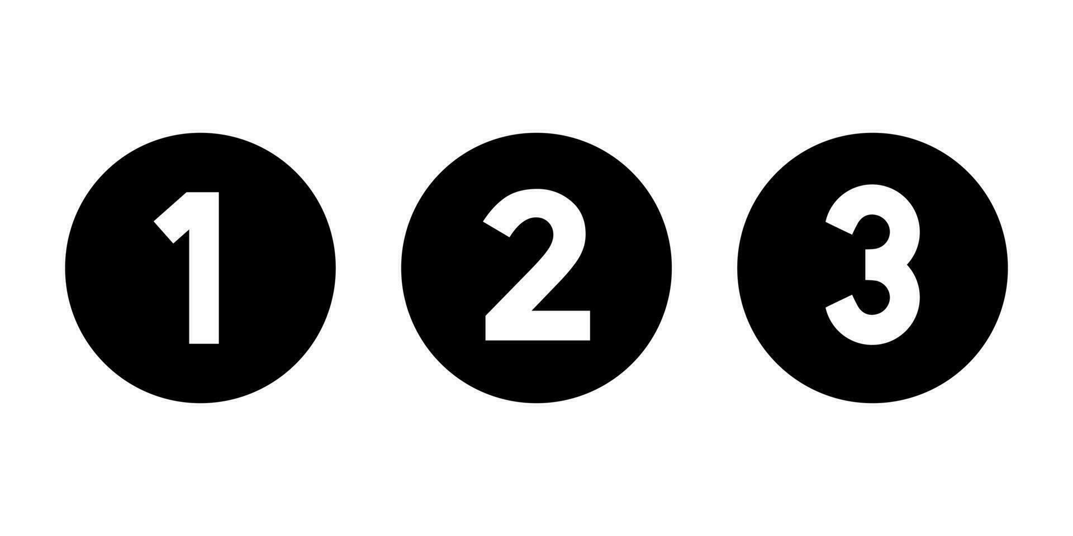

Visualization tools - tensorboard
conda activate dl
pip install tensorboard
import torch
from torch.utils.tensorboard import SummaryWriter
model.to(device)
writer = SummaryWriter(log_dir='runs/model_training')
for epoch in range(num_epochs):
model.train()
train_loss /= len(train_loader)
val_loss /= len(val_loader)
writer.add_scalars('loss', {'train': train_loss, 'val': val_loss}, epoch)
writer.close()
$$⋮$$
When finished type in your command line:
tensorboard --logdir=runs
Then open in your default browser:
http://localhost:6006/

Slide 33
Saving model weights – per epoch
import torch
for epoch in range(num_epochs):
model.train()
for inputs, targets in train_loader:
inputs, targets = inputs.to(device), targets.to(device)
optimizer.zero_grad()
outputs = model(inputs)
loss = criterion(outputs, targets)
loss.backward()
optimizer.step()
torch.save(model.state_dict(), f"model_epoch_{epoch+1}.pth")

Slide 34
Saving model weights – best performance
import torch
model.to(device)
best_val_loss = float('inf')
for epoch in range(num_epochs):
model.train()
for inputs, targets in train_loader:
inputs, targets = inputs.to(device), targets.to(device)
optimizer.zero_grad()
outputs = model(inputs)
loss = criterion(outputs, targets)
loss.backward()
optimizer.step()
# Validation phase
model.eval()
val_loss = 0.0
with torch.no_grad():
for inputs, targets in val_loader:
inputs, targets = inputs.to(device), targets.to(device)
outputs = model(inputs)
loss = criterion(outputs, targets)
val_loss += loss.item()
val_loss /= len(val_loader)
if val_loss < best_val_loss:
best_val_loss = val_loss
torch.save(model.state_dict(), "best_model.pth")
This procedure is applied when the loss is average per batch (reduction='mean')
For reduction='sum' :
val_loss += loss.item()
val_loss /= len(val_loader.dataset)

Slide 35
Loading models
After the model weights have been saved, either per epoch or for the best performance on the validation dataset, we can load them for independent model evaluation:
import torch
model.load_state_dict(torch.load('best_model.pth', weights_only=True)) model.to(device)
model.eval()
predictions = []
with torch.no_grad():
for inputs in test_loader:
inputs = inputs.to(device)
outputs = model(inputs)
predictions.extend(outputs.cpu().numpy())
From Pytorch 2.6 onwards, the weights_only=True has become default.
weights_only=True would be used for most inference tasks when the model architecture is already defined. Typical behavior when loading from disk.
weights_only=False if you want to resume training from a specific checkpoint. It includes metadata and optimizer data.

Slide 36
Reproducing results - seeds
Many operations in deep learning involve randomness (e.g., weight initialization, data shuffling, dropout)
When debugging or running experiments, it’s handy to ensure that every run produces the same outputs: for example, when experimenting with different model architectures or hyperparameters that need to be compared under the same conditions
With seeds we can make the experiments and results reproducible
By setting a seed, the random number generator (RNG) in Python is initialized to a fixed state. This ensures that any subsequent random operations (like weight initialization, shuffling, dropout) generate the same sequence of numbers every time the code is run

Slide 37
Reproducing results - seeds
import torch
import random
import numpy as np
# set the seed to an arbitrary number seed = 42
# set the seed for Pytorch
torch.manual_seed(seed)
# ensure seed is set for all GPUs (if using CUDA)
torch.cuda.manual_seed_all(seed)
# set seed for NumPy
np.random.seed(seed)
# set seed for Python's random module
random.seed(seed)
# ensure deterministic behavior in cuDNN
torch.backends.cudnn.deterministic = True
# disable benchmark mode for full reproducibility
torch.backends.cudnn.benchmark = False

Slide 38
Putting everything together! – part 1
import torch
import torch.nn as nn
import torch.optim as optim
from torch.utils.data import Dataset, DataLoader
import pandas as pd
class CustomDataset(Dataset):
def __init__(self, csv_file, split):
super().__init__() self.data = pd.read_csv(csv_file)
self.data = self.data[self.data['split'] == split]
def __len__(self):
return len(self.data)
def __getitem__(self, index):
row = self.data.iloc[index]
features = torch.tensor([row['feature1'], row['feature2']], dtype=torch.float32)
target = torch.tensor(row['target'], dtype=torch.float32).unsqueeze(0)
return features, target
data.csv

Slide 39
Putting everything together! – part 2
class NeuralNetwork(nn.Module):
def __init__(self, num_inputs, num_hidden, num_outputs):
super().__init__()
self.model = nn.Sequential(
nn.Linear(num_inputs, num_hidden),
nn.ReLU(),
nn.Linear(num_hidden, num_outputs)
)
def forward(self, x):
return self.model(x)

Slide 40
Putting everything together! – part 3
if __name__ == "__main__":
device = torch.device("cuda") if torch.cuda.is_available() else torch.device("cpu")
csv_file = 'data.csv'
train_dataset = CustomDataset(csv_file, split='train')
val_dataset = CustomDataset(csv_file, split='validation')
test_dataset = CustomDataset(csv_file, split='test')
batch_size = 32
train_loader = DataLoader(train_dataset, batch_size=batch_size, shuffle=True)
val_loader = DataLoader(val_dataset, batch_size=batch_size)
test_loader = DataLoader(test_dataset, batch_size=batch_size)
num_epochs = 100
model = NeuralNetwork(2, 10, 1)
criterion = nn.L1Loss()
optimizer = optim.SGD(model.parameters(), lr=0.01, weight_decay=1e-5)

Slide 41
Putting everything together! – part 4
model.to(device)
best_val_loss = float('inf')
for epoch in range(num_epochs):
model.train()
train_loss = 0.0
for inputs, targets in train_loader:
inputs, targets = inputs.to(device), targets.to(device)
optimizer.zero_grad()
outputs = model(inputs)
loss = criterion(outputs, targets)
loss.backward()
optimizer.step()
train_loss += loss.item()
This is a typical training loop in Pytorch!

Slide 42
Putting everything together! – part 5
# Validation phase
model.eval()
val_loss = 0.0
with torch.no_grad():
for inputs, targets in val_loader:
inputs, targets = inputs.to(device), targets.to(device)
outputs = model(inputs)
loss = criterion(outputs, targets)
val_loss += loss.item()
train_loss /= len(train_loader)
val_loss /= len(val_loader)
print(f"Epoch {epoch + 1}/{num_epochs}, Train Loss: {train_loss:.4f}, Val Loss: {val_loss:.4f}")
if val_loss < best_val_loss:
best_val_loss = val_loss
torch.save(model.state_dict(), "best_model.pth")
print("Saved Best Model")
This is a typical validation loop in Pytorch!

Slide 43
Putting everything together! – part 6
# Test phase
model.load_state_dict(torch.load("best_model.pth"))
model.to(device)
model.eval()
with torch.no_grad():
test_loss = 0.0
for inputs, targets in test_loader:
inputs, targets = inputs.to(device), targets.to(device)
outputs = model(inputs)
loss = criterion(outputs, targets)
test_loss += loss.item()
print(f"Test Loss: {test_loss / len(test_loader):.4f}")
This is a typical test
loop in Pytorch!
Preferably, use better-to-understand metrics to evaluate performance:
Regression: RMSE, MAE
Classification: Accuracy, Top-5 score

Slide 44
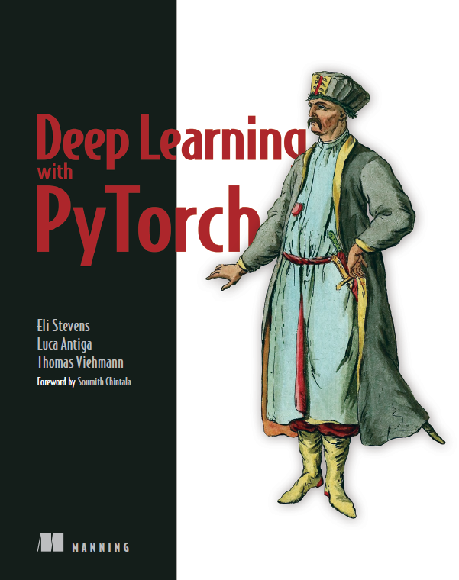
Recommended reading material
Deep Learning with Pytorch book:

Slide 45
Today’s Computer assignment
Pytorch in production

Slide 46

Lab session
Objective: make a custom data loader class, neural network architecture, and training loop in Pytorch
Dataset: abalone with categorial and continuous input data (8 variables) and 1 target (rings): CSV file
Variable name | Role | Data type | Description | Range
Sex | Input variable | Categorical | M (male), F (female), I (infant)
Length | Input variable | Continuous | Longest shell measurement | 0.075 - 0.815
Diameter | Input variable | Continuous | Perpendicular to the length | 0.055 - 0.65
Height | Input variable | Continuous | With meat in shell | 0 - 1.13
Whole_weight | Input variable | Continuous | Whole abalone | 0.002 - 2.8255
Shucked_weight | Input variable | Continuous | Weight of meat | 0.001 - 1.488
Viscera_weight | Input variable | Continuous | Gut weight | 0.0005 - 0.76
Shell_weight | Input variable | Continuous | After being dried | 0.0015 - 1.005
Rings | Target variable (output) | Integer | Indication for the age | 1 - 29

Slide 47
Tasks
Download the Jupyter Notebook (lab04_pytorch.ipynb) and the train.csv and test.csv data files from Canvas
There are three empty cells that need your code: - Dataset: build a custom dataset class that loads and preprocesses the categorical and continuous inputs and target from the CSV file. TIP: apply appropriate splits and prevent data leakage - Neural network architecture: find out what type of data analysis this assignment requires, and construct an architecture for that task - Training loop: implement your training procedure using the defined functions and classes
Revisit the slides to get inspiration!

