Slide 1
Splitting up your problem into microservices
Régina ten Bruggencate
Linda van der Pal
Finalist

Slide 2
Inspired by Erik Talboom & Koen Metsu
Splitting up a problem into microservices
A nice cocktail of hardcore OO design mixed with some microservices, flavoured with single responsibility

Slide 3
Possible splitting criteria
Implementation technology
Computationally heavy
I/O heavy
Geography
location of team
Domain Driven Design

Slide 4
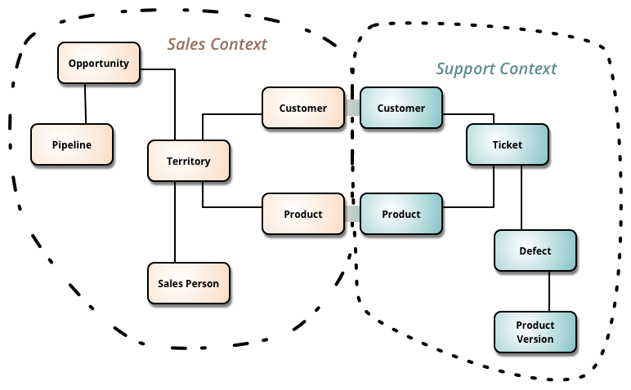
DDD terms explained
domain
model
ubiquitous language
context
bounded context

Slide 5
Building blocks
layered architecture
entities
value objects
domain events
services

Slide 6
Large-scale structure
system metaphor
responsibility layers
knowledge level

Slide 7
References
Building Microservices
Sam Newman
Domain Driven Design
Eric Evans
Microservice Architecture
Irakli Nadareishvili, Ronnie Mitra, Matt McLarty & Mike Amundsen
Microservices for Java Developers
Christian Posta

Slide 8
Set Rules
Each card has four properties
Quantity: 1, 2 or 3
Colour: red, blue or green
Shape: heart, ellipse or square
Filling: open, shaded, full
12 card form a board
3 cards form a set, if any given property
Is equal for all three cards (3x red)
Is unequal for all three cards (red, blue and green)
If no set can be found, 3 extra cards are added
The game is over when all cards are drawn and no more sets can be found

