Slide 1
Boundaries of Microservices How to build them and how to cross them
Linda van der Pal – Trailblazers
Régina ten Bruggencate – Trailblazers
Gunnar Morling – Red Hat
Emmanuel Bernard – Red Hat
`

Slide 2
Agenda
Splitting up your problem into microservices
Theory
Discussion
Programming
…Crossing the boundaries…

Slide 3
Splitting up your problem into µs
Inspired by Erik Talboom & Koen Metsu

Slide 4
Possible splitting criteria
Implementation technology
Computationally heavy
I/O heavy
Geography
location of team
Domain Driven Design

Slide 5
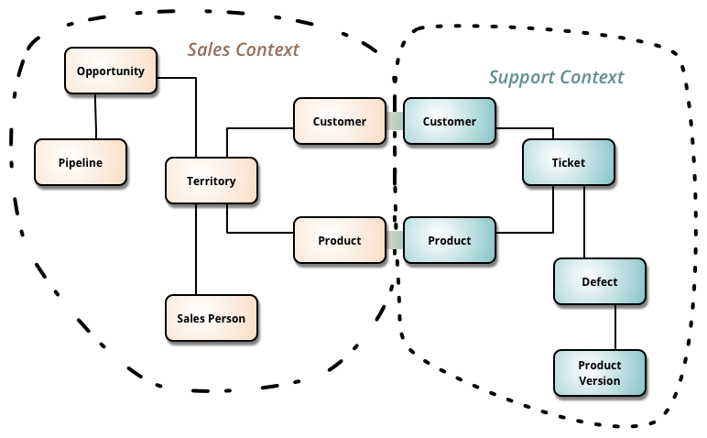
DDD terms explained
domain
model
ubiquitous language
context
bounded context

Slide 6
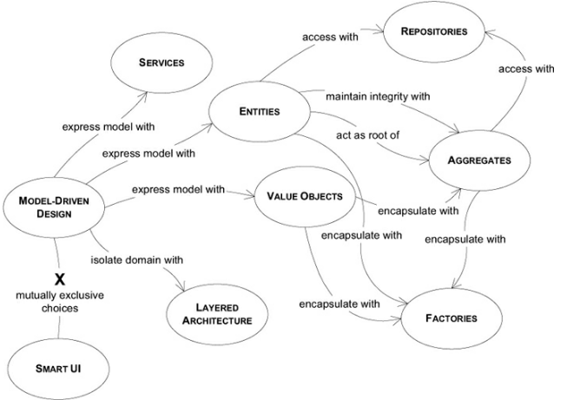
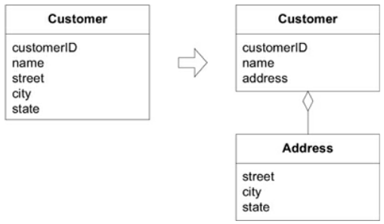
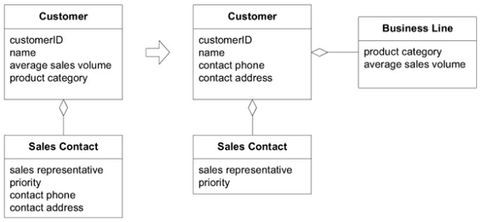
Building blocks
layered architecture
entities
value objects
services
Properties of a service
The operation relates to a domain concept that is not a natural part of an ENTITY or VALUE OBJECT.
The interface is defined in terms of other elements of the domain model.
The operation is stateless.

Slide 7
References
Building Microservices (Sam Newman)
Domain Driven Design (Eric Evans)
Microservice Architecture (I. Nadareishvili, R. Mitra, M. McLarty & M. Amundsen)
Microservices for Java Developers (Christian Posta)
Hexagonal at Scale, with DDD and microservices! (Cyrille Martraire – video will be on Youtube)

