Slide 1

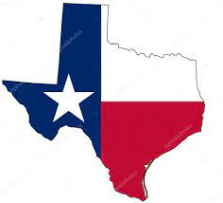
2013 Motor Vehicle Crashes in Texas
Data Wrangling and Visualization Project with Tableau

Slide 2
Exploring Motor Vehicle Crashes Data in Texas
In this presentation, motor vehicle crashes are investigated using this data set.
https://repo.exeterlms.com/documents/V2/DataScience/Data-Wrang-Visual/motor_vehicle_crashes.zip
This dataset has 5258 motor vehicle crashes’ informations with 171 variables.

Slide 3
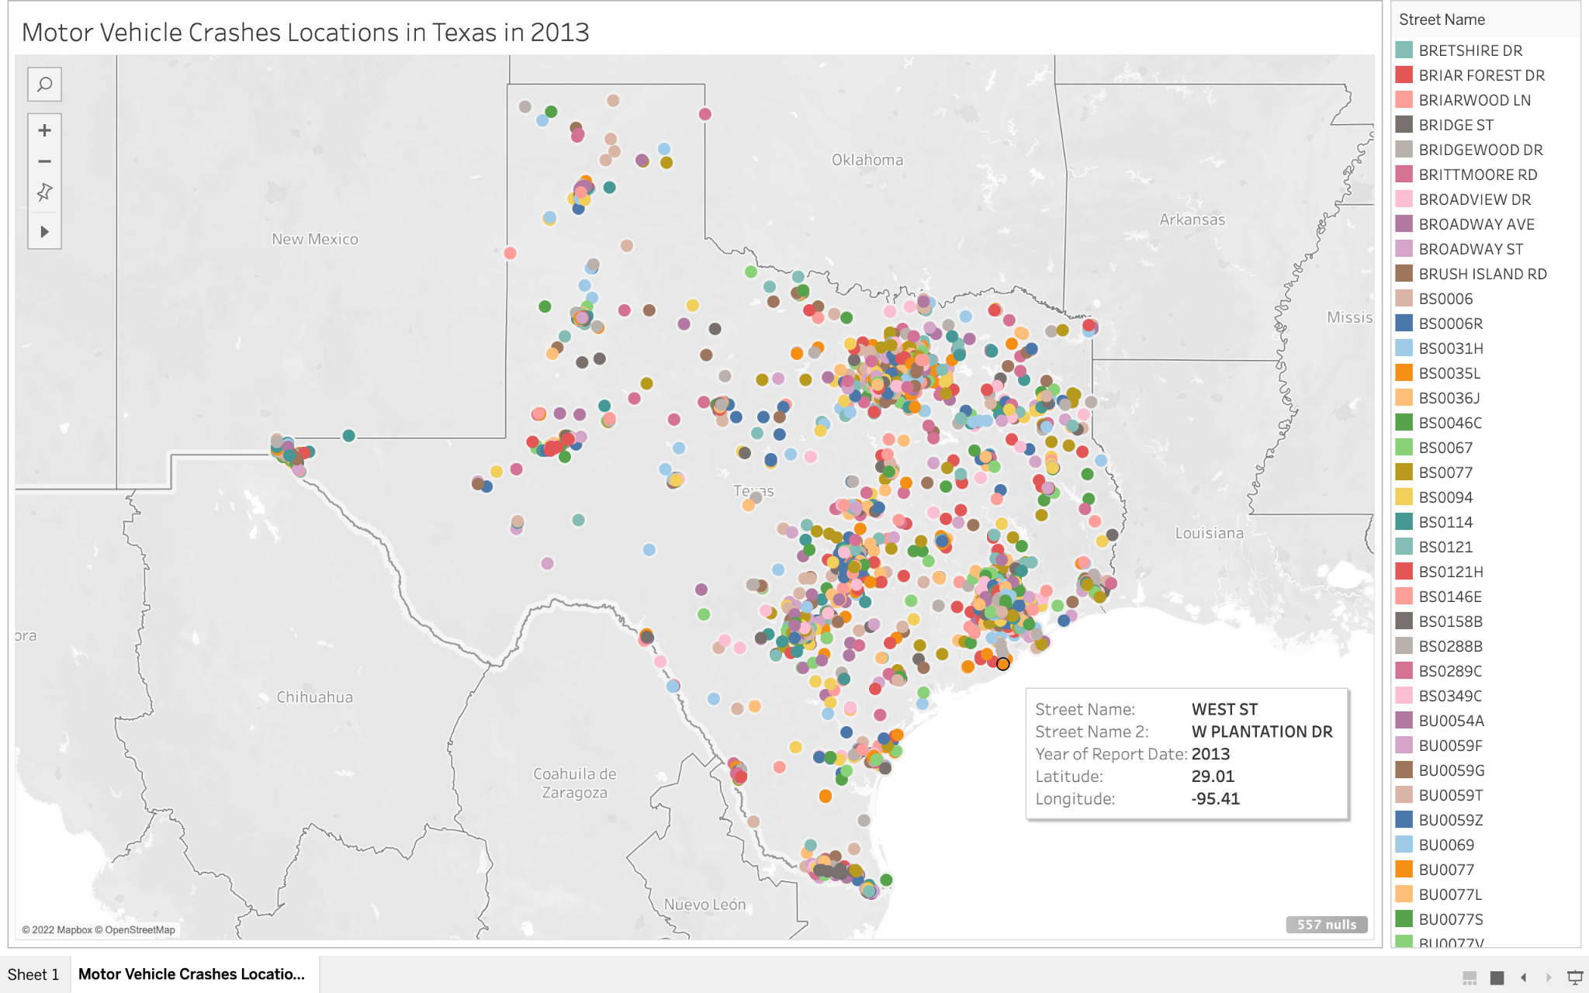
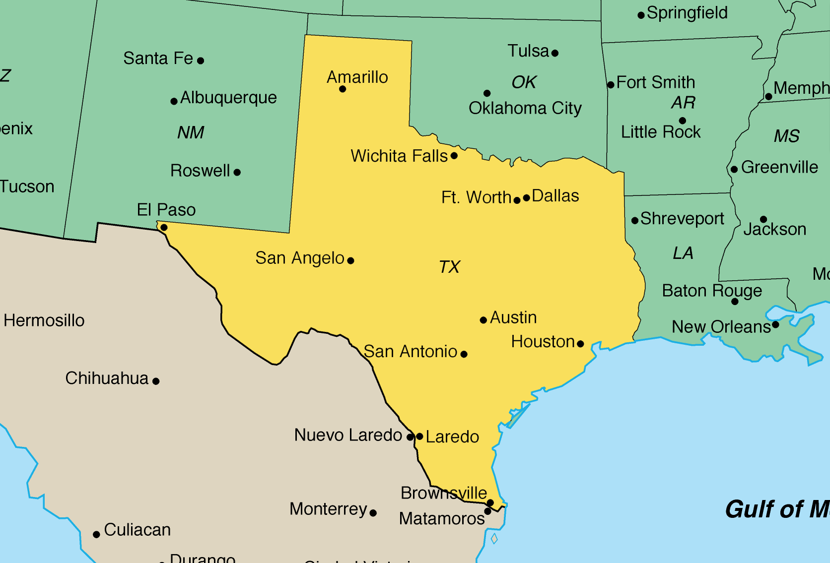
Motor Vehicle Crashes’ Locations in Texas in 2013
-This mapview shows motor vehicle crashes’ locations in Texas in 2013
-As expected, major cities such as Houston, Austin, and Dallas have more crashes than other part of Texas

Slide 4
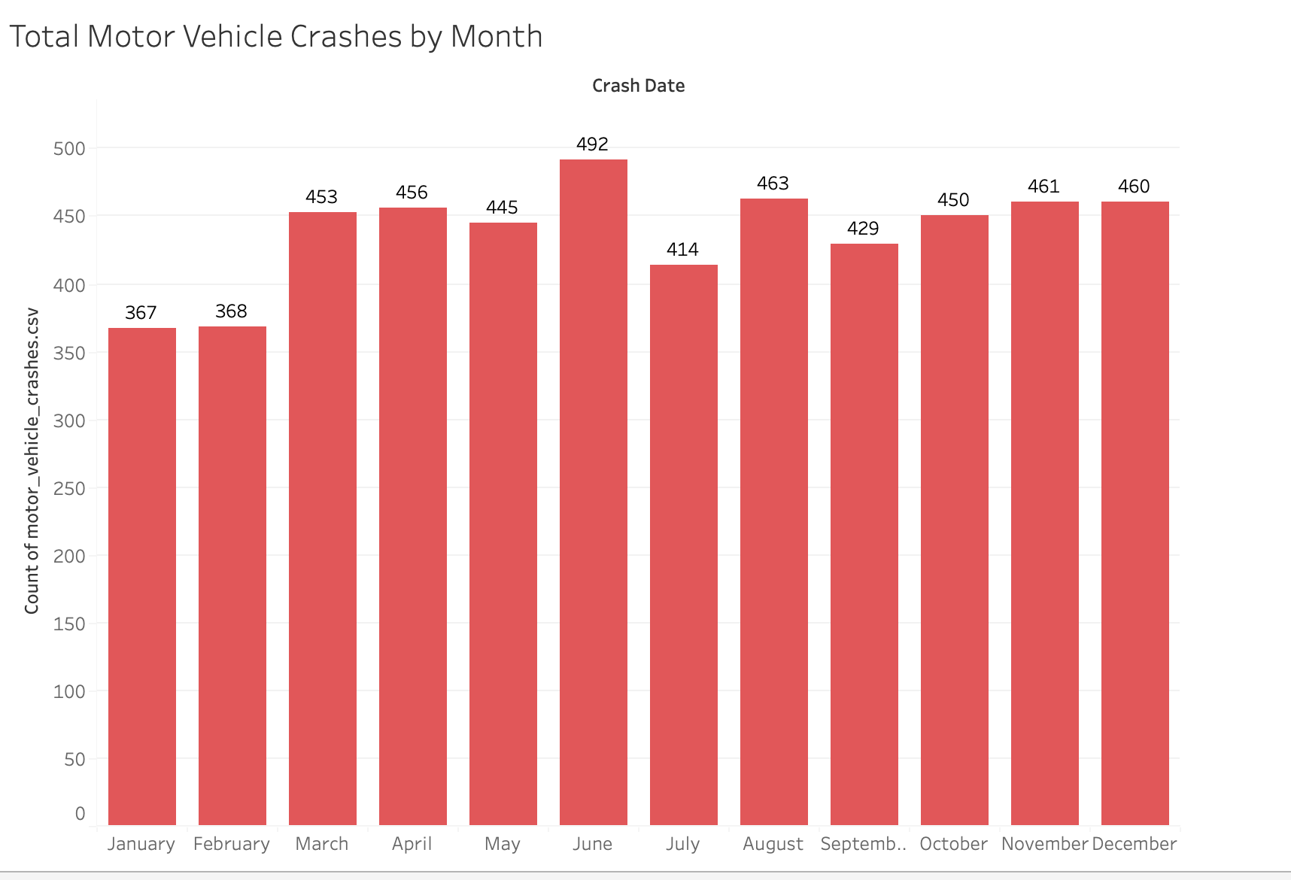
Motor Vehicle Crashes Cumulation Over the Months
5258 motor vehicle crashes occurred in Texas during 2013.
The Plot on the left shows distribution of crashes by month. Even though maximum number of crashes happened in June, the number of crashes above the 400 the most of the months. Average number of motor vehicle crashes is 438.

Slide 5
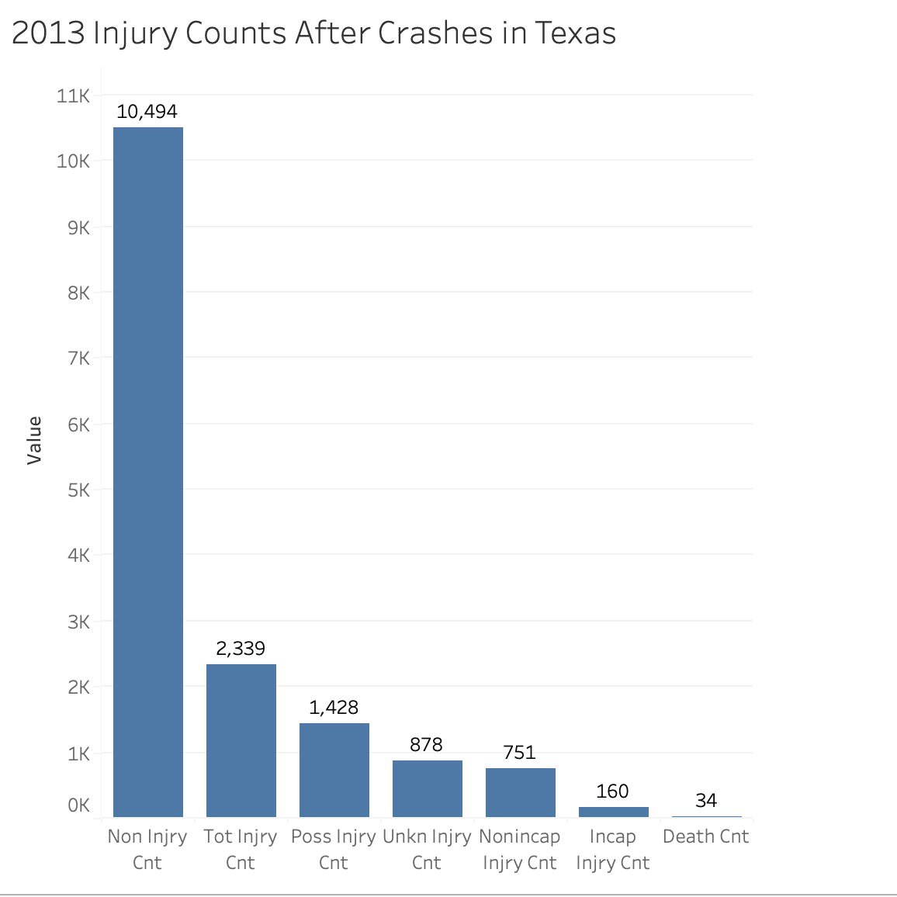
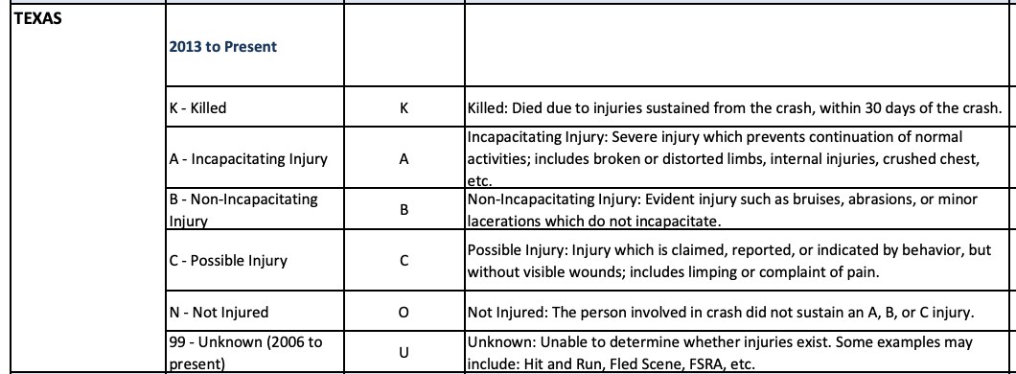
Injury Statistic
Injury Classification Scale and Definitions in Texas
–12,833 people involved motor vehicle crashes in 2013.
–10,494 people didn’t get injured.
–2,339 people injured.
–34 out of 2,339 people were death.
Definition of other injuries explained above at the table.

Slide 6
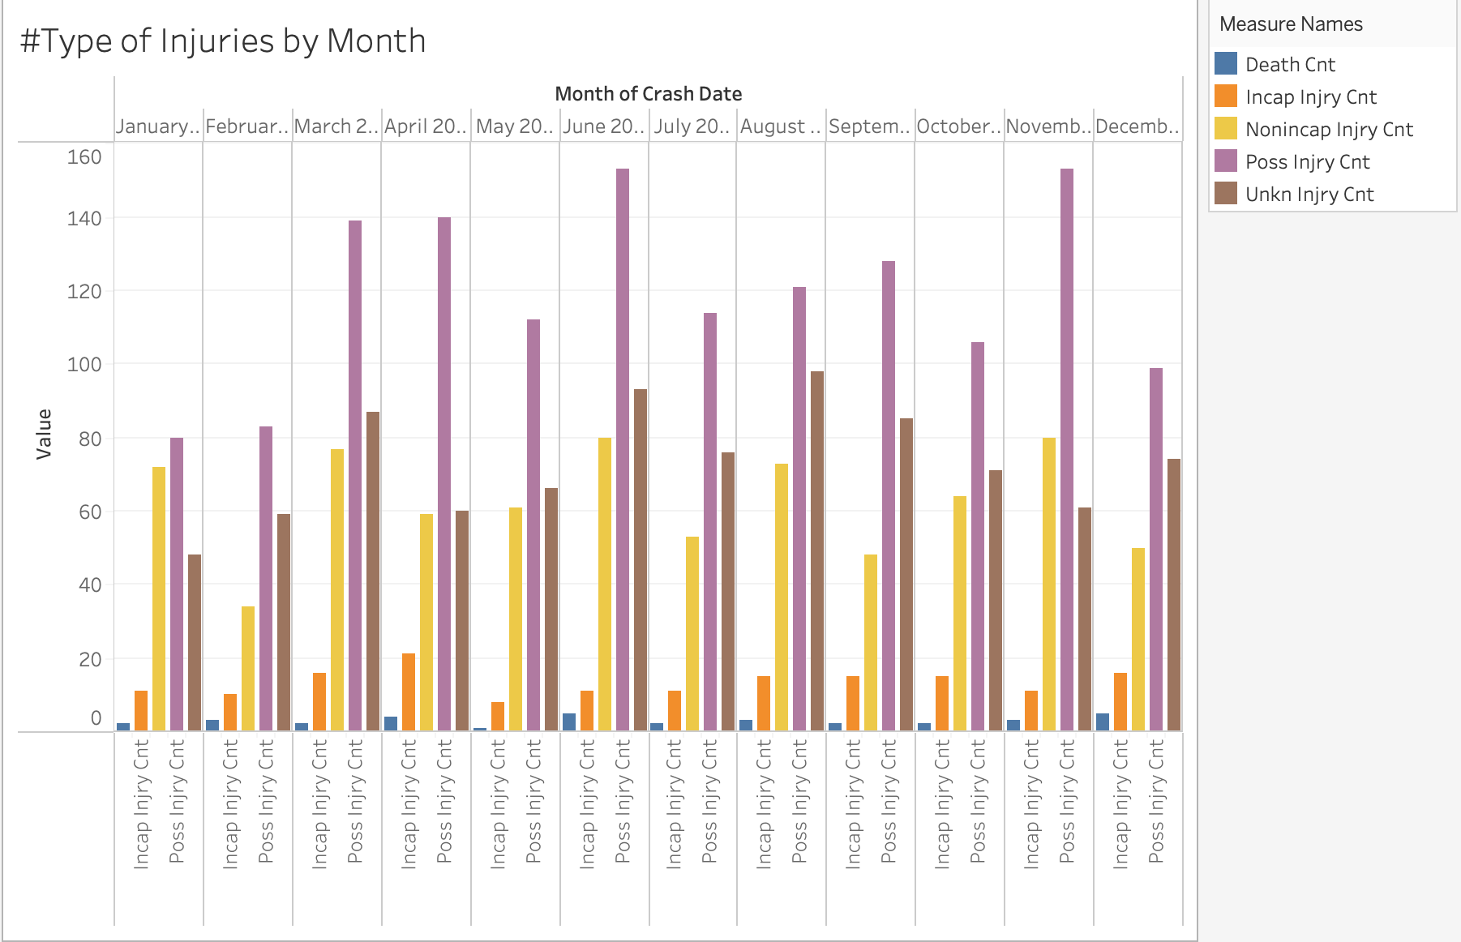
Injury Statistic
The graph on the left shows injury counts by months. It can be seen possible injuries and unknown injuries are the major injury types in motor vehicle crashes.

Slide 7
Summary
5258 motor vehicle crashes in 2013 were investigated.
Big cities have more crashes than other part of Texas.
Not too much difference number of crashes between months of the year. Average is 438 crashes.
12,833 people involved crashes.
2,339 people injured
34 people were killed.

