Slide 1
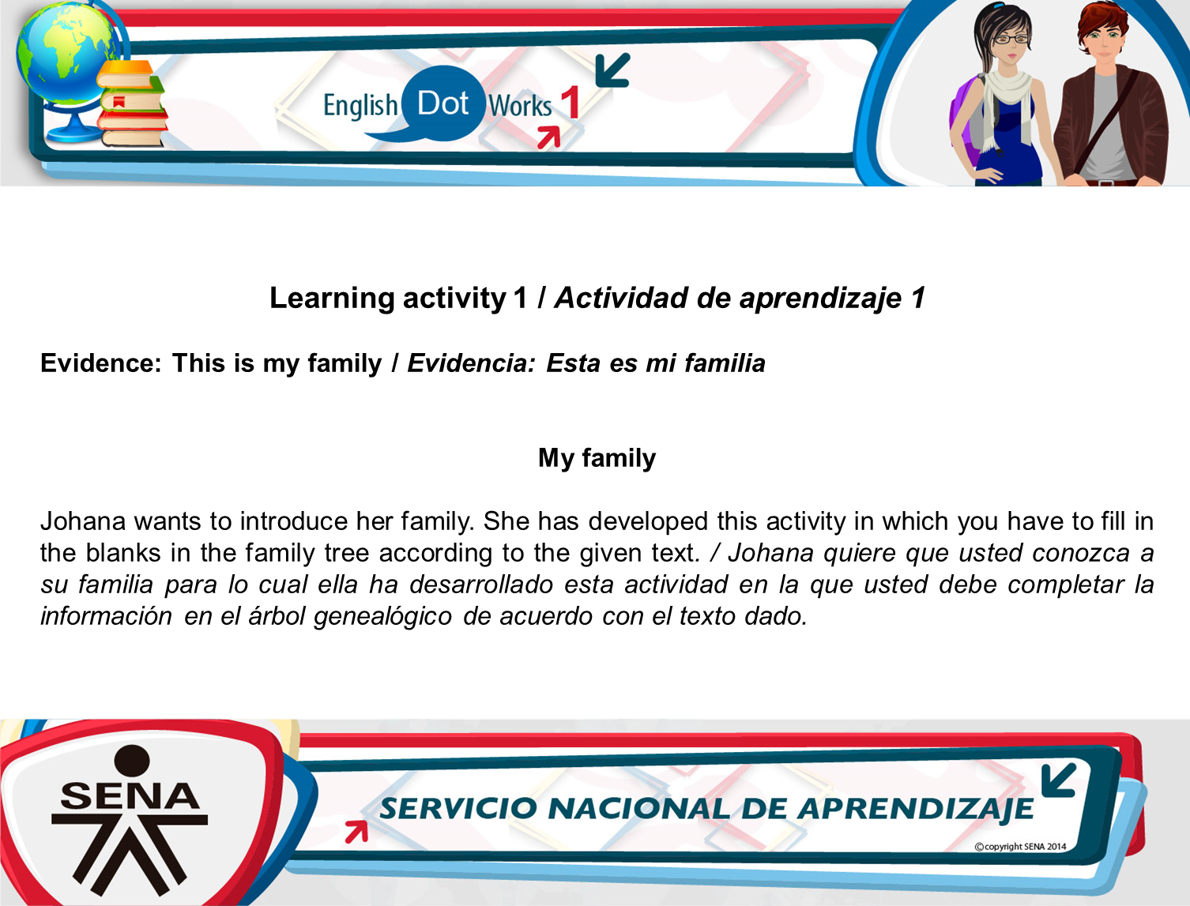

Slide 2
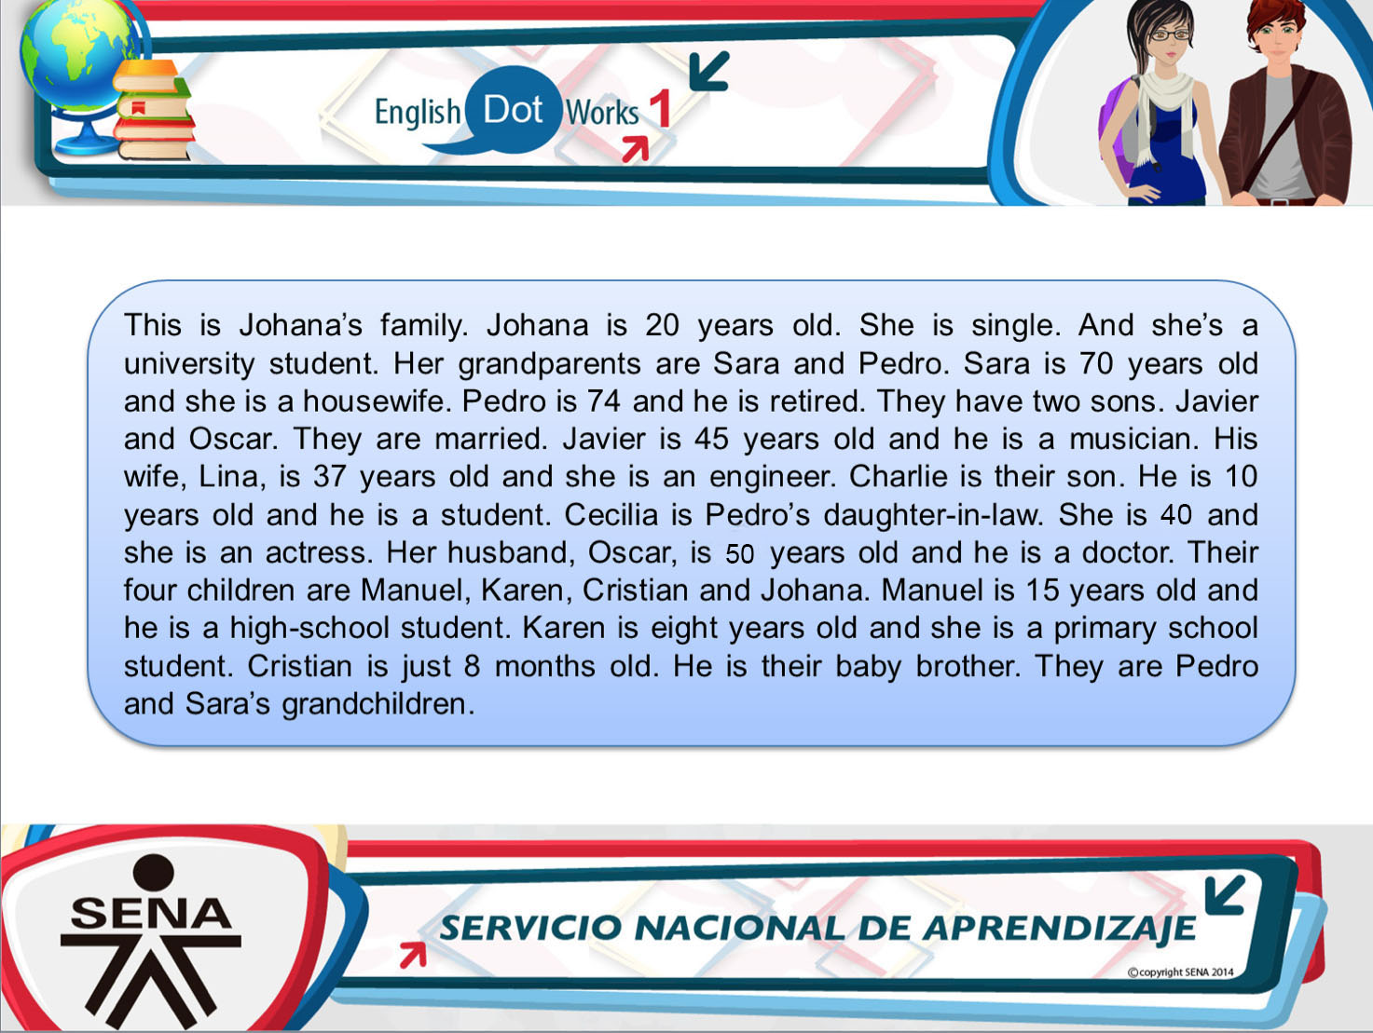

Slide 3
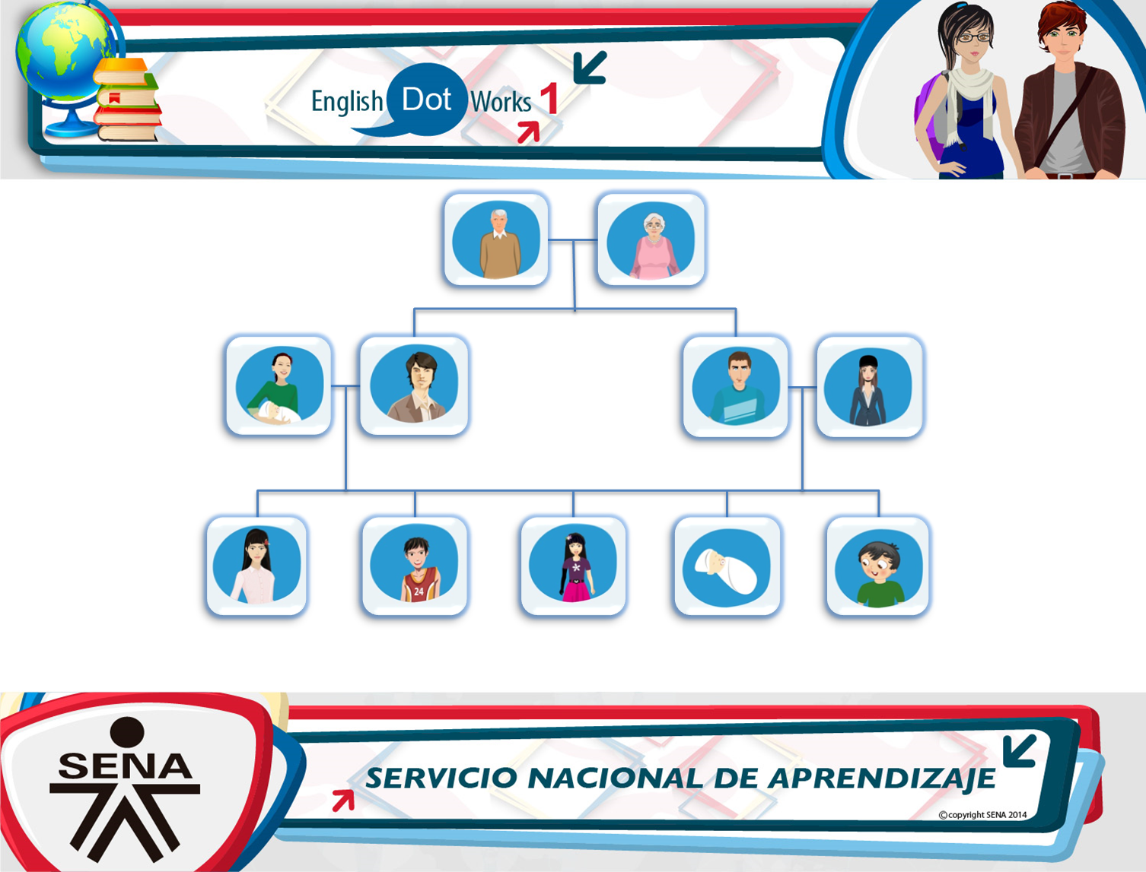

Name: ___Pedro________
Occupation: he is retired__
Age: He is_74_years old_
Name: _Sara___________
Occupation: she is a_housewife
Age: _She is_70 years old_____
Name: __Javier_________
Occupation: He is a musician
Age: _He is 45 years old_
Name: _Oscar_________
Occupation: he is a doctor
Age: he is 50 years old___
Name: ___Lina________
Occupation: she is an engineer
Age: _she is 37 years old___
Name: _Cecilia________
Occupation: She is an actress_
Age: She is 40 years old_
Name: __Johana________
Occupation: she is a university_student__
Age: _she is 20 years old_
Name: _Manuel_________
Occupation: _he is a high-school student_
Age: he is 15 yeras old__
Name: _Charlie___________
Occupation: _he is a student_
Age: __he is 10 years old__
Name: ____Karen_______
Occupation: _she is primary school__
Age: _she is 7 years old_
Name: ___Cristian__
Occupation: _baby___
Age: __8 months old__

