Slide 1
O-RAN ARchitecture
Introduction
O-cloud
Near-RT RIC
SMO ( Service Management and Orchestration)
Non –RT RIC

Slide 2
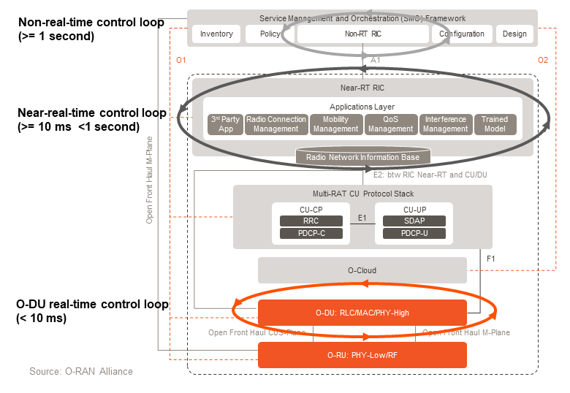
O-RAN ARchitecture
From O-RAN point of view, split 7.2 used for the fronthaul while split 2 may additionally be present, depending on the deployment scenario.
CP: Control plane
MAC: Media Access Control
MANO: Management and Orchestration
NFVI: Network Functions Virtualization infrastructure
ONAP: Open Network Automation Platform
PDCP: Packet Data Convergence Protocol
PHY: Physical Layer
RAT: Radio Access Technology
RLC: Radio Link Control
RRC: Radio Resource Control
SDAP: Service Data Adaption Protocol
UP: User Data Plane
Notes:
MAC: quản lý và điều phối
The control loops are closed loop autonomous action and feedback loops designed for normal operation and/or optimization of the network by feeding (cung cấp) it with real-time intelligence and analytics, thereby realizing the vision ( thực hiện hóa tầm nhìn) of autonomous and self-optimizing networks.
The first loop that should be highlighted is the Real-time O-DU Scheduler control loop, shown in orange in Figure 1 above. It is responsible for real-time processing of radio scheduling information, HARQ, beamforming, etc. The timing of the loop is less than 10 milliseconds, hence real-time.
The Near-real-time control loop operates between 10 milliseconds and 1 second and is associated with the Near-RT RIC. Finally, we have the non-real-time control loop which is associated with Non-RT RIC and operates at over 1 second.

Slide 3
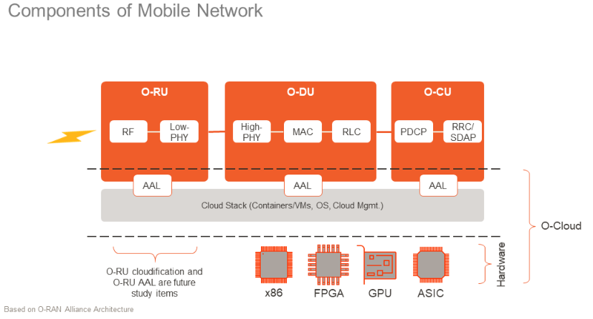
O-Cloud
Define: as a cloud computing platform comprised of a collection of physical infrastructure nodes that meet O-RAN requirements to host the relevant O-RAN function, the supporting software components , and appropriate management anf orchestration function.
Layer:
The top layer is virtualized
software functions.
The mid layer includes Cloud
Stack functions as well as AAL
Functions
At the bottom is the hardware
layer
Notes:
AAL: Acceleration Abstraction Layer
The term O-Cloud refers to a collection of O-Cloud resource pools at one or more location and the software to manage nodes and deployments hosted on them. An O-Cloud will include functionality to support both deployment-plane and management services.
When we talk about decoupling of hardware and software, or disaggregation or cloudification, the intention is that the software will reside on a COTS server on the cell site or in an Edge Cloud or in any data center located anywhere.
An O-Cloud Node is a collection of CPUs, memory,storage,NICs,BIOSes, BMCs,… may inclu hardware accelerators ( bộ tang tốc) to offload computational-intense functions with the aim of optimizing the performance of the O_RAN cloudified Network Functions.
ALL Interface plays a role as it allows different software vendor’s network func to work with deff hardware and accelerators.

Slide 4
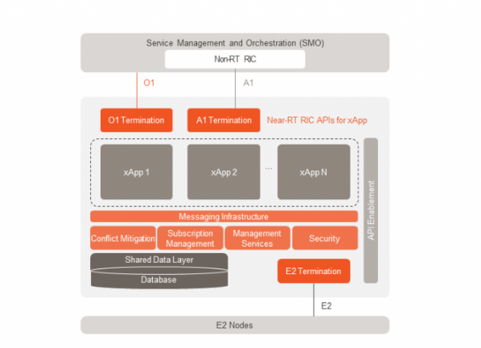
Near-RT RIC
Define: is a logical function that enables near-real-time control and optimization of RAN elements and resource via fine-grained data collection and actions over an E2 interface
Notes:
fine-grained data: data detail
xApp, an application designed to run on the Near-RT RIC, is central to the operation of Near-RT RIC. ‘X’ stands for any, so any app designed to run on the Near-RT RIC.
Each xApp is likely to consist of one or more microservices. At the point of on-boarding, microservices will identify which data it consumes and which data it provides. The important point that has excited many within our industry is that these applications are independent of the Near-RT RIC and may be provided by any third party. The E2 interface enables a direct association between the xApp and the RAN functionality.

Slide 5
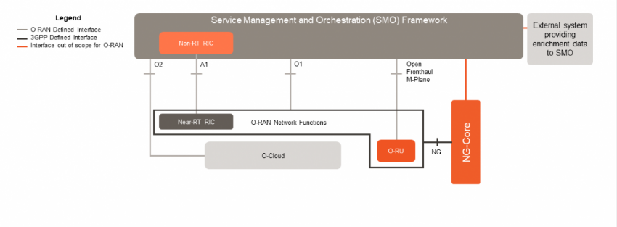
SMO
Define: is a Service management and Orchestration system.
SMO perform its services through four key O-RAN defined interfaces as can be seen in the high-level architecture diagram
Open Front-haul M-plane
A1 interface
O1 Interface
O2 Interface

Slide 6
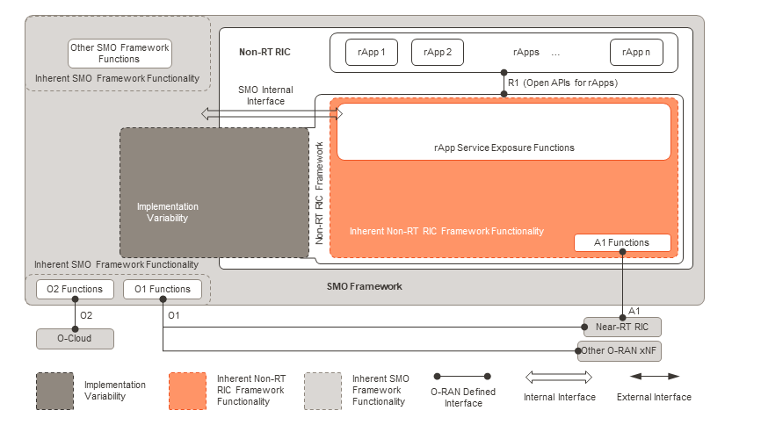
Non-RT RIC
Define: as a logical function within SMO that drives the content carried across the A1 interface
Notes:
The Non-RT RIC enables non-real-t
In comparison, the O1 and O2 interfaces are shown as being directly associated with the SMO Framework itself, which is not specific to the Non-RT RIC. This representation again is intended to communicate that the SMO Framework functionality is directly responsible for driving what is carried across these interfaces.ime control and optimization of RAN elements and resources, it includes AI/ML workflow including model training and updates, and policy-based guidance of applications/features in the Near-RT RIC.
In addition to the external A1 interface, there is also an internal R1 interface. The Non-RT RIC allows applications to run on it. These applications are called rApps, where ‘r’ stands for RAN.

Slide 7
Learning 5G
NG Interface
Definition
Interface Function
Protocol
reference
Radio resource control
Introduction
Produce
Message
States
Reference

Slide 8
I- NG- Interface

Slide 9
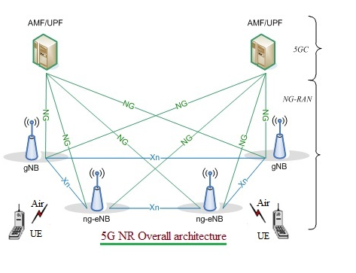
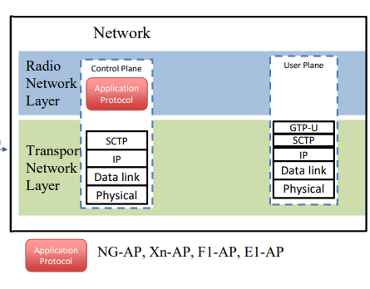
refer 5G NR architecture
5G NR ( New radio) network comprosed of NG RAN and 5GC
Includes interface: Xn, NG, E1, F1, F2.
Notes:
-Xn interface exist between these base station viz between gNB-gNB, gNB-ng eNB, ng-eNB – ng-eNB. Xn is the network interface between NG_RAN nodes.
Xn-U stands for Xn User Plane interface and Xn-C stands for Xn Control Plane interface.
-NG interface exist between 5GC and these base station.
-NG-C : control plane interface between NG-RAN and 5GC.
-NG-U : user plane interface between NG-RAN and 5GC
gNB node providing NR user plane and control plane protocol terminations towards the UE, and connected via the NG interface to the 5GC.
The 5G NR (New Radio) gNB is connected to AMF (Access and Mobility Management Function) and UPF (User Plane Function) in 5GC (5G Core Network).
The protocol layers are mapped into three units viz. RRH (Remote Radio Head), DU (Distributed Unit) and CU (Central Unit)
ng-eNB: node providing E-UTRA user plane and control plane protocol terminations towards the UE and connected via the NG interface to the 5GC.

Slide 10
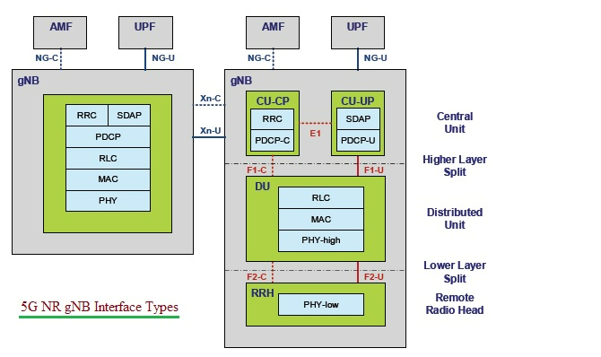
REF -5G NR Interface
Interface:
5G NR Xn interface
5G NR NG Interface
5G NR E1 Interface
5G NR F1 Interface
5G NR F2 Interface
Notes:
+ 5G NR Xn Interface : Xn interface lies between NG-Ran nodes viz gNB &ng-eNb
• Control Plane Functions are as follows: -interface management and error handling (e.g. setup, reset, removal, configuration update) -connected mode mobility management (handover procedures, sequence number status transfer, UE context retrieval) -support of RAN paging -dual connectivity functions (secondary node addition, reconfiguration, modification, release, etc.) • User Plane Functions are as follows: -Data Forwarding -Flow Control
+ 5G NG Interface
Between 5G RAN and 5G Core Network. Both control plane and user plane lies between them and hence there are two interfaces under NG interface viz. NG-C and NG-U. It is similar to LTE interfaces viz. S1-C and S1-U respectively.
Functions
-NG interface supports the exchange of signalling information between NG-RAN and 5GC. -It defines inter connection of NG-RAN nodes with AMFs supplied by different manufacturers. -It specifies the separation of NG interface Radio Network functionality and Transport Network functionality to facilitate introduction of future technology. • Capabilities: -procedures to establish, maintain and release NG-RAN part of PDU sessions -procedures to perform intra-RAT handover and inter-RAT handover -the separation of each UE on the protocol level for user specific signalling management -the transfer of NAS signalling messages between UE and AMF -mechanisms for resource reservation for packet data streams

Slide 11
RF -5G NR Interface
Interface:
5G NR Xn interface
5G NR NG Interface
5G NR E1 Interface
5G NR F1 Interface
5G NR F2 Interface
Notes:
+ 5G NR E1 Interface : From logical perspective, E1 interface is point-to-point interface between a gNB-CU-CP and a gNB-CU-UP
Functions: -E1 interface supports the exchange of signalling information between the endpoints. -It separates Radio Network Layer and Transport Network Layer. -It enables exchange of UE associated information and non-UE associated information.
+ 5G F1 Interface : Between gNB-CU and gNB-DU. It is also separated into F1-C and F1-U based on control plane and user plane functionalities.
Functions: -F1 interface defines inter-connection of a gNB-CU and a gNB-DU supplied by different manufacturers. -It supports control plane and user plane separation. -It separates Radio Network Layer and Transport Network Layer. -F1 interface enables exchange of UE associated information and non-UE associated information.
+ 5G NR F2 Interface
This interface lies between lower and upper parts of the 5G NR physical layer. It is also separated into F2-C and F2-U based on control plane and user plane functionalities.

Slide 12
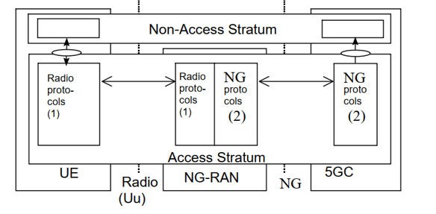
NG interface definition
There are 2 interface Uu and NG that connect NG-RAN to UE via radio and to 5GC
The protocol layer below NAS on NG –RAN –Uu and NG-C are called the Access Strum.
Notes:
NAS ( Non Access Stratum) is highest stratum of the control plane between UE and MME at the radio interface.
Main functions of the protocols that are part of the NAS are support of mobility of the user equitment (UE) and the support
Of session management procedures to establish and maintain IP connectivity between the UE and a packet data network gateway (PDN GW)
+ NAS control protocol performs followings:
EPS bearer management;
Authentication;
ECM-IDLE mobility handling;
Paging origination in ECM-IDLE;
Security control.

Slide 13
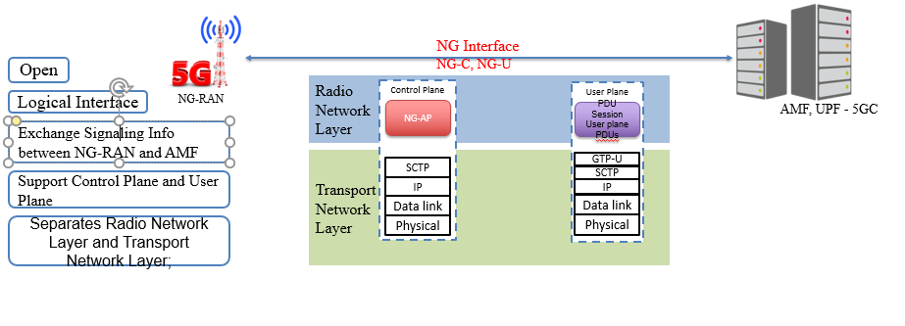
NG interface definition
Notes:
The general priciples for the specification of the NG interface are as fllows.
-is open
Support the exchange of signaling information between the NG-Ran and 5GC
From a logical standpoint,the NG is a point-to-poit interface between an NG-Ran node and a 5GC node .A poit-to-poit logical interface is feasible even in the absence ( khả thi ngay khi cả vắng mặt) of physical direct connection between the NG-Ran and 5GC.
Support control plane and user plane separation
Seperates Radio Network Layer anf transport Network Layer
Is future proof to fulfil different new requirements and support of new services and new functions.
Decoupled with the possible NG-RAN deployment variants
The NG Application Protocol support modular procedures design and user a syntax allowing optimized encodeing/decoding efficiency

Slide 14
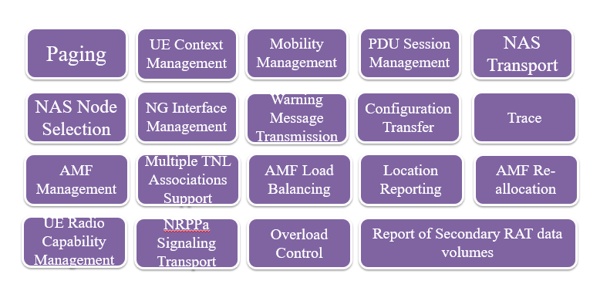
NG Interface function
Notes:
-Paging func: supports the sending pof paging requests to the NG-Ran nodes involved in the paging area
-UE Context Management func: allows the AMF to establish , modify or release a UE Context in the AMF and the NG-Ran node
-Mobility Managemnent function:
-PDU session Management fun: is responsible for establishing, modifying anf releaseing the involved PDU sessions NG-RAN resources for user data transport once a UE context is available in the NG-RAN node.

Slide 15
NG Interface function

Slide 16
II- Radio resource control ( RRC)

Slide 17
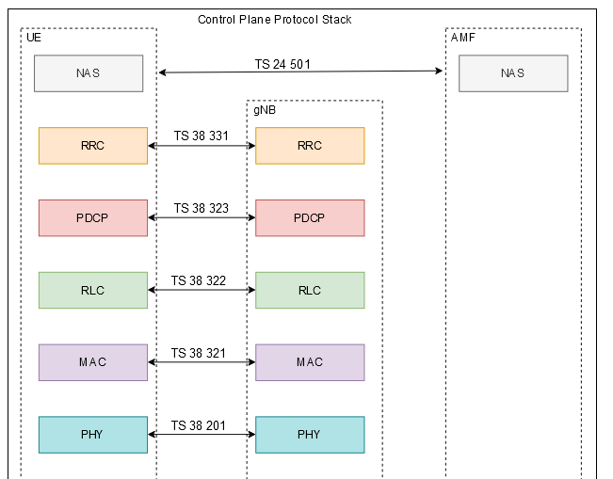
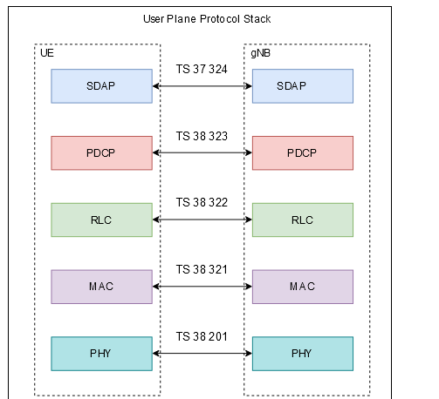
II- 1 introduction
5G NR RRC layer
RRC Layer is a protocol stack
RRC layer is used for Access Layer signaling AS
RRC is a L3 layer protocol
Notes:
The Radio Resource Control (RRC) protocol is used in on the Air Interface. The major functions of the RRC protocol include connection establishment and release functions, broadcast of system information, radio bearer establishment, reconfiguration and release, RRC connection mobility procedures, paging notification and release and outer loop power control.By means of the signaling functions, the RRC configures the user and control planes according to the network status and allows for Radio Resource Management strategies to be implemented

Slide 18
II- 2 PRODUCer

Slide 19
II-3 .Message
ff

Slide 20
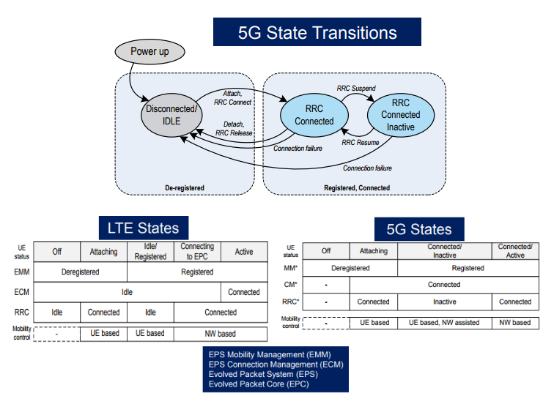
II-4. states
Definition: RRC states?
Appart form RRC connected and RRC IDLE state, 5G NR has introduced a new RRC state names as RRC Inactive state.
NR-RRC CONNECTED
NR-RRC INACTIVE
NR-RRC IDLE
Notes:
The operation of the RRC is guided by a state machine which defines certain specific states that a UE may be present in.
The different RRC states in this state machine have different amounts of radio resources associated with them and these are the resources that the UE may use when it is present in a given specific state.
When UE is power up it is in Disconnected mode/Idle mode, It can move RRC connected with initial attach or with connection establishment. If there is no activity from UE for a short time, It can suspend its session by moving to RRC Inactive and can resume its session moving to RRC connected mode.
A UE can move to RRC Idle mode from RRC connected or RRC Inactive state.
RRC Idle Mode Operations:
PLMN selection
Broadcast of system information
Cell re-selection mobility
Paging for mobile terminated data is initiated by 5GC
Paging for mobile terminated data area is managed by 5GC
DRX for CN paging configured by NAS
RRC Inactive Mode Operation:
Broadcast of system information
Cell re-selection mobility
Paging is initiated by NG-RAN (RAN paging)
RAN-based notification area (RNA) is managed by NG- RAN
DRX for RAN paging configured by NG-RAN
5GC – NG-RAN connection (both C/U-planes) is established for UE
The UE AS context is stored in NG-RAN and the UE
NG-RAN knows the RNA which the UE belongs to
RRC Connected Mode Operation:
5GC – NG-RAN connection (both C/U-planes) is established for UE
The UE AS context is stored in NG-RAN and the UE
NG-RAN knows the cell which the UE belongs to
Transfer of unicast data to/from the UE
Network controlled mobility including measurements

Slide 21
MIMO and beamforming
MOMO (Multiple Input Multiple Output) antenna technonology is a way of increasing the capacity of a radio link using multiple transmit antennas and multiple receive antennas.
MIMO can be implemented in many ways
Diversity
Spatial multiplexing
Beamforming (BF).
Difference between SU-MIMO ( Single User) and MU-MIMO ( Multiple User)
Notes:
Diversity: ( đa dạng)Multiple transmit and receive antennas are used to increase coverage (increased signal to interference plus noise ratio, SINR) (SINR tạp âm)
. Transmit diversity means to have multiple antennas at the sending side and receive diversity means to have multiple antennas at the receiver side to increase the captured radio energy.( tang năng lượng vô tuyến thu được)
Spatial Multiplexing: (ghép kênh) When multiple antennas are used by both sender and receiver, multiple streams can be sent with different information for increased user data bit rate. Transmission of data uses several layers with small phase shift ( độ lệch pha nhỏ) between the layers, enabling a receiver to decode the layers separately.( cho phép máy chủ thu giải mã các lớp riêng biệt)
Beamforming (BF): Multiple transmit antennas will direct the radio energy in a narrow sector ( khu vực hẹp) to increase the SINR and thereby increasing the coverage (or increase the bitrate to the UE at a certain distance from the BS).
If different data streams are sent to the same receiver ( bộ thu), it is referred to as Single User MIMO (SU-MIMO), while if the data streams are transmitted to different users, it is referred to as Multi-User MIMO (MU-MIMO)
With 5G NR, there is possibility of having up to 256 transmit antenna at the BS side ( phía ) and that is where the term ‘massive MIMO’ comes into picture ( xuất hiện). Massive MIMO antennas uses a large number of antenna elements but operate at frequencies below 6 GHz. Essentially ( về cơ bản ), they exploit ( khai thác) many elements to realize ( kết hợp, thưc hiện) a combination of BF and spatial multiplexing.

