Slide 1



SWP391: Final Project Presentation Dental Clinic Management System (DCMS)
Supervisor:
Mr. Nguyễn Văn Sang
Group 1 - Team Members:
Nguyễn Hạnh Nguyên (Leader) – HE140511
Nguyễn Hữu An – HE151411
Nguyễn Xuân Trường - HE141509

Slide 2

Introduction
The Dental Clinic system is expected to help patients who come to the Clinic to limit their close contact in public places, especially the system has services to help visitors quickly book an appointment with a doctor or book a service that is effective and safe.

Slide 3

Context diagram

Slide 4
Application Roles/Actors

Slide 5
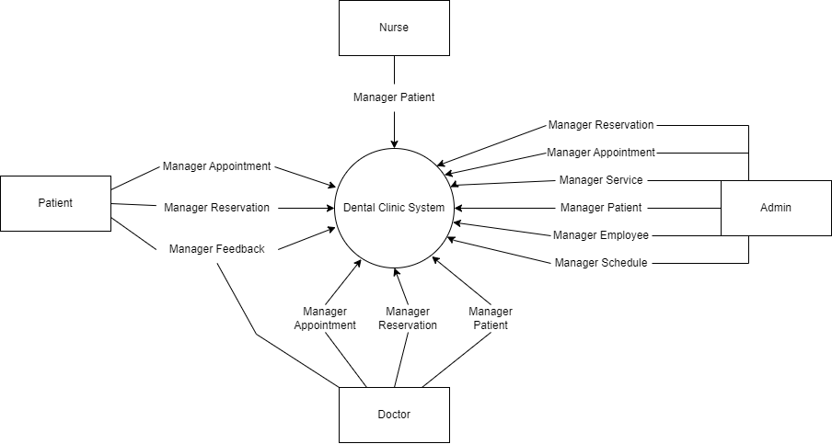

Slide 6








Technology
Communucate
Tool

Slide 7

Roles of project
Guest
Patient
Doctor
Nurse
Admin

Slide 8
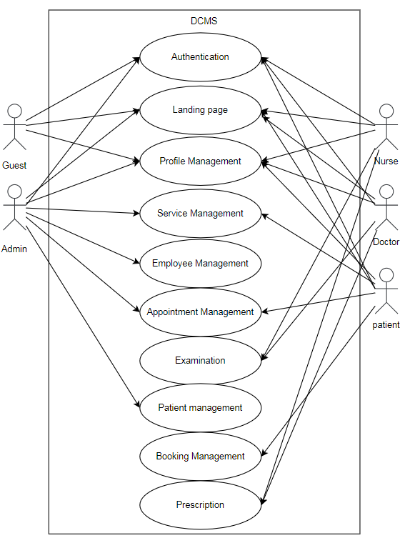
USER CASE - Overview

Slide 9
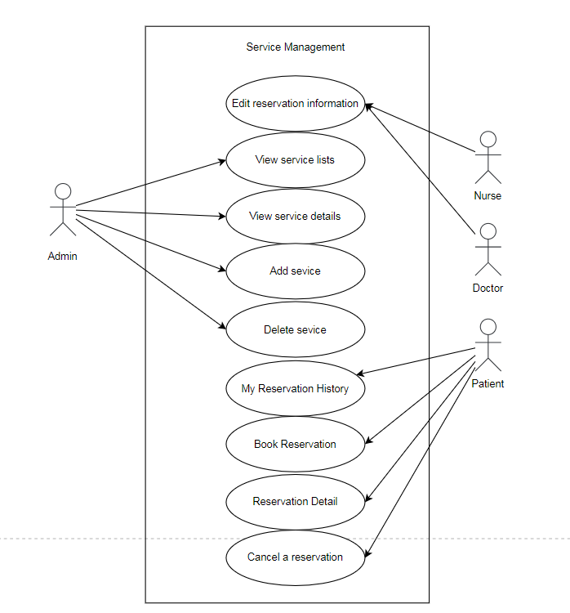
USE CASE - Service Management

Slide 10
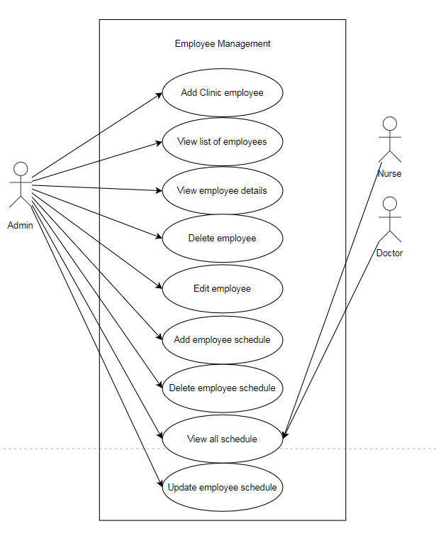
USE CASE - Employee Management

Slide 11
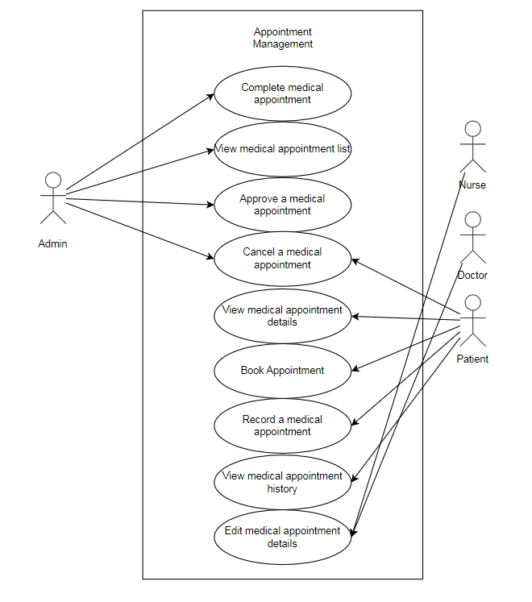
USER CASE - Appointment Management

Slide 12
Application Design

Slide 13
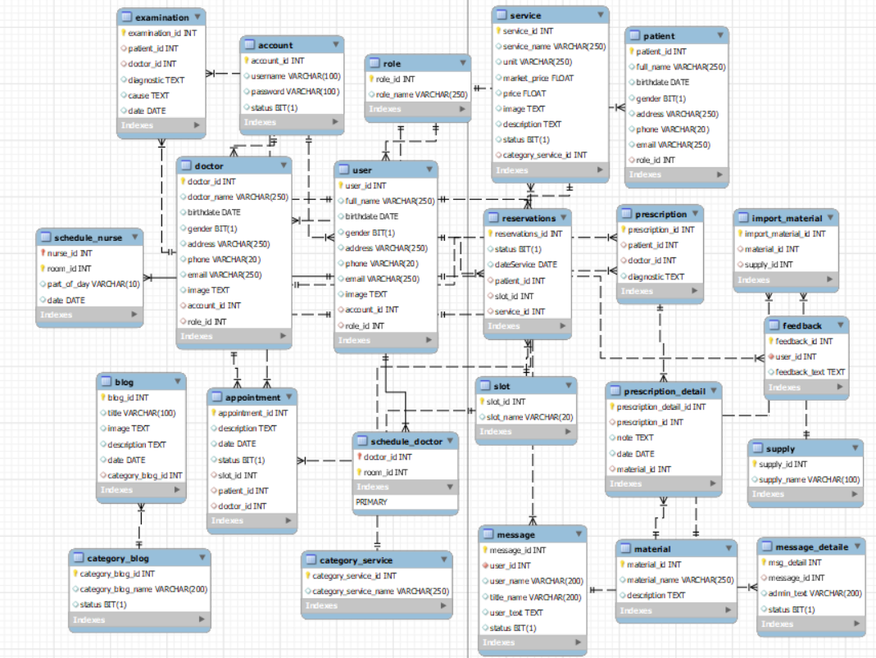
Database schema

Slide 14
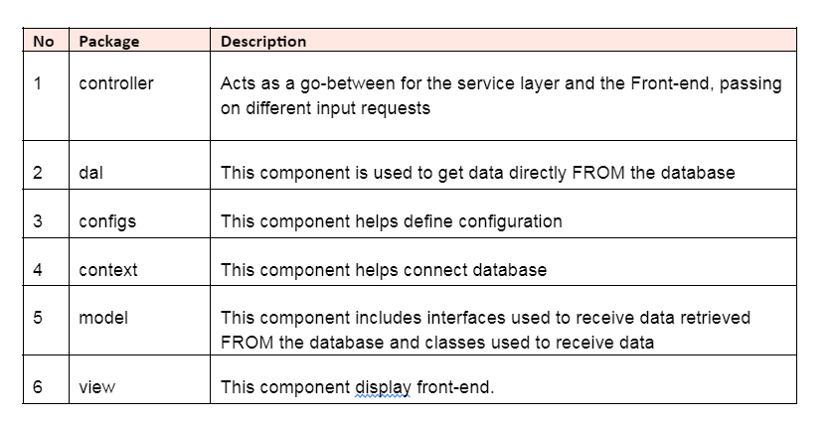
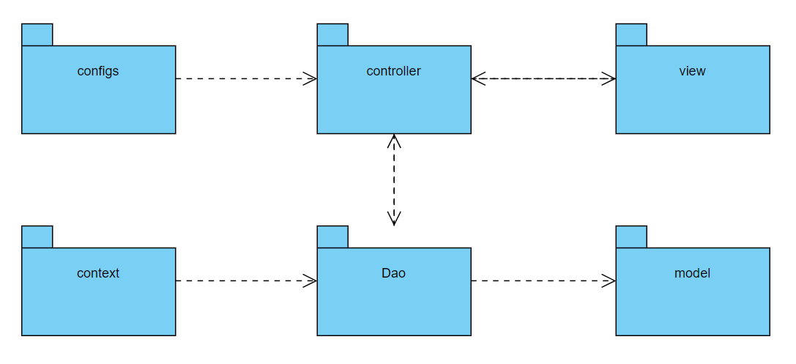
Package diagram

Slide 15
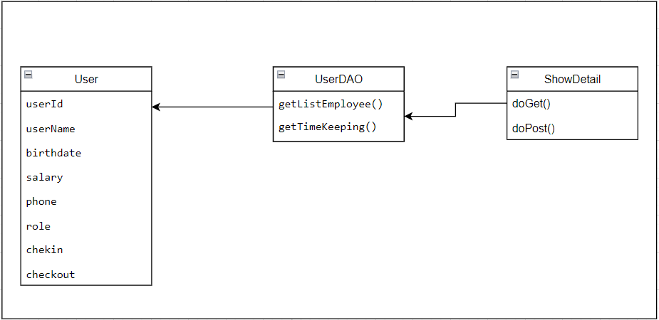
Class Diagram

Slide 16
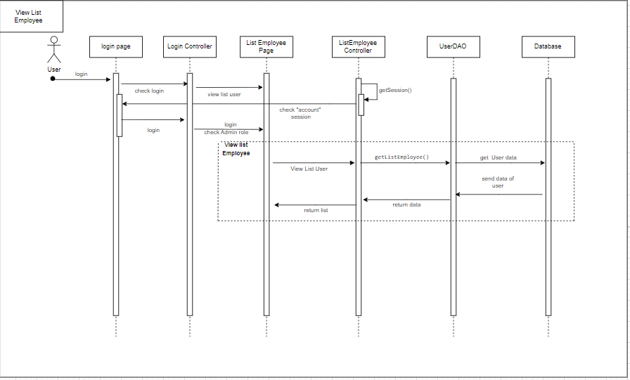
Sequence Diagram(s)

Slide 17

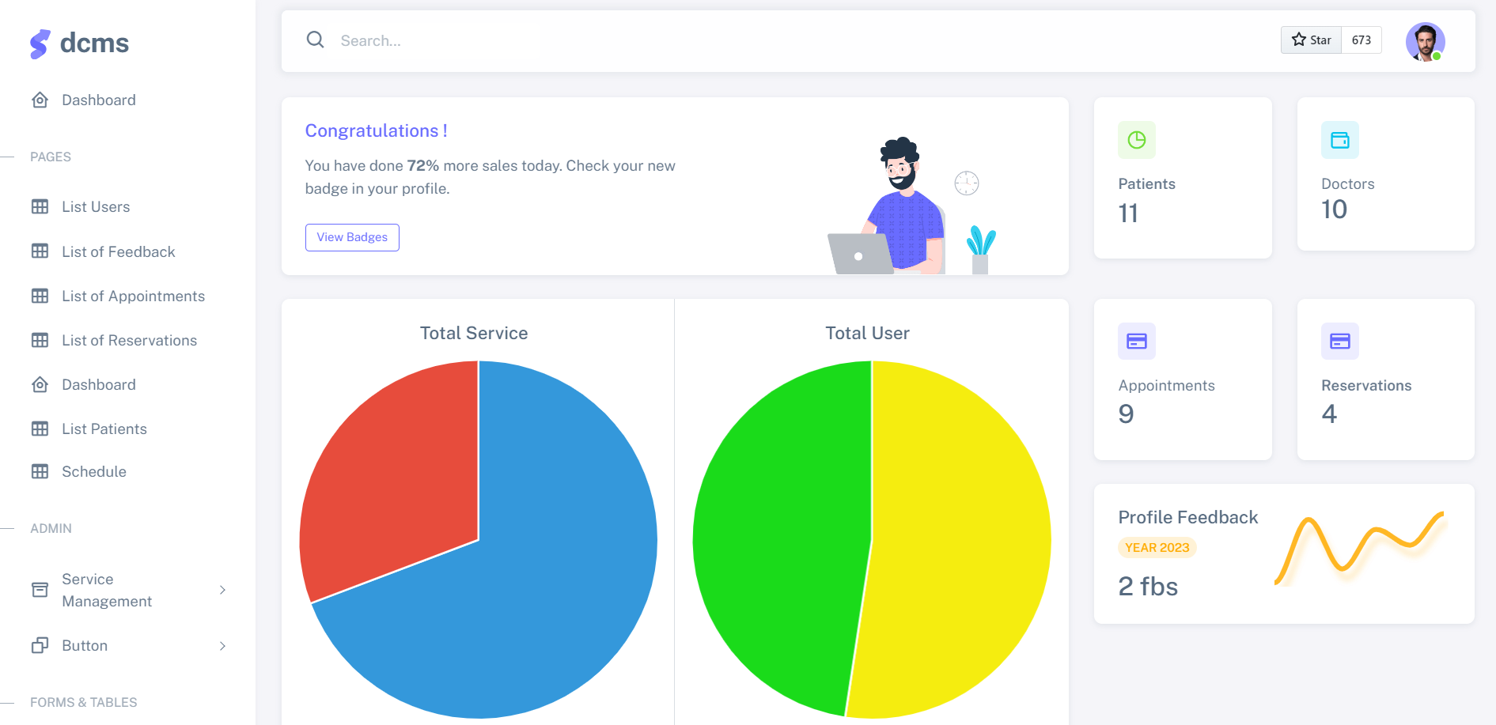
UI Design
Theme: shreethemes.in

Slide 18
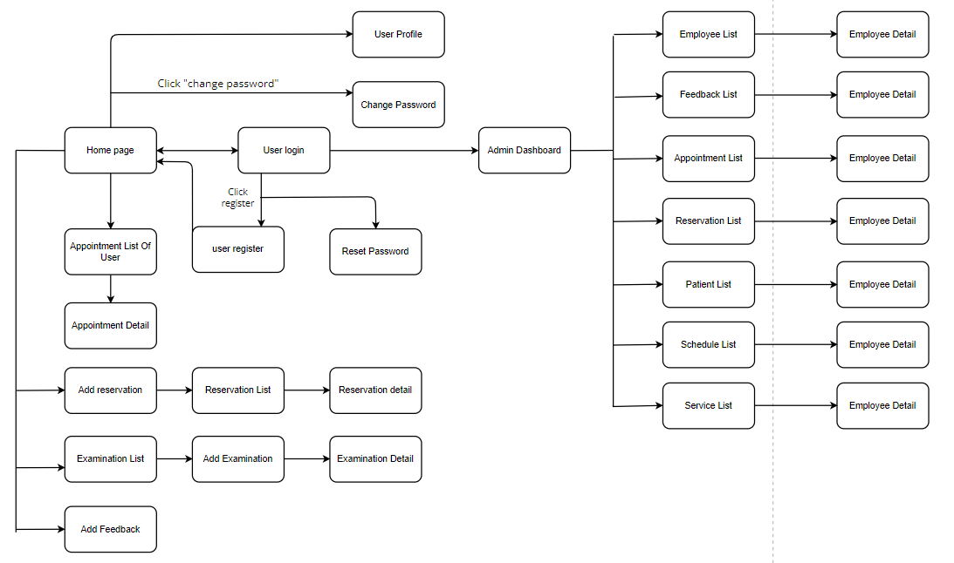
Screen Flow

Slide 19

Project Results

Slide 20
Status of the project
All functions are working properly
User-friendly interface, easy to use

Slide 21




Lessons learned
Teamwork skills
Source code management skills: Gitlab
Database management skills
Project building skills through requirement

Slide 22

The end
Thanks for listening

