Slide 1
Equipment for lining up food bags
Mentor: PhD. Dang Phuoc Vinh
Reserch student: Tran Truong Minh Chanh
Le Viet Hung

Slide 2
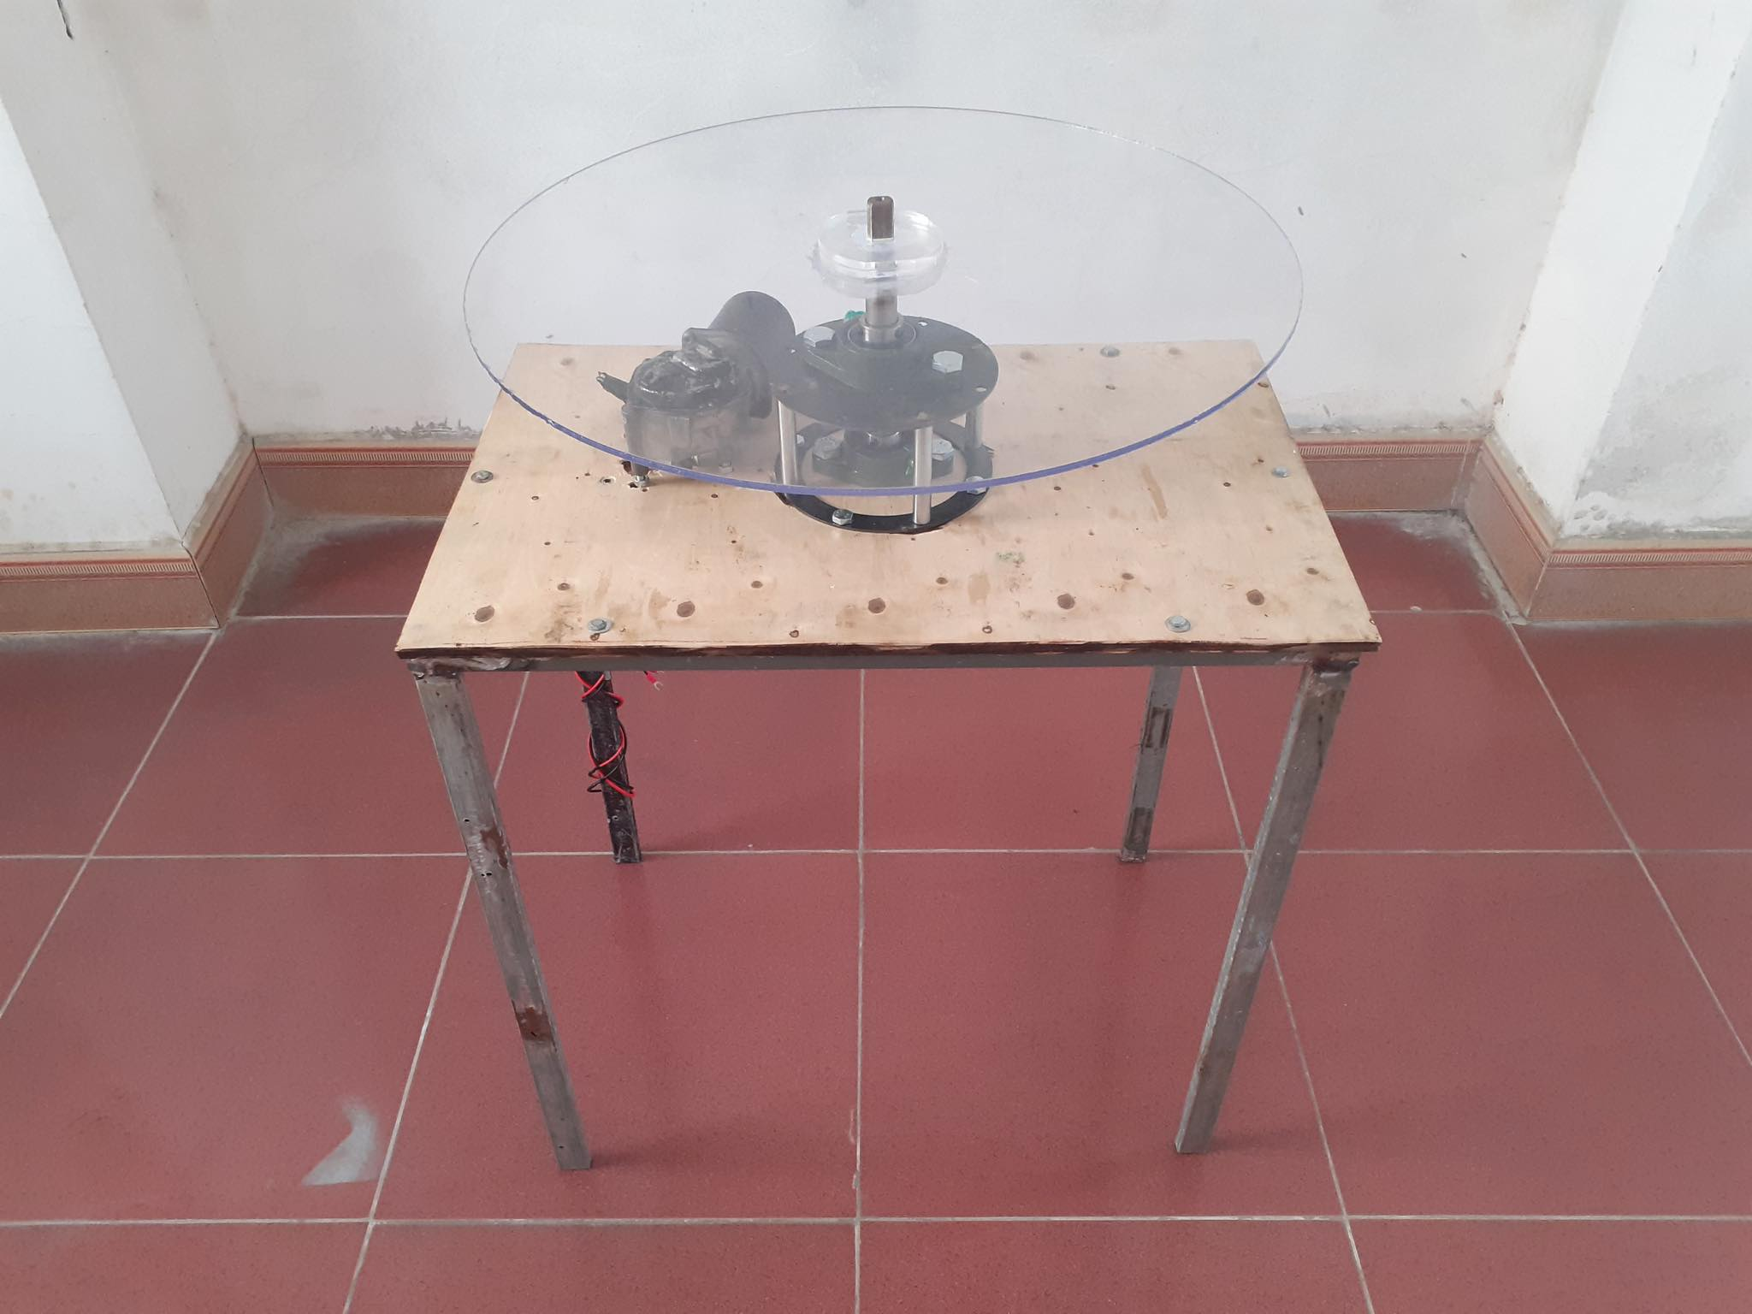
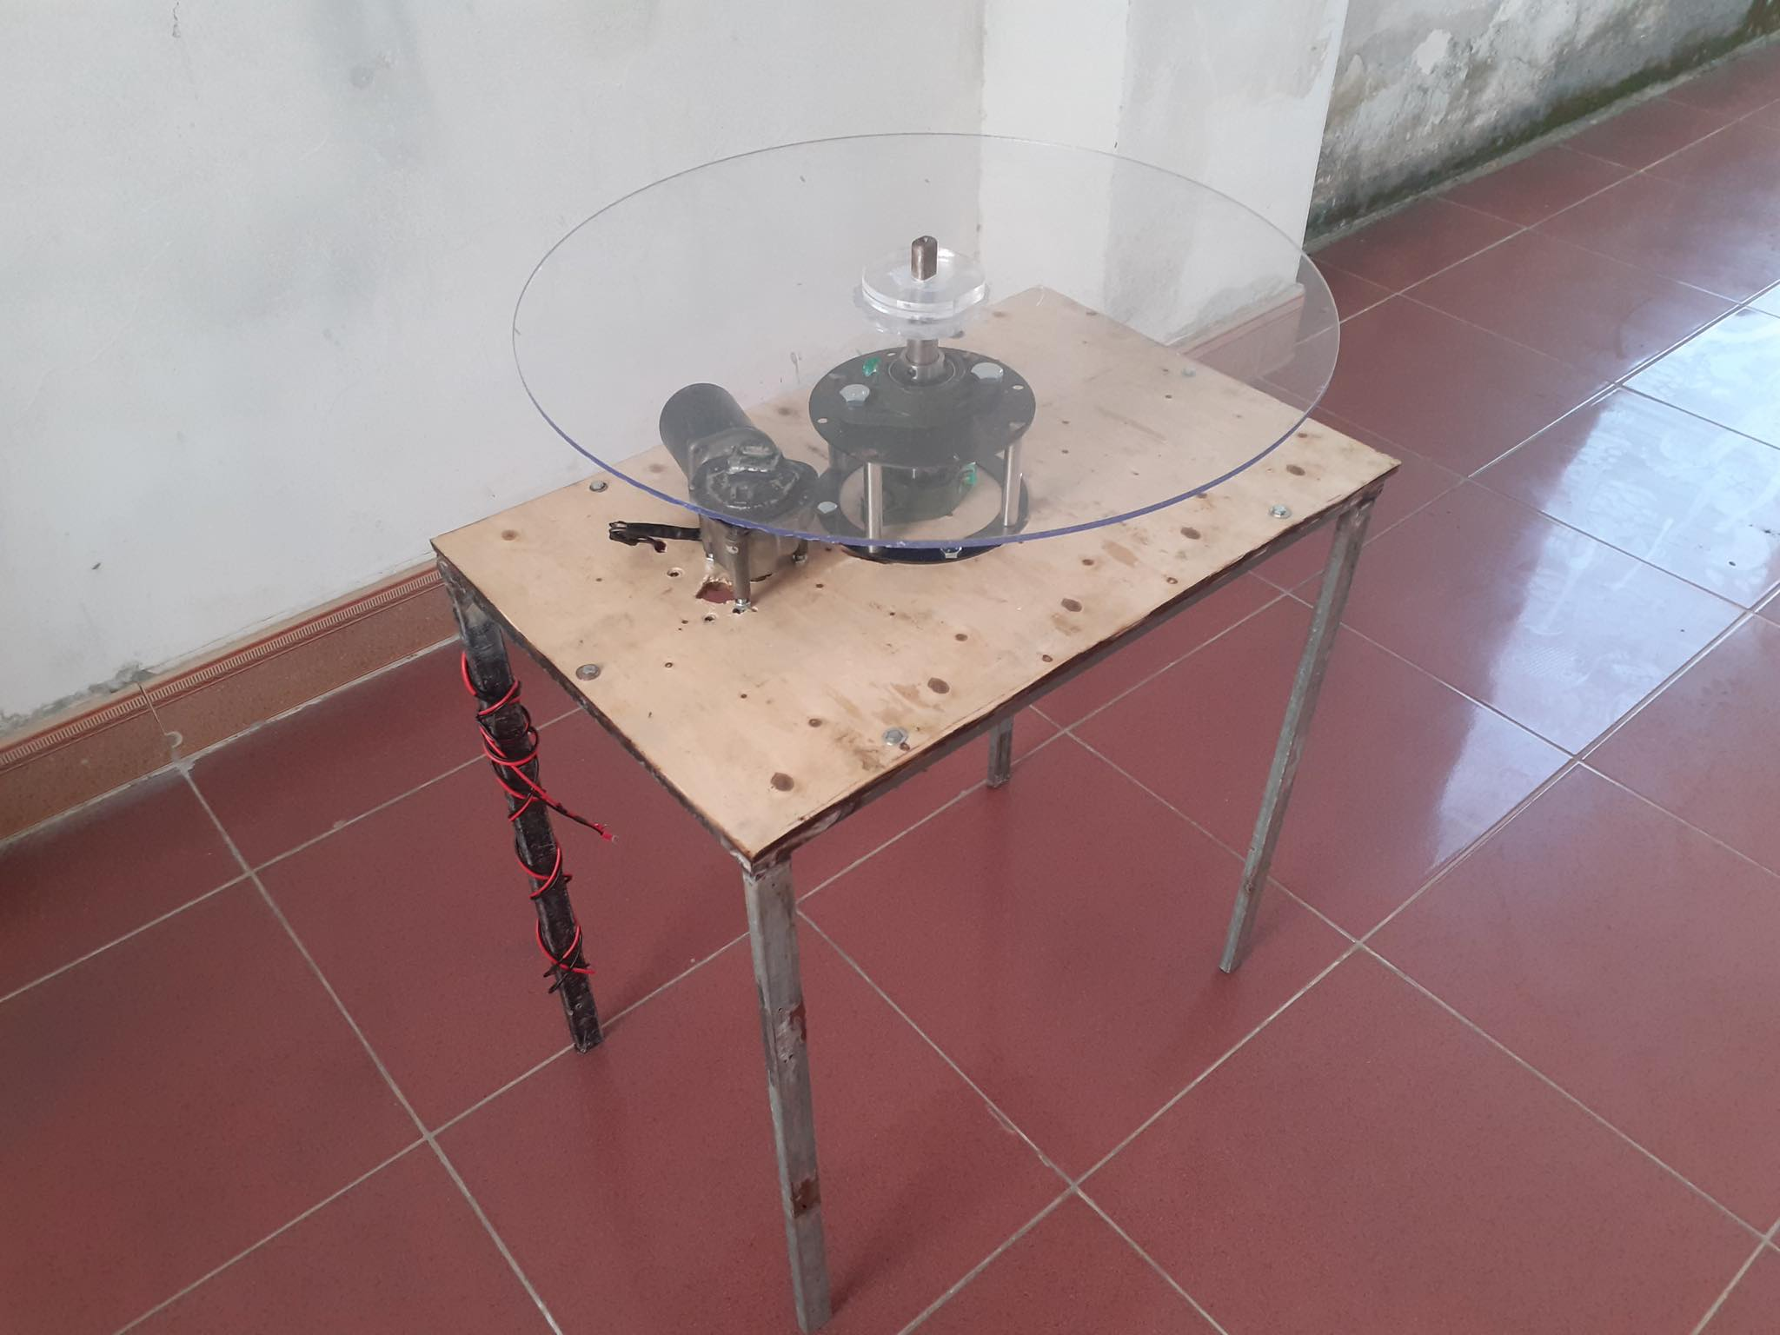
I. Result image
Cone 1: Where to receive input

Slide 3
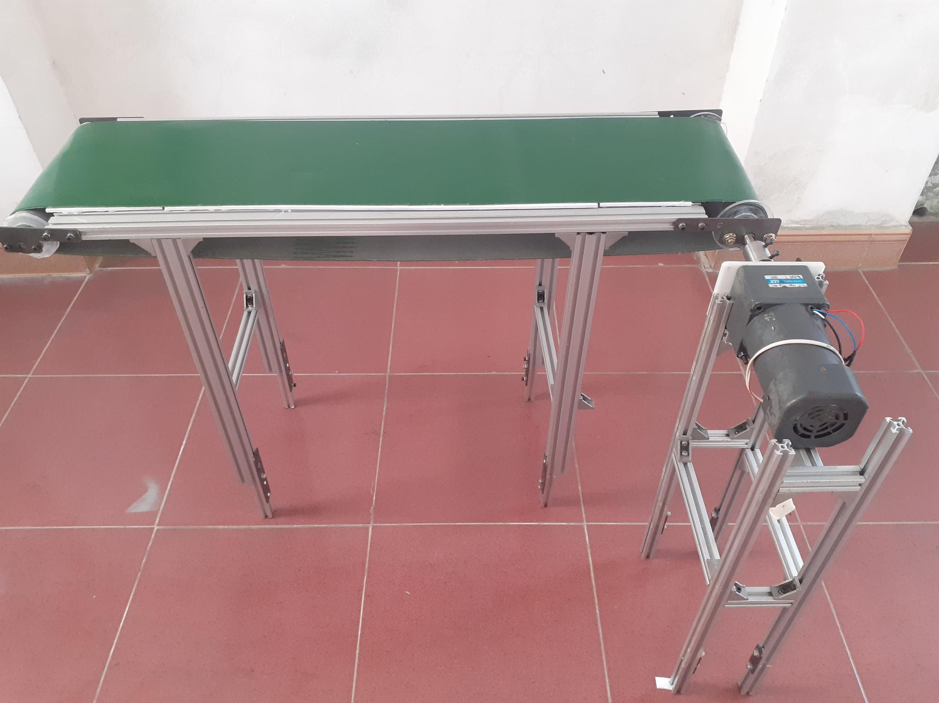
I. Result image
Conveyor 1: Transit item from cone 1 to cone 2

Slide 4
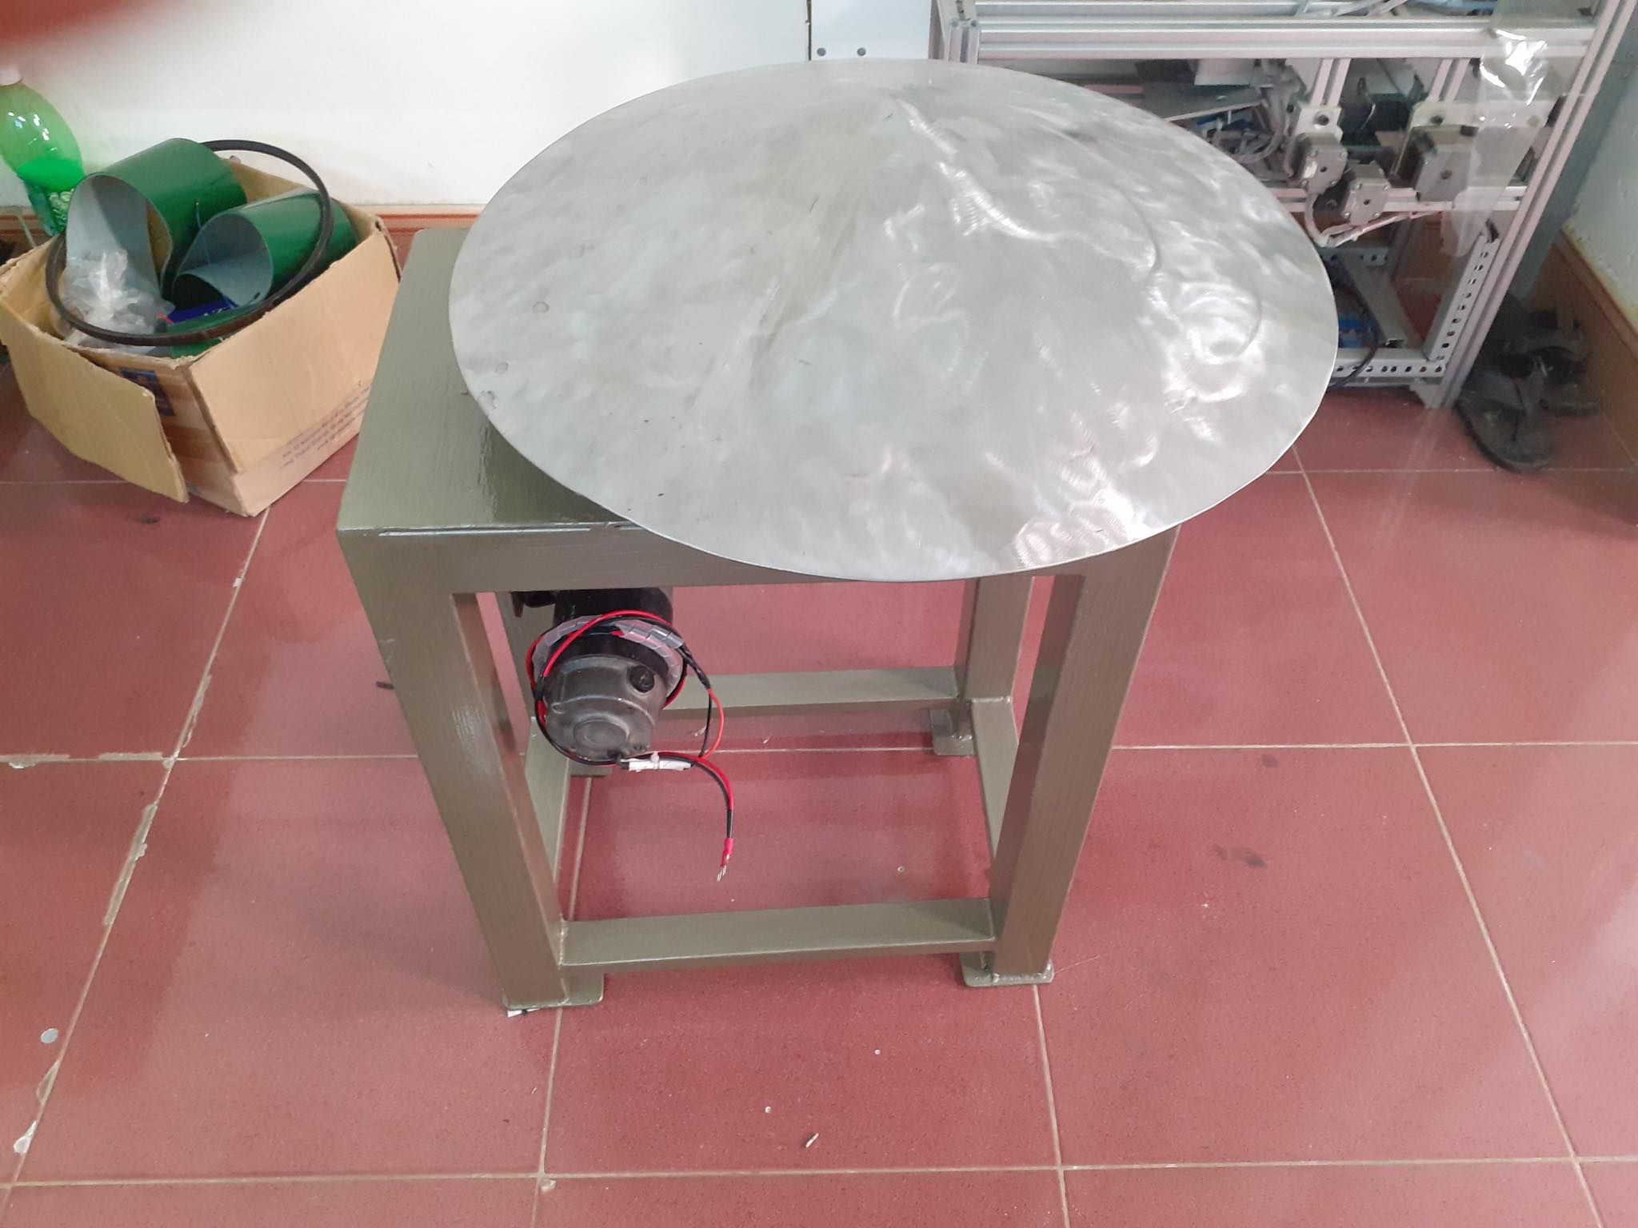
I. Result image
Cone 2: Sort item lining up

Slide 5
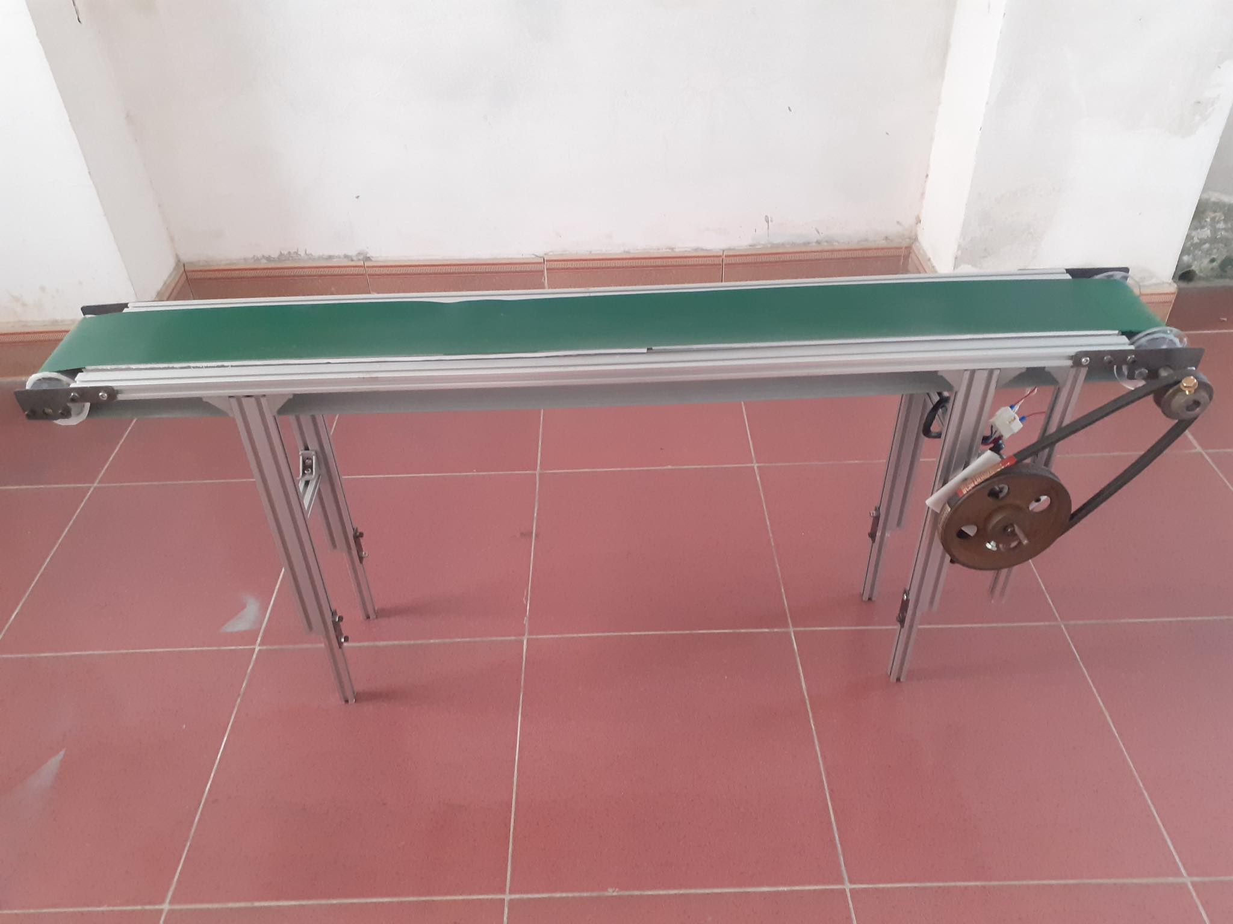
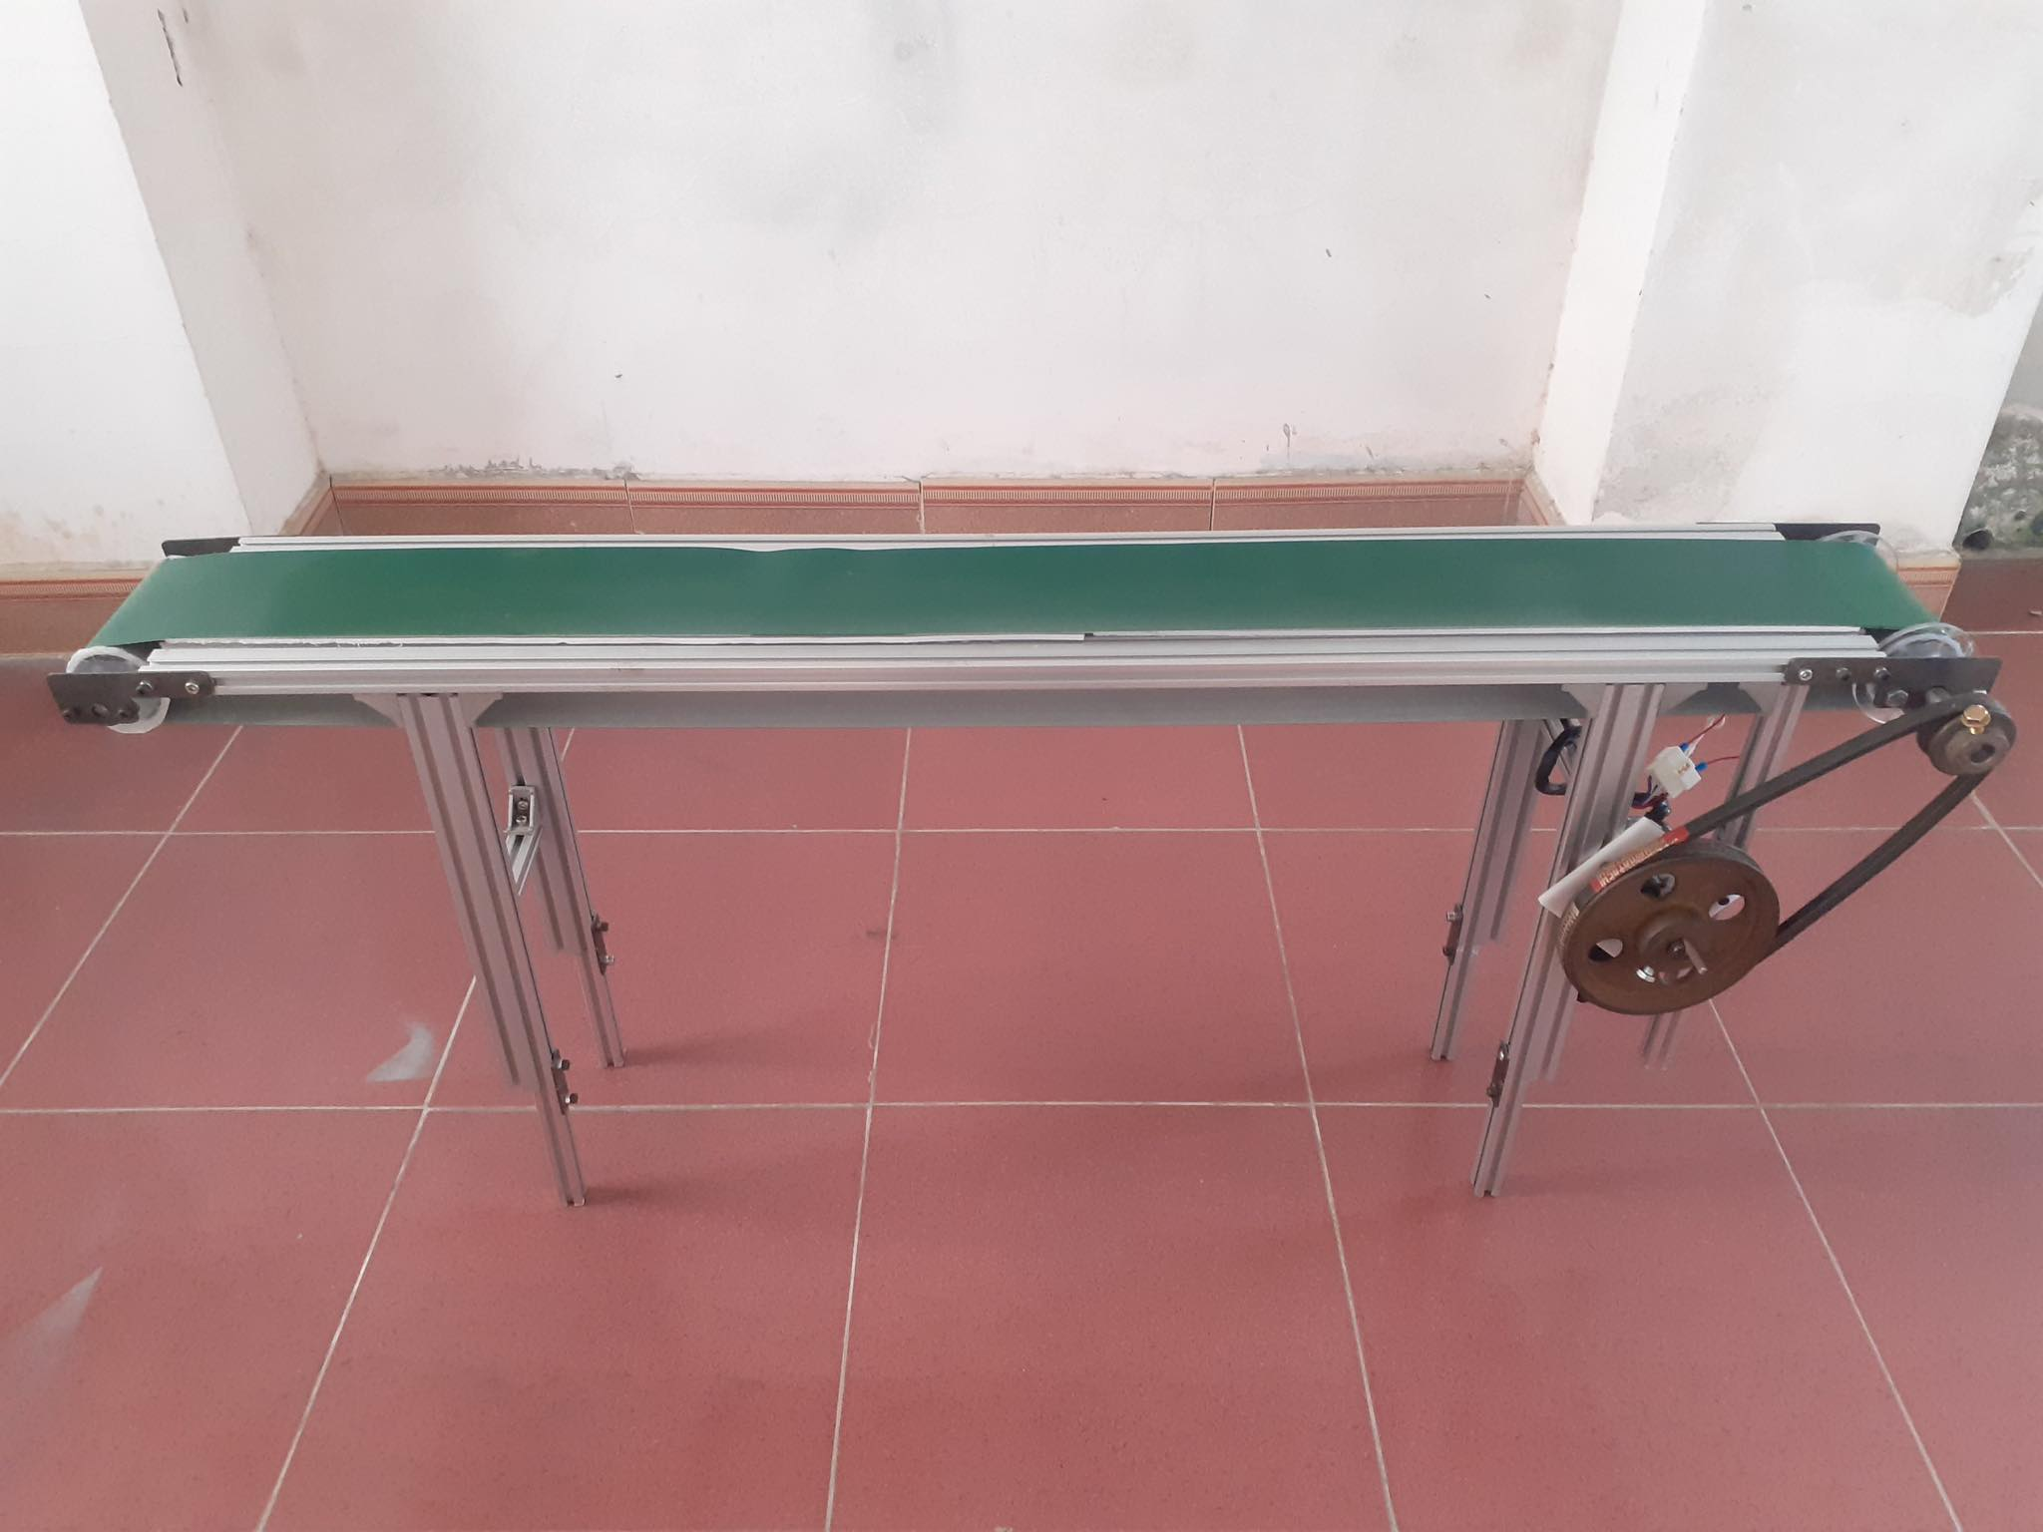
I. Result image
Conveyor 2: Item output

Slide 6
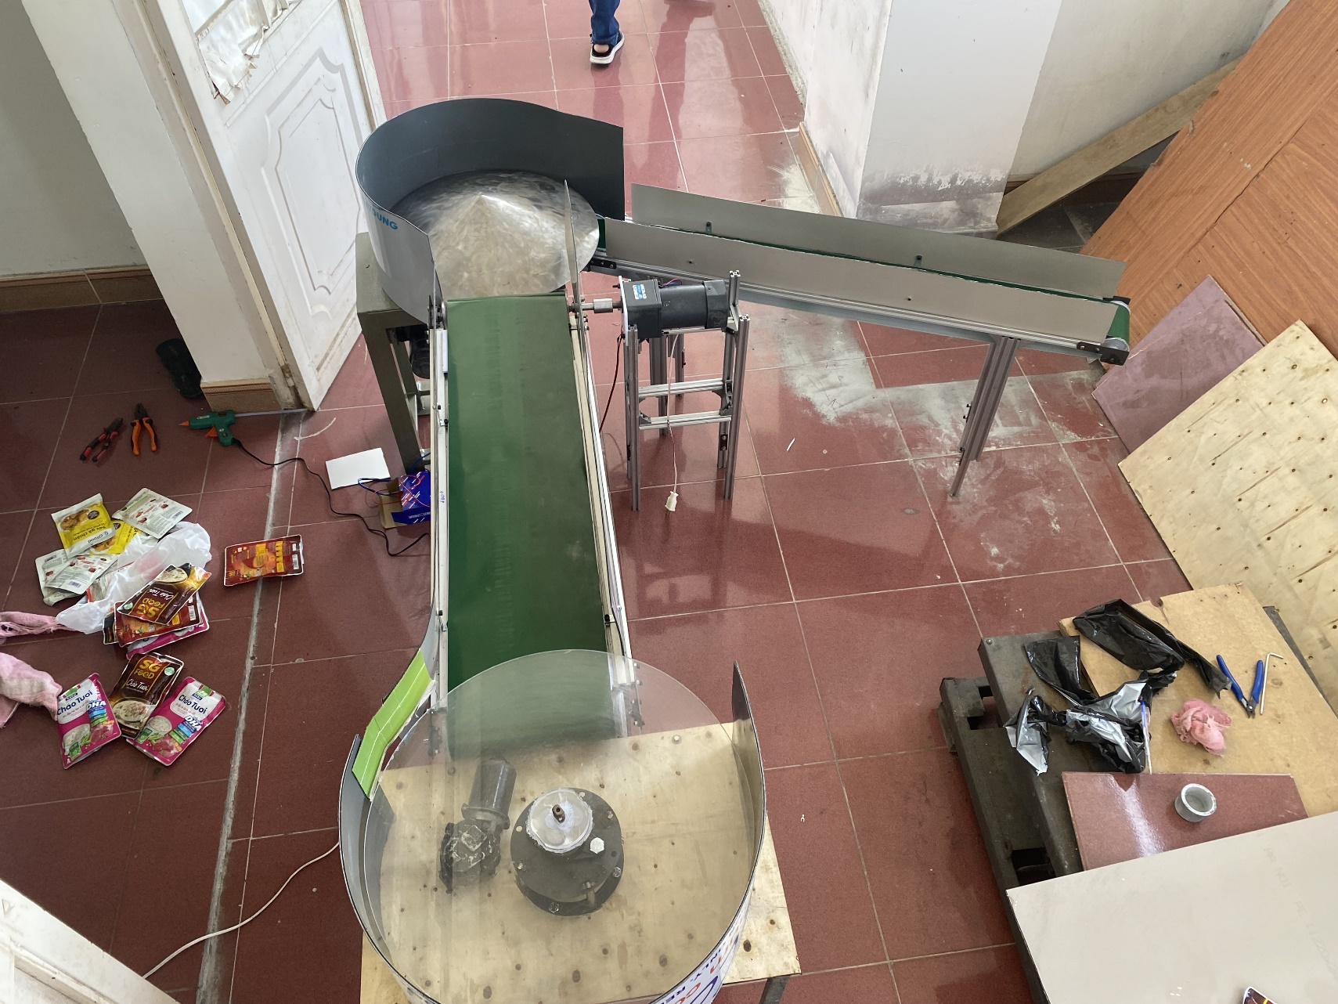
I. Result image
Equipment overview

Slide 7
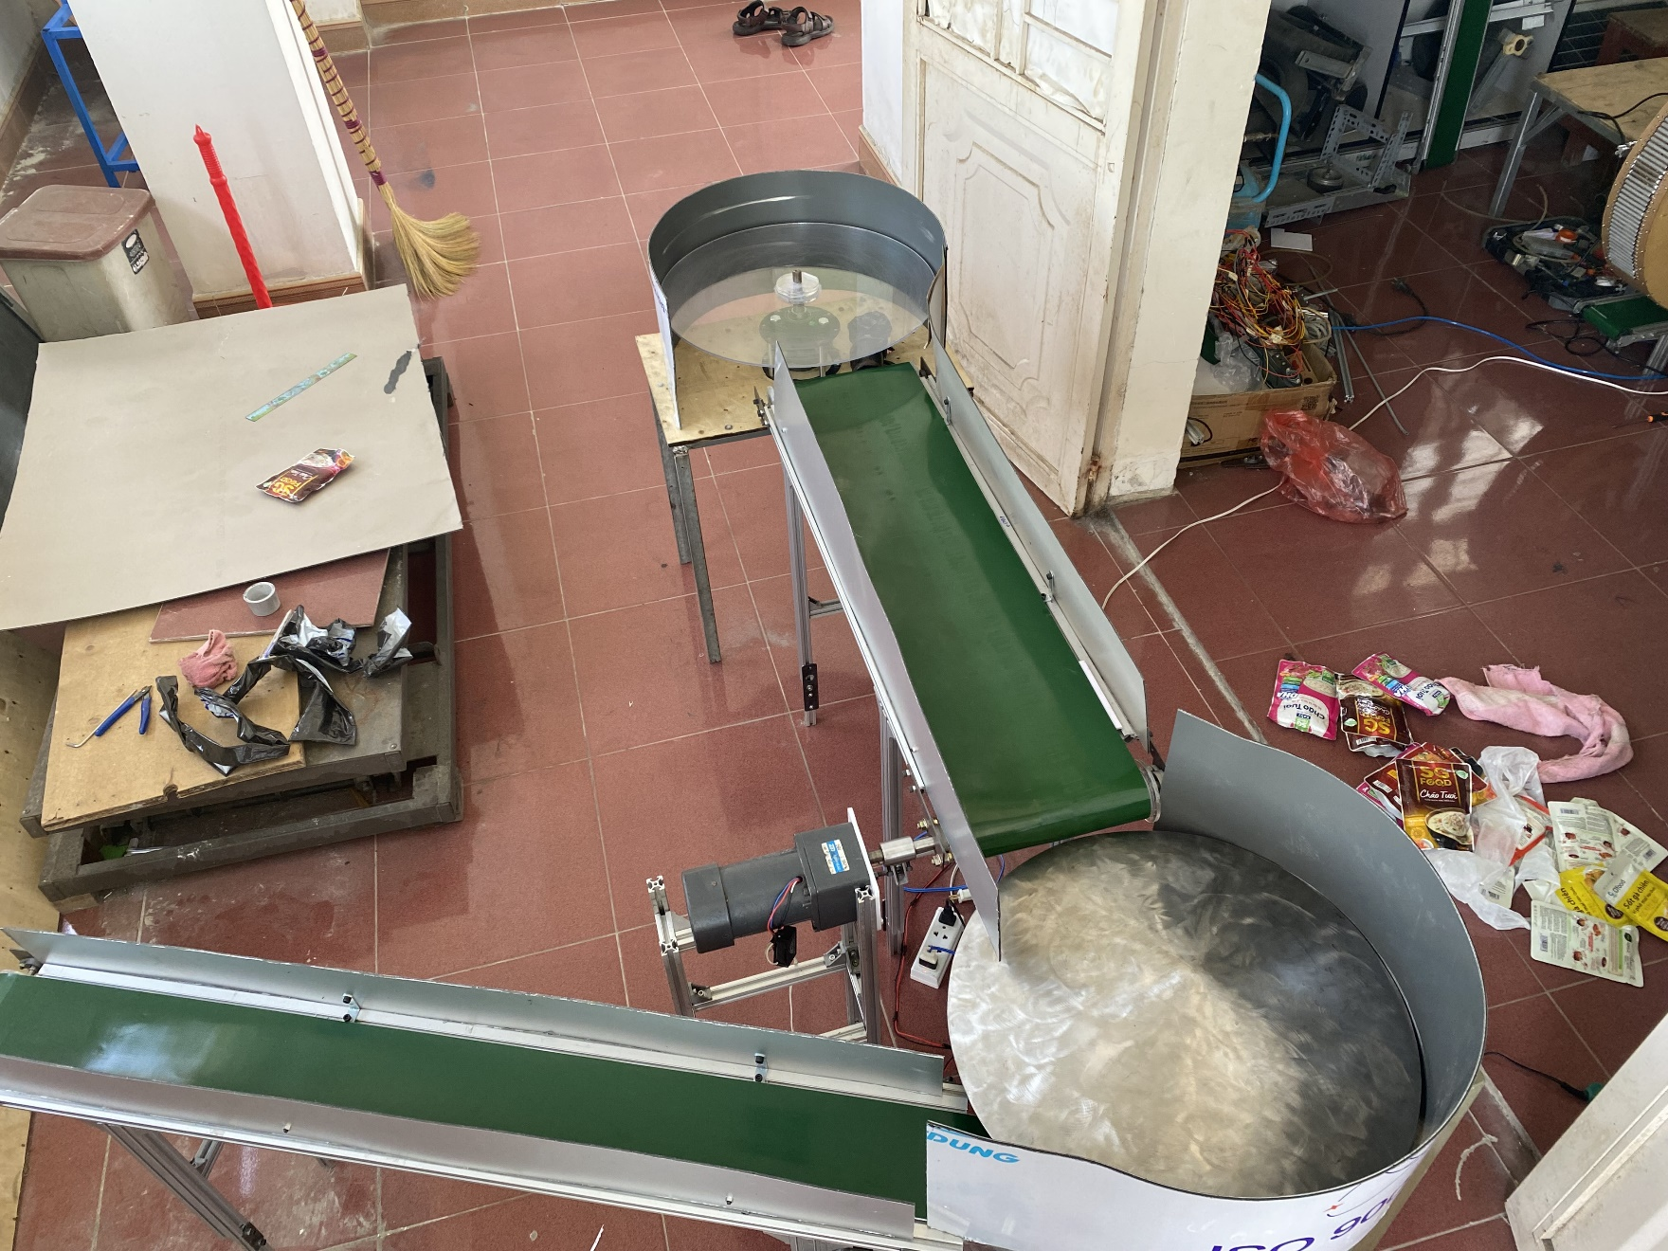
I. Result image
Equipment overview

Slide 8
II. Video demonstration
Overview

Slide 9
II. Video demonstration
1 item

Slide 10
II. Video demonstration
2 item overlapping

Slide 11
II. Video demonstration
3 items overlapping

Slide 12
Thanks for your attention!

