Slide 1
Spring Authorization Server
Oct, 21
Java Club Lviv

Slide 2
OAuth
Oct, 21
The OAuth 2.0 authorization framework enables a third-party application to obtain limited access to an HTTP service, either on behalf of a resource owner by orchestrating an approval interaction between the resource owner and the HTTP service, or by allowing the third-party application to obtain access on its own behalf.
https://datatracker.ietf.org/doc/html/rfc6749

Slide 3
OAuth 2.0 terminology
Oct, 21
Resource Owner: Entity that can grant access to a protected resource. Typically, this is the end-user.
Client: Application requesting access to a protected resource on behalf of the Resource Owner.
Resource Server: Server hosting the protected resources. This is the API you want to access.
Authorization Server: Server that authenticates the Resource Owner and issues Access Tokens after getting proper authorization. In this case, Auth0.
User Agent: Agent used by the Resource Owner to interact with the Client (for example, a browser or a native application).
https://auth0.com/docs/authorization/flows/which-oauth-2-0-flow-should-i-use#oauth-2-0-terminology

Slide 4
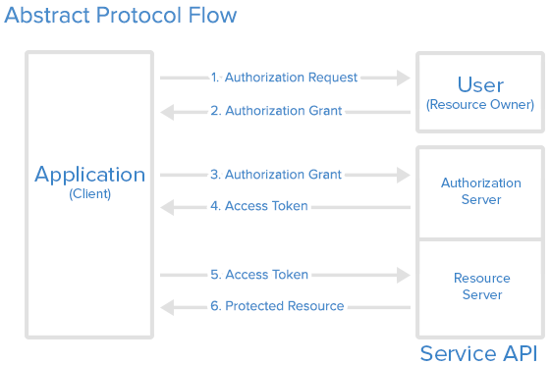
OAuth 2.0 flow
Oct, 21
https://www.digitalocean.com/community/tutorials/an-introduction-to-oauth-2

Slide 5
OAuth vs OIDC
Oct, 21
OpenID Connect 1.0 is a simple identity layer on top of the OAuth 2.0 protocol. It allows Clients to verify the identity of the End-User based on the authentication performed by an Authorization Server, as well as to obtain basic profile information about the End-User in an interoperable and REST-like manner.
https://openid.net/connect/
OpenID
Authentication
OAuth
Authorization

Slide 6
OAuth vs OIDC
Oct, 21
OpenID
OAuth
{ "access_token": "eyJraWQiO….emeQ", "scope": "openid", "id_token": ”....68kdJPQw", "token_type": "Bearer", "expires_in": 1799 }
{ "access_token": "eyJraWQiO….emeQ", "scope": "openid", "token_type": "Bearer", "expires_in": 1799 }

Slide 7


OAuth vs OIDC
Oct, 21
OAuth
OpenID

Slide 8
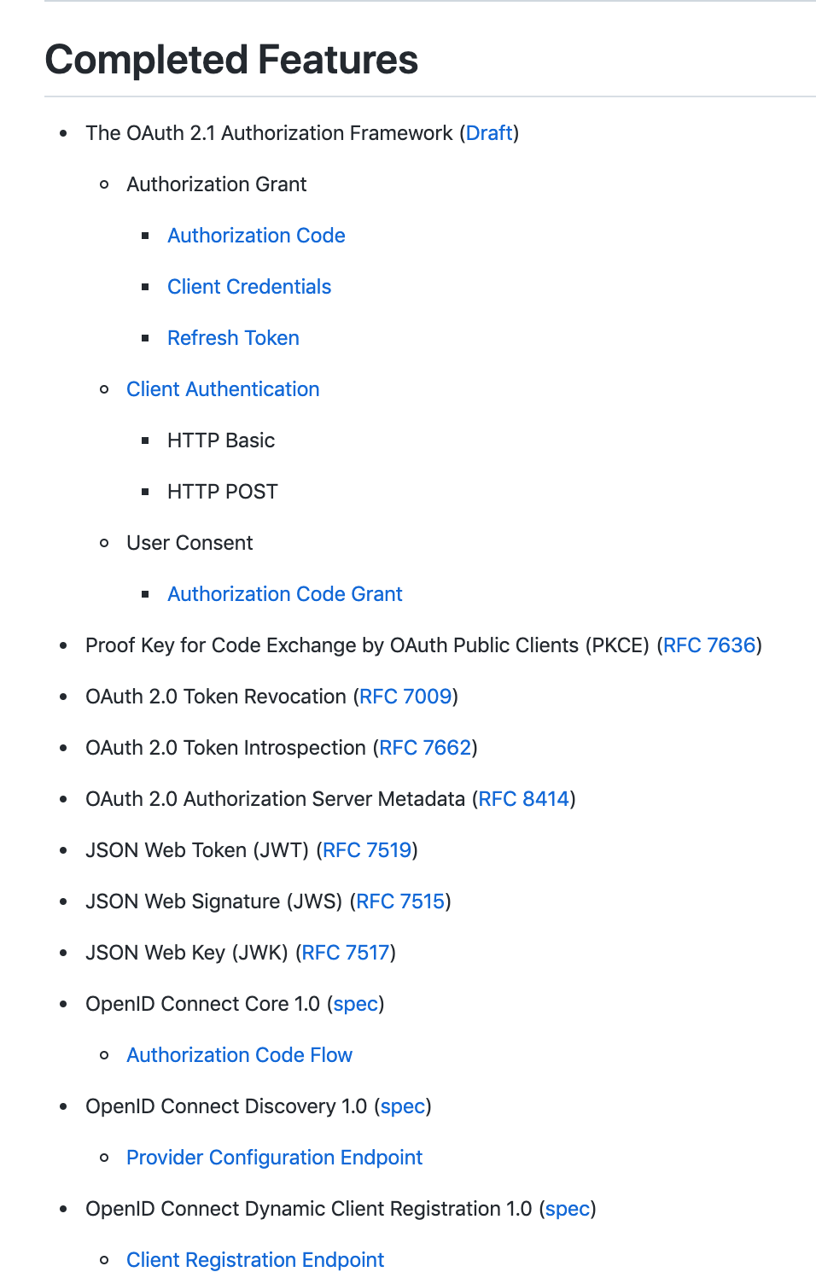
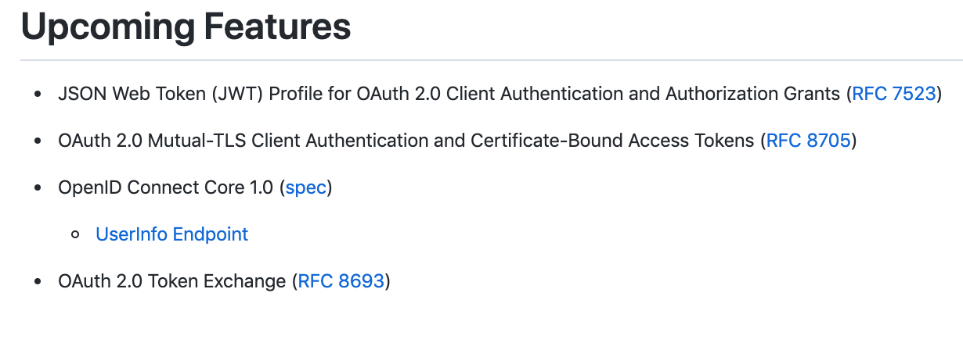
Features list
https://github.com/spring-projects/spring-authorization-server/wiki/Feature-List

Slide 9
OAuth 2.1
Oct, 21
PKCE is required for all OAuth clients using the authorization code flow
Redirect URIs must be compared using exact string matching
The Implicit grant (response_type=token) is omitted from this specification
The Resource Owner Password Credentials grant is omitted from this specification
Bearer token usage omits the use of bearer tokens in the query string of URIs
Refresh tokens for public clients must either be sender-constrained or one-time use
https://oauth.net/2.1/

Slide 10
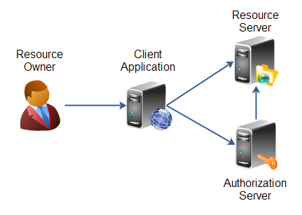
Model to implement
Oct, 21

Slide 11
Useful links
https://oidcdebugger.com/
https://jwt.io/
https://datatracker.ietf.org/doc/html/draft-ietf-oauth-security-topics-14
https://oauth.net/2.1/
https://github.com/spring-projects/spring-authorization-server

