Slide 1
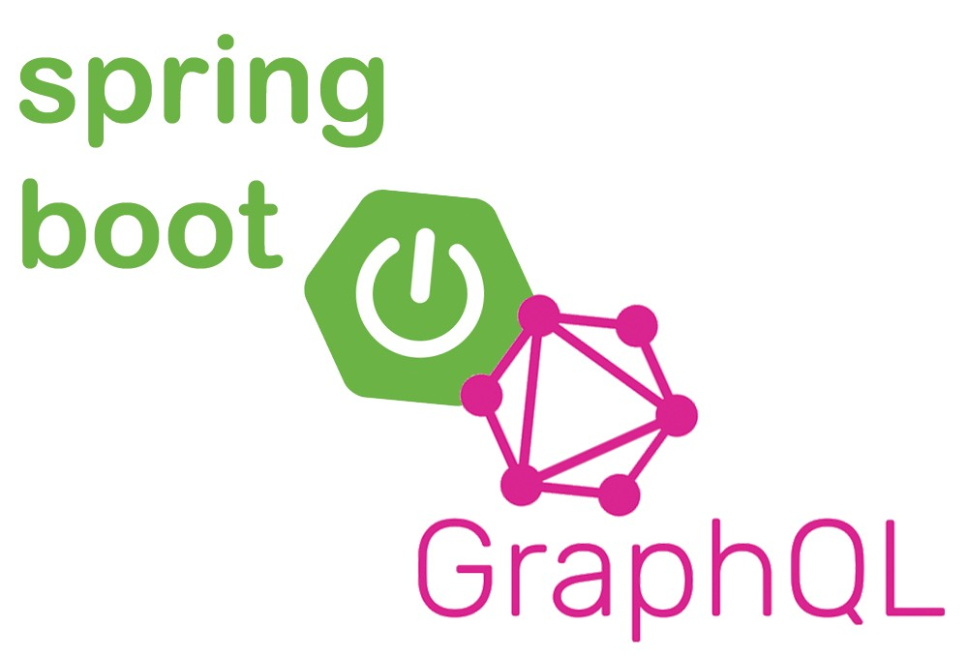
Spring for GraphQL

Slide 2
What GraphQL is?
It was developed internally by Facebook in 2012 before being publicly released in 2015.
GraphQL is designed to make fast, scalable, and dev-friendly APIs.
GraphQL allows developers to build requests that pull data from multiple data sources in a single API call as an alternative to REST.
The real deal is its flexible data fetching - the application only loads relevant data from the server.

Slide 3
Why GraphQL?
As this application grows you are constantly getting requests for new endpoints that return the data in a specific shape.
The next evolution of this API is when more and more clients have requirements for data. You might have 3rd party services, internal microservices, mobile applications and IoT applications all with their own specific data requirements.
Each of these clients have specific limitations and data requirements.
GraphQL has a single endpoint and lets each individual client request exactly what data they need.

Slide 4
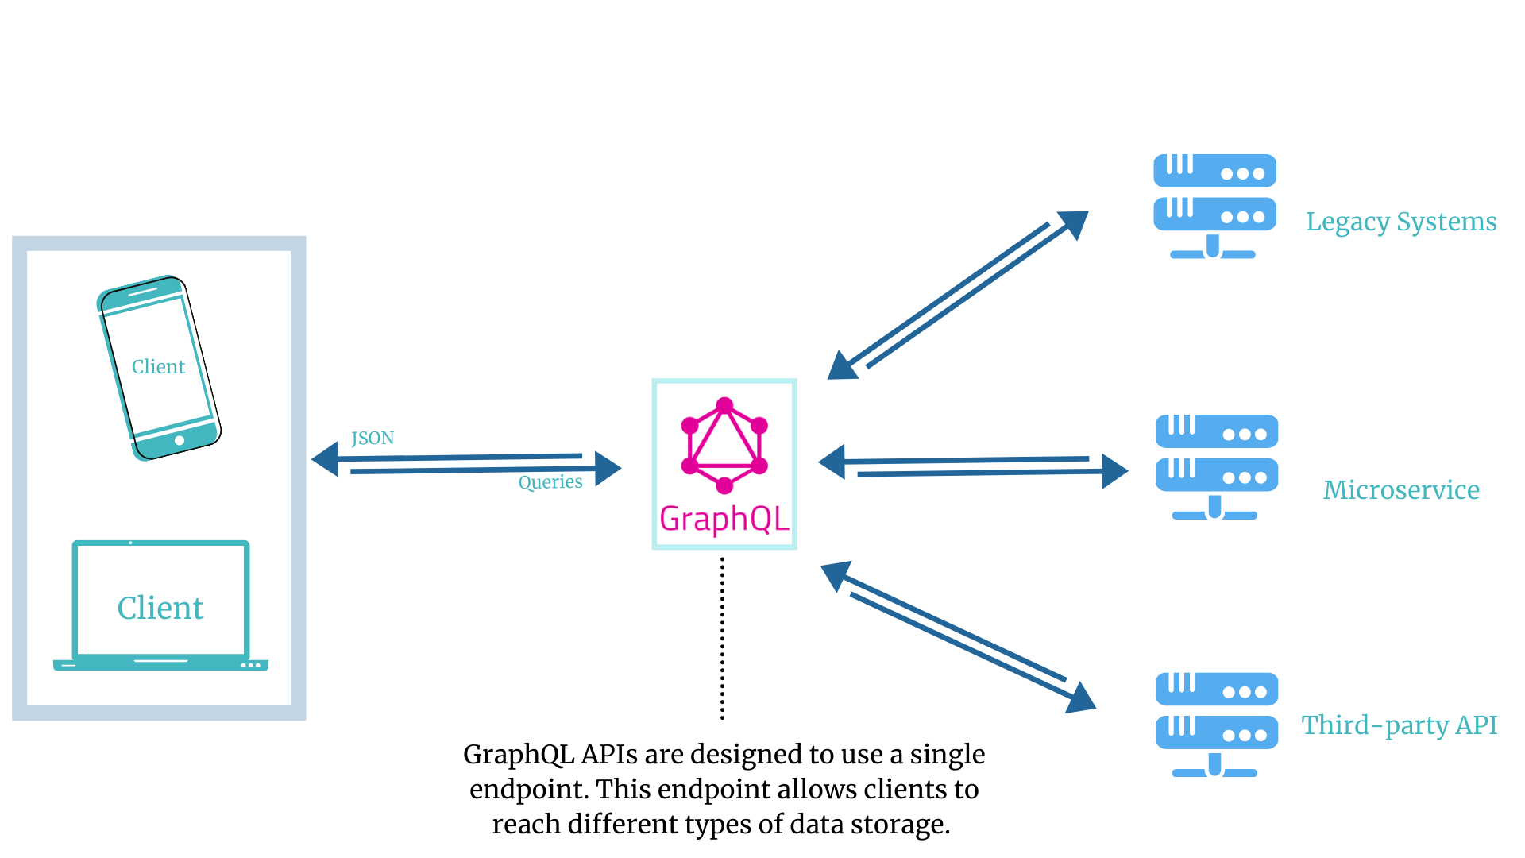
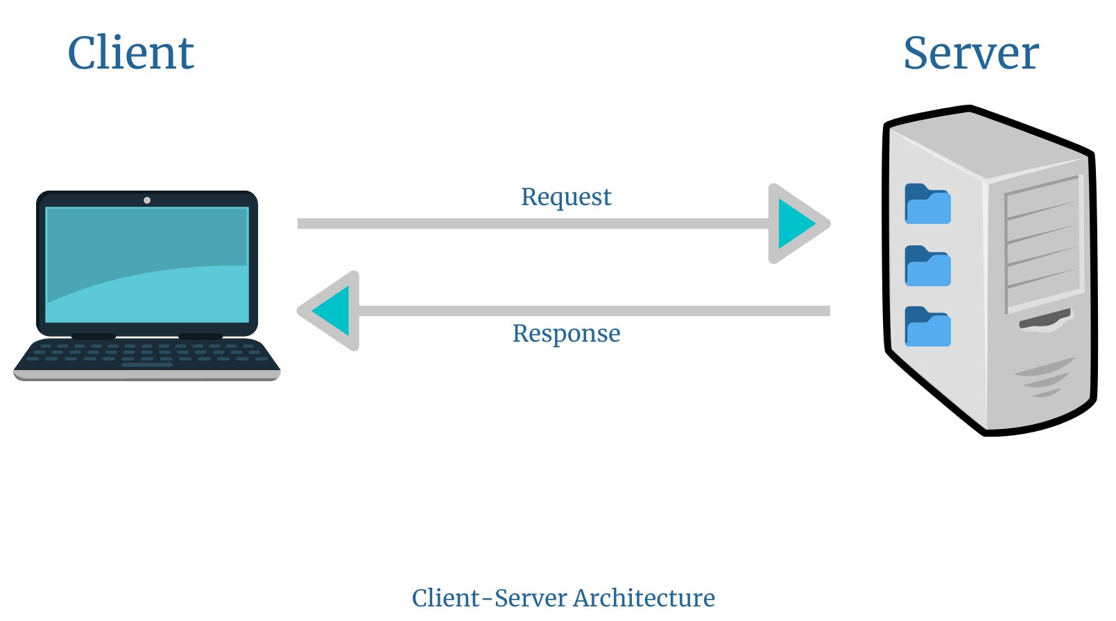
GraphQL vs REST
https://www.imaginarycloud.com/blog/graphql-vs-rest/

Slide 5
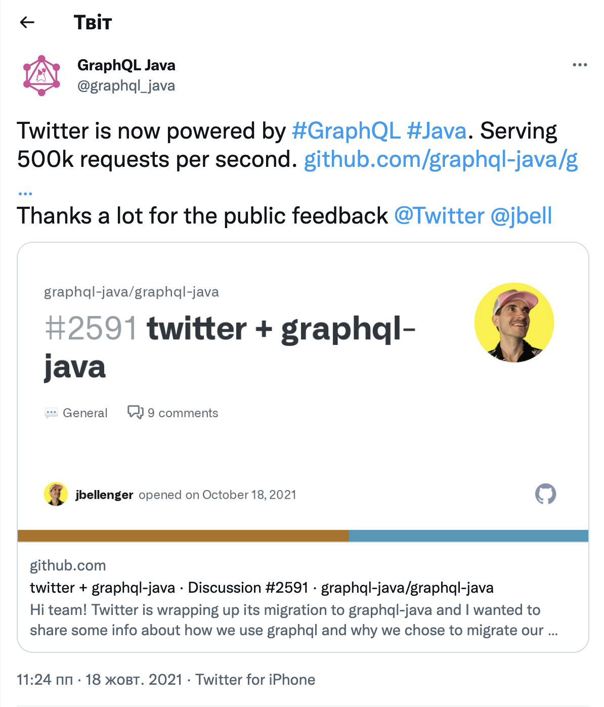
Why GraphQL?

Slide 6
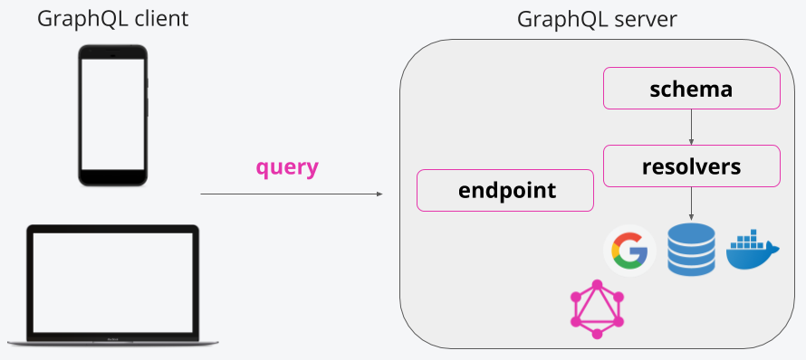
GraphQL for client and server
Client
On the client side you’re working with the Query Language (smth like JSON and DSL)
Server
Execution engine that will execute these queries mapping each of the fields to resolvers, also known as data fetchers.

Slide 7
Fundamentals of GraphQL

Slide 8
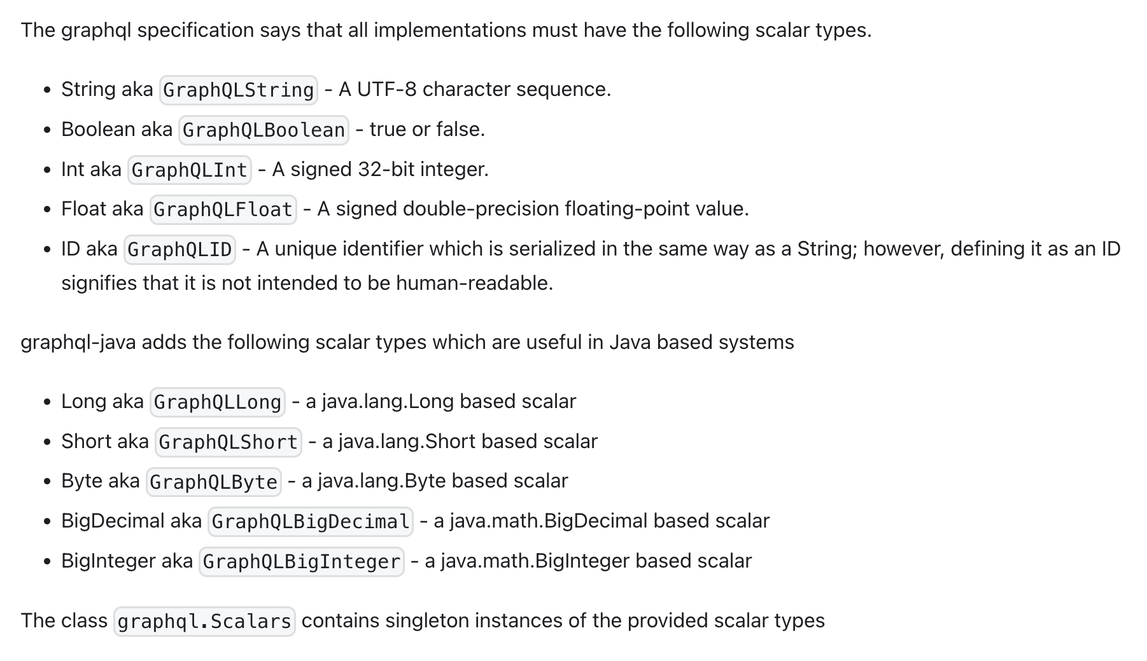
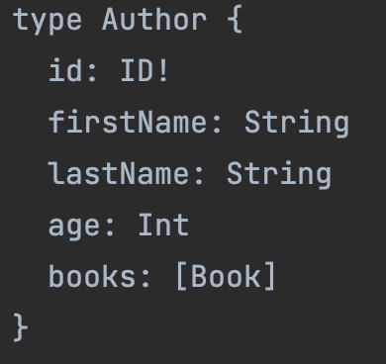
Object Types and Fields

Slide 9
Root Operation Types
Query
Mutation
Subscription
query – a read‐only fetch.
mutation – a write followed by a fetch.
subscription – a long‐lived request that fetches data in response to source events.

Slide 10
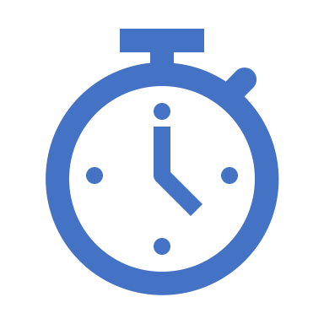
Demo time

Slide 11
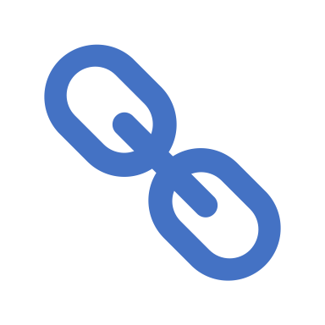
Useful links
https://graphql.org/
https://spec.graphql.org/
https://www.imaginarycloud.com/blog/graphql-vs-rest/
https://spring.io/projects/spring-graphql
https://www.graphql-java.com/

