Slide 1
Transaction Isolation
An isolation level specifies how and when parts of the transaction can and hould become visible to other transactions.
Achieving isolation comes at a cost: to prevent incomplete writes from propagating over transaction boundaries, we need additional coordination and synchronization, wich negatively impacts the performance

Slide 2
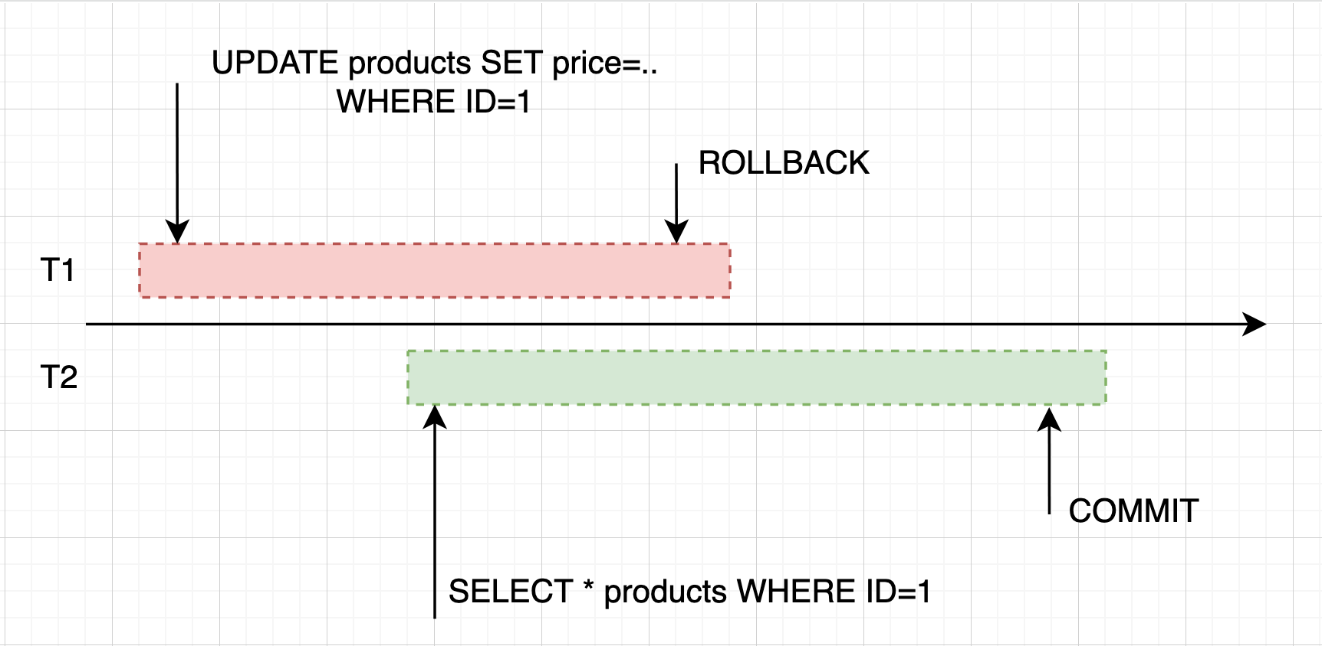
Dirty Read

Slide 3
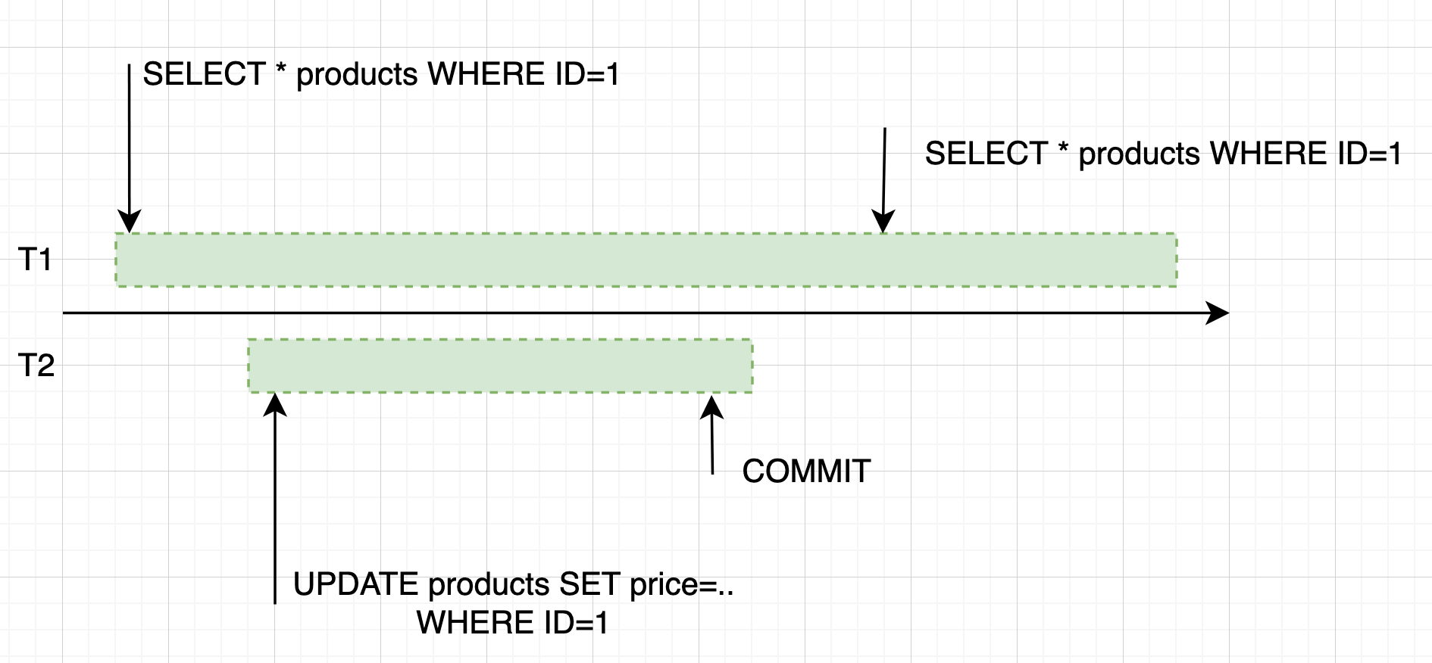
Non-repeatable Read

Slide 4
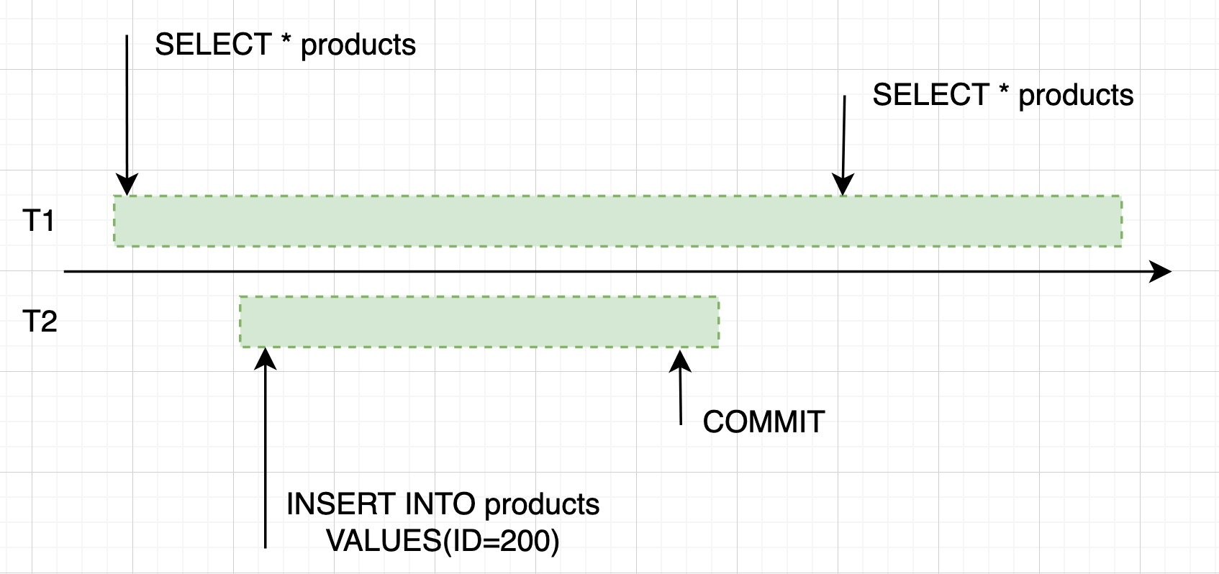
Phantom Reads

Slide 5
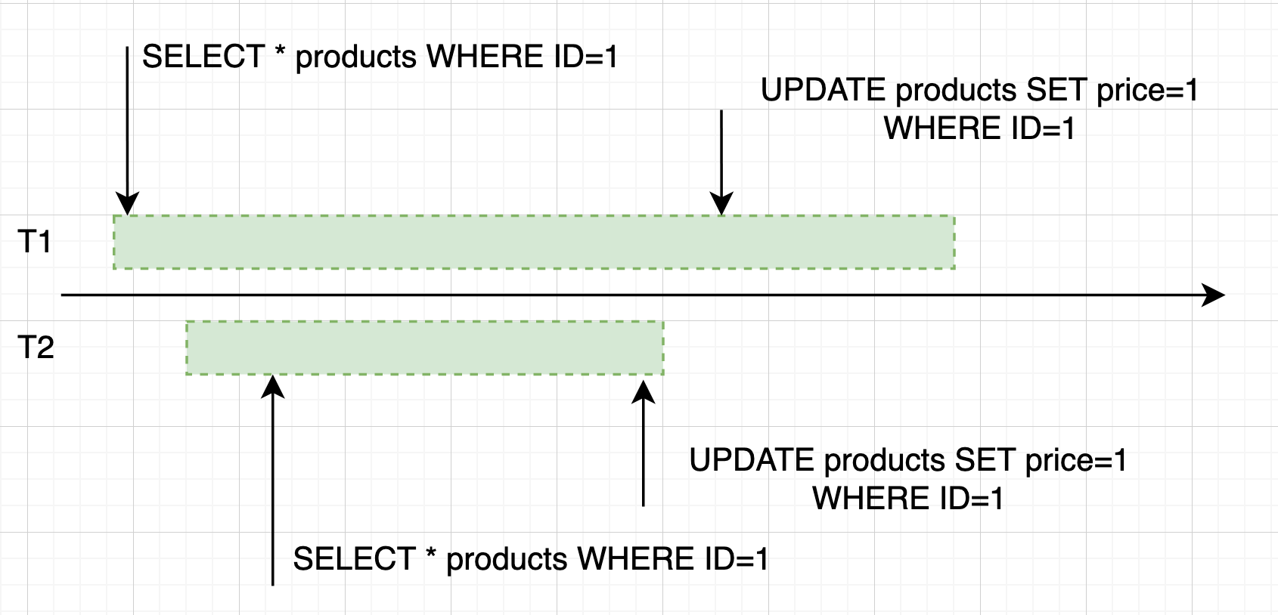
Lost Update

Slide 6
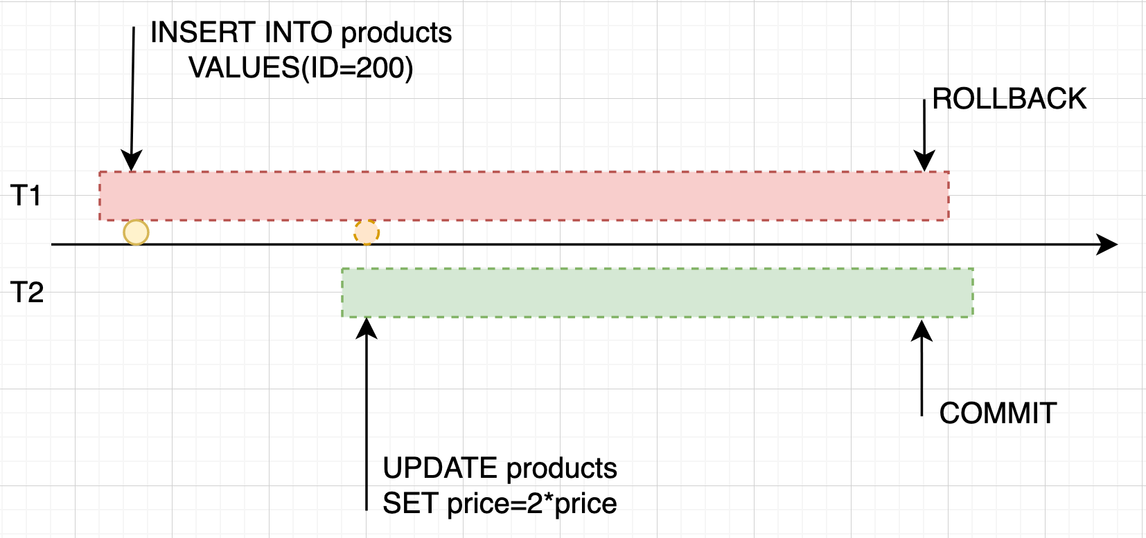
Dirty Write

