Slide 1
Tensorflow初探

Slide 2

1.TensorFlow
https://github.com/tensorflow/tensorflow
https://github.com/tensorflow/models
https://github.com/aymericdamien/TensorFlow-Examples

Slide 3
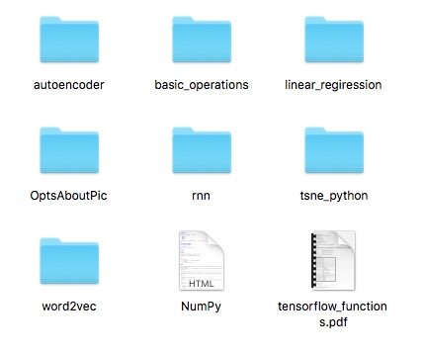
1.TensorFlow
https://github.com/wangqiuli1012/MachineLearning

Slide 4
2.Basic Operations
import tensorflow as tf
hello = tf.constant('hello world!')
sess = tf.Session()
print(sess.run(hello))

Slide 5
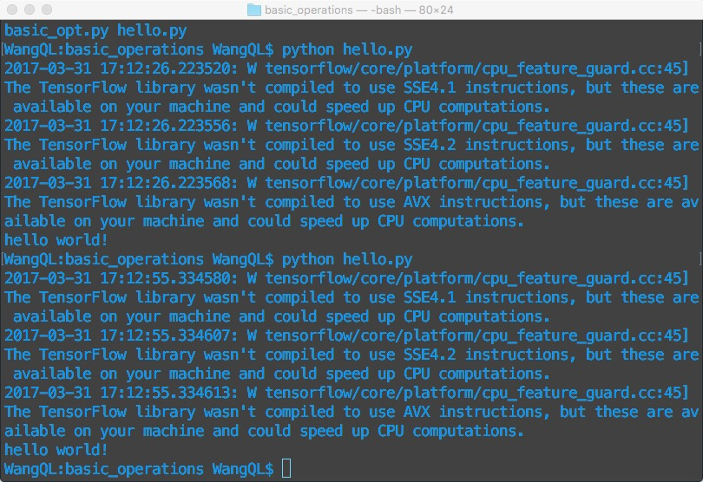

Slide 6

2.Basic Operations
import tensorflow as tf
a = tf.constant(2)
b = tf.constant(3)
with tf.Session() as sess:
print 'a + b = ', sess.run(a + b)
print 'a * b = ', sess.run(a * b)

Slide 7

2.Basic Operations
import tensorflow as tf
# place holder
a = tf.placeholder(tf.int16)
b = tf.placeholder(tf.int16)
# operations
add = tf.add(a, b)
mult = tf.multiply(a, b)
with tf.Session() as sess:
print 'a + b = ', sess.run(add, feed_dict = {a: 2, b: 4})
print 'a * b = ', sess.run(mult, feed_dict = {a: 2, b: 4})

Slide 8
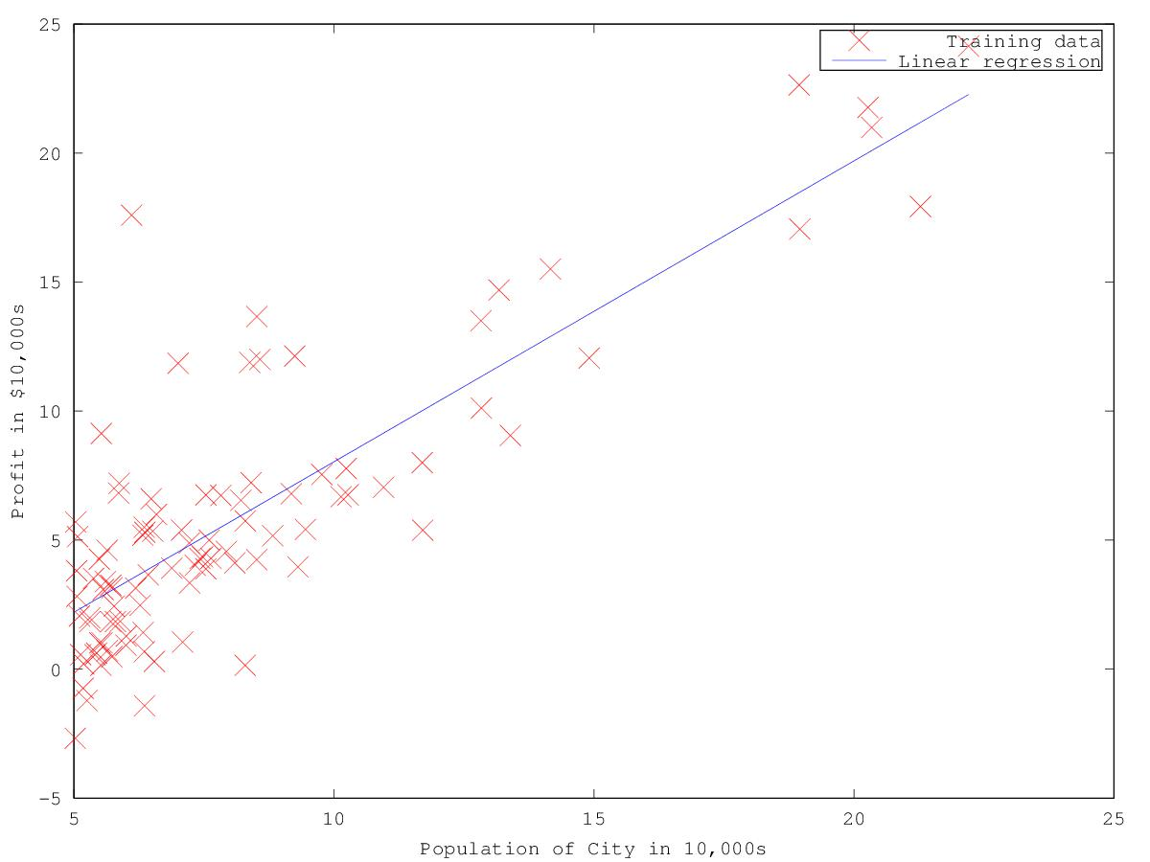
3. Linear Regression

Slide 9
3. Linear Regression
X = tf.placeholder(tf.float32)
Y = tf.placeholder(tf.float32)
W = tf.Variable(tf.random_normal([1]), name='weight')
b = tf.Variable(tf.random_normal([1]), name='bias')
# Y = W * X + b
Y_pred = tf.add(tf.multiply(X, W), b)

Slide 10
3. Linear Regression
# sum (Y_pred - Y)^2 / (n_observations - 1)
cost = tf.reduce_sum(tf.pow(Y_pred - Y, 2)) / (n_observations - 1)
# %% Use gradient descent to optimize W,b
learning_rate = 0.01
optimizer = tf.train.GradientDescentOptimizer(learning_rate).minimize(cost)

Slide 11
n_epochs = 1000
with tf.Session() as sess:
sess.run(tf.global_variables_initializer())
#Fit all training data
prev_training_cost = 0.0
for epoch_i in range(n_epochs):
for(x, y) in zip(xs, ys):
sess.run(optimizer, feed_dict = {X: x, Y: y})
training_cost = sess.run(cost, feed_dict = {X: x, Y: y})
print(training_cost)
if np.abs(prev_training_cost - training_cost) < 0.000001:
break
prev_training_cost = training_cost
yp = Y_pred.eval(feed_dict={X: xs}, session=sess)
plt.plot(xs, yp)

Slide 12
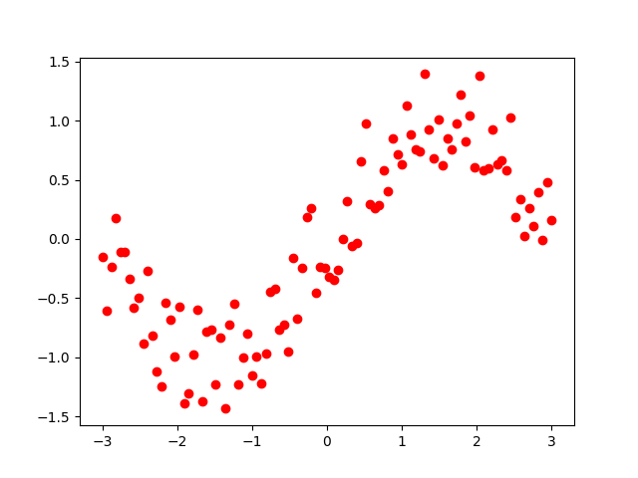
3. Linear Regression
n_observations = 100
xs = np.linspace(-3, 3, n_observations)
ys = np.sin(xs) + np.random.uniform(-0.5, 0.5, n_observations)

Slide 13
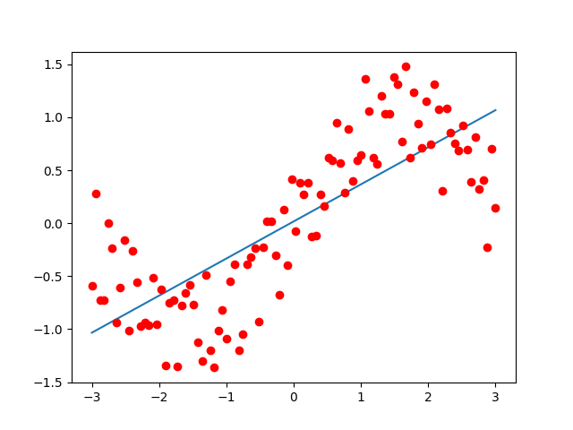
Y_pred = tf.add(tf.multiply(X, W), b)

Slide 14
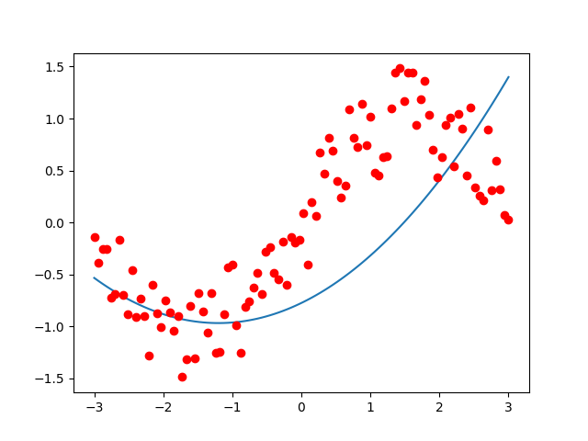
Y_pred = tf.add(tf.add(tf.multiply(tf.pow(X, 2.0), W1), tf.multiply(X, W2)), b)

Slide 15
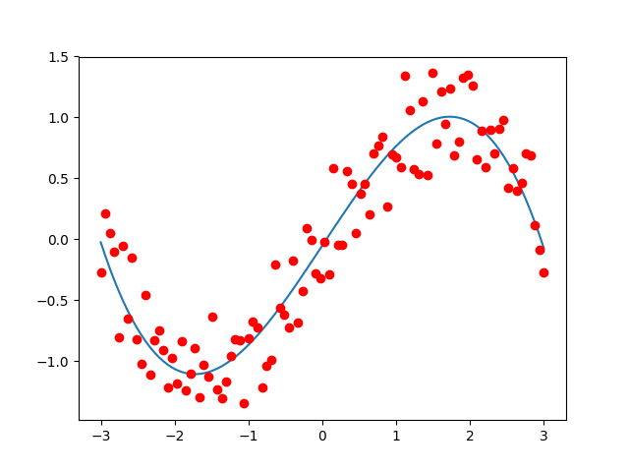
Y_pred = tf.add(tf.add(tf.multiply(tf.pow(X, 3.0), W1), tf.multiply(X, W2)), b)

