Slide 1
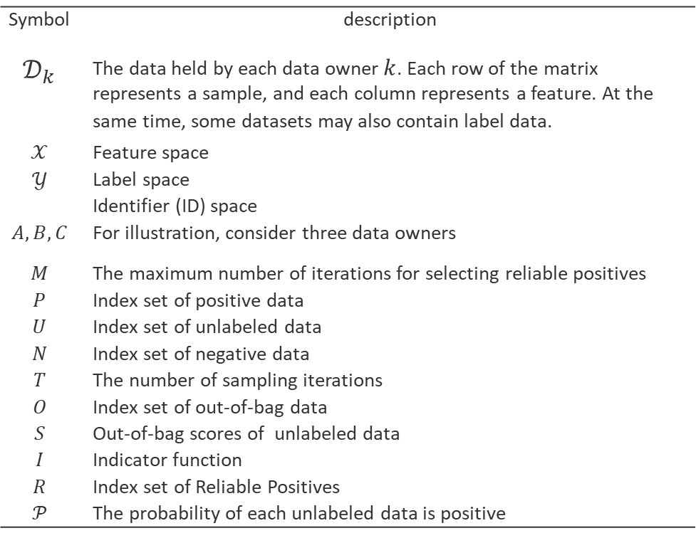
Problem Setup
Symbol | description
$$𝒟_{k}$$ | The data held by each data owner $k$. Each row of the matrix represents a sample, and each column represents a feature. At the same time, some datasets may also contain label data.
$$𝒳$$ | Feature space
$$𝒴$$ | Label space
 | Identifier (ID) space
$$A,B,C$$ | For illustration, consider three data owners
$$M$$ | The maximum number of iterations for selecting reliable positives
$$P$$ | Index set of positive data
$$U$$ | Index set of unlabeled data
$$N$$ | Index set of negative data
$$T$$ | The number of sampling iterations
$$O$$ | Index set of out-of-bag data
$$S$$ | Out-of-bag scores of unlabeled data
$$I$$ | Indicator function
$$R$$ | Index set of Reliable Positives
$$𝒫$$ | The probability of each unlabeled data is positive

Slide 2
Problem Setup
Data Restrictions
A : a limited number of positive samples.
B,C: large datasets consisting of unlabeled samples.
we can define a dataset as :
Terminology
Out-of-bag (OOB) data refers to the data that are not selected during the bootstrap sampling process.
The OOB score is defined as the probability of predicting a positive class for an OOB sample.
RP: Reliable Positives
Indicator function:

Slide 3
Entity Alignment
1. Set Intersection between B and C
2. Set Intersection between A and C
 |  |  | A | B | I | C
Feature space | Label space | ID space | Data owner | Data owner | Indicator function | Data owner

Slide 4
The Bagging process in m-th round
Estimator
train
predict
scores
Estimator
train
predict
scores
Bootstrap
…
Estimator
train
predict
scores
m | T | P | U | N | O | S
Select RP for the m-th round | The iterations of sampling | Index set of positives | Index set of unlabeled data | Index set of negatives | Index set of OOB data | OOB scores

Slide 5
m-th round Bagging，t-th sampling
Positive data
Unlabeled data
Negative data
Train dataset
Test dataset

Slide 6
M-th round Bagging，t-th sampling
1. C calculates
2. C notifies all participants to set their own data
3. C calls the server to conduct federated training and predicting.
m | T | P | U | N | O | B,C | S
Select RP for the m-th round | The iterations of sampling | Index set of positives | Index set of unlabeled data | Index set of negatives | Index set of OOB data | Data owners | OOB scores

Slide 7
The m-th round of selecting reliable positives
m | T | I |  | U | O | R | S
Select RP for the m-th round | The iterations of sampling | Indicator function | the probabilities of each unlabeled data is positive | Index set of unlabeled data | Index set of OOB data | Index set of RP | OOB scores

Slide 8
Expand the set of reliable positives
m | R
Select RP for the m-th round | Index set of Reliable positives

Slide 9
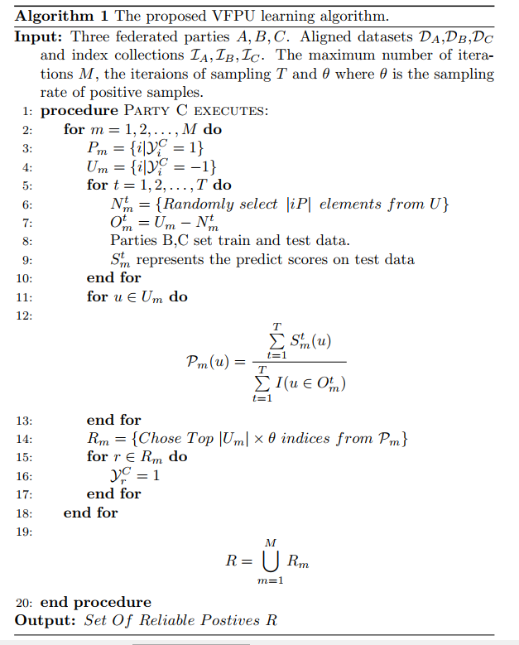

Slide 10
Positive data
Unlabeled data
Negative data
第一种情况

Slide 11
m-th round Bagging，t-th sampling
Positive data
Unlabeled data
Negative data
Train dataset
Test dataset

Slide 12
Positive data
Unlabeled data
Negative data
labeled
unlabeled
1.正样本的数量远远大于负样本的数量
2.负样本的数量远远大于正样本的数量
3.正负样本的数量均衡

Slide 13
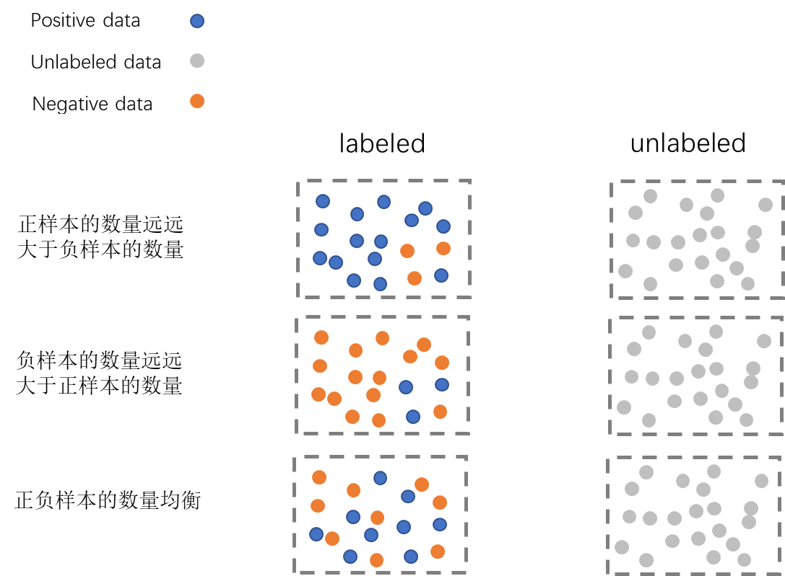

Slide 14
