Slide 1
INTRODUCE TO SHA-512
Subject: Cryptography Theory
Lecturer: Assoc. Prof. Do Trong Tuan
Presentation: Luong Van Minh

Slide 2
Content
1. Hash function overview
2. SHA-512 hash function
3. Implement SHA-512 hash function and test

Slide 3
Content
1. Hash function overview
2. SHA-512 hash function
3. Implement SHA-512 hash function and test

Slide 4
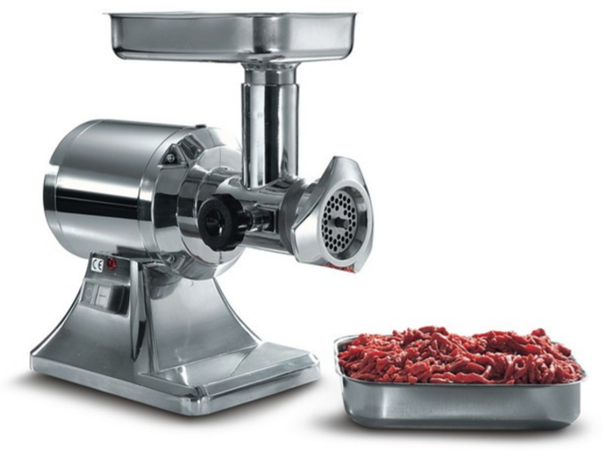
1.1. Introduce to hash function

Slide 5
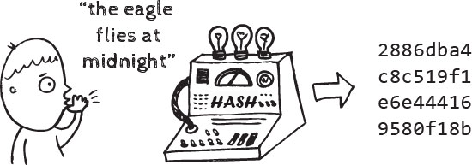
1.1. Introduce to hash function

Slide 6
1.1. Introduce to hash function
Message M (arbitrary length)
HASH ALGORITHM
(H)
h
Hash value (fixed length)

Slide 7
1.2. Properties
Arbitrary-length message to fixed-length digest
Preimage resistant (One-way property)
Second preimage resistant (Weak collision resistant)
Collision resistant (Strong collision resistance)

Slide 8
1.2. Properties
Fixed length
661dce0da2bcb2d8 2884e0162acf8194
Hello, world
H
This is a clear text that can easily read without using the key. The sentence is longer than the text above.
Fixed length digest: L
52f21cf7c7034a20 17a21e17e061a863
H

Slide 9
1.2. Properties
Preimage resistant (One-way property)
Easy
x
y = H(x)
Difficult
(Impossible)

Slide 10
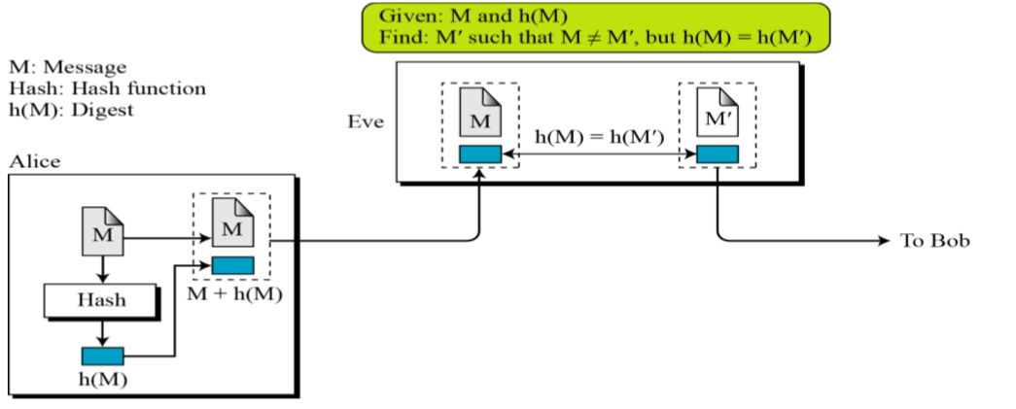
1.2. Properties
Second preimage resistant (Weak collision resistant)

Slide 11
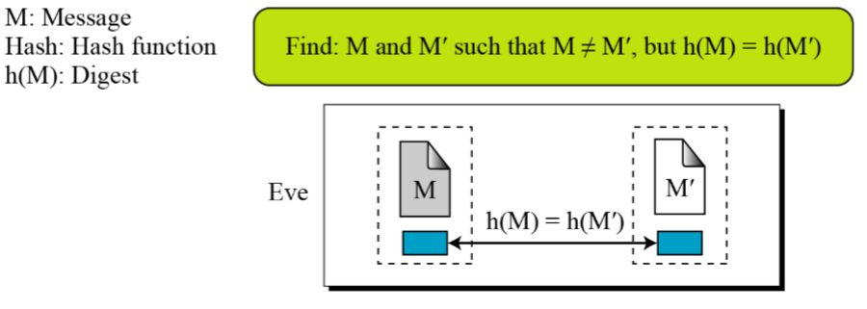
1.2. Properties
Collision Resistant (Strong collision resistant)

Slide 12
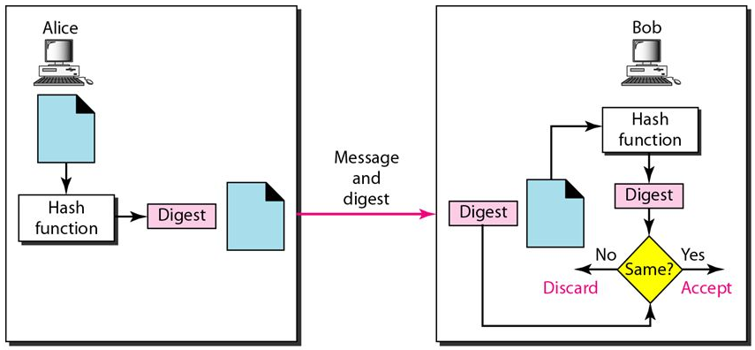
1.3. Applications
Integrity
Notes: We need to make sure the digest cannot be altered by attacker

Slide 13
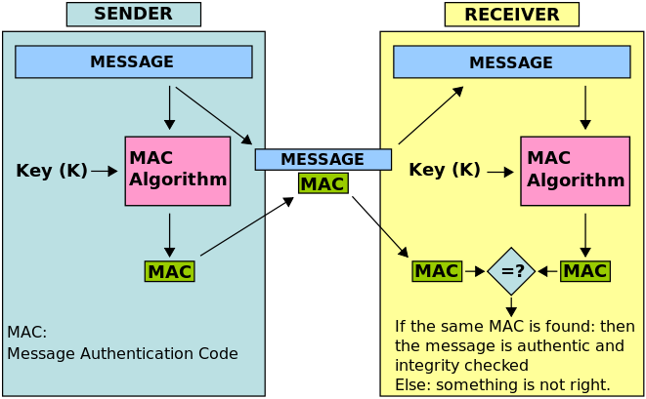
1.3. Application
Authentication

Slide 14
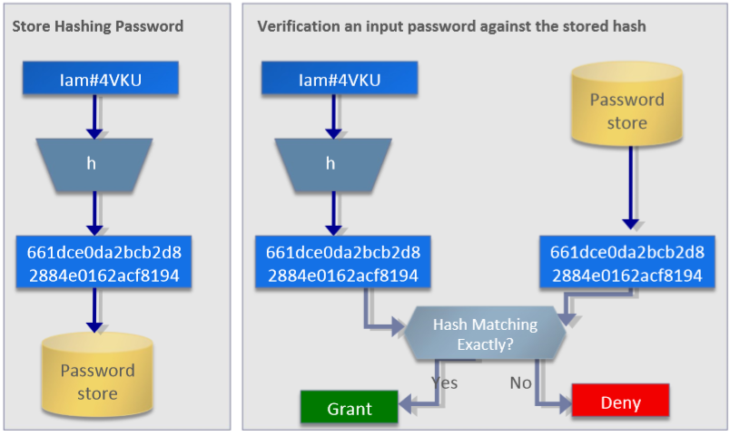
1.3. Application
Password Verification

Slide 15
Content
1. Hash function overview
2. SHA-512 hash function
3. Implement SHA-512 hash function and test

Slide 16
2.1. SHA overview
Published by the National Institute of Standards and Technology (NIST) as a U.S. Federal Information Processing Standard (FIPS)
Including 4 versions:
SHA-0: published in 1993.
SHA-1: designed by the National Security Agency (NSA), published in 1995.
SHA-2: designed by the NSA, 3 types: SHA-224, SHA-384, and SHA-512, published in 2001.
SHA-3: chosen in 2012 after a public competition among non-NSA designers

Slide 17
2.1. SHA overview
Comparing some SHA versions
Characteristics | SHA-1 | SHA-224 | SHA-256 | SHA-384 | SHA-512
Maximum message size | 2⁶⁴ – 1 | 2⁶⁴ – 1 | 2⁶⁴ – 1 | 2¹²⁸ – 1 | 2¹²⁸ – 1
Block size | 512 | 512 | 512 | 1024 | 1024
Message digest size | 160 | 224 | 256 | 384 | 512
Number of rounds | 80 | 64 | 64 | 80 | 80
Word size | 32 | 32 | 32 | 64 | 64

Slide 18

2.2. SHA-512 hash function
SHA-512 is the version of SHA with a 512-bit message digest. This version, like the others in the SHA family of algorithms, is based on the Merkle-Damgard scheme.

Slide 19
2.2. SHA-512 hash function
Merkle–Damgard Scheme
Original message
Padding/Length
n bits
n bits
n bits
M₁
M₂
…
M_{t}
m bits
m bits
f
H₁
f
H₂
…
H_{t-1}
f
H₀
H_{t}
Message digest
Compression function
Compression function
Compression function

Slide 20

2.2. SHA-512 hash function
Message Preparation
Padding and length field in SHA-512
Length < 2¹²⁸ bits
Length: variable
Length: 128 bits
Original
Message
Padding 1000000…00000
Length of
original message
Multiple of 1024 bits
$$(|M|+|P|+128)≡0 (mod 1024)$$

Slide 21
2.2. SHA-512 hash function
Implement the hashing algorithm
Augmented message: multiple of 1024-bits blocks
Block 1
Block 2
Block N
1024 bits
1024 bits
…
1024 bits
Compression function
Compression function
Compression function
512
bits
512
bits
512
bits
…
512
bits
512
bits
Initial
Value
Message
Digest

Slide 22
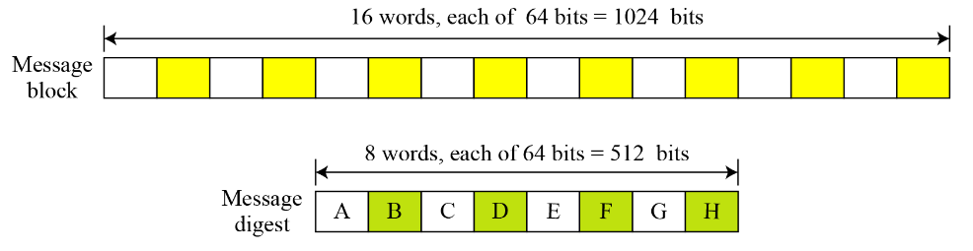
2.2. SHA-512 hash function
Implement the hashing algorithm
Words
16 words, each of 64-bits = 1024-bits
Message block
8 words, each of 64-bits = 512-bits
Message digest

Slide 23
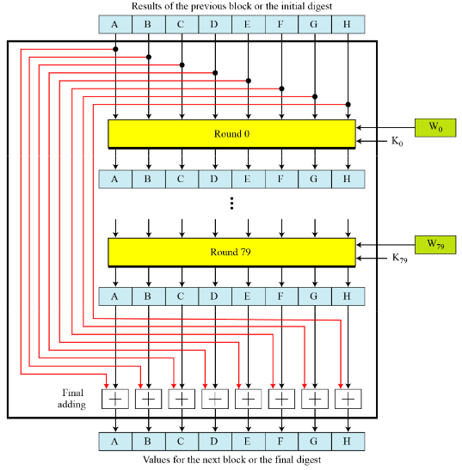
2.2. SHA-512 hash function
Implement the hashing algorithm
Results of the previous block or the initial digest
Compression function
Round 0
Round 79
Final adding
Values for the next block or the final digest

Slide 24
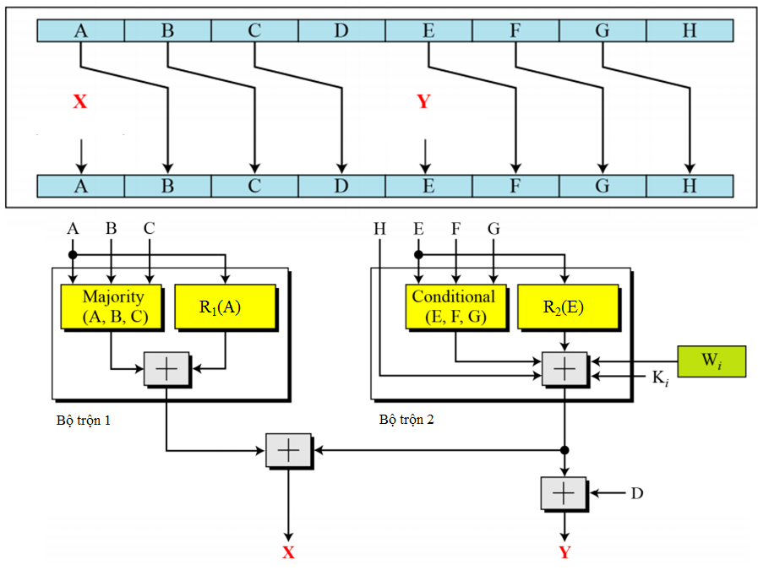
2.2. SHA-512 hash function
Implement the hashing algorithm
Structure of each round
Majority(x, y, z) = (x & y) ⊕ (y & z) ⊕ (z & x)
Conditional(x, y, z) = (x & y) ⊕ (~x & z)
R₁(x) = RotR(x, 28) ⊕ RotR(x, 34) ⊕ RotR(x, 39)
R₂(x) = RotR(x, 14) ⊕ RotR(x, 18) ⊕ RotR(x, 41)
addition modulo 2⁶⁴
RotR(x, n): Right-rotation of the argument x by n bits
Mixer 1
Mixer 2

Slide 25
2.2. SHA-512 hash function
Implement the hashing algorithm
Constant word K_{i}
i = 0 ÷ 19 | i = 20 ÷ 39 | i = 40 ÷ 59 | i = 60 ÷ 79
428A2F98D728AE22 7137449123EF65CD B5C0FBCFEC4D3B2F E9B5DBA58189DBBC 3956C25BF348B538 59F111F1B605D019 923F82A4AF194F9B AB1C5ED5DA6D8118 D807AA98A3030242 12835B0145706FBE 243185BE4EE4B28C 550C7DC3D5FFB4E2 72BE5D74F27B896F 80DEB1FE3B1696B1 9BDC06A725C71235 C19BF174CF692694 E49B69C19EF14AD2 EFBE4786384F25E3 0FC19DC68B8CD5B5 240CA1CC77AC9C65 | 2DE92C6F592B0275 4A7484AA6EA6E483 5CB0A9DCBD41FBD4 76F988DA831153B5 983E5152EE66DFAB A831C66D2DB43210 B00327C898FB213F BF597FC7BEEF0EE4 C6E00BF33DA88FC2 D5A79147930AA725 06CA6351E003826F 142929670A0E6E70 27B70A8546D22FFC 2E1B21385C26C926 4D2C6DFC5AC42AED 53380D139D95B3DF 650A73548BAF63DE 766A0ABB3C77B2A8 81C2C92E47EDAEE6 92722C851482353B | A2BFE8A14CF10364 A81A664BBC423001 C24B8B70D0F89791 C76C51A30654BE30 D192E819D6EF5218 D69906245565A910 F40E35855771202A 106AA07032BBD1B8 19A4C116B8D2D0C8 1E376C085141AB53 2748774CDF8EEB99 34B0BCB5E19B48A8 391C0CB3C5C95A63 4ED8AA4AE3418ACB 5B9CCA4F7763E373 682E6FF3D6B2B8A3 748F82EE5DEFB2FC 78A5636F43172F60 84C87814A1F0AB72 8CC702081A6439EC | 90BEFFFA23631E28 A4506CEBDE82BDE9 BEF9A3F7B2C67915 C67178F2E372532B CA273ECEEA26619C D186B8C721C0C207 EADA7DD6CDE0EB1E F57D4F7FEE6ED178 06F067AA72176FBA 0A637DC5A2C898A6 113F9804BEF90DAE 1B710B35131C471B 28DB77F523047D84 32CAAB7B40C72493 3C9EBE0A15C9BEBC 431D67C49C100D4C 4CC5D4BECB3E42B6 597F299CFC657E2A 5FCB6FAB3AD6FAEC 6C44198C4A475817

Slide 26
2.2. SHA-512 hash function
Implement the hashing algorithm
Results of the previous block or the initial digest
Compression function
Round 0
Round 79
Final adding
Values for the next block or the final digest

Slide 27
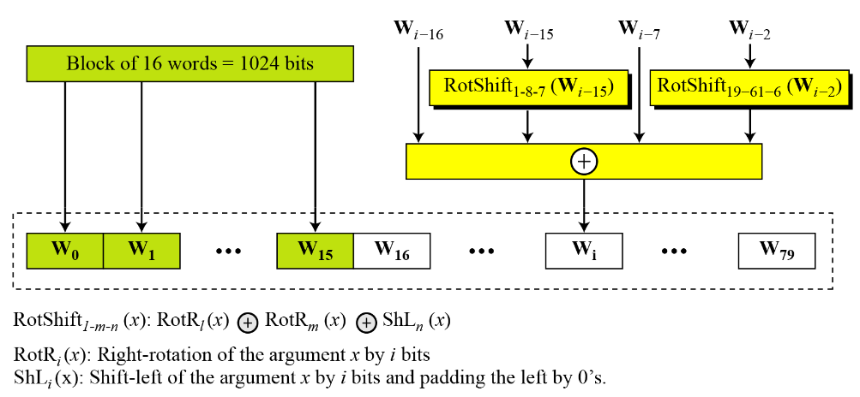
2.2. SHA-512 hash function
Implement the hashing algorithm
Word expansion
ShR_{n}(x)
ShR_{i}(x)

Slide 28
Content
1. Hash function overview
2. SHA-512 hash function
3. Implement SHA-512 hash function and test

Slide 29
INTRODUCE TO SHA-512
THANKS FOR YOUR ATTENTION !
ANY QUESTION ?

