Slide 1

Tuleulenov Dinmukhammed Aidarbek Bekzat Ashimkhan Temirlan
To do list
Web app

Slide 2
Our outline
1. Goal
3. Functions
2. Relevance
4. Conclusion

Slide 3
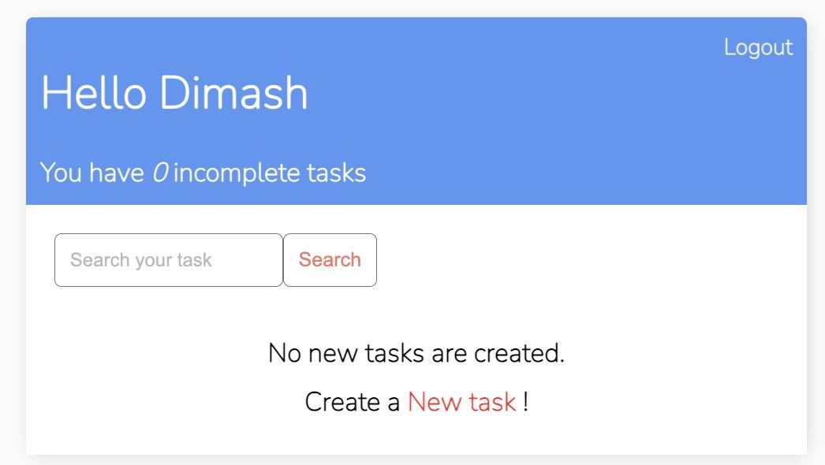
Goal of
To do list
It helps you stay organized. This web app do this by giving you the option to organize your list how you want. You can keep track of when specific tasks are due by tagging them with due dates, stay focused on projects you're working on with your project list, and have different tags for similar activities.

Slide 4
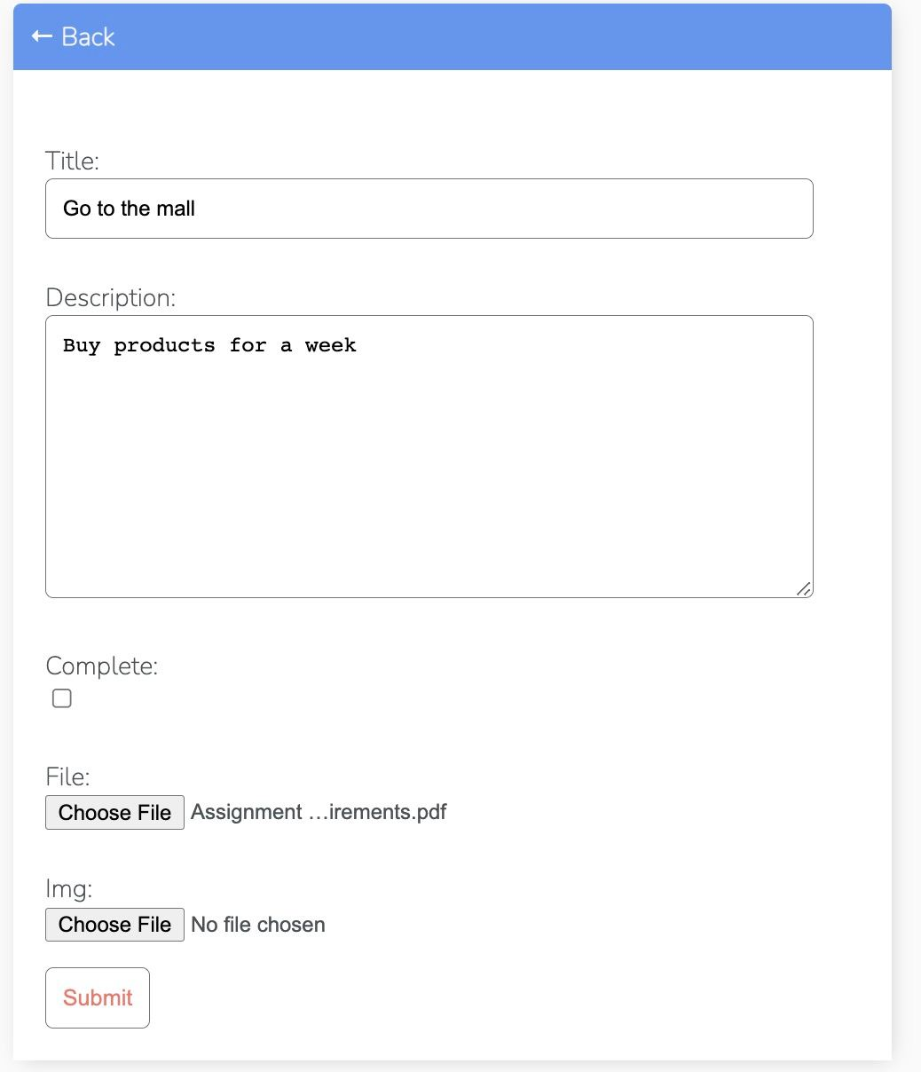
Relevance of
To do list
To-do lists offer a way to increase productivity, stopping you from forgetting things, helps prioritize tasks, manage tasks effectively, use time wisely and improve time management as well as workflow.

Slide 5
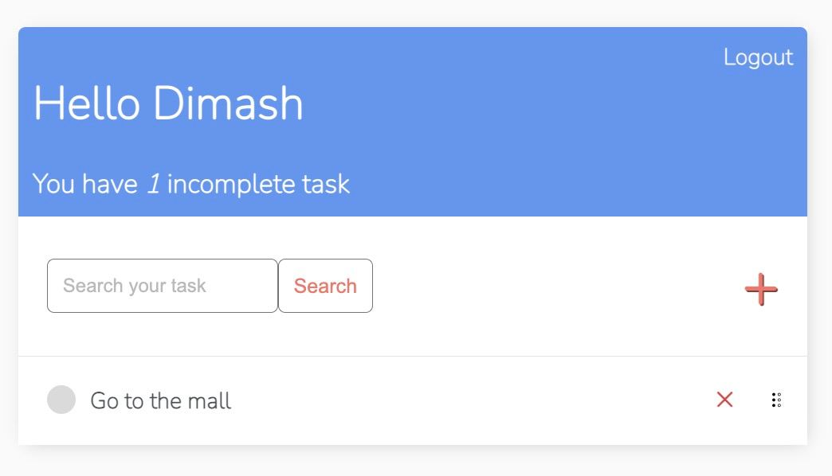
Creates order
A to do list is an orderly way toorganize how to do the things youwant to do, helping to set up theright strategy for getting thingsdone.

Slide 6
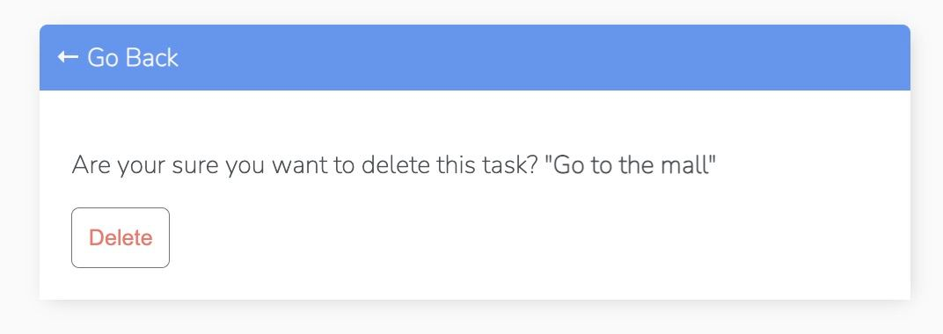
Accountability
The act of writing it down in itself holds youaccountable to get it done. Once you write it down, you have given it life and now are creating a plan to accomplish the goals you would like to see completed. You are now accountable to you.

Slide 7

Rescheduling and organizing your time.
If you finish something quickly or an appointment gets cancelled you can see what is your next step or activity during your day.

Slide 8

Feeling Productive
It is a great feeling to cross items off your list. This gives you back control. It also gives you a positive productive feeling and this alone is worth keeping lists for.

Slide 9

Relieves Stress
As you see work getting done and that you are moving forward efficiently, it allows you to relax more. Work is getting done and so you can take a well-deserved break.

Slide 10

Conclusion
A website does not require special unique functionality. It must have a to do list changeable queue. It also must have a search bar to find an appropriate deal. Login and registration are required to create list. Button completed is also mandatory.

