Slide 1
Battery Management System Chengdu BMS Project
Realize innovation.
Restricted © Siemens AG 2019
Siemens PLM-Nissan Confidential

Slide 2
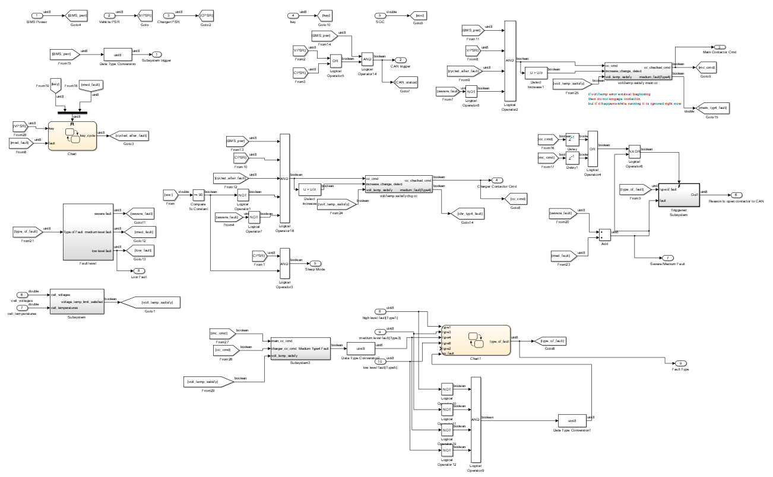
BSC Simulink Model

Slide 3
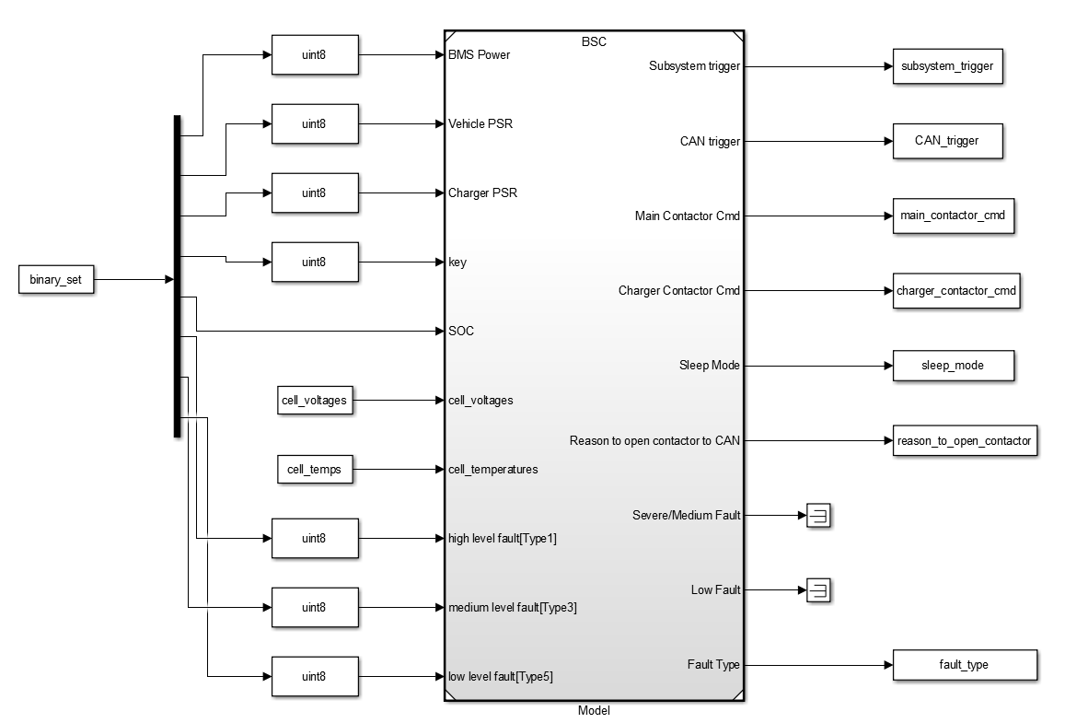
BSC Open Loop Testing Harness
Testing Harness:
Inputs: BMS Power, Vehicle PSR, Charger PSR, key, SOC, cell voltages, cell_temperatures, High level fault [Type 1], Medium level fault [Type 3], Low level fault [Type 4]
Outputs: Subsystem trigger, CAN trigger, main contactor cmd, charger contactor cmd, sleep mode, reason to open contactor, fault type

Slide 4
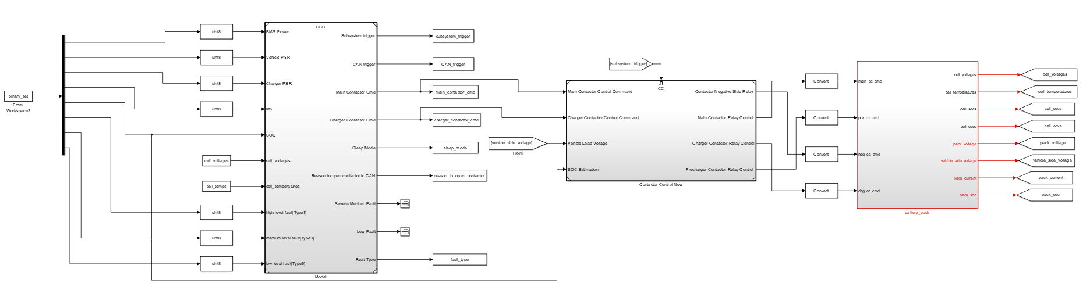
BSC Closed Loop Testing Harness
Testing Harness:
Inputs: BMS Power, Vehicle PSR, Charger PSR, key, SOC, cell voltages, cell_temperatures, High level fault [Type 1], Medium level fault [Type 3], Low level fault [Type 4]
Contactor Control model and Amesim Battery Pack is used in closed loop

Slide 5
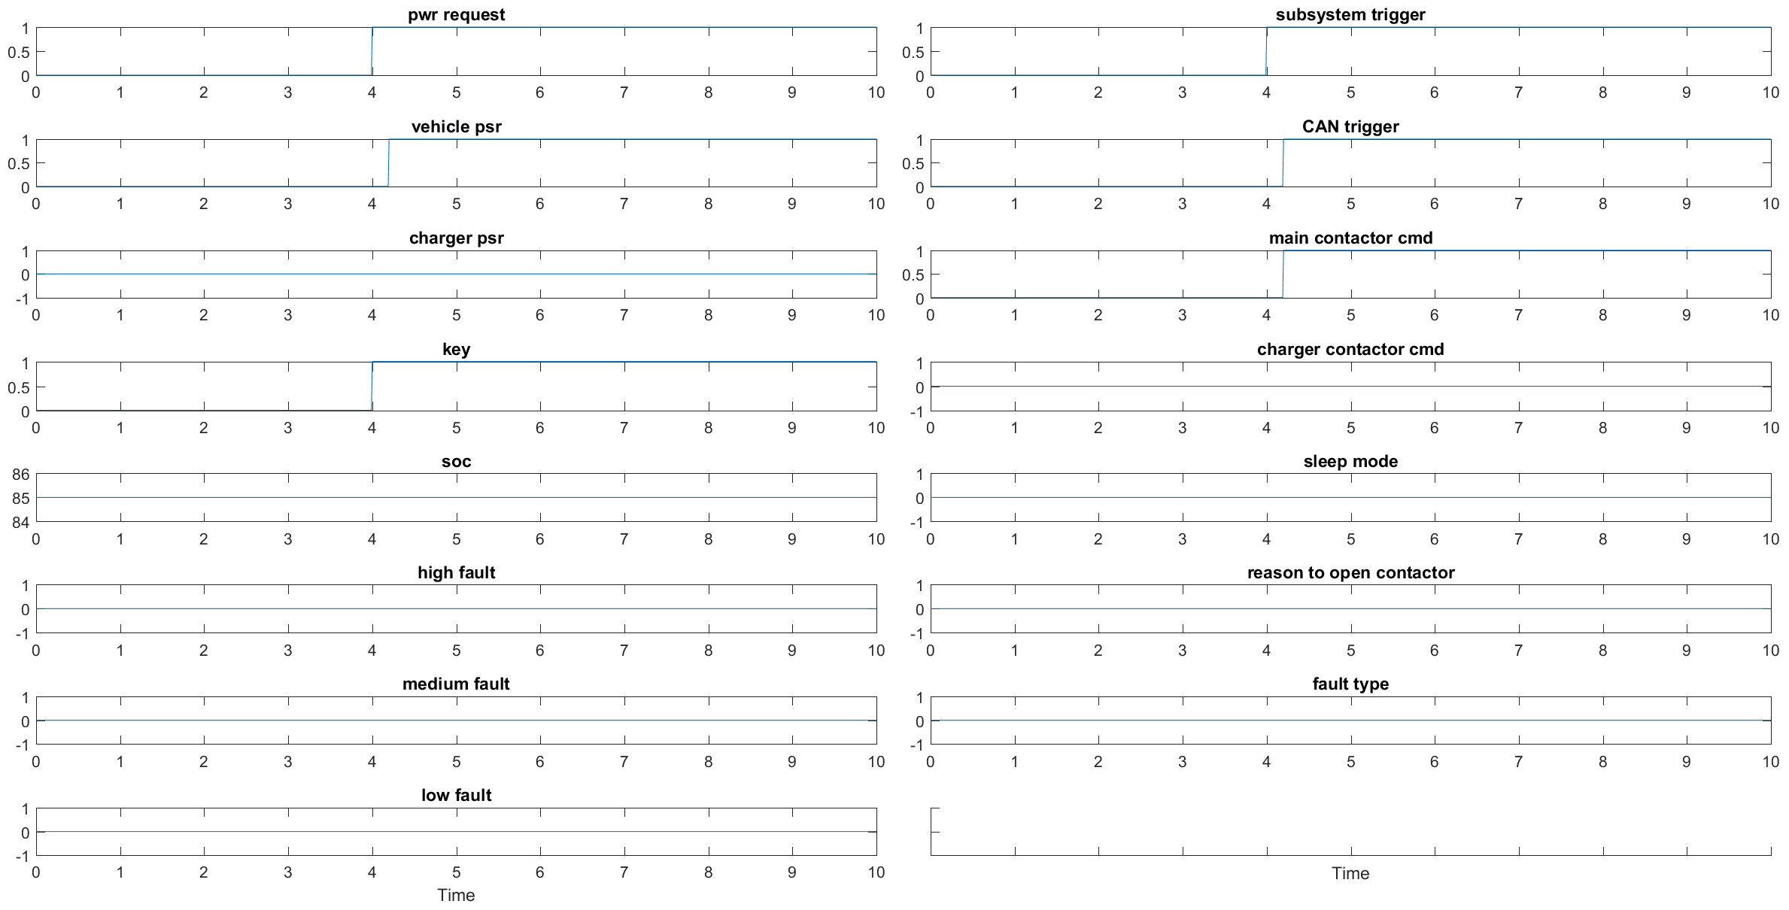
BSC Test Results explained BSC_TS_1
Key is turned ON
Subsystems are triggered, CAN is triggered and Main Contactor cmd is sent

Slide 6
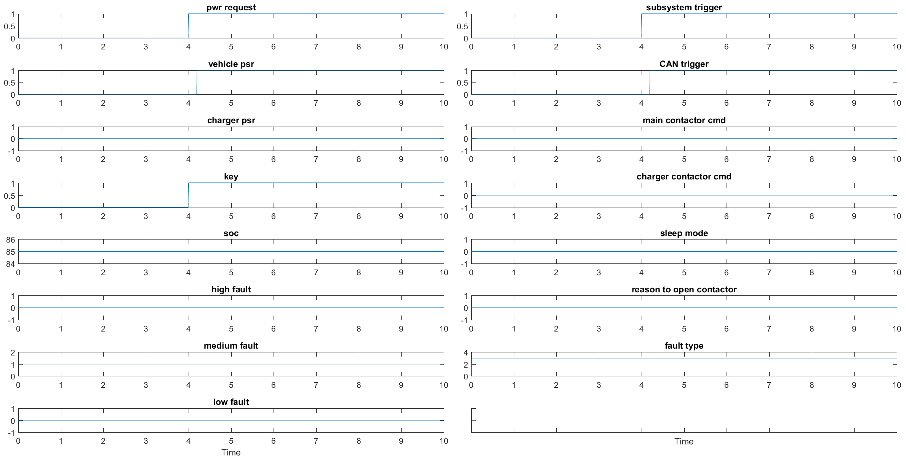
BSC Test Results explained BSC_TS_3
Key is turned ON
There is a medium fault since beginning
Subsystems are triggered, CAN is triggered and Main Contactor cmd is not sent

Slide 7
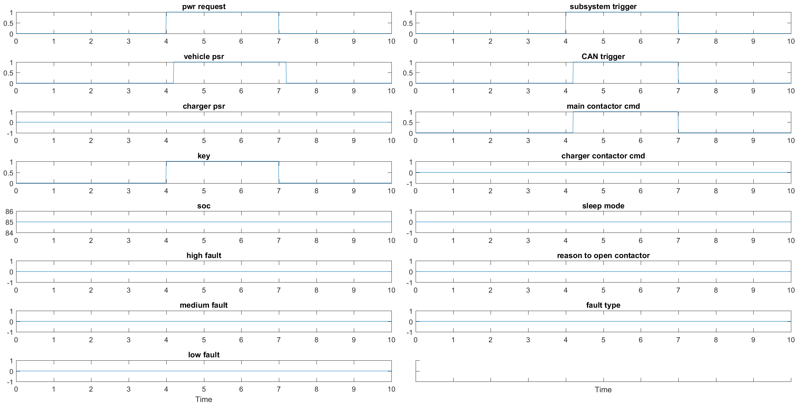
BSC Test Results explained BSC_TS_5
Key is turned ON and OFF
Subsystems are triggered and stopped, CAN is triggered and stopped, Main Contactor cmd is High on key ON and Low on key OFF

Slide 8
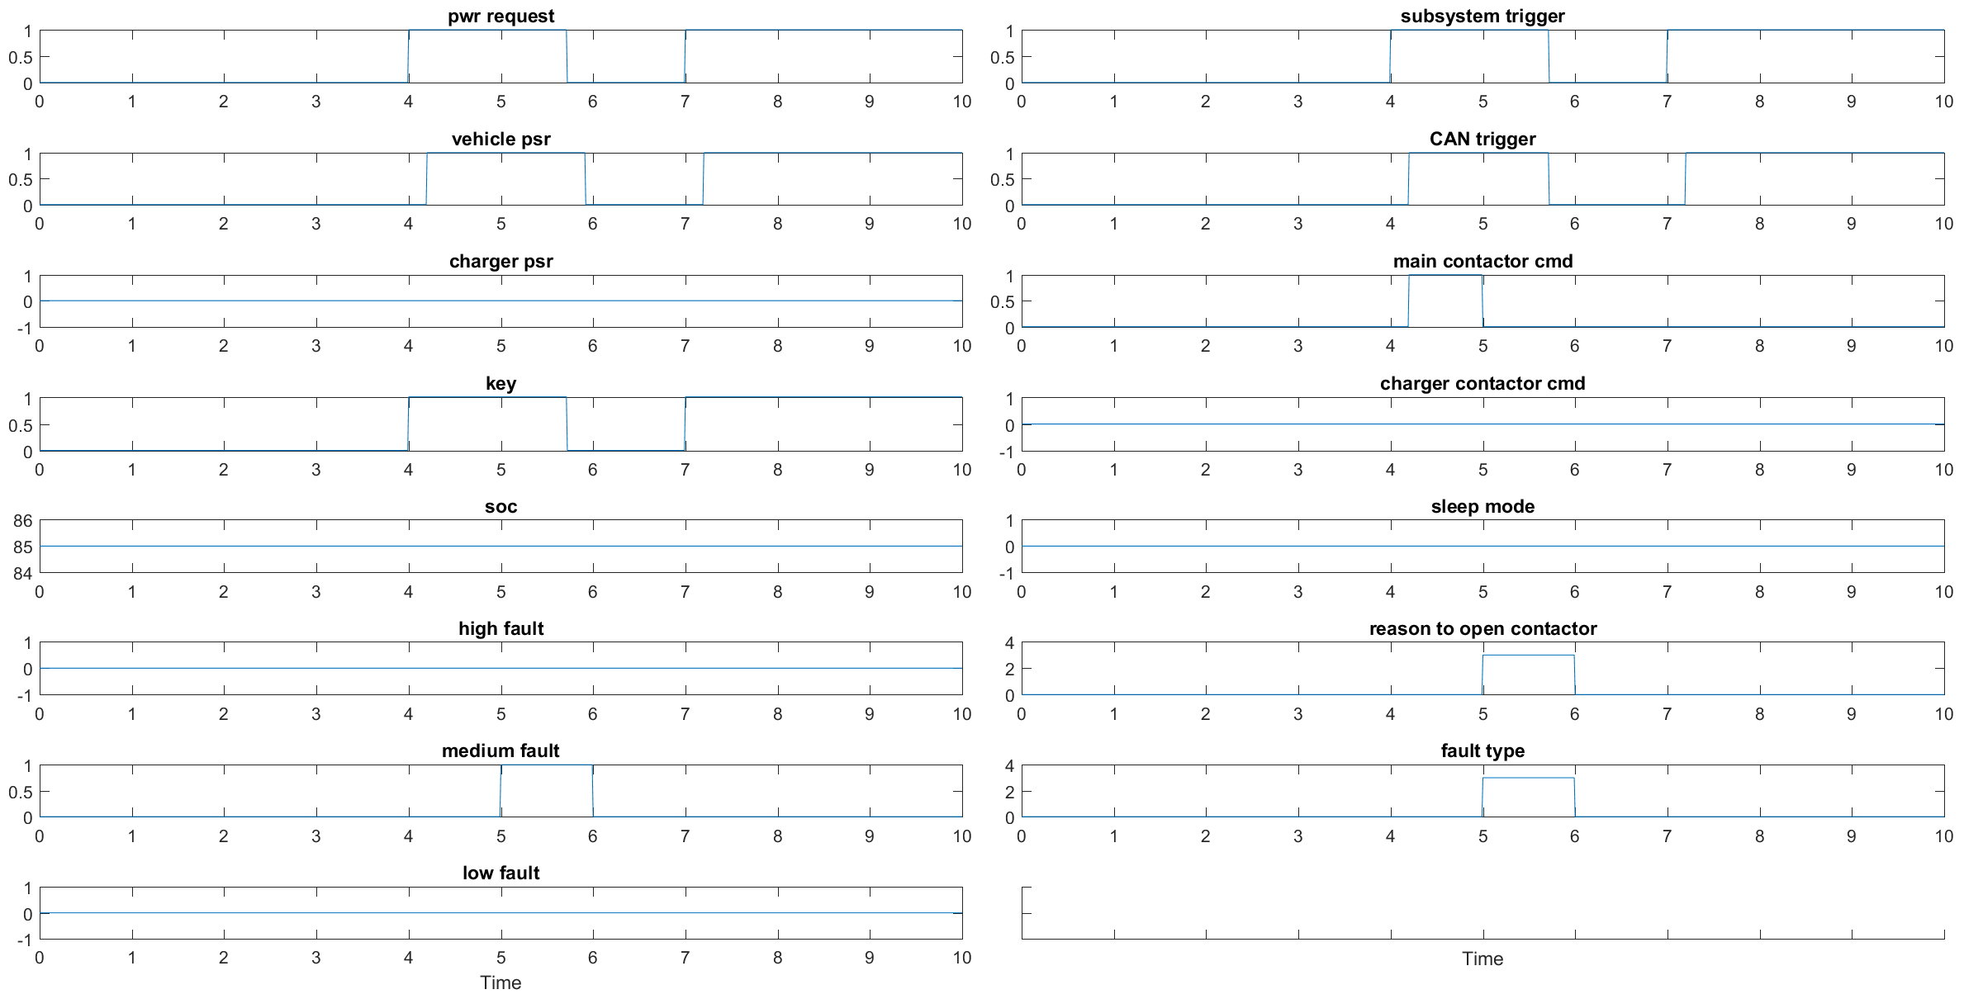
BSC Test Results explained BSC_TS_12
Key is turned ON, a medium level fault occurs and the key is turned back ON
There is no complete cycle of key after the fault went away
Contactor is connected at beginning, but after fault since the key is not cycled after fault went away contactor cmd is not sent.

Slide 9
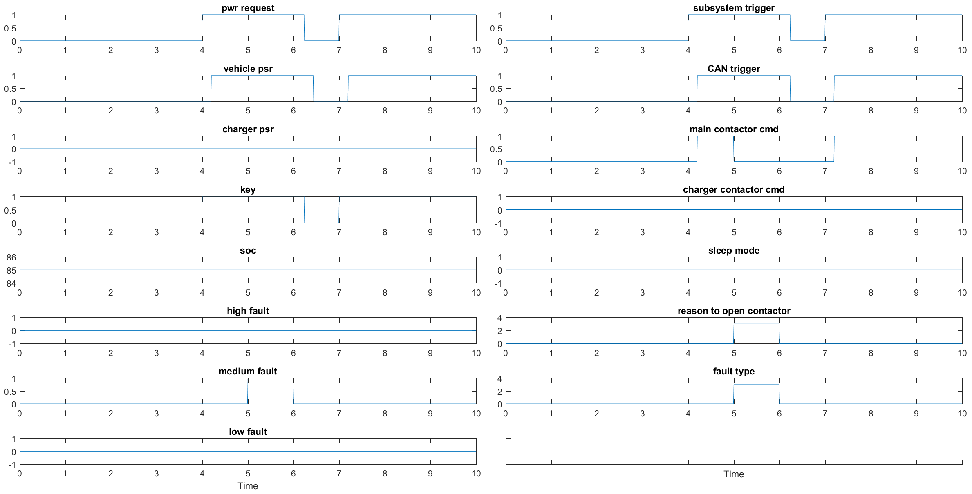
BSC Test Results explained BSC_TS_13
Key is turned ON, a medium level fault occurs and the key is turned back ON
There is a complete cycle of key after the fault went away
Contactor is connected at beginning, and the command is sent again when the key is cycled after fault.

Slide 10
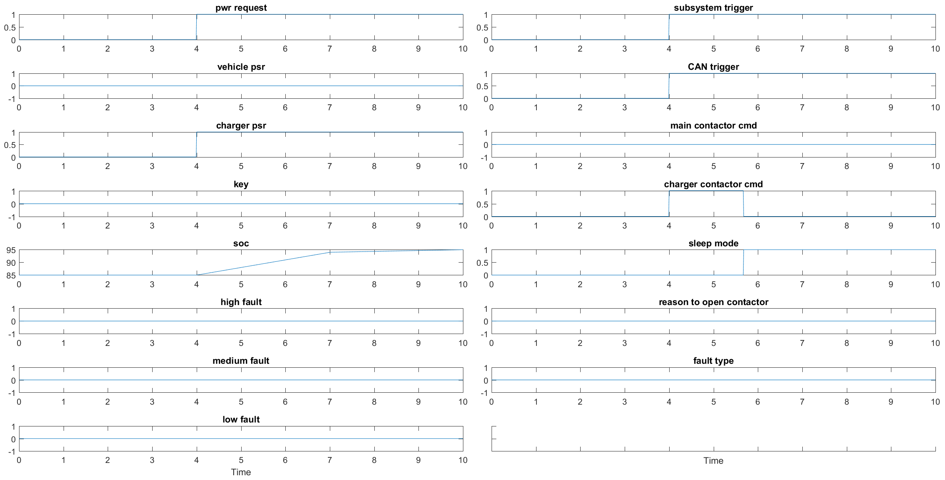
BSC Test Results explained BSC_TS_15
Charger is connected and the SOC crosses 90%
Charger Contactor is pulled down when the charger is connected and the SOC crosses 90%
Sleep Mode is activated when SOC crosses 90%

