Slide 1
Battery Management System Chengdu BMS Project
Realize innovation.
Restricted © Siemens AG 2019
Siemens PLM-Nissan Confidential

Slide 2
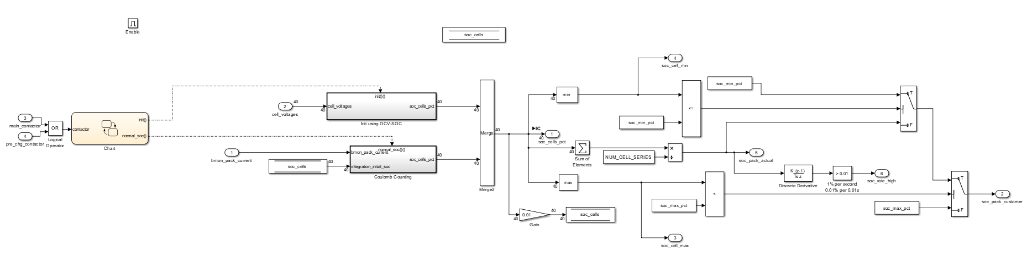
SOC Simulink Model
SOC system is triggered when the key is turned ON
SOC uses OCV-SOC table at beginning to initialize SOC for all cells
It switches to Coulomb counting when either Main Contactor or Charger Contactor is connected

Slide 3
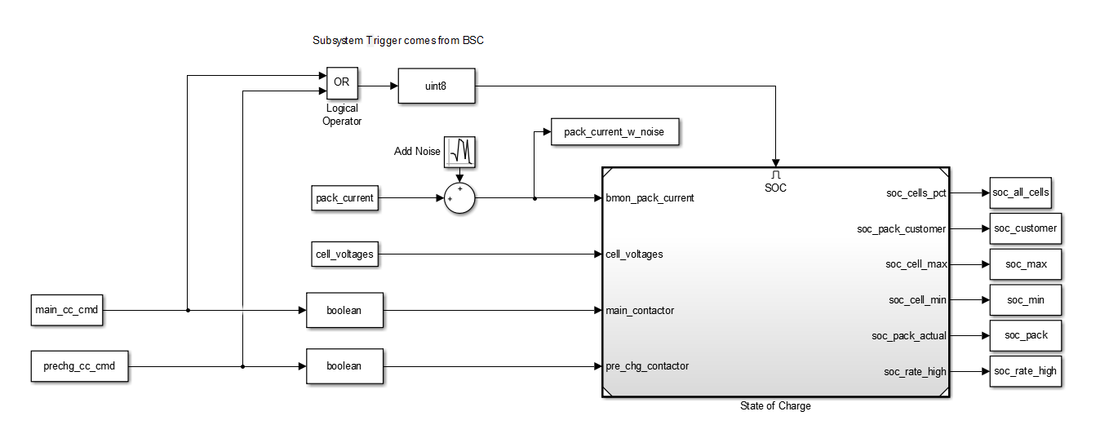
SOC Open Loop Testing Harness
Testing Harness:
Inputs: pack_current, cell_voltages, main_contactor_cmd, precharge_contactor_cmd
Outputs: soc_all_cells, sock_pack_customer, soc_cell_max, soc_min, soc_pack, soc_rate_high

Slide 4
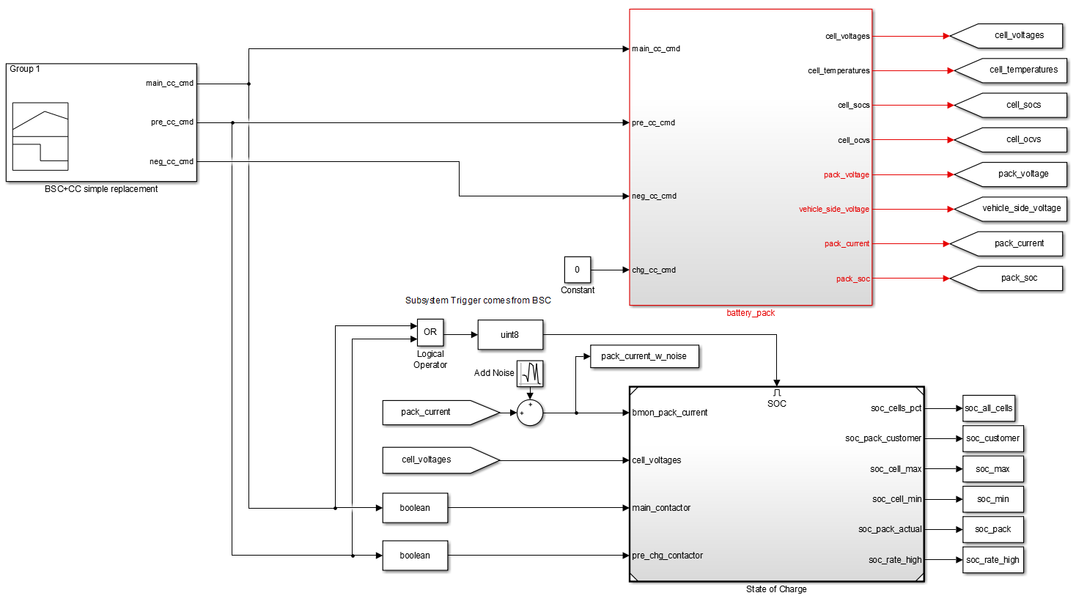
SOC Closed Loop Testing Harness
Testing Harness:
Inputs: pack_current, cell_voltages, main_contactor_cmd, precharge_contactor_cmd
BSC and Contactor Control model is replaced with a simple signal builder replacement
Pack_current and cell_voltages are coming from Amesim Battery Pack Model

Slide 5
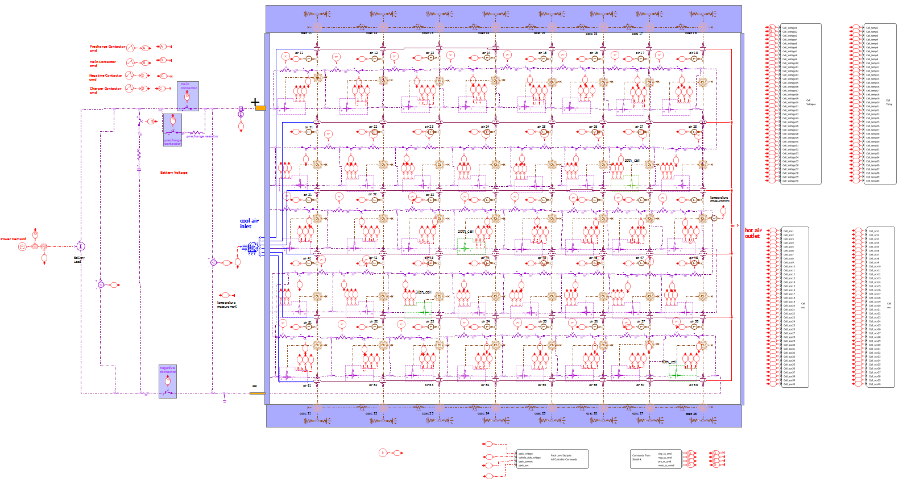
Battery Pack
Battery Pack Used
For reference:
Each Cell:
Nominal Voltage: 3.34
Capacity: 8Ah
Battery:
Voltage = 133.6
8*3.34*40 = 1.06 kWh
Nissan Leaf model 1:
Each Cell:
Nominal Voltage: 3.75
Capacity: 32.5Ah
Battery
Voltage = 3.75*4*48 = 360V
32.5*3.75*192 = 24 kWh
(192 cells, 48 modules with each having 4 cells)

Slide 6
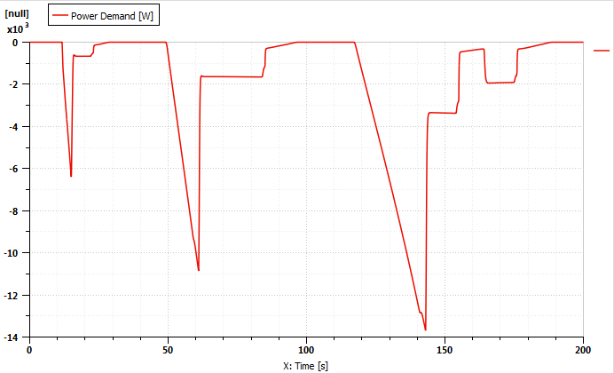
SOC Results NEDC_Drive_Cycle Power Demand

Slide 7
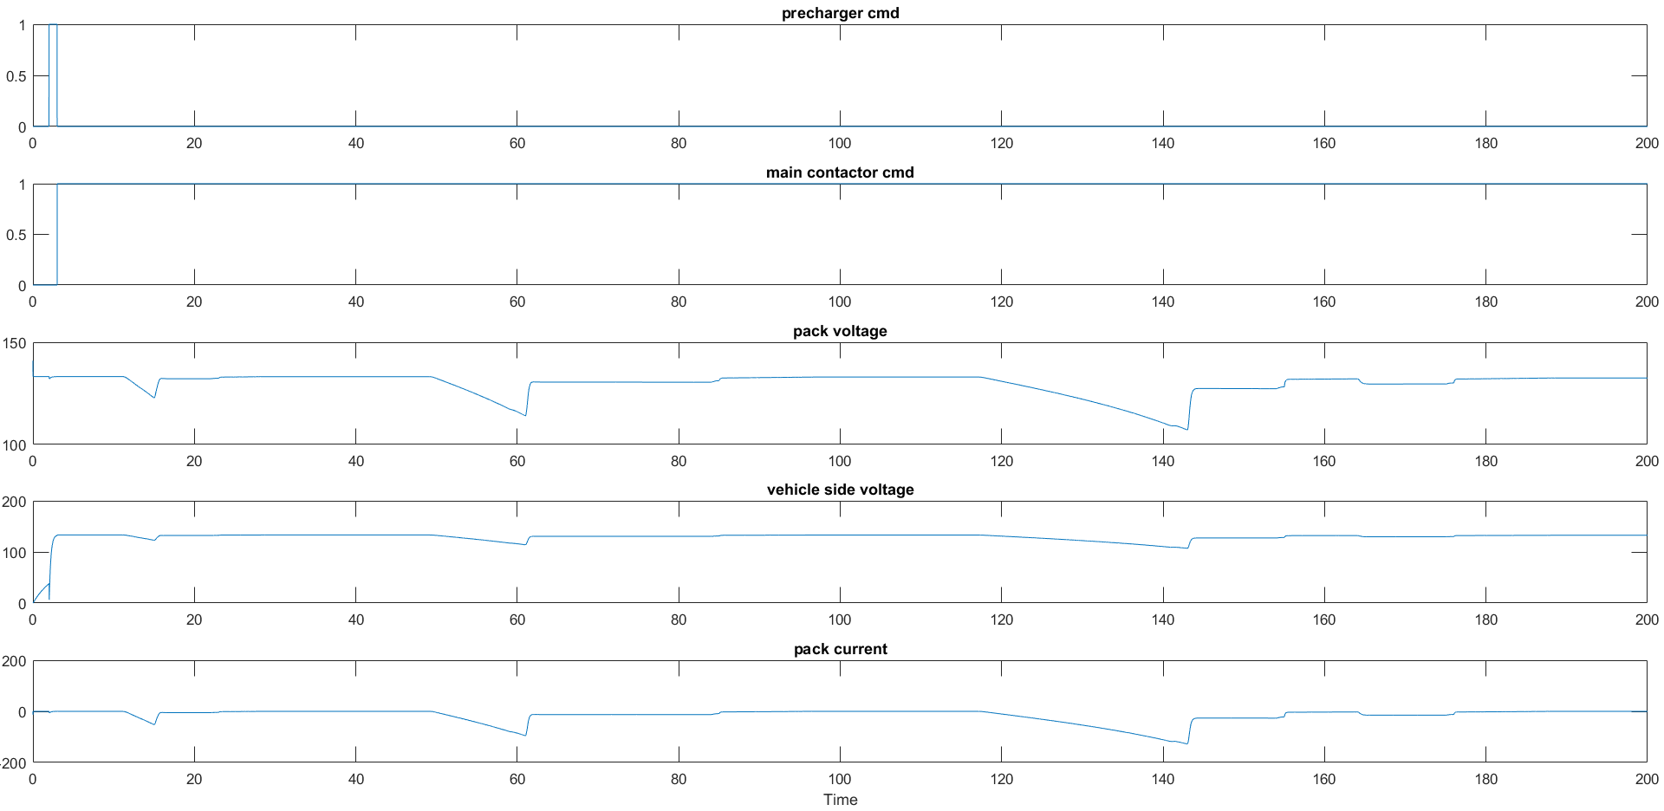
SOC Results NEDC_Drive_Cycle No Noise
Battery Mode

Slide 8
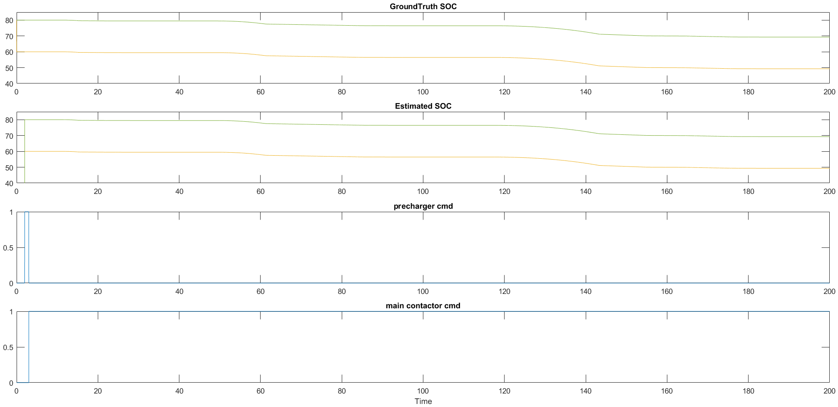
SOC Results NEDC_Drive_Cycle No Noise
Battery Mode

Slide 9
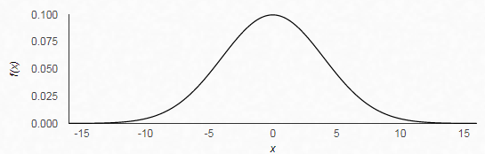
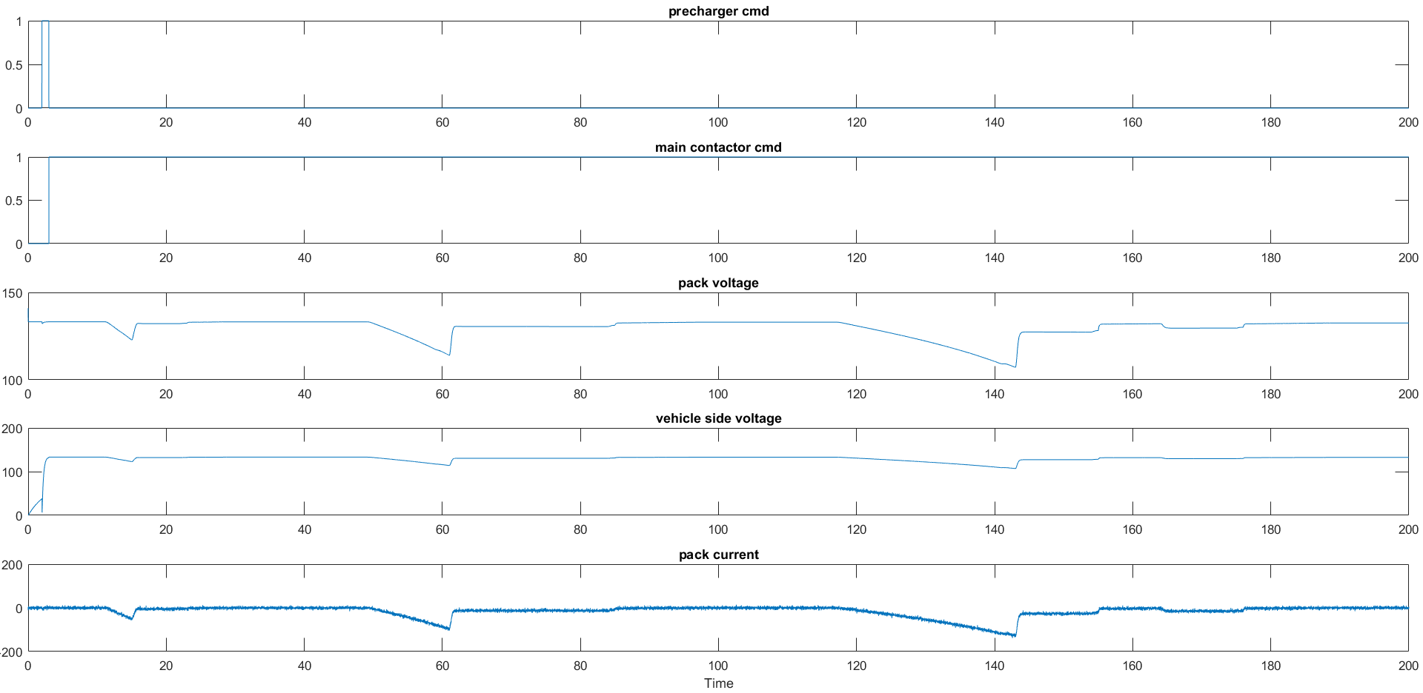
SOC Results NEDC_Drive_Cycle With Noise in current sensor (m=0, σ=4)
Pack Current
Battery Mode

Slide 10

SOC Results NEDC_Drive_Cycle With Noise in current sensor (m=0, σ=4)
Battery Mode

