Slide 1
SAMPLE INTRO TO ACCESSIBILITY SLIDES
Source: Presentation by Andy Ko, Associate Professor, iSchool, UW

Slide 2
Accessibility
Andrew J. Ko
Associate Professor, The Information School
Notes:
Thanks for inviting me to class. Here’s the argument I want to present:

Slide 3
People have all kinds of ability

Slide 4
If you design without accounting for variation in ability, your design will fail
Notes:
The central claim of this talk is...

Slide 5
Designs that account for all abilities are called accessible designs
Notes:
I’m going to teach you about designs that account for all abilities.

Slide 6
Outline
What kinds of abilities are there?
How do we think about ability?
Access technologies
Designing for accessibility

Slide 7
(Some) kinds of disabilities
Vision
Blind
Low-Vision
Color Blind
Hearing
Deaf
Hard of Hearing
Speech
Ability to speak
Speed impediments
Mobility
Ability to walk
Ability to use limbs
Cognitive
Dyslexia, dysgraphia, dyscalculia
ADHD
Memory loss
Learning disabilities
Behavioral
Bipolar
Notes:
And some people have multiple disabilities.

Slide 8
1 in 7 people worldwide have some form of disability
Notes:
Mostly blindness, low-vision, and mobility.

Slide 9
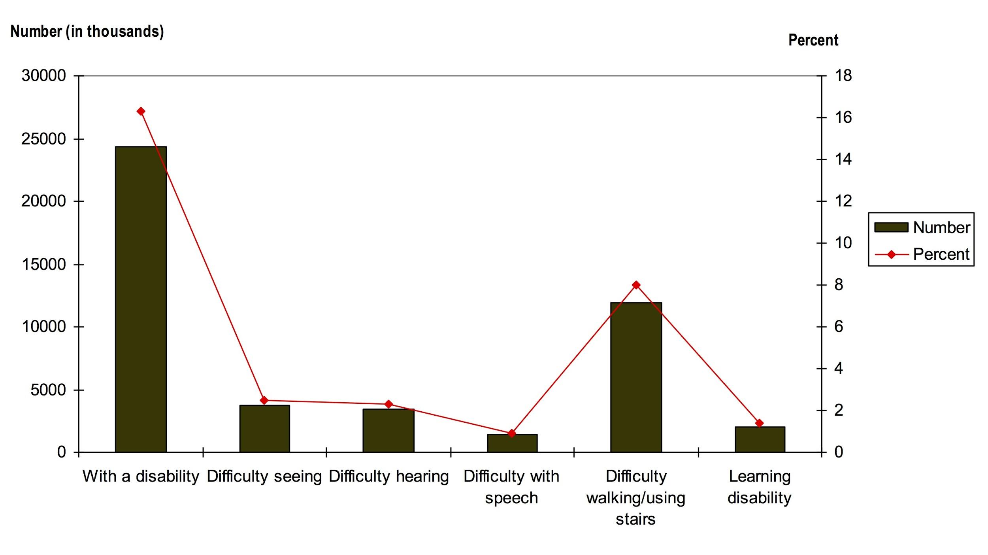
Source: U.S. Census Bureau, Survey of Income and Program Participation, 2002

Slide 10
>15% of K-12 students have a disability
According to reports of IEP and Section 504 accommodations from U.S. public schools.

Slide 11
Disabilities in U.S. schools
Learning | 2,400,000
Speech | 1,400,000
Health | 700,000
Autism | 400,000
Developmental | 400,000
Emotional | 400,000
Hearing | 80,000
Mobility | 60,000
Vision | 30,000
According to U.S. national individualized education plan data from the National Center for Education Statistics.

Slide 12
Discuss with your neighbor: do you know someone who has a disability?
Notes:
Why not? Because society generally doesn’t give people with disabilities the same opportunities.

Slide 13
How should we think about all of these abilities?

Slide 14
The Medical Lens
Disabled people are “patients” who need treatments or cures.
E.g., medication

Slide 15
The Education Lens
Disabled youth need to be educated differently because of their different abilities.
E.g. schools for the deaf, special education

Slide 16
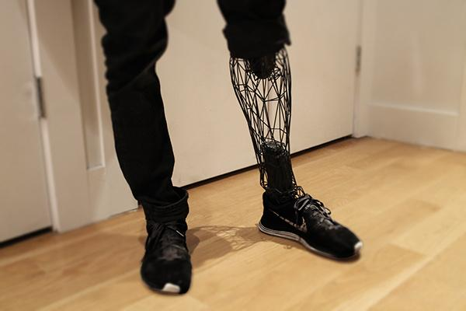
The Rehabilitation Lens
Disabled people need assistive technologies and training to be able to secure employment and care for themselves.
E.g., hearing aid, prosthesis

Slide 17
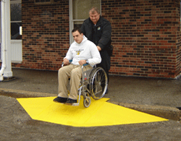
The Legal Lens
Disabled people have rights and responsibilities, such as access to public buildings, voting, education, etc.
E.g., curb cuts

Slide 18
The Sociocultural Lens
Variation in ability is natural. Disability is caused by how society is designed, not by nature.
E.g., video captioning

Slide 19
With your neighbor: one of you take the legal lens and the other take sociocultural lens. Debate how UW should serve deaf students.
Notes:
Each lens is a tool for thinking. Some are more versatile than others.

Slide 20
Widespread information access technologies

Slide 21
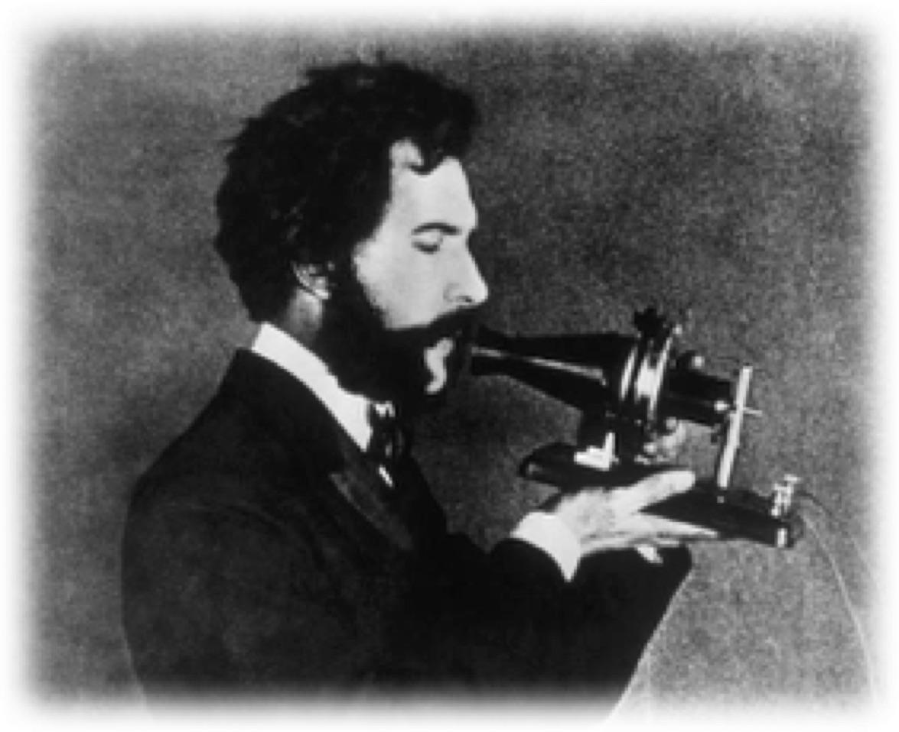
Telephones (1880)
Invented by A.G. Bell
“devising methods of exhibiting the vibrations of sound optically, for use in teaching the deaf and dumb.” (Fay, American Annals of the Deaf, 1887)

Slide 22
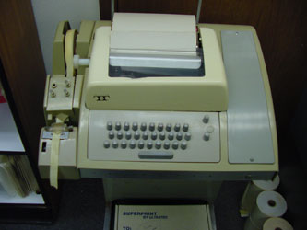
Texting (1960’s)
Began as TTY for transmitting text over phone lines, evolved into SMS on cell phone lines.

Slide 23
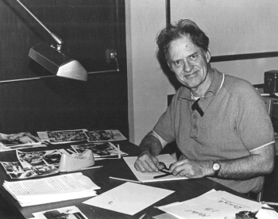
Modems (1960’s)
Robert H. Weitbrecht (deaf), invented modem to optimize TTY communication. Modems became the gateway to internet access in the 1980’s and 1990’s.

Slide 24
Machine vision (1974)
Motivated by Optical Character Recognition (OCR), which helped convert printed materials into machine readable text.
Schantz, Herbert F. (1982). The history of OCR, optical character recognition. [Manchester Center, Vt.]: Recognition Technologies Users Association.

Slide 25
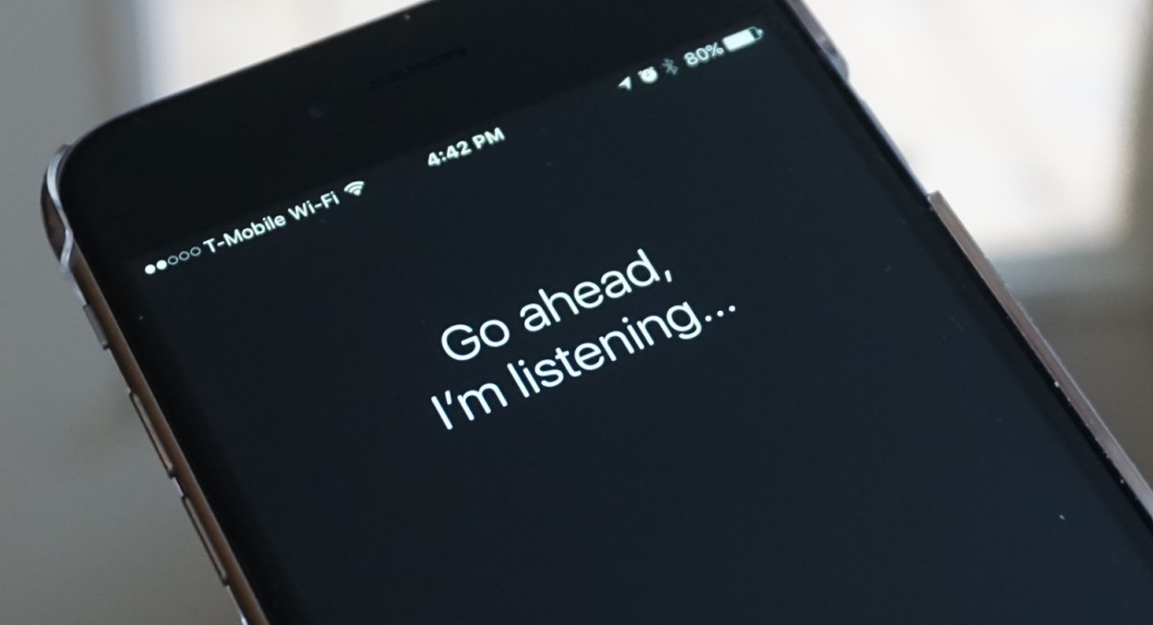
Speech synthesis (1976)
Motivated by need for people without sight to read text.

Slide 26

Speech recognition
Motivated by need for people without sight to enter text without hands.

Slide 27
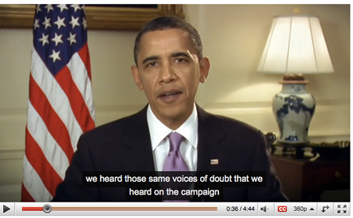
Captioning (1972)
First enabled deaf viewers to read audio.

Slide 28
Screen readers (1980)
Allow non-visual access to computers. Motivated by Section 508 accessible technology requirements.

Slide 29
Discuss with your neighbor: why are access technologies useful to people without disabilities?
Notes:
Because

Slide 30
Situational impairments
Even able-bodied people can be temporarily disabled (broken arm, injured eye, carrying a bag of groceries)
Information access technologies allow us to get information in whatever way is convenient for a situation.

Slide 31
Designing for access

Slide 32
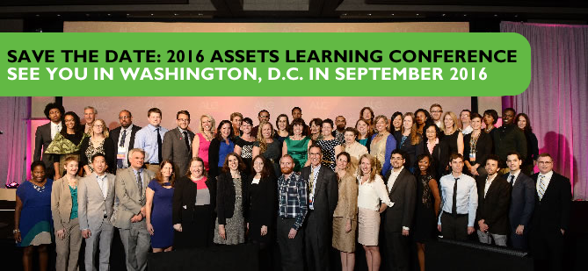
ASSETS
A whole research conference dedicated to research on access technologies.

Slide 33
Universal design
Don’t design for an average user
Design for a distribution of users

Slide 34
Cockpits (1952)
U.S. Air Force redesigned seats to fit the average pilot. Fit nobody, training results dropped.
Redesigned seat to be configurable for any pilot; training results rose above previous levels.

Slide 35
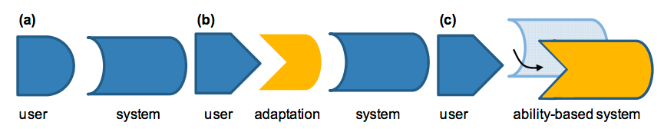
Ability-based design
Adapt systems to individuals, rather than building universal adaptations.

Slide 36
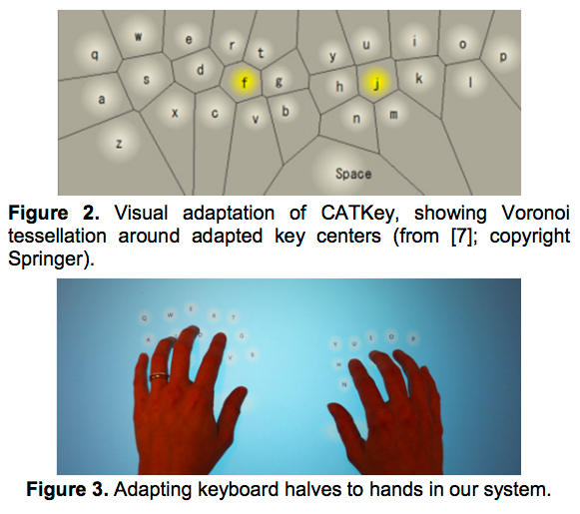
Adaptive keyboards
Automatically generate a layout that works for a specific individual.
Findlater, L. and Wobbrock, J.O. (2012). Personalized input: Improving ten-finger touchscreen typing through automatic adaptation. Proceedings of the ACM Conference on Human Factors in Computing Systems (CHI '12). Austin, Texas (May 5-10, 2012). New York: ACM Press, pp. 815-824

Slide 37
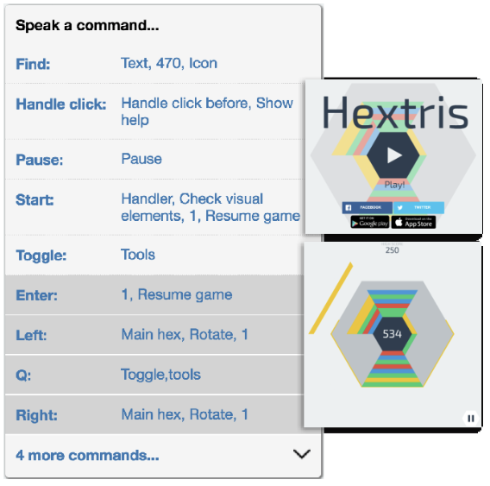
Transform user interfaces
Automatically reverse engineer commands to create alternative accessible interfaces.
Amanda Swearngin, Andrew J. Ko, and James Fogarty (2017). Genie: Input Retargeting on the Web through Command Reverse Engineering ACM Conference on Human Factors in Computing Systems (CHI), to appear.

Slide 38
If universal design improves results for everyone, why don’t more companies do it?

Slide 39
They can’t do it without your help.
Microsoft hired a Chief Accessibility Officer
Adobe built an accessibility training team
Facebook has an Accessibility team
Can’t hire enough designers and engineers who understand accessibility

Slide 40
TeachAccess
Founded by industry to advocate for more teaching about accessibility in colleges and universities.
That’s why you’re reading these words.

Slide 41
Recap
Disability is more prevalent than you think
Ability is partly determined by design
Access technologies can enhance ability
Universal design is reaching industry

Slide 42
Questions?
Notes:
We’ll break and then be doing an activity.

Slide 43
3 minute break

Slide 44
Activity: experience screen readers

Slide 45
Grab your smartphone
We’re going to enable the screen readers on your phone.

Slide 46
Enable your screen reader
iOS: Settings > General > Accessibility > VoiceOver > Hit the switch
Android: Settings > Accessibility > Talkback > Hit the switch

Slide 47
Familiarize yourself.
Input works differently now. For example, tap now reads the screen and double-tap selects. Use two or three fingers to scroll by page. Play with it for a minute.

Slide 48
Close your eyes.
Go to a social media account and read your feed.

Slide 49
How was the experience of reading different?

Slide 50
Keep your eyes closed.
Write an email to your friend/parents saying hello!

Slide 51
What was text entry like?

Slide 52
Download the latest free game from an app store.
Try playing it.

Slide 53
Was it possible to play the game?

Slide 54
About 8 million blind Americans rely on screen readers to access information.

Slide 55
Discuss with your neighbor: what obligation should Apple and Google have to serve these 8 million blind Americans?

Slide 56
Questions?
Notes:
I can also stay and answer questions 1 on 1.

