Slide 1
Git and Version Control Concepts
Lena Voytek
Firmware Developer: JACOBS Engineering
System Administrator: H.A.C.K.S
Technology Outreach Officer: Medical Devices Club

Slide 2
Safety Moment
Stay Hydrated
Eat Food
Take Breaks
Get some sleep if you can

Slide 3
Overview
Version control is essential for modern coding
  Provides reliable backups of data
  Allows for efficient collaboration on team projects
  Previous project iterations can be easily referenced
Git is a very prominent version control system
  Decentralized
  Works offline
  Long standing UNIX integration

Slide 4
Setup and Installation
Windows
  https://git-scm.com/download/win
  Ubuntu Subsystem on the Microsoft Store
Mac
  https://git-scm.com/download/mac
  typing [ git --version ] in Terminal
Ubuntu:
  You probably already have it
  Otherwise [ sudo apt install git ] on command line

Slide 5
Basic Git Commands
Initialization | Updating | Branching
Init Clone | Add Commit Push Pull | Branch Checkout Merge

Slide 6
Initialization
Two options for setting up a git project locally
  Create a new, empty repository in current directory
    Type “git init” on the command line
    Create a new repository on GitHub
    Set the external URL with “git remote add origin [URL]”
  Copy an existing external repository into new folder
    Type “git clone [repository URL]” on the command line

Slide 7
Updating
Sending new code to a repository
  Add files, commit with message, push to repository
    git add [Filenames] (use * for all available files)
    git commit -m “Commit Message”
    git push
Obtaining current code from repository
  git pull
Only push and pull require internet access

Slide 8
Branching
Diverging from the main line of development
  Avoid messing with main code with a new branch
  git branch [new branch name]
  View current branches using git branch with no args
Change the local repository’s branch
  git checkout [branch name]
Recombine with main line of development
  git checkout [original branch name]
  git merge [diverged branch name]

Slide 9
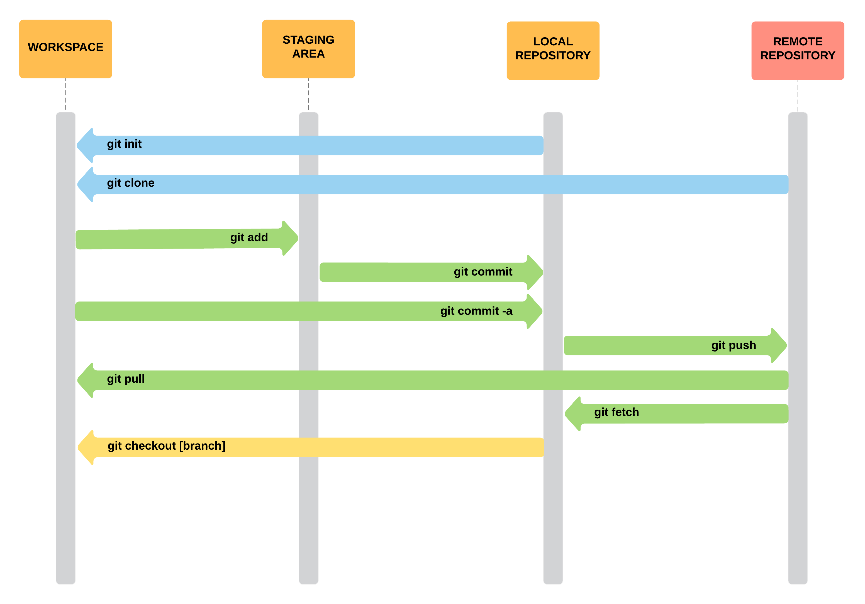
Overall Git Workflow

Slide 10
GitHub Tools
Code
  View current code and any other previous commits
Issues
  A comprehensive list of current problems to be fixed
Pull Requests
  External users can request to modify some of the repository
Projects
  A set of tables showing the flow of development
Wiki
  A comprehensive documentation of the code
Insights
  Information on development progress

Slide 11
Markdown Files
Classified by a .md file extention
Most Git repositories contain a README.md
Specially formatted text file
  Can contain Headers, emphasis, links, images, etc.
General markdown syntax:
  https://github.com/adam-p/markdown-here/wiki/Markdown-Cheatsheet

Slide 12
Other Version Control Systems
SVN
  Centralized, Open Source, by Apache
Mercurial
  Decentralized, Highly Scalable
Team Foundation Server
  Integrated with Visual Studio, Centralized, by Microsoft
And Many More

Slide 13
Time to Git Good
For all the resources from this presentation
  “git clone https://github.com/lvoytek/GitPresentation.git”
Test your new skills on your own new projects
Questions?

