Slide 1


Git and Version Control Concepts
Lena Voytek
Firmware Developer: JACOBS Engineering
System Administrator: H.A.C.K.S
Technology Outreach Officer: Medical Devices Club
Hack Arizona
Powered by

Slide 2
Safety
Stay Hydrated
Eat Food
Take Breaks
Get some sleep if you can
Notes:
<number>

Slide 3
Overview
Version control is essential for modern coding
Provides reliable backups of data
Allows for efficient collaboration on team projects
Previous project iterations can be easily referenced
Git is a very prominent version control system
Decentralized
Works offline
Long standing UNIX integration
Notes:
<number>

Slide 4
Setup and Installation
Windows
https://git-scm.com/download/win
Ubuntu Subsystem on the Microsoft Store
Mac
https://git-scm.com/download/mac
Typing [git --version] in Terminal
Ubuntu
sudo apt install git
Notes:
<number>

Slide 5
Git Commands
Initialization | Updating | Branching
Init Clone | Add Commit Push Pull | Branch Checkout Merge
Notes:
<number>

Slide 6
Initialization
Two options for setting up a git project locally
Create a new, empty repository in current directory
Type “git init” on the command line
Create a new repository on GitHub
Set the external URL with “git remote add origin [URL]”
Copy an existing external repository into new folder
Type “git clone [repository URL]” on the command line
Notes:
<number>

Slide 7
Updating
Sending new code to a repository
Add files, commit with message, push to repository
git add [Filenames] (use * for all available files)
git commit -m “Commit Message”
git push
Obtaining current code from repository
git pull
Only push and pull require internet access
Notes:
<number>

Slide 8
Branching
Diverging from the main line of development
Avoid messing with main code with a new branch
git branch [new branch name]
View current branches using git branch with no args
Change the local repository’s branch
git checkout [branch name]
Recombine with main line of development
git checkout [original branch name]
git merge [diverged branch name]
Notes:
<number>

Slide 9
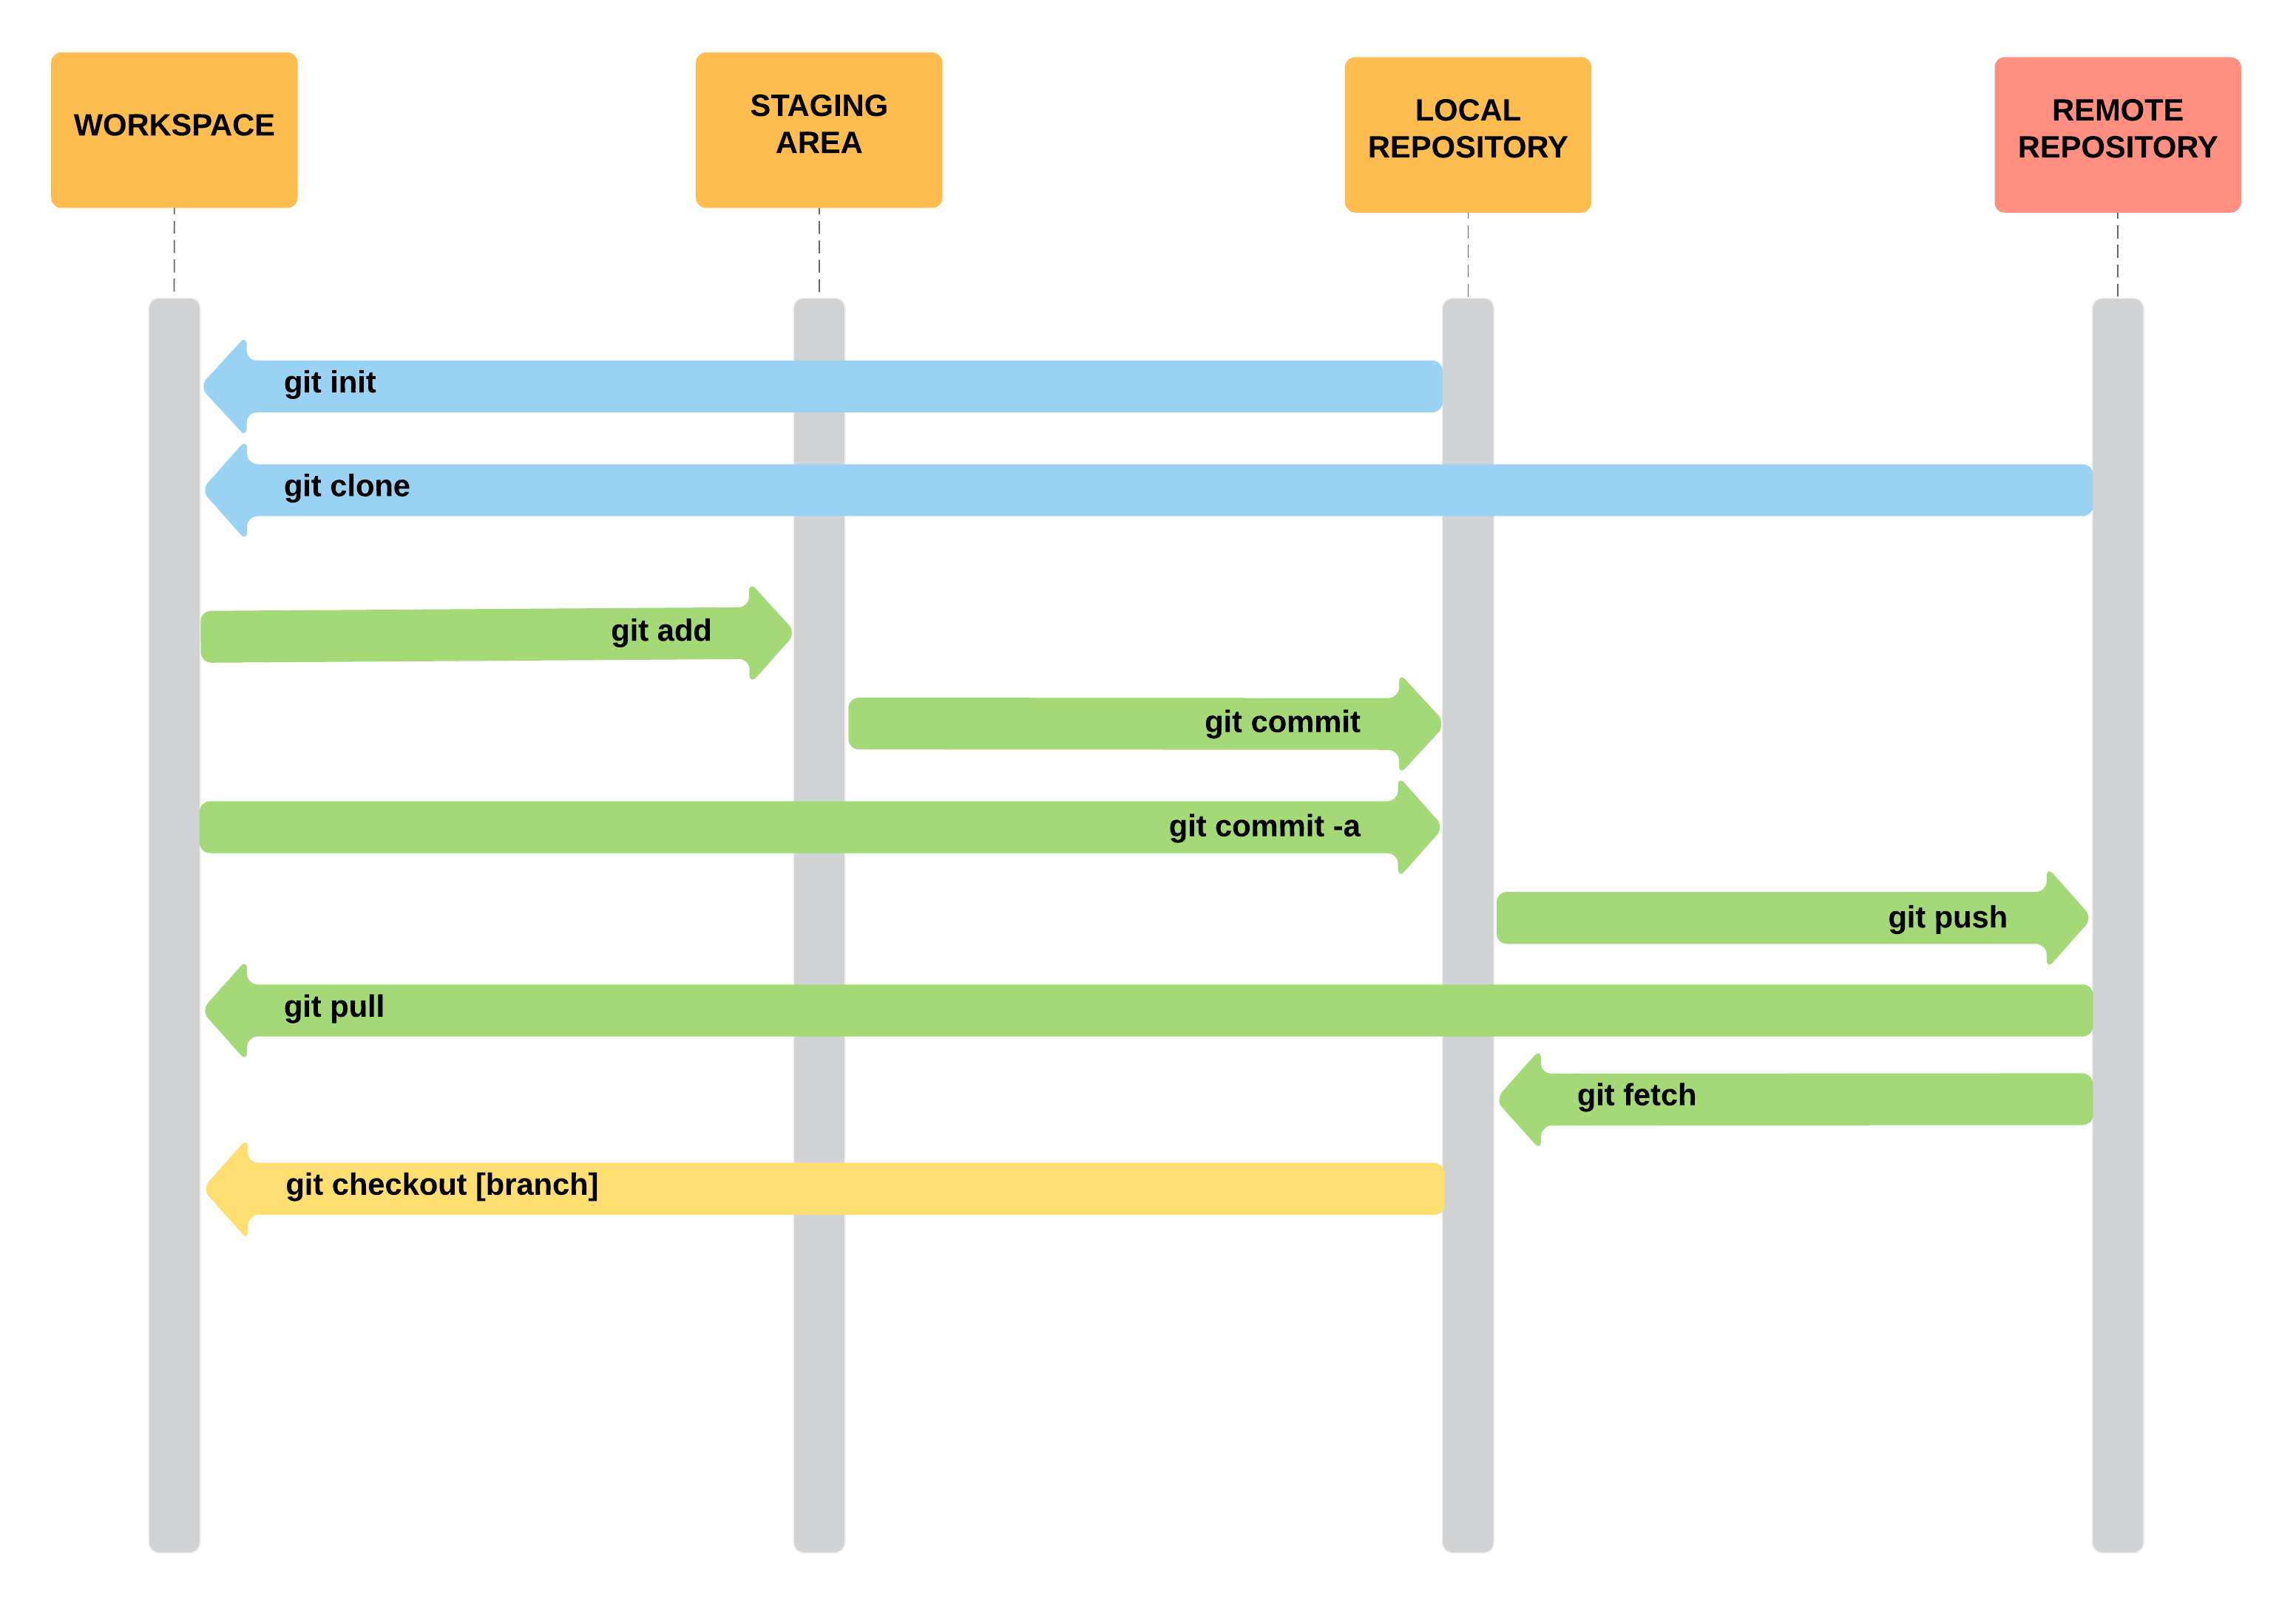
Overall Git Workflow
Notes:
<number>

Slide 10
GitHub Tools
Code: View current code and any other previous commits
Issues: A comprehensive list of current problems to be fixed
Pull Requests: External users can request to modify the repository
Projects: A set of tables showing the flow of development
Wiki: A comprehensive documentation of the code
Insights: Information on development progress
Notes:
<number>

Slide 11
Markdown Files
Classified by a .md file extention
Most Git repositories contain a README.md
Specially formatted text file
Can contain Headers, emphasis, links, images, etc.
General markdown syntax
https://github.com/adam-p/markdown-here/wiki/Markdown-Cheatsheet
Notes:
<number>

Slide 12
Other Version Control Systems
SVN
Centralized, Open Source, by Apache
Mercurial
Decentralized, Highly Scalable
Team Foundation Server
Integrated with Visual Studio, Centralized, by Microsoft
And Many More
Notes:
<number>

Slide 13
Time to Git Good
For all the resources from this presentation
“git clone https://github.com/lvoytek/GitPresentation.git”
Test your new skills on your HackAZ Projects
Questions?
Notes:
<number>

