Slide 1
Voice Modulator
ECE 372A – MICROCONTROLLER ORGANIZATION
ELECTRICAL AND COMPUTER ENGINEERING
UNIVERSITY OF ARIZONA
SPRING 2019

Slide 2
Team Members
Jacob Bowles
Nadine Najdawi
Jessica Sofka
Lena Voytek

Slide 3
Statement of Problem
We are implementing a voice modulator that takes in audio, using a small sound and big sound microphone, and modulates the frequency of that data depending on what the user chooses on the numeric keypad. An LCD screen will display the control waveform from the numeric keypad. Voice modulation data will be outputted to a speaker, It will maintain a clear output, while minimizing feedback. We are using modulated data to fine-tune the pitch. This is an improvement of an autotune device.

Slide 4
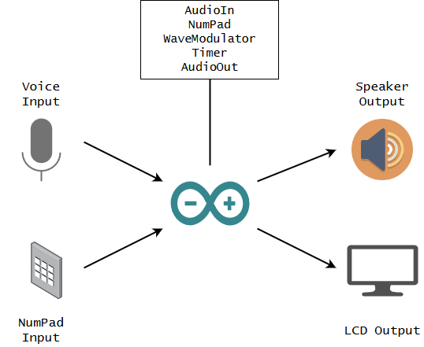
Proposed Prototype Solution
Voice Modulation
The manipulation of pitch through wavelength modulation
Numpad for controlling voice effects for corresponding sound
LCD Output for displaying voice control settings from numpad

Slide 5
Requirements
Requirement 1 – Input voice and output the same voice.
Requirement 2-Waveform modulations manipulate input voice.
Requirement 3-Incorporate a number pad to control waveform modulation.
Requirement 4-Output on a screen the control waveform.
Requirements | 4 | 3 | 2 | 1
Voice Input | Working | Sound Comes out | Voice Goes Into Controller | Not working
Voice Manipulation | Working | Most Frequencies Work | Some Frequencies Work | Not Working
Number Pad | Working | Most Inputs Work | Some Inputs Work | Not Working
Display | Working | Displays Input Data | Displays Characters | Not Working

Slide 6
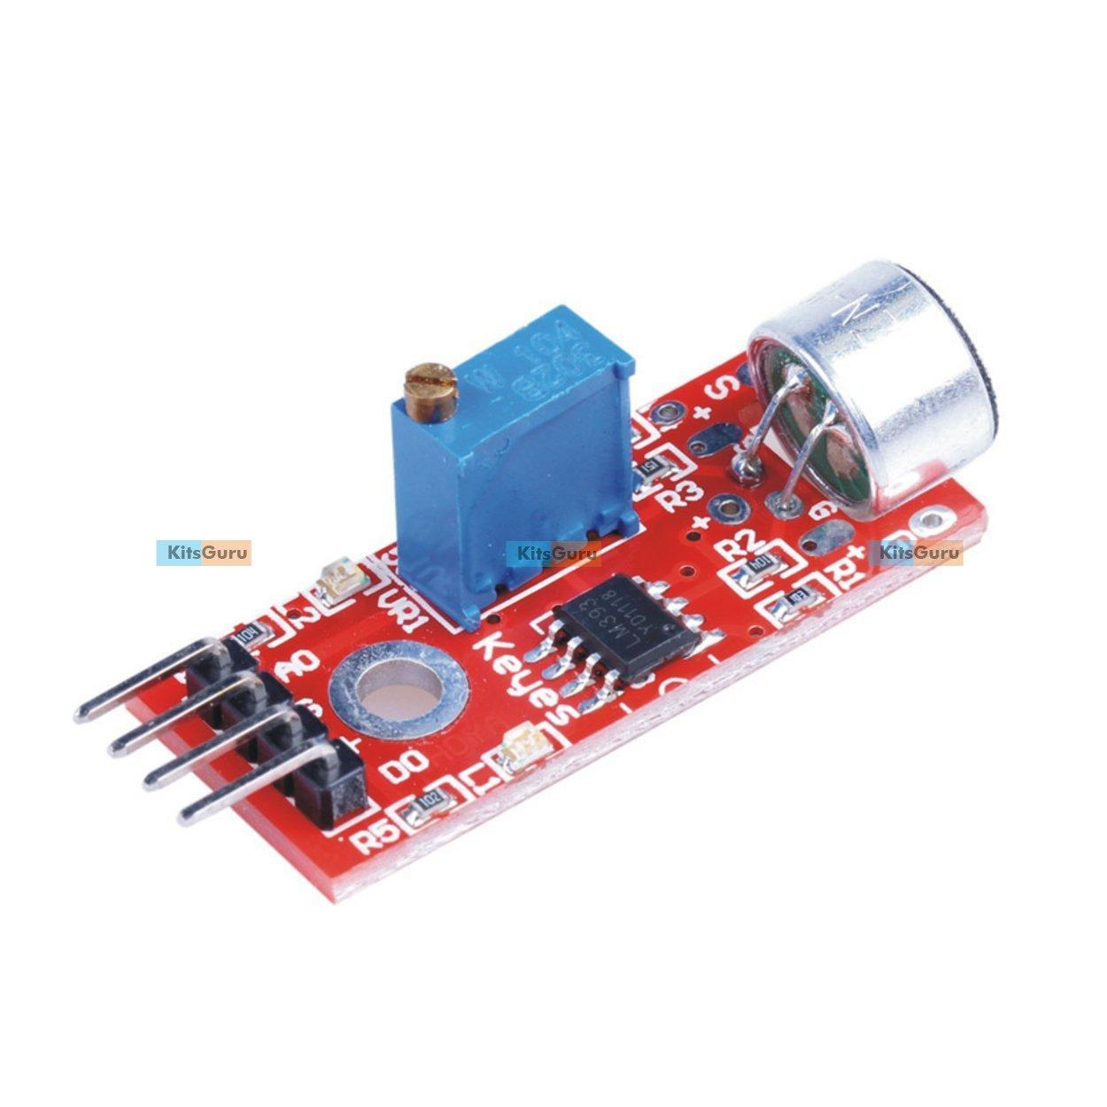
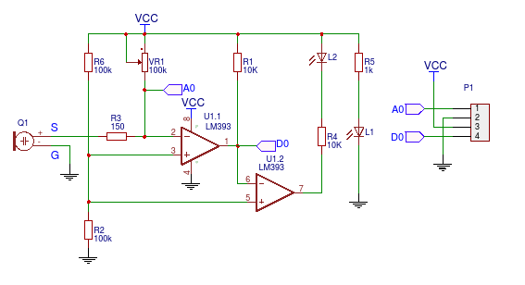
Sensor types
Arduino KY-038 Microphone sound sensor module with big sound mic
(Aka Elegoo Big Sound Module)

Slide 7
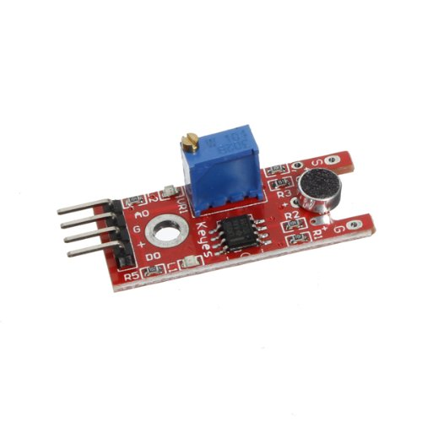
Sensor types
Arduino KY-038 Microphone sound sensor module with small sound mic
(Aka Elegoo Small Sound Module)

Slide 8
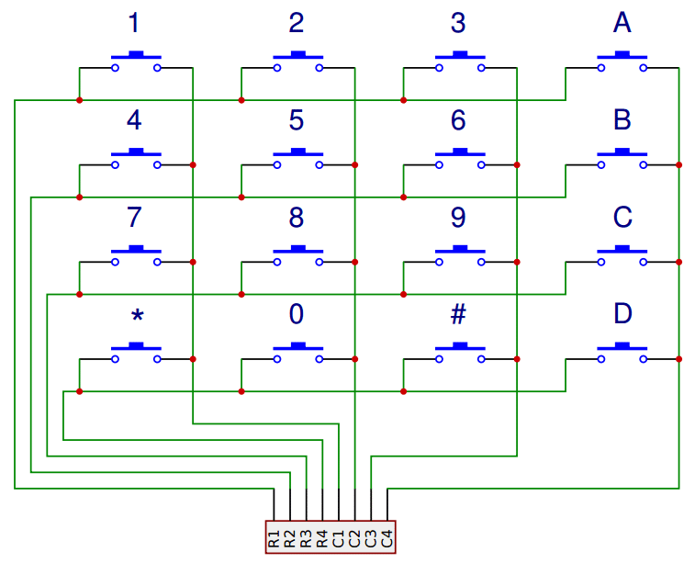
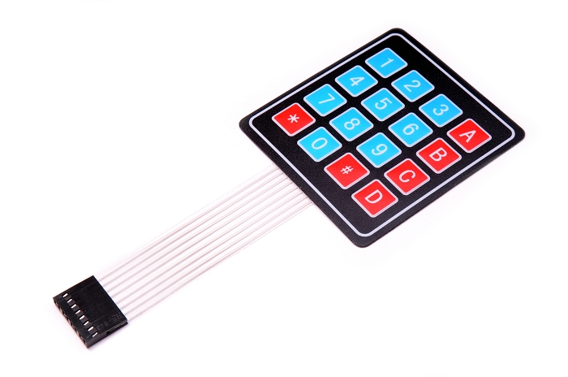
Sensor types
4x4 Membrane Switch Matrix Keypad

Slide 9
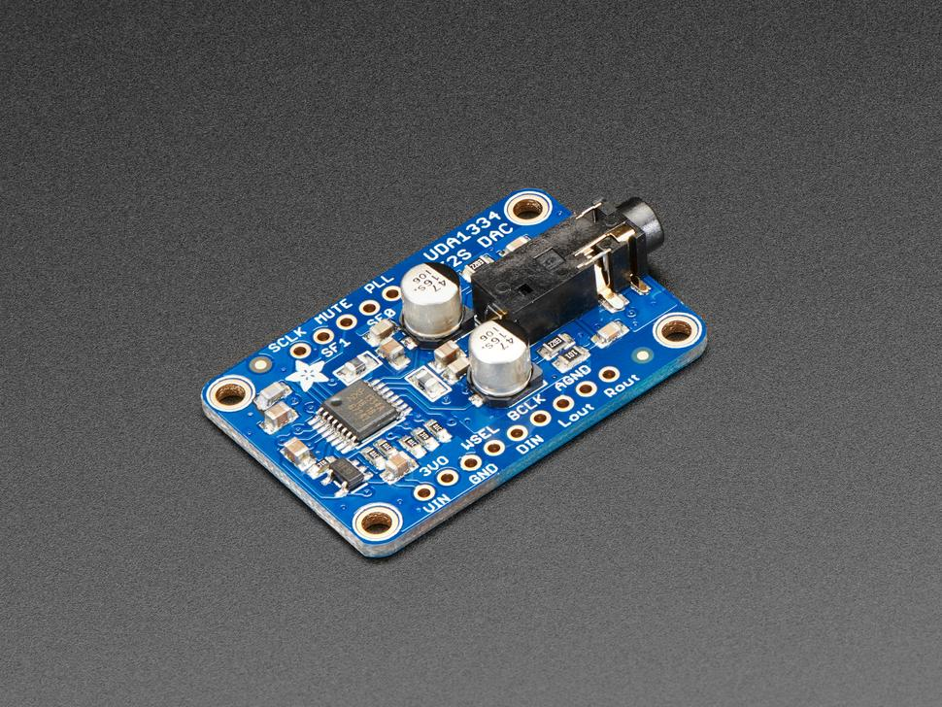
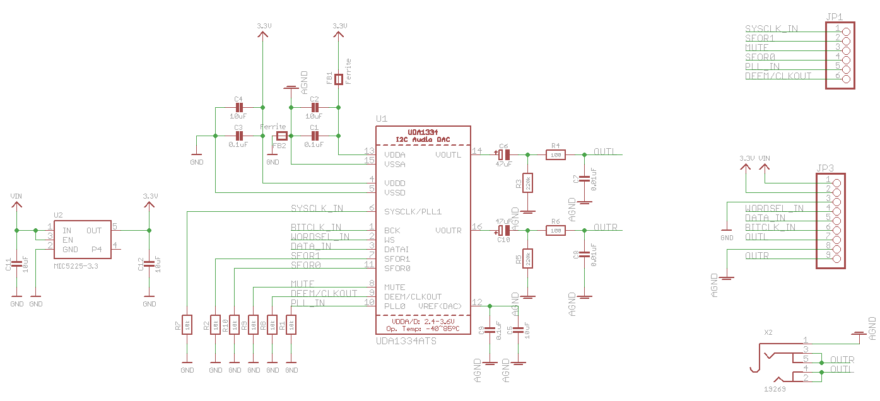
Output Devices
Adafruit I2S Stereo Decoder
UDA1334A Breakout

Slide 10
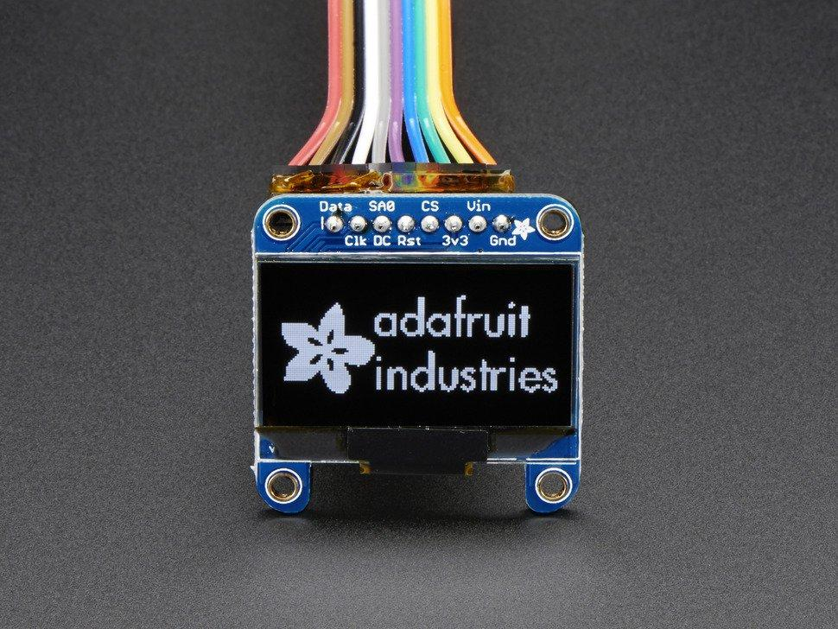
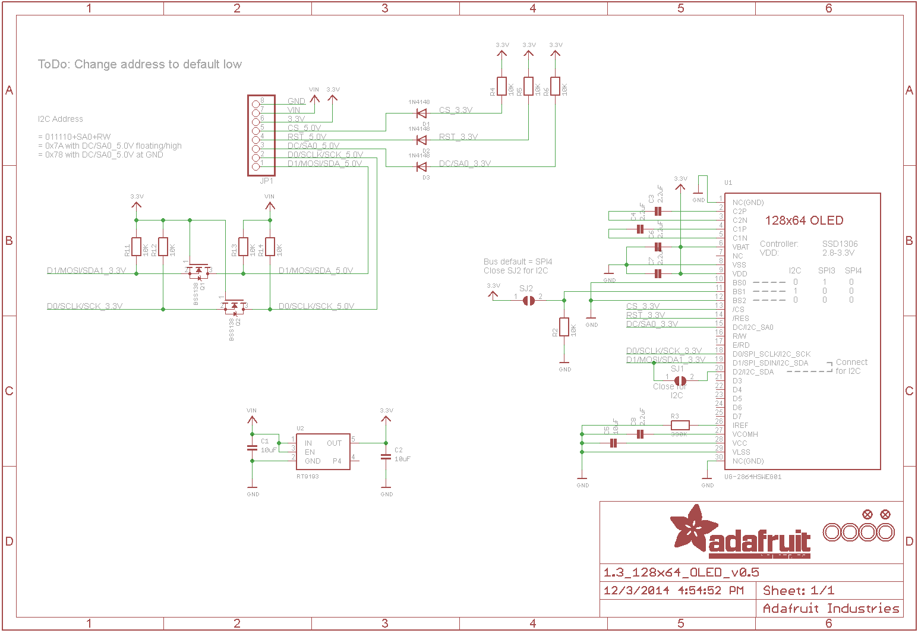
Output Devices
Adafruit Monochrome 1.3” 128x64 OLED graphic Display

Slide 11
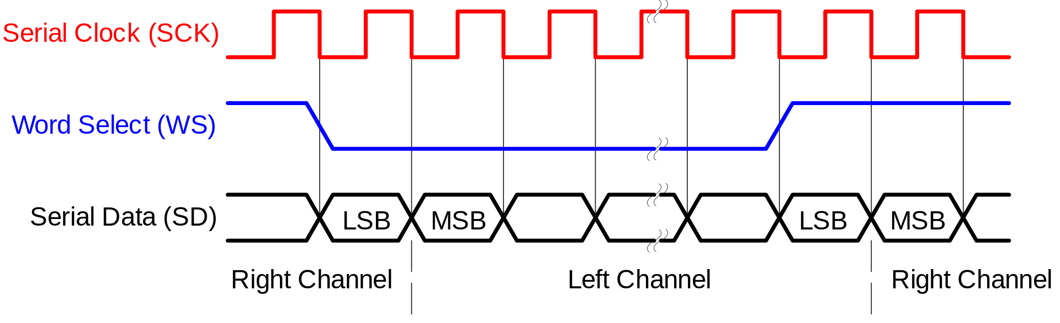
Communication Protocol
Using I2S (Inter-IC Sound) to output live amplified audio to 3.5 mm Audio Jack via the Adafruit I2C Stereo Decoder Breakout
Timing Diagram of the protocol shown below:
Using I2C to output waveform data graph to the Monochrome 1.3” OLED Screen
Uses I2C 7-bit address between 0x3C-0x3D

