Slide 1
Voice Modulator
ECE 372A – Microcontroller organization
Electrical and computer engineering
University of Arizona
SPRING 2019

Slide 2
Team Members
Nadine Alnajdawi
Jacob Bowles
Jessica Sofka
Lena Voytek

Slide 3
Statement of Problem
Describe the problem you are trying to solve

Slide 4
Proposed Prototype Solution
Briefly describe your proposed prototype solution

Slide 5
Requirements
Requirement 1 –Input voice and output the same voice.
Requirement 2-Wavefourm modulations manipulate input voice.
Requirement 3-Incorporate a number pad to control waveform modulation.
Requirement 4-Output on a screen the control waveform.
…..

Slide 6
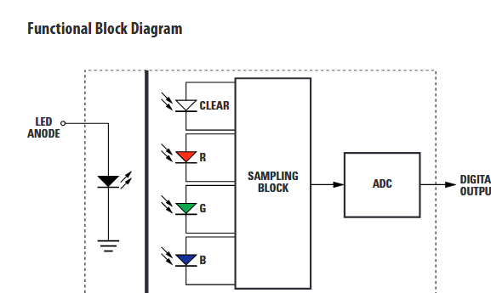
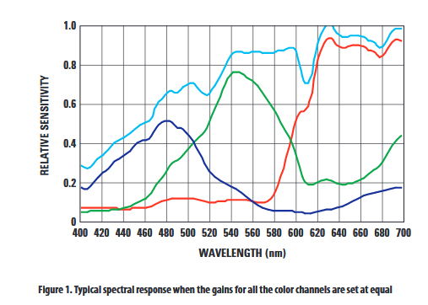
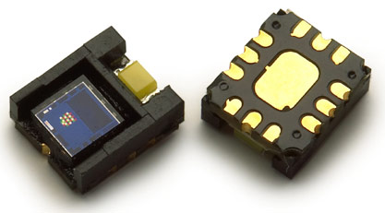
Sensor type(s)
One slide for each sensor with relevant performance specifications (spec sheet data such as resolution, range, data rate, etc…).
Example -
Avago ADJD-S371-QR999
RGB Digital Color Sensor Module

Slide 7
Communication Protocol
Description of Protocol Used (I2C, SPI or RS232). A timing diagram would be useful to include.

