Slide 1
Voice Modulator
ECE 372A – MICROCONTROLLER ORGANIZATION
ELECTRICAL AND COMPUTER ENGINEERING
UNIVERSITY OF ARIZONA
SPRING 2019

Slide 2
Team Members
Jacob Bowles
Nadine Najdawi
Jessica Sofka
Lena Voytek

Slide 3
Statement of Problem
Describe the problem you are trying to solve
We are implementing a voice modulator that takes in audio, using a small sound and big sound microphone, and modulates the frequency of that data depending on what the user chooses on the numeric keypad. It will maintain a clear output, while minimizing feedback.
This is an improvement of an autotune device (on-the-go)
modulating data to fine-tune the pitch
An LCD screen will display the control waveform (frequency) from the numeric keypad
Voice modulation data will be outputted to a speaker

Slide 4
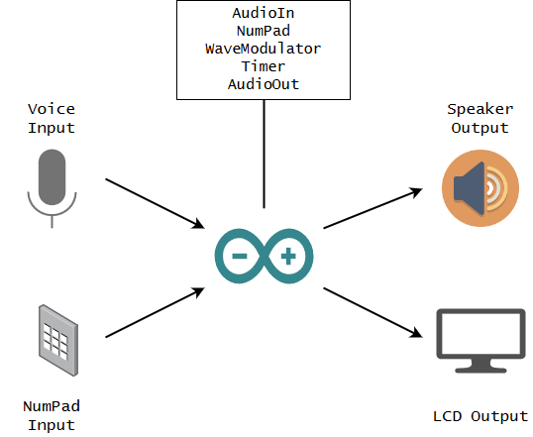
Proposed Prototype Solution
Voice Modulation
The manipulation of pitch through wavelength modulation
Numpad for controlling voice effects for corresponding sound
LCD Output for displaying voice control settings from numpad

Slide 5
Requirements
Requirement 1 – Input voice and output the same voice.
Requirement 2-Waveform modulations manipulate input voice.
Requirement 3-Incorporate a number pad to control waveform modulation.
Requirement 4-Output on a screen the control waveform.
Requirements | 4 | 3 | 2 | 1
Voice Input | Working | Sound Comes out | Voice Goes Into Controller | Not working
Voice Manipulation | Working | Most Frequencies Work | Some Frequencies Work | Not Working
Number Pad | Working | Most Inputs Work | Some Inputs Work | Not Working
Display | Working | Displays Input Data | Displays Characters | Not Working

Slide 6
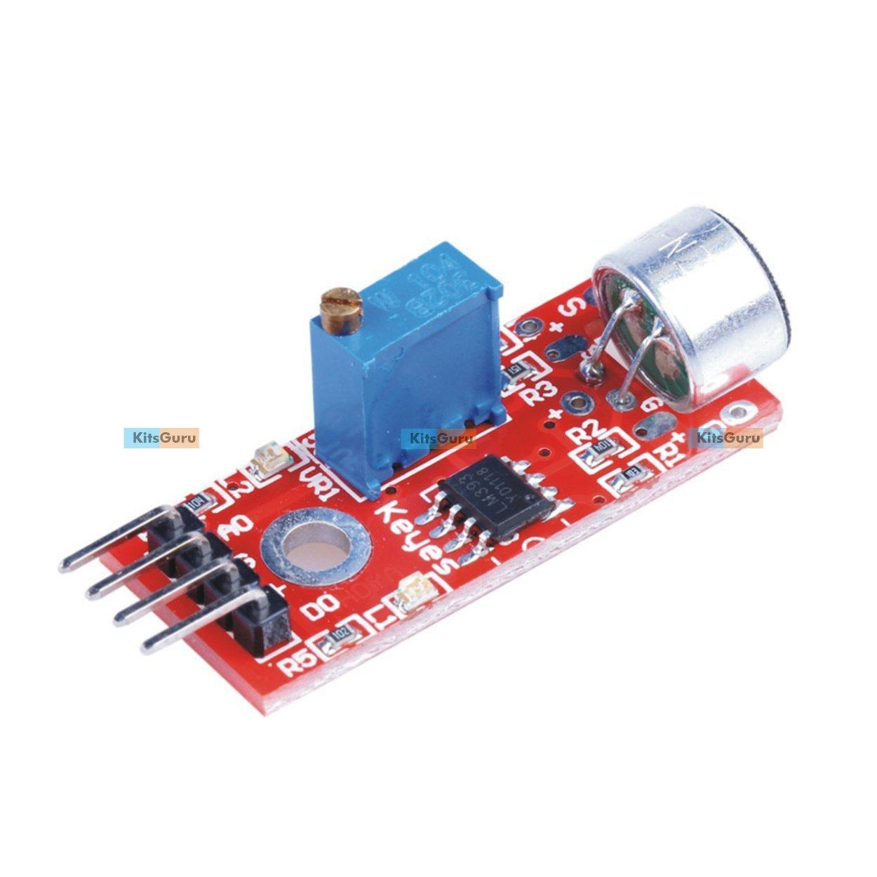
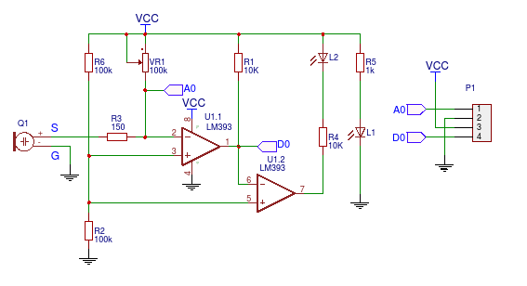
Sensor types
Arduino KY-038 Microphone sound sensor module with big sound mic
(Aka Elegoo Big Sound Module)

Slide 7
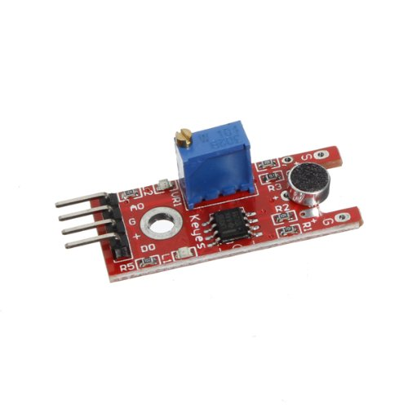
Sensor types
Arduino KY-038 Microphone sound sensor module with small sound mic
(Aka Elegoo Small Sound Module)

Slide 8
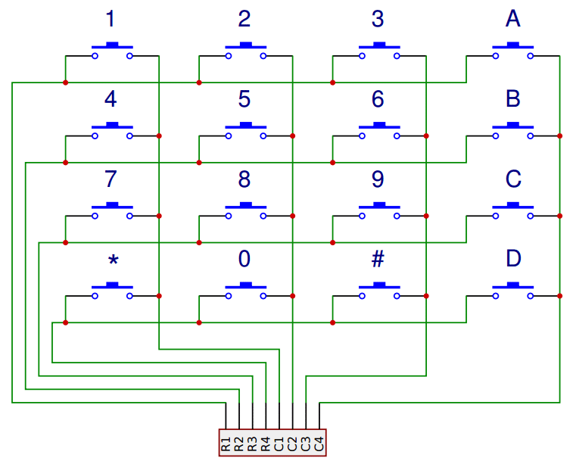
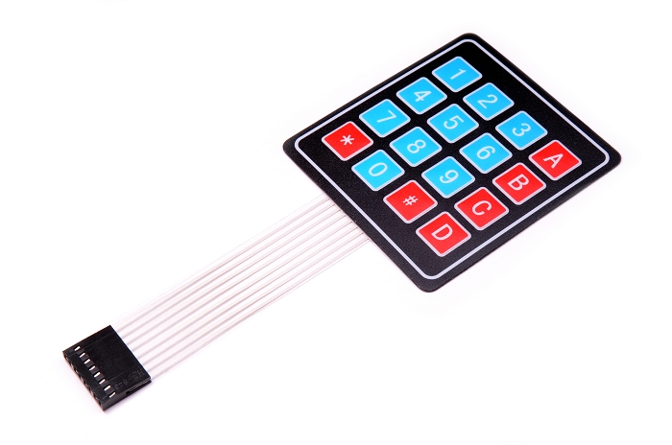
Sensor types
4x4 Membrane Switch Matrix Keypad

Slide 9
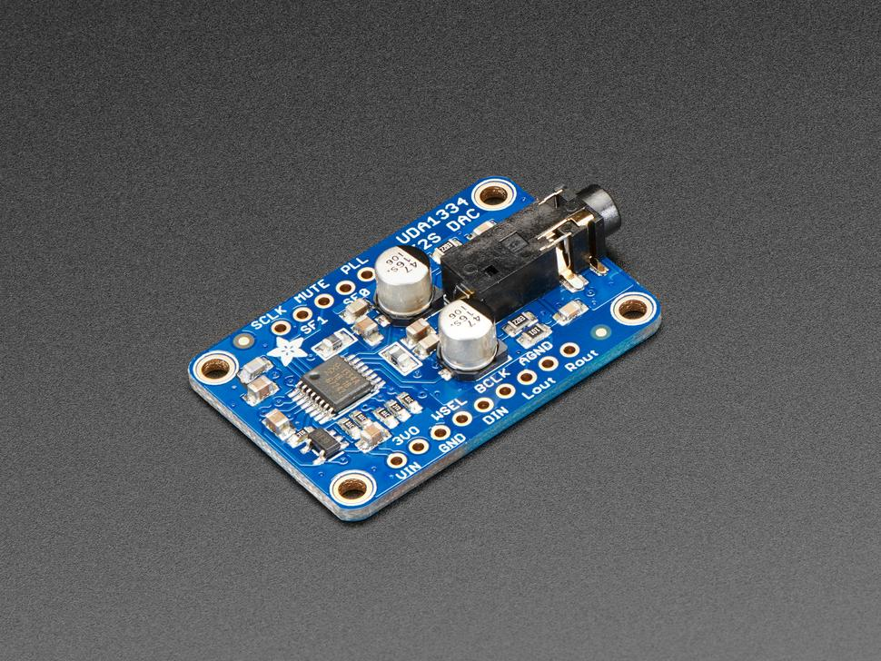
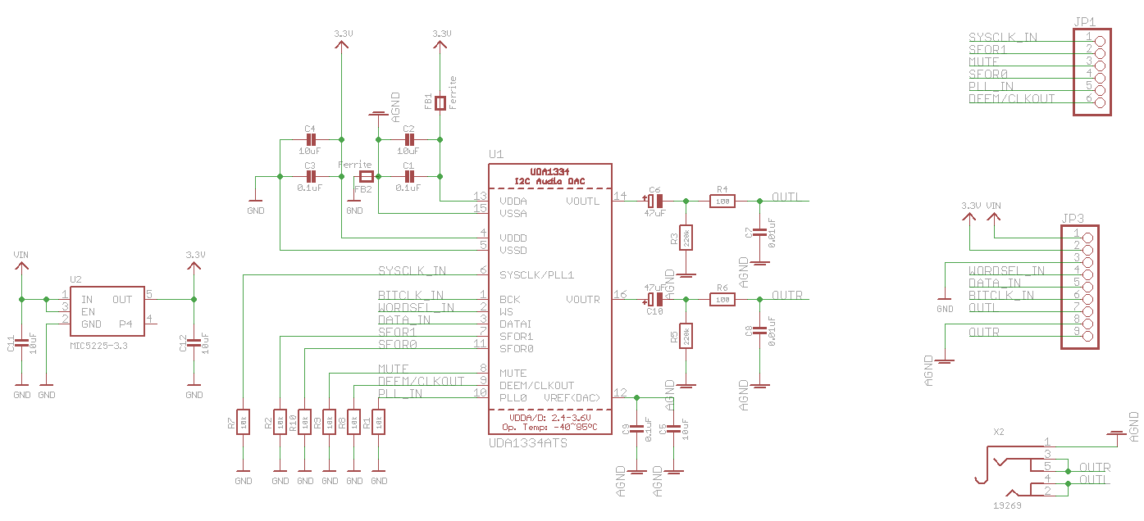
Output Devices
Adafruit I2S Stereo Decoder
UDA1334A Breakout

Slide 10
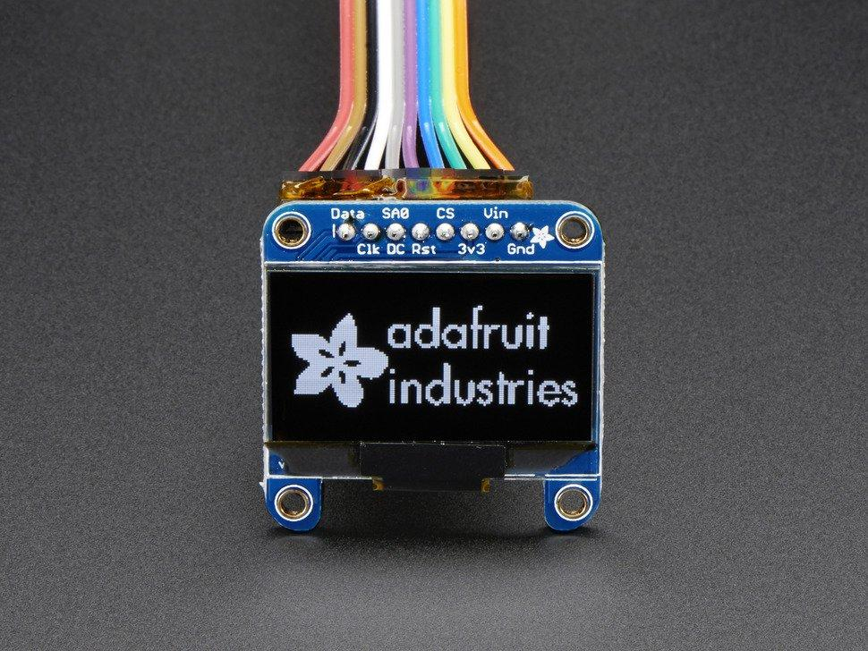
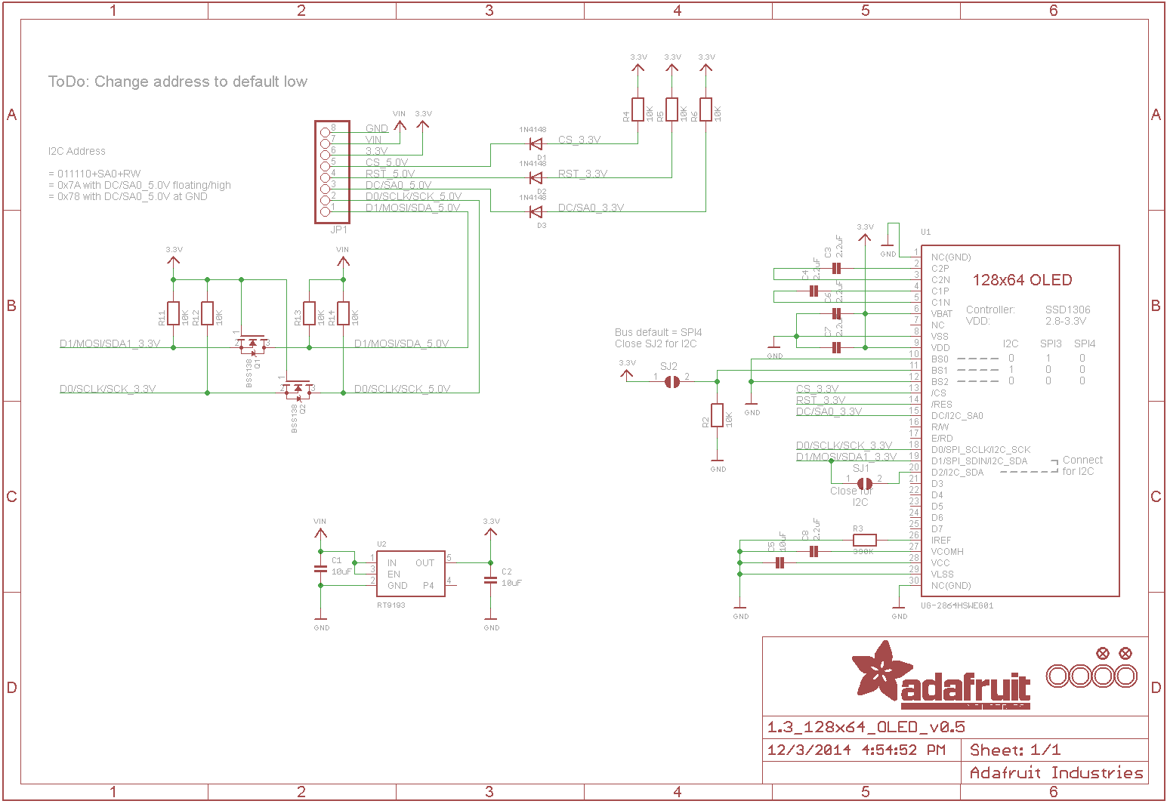
Output Devices
Adafruit Monochrome 1.3” 128x64 OLED graphic Display

Slide 11
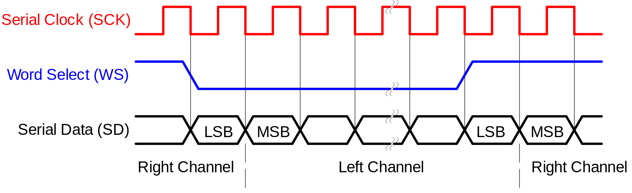
Communication Protocol
Using I2S (Inter-IC Sound) to output live amplified audio to 3.5 mm Audio Jack via the Adafruit I2C Stereo Decoder Breakout
Timing Diagram of the protocol shown below:
Using I2C to output waveform data graph to the Monochrome 1.3” OLED Screen
Uses I2C 7-bit address between 0x3C-0x3D

