Slide 1
Technical Exercise 2
Recipes
Lívia Parente
08/04/2019

Slide 2
Problem Context
Metrics & Results
1
4
EDA & Preprocessing Steps
2
5
Model
3
6

Slide 3
1
Problem Context

Slide 4
1
Problem Context
Recipes country prediction
Recipes of dishes with:
Their country as labels
Their ingredients in binary format (Yes / No)
No. of rows: 57,691
No. of columns: 384
No. of countries:
No. of ingredients: 383
4

Slide 5
1
Problem Context
Recipes country prediction
57,691
examples
69
classes
Multiclass Classification Problem
383
ingredients
Binary attributes
5

Slide 6
2
EDA & Preprocessing Steps

Slide 7
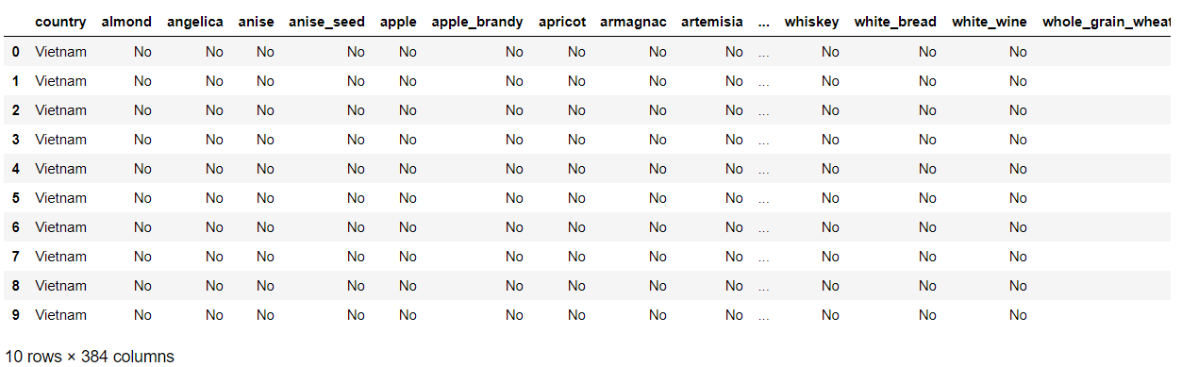
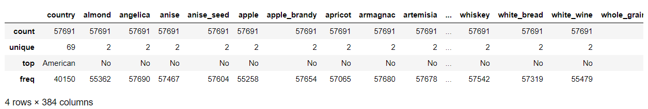
1
Exploratory Data Analysis
Raw Data Visualization:
No missing values
The ‘American’ class is the biggest one
Highly unbalanced dataset (70% of examples are ‘American’)
Describe function:
7

Slide 8
1
Preprocessing Steps
Matrix type transformation:
Binary Attribute
‘Yes’/’No’
Numerical Attribute
1/0
Split labels and attributes:
8

Slide 9
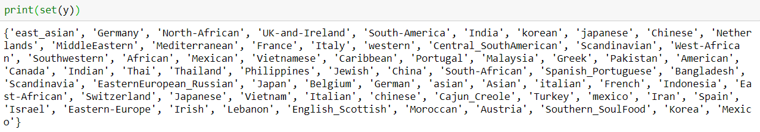
1
Exploratory Data Analysis
Class Labels Analysis
Eliminate Redundant Labels
54 Classes
9

Slide 10
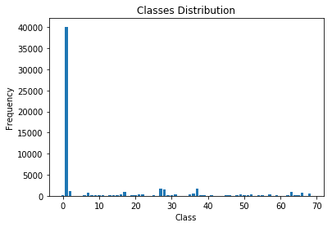
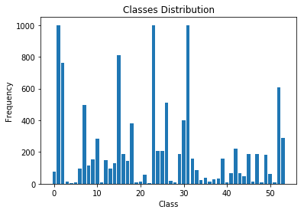
1
Resampling
Eliminate examples of the biggest classes:
American
Italian
Mexican
Data Distribution Plot
Data Distribution Plot after resampling
10

Slide 11
1
One hot encoding labels
From categorical to numerical
‘American’, ‘Mexican’, ‘Korean’, ‘French’, ...
‘American’, ‘Mexican’, ‘Korean’, ‘French’,
‘German’,
‘Caribbean’,
‘Italian’,
...
1 | 0 | 0 | 0
0 | 1 | 0 | 0
0 | 0 | 1 | 0
0 | 0 | 0 | 1
0 | 0 | 0 | 0
0 | 0 | 0 | 0
11

Slide 12
3
Model

Slide 13
3
Neural Network Structure
Using Keras
383
54
Dense
400 units
Dropout
0.5
Softmax
13

Slide 14
3
Neural Network Parameters
Using Keras
Adagrad Optimizer
Mean Absolut Error for loss function
Learning Rate = 0.001
100 Epochs
Batch size = 200
14

Slide 15
4
Metrics & Results

Slide 16
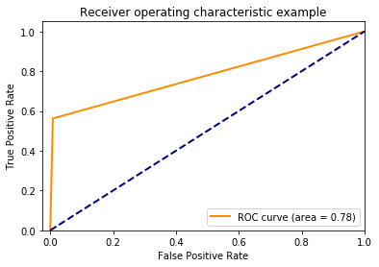
4
Metrics
On test set
Multiclass F1 score: 0.56
Logistic Loss: 15.113
Accuracy: 0.562
16

Slide 17
5
Conclusion
And Other Ideas

Slide 18
4
Conclusion
The biggest problem of the dataset was the classes distribution
Good accuracy when compared with random guessing (0.18 probability)
Good F1 score, meaning that Precision and Recall are balanced
18

Slide 19
4
Other ideas
For further improvements:
Try another resampling method, maybe to choose the best examples to keep
Try different optmizers
19

Slide 20
Thank you!
Lívia Parente
livia.parente@agilesolutions.com

