Slide 1
Ethernet LANs
Starting a Switch

Slide 2
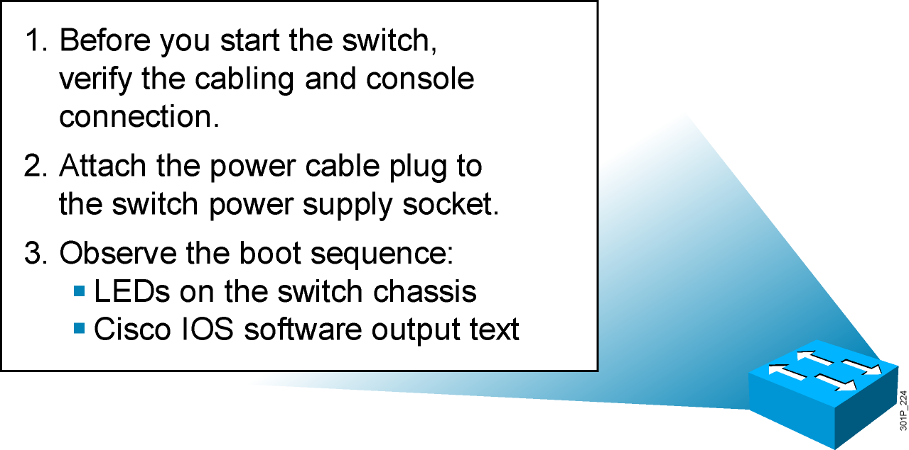
Initial Startup of the Catalyst Switch
  System startup routines initiate switch software.
  Initial startup uses default configuration parameters.
Notes:
Purpose: This slide describes the Catalyst 1900 switch startup procedures.
Emphasize: This slide states the tasks that students will be doing for one of the lab exercises in this module: start the switch, check POST LED display lights, set up required parameters, and check initial configuration messages.
Present this page as a listing of the major activities that your students will learn about in the next several pages, and then practice in the lab.
Item 1 should have been completed with the last chapter. This juncture in the chapter is a good place for you to make sure that these preparations have indeed been done in all the work-groups.
Point out with the item 2 that the Catalyst 1900 switch does not have a power on switch. Plugging in the power cable powers up the switch.
Transition: Use item 3 to transition to the next page for presentation details.

Slide 3
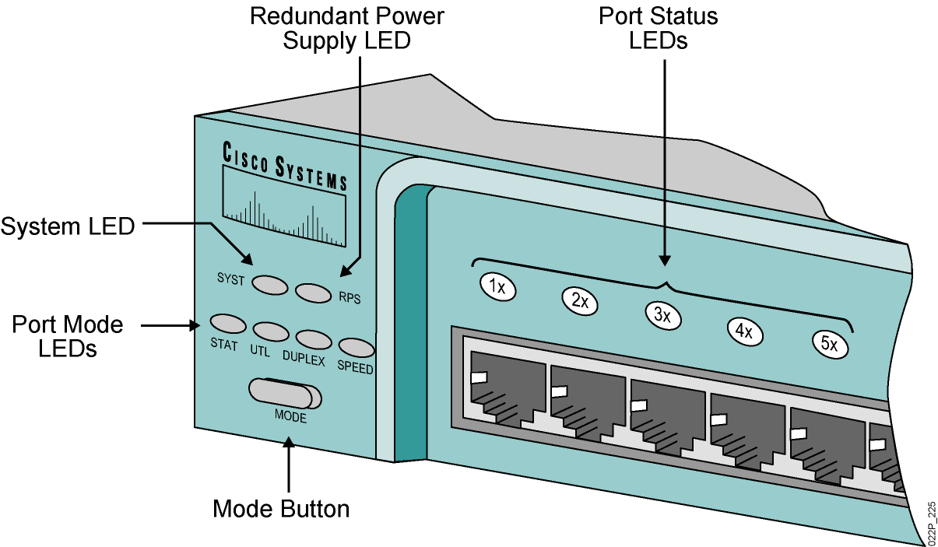
Catalyst 2960 Switch LED Indicators
Notes:
Purpose: This slide describe the LEDs on the Catalyst 1900 switch.
Emphasize: Refer to the table in the Student Guide for presentation details.
Students will not be able to try out the various port LED display modes until they have powered up their switch. Tell your students to put a placeholder on this page so that they can return to it.
Before students can see the three port LED display modes, they will first see the port LEDs indicate a power-on self-test (POST).
Transition: POST indications on the switch port lights.

Slide 4
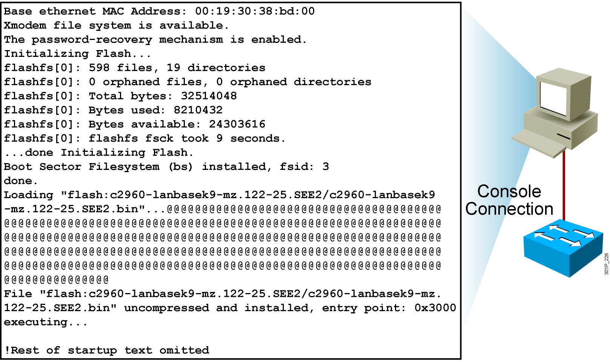
Initial Bootup Output from the Catalyst 2960 Switch
Notes:
Purpose: This slide describes the console output on the Catalyst 1900 switch during startup.
Emphasize: If a POST fails, a corresponding console message will be displayed indicating the POST failure. In this slide, the switch started up without any POST error.
From the User Interface menu, select K to access the command-line interface.
In this class, we will only discuss the Catalyst 1900 CLI configuration method.

Slide 5
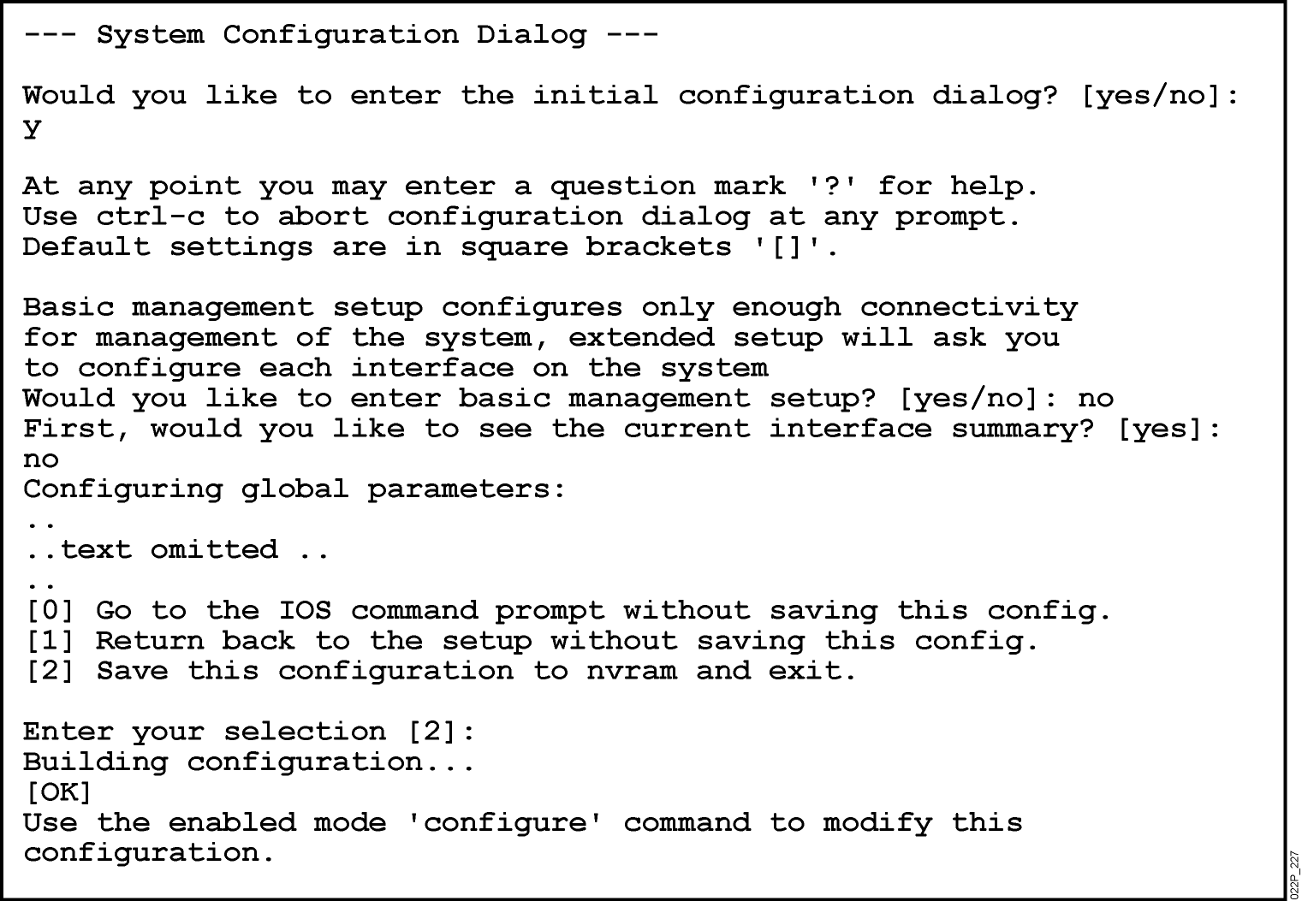
Initial Configuration of the Catalyst 2960 Switch Using Setup
Notes:
Purpose: This slide describes the console output on the Catalyst 1900 switch during startup.
Emphasize: If a POST fails, a corresponding console message will be displayed indicating the POST failure. In this slide, the switch started up without any POST error.
From the User Interface menu, select K to access the command-line interface.
In this class, we will only discuss the Catalyst 1900 CLI configuration method.

Slide 6
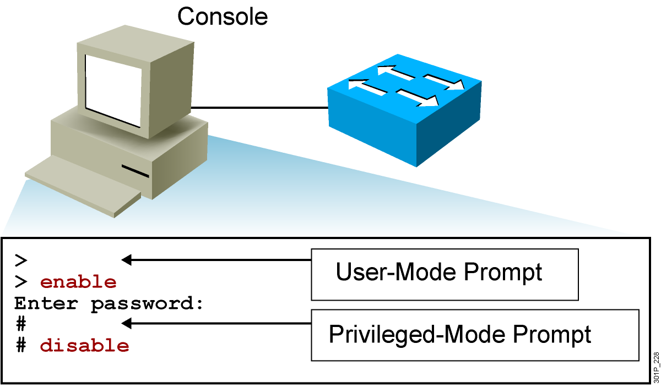
Logging In to the Switch and Entering the Privileged EXEC Mode
Notes:
Purpose: This slide describes logging in the Catalyst 1900 switch.
Emphasize: Earlier you presented an introduction to the two primary EXEC modes with the slides on Cisco IOS user interface fundamentals. Now teach your students about the specifics of the user mode and privileged mode on the Catalyst switch.
Note: The default prompt on the Catalyst 1900 switch is “>” and “#”, without the word “switch” in front of the prompt.
Transition: An overview of the three major types of switch command-line help facilities.

Slide 7

Configuring the Switch
Configuration modes:
  Global configuration mode
    SwitchX#configure terminal
    SwitchX(config)#
  Interface configuration mode
    SwitchX(config)#interface fa0/1
    SwitchX(config-if)#
Notes:
Purpose: This slide describes the configuration modes on the Catalyst 1900 switch.
Emphasize: The Catalyst 1900 Cisco IOS CLI has global and specific configuration modes like the router Cisco IOS CLI.

Slide 8
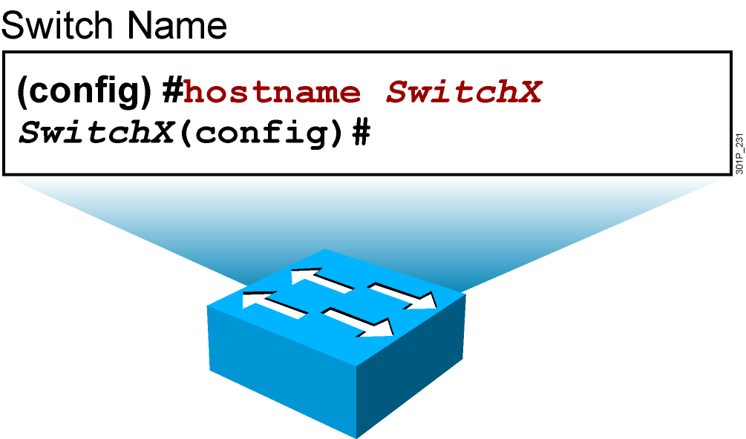
Configuring Switch Identification
Sets the local identity for the switch
Notes:
Purpose: This slide describes configuring the host name on the Catalyst 1900 switch.
Emphasize: To make configuring and maintaining a network easier, several features provide recording and descriptive information in the configuration. The first is the host name, which is simply a name by which this switch is known in the network. When you log in to a switch, the host name is displayed in the prompt. This feature is very convenient when you are remotely configuring switches, because it is a quick reminder of which switch you are accessing.
Note: The Catalyst 1900 switch has no default host name. By default, the global configuration prompt is (config)#.

Slide 9
Configuring the Switch IP Address
SwitchX(config)#interface vlan 1
SwitchX(config-if)#ip address {ip address} {mask}
Example:
SwitchX(config)#interface vlan 1
SwitchX(config-if)#ip address 10.5.5.11 255.255.255.0
SwitchX(config-if)#no shutdown
Note: It is necessary to use the no shutdown command to make the interface operational.
Notes:
Purpose: This slide describes the ip address global configuration command on the Catalyst 1900 switch.
Emphasize: Why does a Layer 2 switch require an IP address? It is used for switch management purposes, for example, to Telnet to the switch, or to use the Web-based Visual Switch Manager to manage the switch.
Note: On the Catalyst 1900 and 2900xl switches, the IP address is always in VLAN1. It cannot be moved to any other VLAN like the Catalyst 5000 SC0 port.

Slide 10
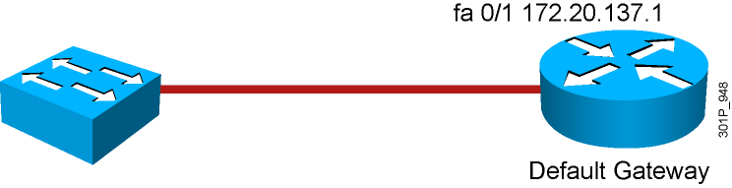
Configuring the Switch Default Gateway
SwitchX(config)#ip default-gateway {ip address}
Example:
SwitchX(config)#ip default-gateway 172.20.137.1
Notes:
Purpose: This slide describes the ip address global configuration command on the Catalyst 1900 switch.
Emphasize: Why does a Layer 2 switch require an IP address? It is used for switch management purposes, for example, to Telnet to the switch, or to use the Web-based Visual Switch Manager to manage the switch.
Note: On the Catalyst 1900 and 2900xl switches, the IP address is always in VLAN1. It cannot be moved to any other VLAN like the Catalyst 5000 SC0 port.

Slide 11
Saving Configurations
SwitchX
SwitchX copy running-config startup-config
Destination filename [startup-config]?
Building configuration…
SwitchX
Copies the current configuration to NVRAM
Notes:
Emphasize: Copying to NVRAM overwrites the contents in NVRAM.

Slide 12
Showing Switch Initial Startup Status
SwitchX#show version
  Displays the configuration of the system hardware, software version, names and sources of configuration files, and boot images
SwitchX#show running-config
  Displays the current active configuration file of the switch
SwitchX#show interfaces
  Displays statistics for all interfaces configured on the switch
Notes:
Purpose: This slide describes three basic show commands on the Catalyst 1900 switch.
Emphasize: The next few slides will show the outputs of these show commands.

Slide 13
Switch show version Command
Switch#show version
SOFTWARE (fc1)
Copyright (c) 1986-2006 by Cisco Systems, Inc.
Compiled Fri 28-Jul-06 11:57 by yenanh
Image text-base: 0x00003000, data-base: 0x00BB7944
ROM: Bootstrap program is C2960 boot loader
BOOTLDR: C2960 Boot Loader (C2960-HBOOT-M) Version 12.2(25r)SEE1, RELEASE SOFTWARE (fc1)
System returned to ROM by power-on
System image file is "flash:c2960-lanbasek9-mz.122-25.SEE2/c2960-lanbasek9-mz.122-25.SEE2.bin"
Processor board ID FOC1052W3XC
Last reset from power-on
1 Virtual Ethernet interface
24 FastEthernet interfaces
2 Gigabit Ethernet interfaces
The password-recovery mechanism is enabled.
! Text omitted
Switch#
Cisco IOS Software, C2960 Software (C2960-LANBASEK9-M), Version 12.2(25)SEE2, RELEASE
Switch uptime is 24 minutes
cisco WS-C2960-24TT-L (PowerPC405) processor (revision B0) with 61440K/4088K bytes of memory.
Notes:
Purpose: This slide describes the show version command output on the Catalyst 1924 switch.
The 1924 has 27 fixed ports (24 10BaseT, 1 AUI, 2 100BaseT).
Emphasize: Point out that this command is useful when troubleshooting problems because it gives the versions of the Cisco IOS software. It also displays how long the switch has been in operation.
Note: The MAC address on each port is based on the base Ethernet address. For example, from this slide, the first port (e0/1) on the switch will have a MAC address of 00-50-BD-73-E2-C1.

Slide 14
Switch show interfaces Command
SwitchX#show interfaces FastEthernet0/2
FastEthernet0/2 is up, line protocol is up (connected)
Hardware is Fast Ethernet, address is 0008.a445.ce82 (bia 0008.a445.ce82)
MTU 1500 bytes, BW 10000 Kbit, DLY 1000 usec,
reliability 255/255, txload 1/255, rxload 1/255
Encapsulation ARPA, loopback not set
Keepalive set (10 sec)
Half-duplex, 10Mb/s
input flow-control is unsupported output flow-control is unsupported
ARP type: ARPA, ARP Timeout 04:00:00
Last input 4w6d, output 00:00:01, output hang never
Last clearing of "show interface" counters never
Input queue: 0/75/0/0 (size/max/drops/flushes); Total output drops: 0
Queueing strategy: fifo
Output queue: 0/40 (size/max)
5 minute input rate 0 bits/sec, 0 packets/sec
5 minute output rate 0 bits/sec, 0 packets/sec
182979 packets input, 16802150 bytes, 0 no buffer
Received 49954 broadcasts (0 multicast)
0 runts, 0 giants, 0 throttles
0 input errors, 0 CRC, 0 frame, 0 overrun, 8 ignored
0 watchdog, 20115 multicast, 0 pause input
0 input packets with dribble condition detected
3747473 packets output, 353656347 bytes, 0 underruns
--More--
Hardware is Fast Ethernet, address is 0008.a445.ce82 (bia 0008.a445.ce82)
Half-duplex, 10Mb/s
0 CRC,
Notes:
Purpose: This slide describes the show interfaces command output on the Catalyst 1900 switch.
Emphasize: The top line of the output tells us that the interface is enabled (active state). Other states are disabled (inactive state, must be manually return to the active state), or suspended (inactive state, will automatically return to the enabled state when conditions causing the suspension are removed; for example, a port security violation error can cause a port to go to the suspended state).
Note: The slide only shows the beginning portion of the show interfaces output.

Slide 15
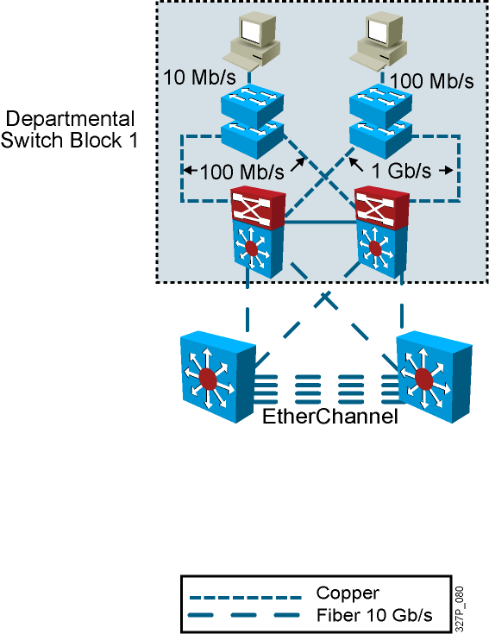
Interconnection Technologies
Technology | Use
Fast Ethernet | Connects end-user devices to the access layer switch
Gigabit Ethernet | Connects access switch to distribution switch and high use servers to switches
10-Gigabit Ethernet | Provides high-speed switch to switch links, backbones
EtherChannel | Provides high-speed switch to switch links, backbones with redundancy
Notes:
142,142,149

Slide 16
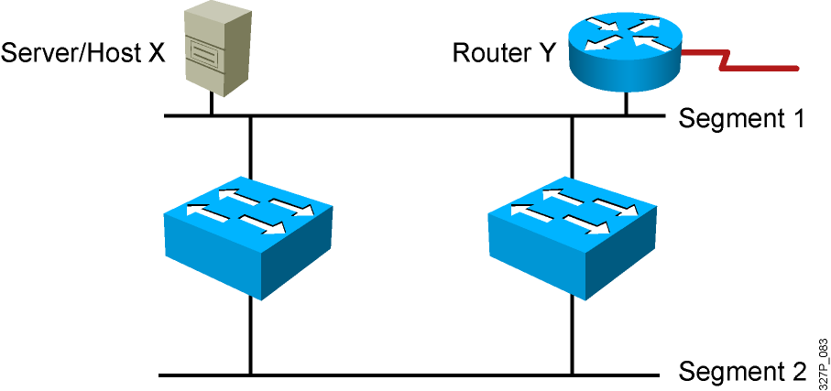
Redundant Topology
Redundant topology eliminates single points of failure.
Redundant topology causes broadcast storms, multiple
frame copies, and MAC address table instability problems.
Notes:
Emphasize: Layer 2 has no mechanism (like a TTL) to stop loops.

Slide 17
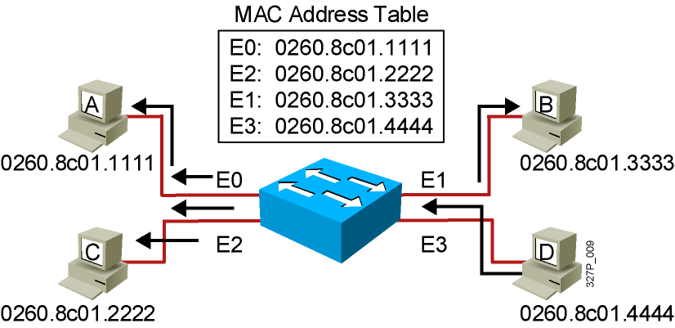
Broadcast Frames
Station D sends a broadcast frame.
Broadcast frames are flooded to all ports
except the originating port.

Slide 18
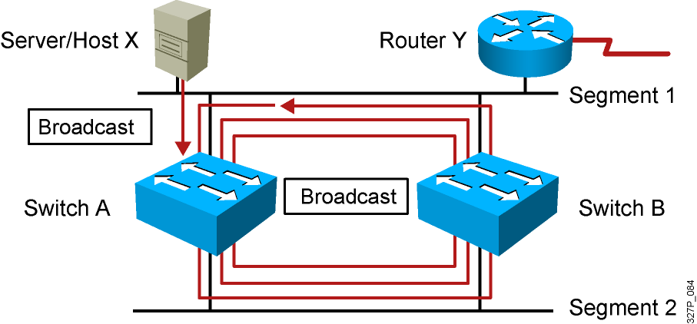
Broadcast Storms
Host X sends a broadcast.
Switches continue to propagate
broadcast traffic over and over.
Notes:
Layer 3 of 3
Emphasize: Layer 2 has no TTL mechanism to stop looping frames.

Slide 19
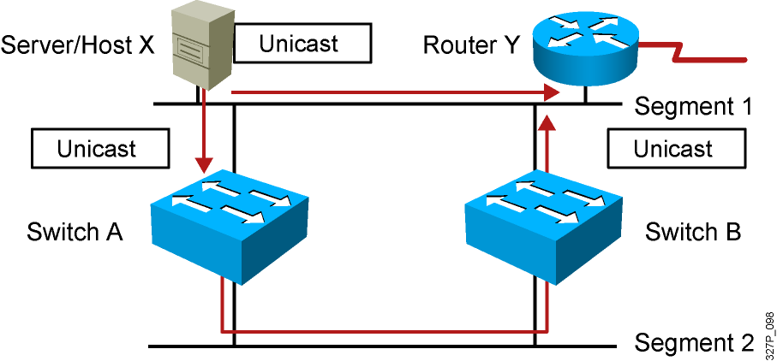
Multiple Frame Copies
Host X sends a unicast frame to router Y.
The MAC address of router Y has not been
learned by either switch.
Router Y will receive two copies of the same frame.
Notes:
Layer 2 of 2

Slide 20
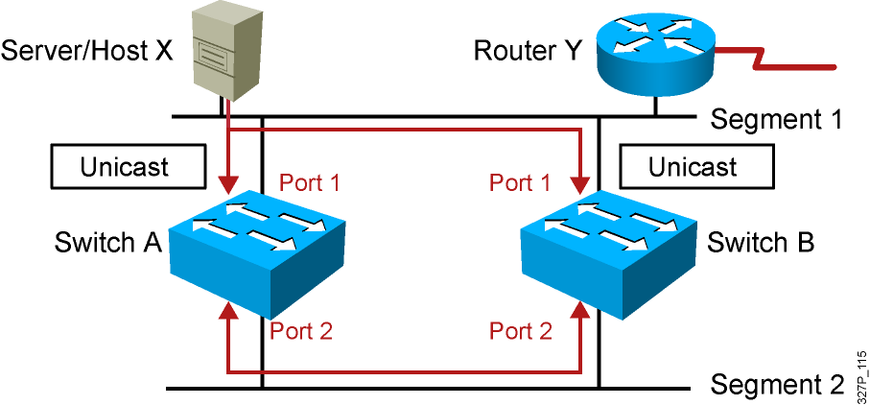
MAC Database Instability
Host X sends a unicast frame to router Y.
The MAC address of router Y has not been learned by either switch.
Switches A and B learn the MAC address of host X on port 1.
The frame to router Y is flooded.
Switches A and B incorrectly learn the MAC address of host X on port 2.
Notes:
Layer 2 of 2

Slide 21
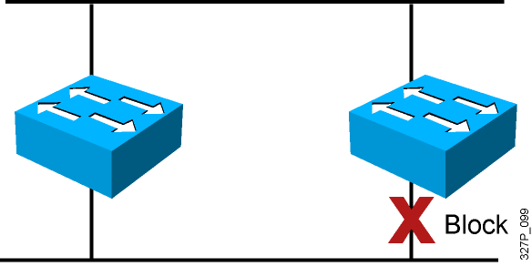
Loop Resolution with STP
Provides a loop-free redundant network topology
by placing certain ports in the blocking state
Published in the IEEE 802.1D specification
Enhanced with the Cisco PVST+ implementation
Notes:
Emphasize: A looped topology is often desired to provide redundancy, but looped traffic is undesirable. The Spanning-Tree protocol was originally designed for bridges. Today, it is also applied to LAN switches and routers operating as a bridge. Spanning-Tree protocol ensures that all bridged segments are reachable but any points where loops occur will be blocked.

Slide 22
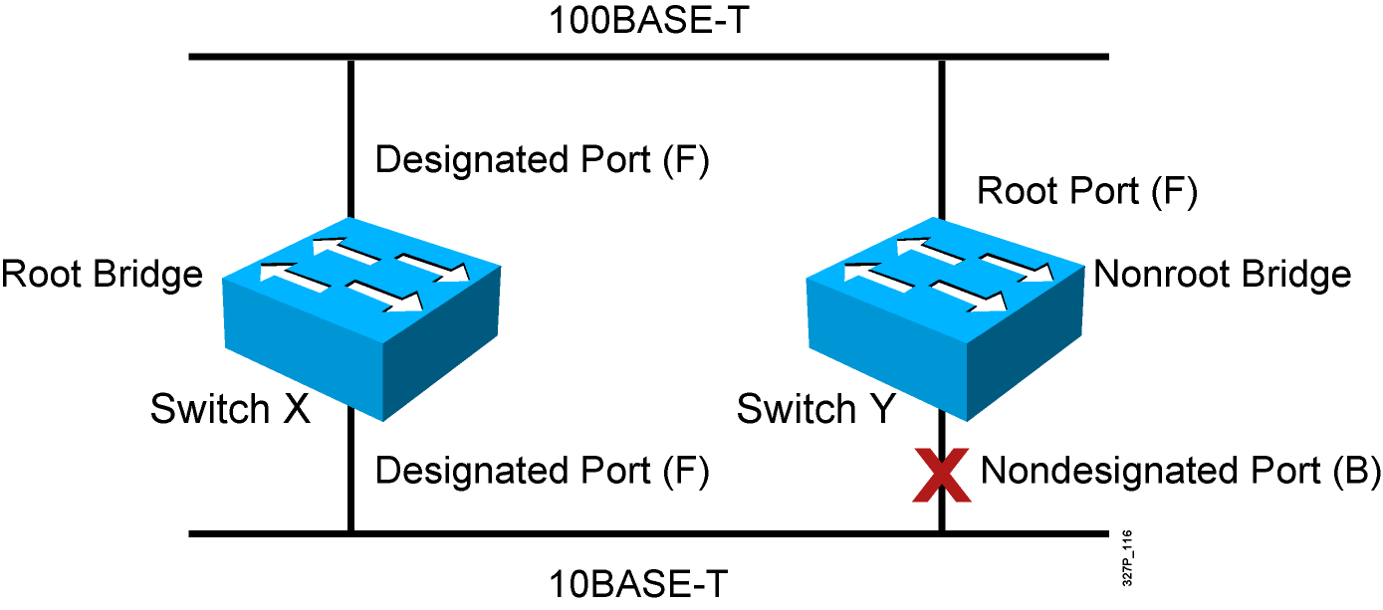
Spanning-Tree Operation
One root bridge per broadcast domain.
One root port per nonroot bridge.
One designated port per segment.
Nondesignated ports are unused.
Notes:
Emphasize: The three general rules when dealing with STP are as follows:
1. One root bridge per network. The root is the bridge with the lowest bridge ID. All the ports on the root bridge are designated ports (forwarding).
2. For every non-root bridge, there is a root port (forwarding). The root port is the port with the lowest accumulated path cost to the root bridge.
3. For every segment, there is only one designated port. The designated port forwards traffic for the segment. The designated port has the lowest accumulated path cost to the root bridge.

Slide 23
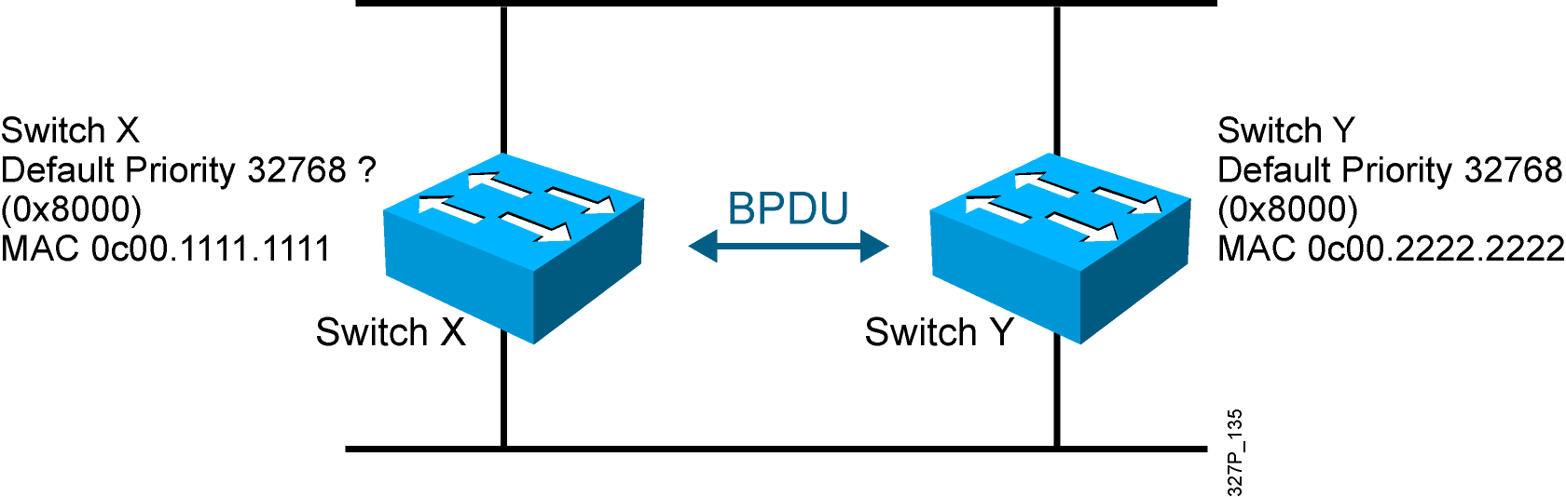
STP Root Bridge Selection
BPDU (default = sent every 2 seconds)
Root bridge = bridge with the lowest bridge ID
Bridge ID =
Bridge
Priority
MAC
Address
Notes:
Emphasize: By default, the switch with the lowest MAC address will be the root bridge.
Note: The Catalyst switches support an instance of spanning tree per VLAN. Each VLAN will use a unique MAC address for spanning tree purposes. On the Catalyst 1900, the address it uses for spanning tree is the MAC address on the various ports. VLAN is discussed in the next chapter.
The IEEE 802.1d specification specifies for a 16-bit priority field. The Catalyst 1900 switch only supports the 802.1d Spanning-Tree protocol. The default priority on the Catalyst 1900 is 32768 in decimal or 8000 in hex, the midrange value.
BPDU contain the following fields:
Protocol ID version
Message type
Flags
Root ID
Cost of path
Bridge ID
Port ID
Message age
Max age
Hello time
Forward delay

Slide 24
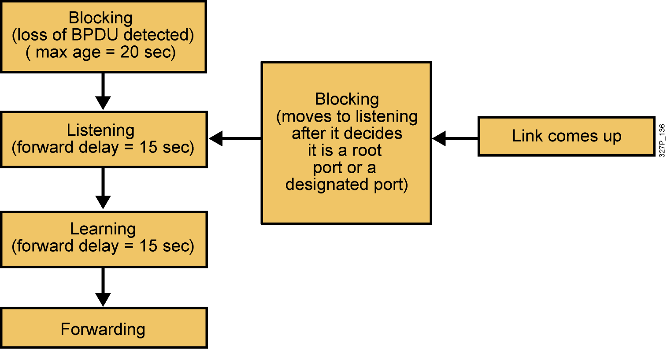
Spanning-Tree Port States
Spanning tree transits each port through several different states:
Notes:
Emphasize: Using the default Spanning-Tree protocol timers setting, the times it takes to go from the blocking state to the forwarding state is 50 sec (20 + 15 + 15).

Slide 25
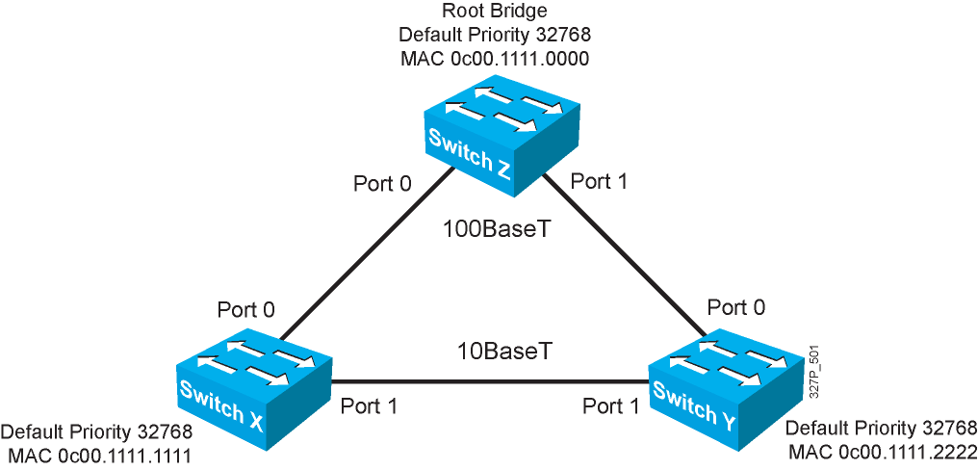
Spanning-Tree Operation Example
Notes:
Layer 2 of 2
Emphasize: Switch X and Y have the same path cost to the root bridge. The DP for the bottom segment is on switch X because switch X has a lower bridge ID than switch Y.

Slide 26
Spanning-Tree Path Cost
Link Speed | Cost (Revised IEEE Specification) | Cost (Previous IEEE Specification)
10 Gb/s | 2 | 1
1 Gb/s | 4 | 1
100 Mb/s | 19 | 10
10 Mb/s | 100 | 100
Notes:
Emphasize: There are two cost calculation methods. The Catalyst 1900 uses the older method. The new method is designed to accommodate the higher gigabit Ethernet speed.
Note:
Port priority is used to determine which path has preference when path costs are equal (for example, when you have two parallel links connecting two switches together). The default port priority is 128.
The port aggregation protocol and EtherChannels® are not taught in this class.
Fast EtherChannel is supported by the Catalyst 1900 switch.

Slide 27
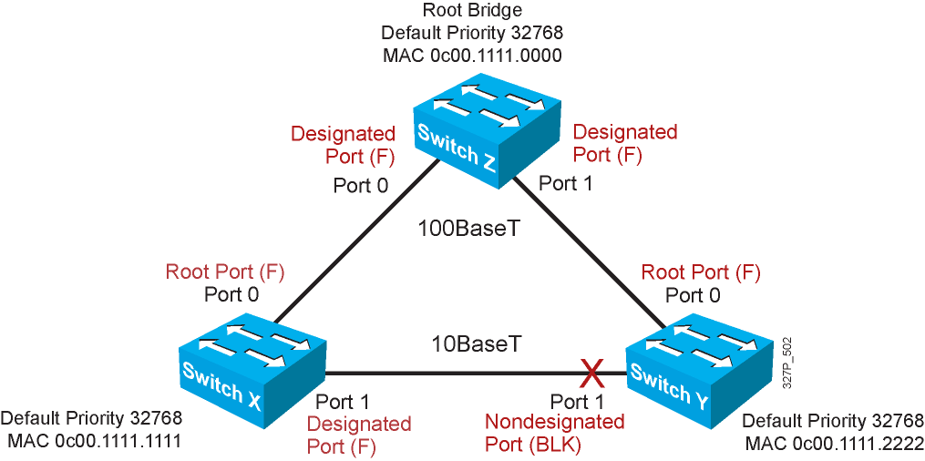
Spanning-Tree Recalculation
Notes:
Emphasize: RPs and DPs are normally in the forwarding state.
There is only one DP per segment.

